Slide 1
Modeling Working Group Breakout Summary
Working Group Lead: Josh Fisher (Chapman U)
Presenter: Wu Sun (Carnegie Institution for Science)
Participants: Katrina Bennett (Los Alamos National Lab), Eren Bilir (JPL), Yaqian He (U Arkansas), Jeralyn Poe (Northern Arizona U), Bethany Sutherland (Woodwell), Jenny Watts (Woodwell), Di Yang (U Florida), Qianlai Zhuang (Purdue U)
wsun@carnegiescience.edu

Slide 2
Outline
Open problems
  Model–data integration
  Sub-grid heterogeneity
  Functional relationships
  Missing representations
  Model evaluation <—> model development
New questions arising from ABoVE efforts
Potential synergy and synthesis opportunities
  ABoVE <—> NGEE-Arctic, CESM, CMIP, etc.
  ABoVE Model Intercomparison

Slide 3
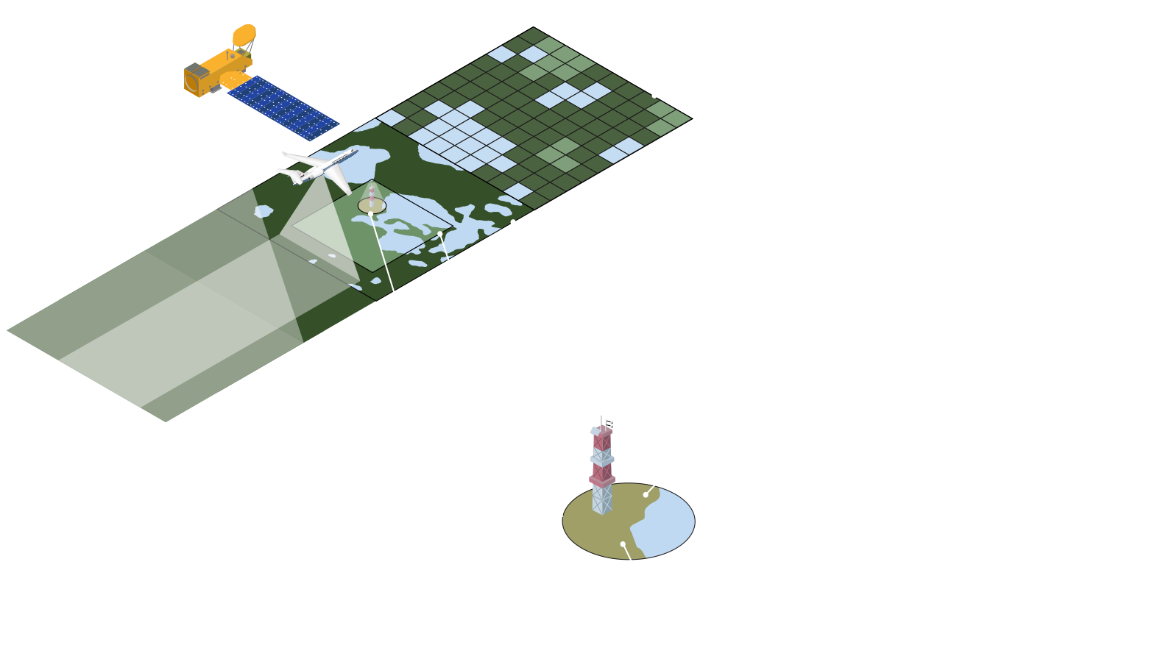
Open problem: Model–data integration
Still challenging to inform terrestrial biosphere models with observations
Lacking a framework to translate fine-scale land cover/plant trait/disturbance maps (1–100 m) into effective grid-scale parameterizations (50–100 km)
What’s observed is not what’s modeled
  Moss may not exist as a PFT and can be misrepresented as grass
  Most models cannot make use of spectral information (need retrieve traits first)
ABoVE Scaling Diagram
Actions/suggestions
Run a “mesoscale” model to bridge field and grid scales (Katrina Bennett, NGEE-Arctic)
ABoVE-specific high-resolution CESM simulations (Yaqian He)
Continued support for data harmonization - make them digestible by models

Slide 4
Open problem: Sub-grid heterogeneity
The Arctic–boreal landscapes are incredibly heterogeneous, sometimes varying at the spatial scale of meters
Models may use fractional land cover/land columns/tree cohorts to parameterize sub-grid heterogeneity, but it’s challenging to evaluate the effectiveness
There is a long way to go for models to represent disturbance-induced sub-grid heterogeneity: fire scars, hill slopes, permafrost thaw slumps, thermokarst, etc.
Nonlinearity: Sub-grid processes may not scale linearly (due to Jensen’s inequality) and it is challenging to convert parameterizations across scales
  e.g., CH₄ emissions could be dominated by hotspots; an average patch isn’t representative

Slide 5
Open problem: Functional relationships
Equifinality: Model can be tuned to give seemingly convergent outcomes, but the underlying functional responses may differ (e.g., GPP vs. soil moisture)
While we may constrain functional responses using observations, knowing these responses may not pinpoint which process or parameter to fix in a model
  e.g., multiple stomatal and plant hydraulic parameters regulate GPP response to soil moisture

Slide 6
Open problem: Missing representations
Potential priorities
Permafrost and peatland processes (only one among TRENDY models has them)
Moss as a plant functional type
Soil carbon pools as initial conditions - models often need a lengthy spin-up run because we do not know the initial carbon pools precisely
Woody biomass harvest - an important lateral carbon flux
Land-to-river carbon transport - another important lateral carbon flux

Slide 7
Open problem: Evaluation <—> development
We often learn something when models disagree with observations
Need to translate insights obtained from model evaluation into actionable items that feed back to model development processes, sustaining a virtuous cycle

Slide 8
New questions arising from ABoVE efforts
Or what new questions would you focus on if you were to start ABoVE right now?
What happens in the Arctic does not stay in the Arctic: teleconnections of Arctic–boreal changes to the Earth system (e.g., extreme weather, climate feedbacks)
Strengthening the dialogue between modelers and observationalists (Qianlai Zhuang)
Integrated energy balance perspective: carbon cycle processes are regulated by energy and water cycle processes such as soil freeze/thaw dynamics and snow melt and shouldn’t be studied in isolation (Eren Bilir)
Belowground carbon dynamics: model improvements can be biased toward aboveground processes because they are observable
Model–data fusion: we can evaluate the sensitivity of an output variable (e.g., carbon/water fluxes) to climate, but to improve the model requires using data to effect a change in model representation (Eren Bilir)

Slide 9
Potential synergy and synthesis opportunities
NGEE-Arctic <—> ABoVE
  Exchange of data, modeling frameworks, and expertise
  Wishlist: cross-agency funding opportunity to pool resources and solve common challenges
ABoVE Model Intercomparison Project (MIP)
  MIP effort targeting key ABoVE-specific processes, e.g., permafrost and peatland processes, Arctic PFT representations
Assessment of the state of knowledge and modeling capability
  To what extent have modeling efforts addressed the ABoVE science objectives?
  In retrospect, have modeling efforts focused on processes that contribute the most uncertainties?
  What are the lessons learned that could be transferable to the next NASA Terrestrial Ecology campaign (ARID and/or PANGEA)?
Continued support is key to ensuring a lasting impact of ABoVE modeling efforts
wsun@carnegiescience.edu

