Slide 1
Collaborations and Engagement
A systems approach to sharing science

Slide 2
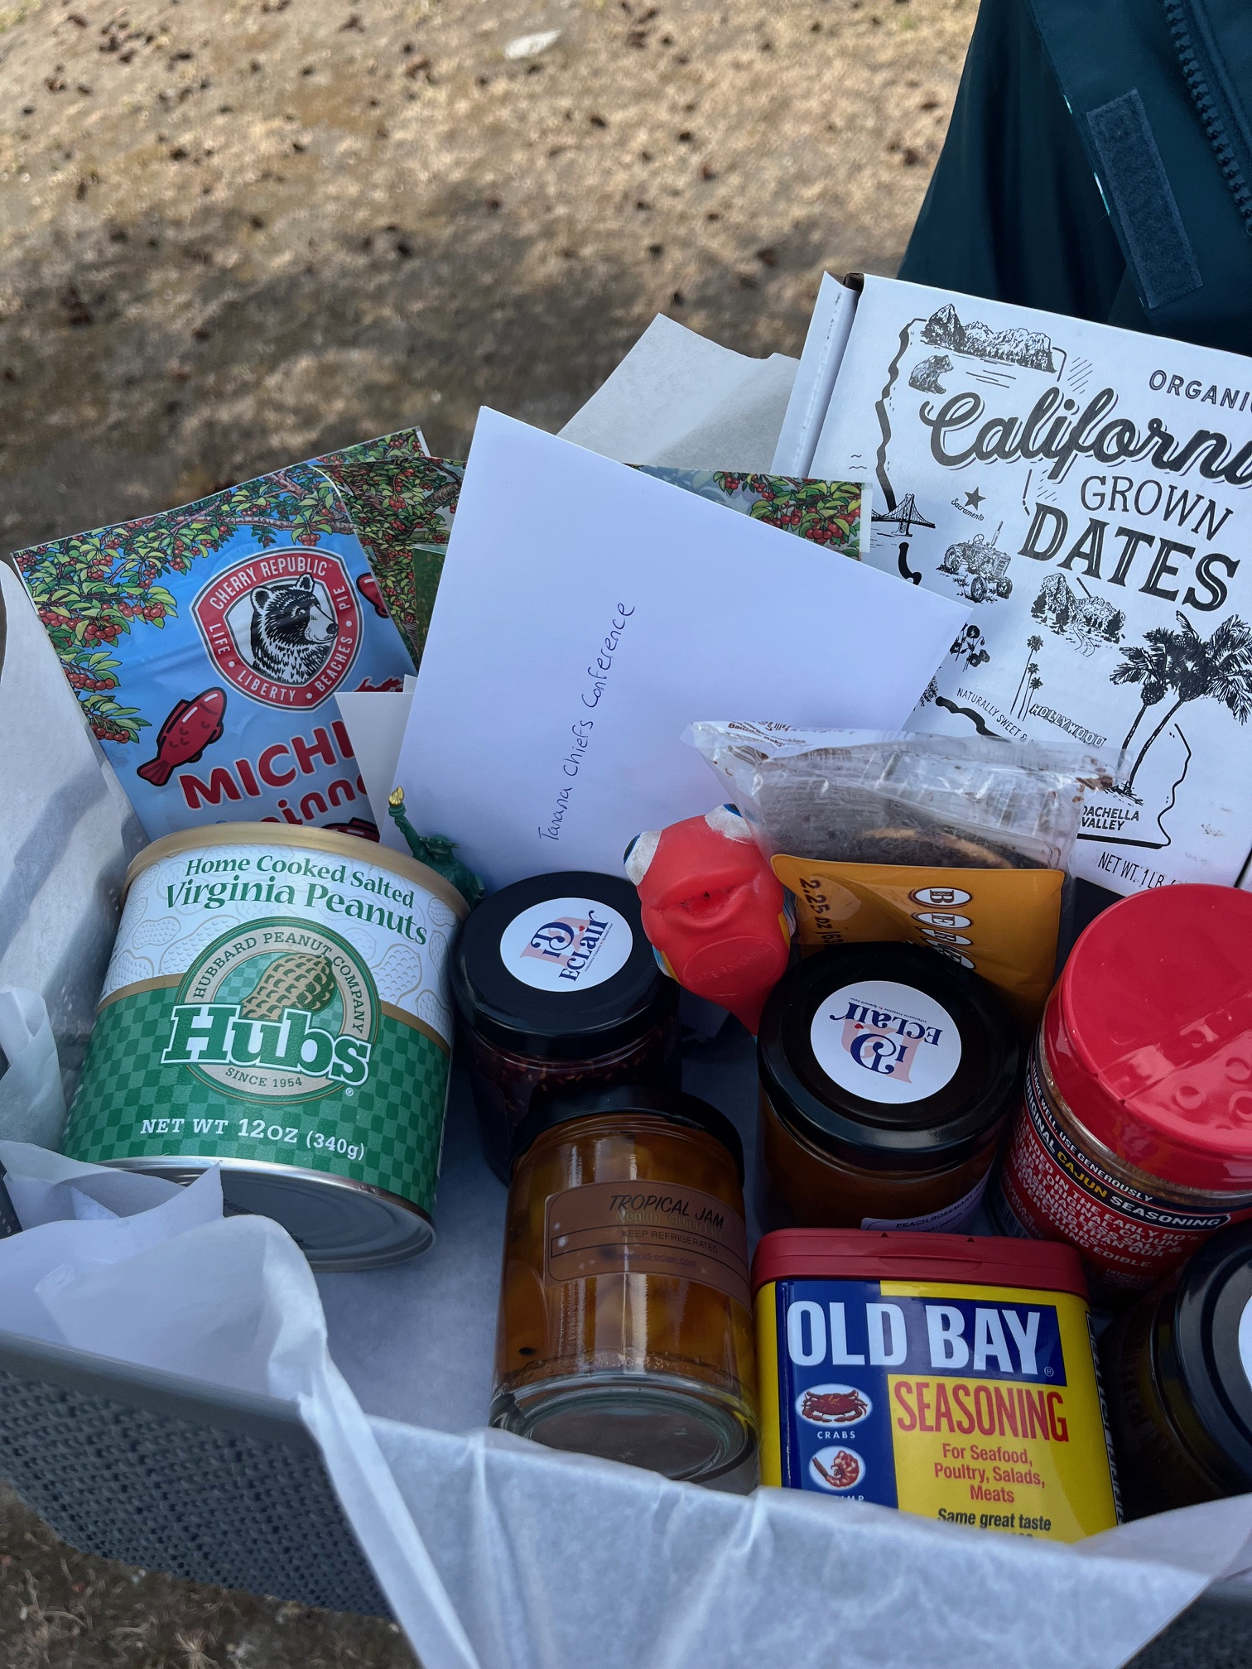
Gift basket delivery!

Slide 3
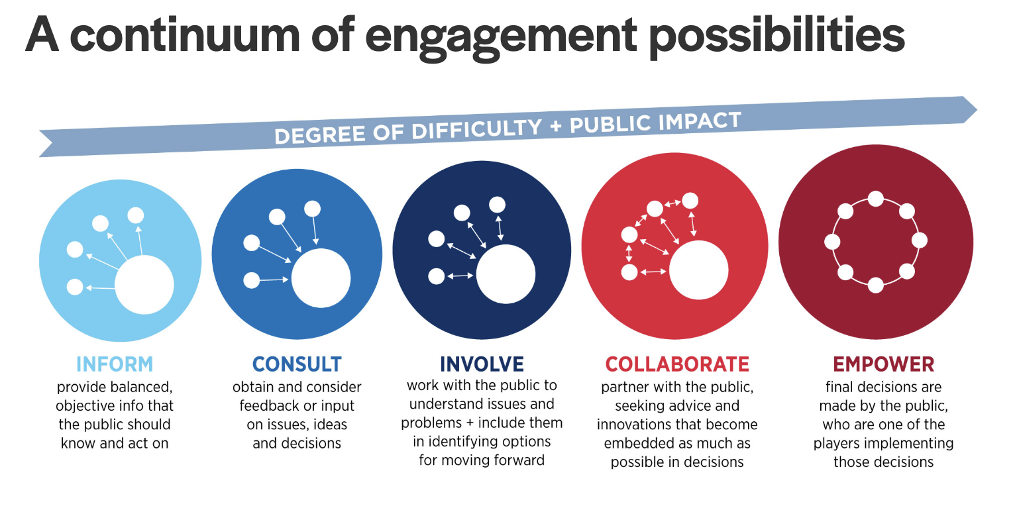
Directional. Good, but we can improve

Slide 4
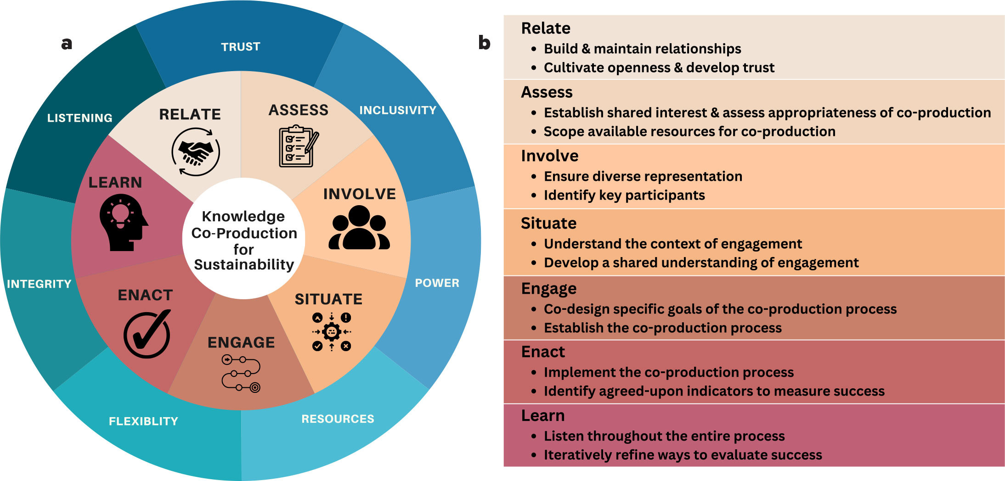

Slide 5
Summary of ABoVE Engagement and Outreach Responses
Current Engagement and Outreach Activities
Academic outreach: Presentations at undergraduate student seminars and guest lectures at high schools
Community engagement: Booths at events like "Engineering open house" and workshops with Indigenous communities
Media communication: Press releases, radio/TV interviews, print media interviews, and "Notes from the Field" blog posts
Government consultation: Work with Canadian federal, territorial, and Indigenous governments
Public education: Museum exhibits, visitor center displays, and public presentations
Professional collaboration: Earth to Sky Collaboration hosting scientists for training courses, webinars, and conferences

Slide 6
Future Engagement Plans
Continue media engagement: Getting journalists and science writers interested in ABoVE research
Data sharing: Publishing data products on repositories like ORNL DAAC
Two-way communication: Exploring approaches for dialogue with Alaska resource agencies and local communities
Public education: Continuing museum/visitor center exhibits and public presentations
Classroom activities: K-12 classroom visits and using ABoVE products for classroom demonstrations
Remote outreach: Delivering science talks to Indigenous communities or high school students in Alaska

Slide 7
Needs for Successful Engagement
Resources: Time to develop relationships, travel funding for invitational events
Communication support: Connections to journalists and science writers, help with community communications
Visual materials: High-quality photos, maps, and other visuals, hyperwall displays for outreach
Knowledge repositories: Archives of ABoVE PI slides, tools sections for developed resources
Contact information: Compiled lists of resources for contact with organizations like IARPC and Alaska Climate Adaptation Center
Boundary spanners: People who can facilitate connections and maintain institutional knowledge
Simplified information: Easier language to explain technical concepts (e.g., what 'L-BAND' means in ecological terms)
Many respondents noted they are new to ABoVE and have limited outreach to report but express interest in future engagement activities.

