Slide 1
Brief Background/Intro
Research interests: Remote sensing of land cover change in relation to climate and disturbances, currently focusing on Arctic shrub expansion and phenology
Ph.D. Candidate in Earth & Environment at BU
Advised by Dr. Mark Friedl
Involved w/ ABoVE since Summer 2022

Slide 2


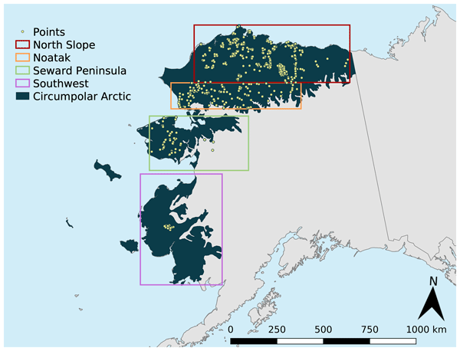
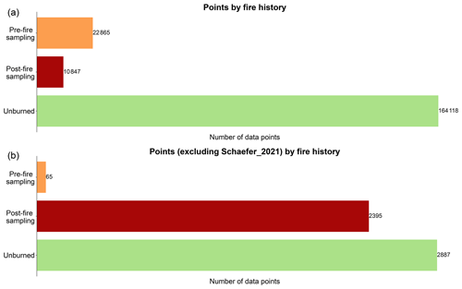
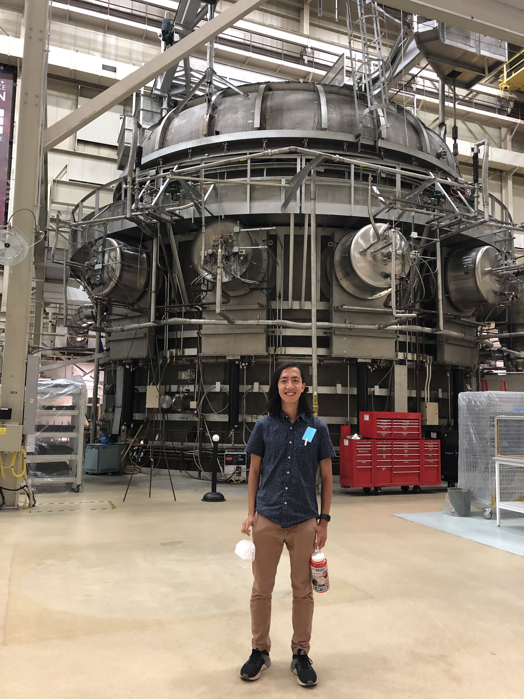
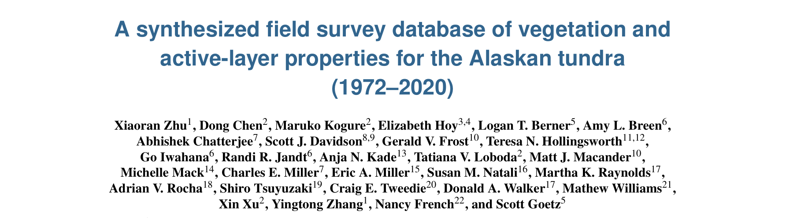
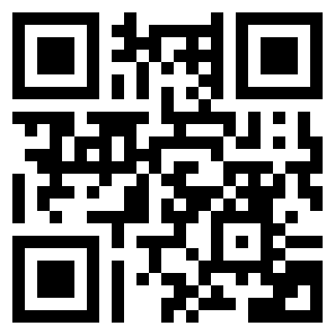
ABoVE Internship – Summer 2022
← Data: https://doi.org/10.3334/ORNLDAAC/2177

Slide 3
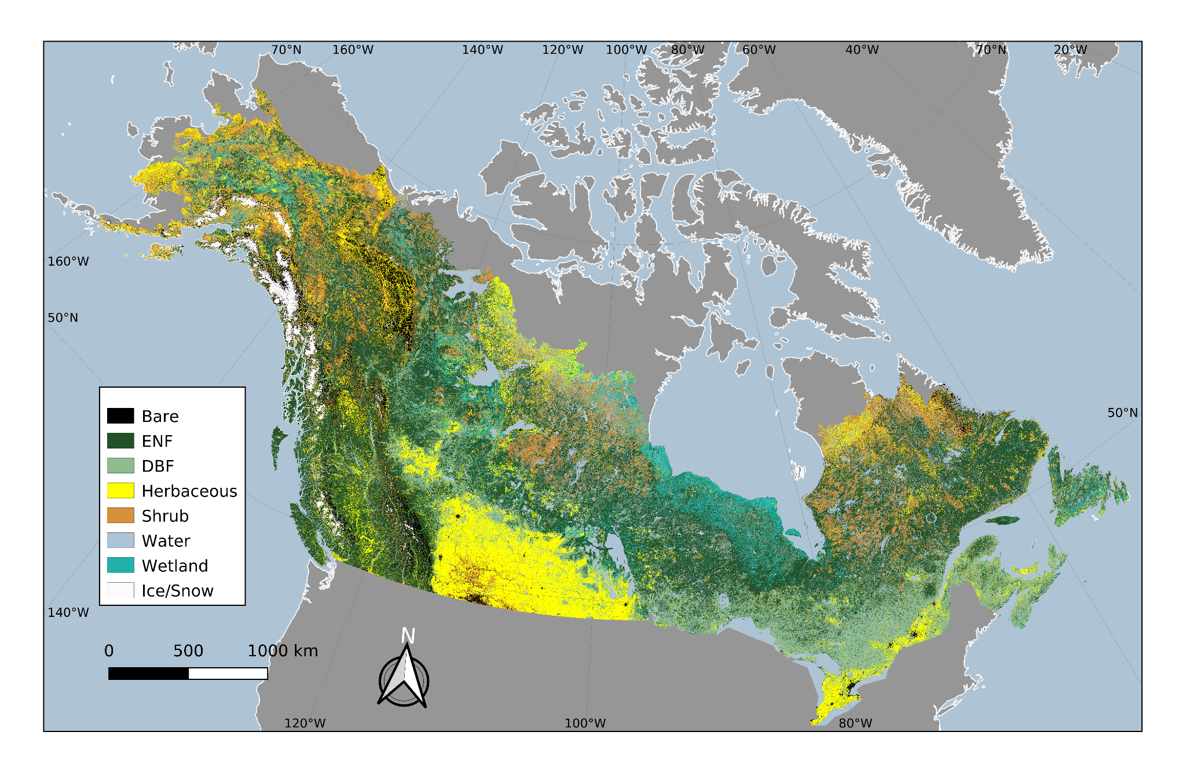
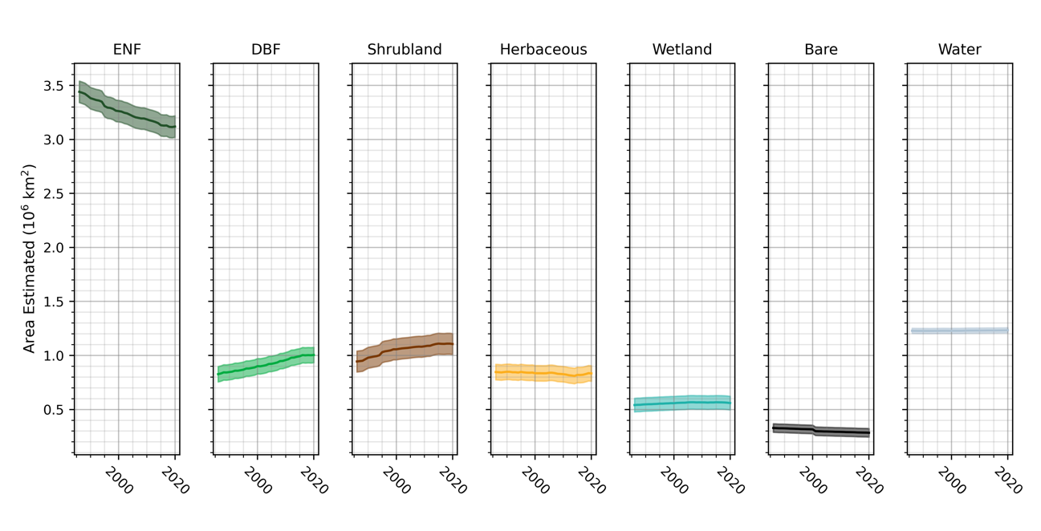
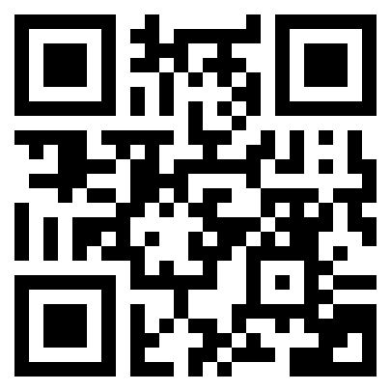
BU: Involvement w/ Jon’s phase 3 project – Starting Fall 2022
ABoVE: Landsat-derived Annual Boreal Dominant Land Cover, 1986-2020
Hu, K.T., J.A. Wang, X. Zhu, W. Liang, D.C. Morton, J. Kim, J.T. Randerson, and M.A. Friedl. 2025. ABoVE: Landsat-derived Annual Boreal Dominant Land Cover, 1986-2020. ORNL DAAC, Oak Ridge, Tennessee, USA. https://doi.org/10.3334/ORNLDAAC/2423
← Data

Slide 4


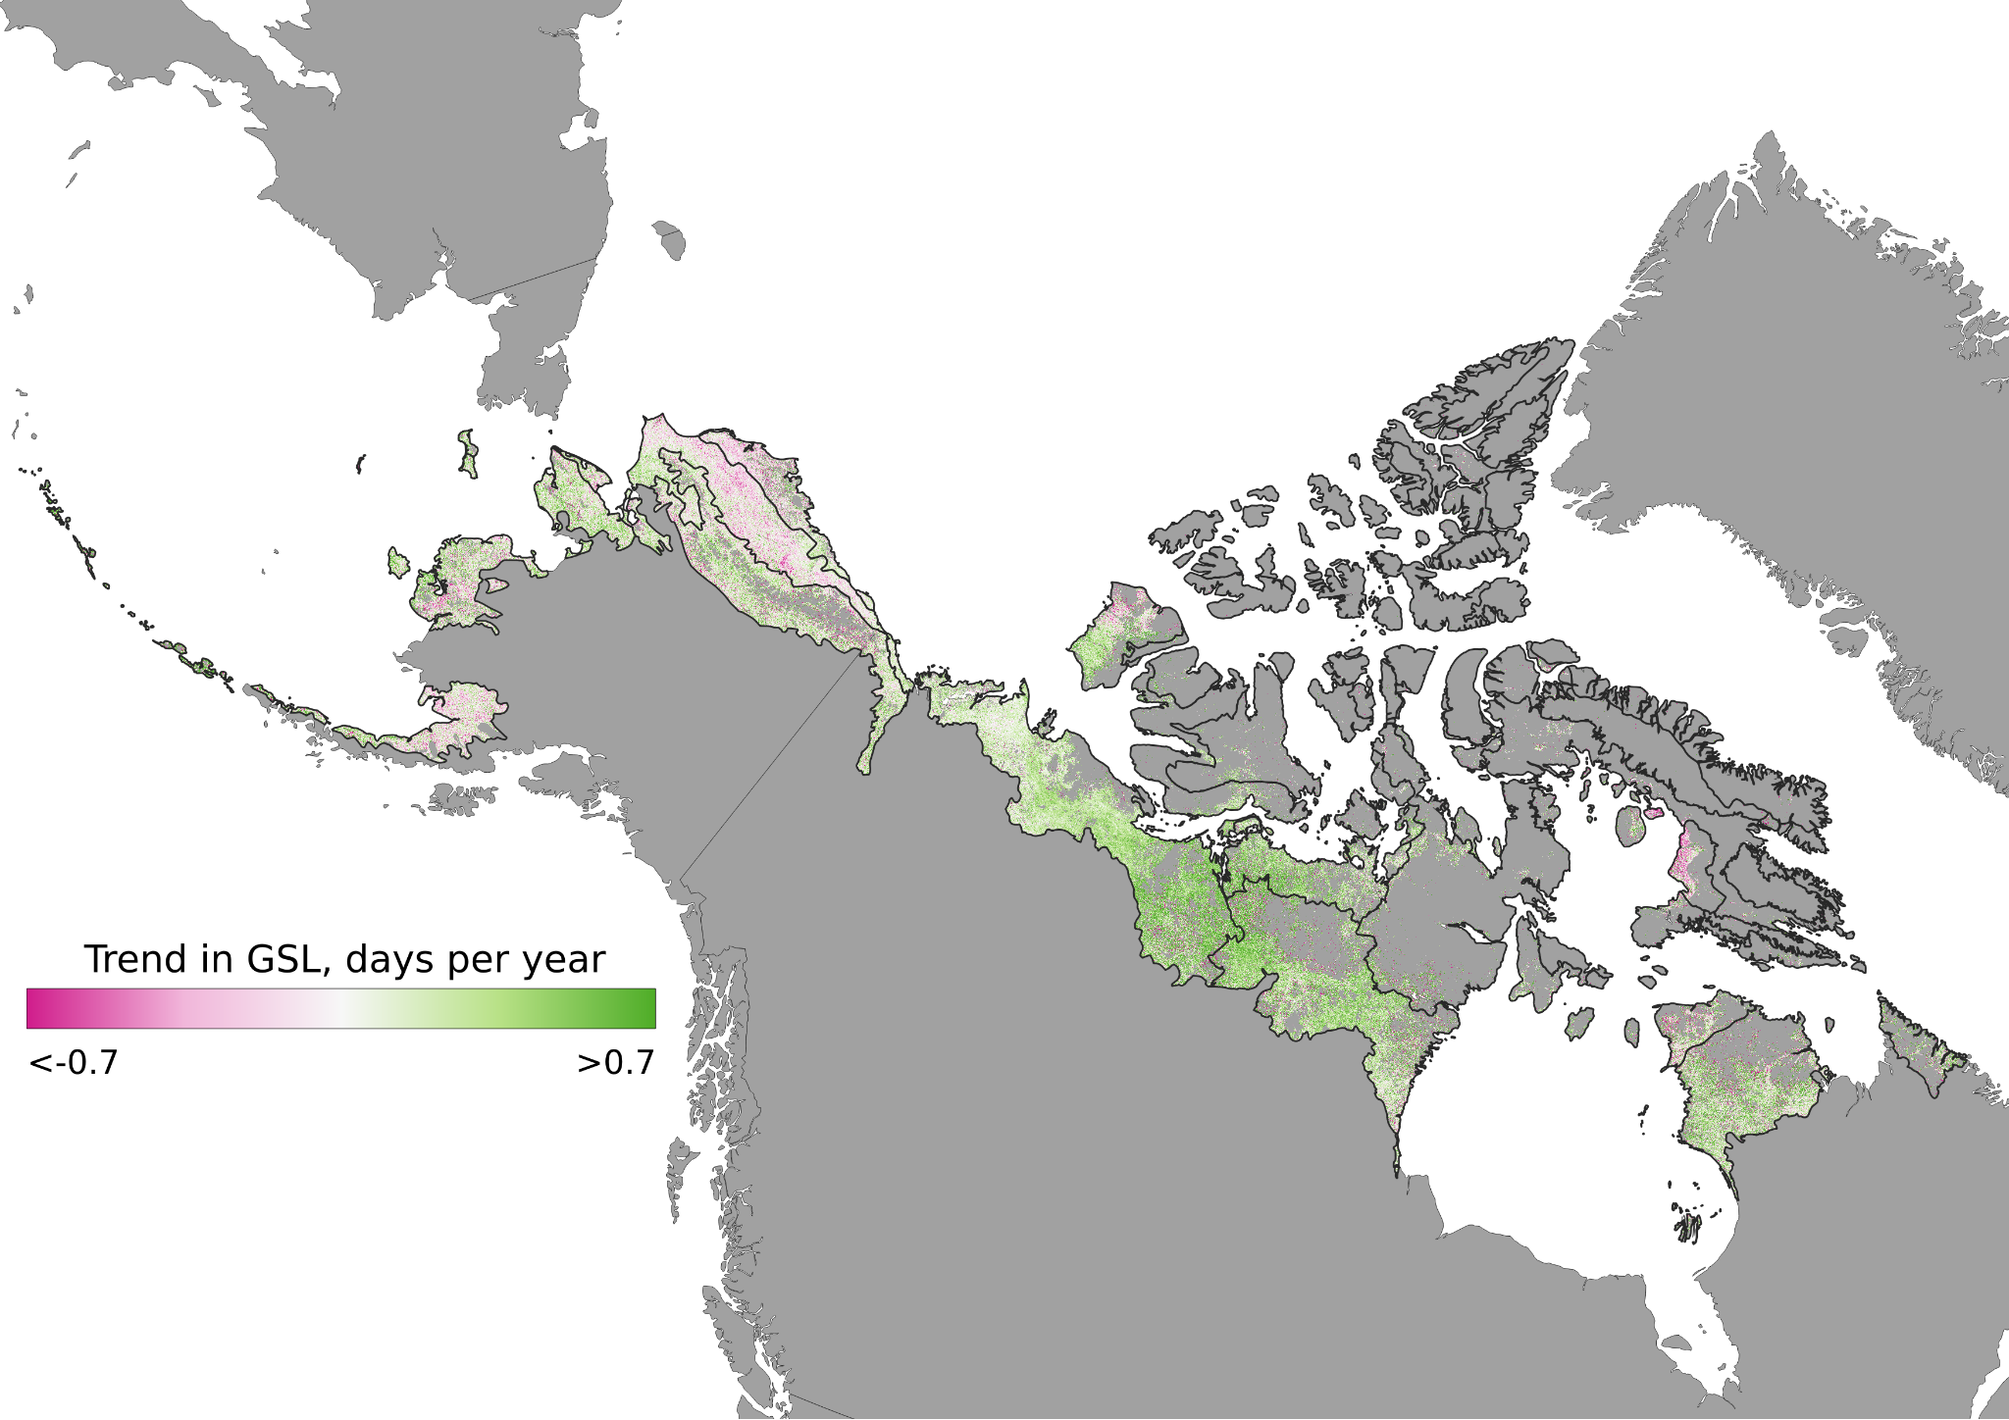
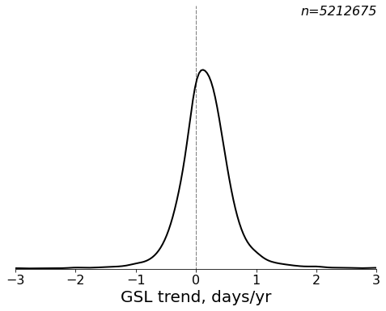
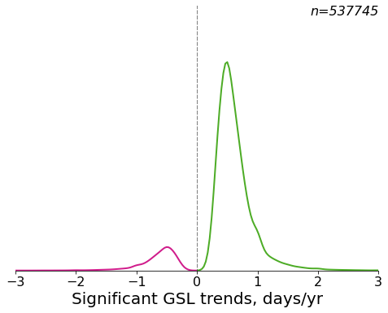
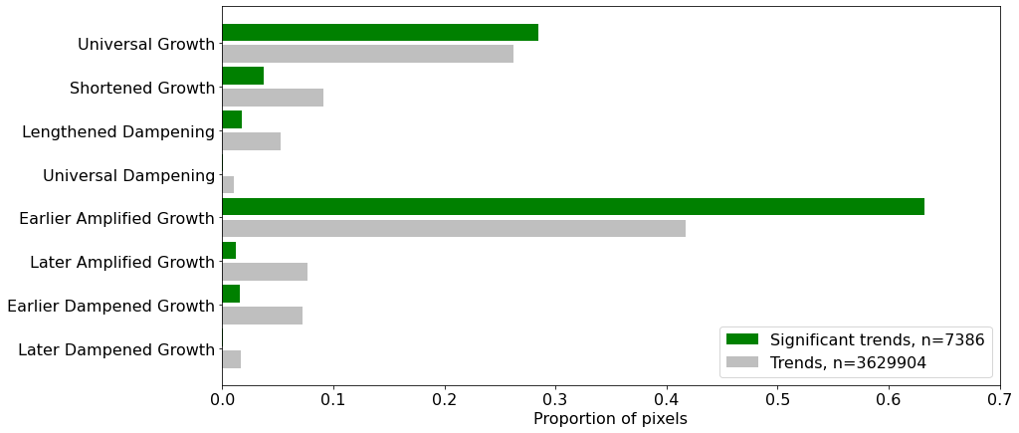
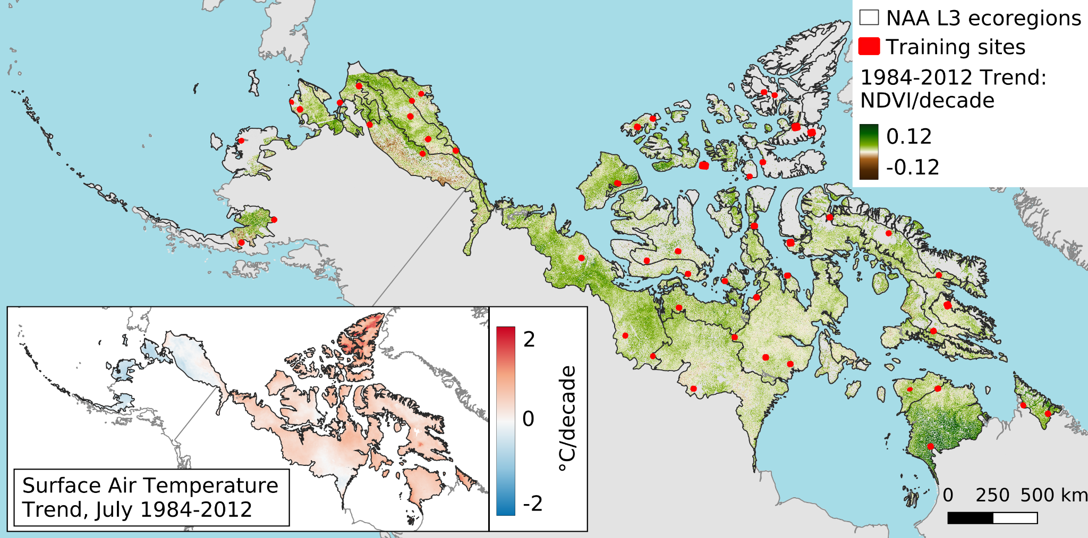
BU: Dissertation research
Vegetation composition change and greening
Phenology change and climate sensitivity

