Slide 1
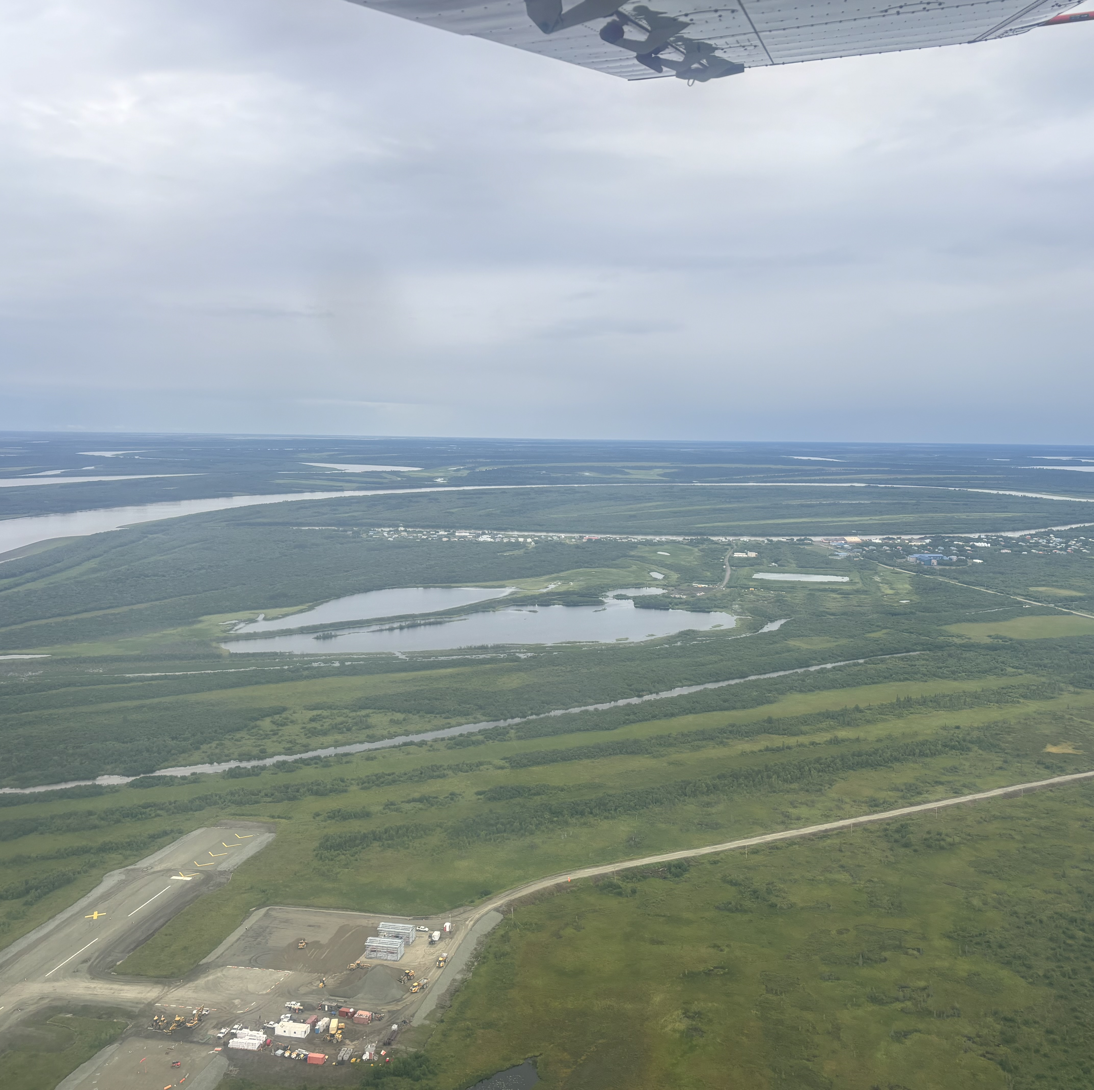
Carbon Dynamics Working Group Breakout Report

Slide 2
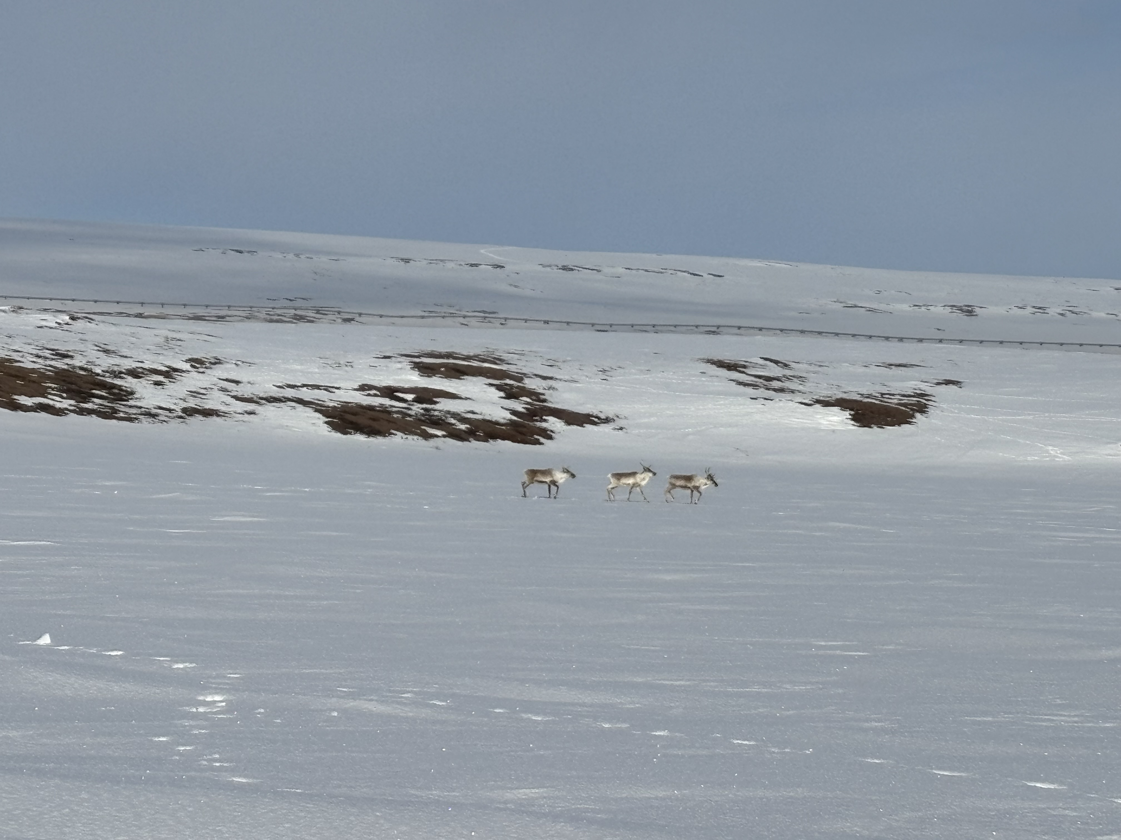
1. Synthesis Activities

Slide 3
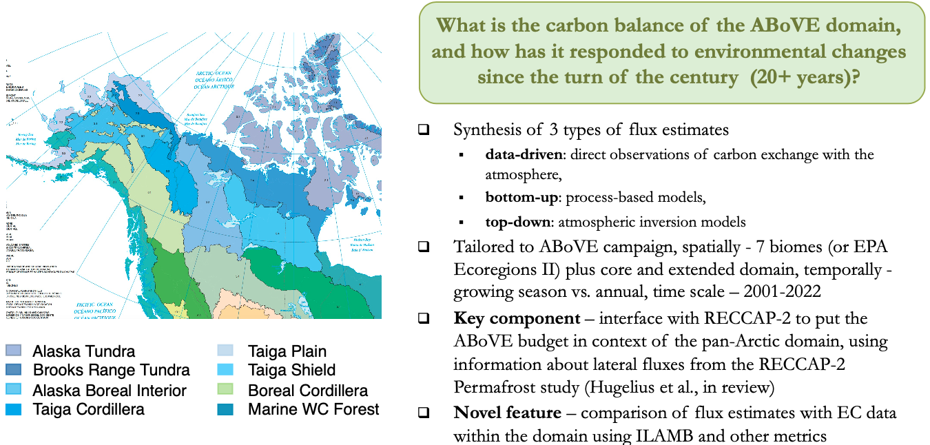
Carbon Synthesis Activity 1: ABoVE CO₂ Flux Budgets, Status & Uncertainty
Leads: Jeralyn Poe & Abhishek Chatterjee
IN PREP! Targeting 2025 submission!

Slide 4
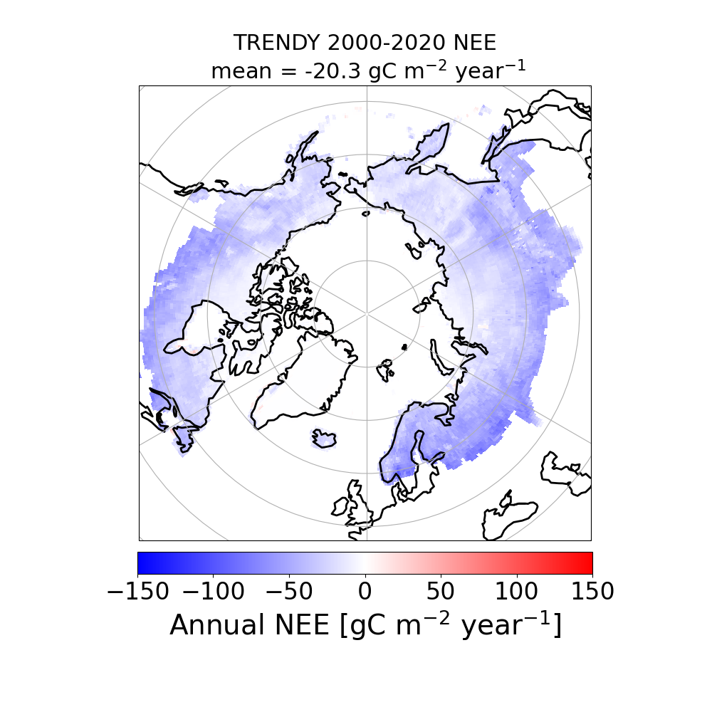
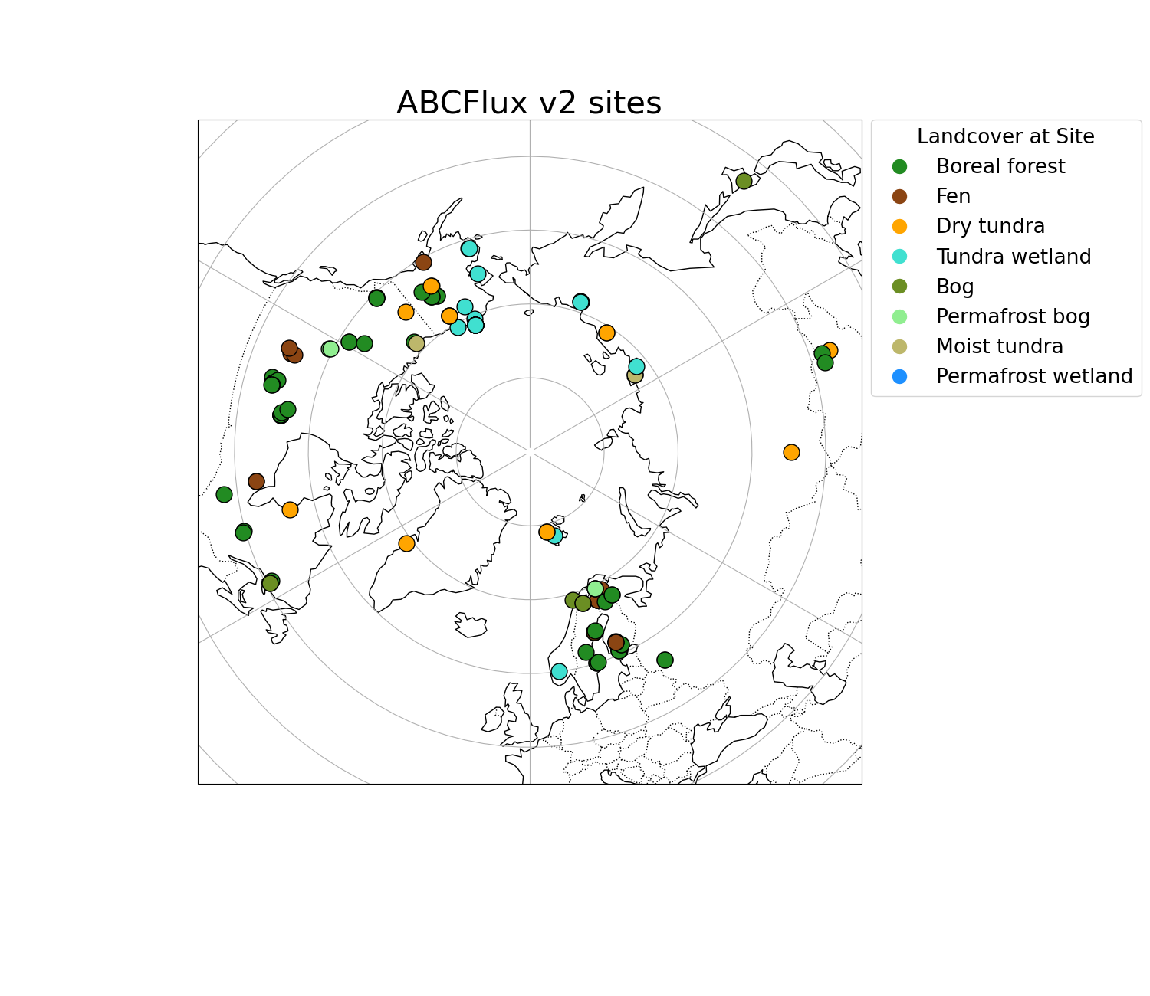
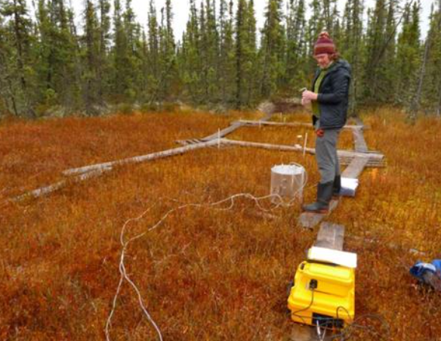
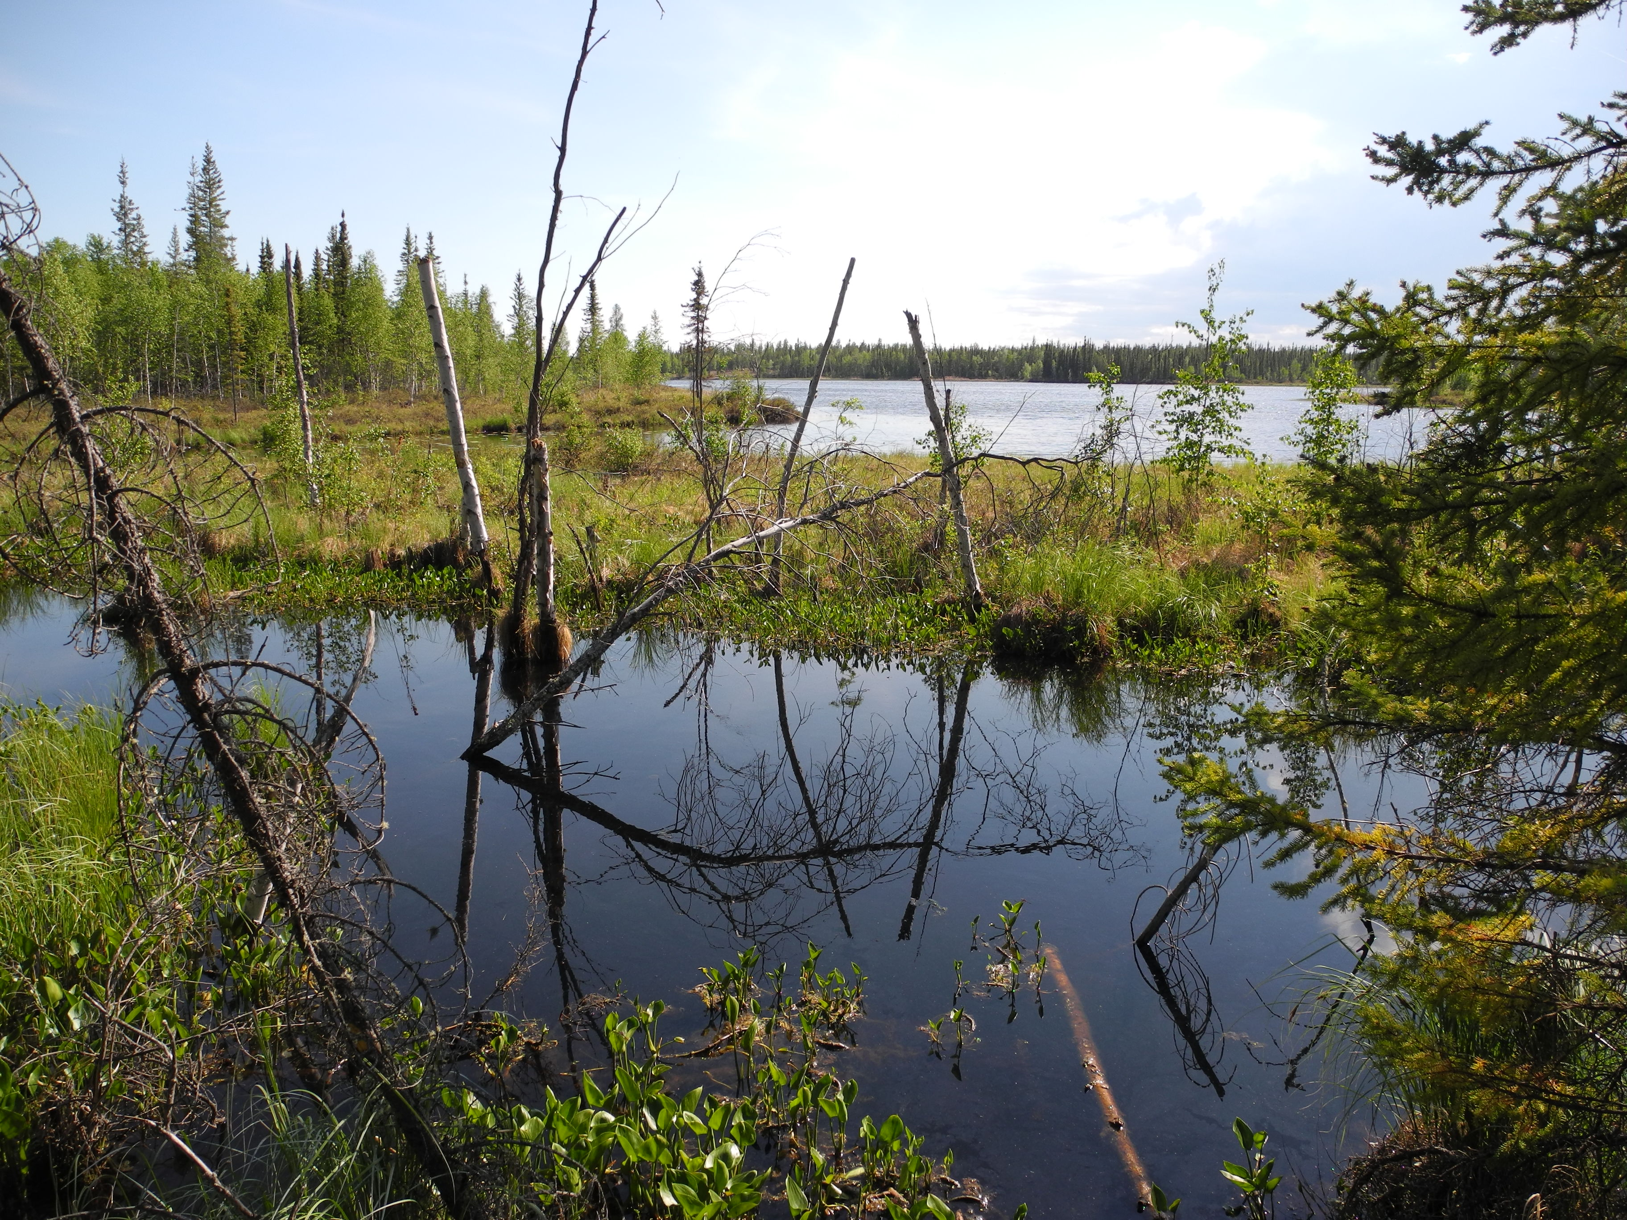
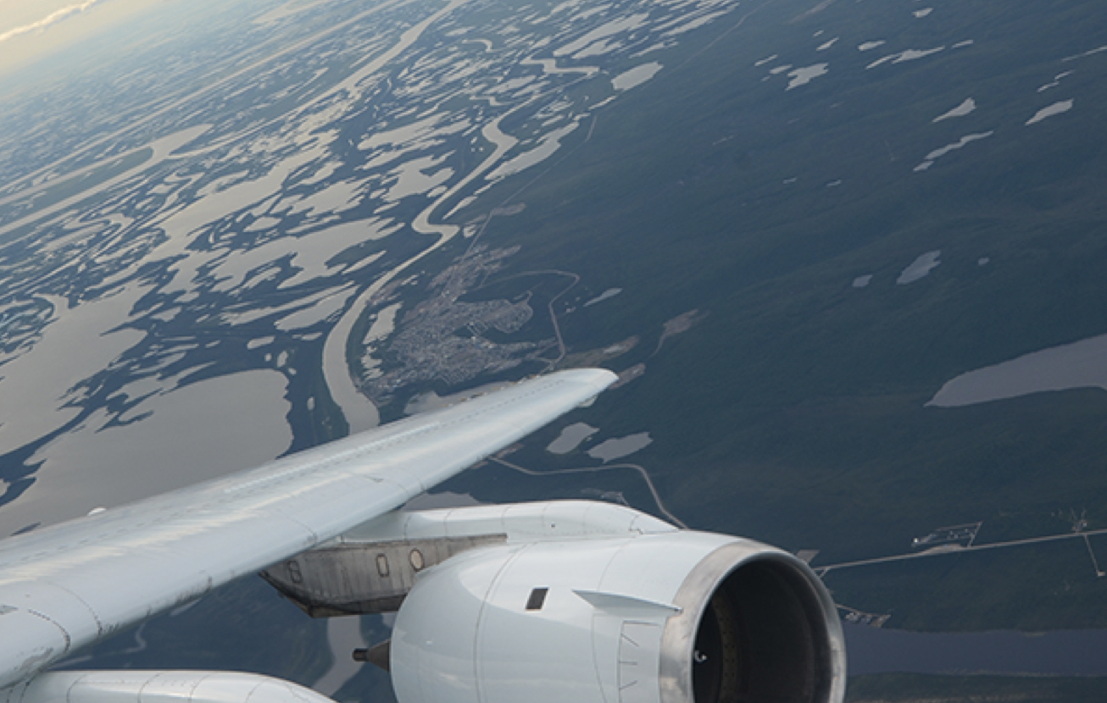
Carbon Synthesis Activity 2: pan-Arctic-boreal Flux Budgets
Leads: Beth Sutherland & Jenny Watts
Builds upon the Poe & Chatterjee synthesis, expanding to the full ABZ; including CO₂ & CH₄.
Includes process models, inversions, and other bottom-up budgets (including ML)
Model verification with ABCFlux2 and atmosphere (tall tower & airborne, w/ polarWRF-STILT)
In collaboration with Permafrost Carbon Network (PCN); part of Watts TE 2021 study.
Boreal
Wetlands/aquatic
Tundra

Slide 5

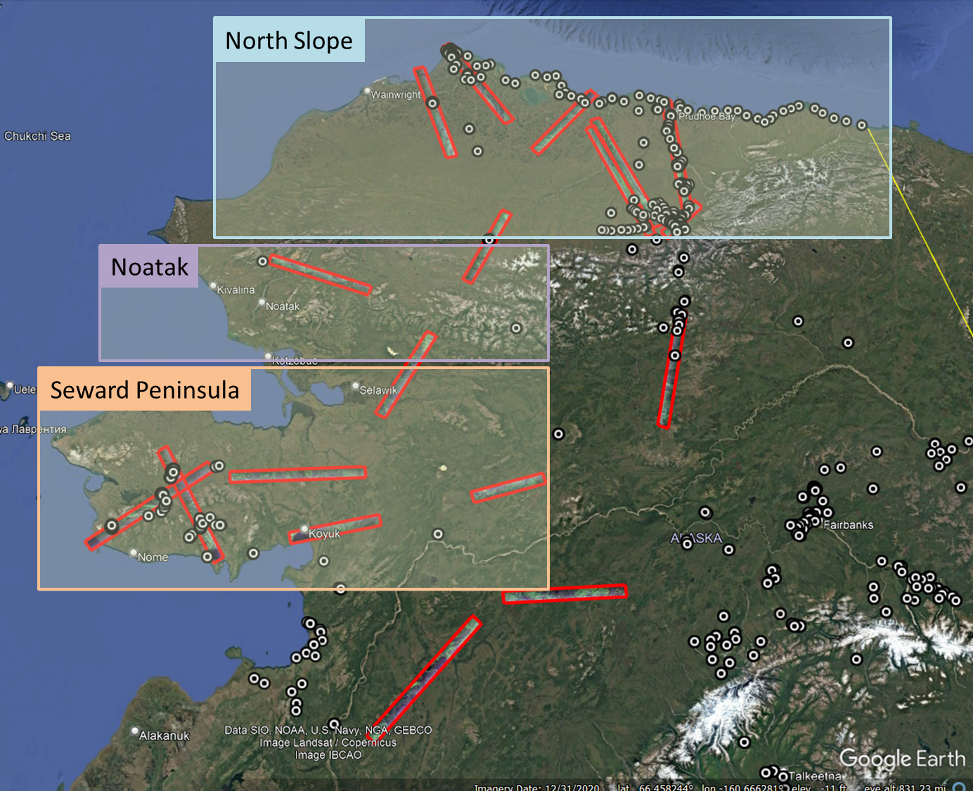

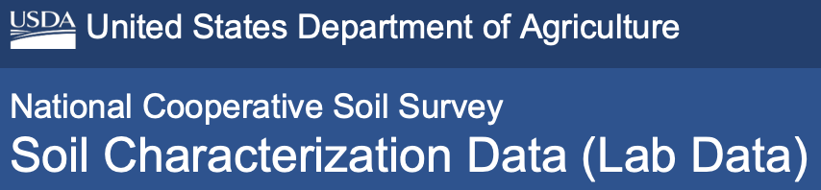













Carbon Synthesis Activity 3: The Alaskan Tundra In-Situ Soil Organic Carbon Synthesis Dataset
Sophia Henze, Kazem Bakian-Dogaheh, Jinyang Du, John Kimball, Mahta Moghaddam
Objective: In-situ SOC data are sparse in the Tundra region. However, in-situ SOC data is highly required for ecosystem modeling needs, radar remote sensing modeling as well as calibration and validation activities. In-situ SOC data also play an important role in understanding changes in the disturbance regime, and the impact of wildfires and retrogressive thaw slumps on the carbon dynamics.
We aim to synthesis 3 decades of in-situ SOC observations in the Tundra region of Alaska.
Methods:
Three Regions: Seward Peninsula, Noatak, North Slope
Seven Databases
66 PIs, ~1,400 Soil Cores, ~15,000 Soil Samples
Broader Impacts: In recent years, many projects have collected and partially consolidated in-situ soil data in the ABoVE domain; this in-situ SOC synthesis project aims to complement other synthesis studies by compiling and harmonizing quantitative information on multiple key soil properties, including:
Initial Sampling Locations (Regions of Interest)
1. NSF Arctic Data Center
2. National Cooperative Soil Survey
3. DOE (ESS-DIVE)
4. International Soil Carbon Network
5. ORNL DAAC
6. Toolik LTRE
7. USGS Science Data Catalog
Depth Information | Soil Organic Carbon | Organic Matter | Bulk Density | Porosity | Burn/ Unburned | C:N Ratio | Sand/Silt/ Clay
Further information will be provided at poster during “Permafrost and Hydrology” session.

Slide 6
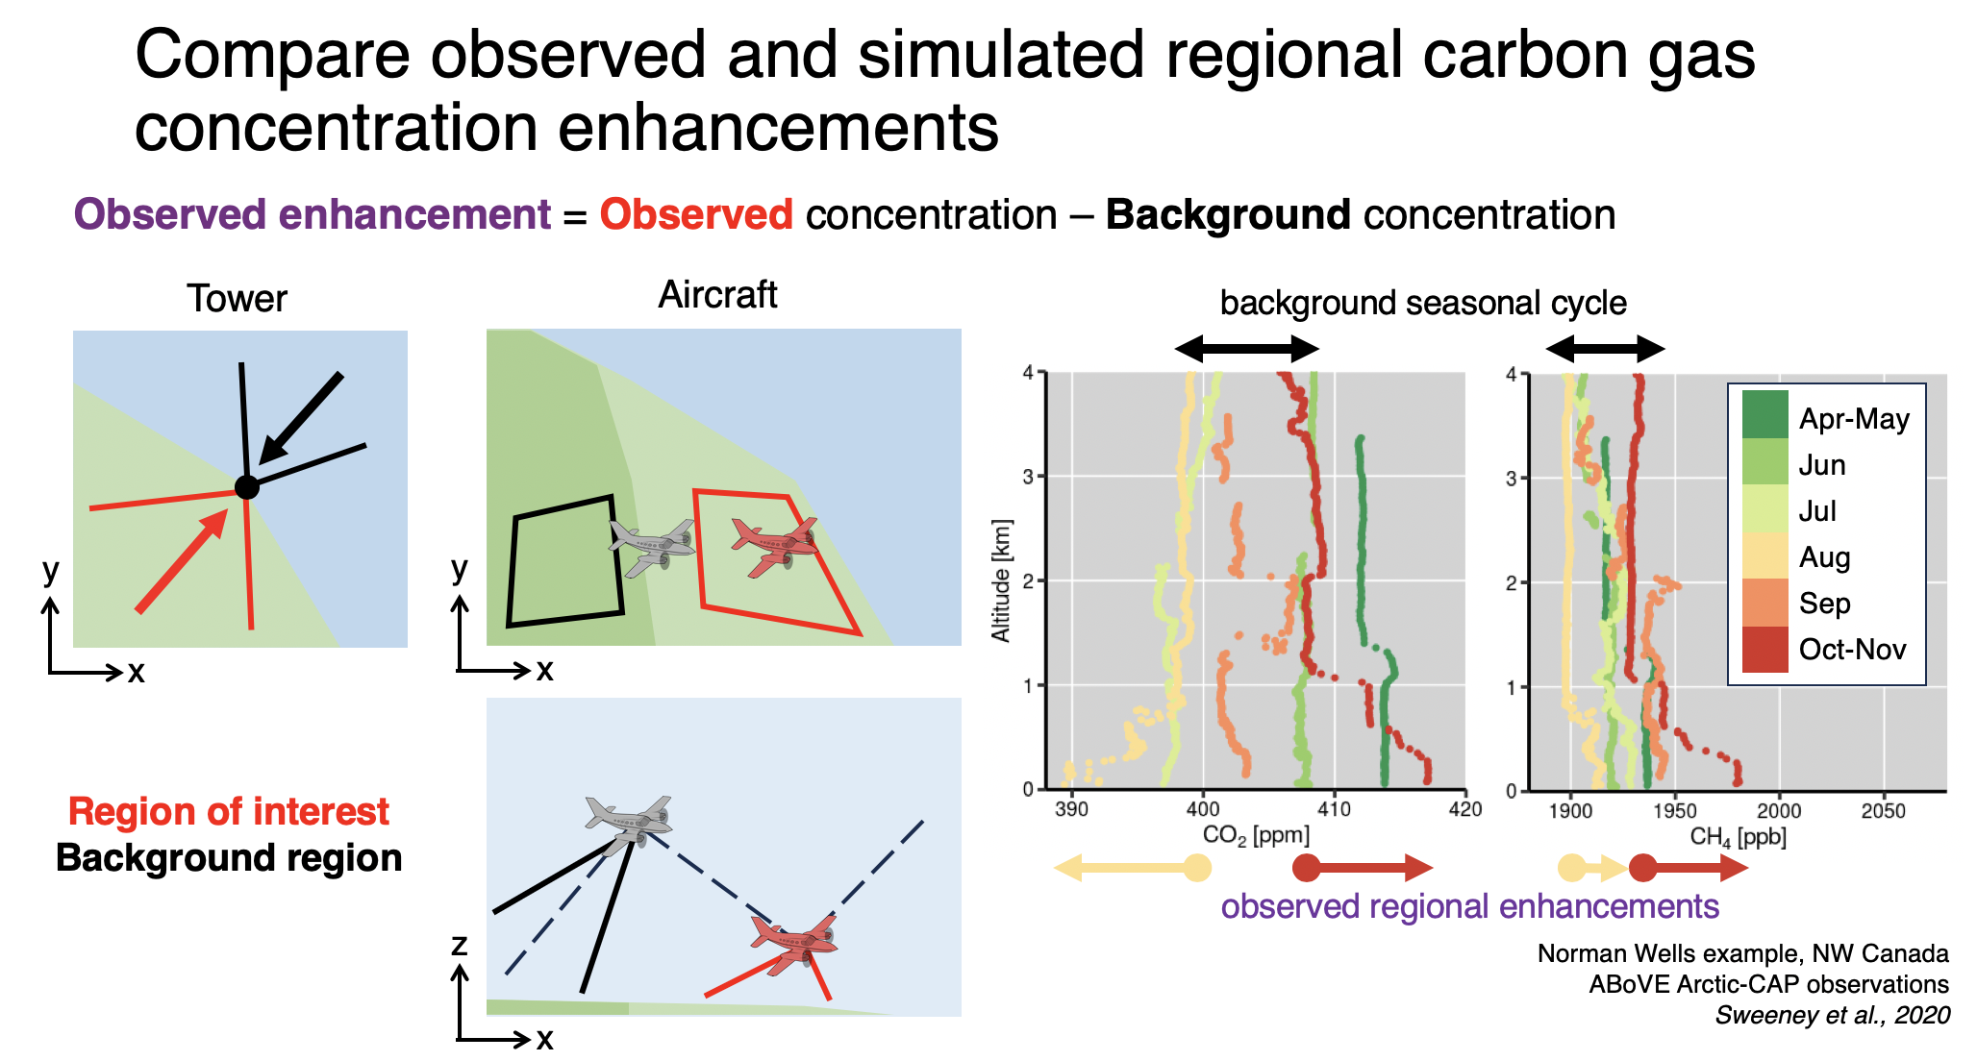
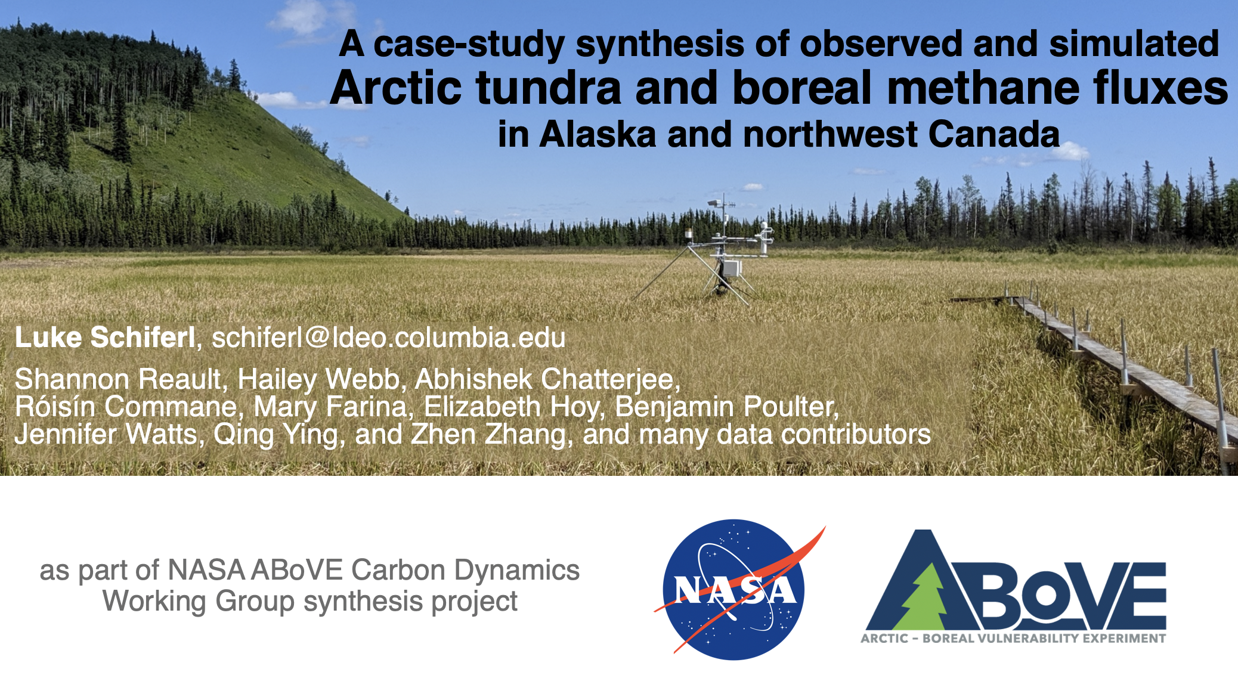
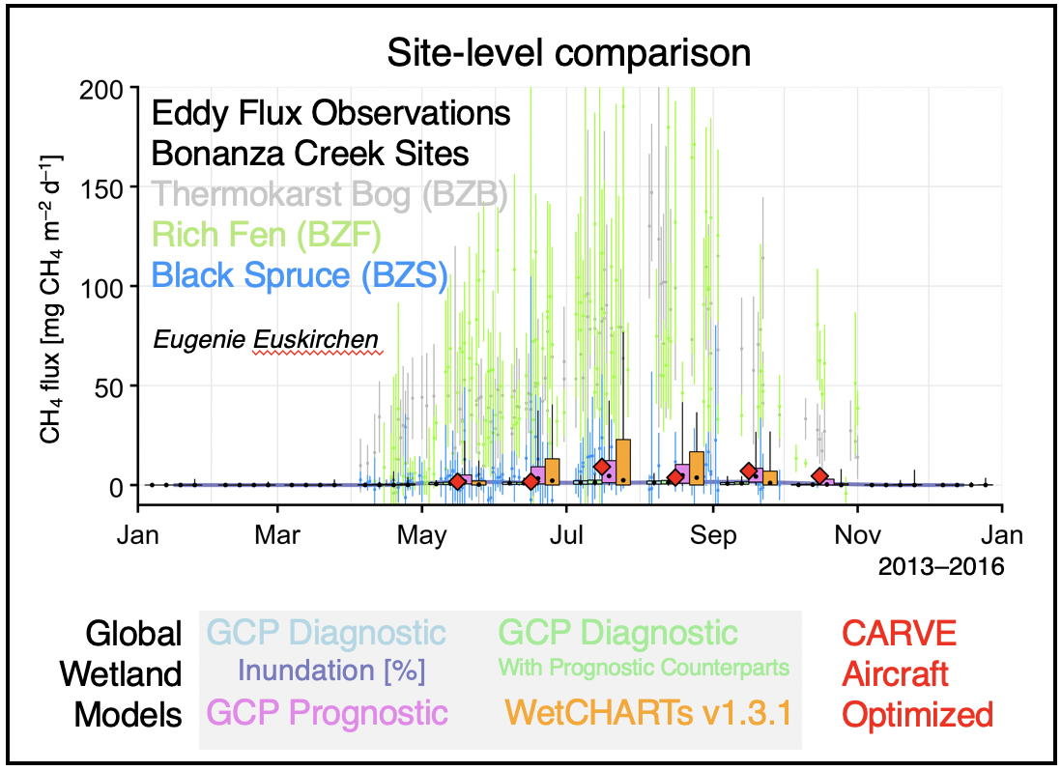
Carbon Synthesis Activity 4: ABoVE Ecosystem CH₄ Synthesis (Model + Wetland Land Cover Impacts on Uncertainty)
Leads: Luke Schiferl, Roisin Commane, Jenny Watts
Standby -- >. Submission TBD.

Slide 7
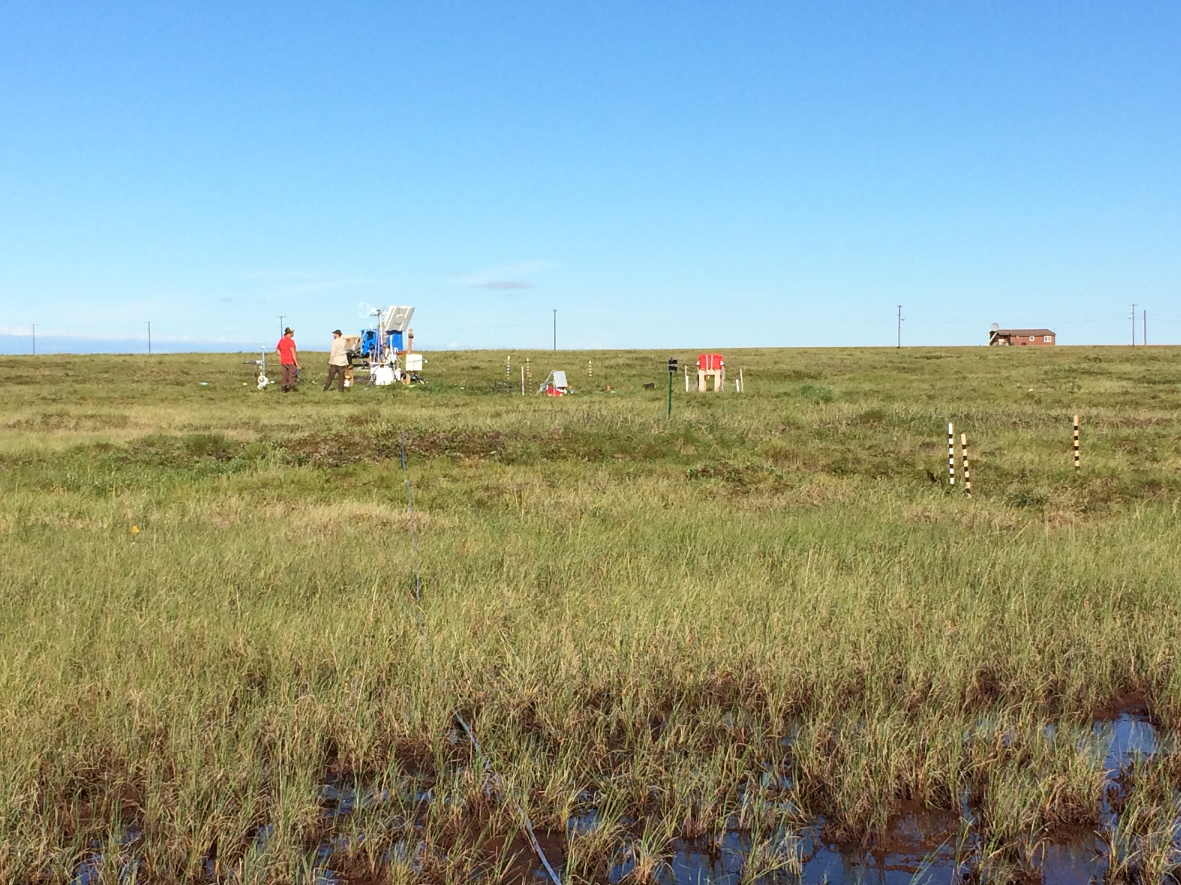
2. What we discussed during the breakout session

Slide 8
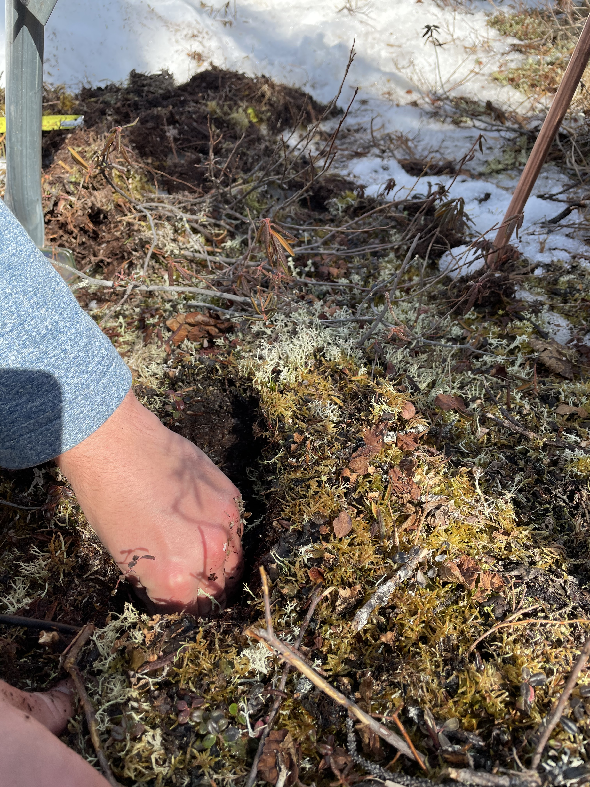
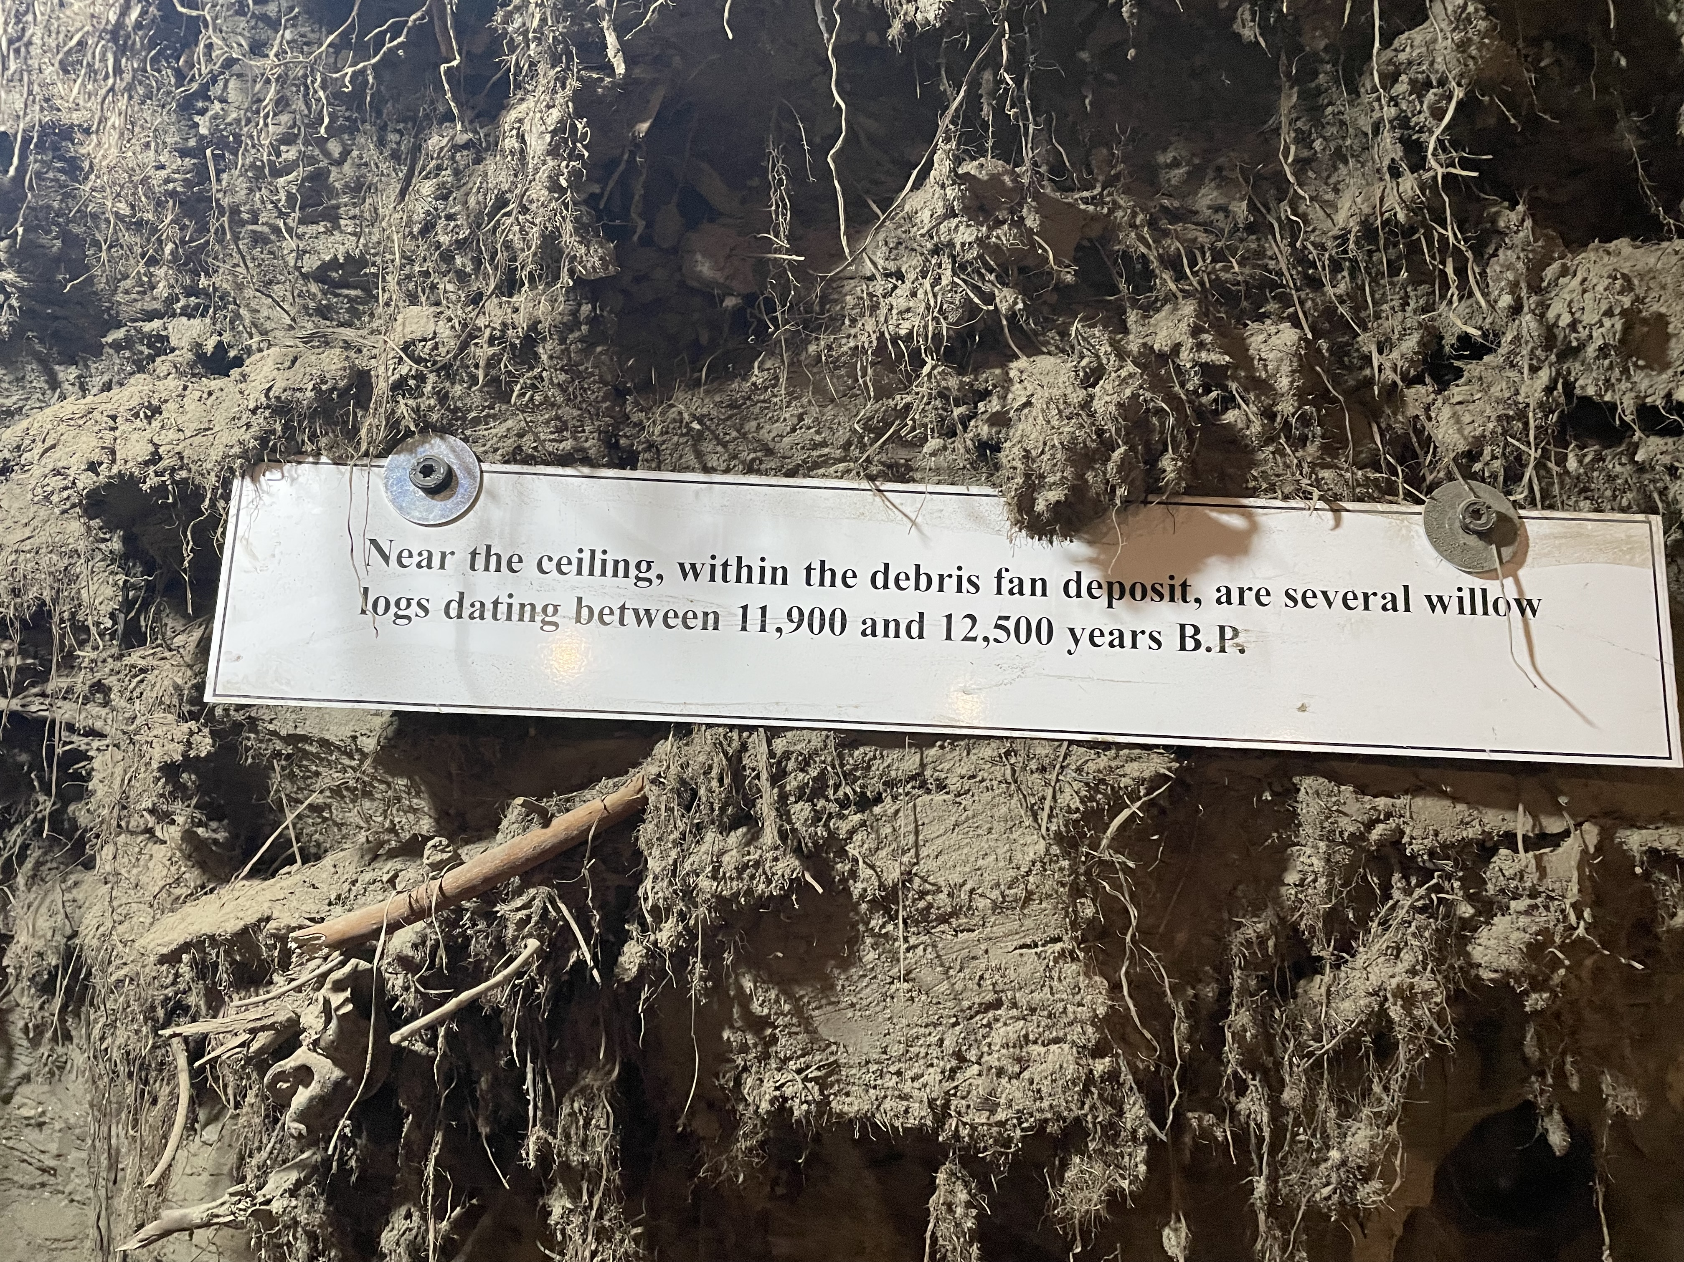
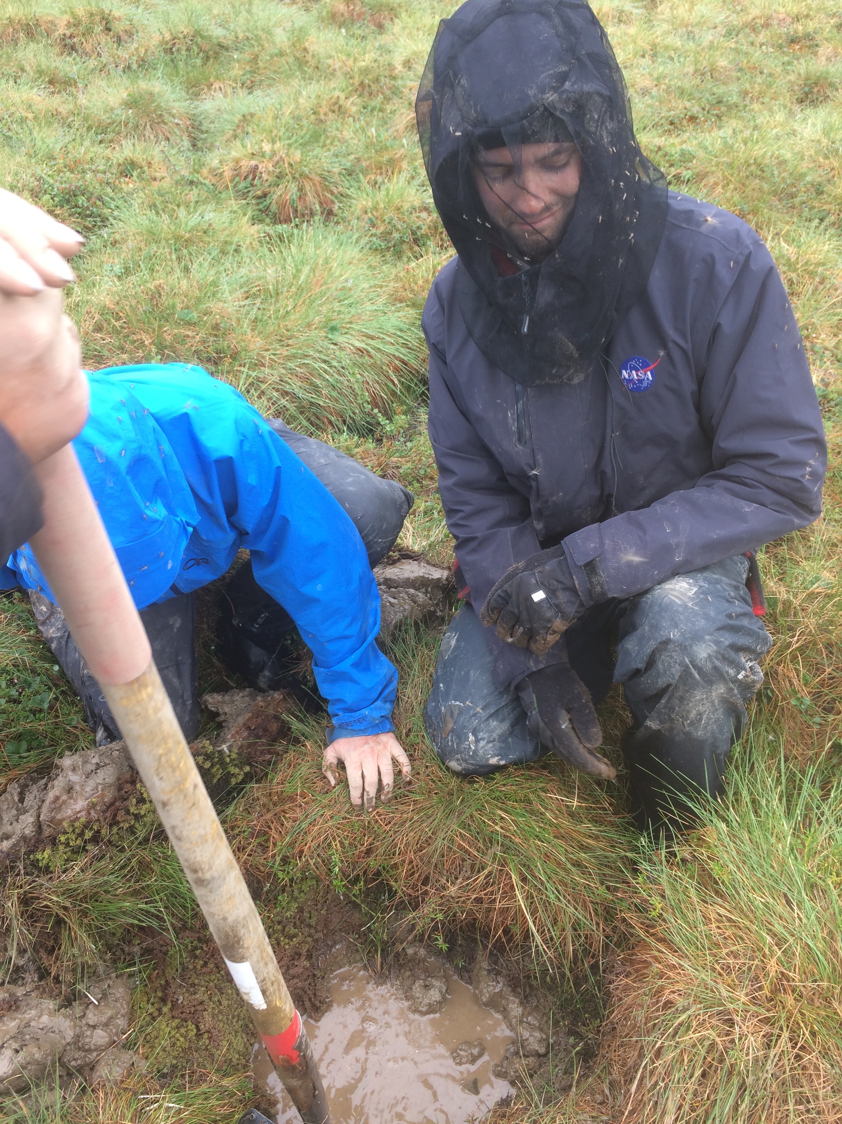
1. Building off Sophia & Kazem’s soil carbon synthesis, we’ve identified an opportunity to “dig into” understanding of pattern/drivers of soil respiration using field data available throughout the ABoVE domain. Use this info to study soil respiration response based on ecosystem characteristics, conditions, disturbances and feedbacks.

Slide 9
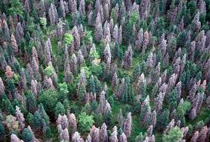
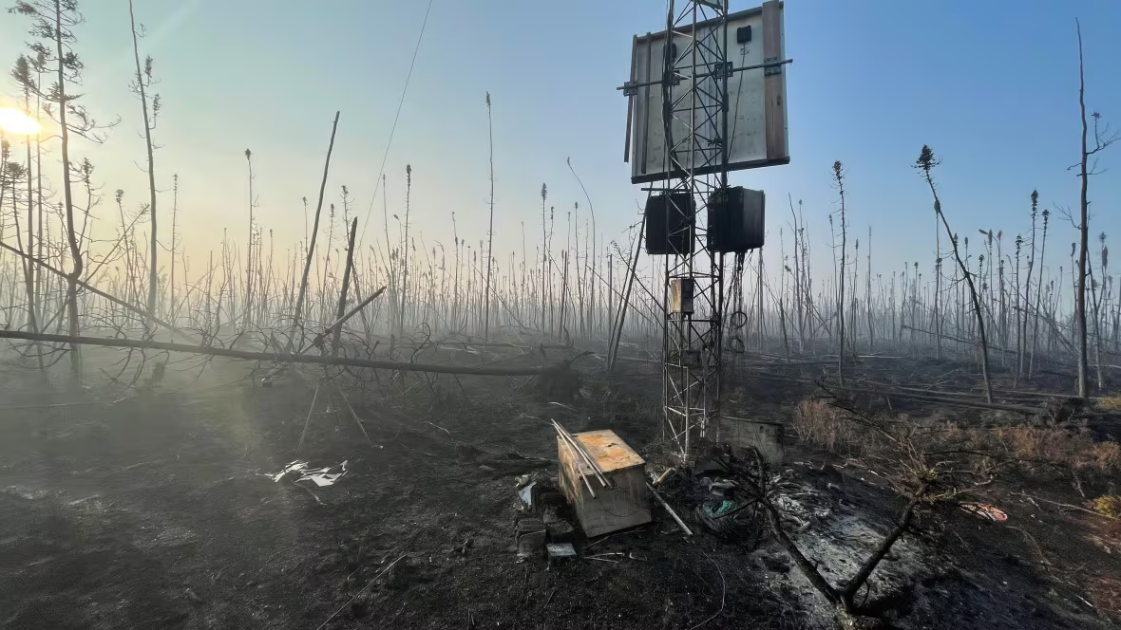
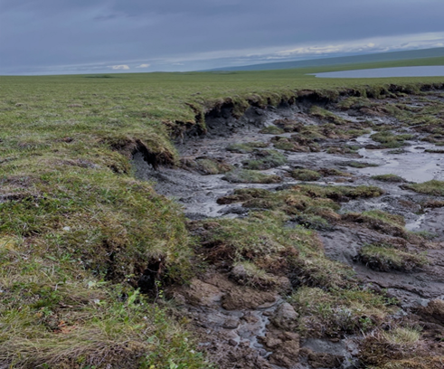
A need to identify the carbon impacts of biotic and abiotic disturbances (insect, fungal outbreaks, herbivory, fire, abrupt thaw, wetting/drying, etc.). from both a GPP and (above and belowground) respiration perspective.
Need to map/understand disturbance regimes/events (natural and anthropogenetic)

Slide 10
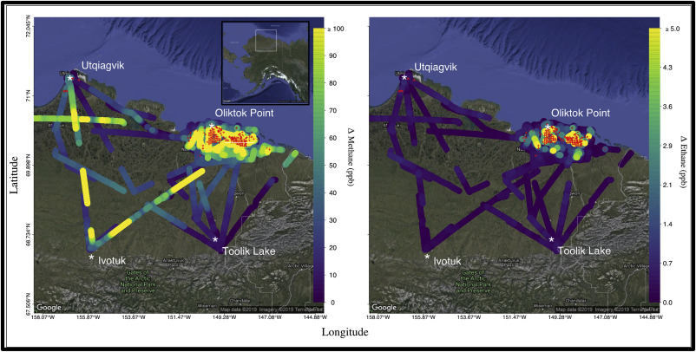
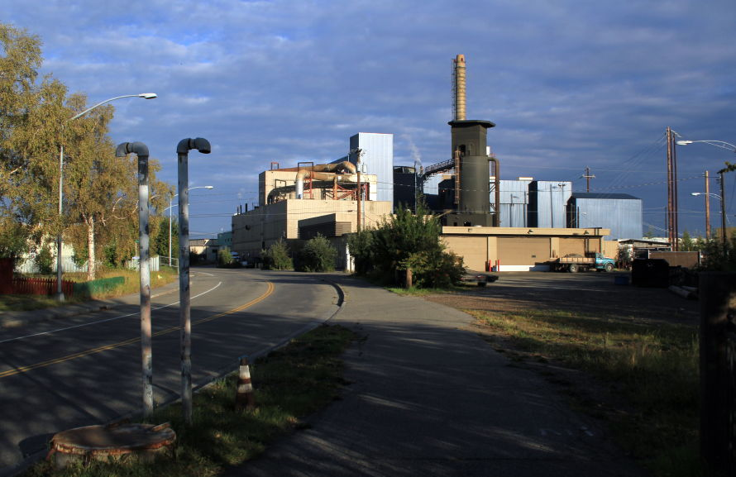
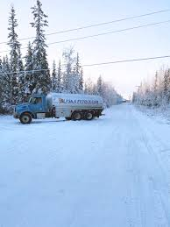
4. Understand/quantify how large are anthropogenic influences (carbon emissions; also impacts to water and energy, etc.) relative to natural systems across the ABoVE and pan-Arctic-boreal region.
Floerchinger, C., McKain, K., Bonin, T., Peischl, J., Biraud, S. C., Miller, C., ... & Sweeney, C. (2019). Methane emissions from oil and gas production on the North Slope of Alaska. Atmospheric Environment, 218, 116985.

Slide 11
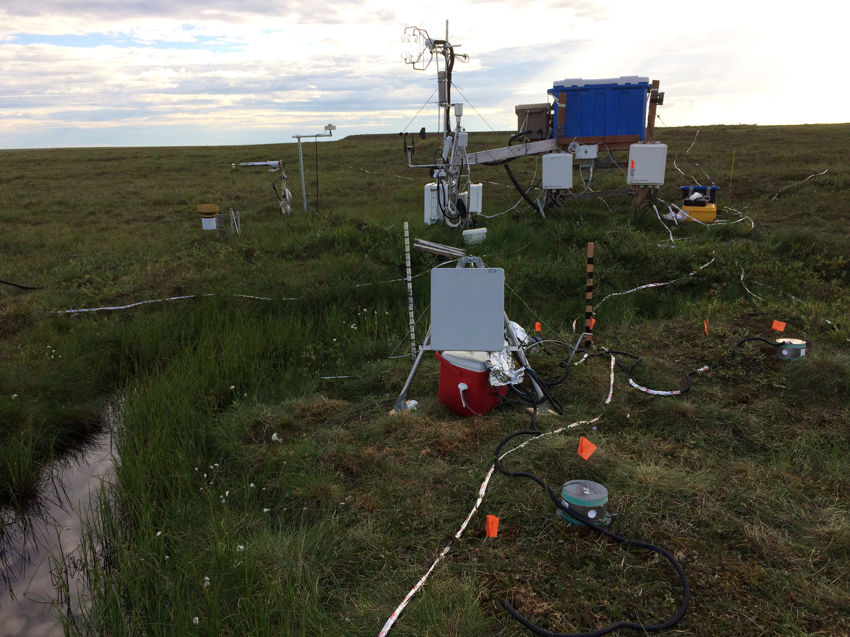
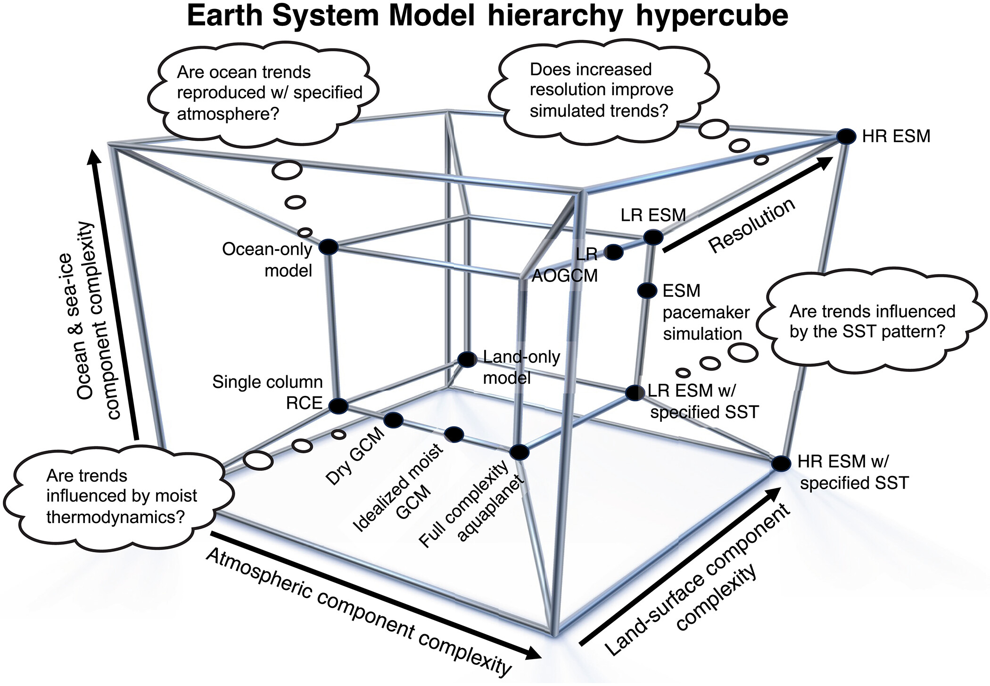
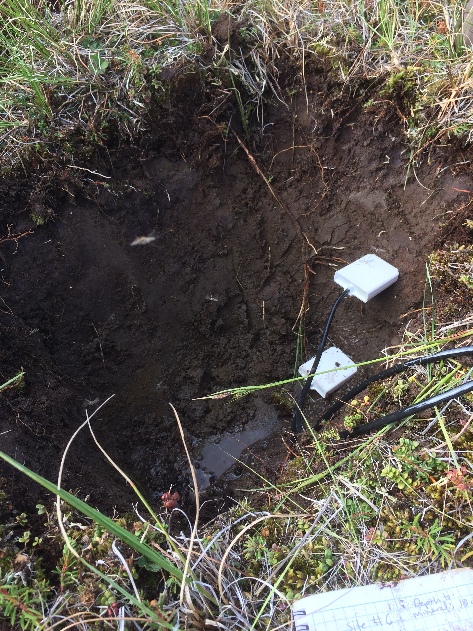
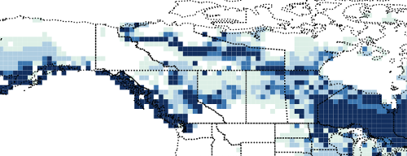
5. Do we have the correct spatial resolution in models and observations to answer the important answers? Spatial heterogeneity, etc. Problem with monthly time step in many process models… difficult to test/identify impact of changing start-of-greenup on carbon budgets, impacts of severe weather, etc. Difficult to compare with atmospheric measurements.
6. Why don’t bottom-up model estimates match top-down?
Problem with maps? Problem with process representation?
To this…
From this…
Simpson et al. (2025) Science Advances.

Slide 12
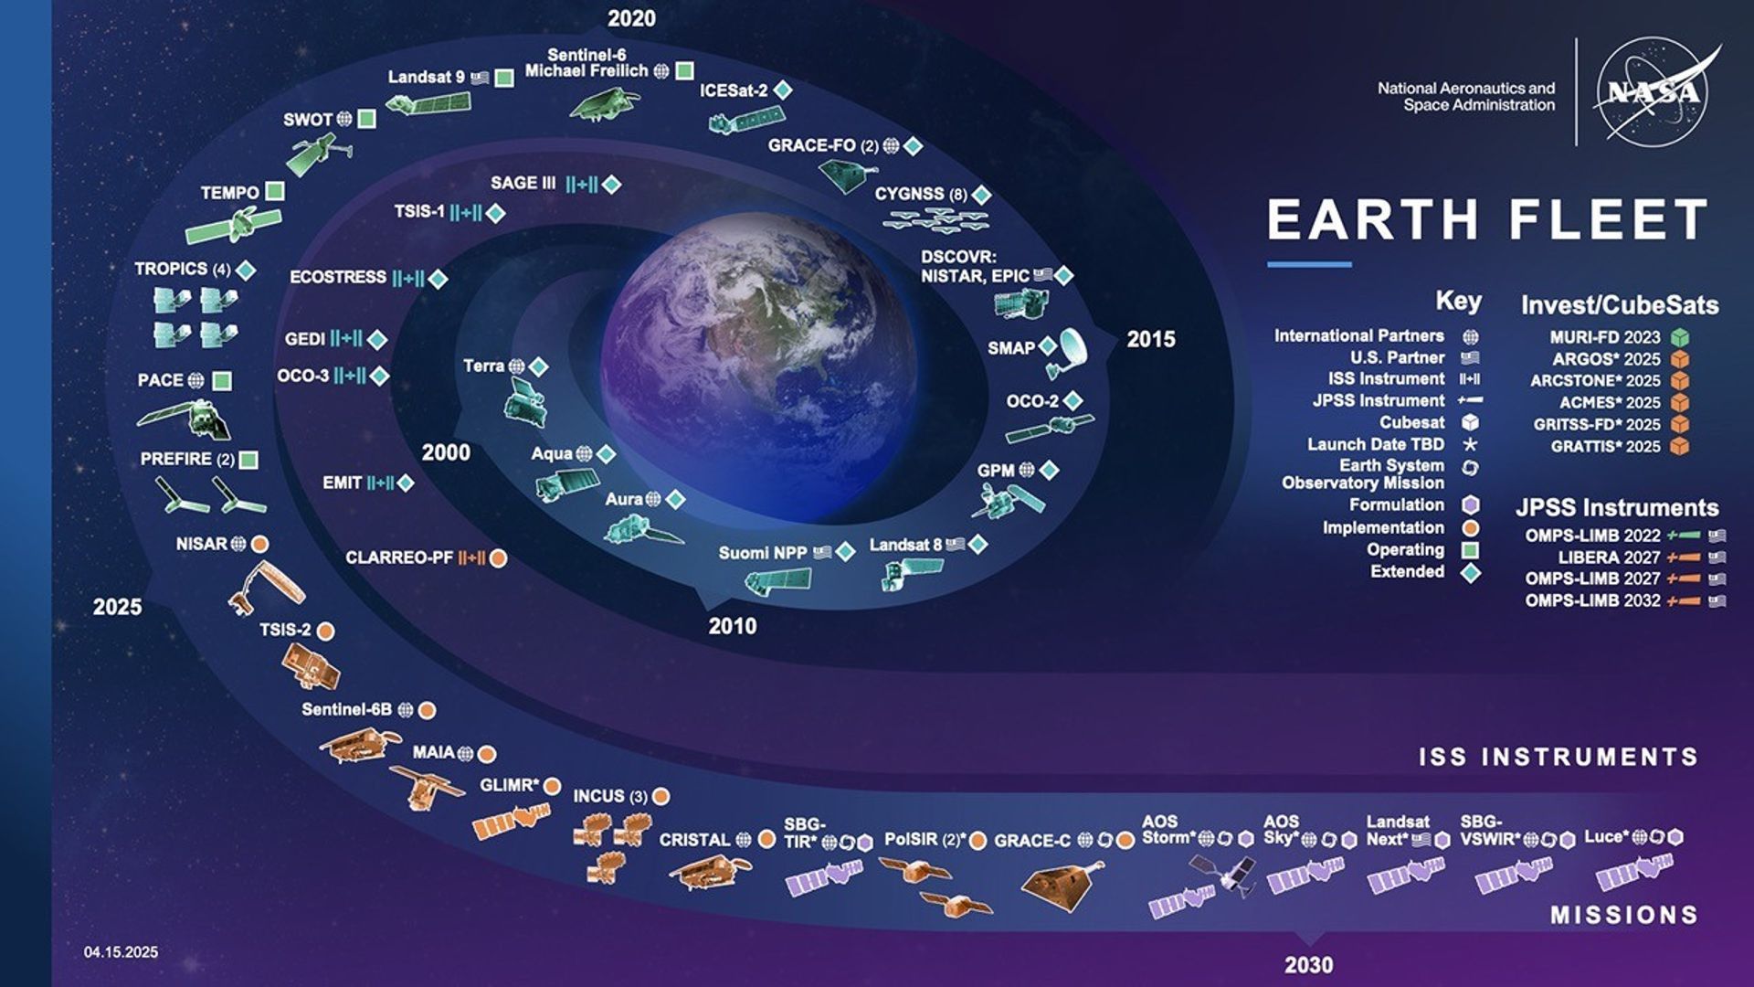
7. How might future Arctic-boreal research benefit from new and upcoming NASA (and NASA partner) missions?

