Slide 1
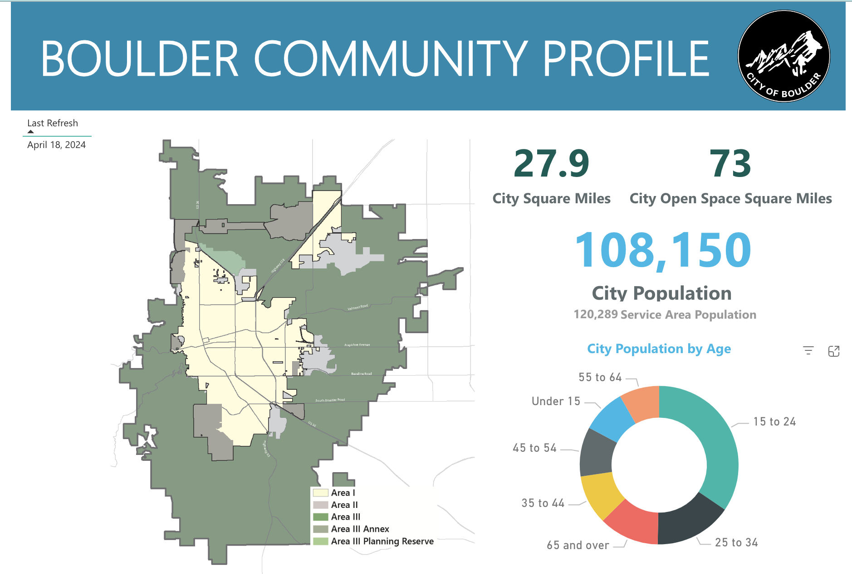
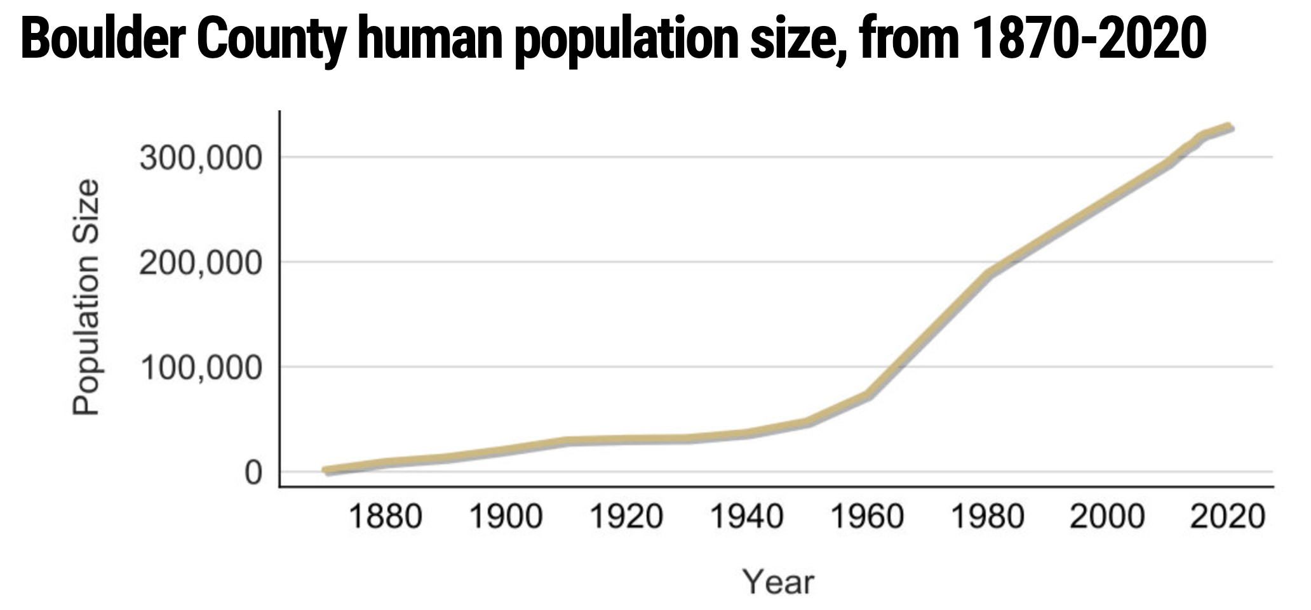
About Boulder
Modern Boulder was founded in late 1858…during the Colorado Gold Rush. Arapaho leader Niwot allowed [the prospectors] to stay for the winter, but this decision ultimately cost his people their land. In early 1859, gold was discovered along Boulder Creek… and by 1860 [Boulder] had 70 cabins, mostly occupied by Anglo families. Non-whites like Chinese miners and black residents were part of early Boulder but rarely pictured.
In 1861, Boulder County was created and the Arapaho were forced to relocate per the Treaty of Fort Wise. With declining numbers, Niwot's band soon moved to the Cheyenne-Arapaho Reservation.
Figure 1. Boulder County human population size from 1870-2020. Source: https://worldpopulationreview.com/us-counties/co/boulder-county-population
Sources: https://en.wikipedia.org/wiki/Boulder,_Colorado, https://bouldercolorado.gov/boulder-measures/about-us-boulder-community-profile, https://cslc.colorado.edu/2020-trends/boulders-human-population-has-increased
Notes:
Area I is the area within the City of Boulder. This land has adequate urban facilities and services and is expected to continue to accommodate urban development.
Area II is under Boulder County's jurisdiction, where annexation to the city could be considered. New urban development may only occur if adequate facilities and services are or will be available.
Area III is the remainder of the Boulder Valley and for the most part is in Boulder County. The Area III-Rural Preservation Area is preserved for rural land uses and character. The Area III-Planning Reserve Area is where the city and county maintain the option of future development.

Slide 2
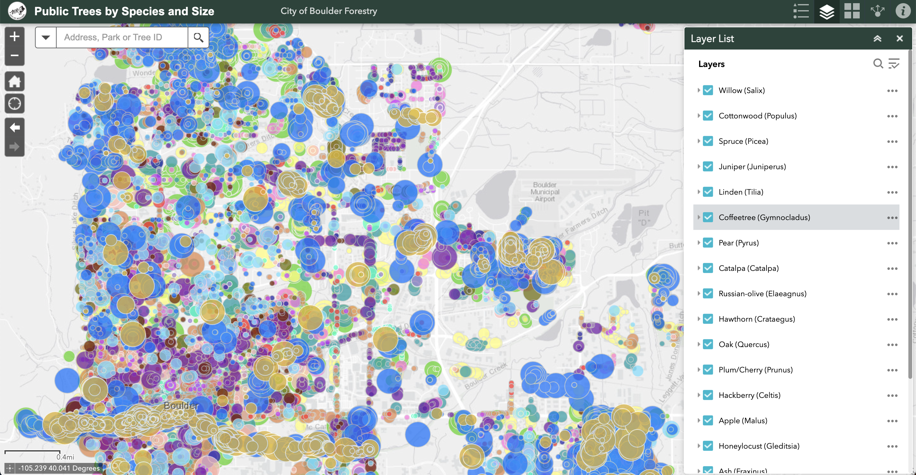
About Boulder
Source: https://boulder.maps.arcgis.com/apps/webappviewer/index.html?id=15a85a7559f545f188dc92fdead93c19

Slide 3
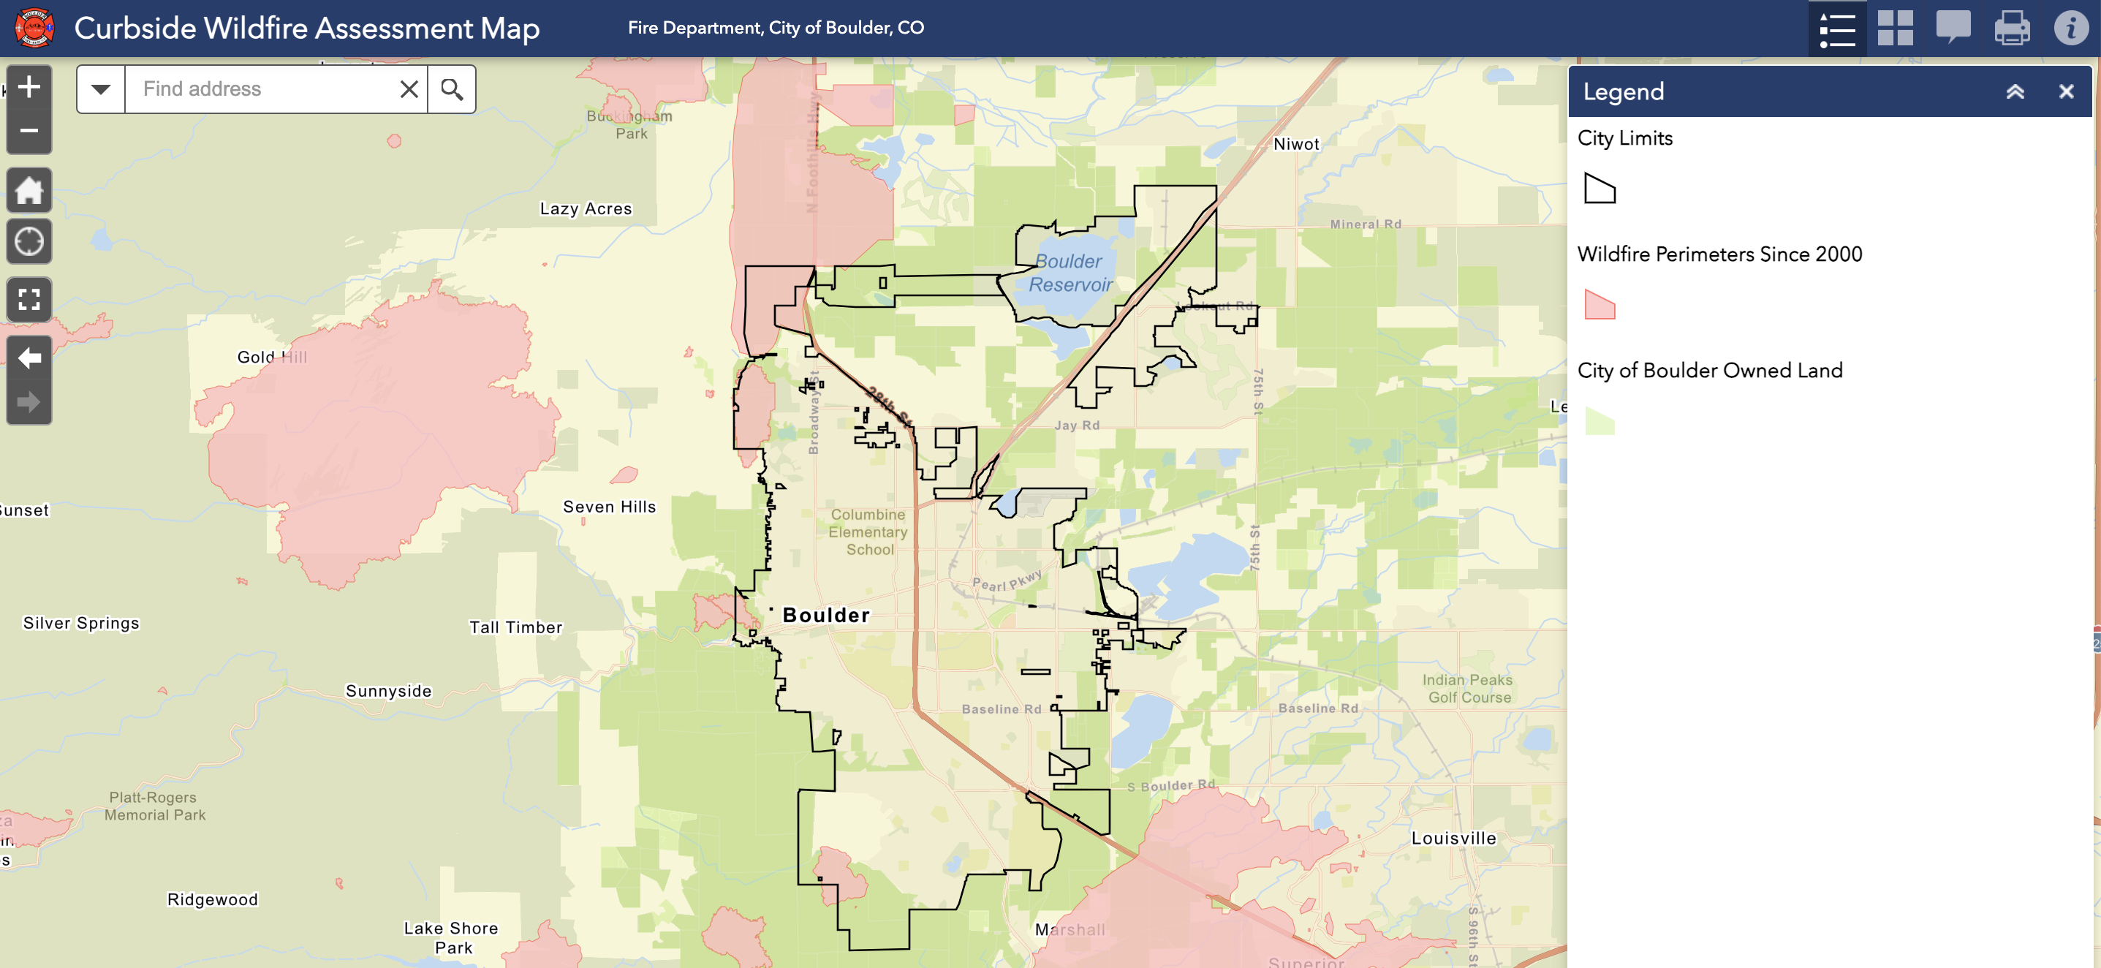
About Boulder
Source: https://maps.bouldercolorado.gov/fire-curbside/#

Slide 4
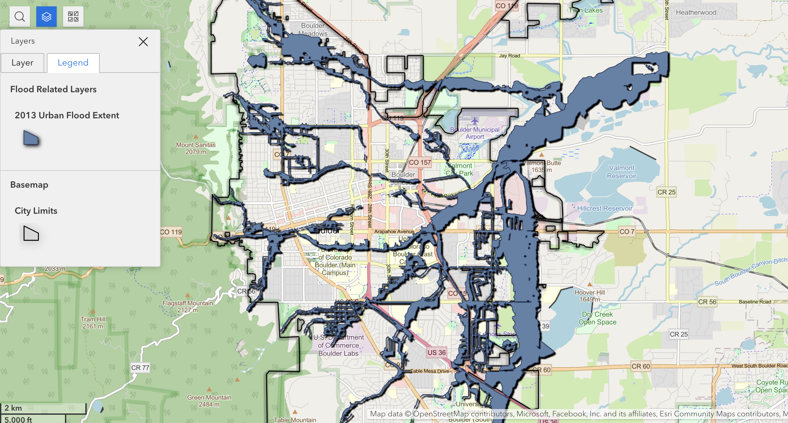
About Boulder
Boulder officially recorded 17.24″ of precipitation, nearly a year’s worth of rain, in just eight days.
September 2013 went down as the wettest September and wettest month ever.
The 9.08″ of rain that fell in the 24-hour period ending at 6 pm on September 12 was the wettest 24-hour period on record, nearly doubling the prior best.
The 7-day rainfall record was also shattered.
Sources: https://experience.arcgis.com/experience/532e95d470754d00aec6dbde8482a36a/page/In-English/, https://bouldercast.com/the-2013-boulder-flood-two-years-and-three-billion-dollars-later/

Slide 5
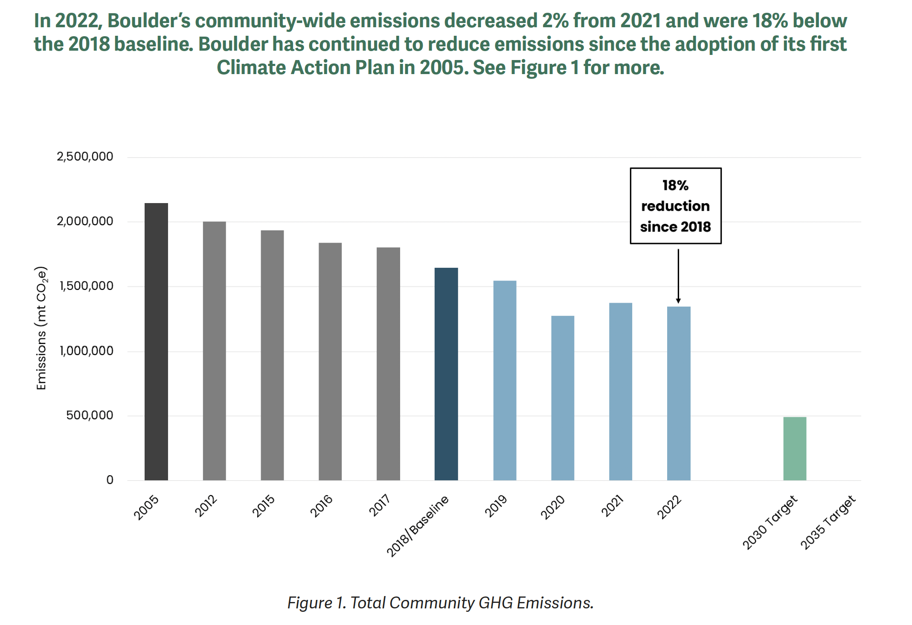
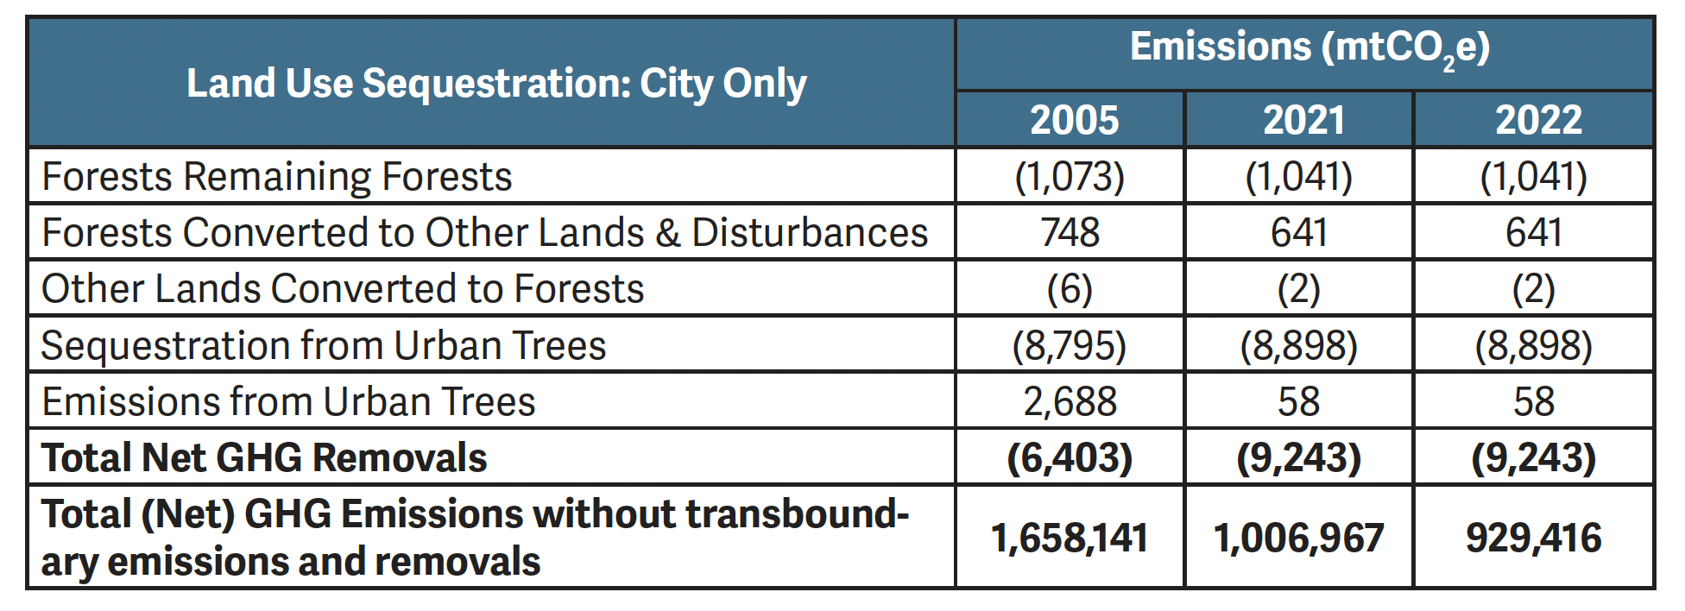
About Boulder
“One of the first areas in which the climate benefits of natural climate solutions are being quantified is urban forestry. In 2021, the city participated in the piloting of a new ICLEI protocol – Appendix J to the U.S. Community Protocol…
Currently there are not established protocols for capturing carbon sequestration benefits in land management other than forests. The city is working with a broad consortium of organizations to develop these protocols. This would enable the city to start capturing the soil-based sequestration efforts it is engaged in along with other potential natural climate solutions.”
Source: City of Boulder Community-wide Greenhouse Gas Emissions Summary Report, Calendar Year 2022
Notes:
3 In 2022, Boulder’s community-wide emissions decreased 2% from 2021 and were 18% below the 2018 baseline. Boulder has continued to reduce emissions since the adoption of its first Climate Action Plan in 2005. See Figure 1 for more.
Emissions Snapshot
In 2022, the biggest contributors to emissions come from:
Building electricity use (38%)
Building natural gas use (25%)
On-road transportation fuels (29%)
Aviation fuels (7%)

Slide 6
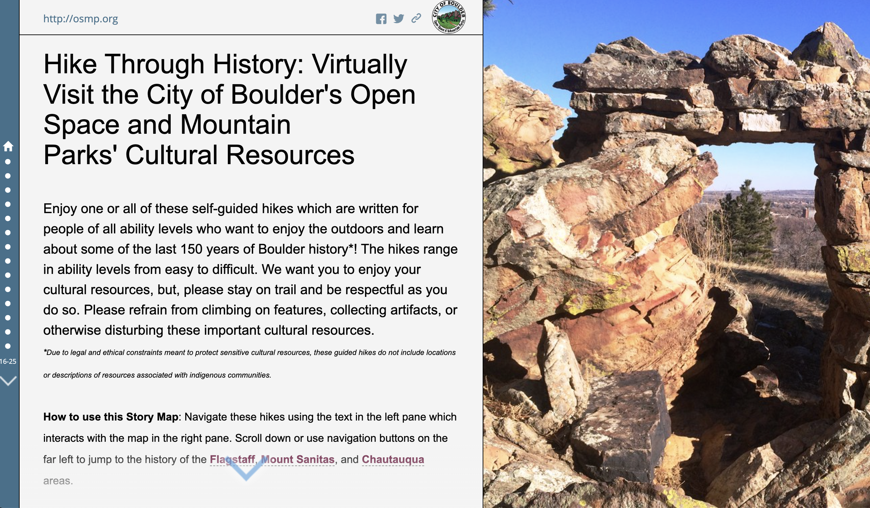
About Boulder
If you have time to explore:
City of Boulder Open Space & Mountain Parks
http://osmp.org
https://templates.maptiks.com/MapJournal/index.html?appid=45ae93bcbaa04046bef1f15eec914cd6

