Slide 1

Welcome to ASTM-10!
Leadership Group
Goetz, Miller, Griffith,
Larson, Hoy, Hodkinson
[HQ: Margolis & Pavlick]
Special thanks to
WG Leads
CCEO / Support Office
Planning Committee
+ All who contributed data,
results, outreach & interpretation
ABoVE & Beyond..

Slide 2
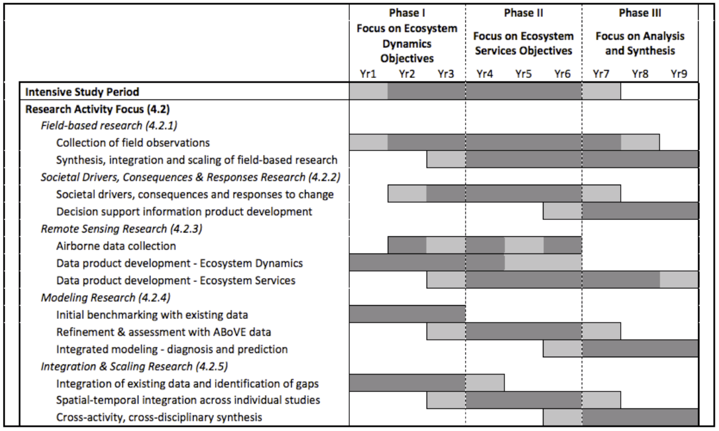
Phases & Timing of ABoVE
circa 2014 CEP
above.nasa.gov/about
ABoVE Concise Experiment Plan (2014)

Slide 3
ASTM-10 Objectives
Reports from NASA and Affiliated projects via plenary and parallel sessions & posters (emphasis on Phase-3 projects)
Presentations & discussions with partners, collaborators, “stakeholders & rightsholders” re: engagement & implementation
Reports, interactions & advances of Working Groups (status in Phase-3)
Breakout sessions to review, discuss, refine & advance integration, synthesis and modeling activities.. and final steps..
Discuss plans for residual / remaining airborne remote sensing
Identify any issues & consider opportunities and to maximize impact
ASTM-10 Boulder
May 2024
above.nasa.gov

Slide 4
ABoVE peer-reviewed Publications thus far..
574 reported by 157 projects*
449 by NASA funded projects
(86 TE ABoVE + 37 other NASA = 123 projects)
143 by affiliated projects (n=34)*
*Not including ABoVE Partners (NGEE-Arctic, POLAR, CFS, NEON)
42 pubs in the Nature, Science, PNAS family of journals
Please be sure to upload your publications to the ABoVE web site
& post WWL and HQ MSR slides along with them.
The ABoVE ST currently has 1,040+ members
and 2,040+ participants
(ST + resource managers, postdocs, graduate students
& all others following)
ASTM-10 Boulder
May 2024

Slide 5
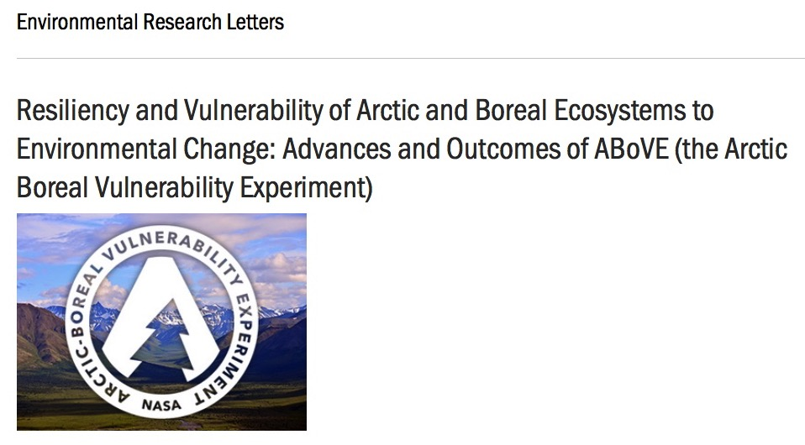
ABoVE Special Issues / Focus Collections..
110 papers in the collection as of May 2024
+ others in review
3 new collections in Environmental Research Ecology
- Terrestrial Biosphere Models: State of the Science
- Focus on Remote Sensing Scaling for Advancing Arctic Ecology Research
- Climate Change and Permafrost Ecosystems

Slide 6
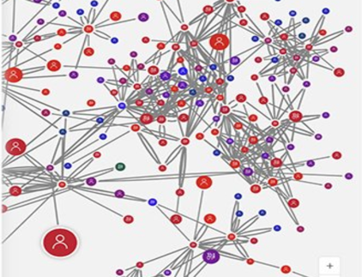
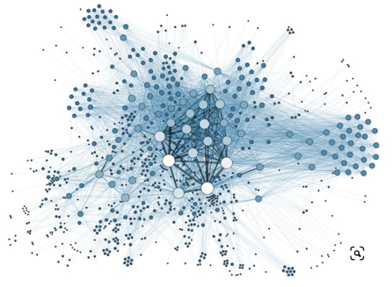

Data Publications thus far..
200+ Data sets archived
Accessed ~90k times by ~16k unique users
Another 118 planned / in progress
Reminder: Data archiving / publishing is critical
for future research mining of what we’ve measured and learned.
Early data release / sharing is valuable for collaborative efforts across projects and working groups, including synthesis activities
ABoVE and the DAACs have tools, resources and personnel to help you make data available.
ASTM-10 Boulder
May 2024

