Slide 1
ABoVE Modeling Breakout
Joshua B. Fisher (Chair)
Jeralyn Poe Anna Gagne-Landmann Colleen Iversen Shelby Sundquist Ryan Pavlick Liz Hoy Jiaming Wen Matthew Fortier Erin Goodnough Li Shuai Joshua Rady
Above- modeling group working.
(not the ABoVE Modeling Working Group)

Slide 2

Working Group
Collective objectives are more readily achievable as a strong team than by individuals.
Getty Images/iStockphoto

Slide 3

Overarching Goal
Reduce model uncertainties in simulations/projections in the ABR across all ABoVE ecosystem indicators
kappanonline.org

Slide 4

Phase III Plan
Establish monthly seminar/workshop series. [Josh Fisher, Debbie Huntzinger]
Training on ILaMB. Discussion of additional data, tests, uncertainties. [Renato Braghiere, Forrest Hoffman, Nate Collier]
Modelers run models on ILaMB now. [All modelers]
Introduction to MsTMIP→WRPMIP protocol. [Debbie Huntzinger]
Identify Top-5 functional relationships that need data constraint in ABR. [All modelers]
Mine ASC for functional relationships. Determine points v. domain. [Jeralyn Poe, Debbie Huntzinger, Josh Fisher, Kevin Schaefer]
Integration of ABoVE functional relationships into ILaMB. [Jeralyn Poe, Debbie Huntzinger, Josh Fisher, Kevin Schaefer, Forrest Hoffman]
WG consensus on ILaMB tests, weights. [All modelers]
Establish catalog of model developments throughout ABoVE.
Lightning presentations. [Josh Fisher, Debbie Huntzinger, All modelers]
Model developments. [All modelers]
Re-run updated models on ILaMB. [All modelers]
Synthesize results. [Josh Fisher, Debbie Huntzinger]
ampcool - stock.adobe.com

Slide 5

Data
Modeling
Bridge needed—can’t just jump

Slide 6
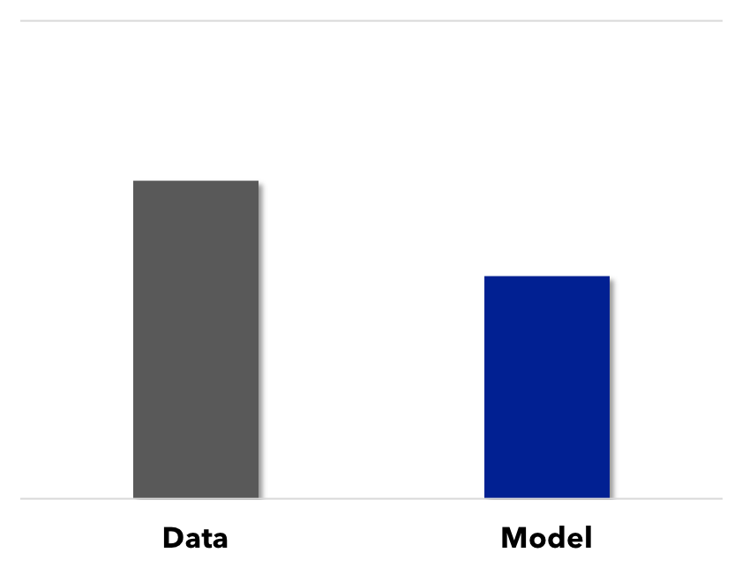

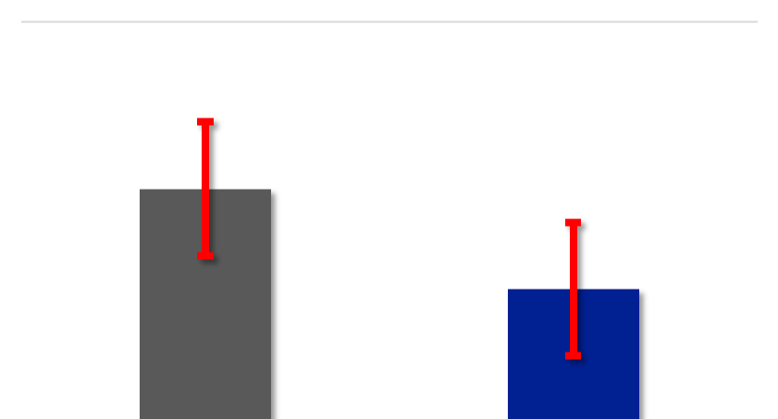
Need Uncertainties

Slide 7
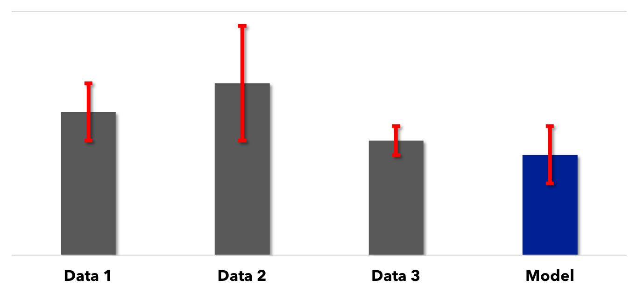
Combining multiple datasets of same quantity

Slide 8
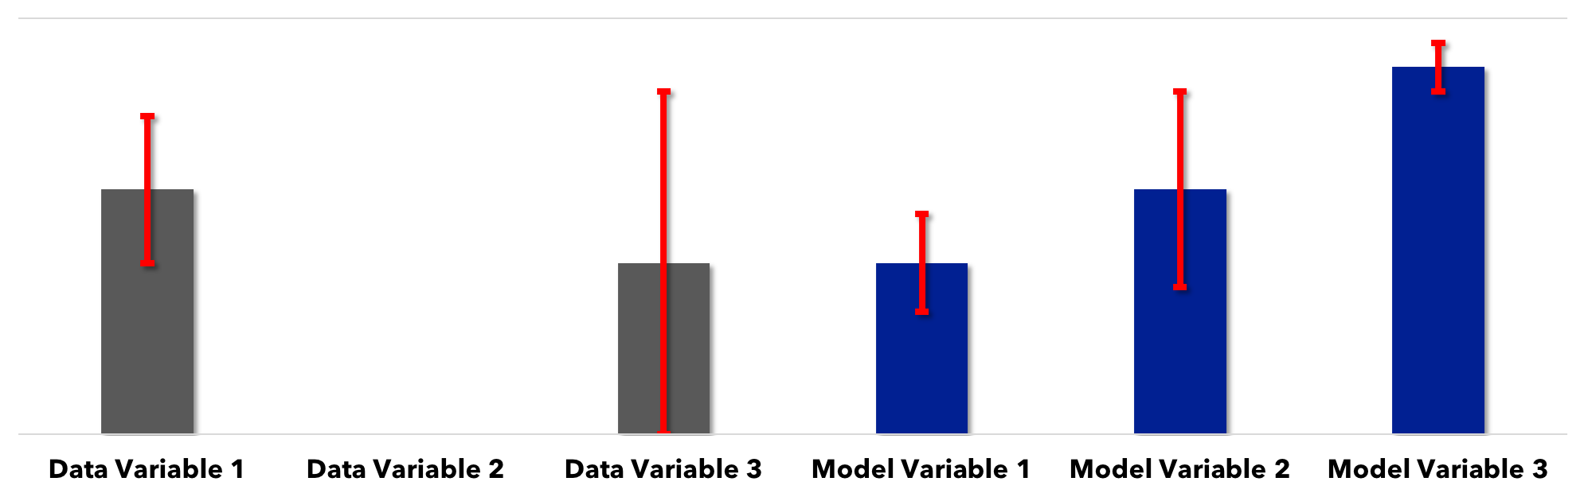
Identification of missing benchmarks and/or those with
large uncertainties → feedback to data collection

Slide 9
Identification of missing benchmarks and/or those with
large uncertainties → feedback to data collection

Slide 10
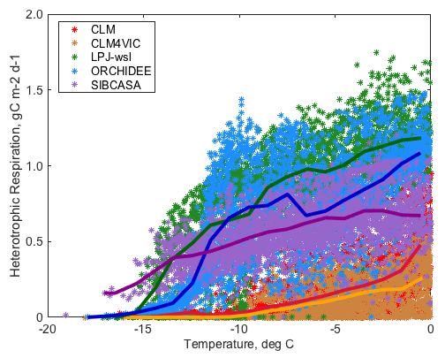


Functional Relationships
From: Debbie Huntzinger, Kevin Schaefer
Getty Images
Notes:
These concurrency requirements enable modelers to extrapolate spatially beyond existing intensive but sparse study sites, as well as refine sensitivities and tipping points/thresholds temporally. This is particularly acute for residence time and turnover of soil and plant carbon stocks; implicit here is turnover related to disturbance with respect to accurate quantification of fuels, fates, and frequencies.

Slide 11
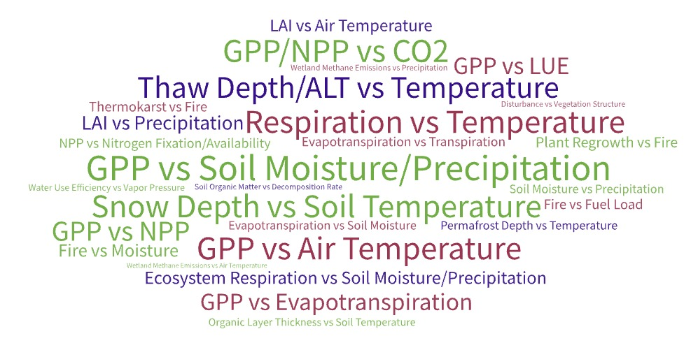
Functional Relationships Survey
Survey sent out to ABoVE modeling working group
47 relationships reported
25 different relationships
Credit: Jeralyn Poe
Top 5 most popular responses: #1 GPP vs soil moisture/precipitation (6 votes) #2 respiration vs air/soil temperature (6 votes) #3 snow depth vs soil temp (4 votes) #4 GPP vs air temp #5 thaw depth vs temperature (3 votes)
Notes:
-Top 5 most popular responses: #1 GPP vs soil moisture/precipitation (6 votes) #2 respiration vs air/soil temperature (6 votes) #3 snow depth vs soil temp (4 votes) #4 GPP vs air temp #5 thaw depth vs temperature (3 votes)
-Figure on the right shows each response, with more popular responses in a larger font
-Figure on the left shows responses grouped by ABoVE theme. When creating this figure, I determined the category based on the dependent variable

Slide 12
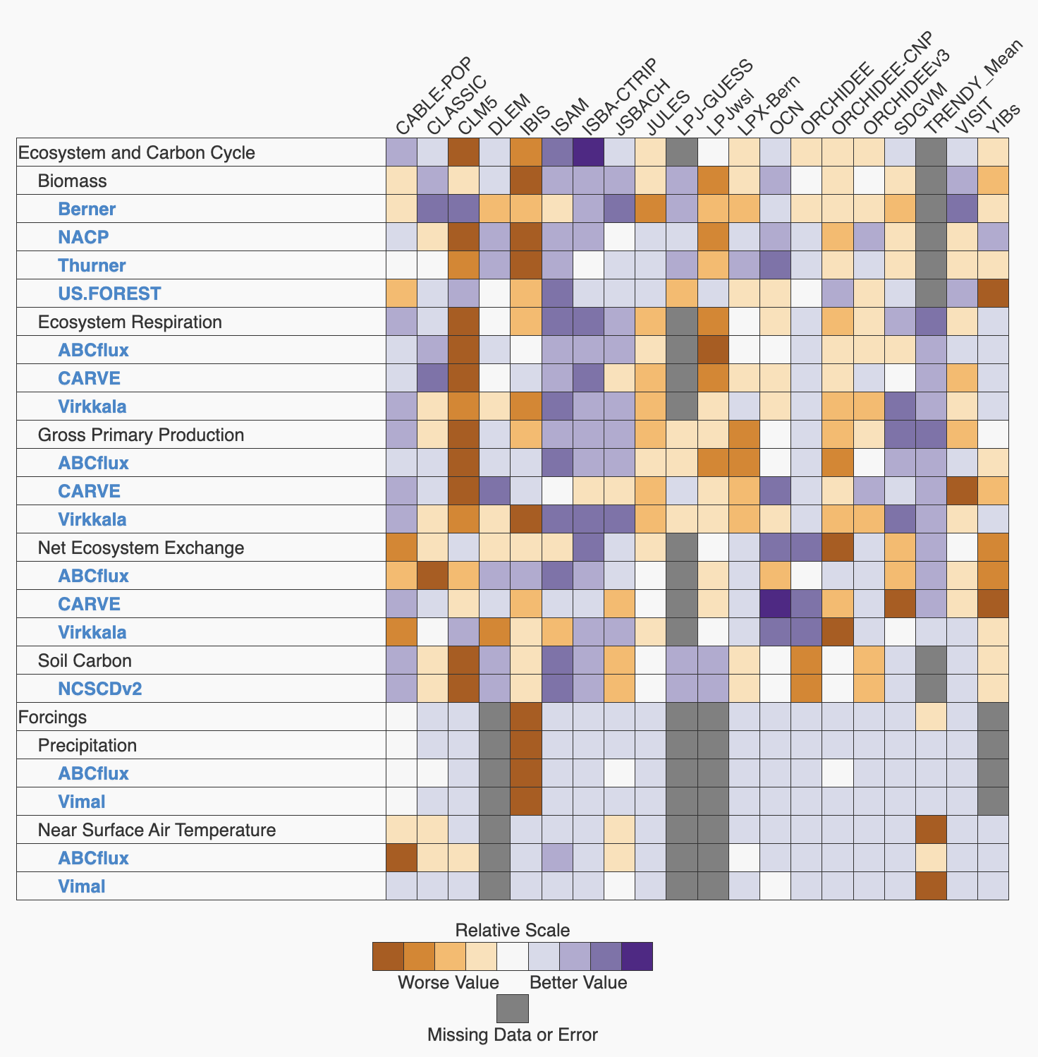
TRENDY v9 Results with ABoVE Benchmarks
Currently ~85 datasets on ILAMB database (mainly global datasets)
17 ABoVE datasets added to ILAMB (https://ilamb.org/ABoVE-Data/)
Poe et al. in prep
Credit: Jeralyn Poe
Notes:
-ABoVE datasets added to ILAMB are shown in the rows in the figure on the right. Evapotranspiration and RSDS ABoVE datasets were also added to ILAMB (not pictured here)
-NACP and US FOREST (biomass) and NCSCDv2 (soil carbon) are some of the few Arctic datasets that were already in ILAMB.
-The figure on the left shows overall TRENDY model scores for GPP. In this figure, I evaluate TRENDY models over the globe (orange dots), across the ABoVE domain using global datasets such as FLUXCOM and WECANN (yellow dots), and then compare how models scores change when using ABoVE GPP datasets (green dots). We found that when benchmarking models with regional datasets, model scores tended to be very different (and much lower) compared to when benchmarking with global datasets. This could indicate that if we are only using global datasets to benchmark our models in the ABoVE region, model scores could potentially be inflated. But if we are using multiple datasets (both ABoVE and global) we are more likely to see the full range of a model’s skill.

Slide 13
Data-to-model: scaling
Notes:
A particular strength of ABoVE for modeling is that there is a concerted effort to scale up site level data through airborne and satellite observations (see: above.nasa.gov/images/Scaling%20Diagram_169.jpg). This allows an improved direct comparison between the coarse model pixels and the ground data.

Slide 14
Refinement of datasets, formatting
Connection to NGEE Arctic (Natalie Griffiths)
Prioritization of datasets (Jeralyn, compromise with Shelby/UVAFME)
-->send to Liz with format requirements, temporal processing→To Erin for processing

