Slide 1
Vegetation Dynamics, Composition, Structure and Function / Disturbance
Paul "Photon Counter" Montesano
Matt Macander
Dong (Tony) Chen
Jinhyuk (Jin) Kim

Slide 2
Disturbance
Carbon
Vegetation Dynamics, Composition, Structure, and Function
Wetlands
Ecosystem Services
Hydrology
Permafrost

Slide 3
Past Vegetation Syntheses
Multi-Disturbance synthesis (Foster et al.)
Gridded LVIS Vegetation Structure (Montessano and Macander)
Dynamic Vegetation Model comparison (Hefernan and Epstein)

Slide 4
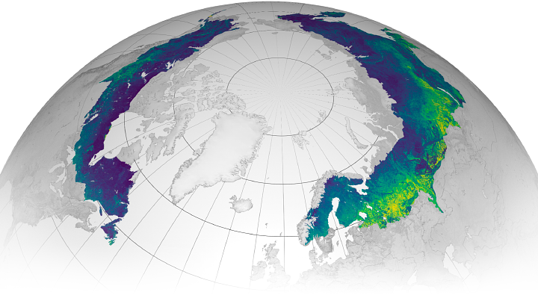
Review of Arctic/Boreal biomass mapping
Berner et al.
Duncanson et al.
Goal: review and describe the various AGB datasets produced for ABoVE
key differences in:
methods
spatial/temporal extents
input data
key strengths of each
Wang et al.

Slide 5
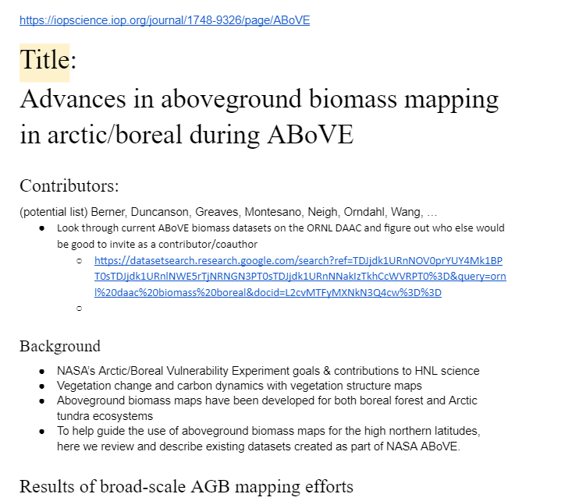
Above Ground Biomass
Vegetation and Disturbance
Paul Montesano, Matt Macander, Logan Berner, Jon Wang, Wanwan Liang, Laura Duncanson, Laura Bourgeau-Chavez, Liz Hoy, NASA GSFC Intern et al.
Perspective paper summarizing existing and planned AGB products over ABoVE domain.
Extents, Resolution, Period(s)
Biomass pool (woody, trees, live, total)
Training data, Predictors, Model method
Commonalities and key differences from end-user perspective
Use cases
Fire Management and Modeling
Partitioning, e.g. tree species

Slide 6
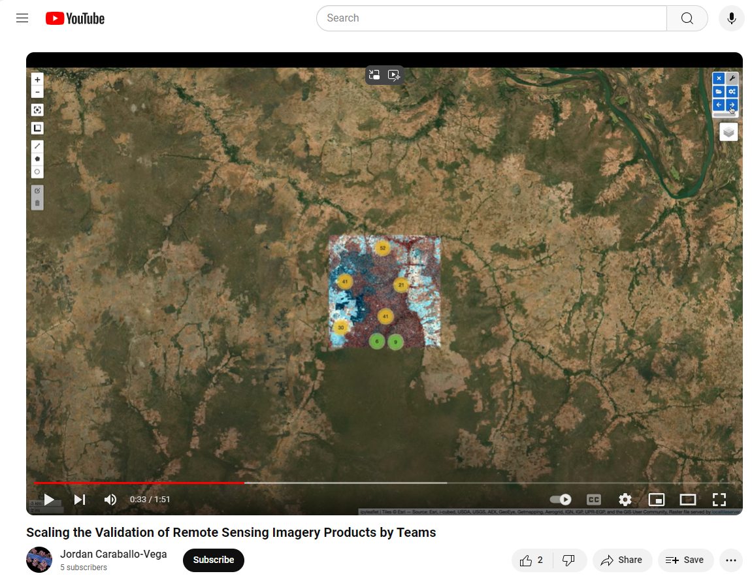
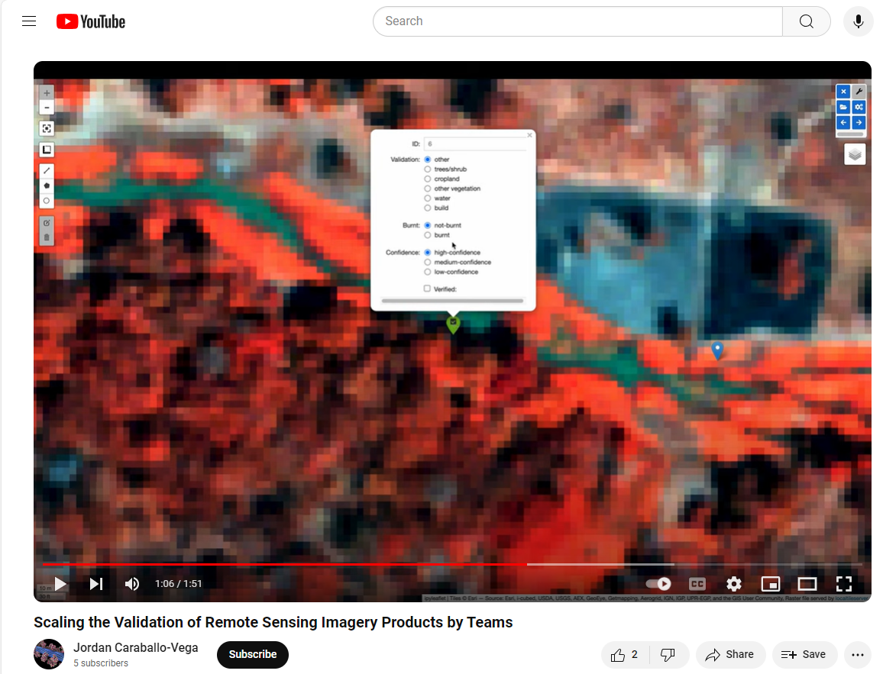
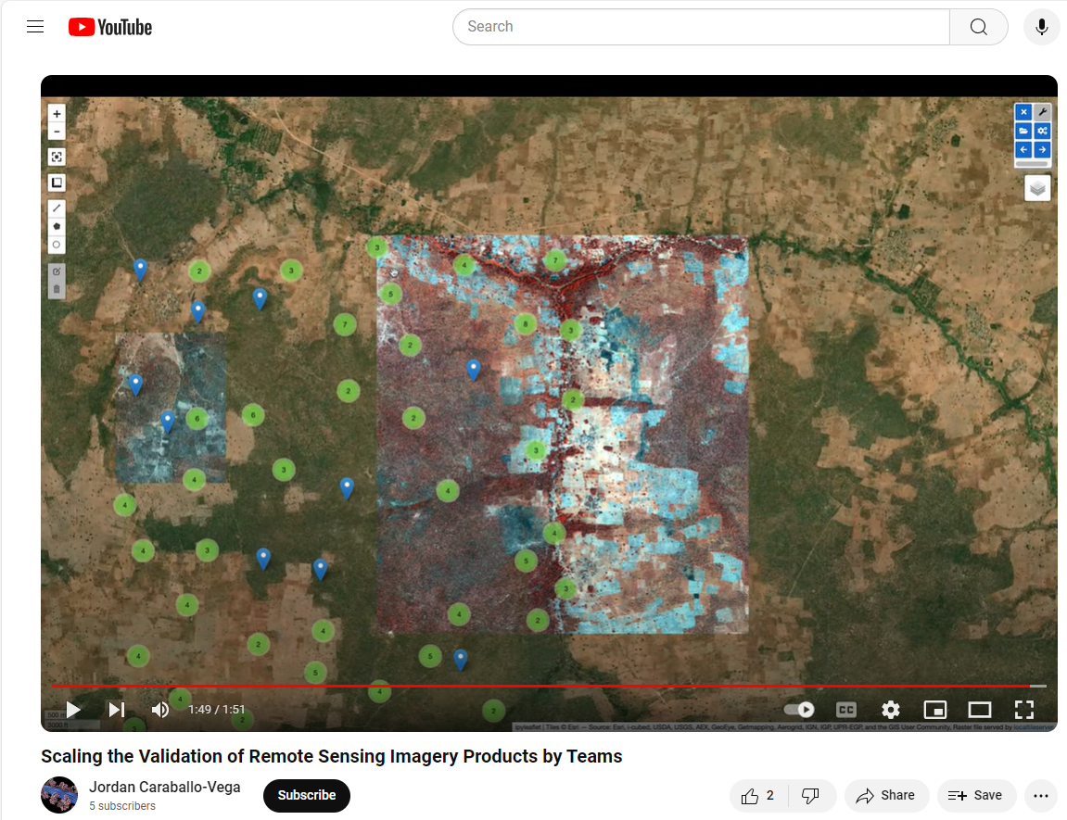
Demo/tutorial of Land Cover Validation tool
A tool to compile a database of manually surveyed points attributed with land cover classes to validate land cover model results
open-source
wide interest from members of WG
will be used in Frost’s Phase 3 project
built by Jordan Caraballo-Vega et al.
This tool could be adopted broadly as a way to advance validation efforts of individual projects, leveraging domain expertise:
within Science Team
among local partners

Slide 7
Arctic Greening and Browning Synthesis Paper
What are the Top 3 statements you would wish to make about patterns of change and stability in Arctic ecosystems?
How has your thinking changed over the last 3 – 20 years, and what has surprised you?
What are your expectations for the coming 10 years?
responses to jfrost@abrinc.com

Slide 8
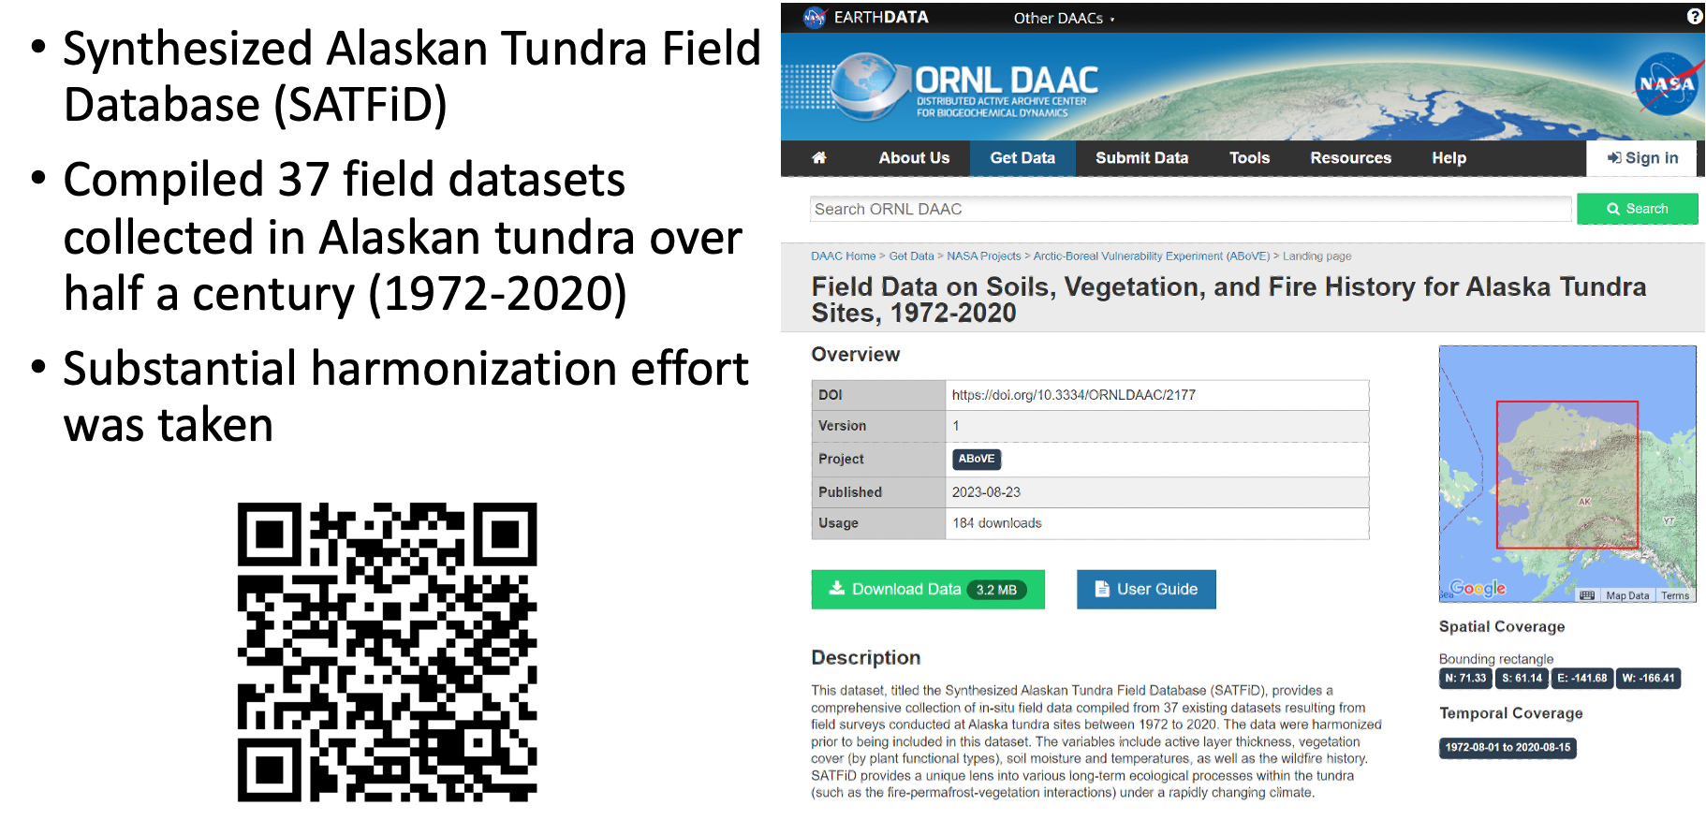
Synthesis Activity: SATFiD

Slide 9
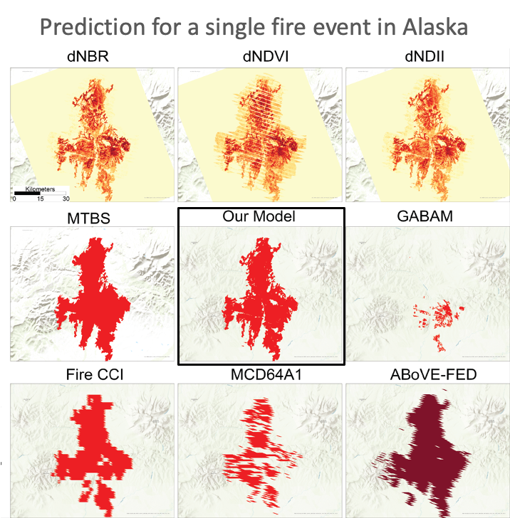
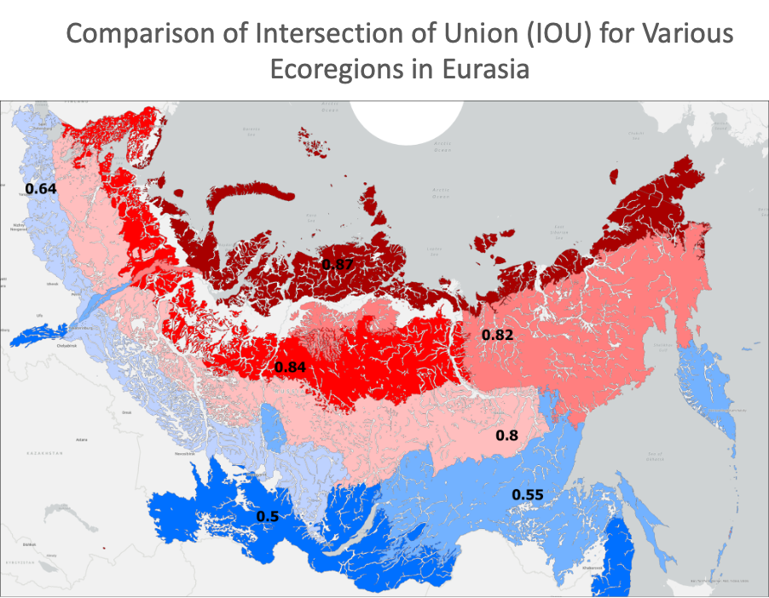
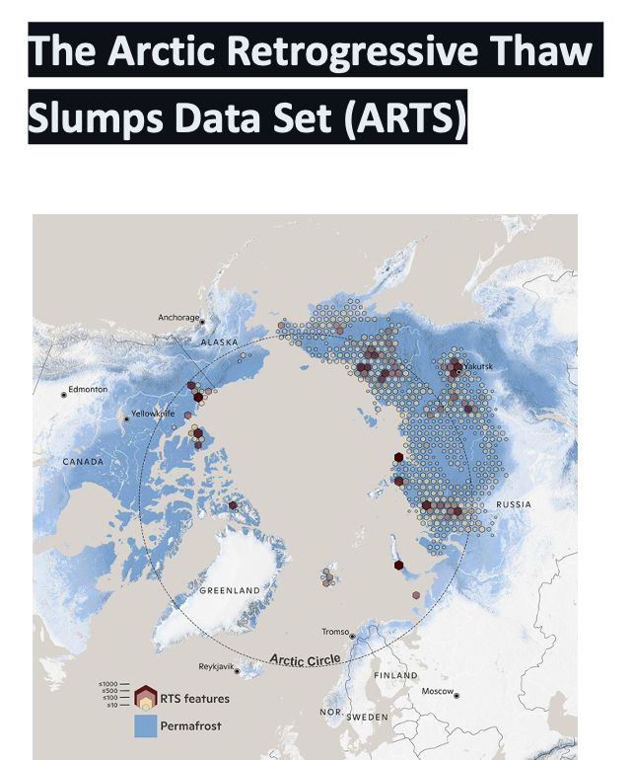
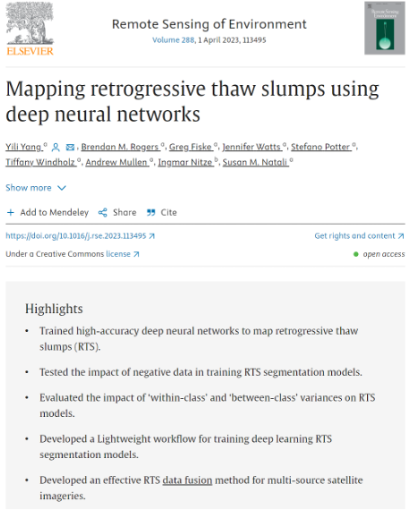
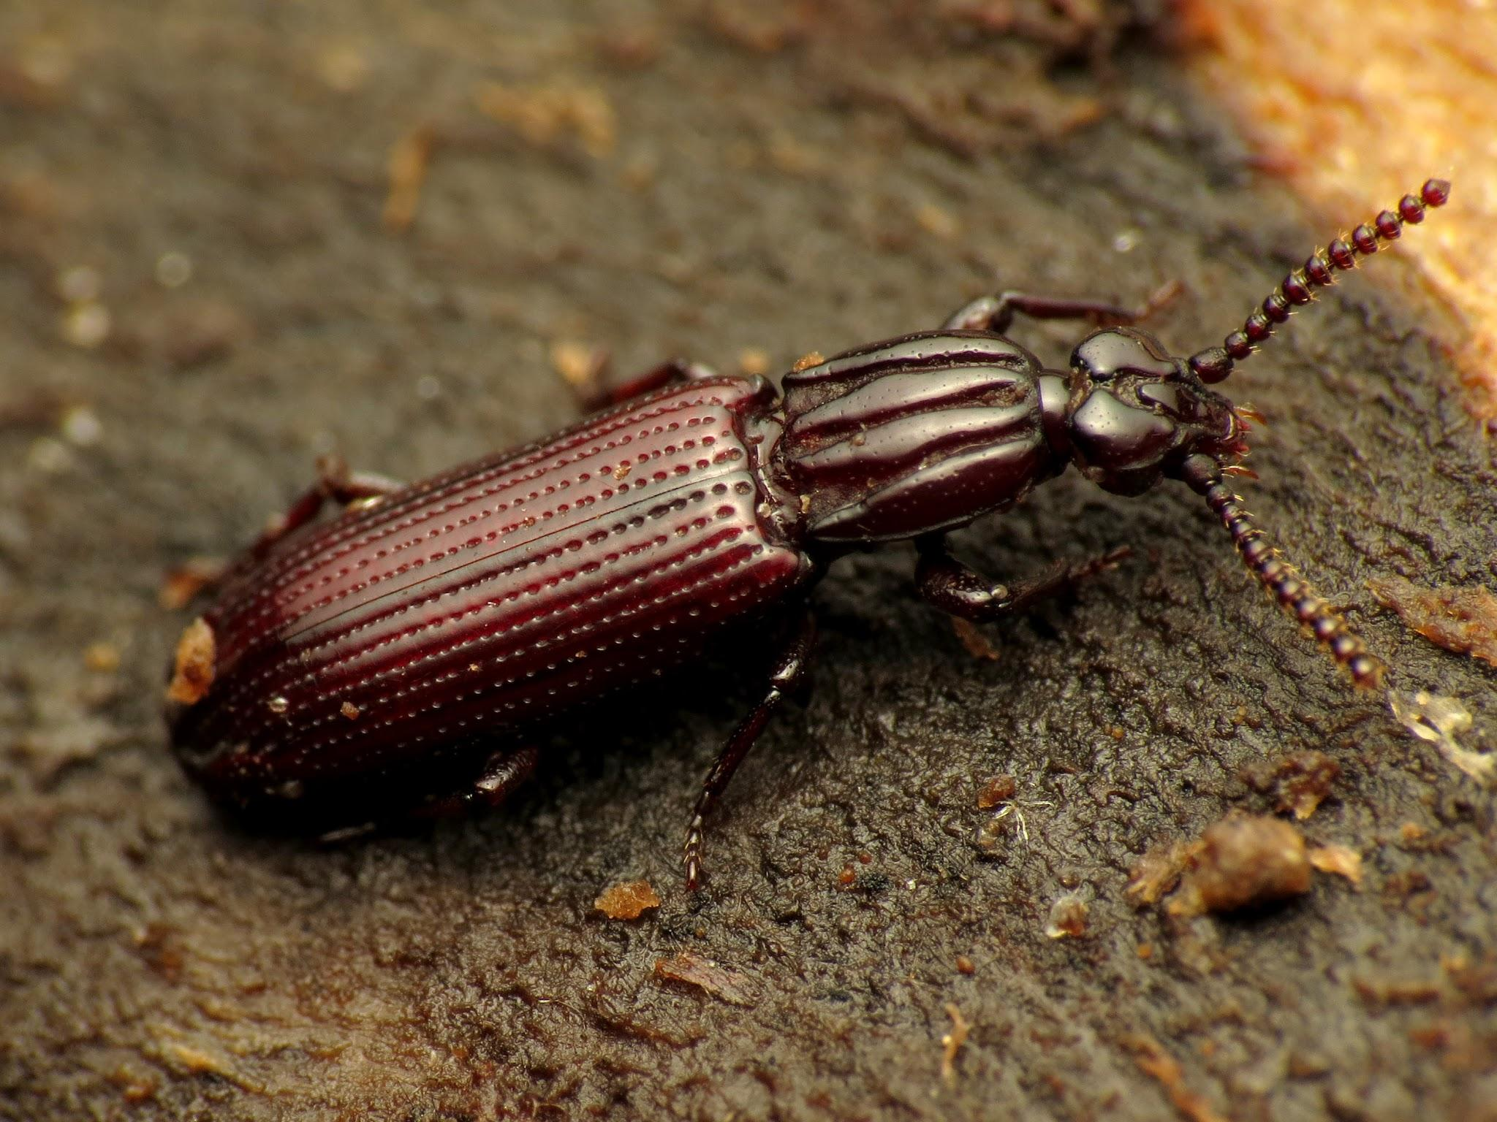
Lots of different disturbance products out there and in production
NBAC back to 1970s!
Mega Slumps!

Slide 10
Future Working Group Synthesis
Synthesis paper: Post-disturbance and succession data and methods
Build on Adrianna Foster led disturbance synthesis (Foster et al. 2022, ERL)
Review of papers that have done post-disturbance succession analysis
List the datasets that are available for disturbance and how they can be combined with various vegetation products
Methods: space-for-time, long-time series etc.
PFT fraction, biomass, functional traits etc.
Highlight a select few disturbances from different biomes like the tundra, boreal, NA, EA etc.
Show how these datasets can be used together and differences between products to guide users dependent on their scientific questions and the tools that can be used etc.
Combined working group meetings between vegetation and disturbance every 2-3 months

