Slide 1
Spectral Imaging Working Group Breakout Session ASTM 10 Boulder
Revisit & review status of ongoing Synthesis Activities
See the excellent “reports back” from ASTM-9 thematic WGs https://above.nasa.gov/meeting_2023/agenda.html (Day 3)
Include identification of leads & titles & status
Update list of syntheses completed (e.g. “Multi-Disturbance synthesis,” Foster et al. 2022 ERL)
Discuss how & reasonably when to bring the ongoing activities to fruition
e.g. with publications as a working framework
Discuss how best to augment current WG efforts / cross-project activities
e.g. how to leverage ongoing activities & maintain engagement?
Consider new Synthesis Activities (as makes sense & can be completed with time remaining).

Slide 2
Spectral Imaging Working Group Breakout Session ASTM 10 Boulder
Attendees:
Peter Nelson, Fred Hummerich, Mark Lara, Daryl Yang, Ian Schuman, Wes Moses, Anna T., Anna Ruchie, Sandra Yaacoub, Brad Gay, Kyle Kovach, Phil Townsend, Nancy French, Ryan Pavlick
Special issue
invitations coming out soon
more than just spectral imaging scaling
Want to produce a group paper on scaling issues
As with our previous group paper we want many people to provide material for this paper
Using examples from our ABoVE research to discuss characteristics of high latitude environments that have to be taken into account when scaling
A goal of the paper is not necessarily to solve these issues but to clarify the problems in this environment

Slide 3
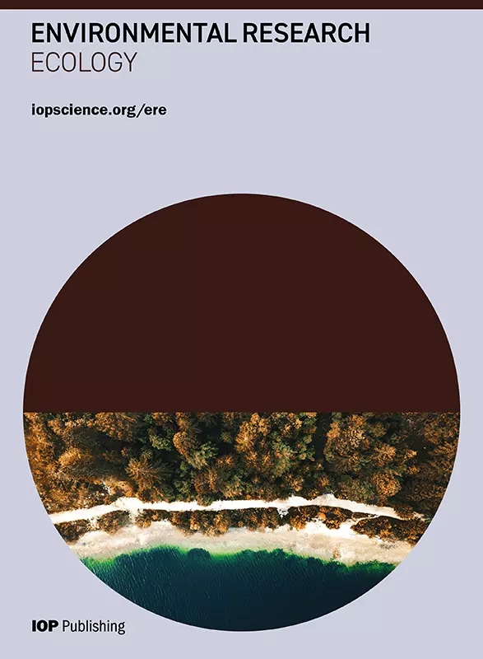
Special Issue: Focus on Remote Sensing Scaling for Advancing Arctic Ecology
Special Issue: Focus on Remote Sensing Scaling for Advancing Arctic Ecology Research in the IOPScience Journal Environmental Research Ecology.
ERE is a newer journal focused on scale/scaling in Ecology, Biodiversity and Conservation.
Special Issue at: https://iopscience.iop.org/collections/ere-240404-518
Invitations being sent out soon!
Open for submissions until 31 December 2024 We invite studies that couple field data with remote sensing (e.g., spectral imaging, thermal imaging, LiDAR, UASs) across scales to study the effects of spatial, temporal, and/or spectral scaling on understanding the complexity of Arctic ecosystems.
Terrestrial ecosystems in the Arctic
Aquatic ecosystem in the Arctic
Permafrost
Remote sensing
Plant functional traits
Carbon cycling
Heterogeneity of Arctic Ecology
Spatiotemporal representativeness of remote sensing
Notes:
We want to encourage submissions to this special issue

Slide 4
Spectral Imaging Working Group Breakout Session ASTM 10 Boulder
Algorithms that work at one scale may not carry over to another
Different assumptions across scales
Experiment design
How to make ground sampling that will ultimately be representative of the region
Land cover types, topography, plant functional types
For AVIRIS Flights there was a Representativeness analysis (based on available data at the time and accessibility)
Post experiment, we can evaluate that analysis
Although AVIRIS is an important data source for ABoVE, we are interested in looking at multiple data sources (ground measurements, satellite data)

Slide 5
Spectral Imaging Working Group Breakout Session ASTM 10 Boulder
Dimensionality analysis of AVIRIS dataset
What is the spectral information in the imagery
It is driven by the heterogeneity of the landscape
What does it mean?
Perform a similar analysis of ground measured plot reflectance data where we have more information on the characteristics of the surface
Effects of timing of observations
Seasonality, diurnal
may introduce bias by incomplete sampling
pool data for analysis based on time
Describe system dynamics
Process based model output can be a tool for this

Slide 6
Spectral Imaging Working Group Breakout Session ASTM 10 Boulder
Representativeness
analysis
Gradient continuous multivariate representation
Some multivariate analysis other than PCA
of spectra
AVIRIS
Ground
Other
Space
Ways to interpret
Spectral dimensionality
Strata and
Ground
Sampling
Bias
Time
Spectra
(or data fusion)
Feature Depth
These ideas form the basis for a synthesis article which the whole working group would contribute to as a submission to the special issue
Sensitivity Study (bias)
Uncertainty
Applications
Across
Scales
Propagates to models
Inference

Slide 7
Special Issue: Focus on Remote Sensing Scaling for Advancing Arctic Ecology
Questions?
Special Issue: Focus on Remote Sensing Scaling for Advancing Arctic Ecology Research in the IOPScience Journal Environmental Research Ecology.
ERE is a newer journal focused on scale/scaling in Ecology, Biodiversity and Conservation.
Special Issue at: https://iopscience.iop.org/collections/ere-240404-518
Invitations being sent out soon!
Open for submissions until 31 December 2024
Notes:
We want to encourage submissions to this special issue

