Slide 1
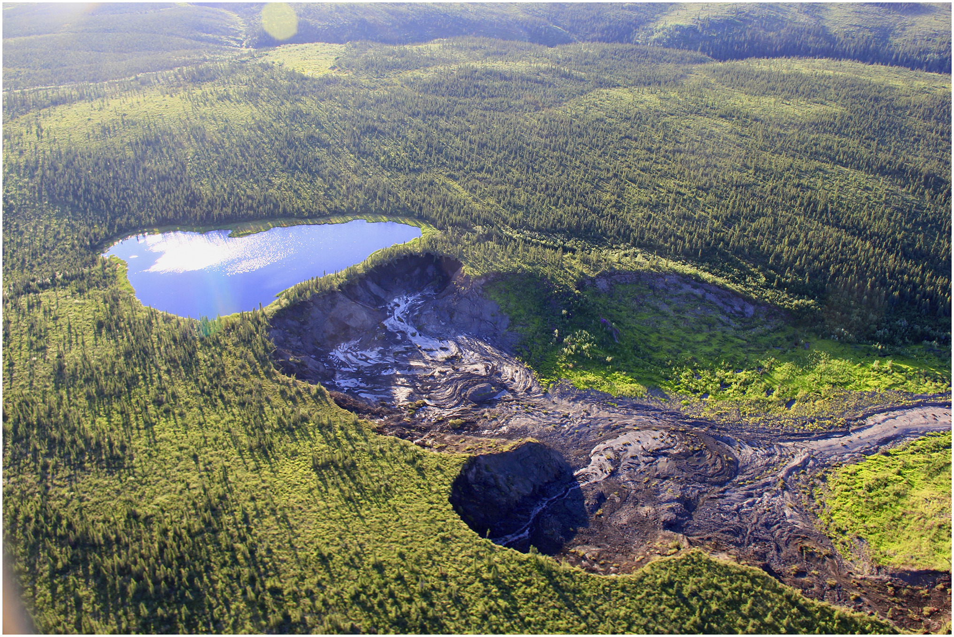
Hydrology, Permafrost & Wetlands Working Group
Breakout Session

Slide 2
Attendees – 12
Bolton, Bob (Oak Ridge National Laboratory)
Chapman, Bruce (JPL)
Du, Jinyang (University of Montana)
Edwards, Rebecca (Becky) (Ducks Unlimited Canada)
Kyzivat, Ethan (Harvard University)
Little, Kyle (GNWT Center for Geomatics)
Policelli, Frederick (Fritz) (NASA Goddard Space Flight Center)
Rawlins, Michael (University of Massachusetts)
Redhuis, Dana (Michigan Technological University)
Schwab, Melissa (JPL)
Turner, Kevin (Brock University)
Zavoico, Vassily (Sebastian) (University of Alaska, Fairbanks)

Slide 3
Synthesis Activities
# | Synthesis Topic Name | Leads | End Date | Status
1 | AK Boreal Ecotype Trends & Drivers | T. Jorgenson | 2022 | ERL review paper
2 | Improved tundra soil dielectric models | K. Bakian-Dogaheh | 2022 | ERL
3 | Impact of changing snow and soil moisture regimes on tundra C sequestration | D. Zona D. Zona | 2022 2022 | Sci. Reports GCB
4 | Mapping Surface Organic Soil Properties in Arctic Tundra using C-band SAR Data | Y. Yi | 2023 | IEEE
5 | Alaska SAR ALT upscaling | J. Whitcomb | 2023 | ERL
6 | Northern Hemisphere ALT trends | Z. Liu | 2023 | ERL
7 | NWT Thermokarst Mapping | S.V. Kokelj | 2023 | Arctic Science
8 | Advances in wetland hydrology: the Canadian contribution over 75 years | J.S. Price | 2023 | Canadian Water Resources Journal
9 | Estimation of northern hemisphere soil freeze-thaw dynamics | K. Donahue | 2023 | Frontiers in Big Data

Slide 4
Proposed Synthesis Activities – Phase III
Aquatic Trends
Zero Curtain
CH₄ Emissions
Modeling Component

Slide 5
Aquatic Trends
Comparing and harmonizing products:
・Surface water ・Wetlands
・Inundation ・Soil moisture
Upscaling
Trend analyses
Contact: David Butman
Contributors: John Kimball, Laura Bourgeau-Chavez, Tyler Albrethsen,
Mark Carroll, Jennifer Watts (ABoVE interns)
CHALLENGES
Harmonizing data from various sources and platforms is complex.
Differences in thematic scales and sensor data increase the difficulty.
Vegetation complicates accurate wetland mapping.
Wetlands and inundation are not easily separable.
Field data sets for upscaling and verification are often missing.

Slide 6
Zero Curtain
Extent and duration
Retrieve from modeling frameworks
Indirect request from atmospheric inversion
Reconciliation and attribution of methane emissions over land (top-down vs bottom-up)
Contacts: John Kimball, Yonghong Yi
Contributors: Chip Miller, Róisín Commane, Luke Schiferl
+ Jinyang Du

Slide 7
CH₄ Emissions
Title: Relating CH₄ hotspot patterns to permafrost and surface hydrology elements, inferred from ground and remote sensing observations.
Identifying CH₄ trends and drivers across the ABoVE domain
Contact: Clayton Elder
Contributors: Bruce Chapman, Laura Bourgeau-Chavez, Qianlai Zhuang, Interns

Slide 8
Modeling Component
Testing process model assumptions to improve the bottom-up Earth system projections
Exploit modeling framework to link with other disciplinary elements (carbon, disturbance, LC change)
Contact: Qianlai Zhuang
Contributors: multiple

Slide 9
Synthesis Efforts for FORTE & Arctic-COLORS
Integrating field measurements, remote sensing, and modeling to derive fluvial and subsurface fluxes of freshwater and organic carbon to coastal regions.
Providing products on active layer thickness, soil carbon, freeze/thaw dynamics etc. for watersheds and coastal regions.
Contact: Michael Rawlins
Contributors: Jinyang Du, Wes Moses, Melissa Schwab, Kevin Turner,
Maria Tzortziou

Slide 10
Outreach to Communities, Land Managers, and Decision-Makers
POTENTIAL PRODUCTS
Wetlands
Inundation
Surface water
Soil moisture
Zero Curtain
Freeze/Thaw
Basin Water Budgets
CH₄ emissions
…

Slide 11
Outreach to Communities, Land Managers, and Decision-Makers
ENGAGEMENT TECHNIQUES
Native land boundaries or buffering/gradient “boundaries”
Indigenous Location/Flora/Fauna Names
Bilingual or Multilingual Resources
Storytelling (e.g., introduce yourself as a person first, share your motivations)
Podcasts/Local Radio Broadcasts
Videos/Movies
1-Page Summaries
Interactive maps
StoryMaps
GIS Layers

Slide 12
Outreach to Communities, Land Managers, and Decision-Makers
PLATFORMS OF DISTRIBUTION
Facebook
SIKU (Indigenous Knowledge Social Network)
Podcasts/Radio
Community Workshops and Trainings
Collaborative Projects with Local Schools
Regular Newsletter and Email Updates
In-person Meetings (Party/BBQ; sharing stories and science)

