Slide 1
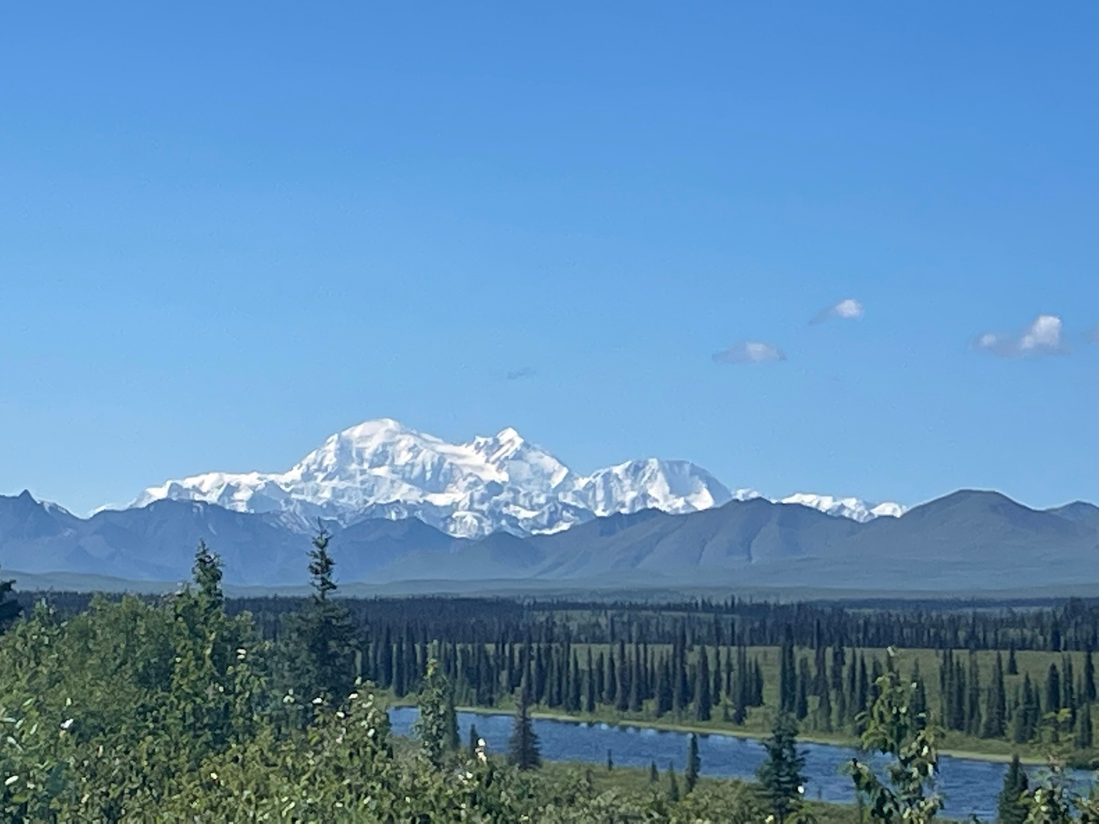
Carbon Dynamics Working Group
WG Leads: Jon Wang & Jenny Watts
May 22, 2024

Slide 2
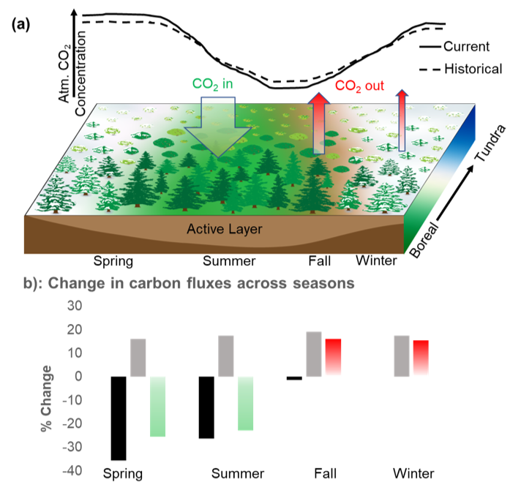
Carbon Synthesis Activity 1: Trends & Drivers of Enhanced Seasonal CO₂ Amplitude in Northern Latitudes
Lead: Zhihua Liu (U Montana) & The ABoVE Carbon Working Group
Background: The enhanced seasonal cycle amplitude of atmospheric CO₂ (SCA) in the northern high latitudes (NHL > 45°N) has been a prominent indicator of changes in the global carbon cycle, but the underlying mechanisms are still unclear. In this review, we summarize the current understanding of NHL terrestrial contributions to increasing SCA and discuss results from both a comprehensive literature review and a survey of experts on the magnitude and direction of underlying carbon cycle processes and associated drivers.
Key points: (1) The increasing NHL SCA is primarily driven by increased growing season plant productivity due to warming and CO₂ fertilization. (2) However, the SCA is also responding to enhanced respiratory carbon release to the atmosphere in the non-growing season.
Future suggestions: A more spatially extensive observation network of long-term, year-round CO₂ fluxes and associated site-level drivers is needed to explain the asymmetrical seasonal dynamics of above- and below-ground carbon cycle processes to changing climate and environmental conditions. Earth System Models should continue focusing on regional improvements in representing climate-carbon feedback to better simulate seasonal dynamics of net CO₂ exchange in the NHL under past and future climates.
Conceptual diagram showing the seasonally-varying CO₂ fluxes underlying the intensification of SCA across the northern high latitudes.
Paper In revision at Nature Reviews Earth & Environment.

Slide 3
Carbon Synthesis Activity 2: ABoVE Ecosystem CH₄ Synthesis
IN PREP! Targeting early 2025 submission!

Slide 4
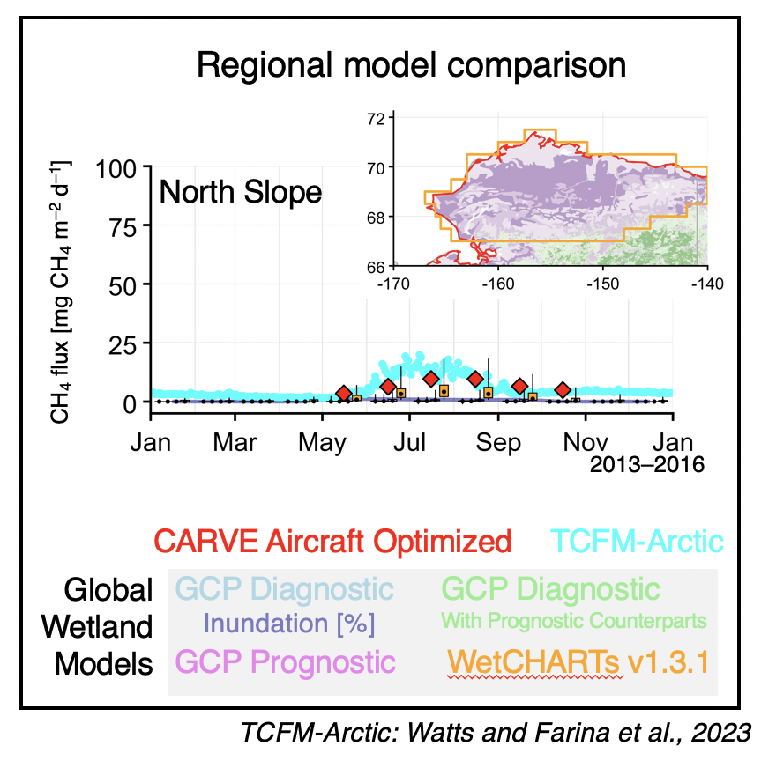
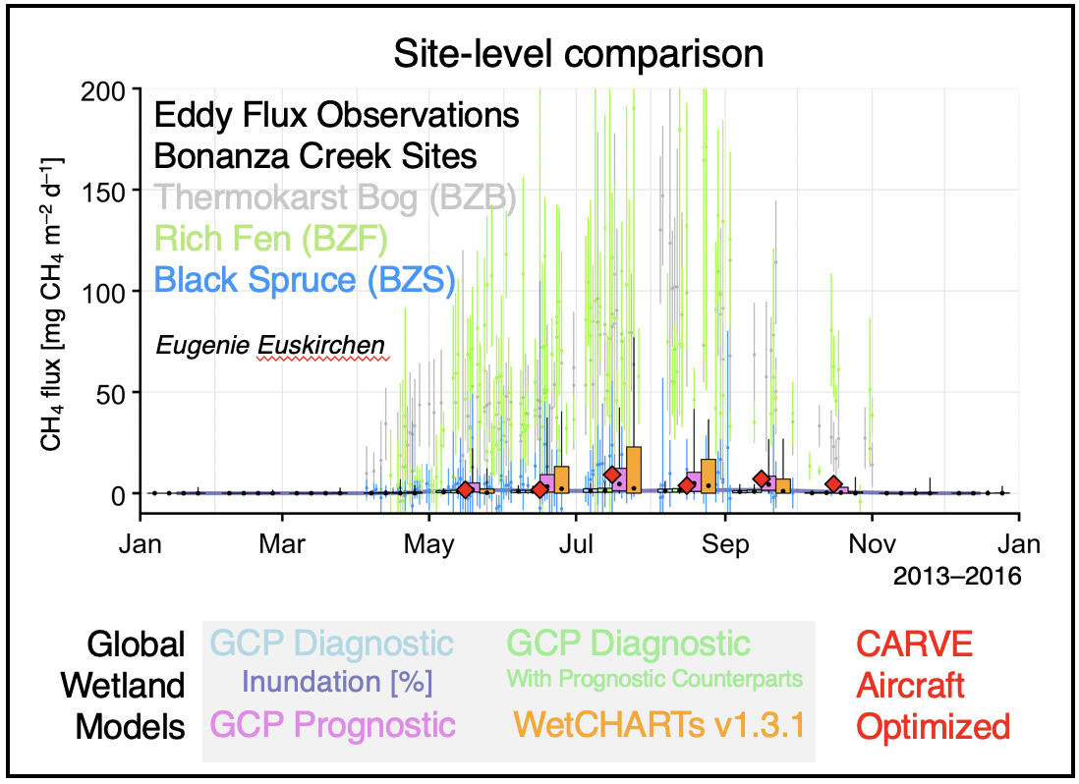
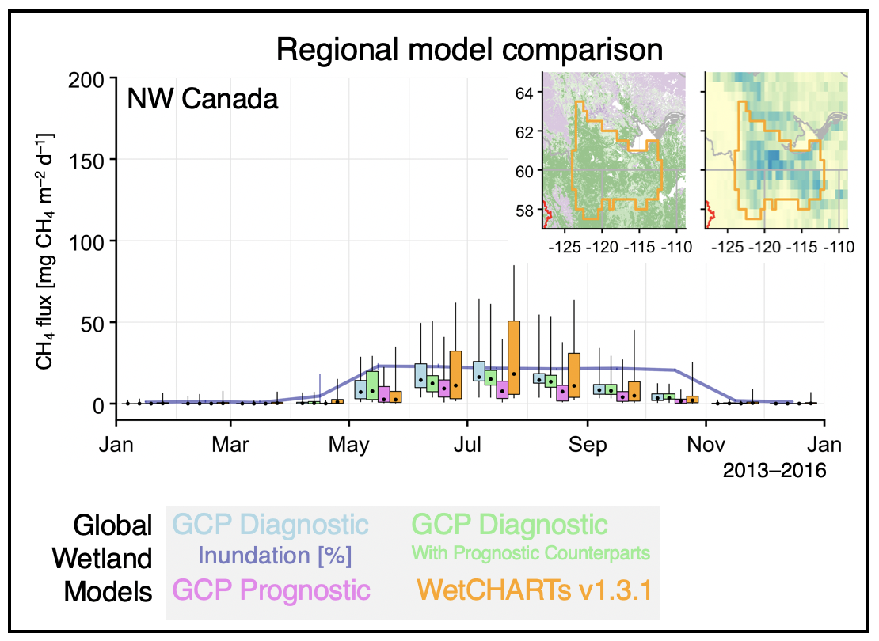
Carbon Synthesis Activity 2: ABoVE Ecosystem CH₄ Synthesis
Goal/Objective:
What we’ve learned so far:
Using top-down to diagnose bottom-up can be highly effective (new insights gained!)
Vegetation type + landscape wetness matters! CH₄ happens outside of inundation.
Major improvements are needed to inform models of (dynamic) CH₄ emitting vs oxidizing surfaces.

Slide 5
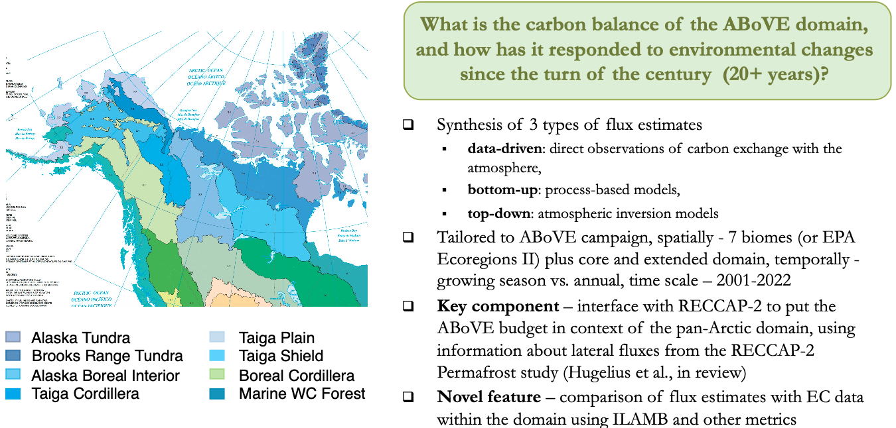
Carbon Synthesis Activity 3: ABoVE CO₂ Flux Budgets, Status & Uncertainty
Lead Abhishek Chatterjee (JPL) & The ABoVE Carbon WG Members
IN PREP! Targeting late 2024 or early 2025 submission!

Slide 6
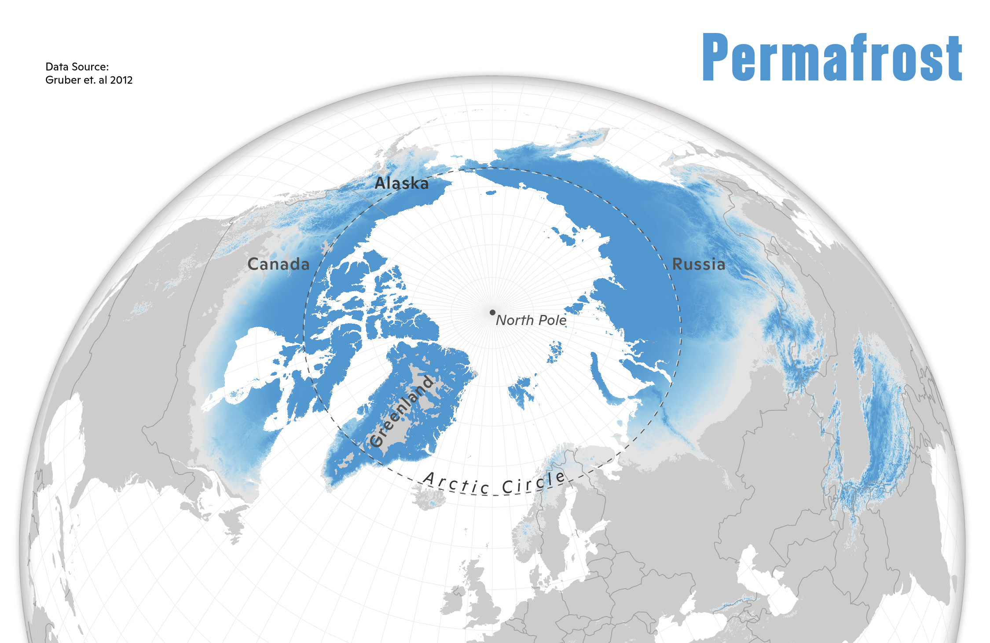
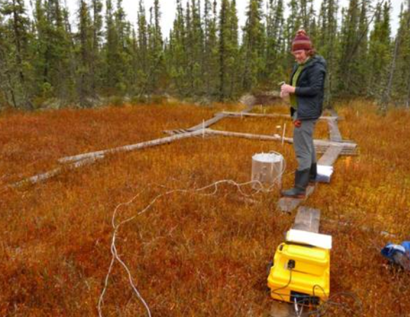
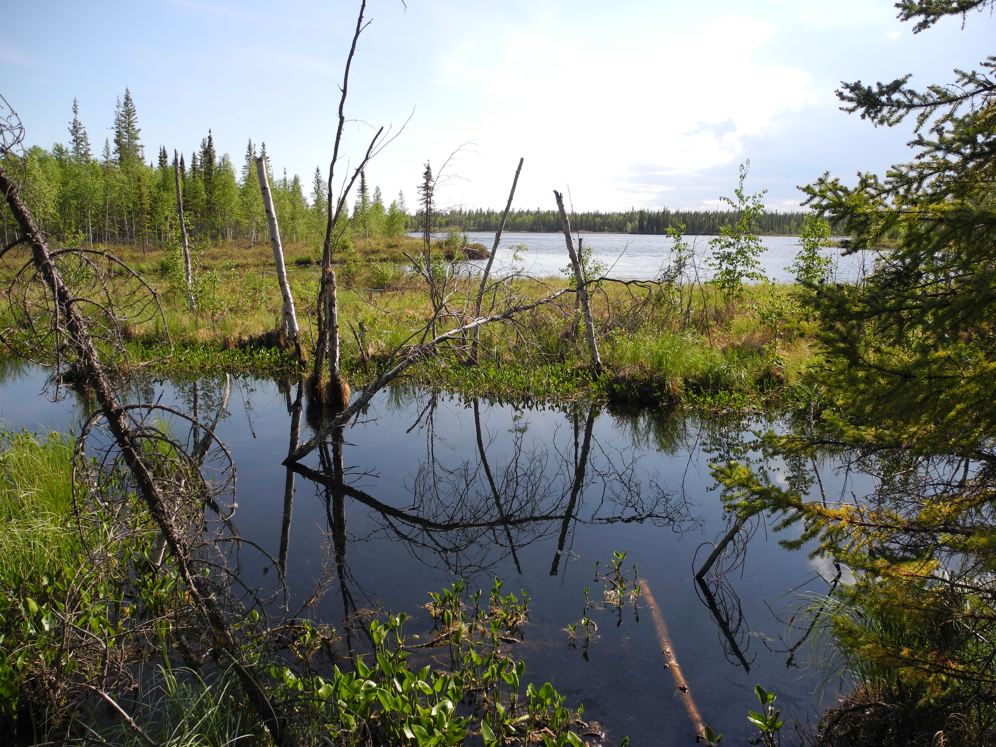
Carbon Synthesis Activity 4: pan-Arctic-boreal Flux Budgets
Lead Jenny Watts & Beth Sutherland (Woodwell) & The ABoVE Carbon WG
Builds upon the Chatterjee Synthesis, expanding to the full Arctic-boreal pf zone; including CO₂ & CH₄.
-- We are planning to start this synthesis in late 2024.
-- Focused on reducing uncertainty in understanding of carbon budgets & status (top down & bottom-up)
-- International effort, linking with the Permafrost Carbon Network (PCN) and future RECCAP activities.
-- Contact: jwatts@woodwellclimate.org if you would like to participate.
Boreal
Wetlands
Tundra

Slide 7
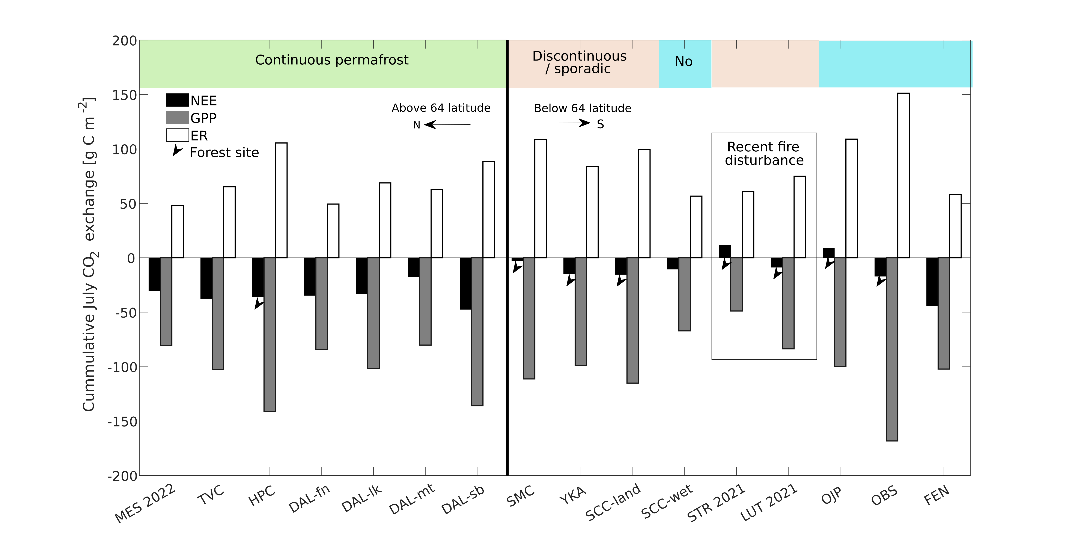
New Synthesis Activity Idea 1: Leveraging 2017 Airborne Campaign
Oliver Sonnentag Presenting; Needs an ABoVE Lead!
16 EC towers (13 in 2017): peak growing season CO₂ sink-source strength (July) across northwestern Canada
(Lhosmot et al., in preparation, ERL)

Slide 8
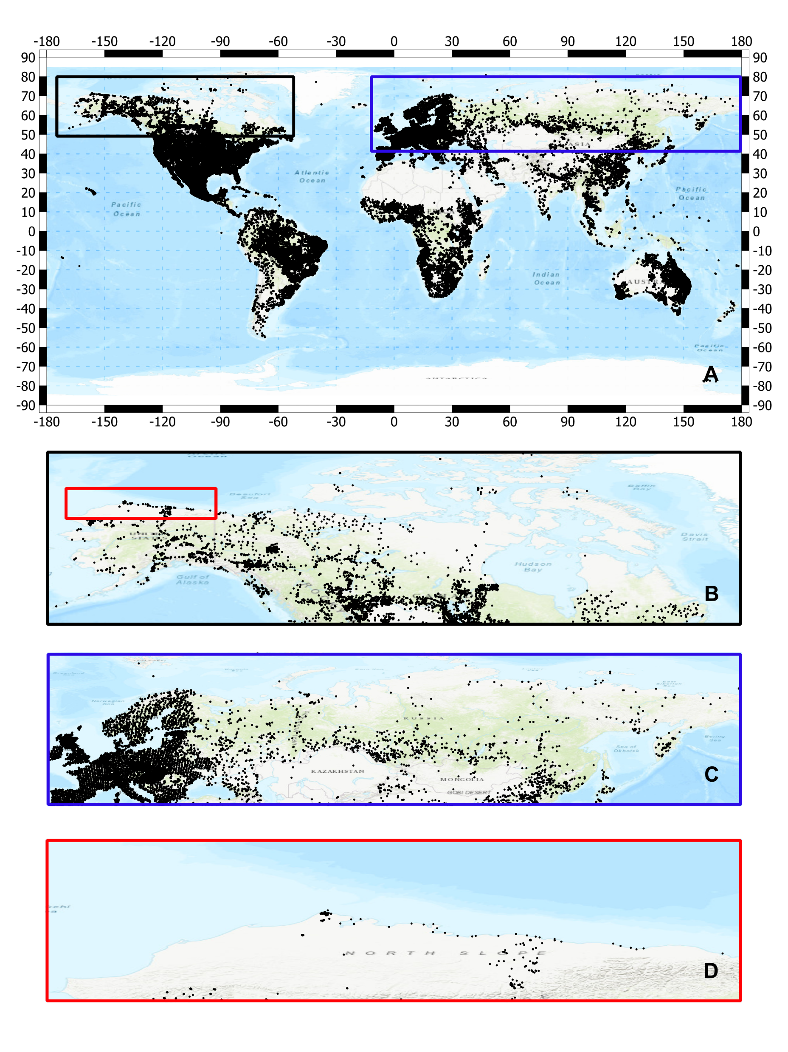
Would you be okay if we set our regular meeting time this summer to be Fridays 11am-12pm?
New Synthesis Activity Idea 2: Compile in-situ SOC observations
ABoVE Airborne Campaign provided a mean to use P-band (or L-band) data for mapping SOC
However, calibration/validation only legacy SOC dataset (e.g, NCCSD, SoilGrids).
Proposal: compile a new database with new in-situ SOC measurements within ABoVE domain or otherwise in ABZ.
Enables further algorithm benchmarking and improvement using AirMOSS (P-band), and UAVSAR (L-band), as the NISAR (L-band) and BIOMASS (P-band)
Potential collaboration between ABoVE and other communities (Permafrost Carbon Network)
Led by Kazem Bakian Dogaheh (bakiando@usc.edu)!!
Fig 1. Existing soil profile inputs for estimating soil carbon stocks are very limited in northern higher latitude. The dots in the figure represent the input profile data for Northern Circumpolar Soil Carbon Data Bases (NCSCD), and SoilGrids.
Fig 2. Ongoing integrated in-situ soil carbon databases for benchmarking activities.

Slide 9
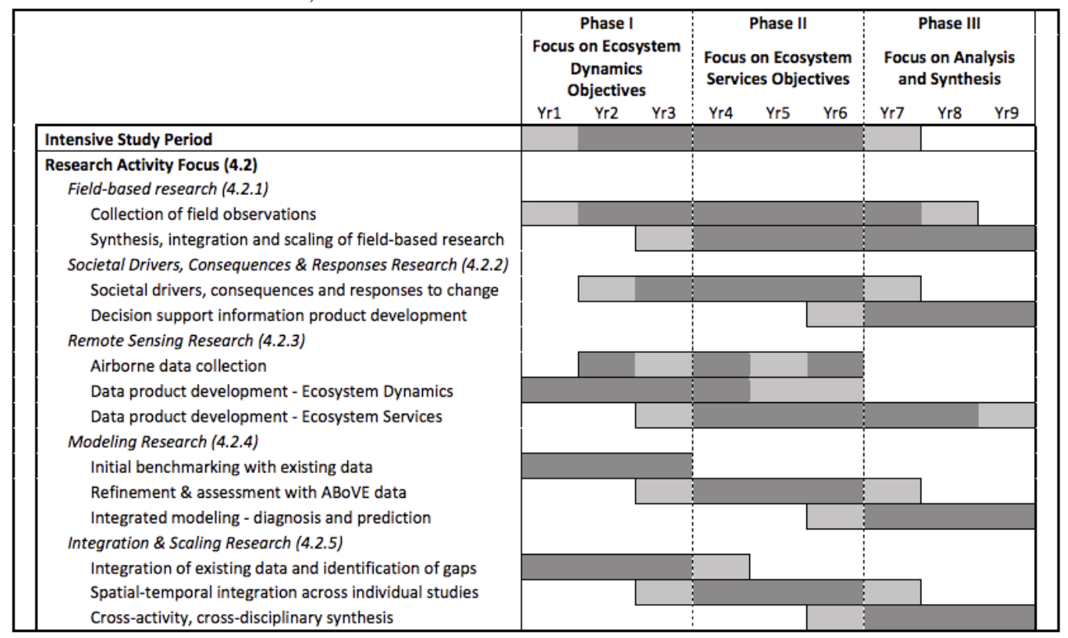
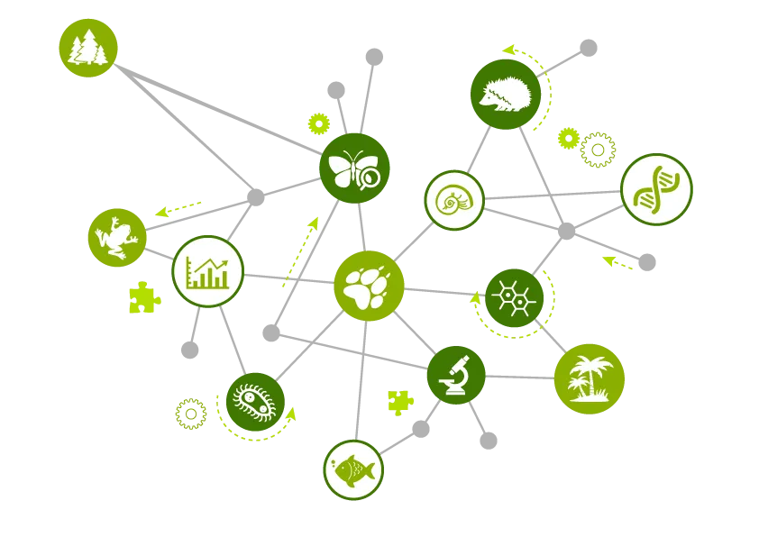
New Synthesis Activity Idea 3: ABoVE Synthesis with WG Inputs
Building from Scott Goetz manuscript? Will need a paper lead.
Summary of all ecological data collected from ABoVE; modeling activities & results
Overviews what was done/learned/remaining uncertainties across all ABoVE Phases, with sub-sections contributed by each ABoVE WG.

