Slide 1
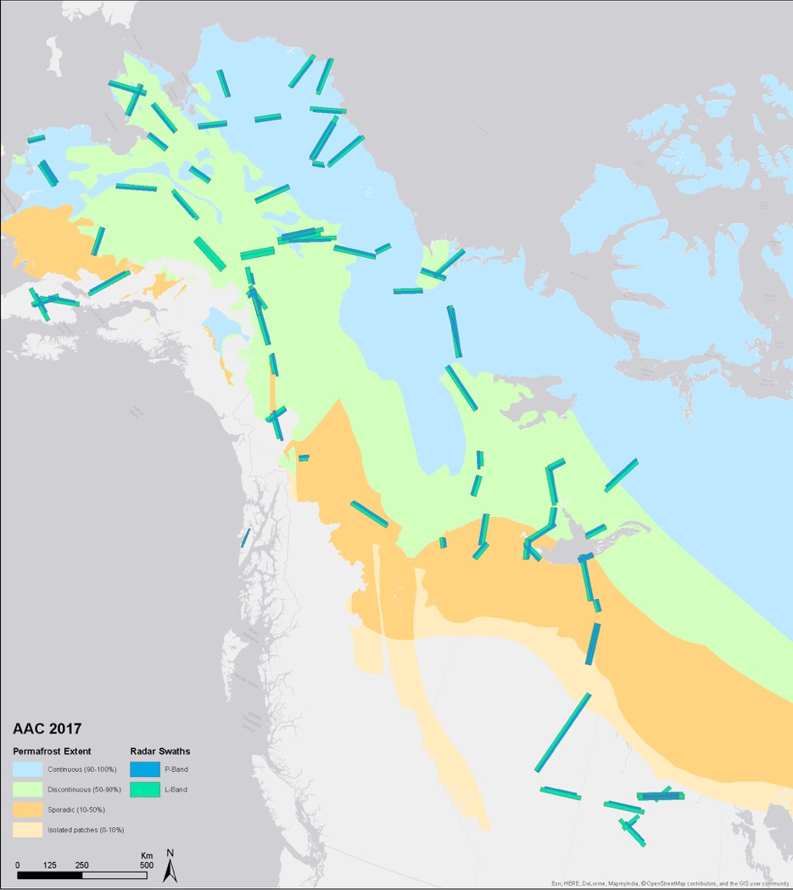
ABoVE Airborne Campaigns
AAC flight lines developed based on careful consideration of all objectives and requirements
Lines & grids modified as needed for PI-led projects; Partner priorities
2017: L-band SAR, AVIRIS-ng, LVIS, AirSWOT, CFIS, Arctic-CAP, ASCENDS, P-band SAR, ATOM
2018: L-band SAR, AVIRIS-ng, G-LiHT
2019: L-band SAR, AVIRIS-ng, LVIS, F-SAR (DLR), ASAR (ISRO)
2020: L-band SAR, AVIRIS-ng – Deferred to 2021
2021: L-band SAR; AVIRIS-ng – Deferred to 2022
2022: L-band SAR, AVIRIS-ng, G-LiHT, COMET-2 (DLR)
2023: SnowEx-ABoVE (Apr/May) – AVIRIS-ng
2023: AVIRIS-3
2024 – L-band SAR (scheduled 13-26 Aug)
Miller et al., ERL (2019)

Slide 2
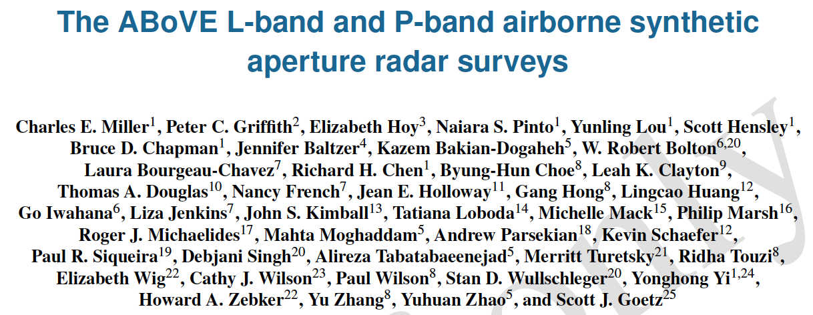
ESSD-2021-172 In Press

Slide 3
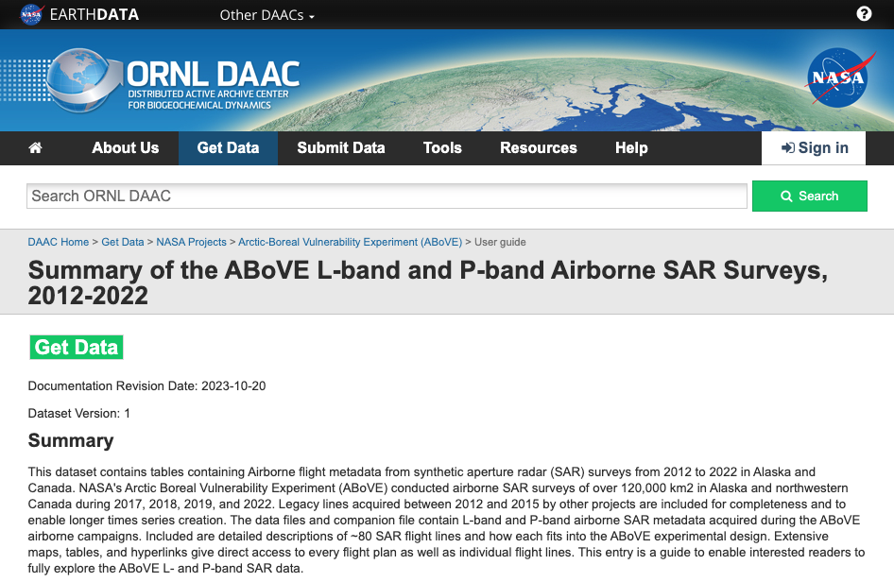
https://daac.ornl.gov/ABOVE/guides/ABoVE_SAR_Surveys.html

Slide 4
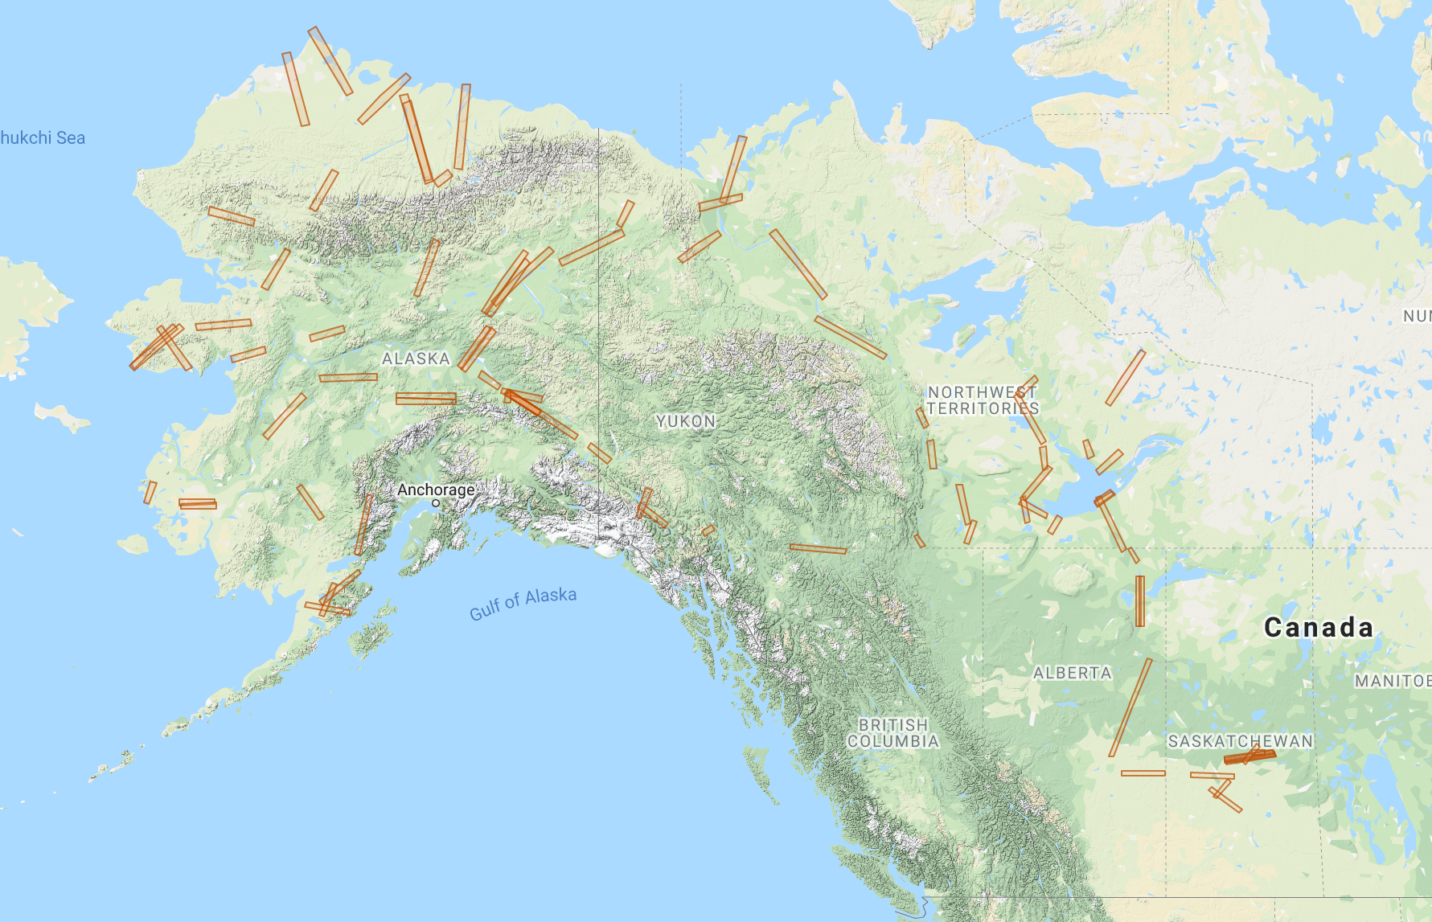
A1
A2
C1
A3
C4
C2
C3
A4
C5
C6
New SAR DEM question
Miller et al., Earth Sys Sci Data, in press
Notes:
L-band SAR flight lines divided into Alaska (A) and Canadian (C) sectors
Approx 80 lines
New Lines for 2022:
BonanW – modified due to new ATC keep out zone north of Fairbanks
HDZAOI – Husky Drop Zone – permafrost degradation SE of Fairbanks
GambA, B – Coast Mountains of BC for rapid glacial retreat
Repeated TomoSAR flights over BERMS area

Slide 5
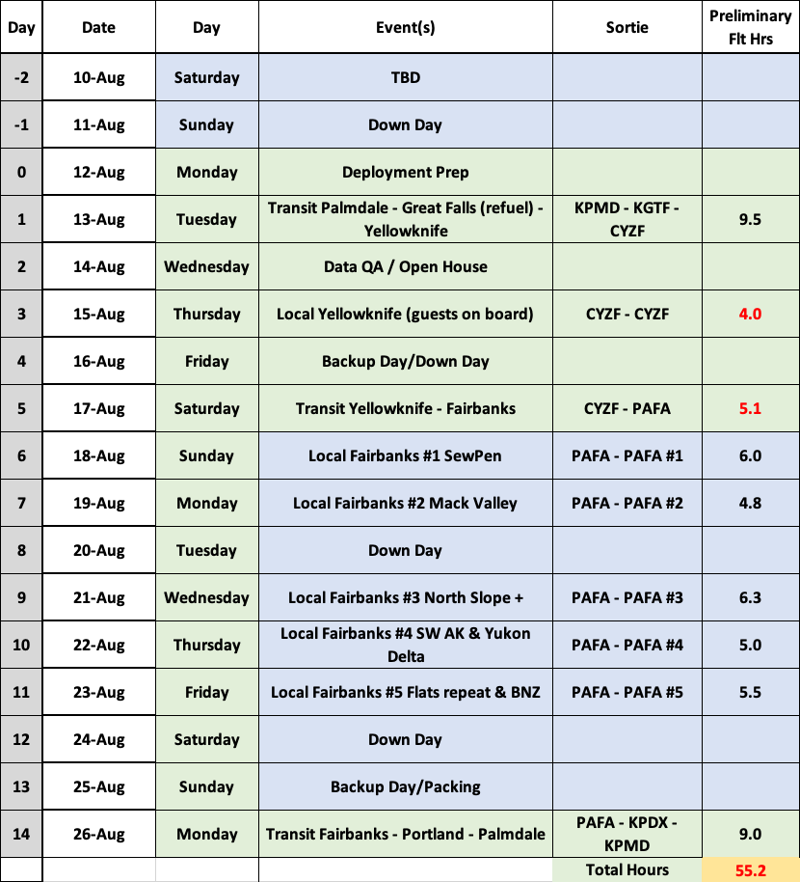
Plan for ABoVE 2024 L-band SAR Campaign
Day 1 - Palmdale – Yellowknife transit includes Peace-Athabasca Delta
Days 7 + 11 include repeat flights over the Yukon Flats for SWOT validation
Fairbanks Flight Plans may be reordered based on actual schedule and SWOT overpass times

Slide 6
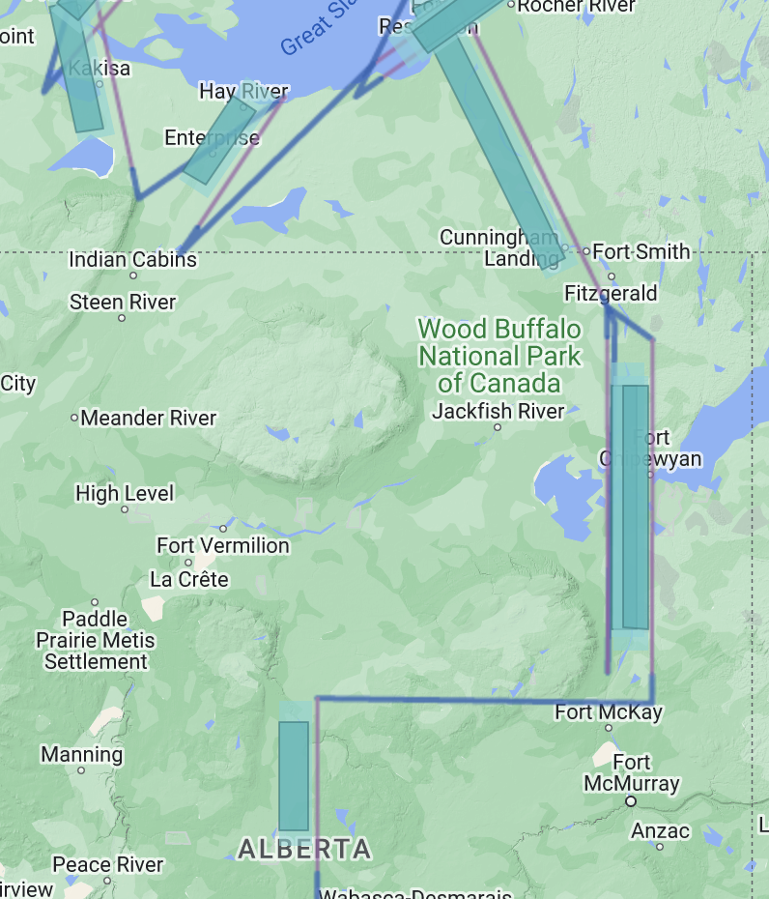
New for 2024 – Alberta
Alberta Red Earth Creek loggers (LBC)
Transit to Yellowknife Sortie
1

Slide 7
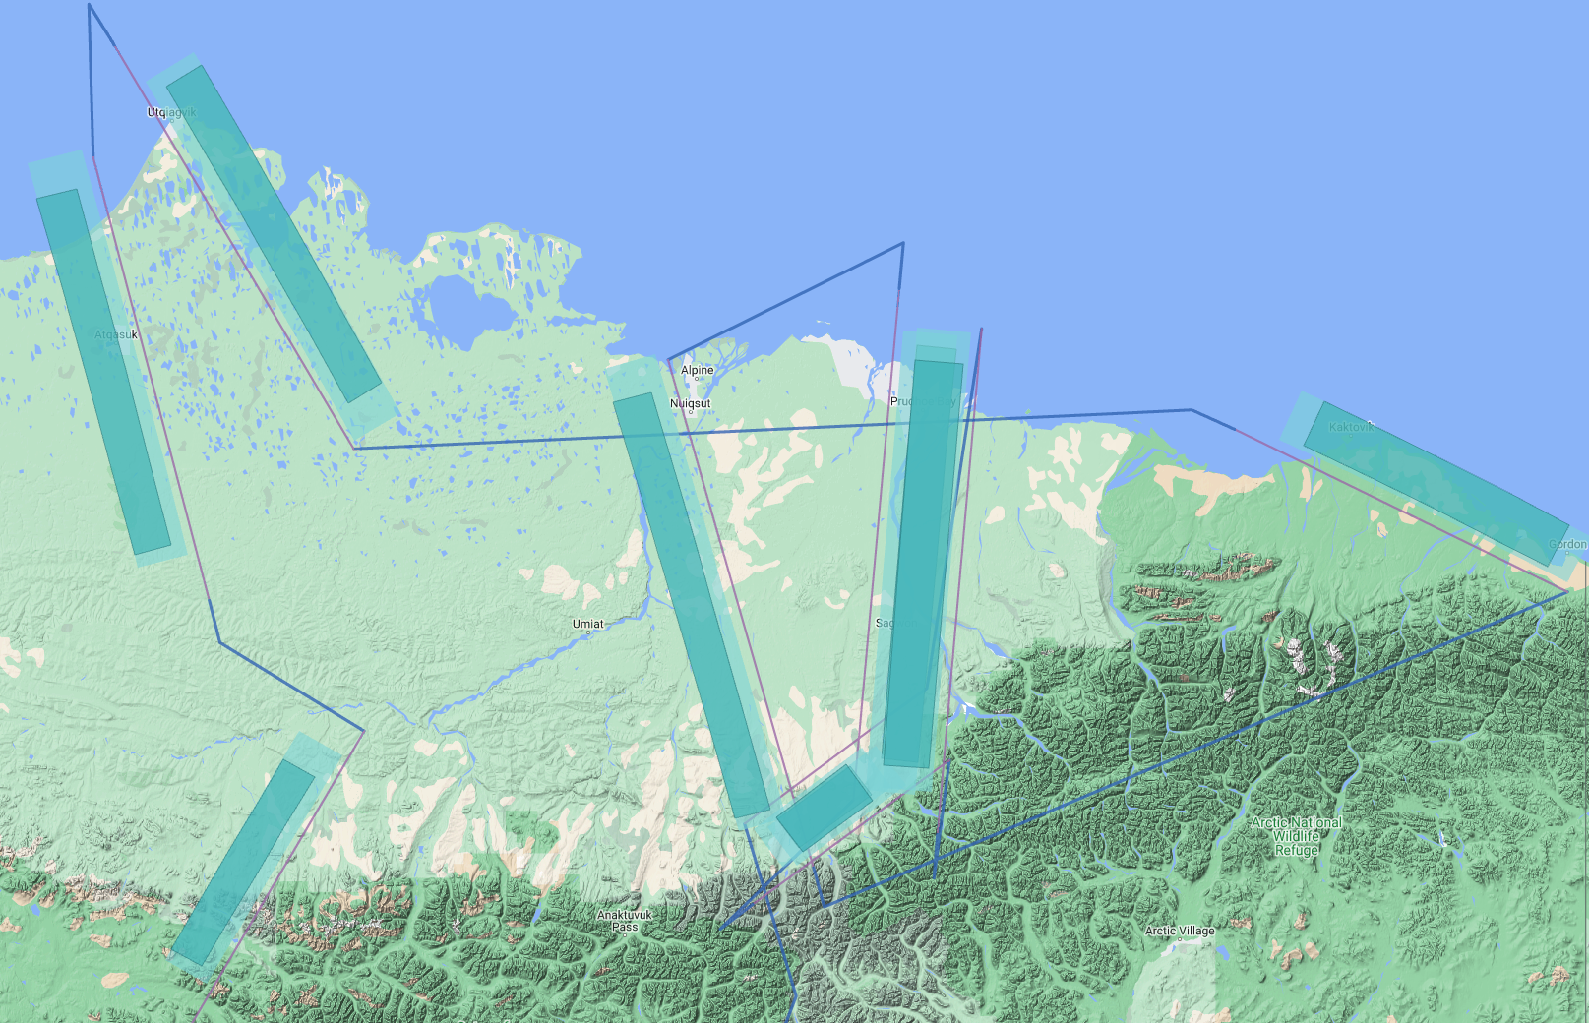
New for 2024 – North Slope
KIC-1 Well Pad, Kaktovik Lagoon (B Gay)
Bi-directional collection over Deadhorse/Dalton Hwy (K Bakian-Dogaheh)
Bi-directional collection over Toolik Lake (K Bakian-Dogaheh)
Arctic Coastal Zone (tbd) (FORTE, Arctic Colors)
North Slope Sortie
4
1
2
3

Slide 8
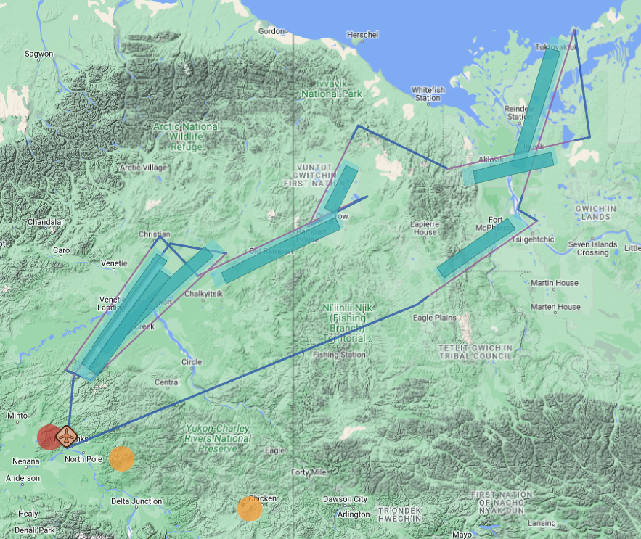
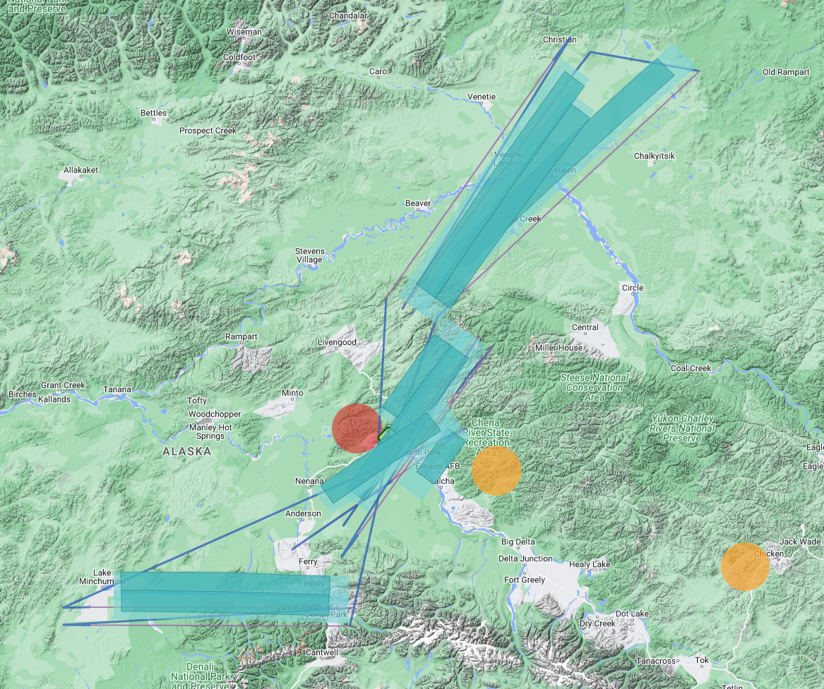
New for 2024 – SWOT Validation – Yukon Flats (Pavelsky, Smith, Butman, SWOT ST)
Mackenzie Valley Sortie
Interior AK Sortie
Repeat flights over 3 Yukon Flats lines with 3-5 day interval between revisits
Timed to SWOT overpasses
Lines flown by AirSWOT in 2017
Notes:
We have almost total control over what plan we fly on what day, so can adjust the acquisitions to coincide with SWOT overflights once we arrive in Fairbanks

