Slide 1
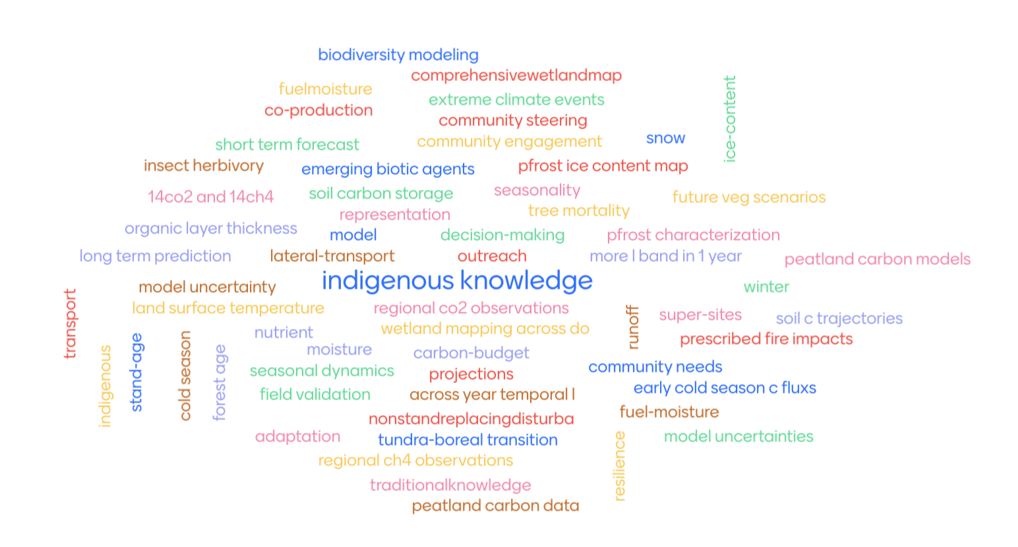
Question: What are key remaining knowledge gaps? (what did we miss, not do well, or were unable to address?)

