Slide 1
Perspective from NASA Headquarters
Ryan Pavlick
Program Manager, Terrestrial Ecology
NASA Earth Science Division
Notes:
STILL

Slide 2
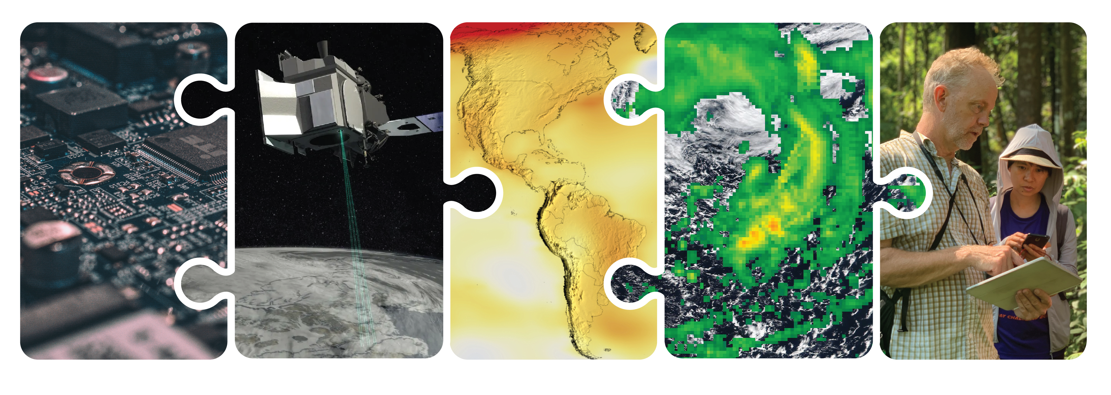
Earth Science: who’s included
Research and Analysis
Technology
Flight
Data and Compute
Earth Action
2
03.01.2024
2
Notes:
WE’RE ALSO TALKING ABOUT EVERY PART OF THE EARTH SCIENCE DVISION: TECHNOLOGY DEVELOPMENT IN ESTO, OUR FLIGHT PROGRAMS, RESEARCH AND MODELING WITHIN R&A, OUR DATA SYSTEMS, AND EARTH ACTION.
THE WHOLE ES2A STRATEGY IS BUILT ON NASA’S UNIQUE POSITION AS A SPACE AGENCY WITH THESE END-TO-END CAPABILITIES – FROM DEVELOPING INNOVATIVE TECHNOLOGY TO LAUNCHING IT INTO ORBIT, TO GROWING OUR SCIENTIFIC UNDERSTANDING, TO DEVELOPING MODELS AND TOOLS THAT CAN HELP INFORM DECISIONS BY END USERS TO ADDRESS REAL-WORLD CHALLENGES.
NO MATTER WHERE YOU FIT IN THIS PUZZLE, YOU HAVE A PART.

Slide 3
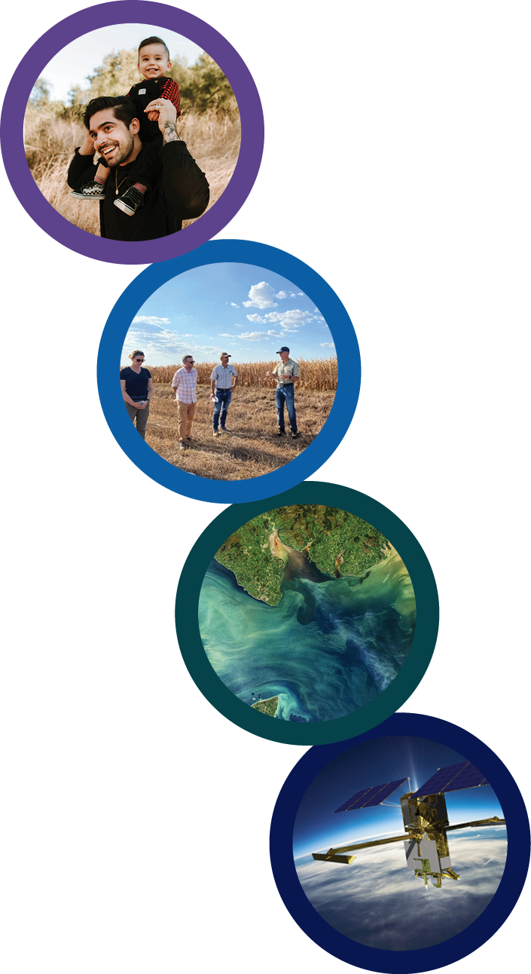
Earth Science to Action Strategy
Virtuous Cycle
User needs inform next iteration of programs, missions and initiatives
Earth Science to Action
Public Understanding & Exchange
Put more scientific understanding into public sphere
Deliver applied science to users
Participate in multi-way info exchange
Use input to inform subsequent work
Solutions & Societal Value
Offer models, scientific findings and info through Open-Source Science principles
Support climate services
Provide science applications and tools to inform decisions
Earth System Science & Applied Research
Grow scientific understanding of Earth’s systems
Develop predictive modeling for science applications and tools to mitigate, adapt and respond to climate change
Foundational Knowledge, Technology, Missions & Data
Technology innovation
Earth observations missions
Data collected from space, air and ground
02.13.2024
Notes:
I'LL START WITH OUR EARTH SCIENCE TO ACTION PRISM—A VISUAL REPRESENTATION OF HOW THE STRATEGY WORKS. I HOPE YOU’VE SEEN A VERSION OF THIS PRISM BEFORE TODAY, WE’VE ALREADY BEEN USING IT A LOT.
BASE LAYER: FOUNDATIONAL KNOWLEDGE, TECHNOLOGY, MISSIONS & DATA. INCLUDES BUILDING MODELS. (KNOWING)
2ND LAYER: EARTH SYSTEM SCIENCE AND APPLIED RESEARCH. INCLUDES IMPROVING MODELS (LEARNING)
3RD LAYER: SOLUTIONS & SOCIETAL VALUE INCLUDES USING MODELS (DOING)
TOP LAYER: PUBLIC UNDERSTANDING & EXCHANGE (TEACHING)

Slide 4
What do we mean by “action”?
Our definition of action is accelerating the use of Earth science to support policy and decision-making for society’s well-being
Scale up: Scale up existing efforts to get NASA science and data into hands of end users to solve real-world challenges
Build bridges:
Build structural and cultural bridges between research, technology, flight, data, and Earth action elements
Identify and remove barriers to collaboration
Be user centered: Prioritize info exchange with end users to allow their experiences to inform future programs
Notes:
WE’VE TALKED ABOUT WHAT WE MEAN BY EARTH SCIENCE, NOW WHAT DO WE MEAN BY ACTION
WE WANT TO ACCELERATE THE USE OF EARTH SCIENCE IN DECISION MAKING OF ALL KINDS
TO DO THIS, LEADERS AT ALL LEVELS FROM NEIGHBORHOODS TO NATIONS, FROM FAMILY BUSINESSES TO GLOBAL SUPPLIERS, MUST HAVE THE BEST SCIENTIFIC INSIGHT AND KNOWLEDGE TO INFORM THEIR ACTIONS. IT IS THEIR ACTIONS THAT THIS STRATEGY IS SEEKING TO ENABLE.
THREE PIECES ARE CRITICAL TO GETTING THAT INSIGHT AND KNOWLEDGE TO THE PEOPLE WHO NEED IT.
WE HAVE TO SCALE UP OUR EFFORTS TO REACH MORE PEOPLE.
WE HAVE TO BUILD BRIDGES ACROSS OUR ENTERPRISE.
WE HAVE TO FOCUS ON THE NEEDS OF USERS, WHETHER THAT’S A FEDERAL AGENCY PARTNER OR AN EMERGENCY MANAGER.

Slide 5
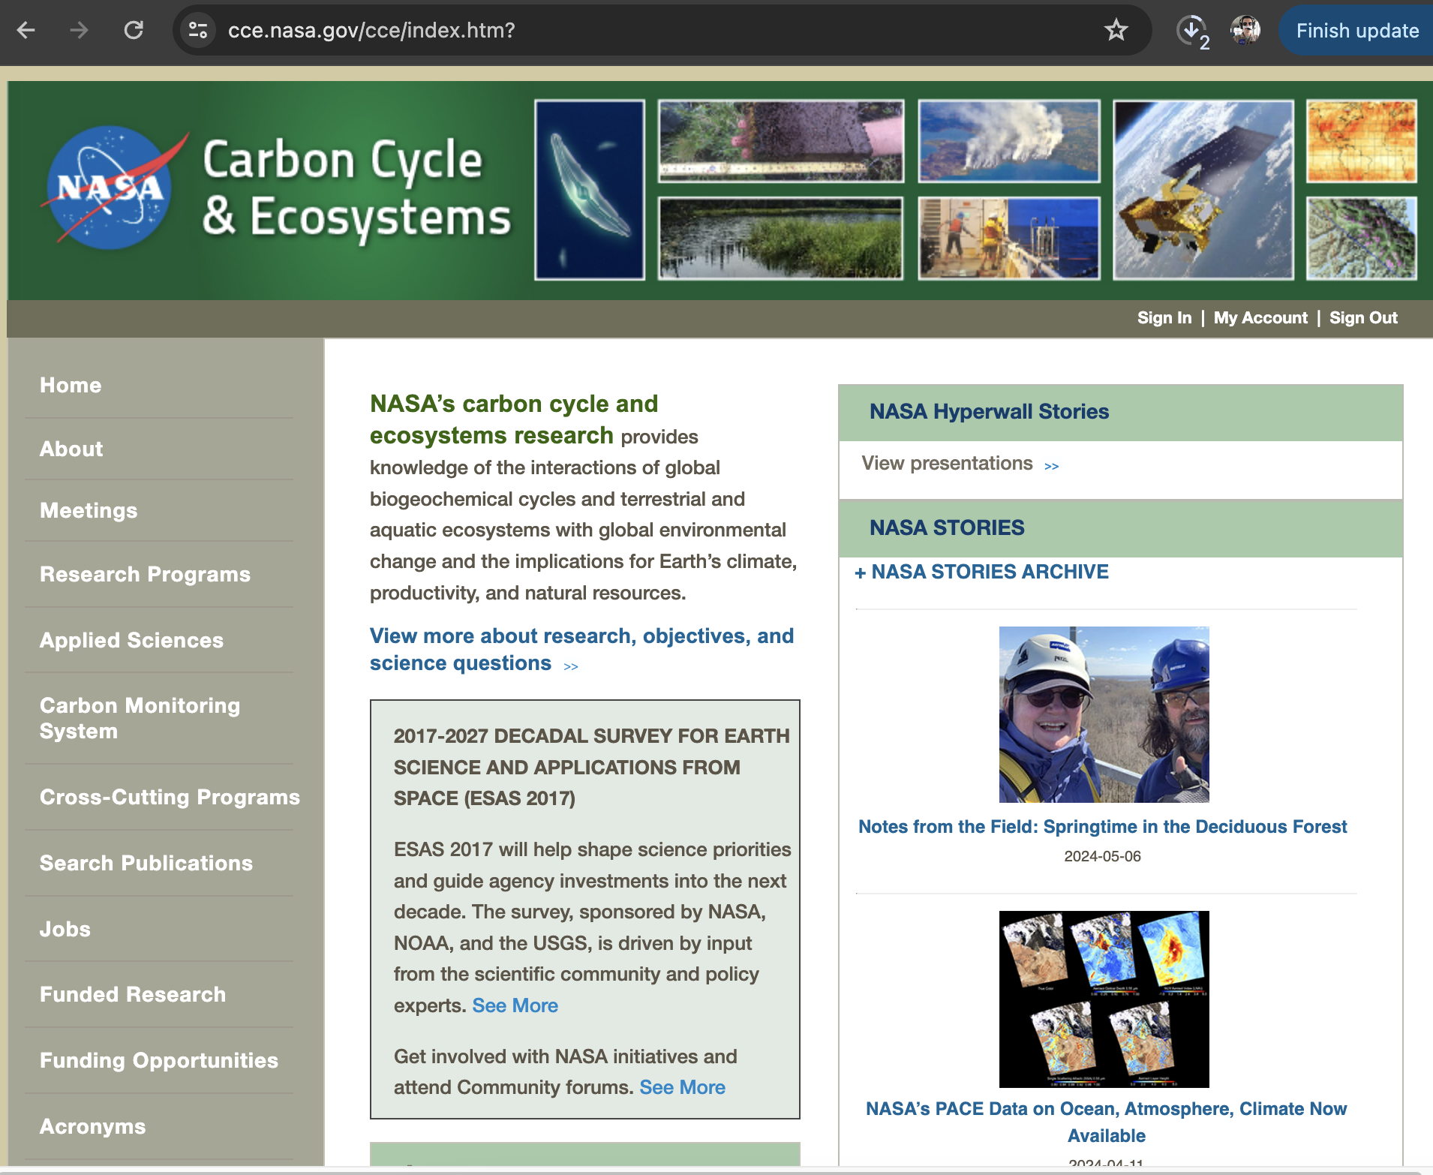
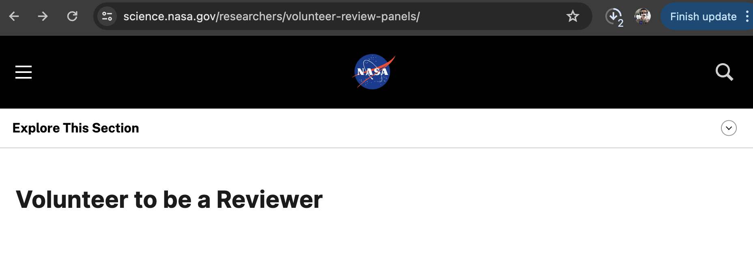
NASA Indigenous Peoples Initiative
cce.nasa.gov

Slide 8
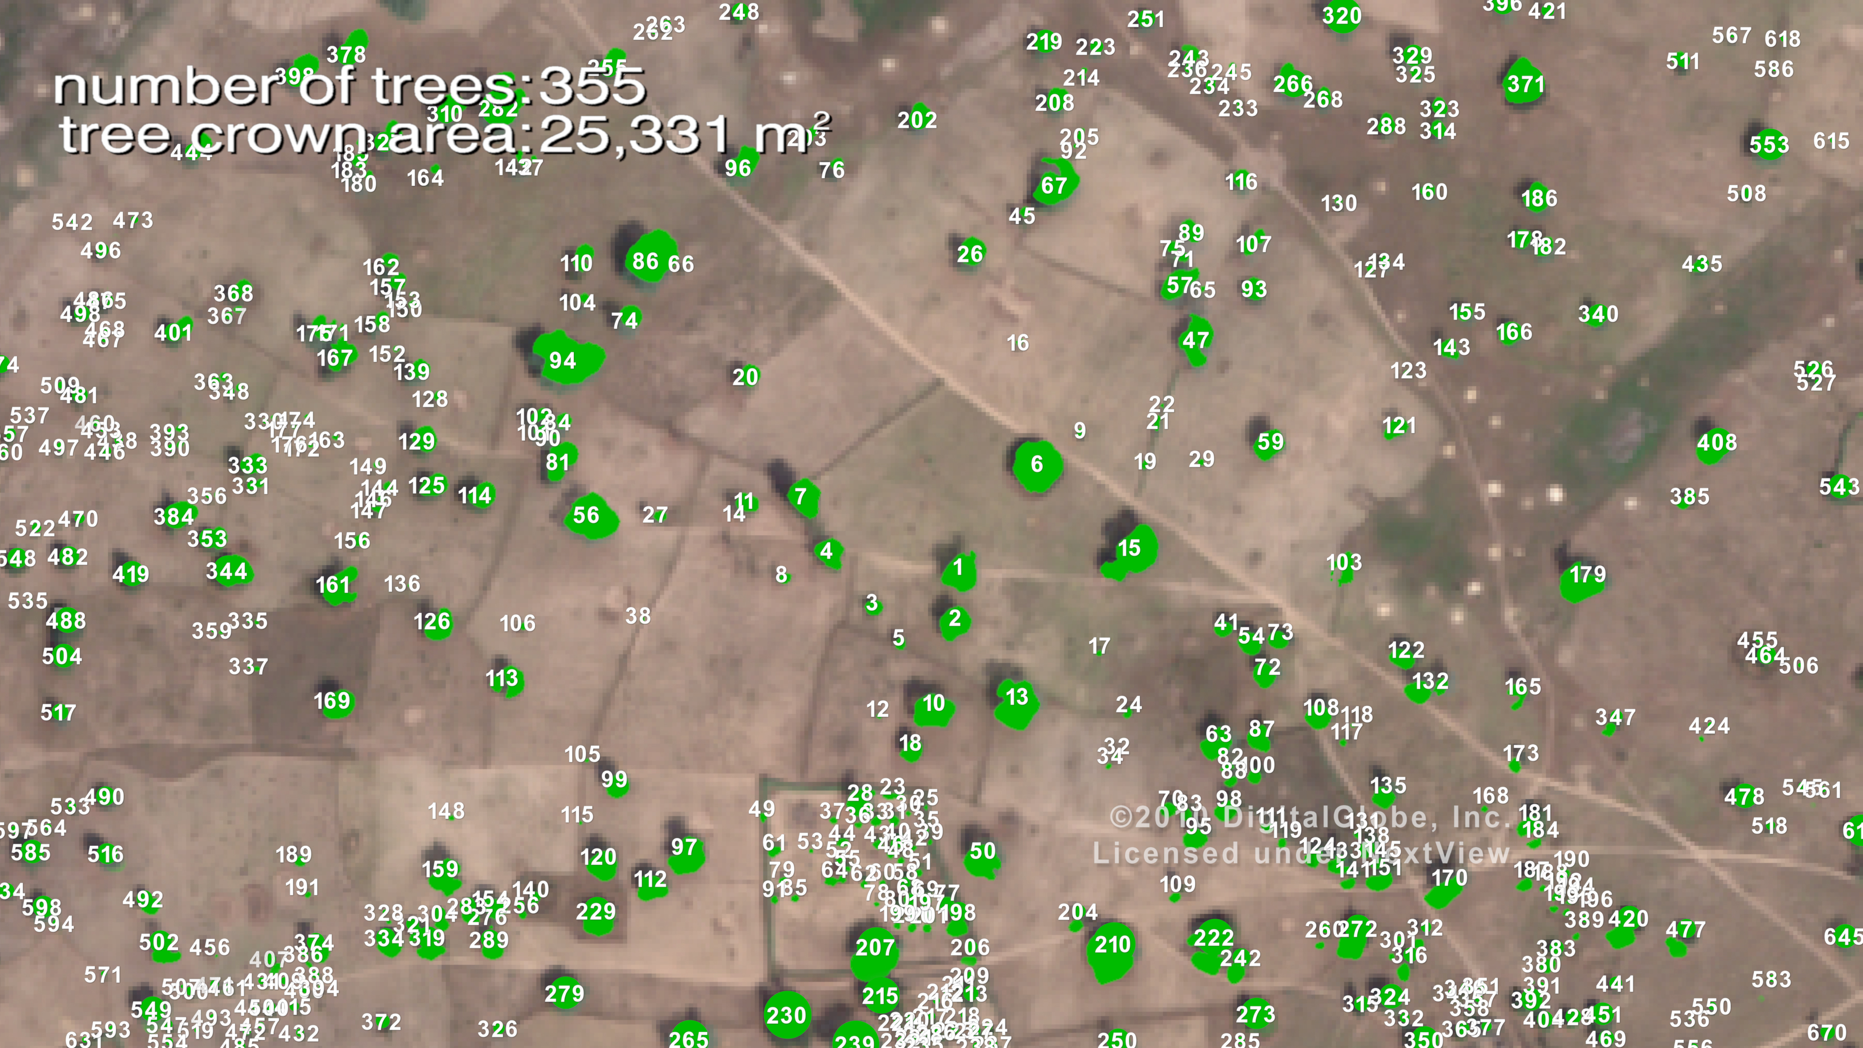
Tucker et al 2023

Slide 9
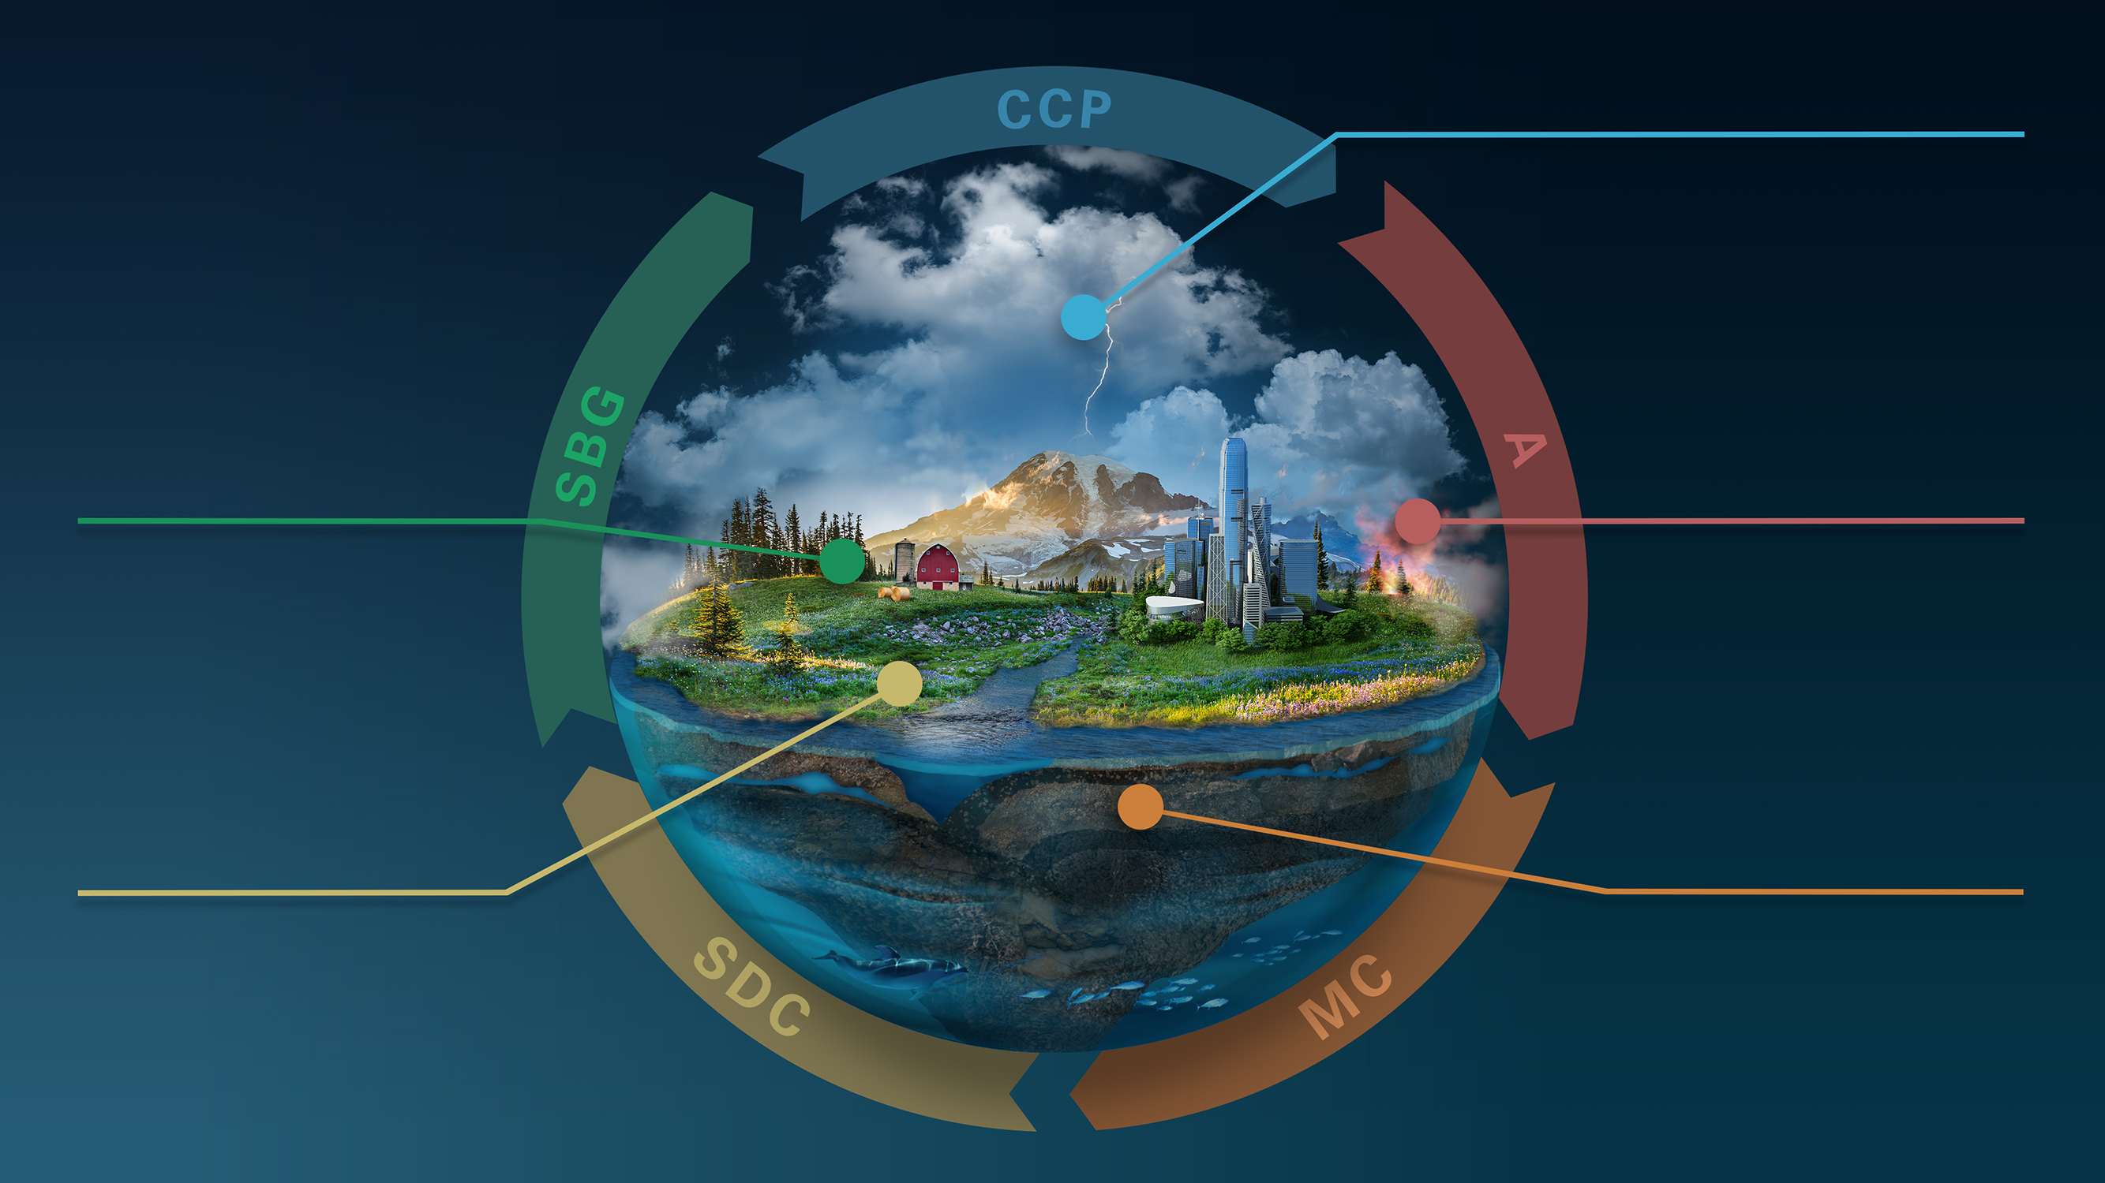
Atmospheric Science Missions
CLOUDS, CONVECTION
AND PRECIPITATION
Water and Energy in the Atmosphere
INTERCONNECTED
CORE MISSIONS
SURFACE BIOLOGY
AND GEOLOGY
AEROSOLS
Particles in the
Atmosphere
Earth Surface & Ecosystems
SBG-TIR
SBG-VSWIR
MASS CHANGE
SURFACE DEFORMATION
AND CHANGE
Large-scale Mass
Redistribution
GRACE-C
Earth Surface Dynamics
Met by NISAR launch in 2024
Observables now in Mission Formulation
Notes:
Walk out chart - Make some concluding remarks and now will dive into the three missions that are in the formulation stage.
As you can see, we have adjusted this ESO chart to reflect all the changes we just discussed.
Looking ahead, in a few months we will launch NISAR, which is the pathfinder for the decadal recommended Earth System Observatory (ESO), focused on these designated observables. In FY25, we will continue to advance our instrument and spacecraft technology in preparation to fly the next missions in the ESO, starting with GRACE-C.
As mentioned earlier, we are taking a “Decouple, Partner, and Compete” approach to reduce cost and scope.

Slide 11
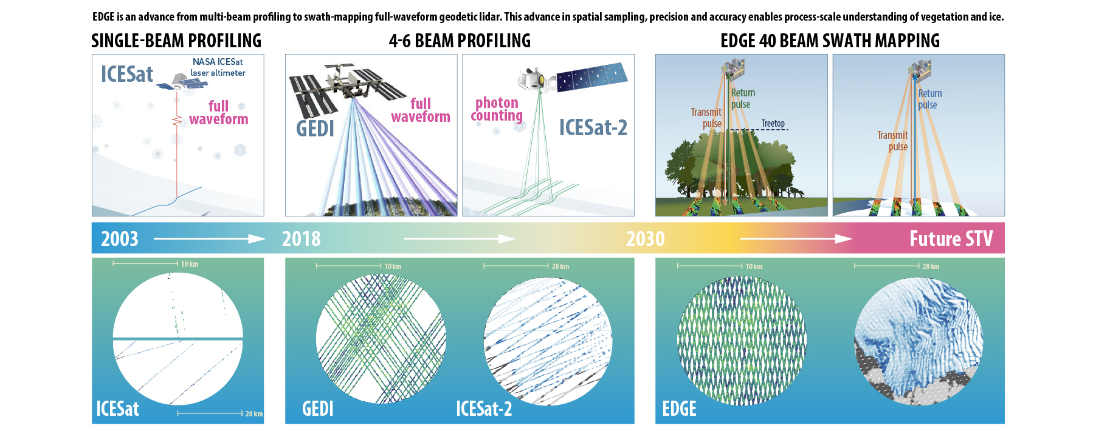

Slide 12
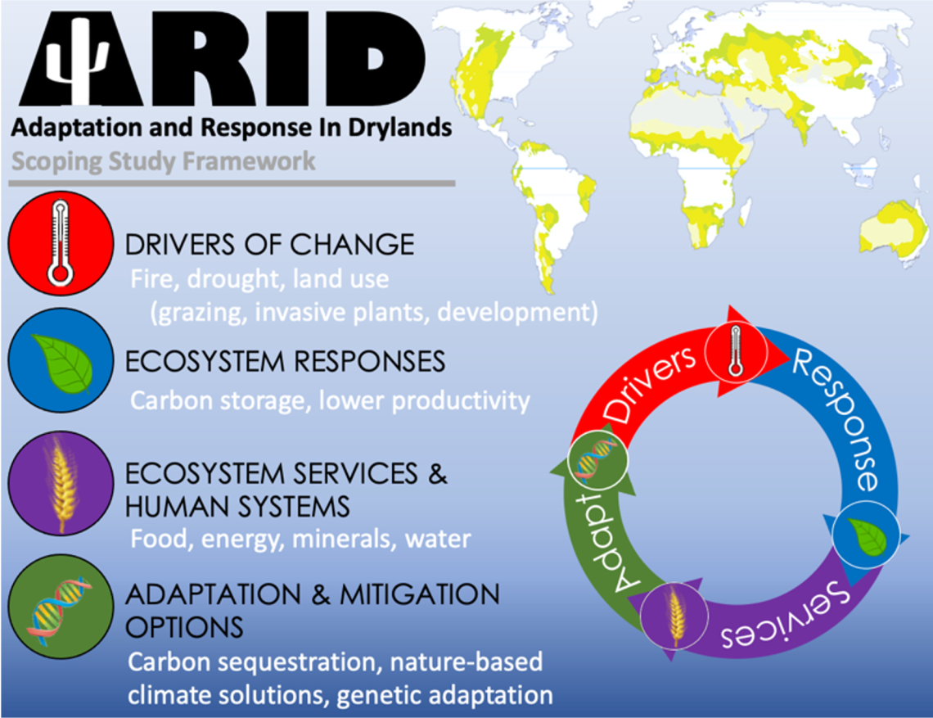
Where to next?
tropicalforestscoping.com
aridscoping.arizona.edu

