Slide 1
Promoting Inclusive and Equitable Research (PIER) in the Arctic
Bob Bolton & Colleen Iversen
On Behalf of the NGEE Arctic Team
NASA ABoVE
Annual Science Team Meeting
24 May 2024

Slide 2
There are unique challenges to leading integrated, large-scale projects that span scientific disciplines, institutions, and cultures.
Iversen et al. 2020 (Eos)

Slide 3
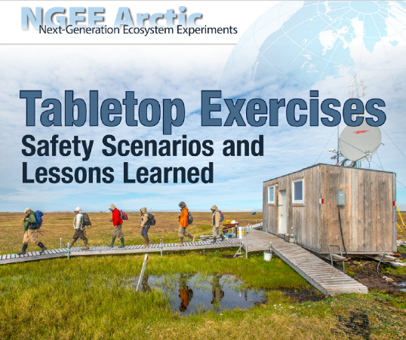
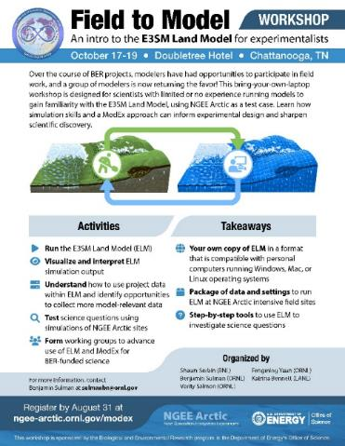
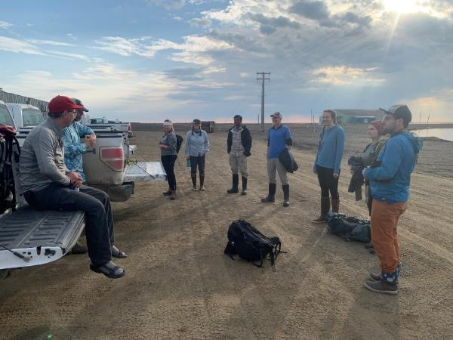
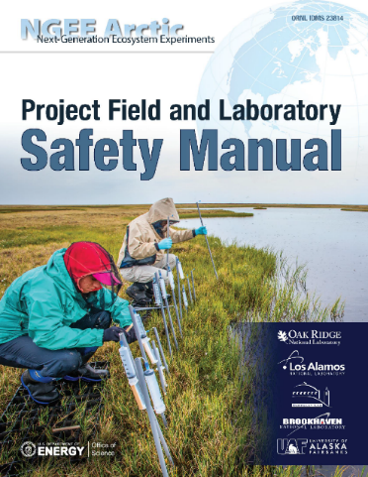
We Intentionally Develop the Culture We Want
Development of project culture has been a continuous, iterative process
Always looking for ways to improve, grow culture of safety and inclusion, expectations and practices
The DOE Office of Science PIER plan framework is an opportunity to build on our core values with specific and measurable deliverables
The best science is only possible with an inclusive project culture

Slide 4



Our Phase 4 PIER Plan Emphasizes Three Themes:
1. Safety and Inclusion
2. Communication and Engagement
3. Developing Leaders
Empowerment
Inclusive and Diverse
Setting Expectations
Open and Continuous Conversation
Respect for Local Culture and Environment
Safe and Secure

Slide 5
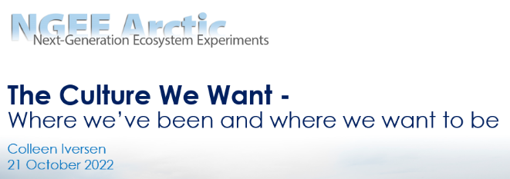
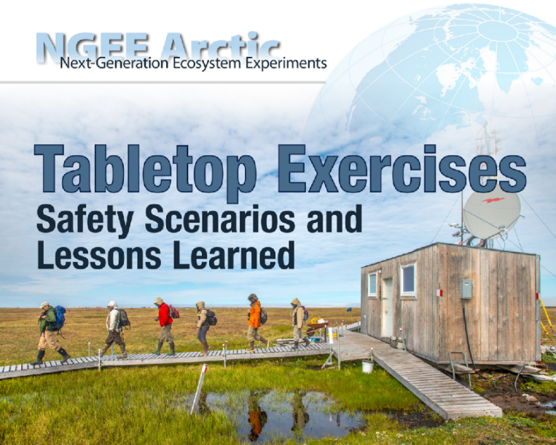
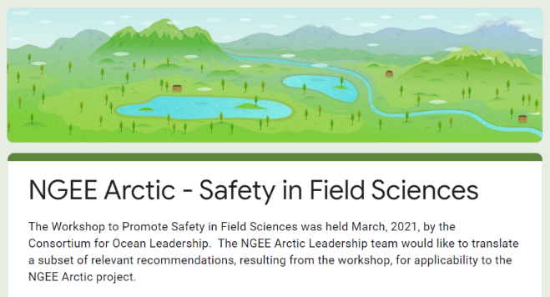
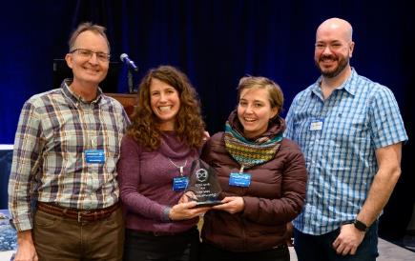
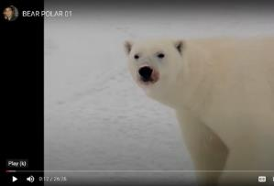
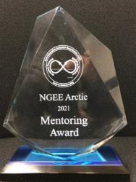

Safety and Inclusion are Key to Scientific Success
We have developed…extensive physical safety documentation and training, with an increasing emphasis on psychological safety.

Slide 6

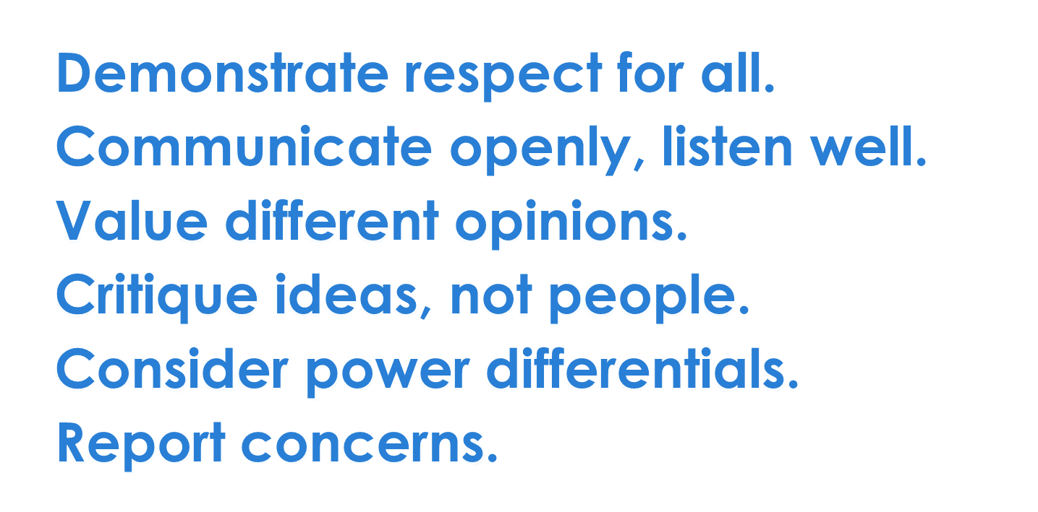
Safety and Inclusion are Key to Scientific Success
Next steps include…
Formalizing our Project-Wide Code of Conduct
Clear expectations for behavior
Clear reporting, consequences
Leadership support, enforcement
Re-Evaluating Data Sharing, Authorship
Emphasize cross-disciplinary collaboration
New, international collaborations
Continuing Preparedness Exercises
Team building
Bystander intervention training and refreshers

Slide 7

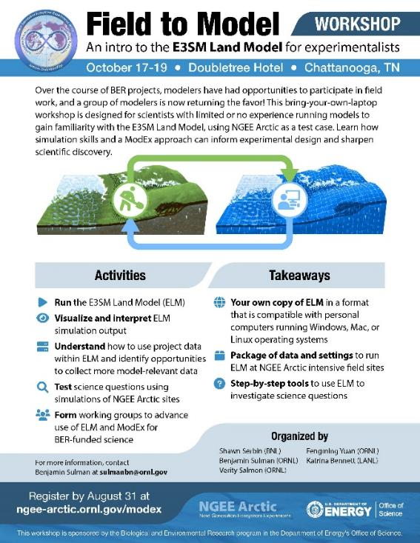

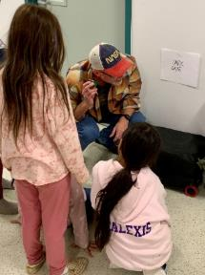

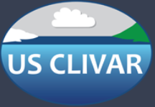
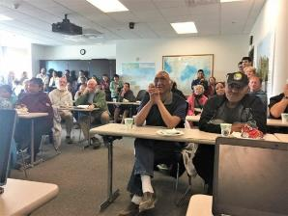
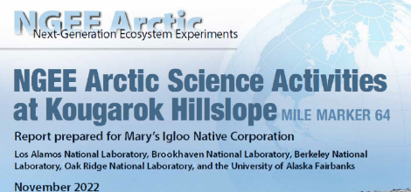



Communication and Engagement Keep Promises
We have engaged with…(and listened to) local communities, the broader scientific community, and the public to share science and give thanks.
Strait Science Series Lectures

Slide 8

Communication and Engagement Keep Promises
Next steps include…
Facilitate Knowledge Exchange
New, project-funded NGEE Arctic
engagement
coordinator
Ask a local community member to join our SAB
Communicate
Scientific Findings
Radio broadcasts, podcasts targeted to local communities
GIS Story Maps
Strait Science Series Lectures

Slide 9
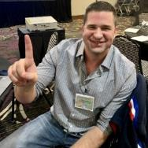
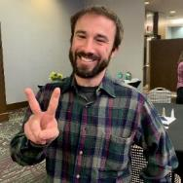
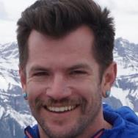
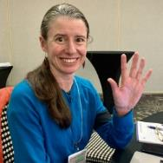
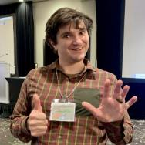
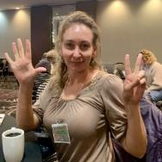
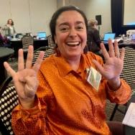
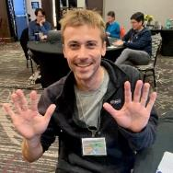
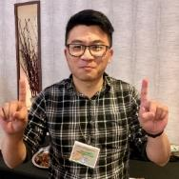
We Intentionally Develop the Next Generation of Scientific and Arctic Leaders
We have emphasized…recruitment and retention of diverse scientists, intentional leadership development and succession planning.
LABORATORY RESEARCH DIRECTOR Colleen Iversen (ORNL) | INSTITUTIONAL LEADERS | Katrina Bennett (LANL) Baptiste Dafflon (LBNL) Eugenie Euskirchen (UAF) Alistair Rogers (BNL)
TECHNICAL PROJECT MANAGER Sue Heinz (ORNL) DEPUTY OF OPERATIONS Bob Bolton (ORNL) SPECIAL PROJECT ADVISOR Stan Wullschleger (ORNL, retired) | SCIENCE TEAM LEADERS | Baptiste Dafflon (LBNL) Scott Painter (ORNL) Ben Sulman (ORNL) Neslihan Taş (LBNL) Katrina Bennett (LANL) Daryl Yang (BNL) Forrest Hoffman (ORNL) Alistair Rogers (BNL) Peter Thornton (ORNL) Chuck Abolt (LANL) Eugenie Euskirchen (UAF) Charlie Koven (LBNL) Michele Thornton (ORNL) Terri Velliquette (ORNL)
 | RISING LEADERS | Ryan Crumley (LANL) Jennifer Holm (LBNL) Hannah Mevenkamp (UAF) Fernanda Santos (ORNL) Daryl Yang (BNL)
*New leaders.
Notes:
.

Slide 10
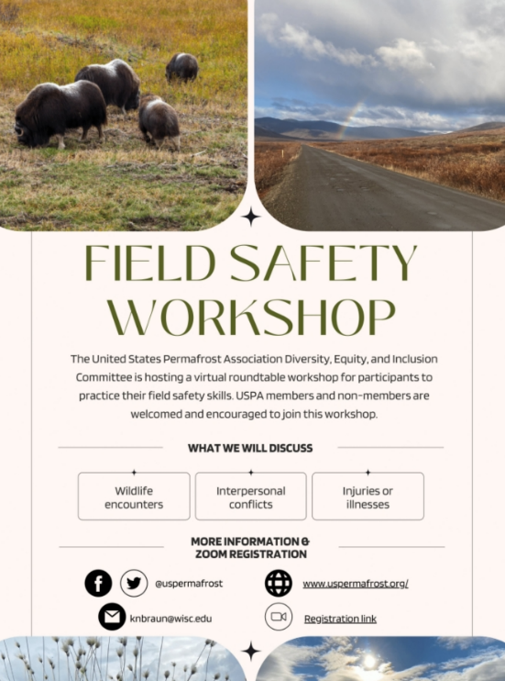
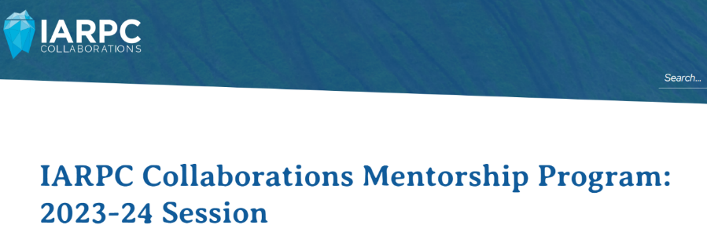
We Intentionally Develop the Next Generation of Scientific and Arctic Leaders
Next steps include…
Developing Leaders
Rising Leaders on Phase 4 proposal, Leadership Team
Updated succession plan from each institutional partner
Mentoring Program
Formalize project-wide mentoring program
Mentoring awards

Slide 11
We Hold Ourselves Accountable with Deliverables
SI3 – Bystander Intervention Workshop
CE1 – Relationships Developed with Communities at Model Evaluation Sites
DL1 – Update Succession Planning
DL2 – Early-Career Exchange Program
Safety Plan – Maintain, Improve Safety Manual
FY
2025
FY
2027
SI1 – Project-Wide Code of Conduct
SI2 – Data Sharing and Authorship
SI3 – Bystander Training, Tabletop Exercises
CE1 – Project Engagement Coordinator
CE1 – Invite Community Member to Join SAB
CE2 – Arctic Story Maps
DL1 – Rising Leaders Embedded with All Partners
DL2 – Project-wide Mentoring Plan
Safety Plan – Maintain, Improve Safety Manual
Develop, Maintain Culture of Safety and Inclusion for Ourselves and Collaborators
Model Inclusive Science for Broader Arctic Research Community
Demonstrate that Valuing Project Culture Leads to Better Science
Share Lessons Learned with Broader Community
FY
2026

