Slide 1

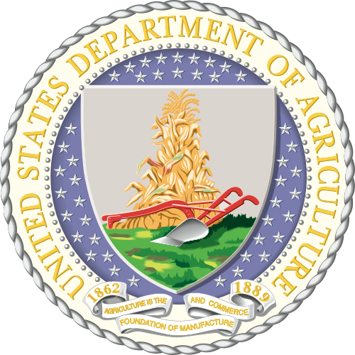

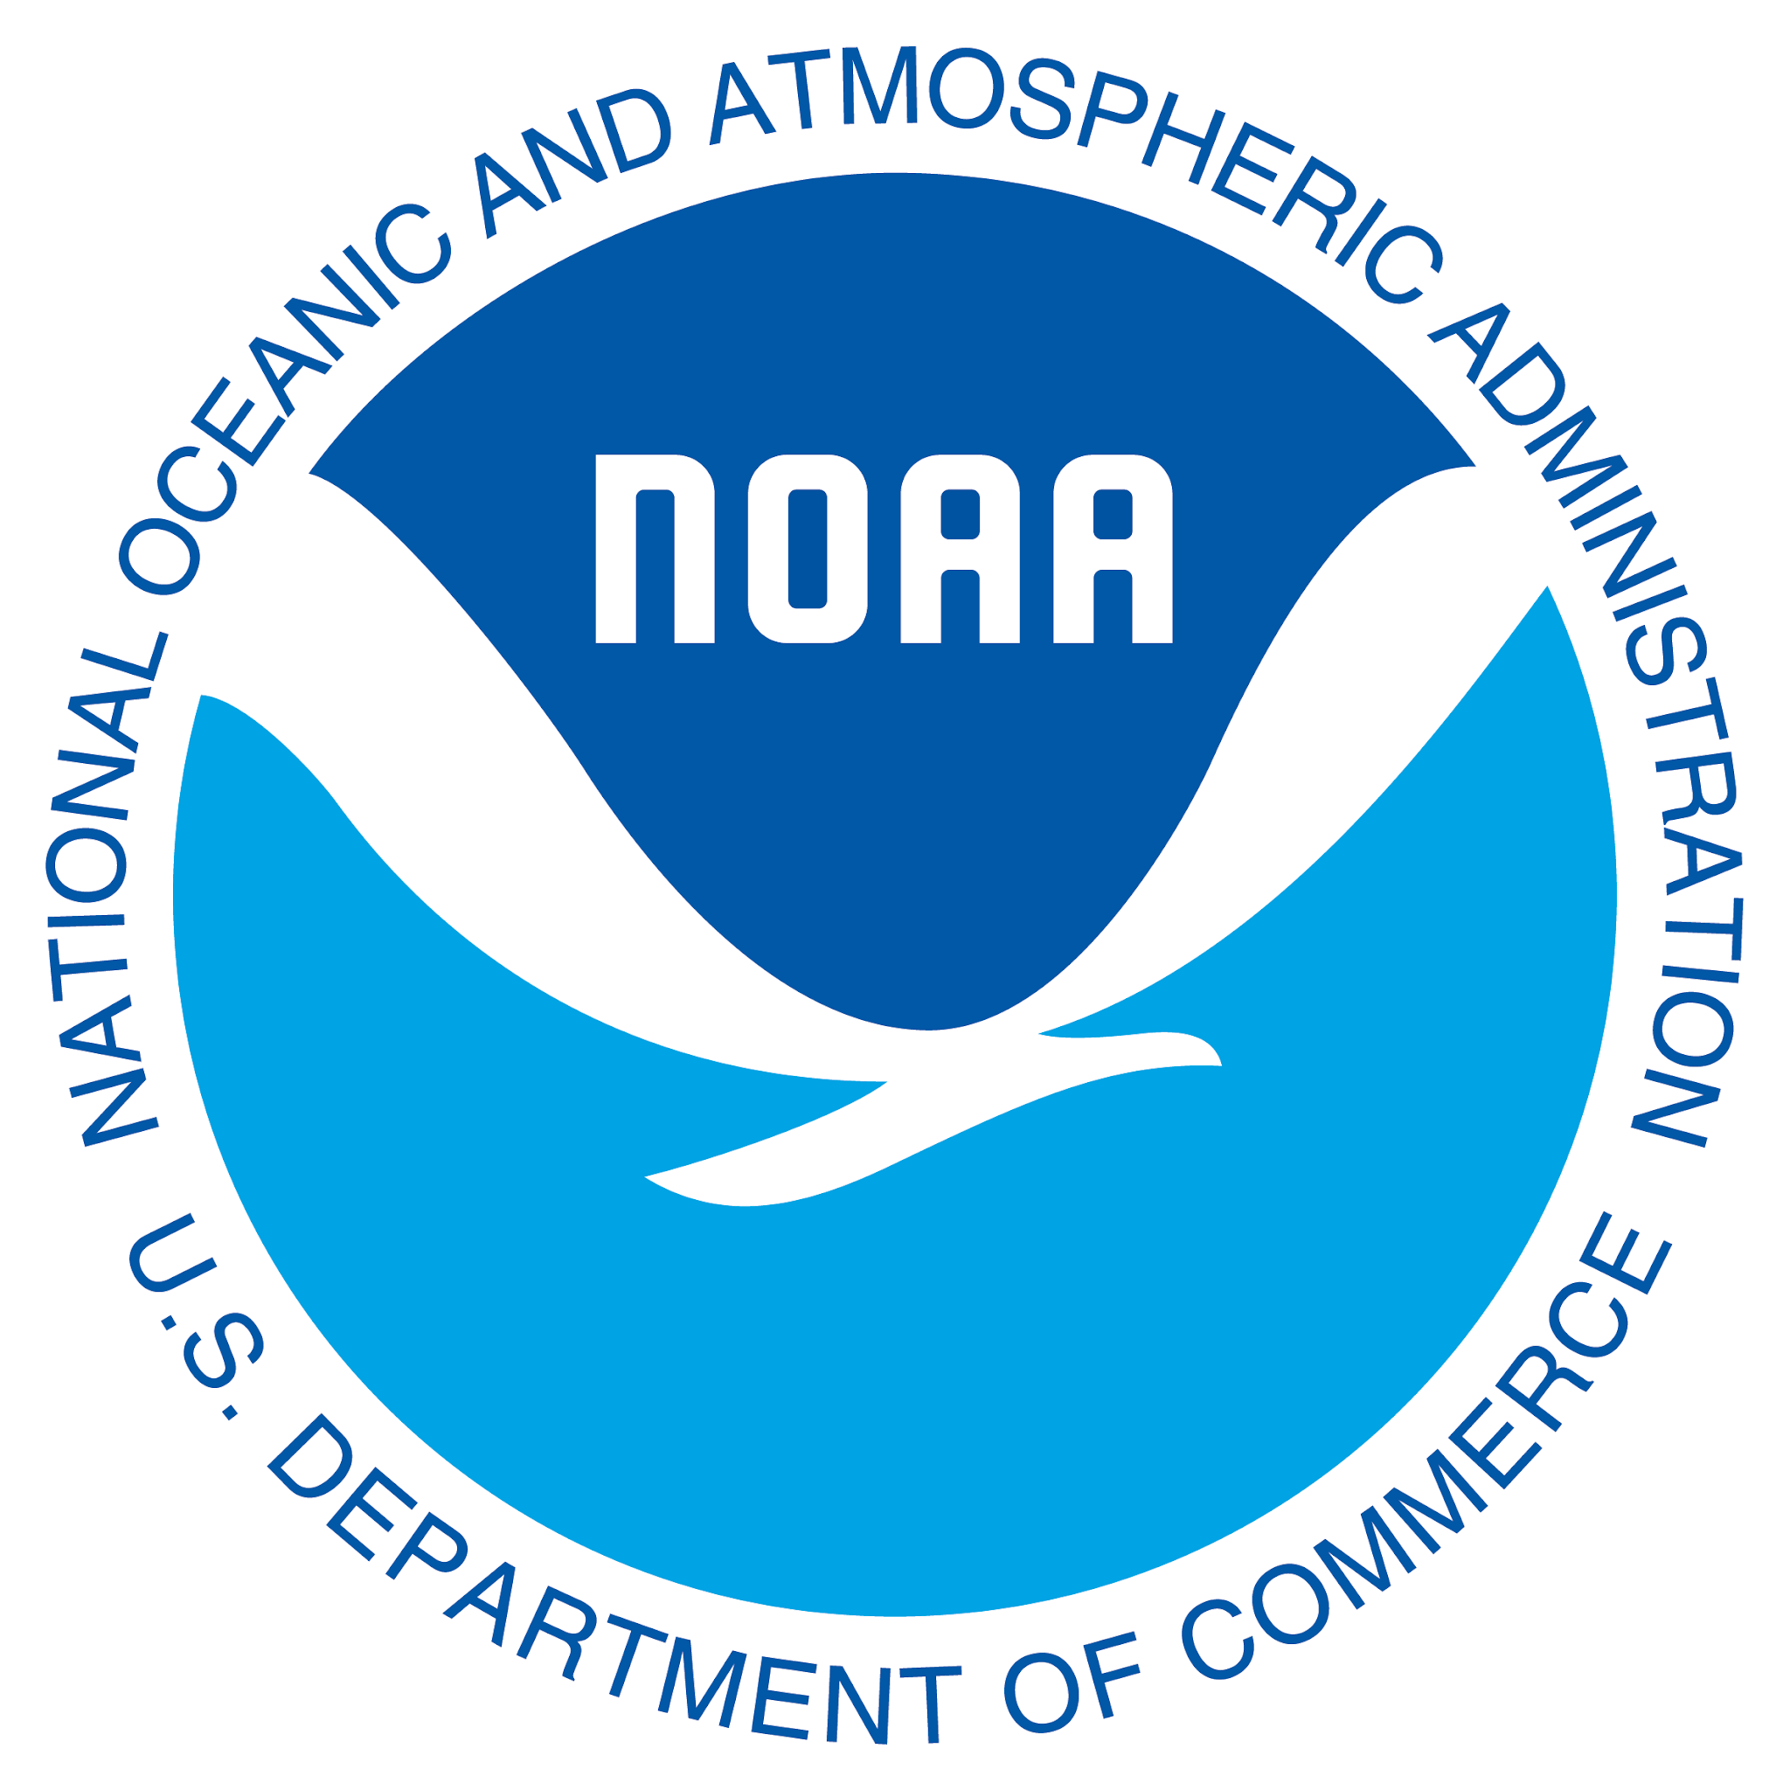




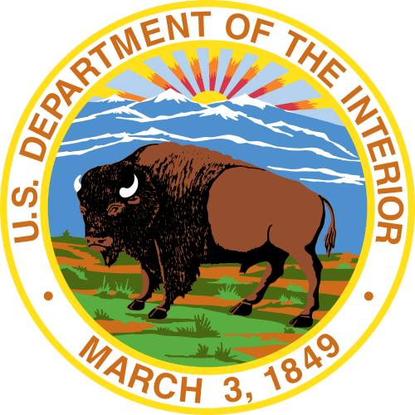



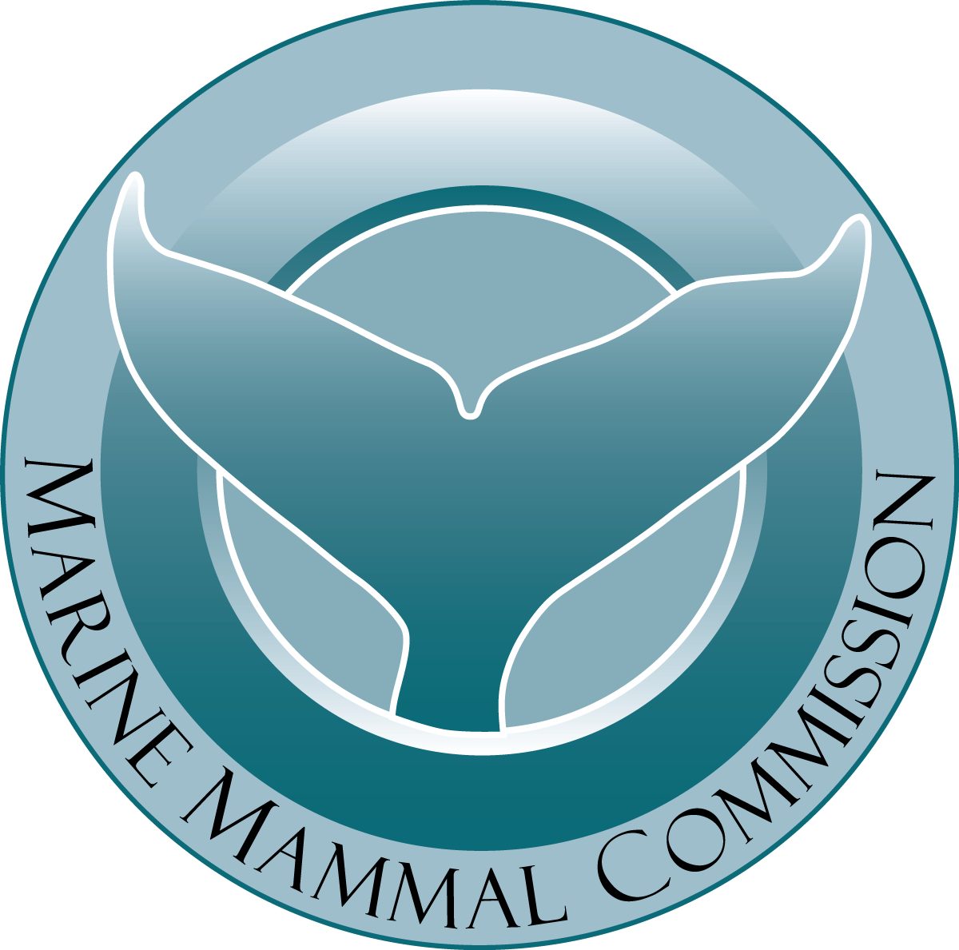


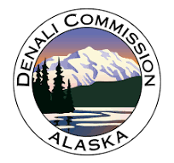
Interagency Arctic Research and Policy Committee (IARPC)
What is IARPC?
Subcommittee under the National Science and Technology Council (NSTC)
Brings together leaders from 18 agencies, departments, and offices across the U.S. federal government
Created in 1984 under the Arctic Research and Policy Act of 1984 - comprehensive national policy on research needs in the Arctic

Slide 2
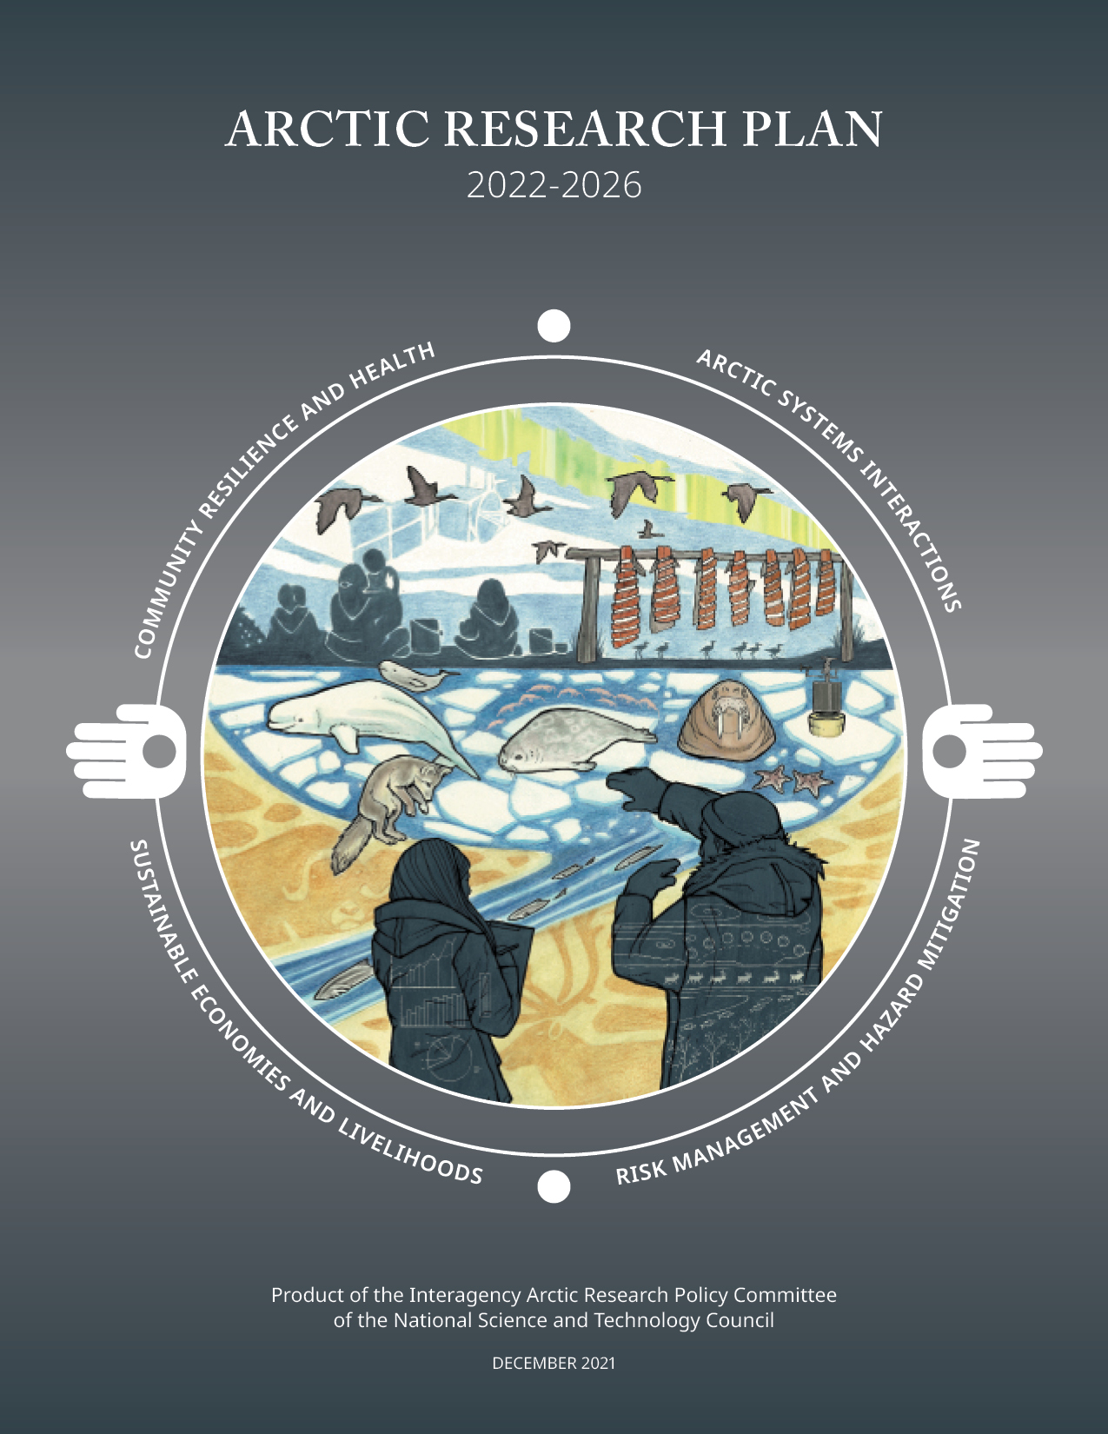
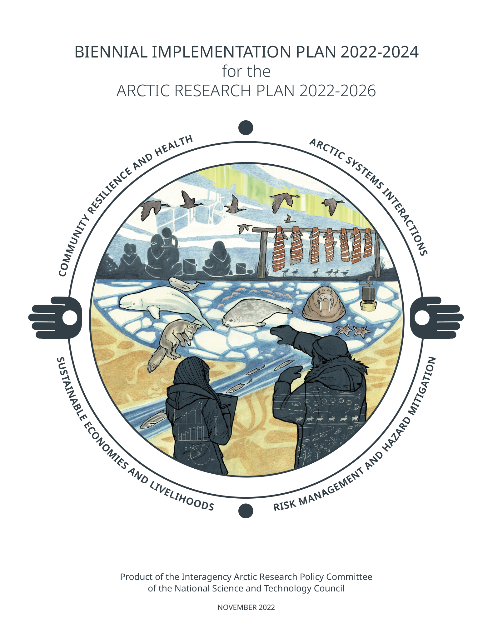
Interagency Arctic Research and Policy Committee (IARPC)
How is it set up?
Federal 5-year research plan
Focus on high level goals for Arctic research
Specific deliverables are then covered in the 2-year implementation plan
Interdisciplinary plan, with topics such as Arctic System Interactions
Notes:
In 2021, IARPC launched the Arctic Research Plan 2022-2026.
While this is a federal plan, nonfederal researchers and community members are vital to its success. The research you conduct and the information you generate is central to the Arctic Research Plan.
This five-year plan focuses on high level goals for Arctic research. More specific deliverables are then laid out in the two-year implementation plans, the first of which was released in December 2022 and contains deliverables to be completed by 2024.
This shift to two year implementation plans will help us be more nimble and responsive to emerging issues.
This plan is also highly interdisciplinary. Previous plans tended to have goals around specific disciplines of science: for example permafrost, or sea ice. But in recent years, our teams started co-hosting meetings with increasing frequency, because many of the challenges in Arctic research require this kind of collaboration approach. The new Arctic Research Plan reflects that shift.

Slide 3
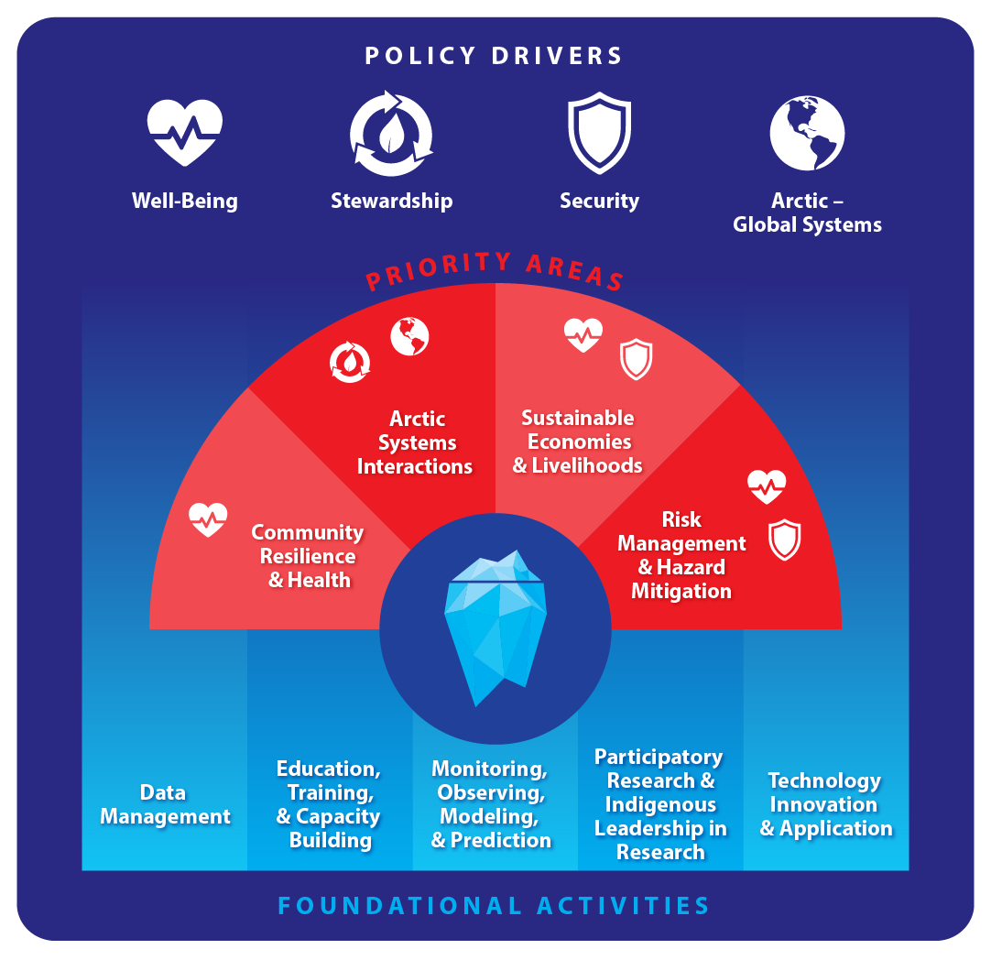
IARPC Teams
4 Priority Area Teams
5 Foundational Activities Teams
15 Communities of Practice
Collaboratively working on 91 deliverables of the Arctic Research Plan

Slide 4
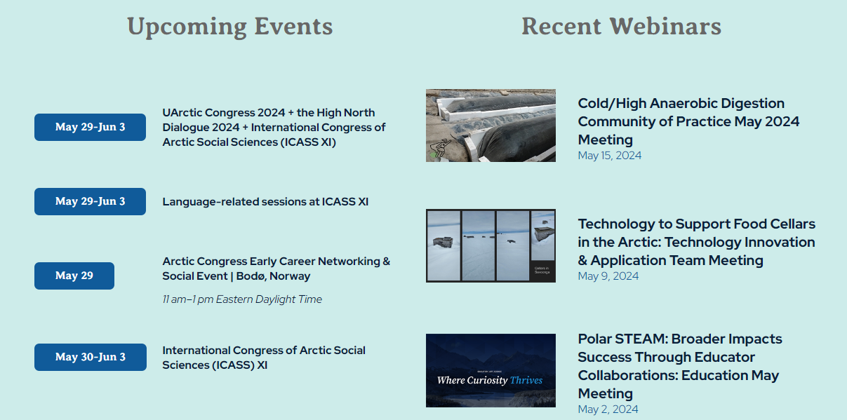
What could IARPC mean to you?
IARPC Collaborations - A hub for building connections and facilitating research for a thriving Arctic and Earth
www.iarpccollaborations.org
Notes:
We use our innovative web platform, IARPC Collaborations, to share information and track progress toward the plan’s deliverables. I will say more about IARPC Collaborations in a few minutes, but I will mention now that IARPC Collaborations is a hub for anyone involved in Arctic research, not just feds, and if you aren’t already a member I encourage you to sign up at iarpccollaborations.org.

Slide 5
How is ABoVE Involved?
Co-leads the Terrestrial Ecosystems Community of Practice (Liz Hoy, Daryl Yang, and Elizabeth Powers from USGS)
ABoVE research discussed in the last year:
  Adrianna Foster – Multi-disturbance synthesis
  Scott Goetz – ABoVE Research Highlights
  Matt Macader – Vegetation Mapping
  Data Center Panel including the ABoVE archive at the ORNL DAAC
  Kevin Schaefer – Permafrost Dynamics
  Dong Chen – Burned Area Product
Join a Team
Tell me about your research!
www.iarpccollaborations.org

Slide 6
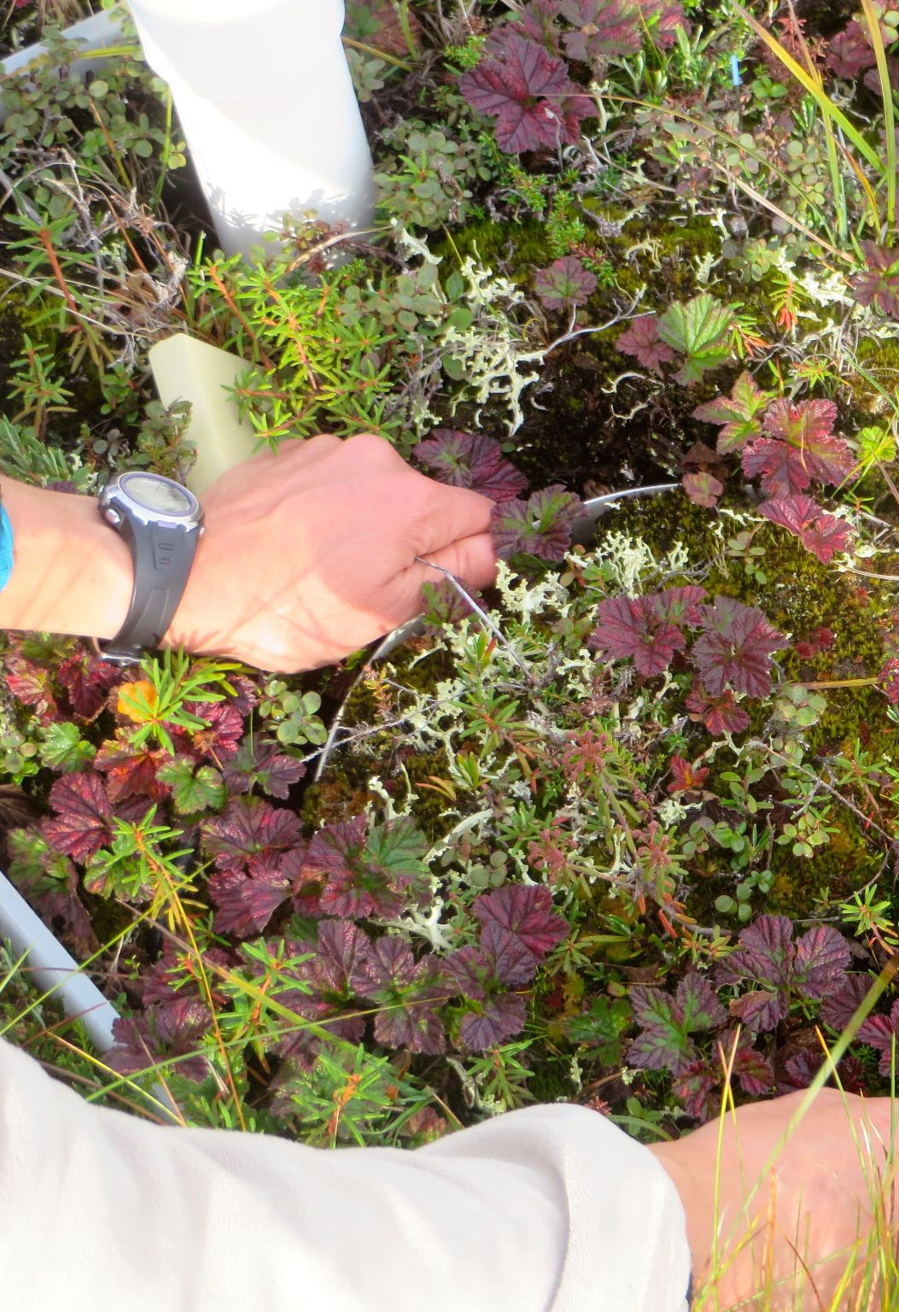

Biennial Implementation Plan – Call for Input
Which objectives/deliverables should be continued?
Which should be closed out?
What should be added?
Form Available Until May 31st
Photo: Karen Temple Beamish (PolarTREC 2016), courtesy of ARCUS

Slide 7
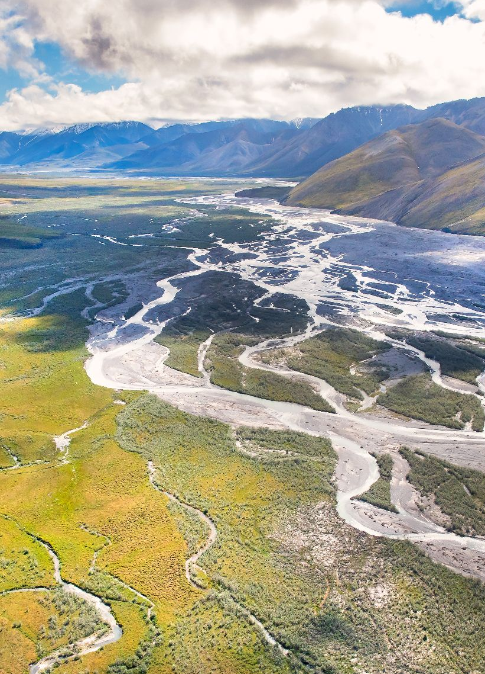
Arctic Terrestrial Systems Interactions Workshop Planning
Summarize available hazards data (landscape change from wildfires, permafrost degradation, vegetation change, and hydrologic change)
Identify end users needs
Identify gaps between research community/products and end user needs
Photo: Lisa Hupp/USFWS

