Slide 1
Overview and Status of ISRO-NASA Synthetic Aperture Radar
(NISAR)
Presented by Dr. Nancy HF French, Michigan Tech Research Institute NISAR Ambassador
Slides from March 2024 presented at the
NISAR and SDC Community Virtual Town Hall by Dr. Gerald Bawden
ABoVE Science Team Meeting
24 May 2024

Slide 2
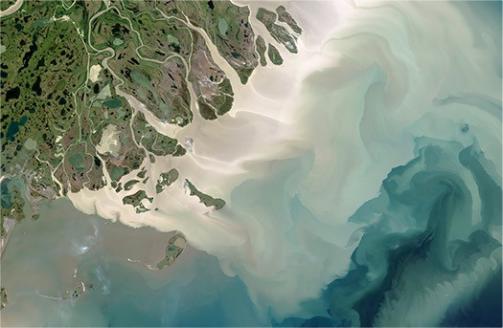
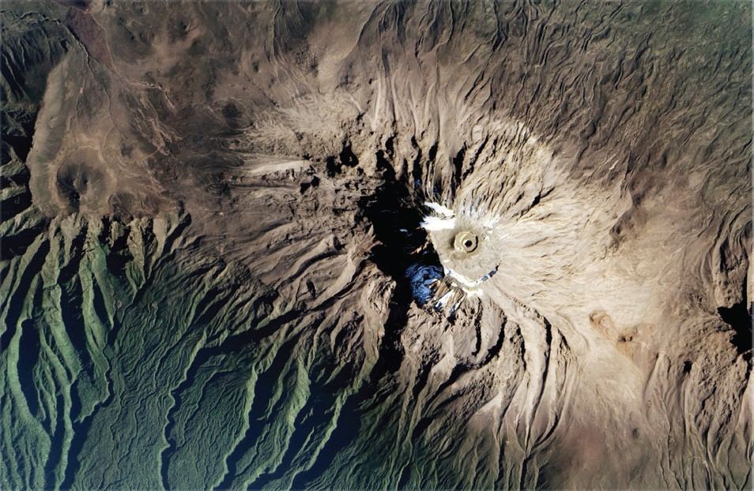
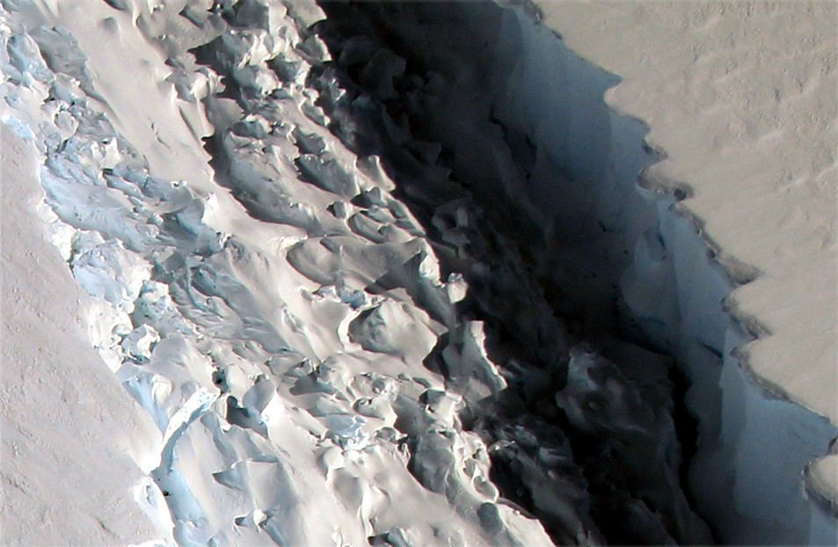
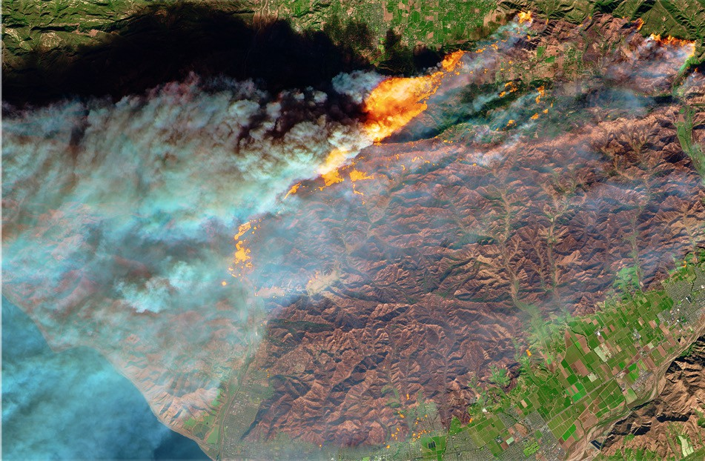



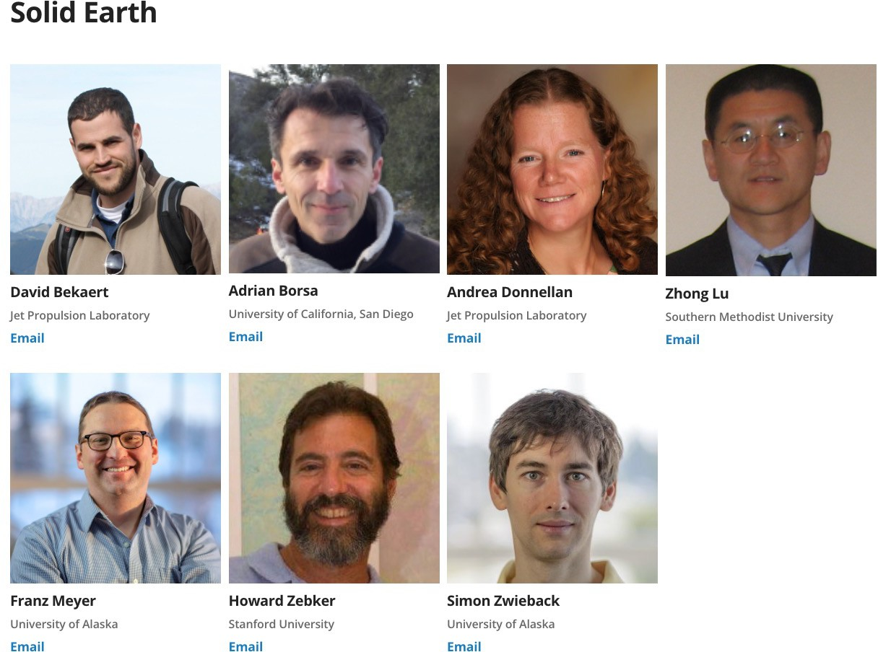
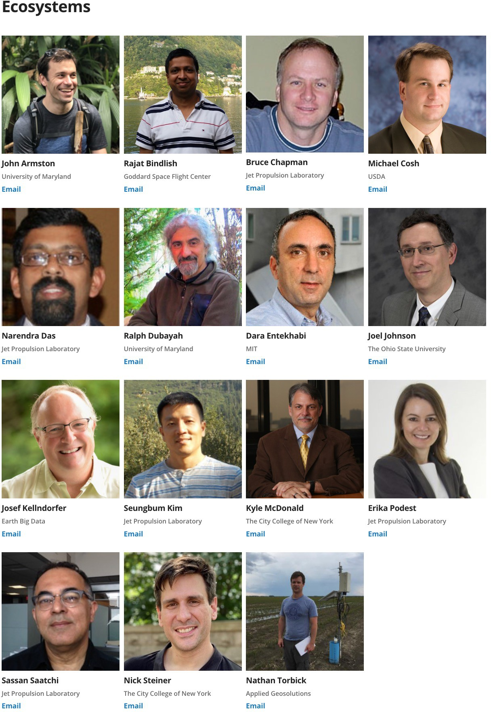
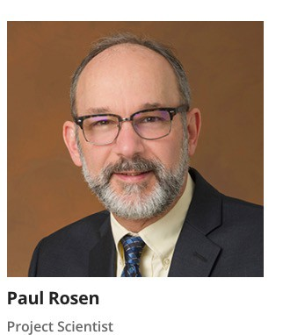

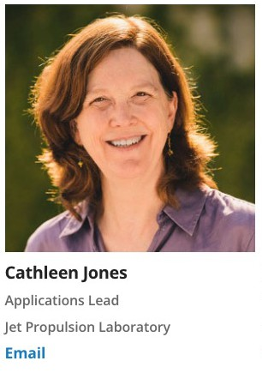
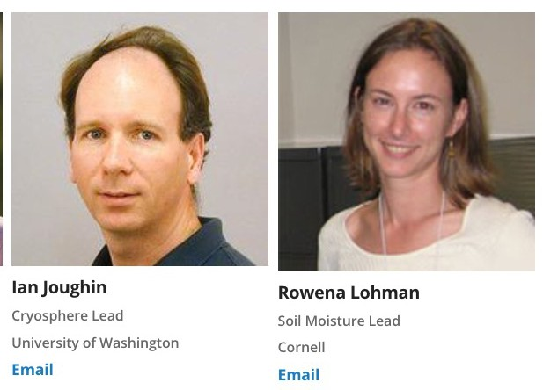
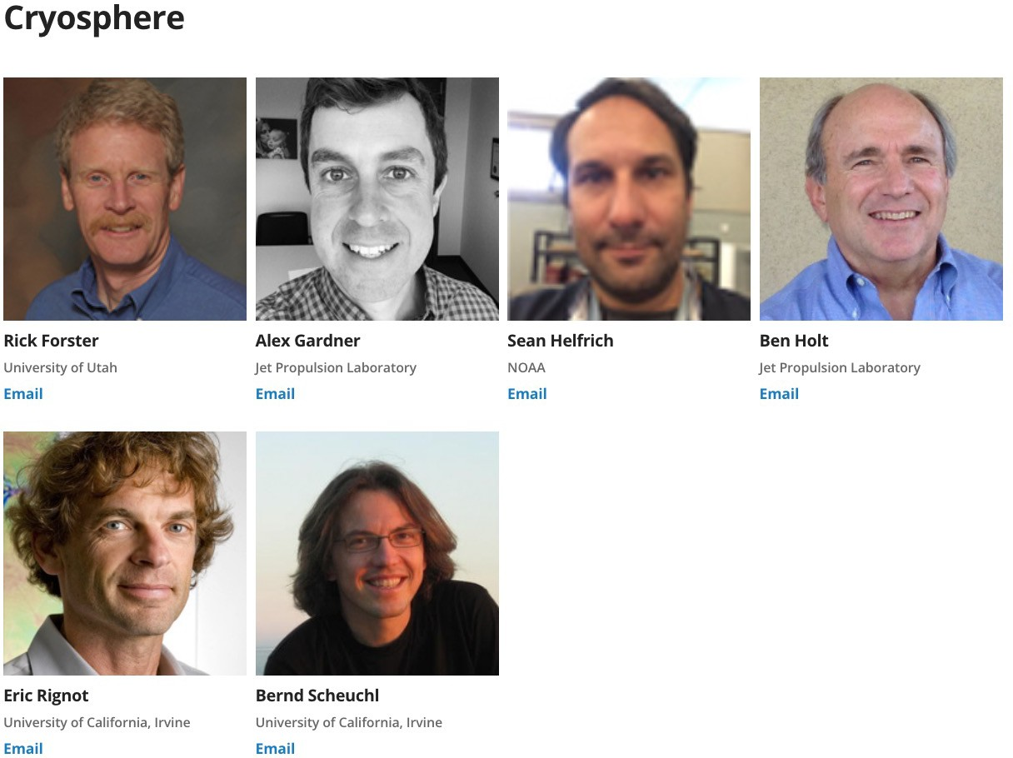
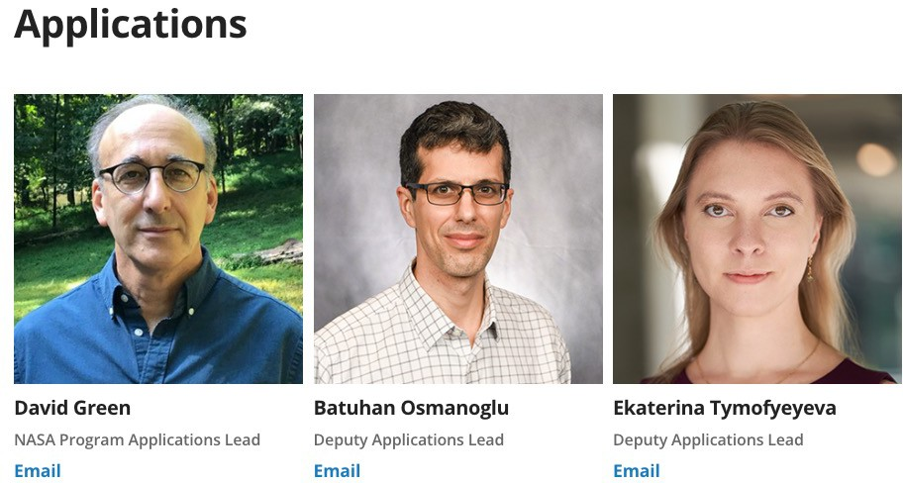


Status of NISAR & SDC
NISAR and SDC Community Virtual Town Hall – Pasadena/Caltech/Virtual – March 27, 2024
Science Team Leadership Solid Earth Ecosystems
Dr. Gerald Bawden
Program Scientist for NISAR
NASA Headquarters
Cryosphere
Gerald.Bawden@NASA.gov
Applications
Shanna McClain
NASA NISAR Science Team

Slide 3
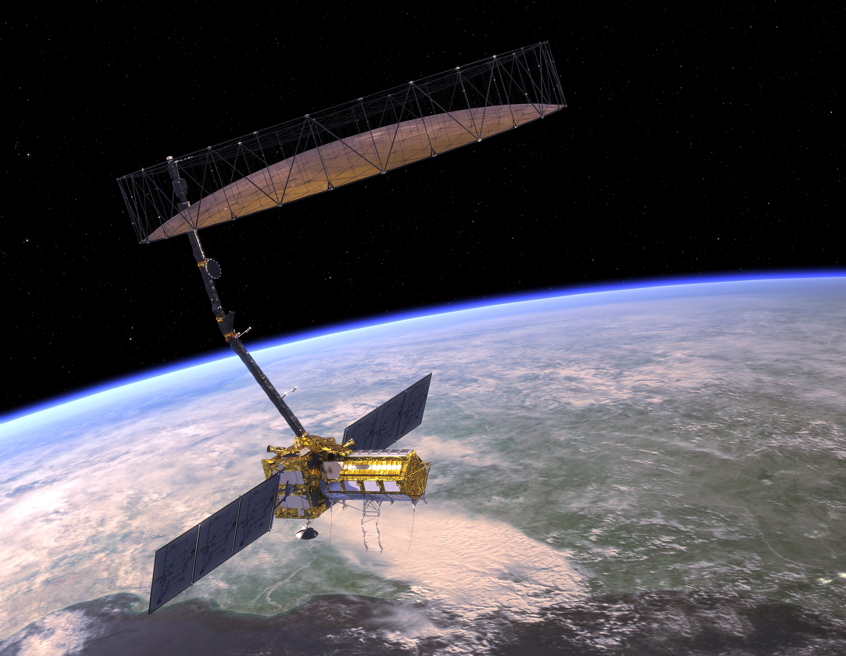
Partnership between NASA and ISRO
Dual frequency SAR L-band – 24 cm
S-band –10 cm
12 day exact repeat for interferometry
~6 day coverage with ascending and descending orbits
Near global land and ice coverage
5

Slide 4
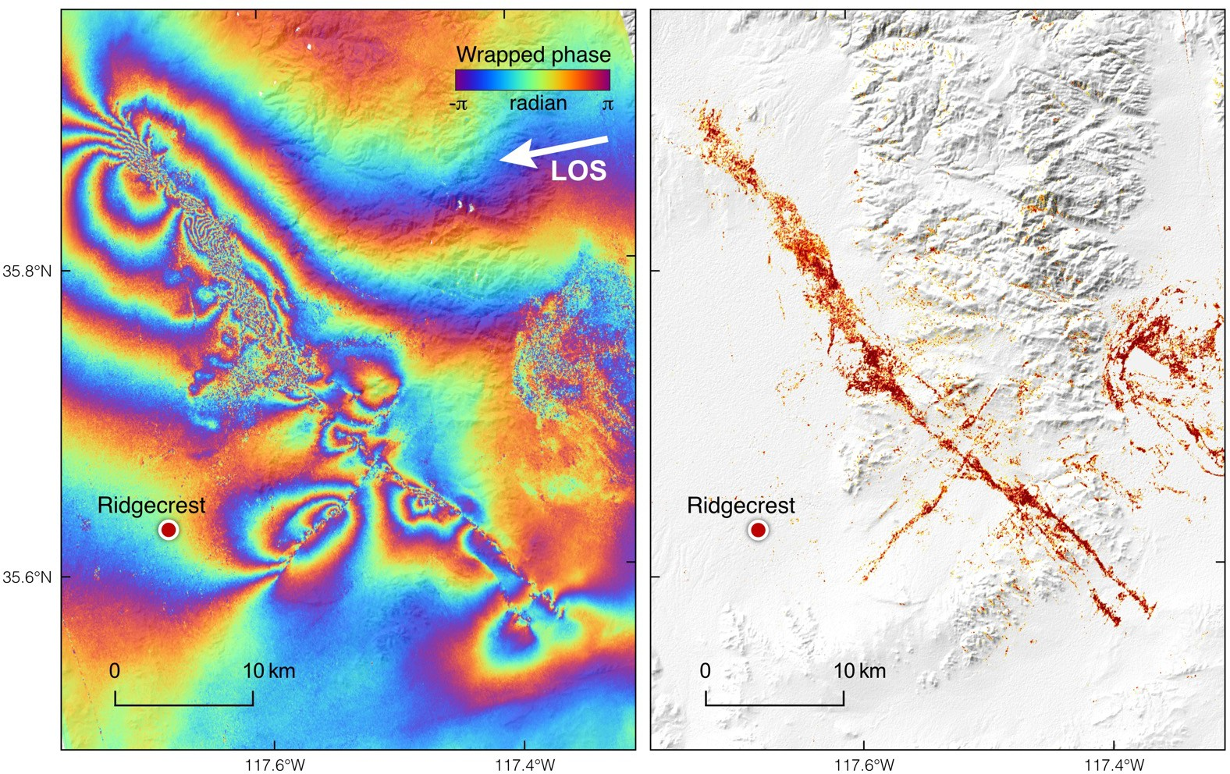
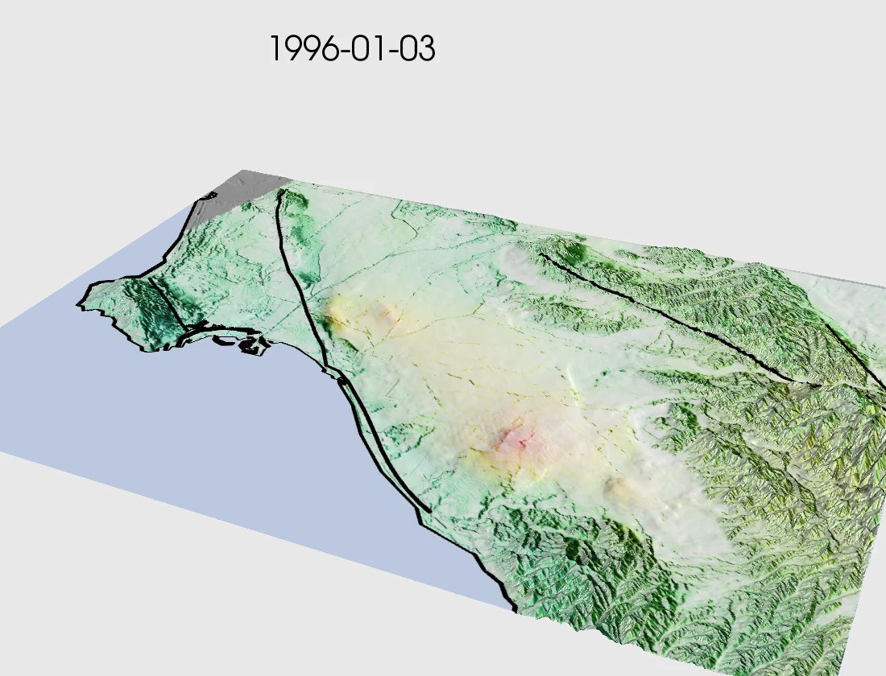
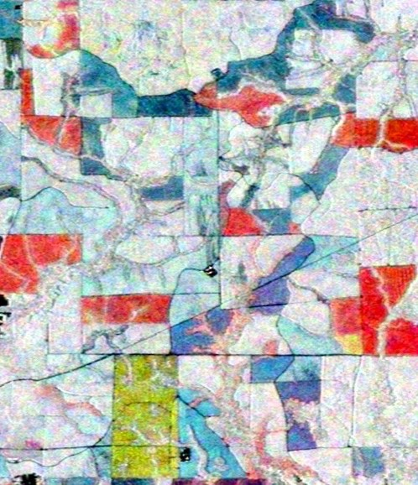
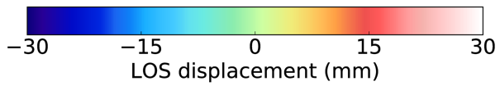
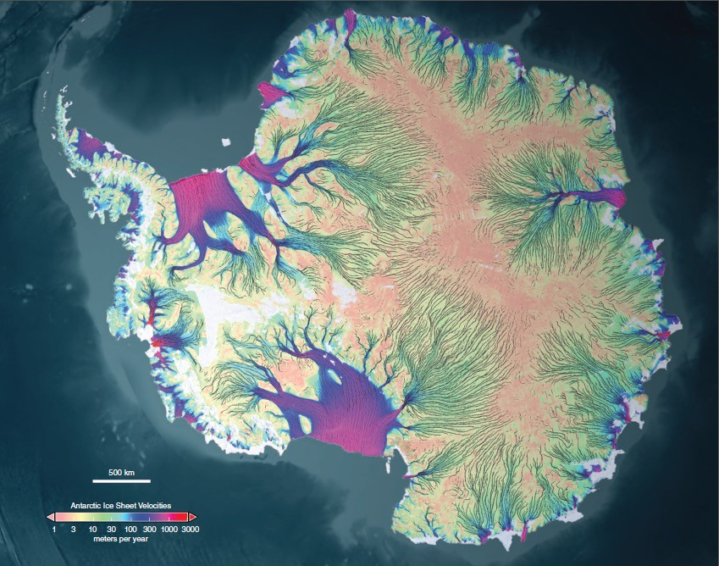
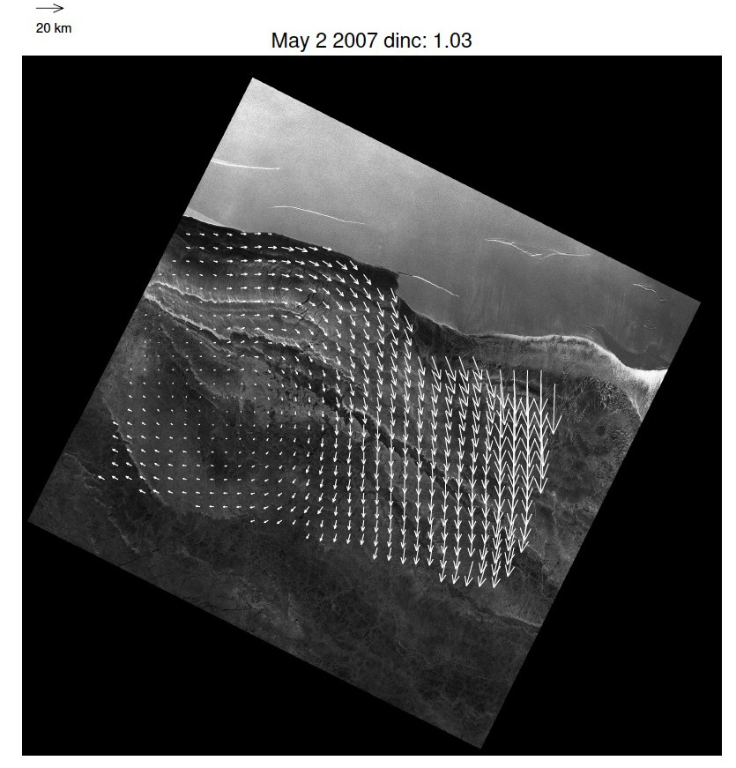
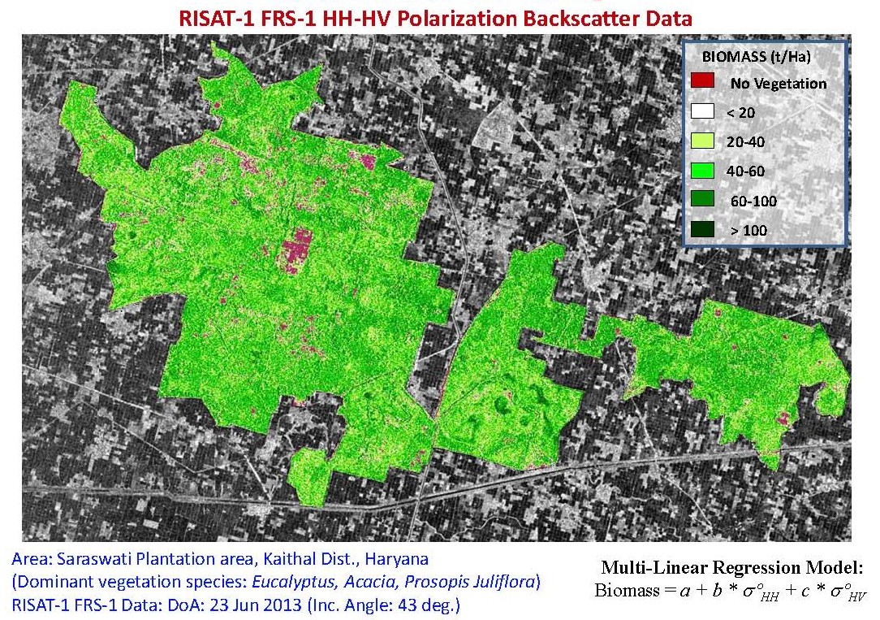
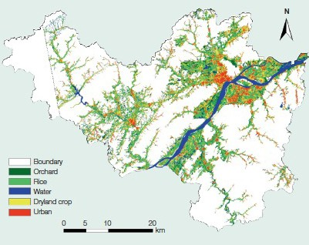
NISAR Will Enable New and Innovative Research Spanning the Earth Sciences: Climate, Carbon, and Catastrophes ++
2019 Ridgecrest Earthquake
Los Angeles Basin Aquifer
Subsurface
Deformation
Ross et al., Science (2019)
Damage
Aquifers
Disturbance
Ice Sheet Velocity Monthly
Biomass
Crops
Sea-ice deformation Sub-weekly
6

Slide 5
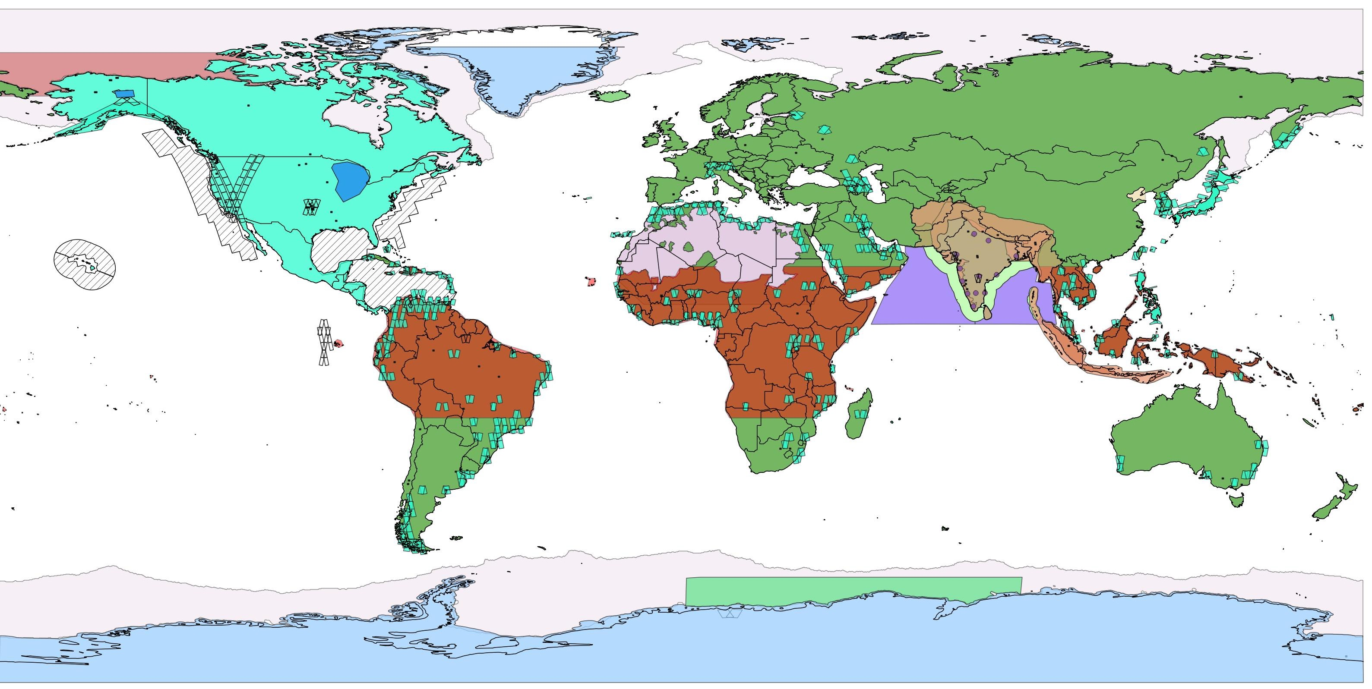
Oct. 2023 Observation Plan
Revised every 6 months
Greenland 25MHz CP &
37.5MHz HH
SSAR
Greenland 80MHz SP LSAR
Beaufort Sea – Sea Ice Mode
Background Land 20MHz DP
Sea Ice 5MHz
North America 40MHz DP &
Sahara 5MHz SP VV
5 MHz ~ 30 x 6 m
20 MHz ~ 7.5 x 6 m
40 MHz ~ 3.75 x 6 m
80 MHz ~ 1.95 x 6 m
20MHz QP
SNWG-2016
enabled high- resolution data over North America
SP – Single Pol
DP – Dual Pol QP – Quad Pol CP – Cross Pol
Coverage of India Region with LSAR & SSAR
US Coastal Waters - 5 MHz Gulf of Mexico
Caribbean
Urban Areas 40MHz DP
North America 40MHz DP &
Background Land 20MHz SP
Descending direction
Alternating each 12 days with Africa and South America
20MHz QP
Sea Ice Quadrant with LSAR & SSAR
Qual-Pol modes are Fixed All other modes are Dithered
Antarctica 40&80MHz SP
Antarctica 25MHz CP &
37.5MHz HH
4-Oct-2023
L-SAR
S-SAR
8

Slide 6
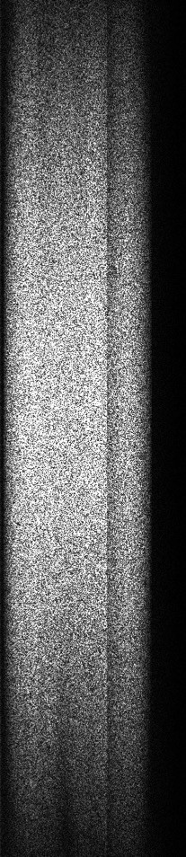
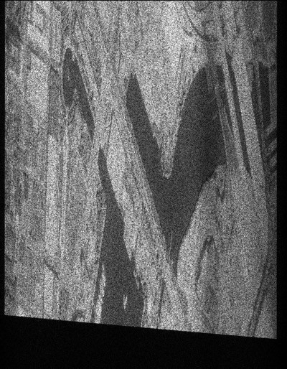
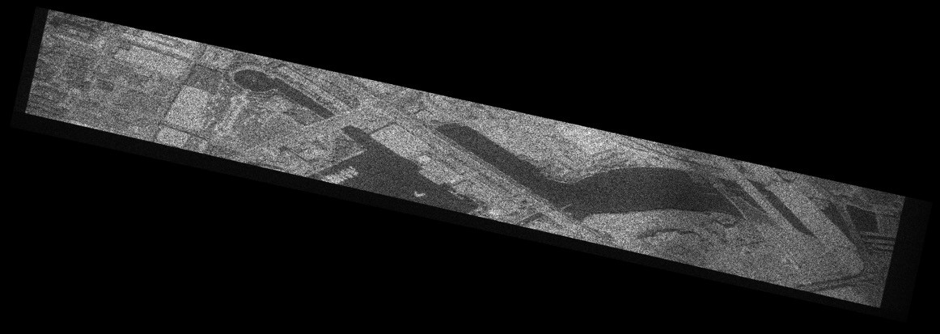
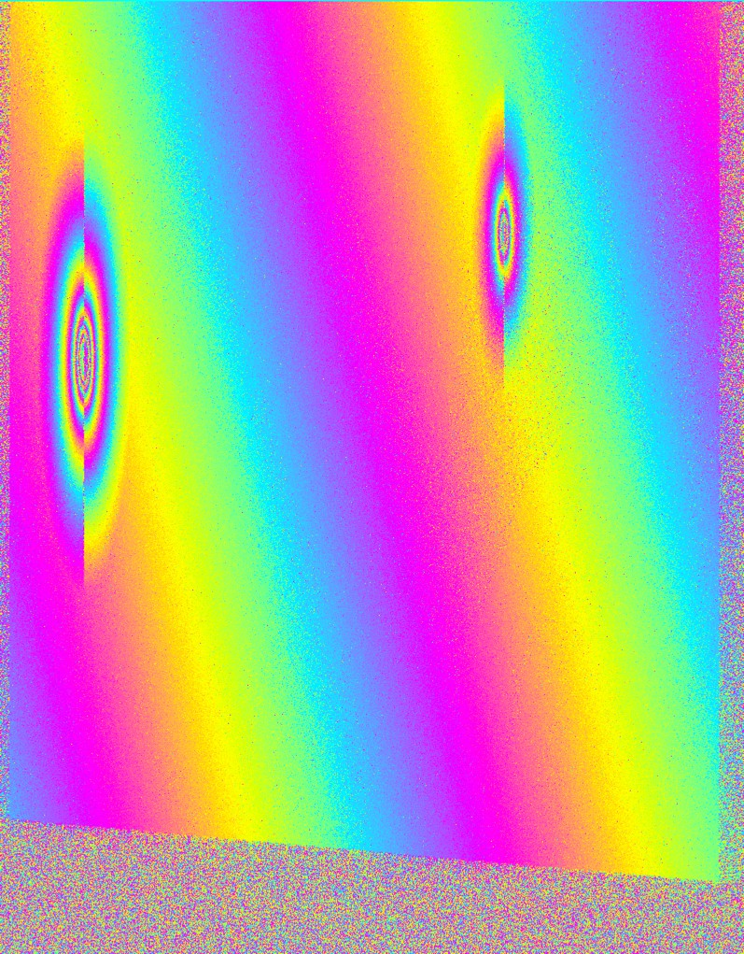
Science Data System Products Latency
L0 - Raw
L1 - RSLC
Products | Requirement | Current Best Estimate | Urgent Response
L0 | 24 Hours | 12 Hours | 2 Hours
L1 | 9 Days | 1 Day | 4 Hours
L2 | 9 Days | 2 Days | 6 Hours
L2 - GSLC
Science Data System is sized to produce this data within 1 day latency
Limiting factor is receiving all the ancillary files, specifically the Medium accuracy Orbit Ephemeris from GNSS

Slide 7
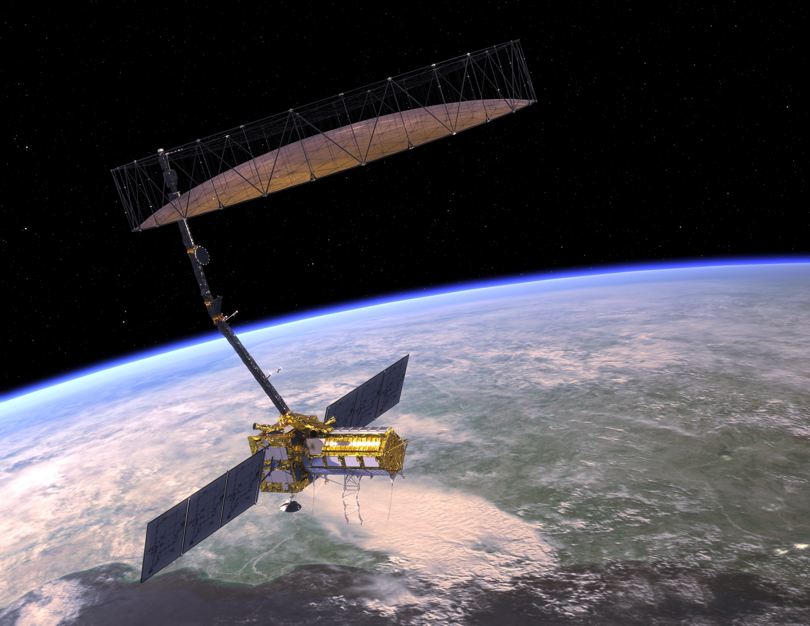
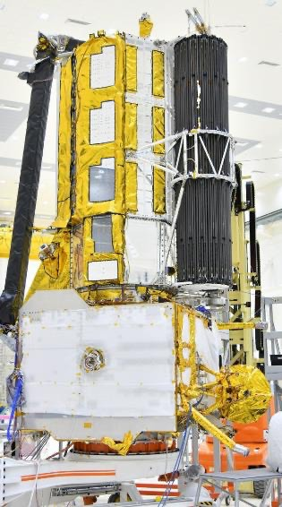
NISAR’s launch readiness date has been delayed
New launch date is in August 2024
Testing and analysis identified a potential for the reflector to experience higher-than- previously-anticipated temperatures in its stowed configuration in flight.
A special coating being added will limit the temperature by reflecting more solar radiation off the reflector hardware. Due to the reflector’s size and complexity, it is being shipped from the ISRO site in India where the satellite is being assembled to a specialized facility in California for the application of the coating.
Once the thermal performance of the coating has been fully verified, a launch readiness date will be set.
When the reflector returns to India, teams from NASA’s Jet Propulsion Laboratory and ISRO
will reintegrate it onto the satellite.
https://blogs.nasa.gov/nisar
3

Slide 8



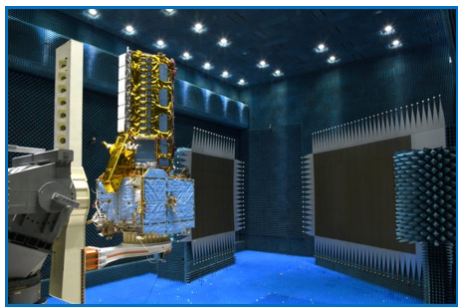
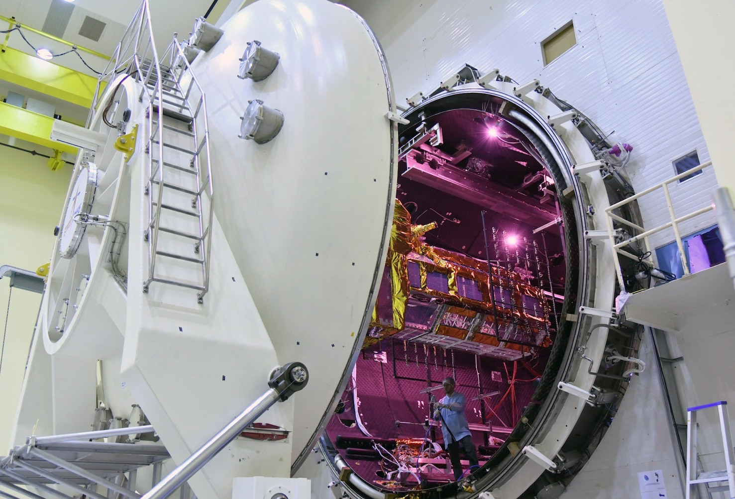
NISAR is 99.99% Completed and Tested
NISAR was completely integrated in India before the radar reflector’s thermal risk was identified
Reflector landed in Los Angeles late March
Reflector will return to India, reintegrated, and tested before launch.
First light images 2-3 months after launch
Science operations 3 months after launch
Global products to Level 2 will be fully and openly available to the global community
NISAR data/products @ Alaska Satellite Facility
Go to NISAR and ASF webpages for more information on how to get ready for NISAR
  https://nisar.jpl.nasa.gov/
  https://asf.alaska.edu/
https://nisar.jpl.nasa.gov/
https://www.isro.gov.in/NISARNASA.html
4

Slide 9
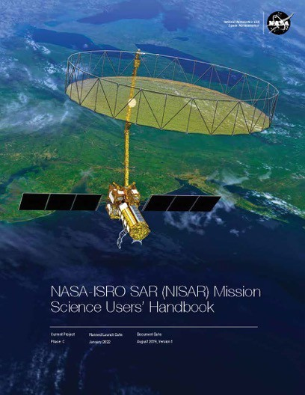
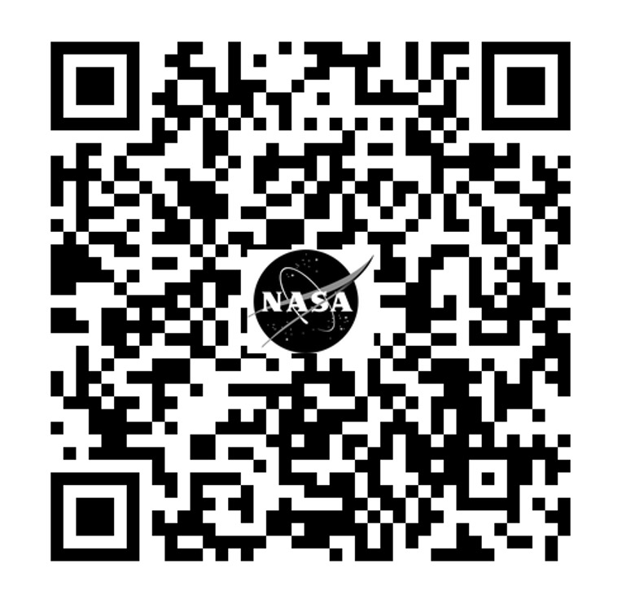
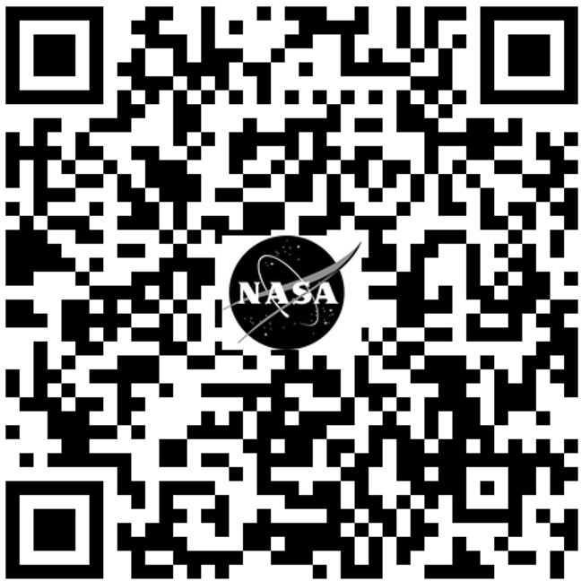

Thank You
NISAR
Community of Practice & Early Adopters
http://nisar.jpl.nasa.gov
Dr. Gerald Bawden
Program Scientist/Manager NISAR/SDC/UAVSAR/OASIS/ OPERA/ASF
NASA Headquarters
Gerald.Bawden@NASA.gov

