Slide 1
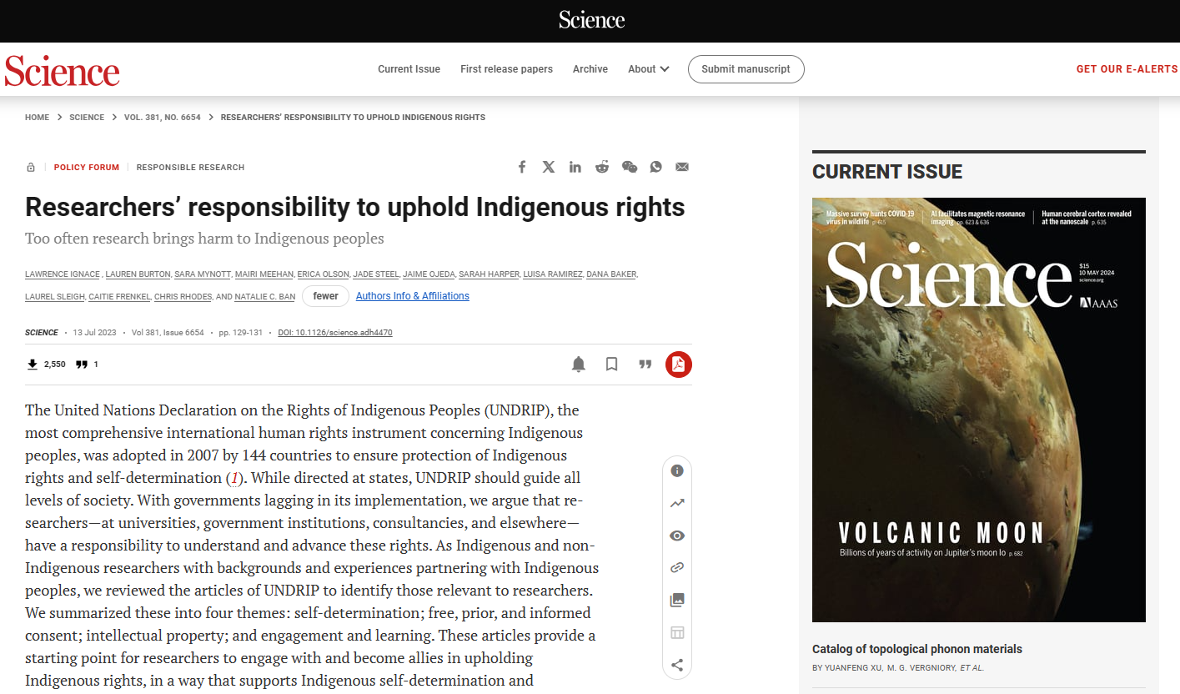

Slide 2
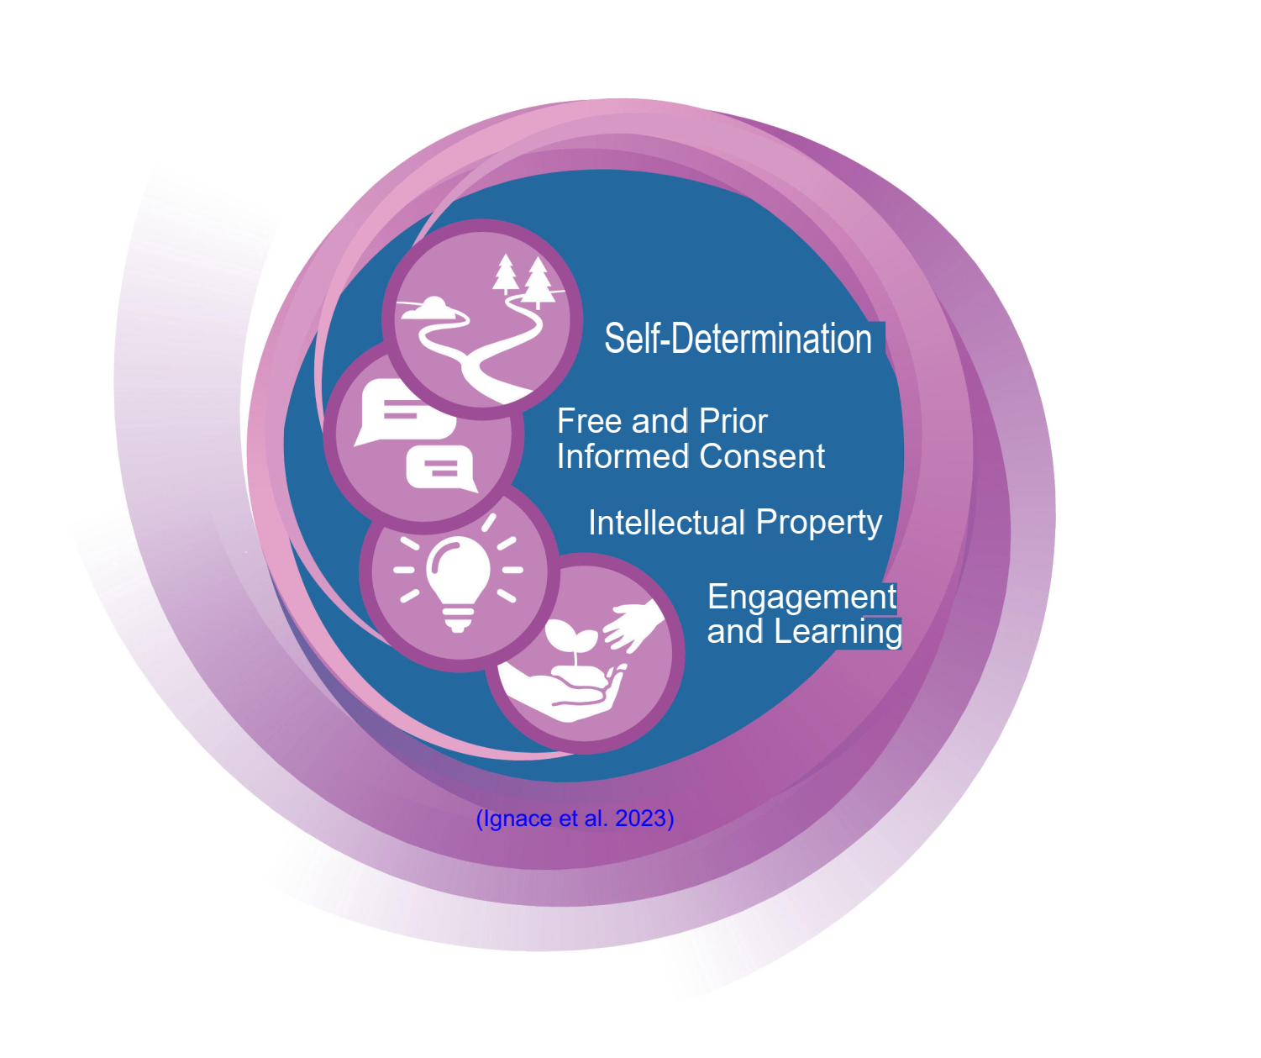

Slide 5
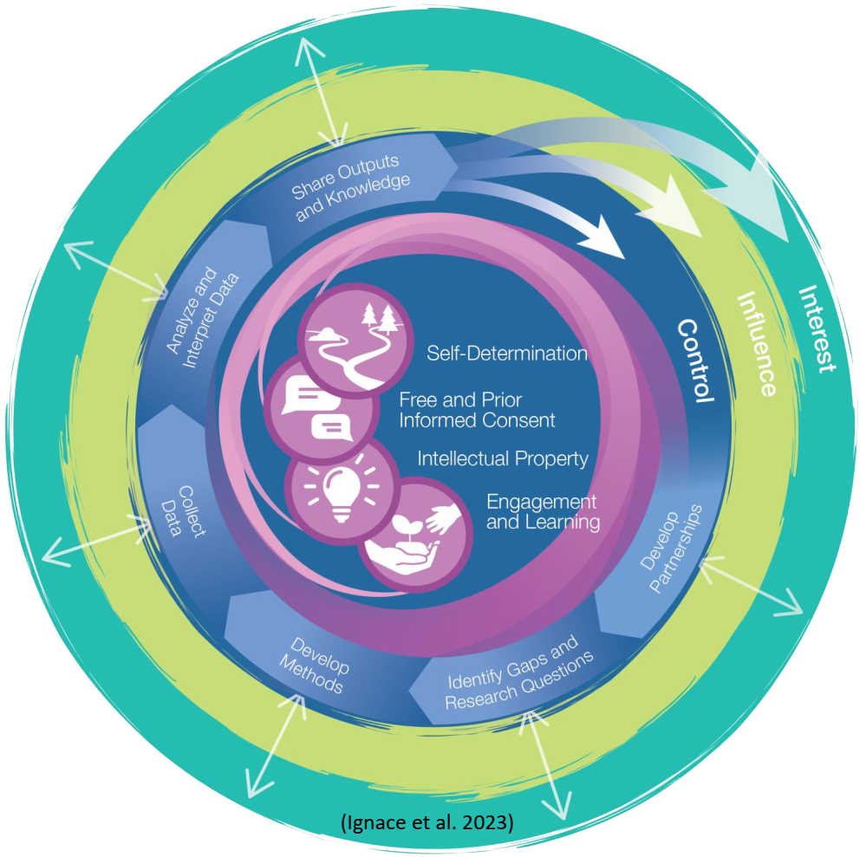

Slide 6
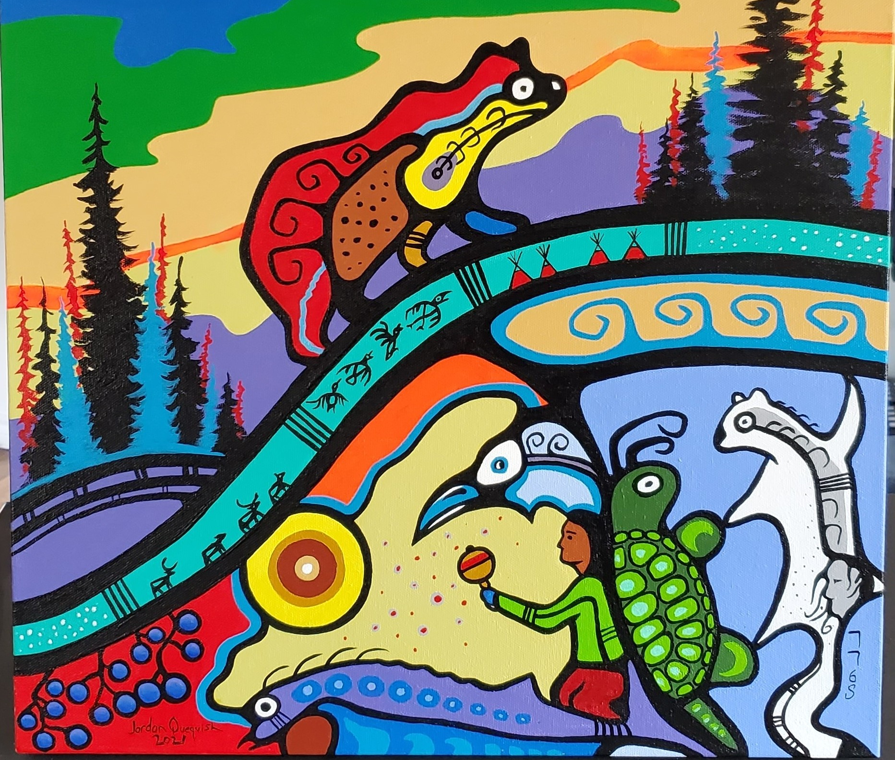
Jordan Quequish
Concluding words
No one person or culture holds all the answers.
In our shared work we need to resist the urge to colonize the process of reconciliation and knowledge co-production. Placing emphasis on how to be equal partners.
There are opportunities for braiding knowledge systems to broaden our current understanding in preparation our shared future challenges.
Kwä̀naschis
Shä́w níthän
Miigwetch
Thank you
Tl’ahų
Questions?

