Slide 1
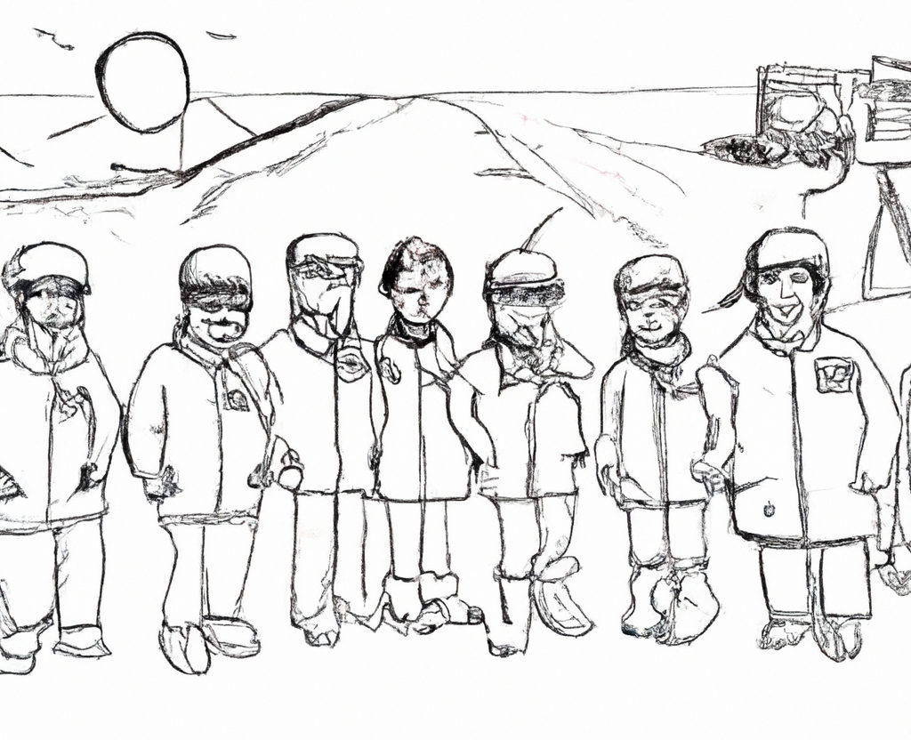
Spectral Imaging Working Group breakout report
Co-leads Fred H. and Peter N.
Notes by Peter N. and Petya C.
16 Attendees (1 online)
DALLE-2: cartoon of the NASA Arctic Boreal Vulnerability Experiment Spectral Imaging Working Group

Slide 2
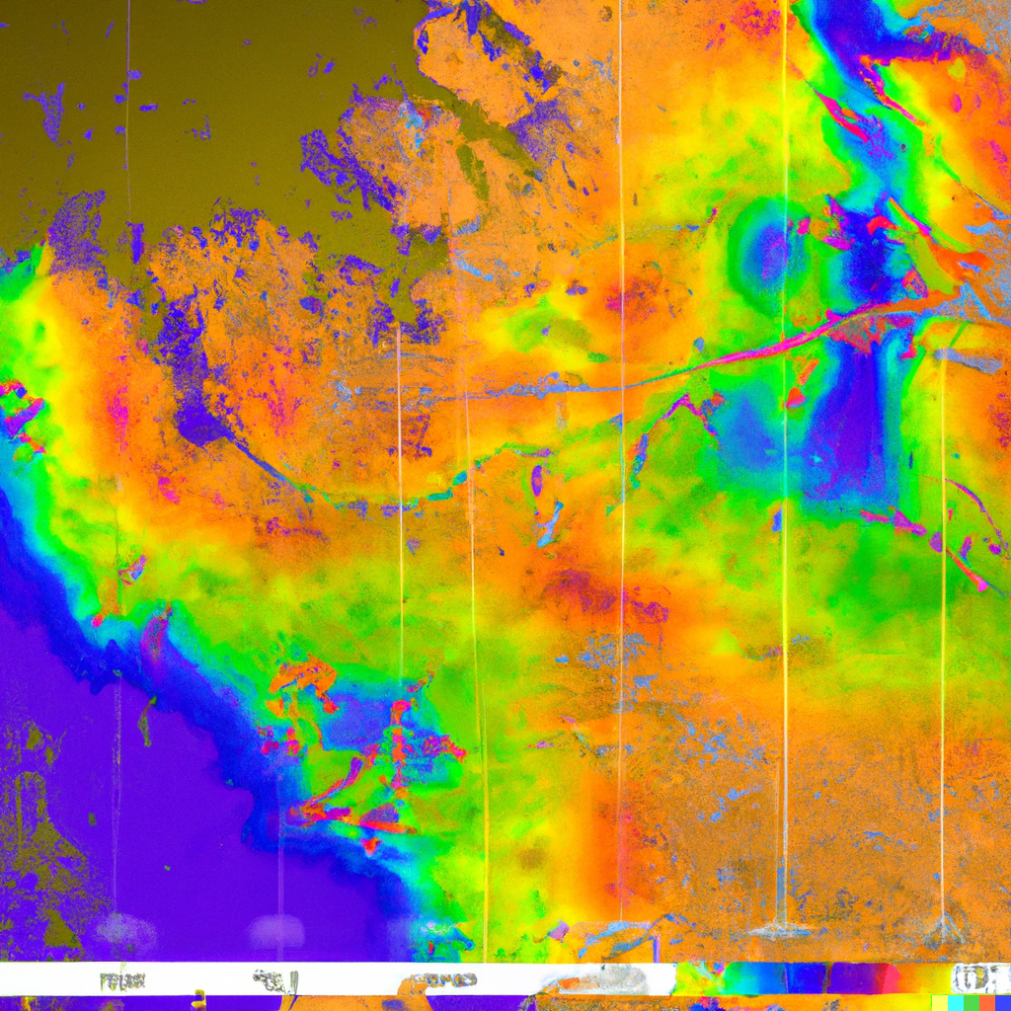
Discuss Phase 3 projects in the context of the working group
Laura B.-C.: Gap in knowing the different mosses. Going to use AVIRIS to map these to constrain the models. Sphagnum vs feather mosses.
Mark L: Hist project looks at interaction between spectra and dominant vegetation types. Use simulated hyperspectral data to improve mapping across larger spatial domains? How to characterize uncertainty using AVIRIS when ground data weren’t collected at the same time.
Phil T: His project trying to connect to flux tower data to AVIRIS
Peter N: Refining PFT fractional cover under AVIRIS for refining wall-to-wall Landsat PFT mapping
DALLE-2: hyperspectral arctic boreal vulnerability

Slide 3
Review on going synthesis and timeline
Based on our WG meetings,
Notional synthesis papers in possible special issue could include:
Cross-component scaling interactions
Spatial scaling (Info loss as pixel size changes?)
Temporal Scaling (How frequently to measure?)
Spectral scaling (Cross instrument corrections?)
Taxonomic scaling (Which PFTs should we use?)
Applications where scale features prominently
Notional Timeline:
8-12 mo on paper after start
One monthly SIWG meeting per chapter
Sub-groups for each chapter will meet biweekly afterwards until paper submission

Slide 4
Consider new syntheses

Slide 5
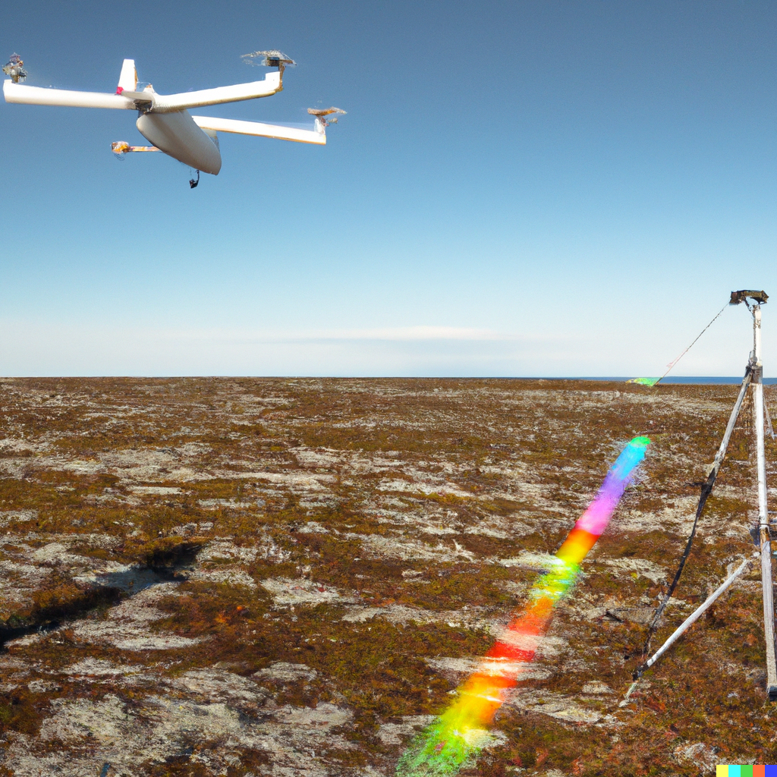
Additional discussion on:
AVIRIS image format, location and update frequency (Chris N./Bruce W.)
Need for more transferrable algorithms across scenes (Maria B.)
Please join our monthly meetings!
Questions?
DALLE-2: realistic photograph of someone measuring spectra on the tundra while a drone and airplane and satellite pass overhead

