Slide 1
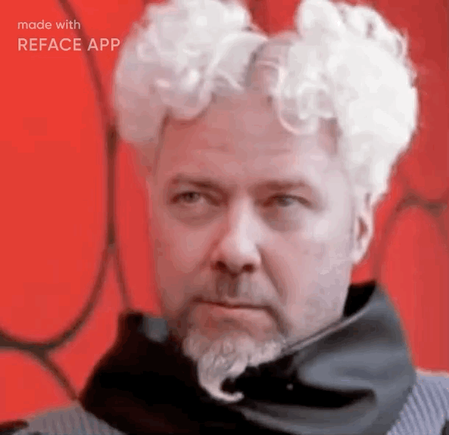
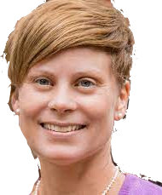
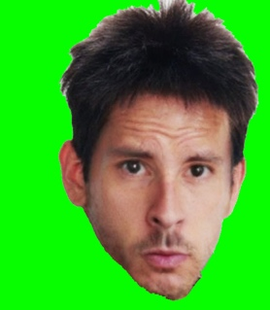
ABoVE Modeling Working Group
Joshua B. Fisher (CHAPMAN U. | WG Lead)
Deborah Huntzinger (NAU | WG Co-Lead)
Amanda armstrong (U.Virginia)
KAZEM BAKIAN DOGAHEH (USC)
LEAH BIRCH (WcRC)
RENATO BRAGHIERE (nasa/JPL)
BRENDAN BYRNE (nasa/JPL)
ABHISHEK CHATTERJEE (NASA/GSFC)
MIN CHEN (U.WISCONSIN)
ROISIN COMMANE (COLUMBIA U.)
ADRIANNA FOSTER (NAU)
ANDY FOX (U.ARIZONA)
ANNA GAGNE-LANDMANN (U. laval)
JOHN GAMON (U.Alberta)
HéLÈNE GENET (I.ARCTIC BIOLOGY)
Scott Goetz (NAU)
Daniel Hayes (U.Maine)
JOHN HENDERSON (AER)
Lei Hu (noaa)
Xueli huo (U.ARIZONA)
Elchin Jafarov (LANL)
Aleya Kaushik (noaa)
RALPH KEELING (SCRIPPS)
John Kimball (U.Montana)
ERIK LARSON (HARVARD U.)
PHIL MARSH (WILFRID LAUERIER U.)
ANNA MICHALAK (CARNEGIE INST.)
Chip Miller (NASA/JPL)
Dave moore (u.arizona)
BILL MUNGER (HARVARD U.)
Walt Oechel (SDSU)
NICK PARAZOO (NASA/JPL)
Mark Piper (U.Colorado)
Chris Potter (NASA/Ames)
BEN POULTER (NASA/GSFC)
David Price (NoFC)
Brendan Rogers (woodwell)
Kevin Schaefer (NSIDC)
LUKE SCHIFERL (HARVARD U.)
Christopher Schwalm (woodwell)
Shawn serbin (bnl)
Hank Shugart (U.Virginia)
Jackie Shuman (ncar)
WU SUN (CARNEGIE INST.)
PETER THORNTON (ORNL)
PHIL TOWNSEND (U.WISCONSIN)
Anna virkkala (woodwell)
JENNIFER WATTS (woodwell)
Stan Wullschleger (DOE/ORNL)
Yu Zhang (CCMEO)
ZHEN ZHANG (U.MARYLAND)
Above- modeling group working.
(not the ABoVE Modeling Working Group)

Slide 2
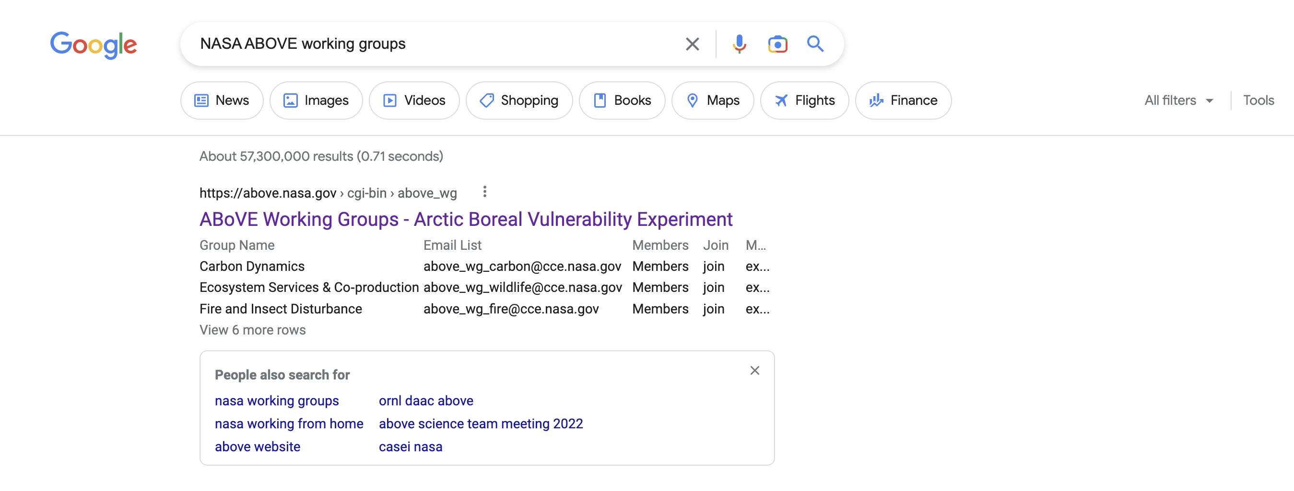

Slide 3

Objectives
Big picture
Establish team
Define team goals;
outline plan forward
Credit: Sergey Nivens - Fotolia

Slide 4

Why a Working Group?
Collective objectives are more readily achievable as a strong team than by individuals.
Getty Images/iStockphoto

Slide 5
Anna Gagne-Landmann: CliMA; plant hydraulics → carbon dynamics TBD
Wu Sun w/ Anna Michalak: TRENDY, GFDL LM3; GPP/Re-T sensitivity; topdown constraints
Jan Eitel: ED2+snow
Kazem Bakian w/ Mahta Moghaddam: SOC w/ Radar; RS models
Kevin Schaefer: Hg permafrost, river routing, lakes, fire; SiB-CASA; permafrost benchmarking
Debbie Huntzinger w/ Scott Miller, Jeralyn Poe: topdown/bottomup matching for CO2/CH4; TRENDY; GCP CH4; WARPMIP: permafrost
  w/ Woodwell (w/ Brendan Rogers et al): state of permafrost; ABoVE benchmarks
Renato Braghiere: CLiMA; plant physiology, radiative transfer, soil C; uniqueness: uses EO to drive parameterization; also, CLM, ELM, nutrient cycling; ILaMB benchmarking
Brendan Rogers, Jenny Watts: DVM-DOS-TEM; CH4, fire, thermokarst, aquatic; data assimilation; radiative forcing
Colleen Iverson: ELM; hillslopes, inundation, snow, plant traits, veg dynamics (FATES), biogeochemistry; PFLOTRAN, ATS (Advanced Terrestrial Simulator)—3d belowground, subsidence, topo
Aleya Kaushik: COS; polar VPRM (top-down); SiB-4 (C13 isotopes), Re, biomass; C turnover times; gs, drought, fire
Yanlan Liu: veg resilience, demography (e.g., shrub expansion, veg distr shifts); ELM-FATES; freeze/thaw; plant stress
Howie Epstein: DGVM comparison
Anthony Bloom: CARDAMOM

Slide 6
Anna Gagne-Landmann: CliMA; plant hydraulics → carbon dynamics TBD
Wu Sun w/ Anna Michalak: TRENDY, GFDL LM3; GPP/Re-T sensitivity; topdown constraints
Jan Eitel: ED2+snow
Kazem Bakian w/ Mahta Moghaddam: SOC w/ Radar; RS models
Kevin Schaefer: Hg permafrost, river routing, lakes, fire; SiB-CASA; permafrost benchmarking
Debbie Huntzinger w/ Scott Miller, Jeralyn Poe: topdown/bottomup matching for CO2/CH4; TRENDY; GCP CH4; WARPMIP: permafrost
  w/ Woodwell (w/ Brendan Rogers et al): state of permafrost; ABoVE benchmarks
Renato Braghiere: CLiMA; plant physiology, radiative transfer, soil C; uniqueness: uses EO to drive parameterization; also, CLM, ELM, nutrient cycling; ILaMB benchmarking
Brendan Rogers, Jenny Watts: DVM-DOS-TEM; CH4, fire, thermokarst, aquatic; data assimilation; radiative forcing
Colleen Iverson: ELM; hillslopes, inundation, snow, plant traits, veg dynamics (FATES), biogeochemistry; PFLOTRAN, ATS (Advanced Terrestrial Simulator)—3d belowground, subsidence, topo
Aleya Kaushik: COS; polar VPRM (top-down); SiB-4 (C13 isotopes), Re, biomass; C turnover times; gs, drought, fire
Yanlan Liu: veg resilience, demography (e.g., shrub expansion, veg distr shifts); ELM-FATES; freeze/thaw; plant stress
Howie Epstein: DGVM comparison
Anthony Bloom: CARDAMOM

Slide 7

Overarching Goal
Reduce model uncertainties in simulations/projections in the ABR across all ABoVE ecosystem indicators
kappanonline.org

Slide 8

Establish monthly seminar/workshop series. [Josh Fisher, Debbie Huntzinger]
Training on ILaMB. Discussion of additional data, tests, uncertainties. [Renato Braghiere, Forrest Hoffman, Nate Collier]
Modelers run models on ILaMB now. [All modelers]
Introduction to MsTMIP protocol. [Debbie Huntzinger]
Identify Top-5 functional relationships that need data constraint in ABR. [All modelers]
Mine ASC for functional relationships. Determine points v. domain. [Josh Fisher, Debbie Huntzinger, Kevin Schaefer]
Integration of ABoVE functional relationships into ILaMB. [Josh Fisher, Debbie Huntzinger, Kevin Schaefer, Forrest Hoffman]
WG consensus on ILaMB tests, weights. [All modelers]
Establish catalog of model developments throughout ABoVE.
Lightning presentations. [Josh Fisher, Debbie Huntzinger, All modelers]
Model developments. [All modelers]
Re-run updated models on ILaMB. [All modelers]
Synthesize results. [Josh Fisher, Debbie Huntzinger]
ampcool - stock.adobe.com

Slide 9

Monthly Seminar/Workshop Series
1 [FEB]. Overview + ILaMB training.
2 [MAR]. ILaMB results report-back #1.
3 [APR]. MsTMIP introduction + Functional relationships overview.
4 [MAY]. Top-5 functional relationships report-back.
5 [JUN]. Model developments lightning talks.
6 [JUL]. Model synergies exercise.
7 [AUG]. TBD/buffer.
8 [SEP]. ILaMB data integration update. Discussion of tests, weights.
9 [OCT]. TBD/buffer.
10 [NOV]. ILaMB results report-back #2.
11 [DEC]. TBD/buffer.
12 [JAN]. Synthesis.
AISES

Slide 10
6 COURSE SYNTHESIS TOPICS
6 COURSE SYNTHESIS TOPICS
BOTTOM-UP AND TOP-DOWN MODELS
What is the carbon budget over the ABoVE domain? Can we
reconcile top-down and bottom-up estimates of C-budgets?
$ RESOLUTIONS & DOMAINS $
Abhishek Chatterjee, Brendan Byrne, Lei Hu,
Anna Virkkala, Brendan Rogers, Jennifer Watts, Josh Fisher
STATE OF ABR ECOSYSTEM PROCESSES
Some models have more “advanced” ABR process
representation than others. Differences?
$ REVIEW & ROADMAP $
Elise Heffernan, Howie Epstein, Amanda Armstrong,
Josh Fisher, Anna Virkkala, Brendan Rogers, Jennifer Watts
SUB-GRID VARIABILITY
Fine spatial resolution landscape features drive ecosystem functioning in the ABR. Approaches and impacts?
$ REMOTE SENSING → MODELING $
Jennifer Watts, Ben Poulter, Mary Farina
INDIVIDUAL-BASED AND PFT MODELS
ABR ecosystem modeling is broadly grouped into two camps: individual-based models and PFT/trait-based models.
$ ED, UVAFME, CLM ⇿ CLM-FATES $
Adrianna Foster, Jackie Shuman, Erik Larson, Shawn Serbin
DRIVERS AND RUN PROTOCOLS
Specification paper needed on agreed-upon model drivers and run protocols for ABR model runs.
$ DAYMET, MESONET, CRU-NCEP, GSWP $
Dave Moore, Min Chen, Erik Larson, Kevin Schaefer, Nick Parazoo
ABOVE DATA FOR MODELS
Deep dive into entire ABoVE database. Extraction of functional relationships and benchmarks.
$ UNCERTAINTY, INTEGRATION $
Josh Fisher, Dan Hayes, Andy Fox, Shawn Serbin
canva
page 1 of 2
canva
page 2 of 2

Slide 11
Charge to Thematic Breakout groups
Review & update list of ongoing Synthesis Activities
  Include identification of leads & titles
  Compile a list of syntheses completed (e.g. “boreal regeneration synthesis,” Baltzer et al. 2021 PNAS)
Discuss how & reasonably when to bring the ongoing activities to fruition
  e.g. with publications as a working framework
Consider new Synthesis Activities (as makes sense).
Discuss how Phase 3 projects might best augment current WG efforts / cross-project activities
  If key projects / people were not re-selected, how to leverage & maintain engagement?
Discuss WG Lead(s) – encourage early career scientists to co-lead (volunteers?)
  Most changes are already resolved, so as needed..

Slide 12
Example of current synthesis activities (C-dynamics focused)
# | Synthesis Topic Name | Leads | Email Contact | Start Date | End Date | Status/ Progress Bar
1 | Carbon Budget for the ABoVE domain | Abhishek Chatterjee, Jon Wang, Dan Hayes | abhishek.chatterjee@ jpl.nasa.gov | 2020 | 2022 | Abhishek’s paper draft
2 | Impact of climate & wildfire on Alaska’s GPP | Nick Parazoo | nicholas.c.parazoo@ jpl.nasa.gov | 2020 | 2021 | Madani et al. (2021), JGR-Biogeosciences
 |  | Nima Madani
3 | Methane fluxes, model-data mismatch and knowledge gaps | Jennifer Watts | jwatts@woodwell.org | 2020 | TBD | Luke’s paper draft
 |  | Roisin Commane | r.commane@columbia.edu
4 | CO₂ amplitude synthesis - trends, drivers and projections | Brendan Rogers | brogers@woodwell.org | Mid-2020 | TBD | broken up into 4 WGs: atmospheric, terrestrial remote sensing, in situ measurements, process-based models; conducting literature review.s
 |  | Manuel Helbig, Gretchen Keppel-Aleks, Zhihua Liu, Lei Hu | …

Slide 13
(Tues 1/24) 5 breakout groups (chairs): Rooms
Carbon Dynamics / Budgets (Chatterjee / J. Wang): Room: Pacific A (plenary)
Fire & Insect Disturbance (French / T. Chen): Room: Pacific B
Wildlife & Ecosystem Services (Boelman): Room: Pacific C
Spectral Imaging (Huemmrich / P. Nelson): Room: East Coast
*Modeling (Fisher / Huntzinger): Room: West Coast
Self-select to breakouts
  If you have multiple project participants, go to different WGs
Assign / volunteer a rapporteur and someone to liaise with Zoom online participants (follow chat, raised hands, etc).

Slide 14
Weds (1/25) 4 (or 5?) breakout groups (chairs): Rooms
Collaborations & Engagement (Larson / Miner): Room: Pacific B
Vegetation Dynamics & Structure (Epstein / Macander / Montesano): Room: Pacific A (plenary)
Permafrost and Hydrology (Kimball): Room: Pacific C
Wetlands (Butman / Bourgeau-Chavez): Room: East Coast
Ad hoc: Room: West Coast
Self-select to breakouts
  If you have multiple project participants, go to different WGs
Assign / volunteer a rapporteur and someone to liaise with Zoom online participants (follow chat, raised hands, etc).

