Slide 1
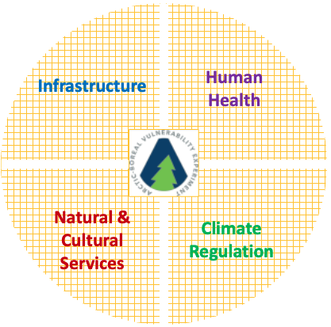
Ecosystem Services WG

Slide 2
In the room…
Amanda Koltz
Ken Tape
John Kimball
Sebastian Voico
David Lutz
Libby Larson
David Lutz
Scott Goetz
Hank Margolis
Peter Griffith
Natalie Boelman
Ryan Danby (virtual)

Slide 3
Several individual projects (Phases 1-3) have explicit objectives focused on Ecosystem Services
Yay!
But what else does the ABoVE Science Team have hiding in their pockets that could be used to inform the current & future state of various Ecosystem Services?

Slide 4
The trick is that we need to find the right balance between: 1. What societies need most: - information identified by individual projects - other information that we identify by talking to local communities i.e. Kimberly Miner’s list from communities in the Whitehorse area & 2. What products/information the ABoVE Science Team is (highly) qualified and able to provide - science-based products

Slide 5
The trick is that we need to find the right balance between: 1. What societies need most: - information identified by individual projects - other information that we identify by talking to local communities i.e. Kimberly Miner’s list from communities in the Whitehorse area, and more to come & 2. What products/information the ABoVE Science Team is (highly) qualified and able to provide - science-based products

Slide 6
Goal: To compile a user friendly collection of ecosystem service support products (with metadata) generated by ABoVE projects that can be used by communities in whatever way(s) they need. Could give the collection to central agencies that are already contact points for indigenous communities i.e. the Alaska Clearing House; Govt. of NWT Yukon Government (or Polar Knowledge Canada)
Examples of ecosystem service support products requested:
- maps of dall sheep locations (present & future(?))
- maps of snow cover (current & future)
- other straight forward products
Examples of products that are not ecosystem service support products
- methane hotspot

Slide 7
How to build the compilation?
Search for exisiting, easily digestable, societally applicable products on the ORNL DAAC, ABoVE website, and in the figure sets of ABoVE publications
Work with projects to tweak any products that are one step away from being a valuable ecosystem support product
a living compilation that is updated for the next few years as products role out

Slide 8
Ecosystem Services WG (Societal Applications WG?) is not the same as Collaborations & Engagement WG

Slide 9
Can we crosswalk projects with types of societal applications
they address?
[Transportation & Infrastructure] Assess how future climate warming is likely to affect infrastructure & transportation networks. [Human Health] Determine how changes to disturbance regimes, flora & fauna, permafrost conditions, and/or hydrology influence human health outcomes in the ABR. [Subsistence] Evaluate how changes to ecosystems will influence subsistence opportunities. [Resource Management] Analyze how changes to natural & cultural resources will impact local communities as well as influence land management policies and practices.
[Climate Regulation] Determine the sources of variations in climate feedbacks from Arctic & boreal ecosystems, and assess the potential for future changes to climate regulating services at regional to global scales.
[Ecosystem Services Interactions] Determine the degree to which changing environment & altered human activities result in synergistic or antagonistic changes in ecosystem services.
Permafrost Vulnerability Resilience
Microbes, Plants, Animal Interactions
Vegetation, Hydrology, Disturbance Interactions
Ecosystem Dynamics
Ecosystem Services
Snow Impacts
Vegetation Greening
& Browning
Controls on C Biogeochemistry
Changes to Fish
& Wildlife Habitat

Slide 10
Identify past and Phase-3 projects that address:
1. infrastructure & transportation
Boelman (phase-2 & 3)
2. human health
Loboda (phase-2)
Miner et al (phase-3)
3. subsistence / provisioning
Brinkman (phase-1)
4a. impacts of change on local communities
Brinkman (phase-1)
4b. impacts of change on resource management agencies
Lutz (phase-3)
+ a number of other projects are collaborating with management agencies
5. climate feedbacks / regulation
Which explicitly address this?
6. interacting ecosystem services / feedbacks
Which explicitly address this?

