Slide 1
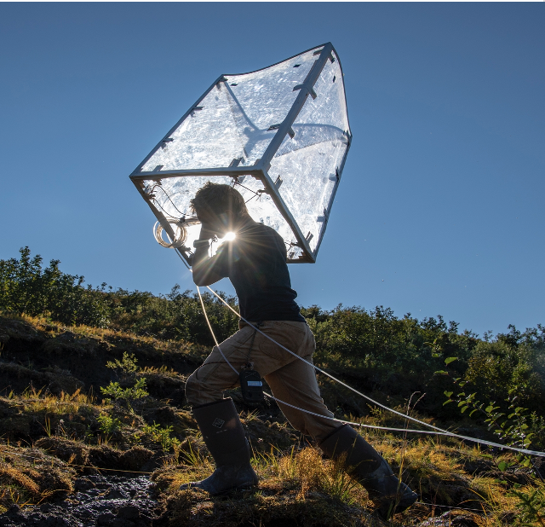
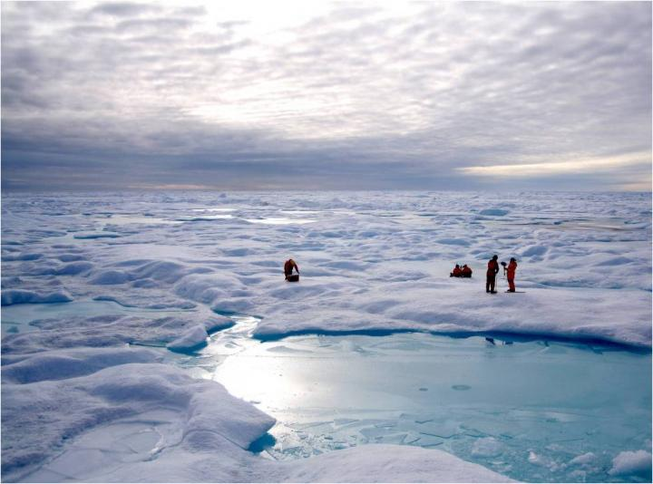
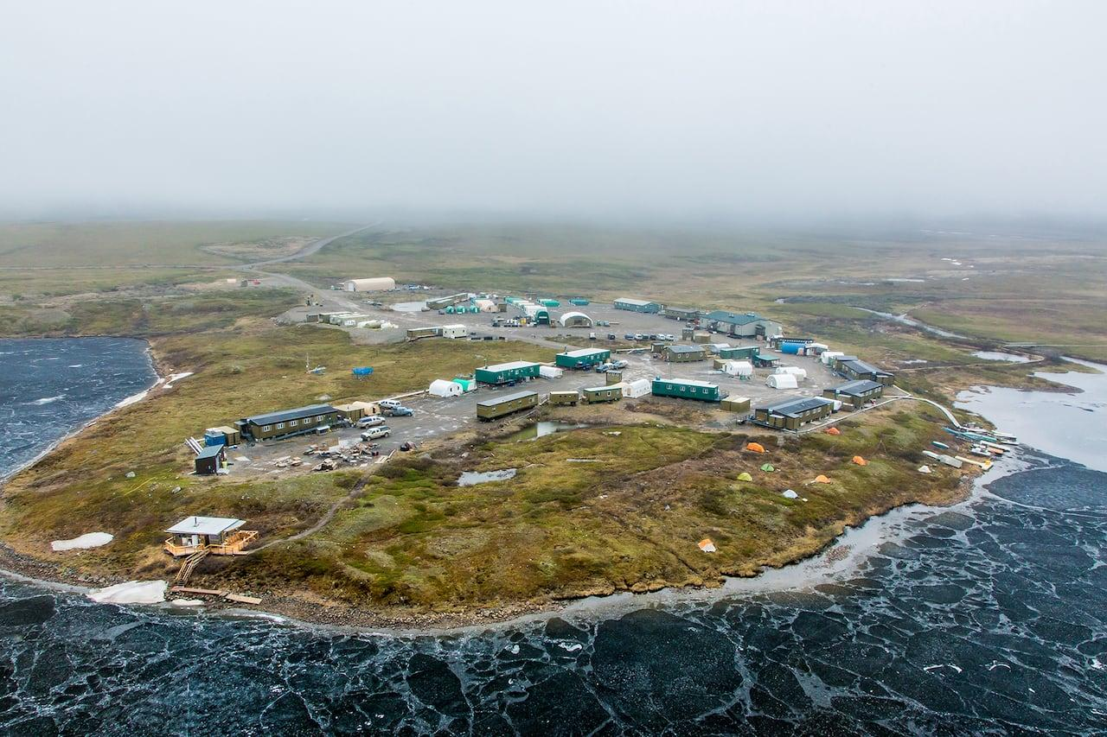
Collaborations working group
Our goal is to work within the framework of ethical space* to build a cooperative spirit between Land managers, Indigenous leadership, and Western institutions. Join us!
The Collaborations and Engagement working group focuses on developing, coordinating, and maintaining partnerships across working sectors and geographies for the ABoVE Science Team
We engage with governments, Indigenous Nations, organizations and research institutions
We collate and share ABoVE data products, GIS maps, and measurements with managers and decision-makers working across the Arctic
*Ermine, W., 2007. The Ethical Space of Engagement. Indigenous Law Journal 6. https://jps.library.utoronto.ca/index.php/ilj/article/view/27669

Slide 2
Planned WG activities 2023
Reminding science team members to review their commitments to engagement and outreach from their proposal
Expanding and sharing working document on Engagement and Communication resources and best practices
Crowd-sourcing within ABoVE ST and beyond to find requested data
Initial focus on list identified by Kimberley’s work in Whitehorse area (next slide)
More engagement with communities, decision makers, other collaborators about their data needs and interest to expand work in #3.
Commitment to building and maintaining good relations
Document institutional/structural barriers that hinder good relations
Notes:
Monthly meetings

Slide 3
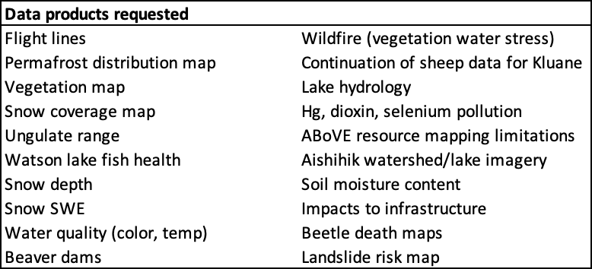
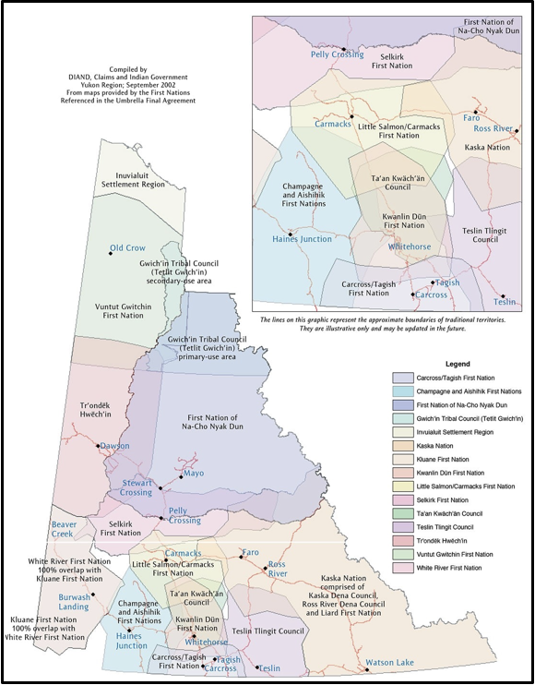

Slide 4
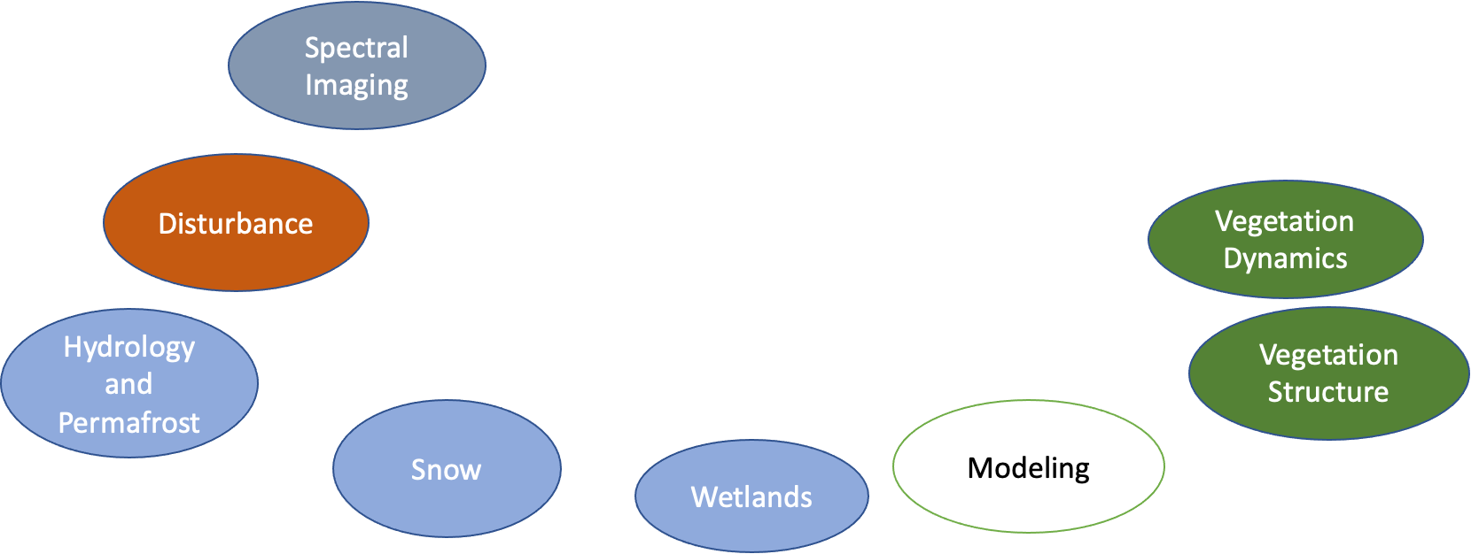
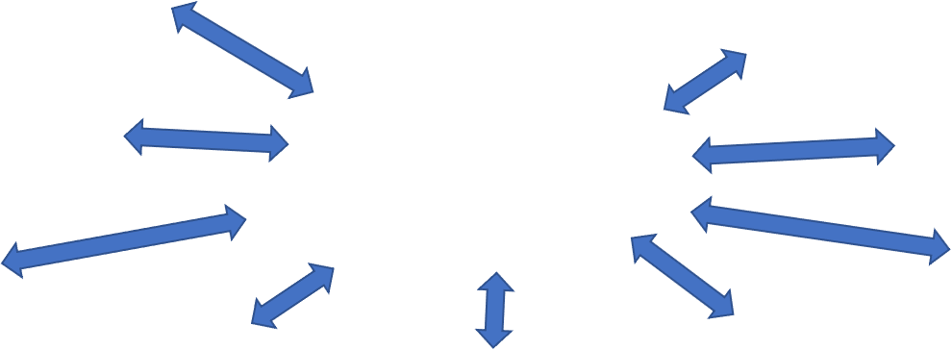
Carbon
Collaborations & Engagement

