Slide 1
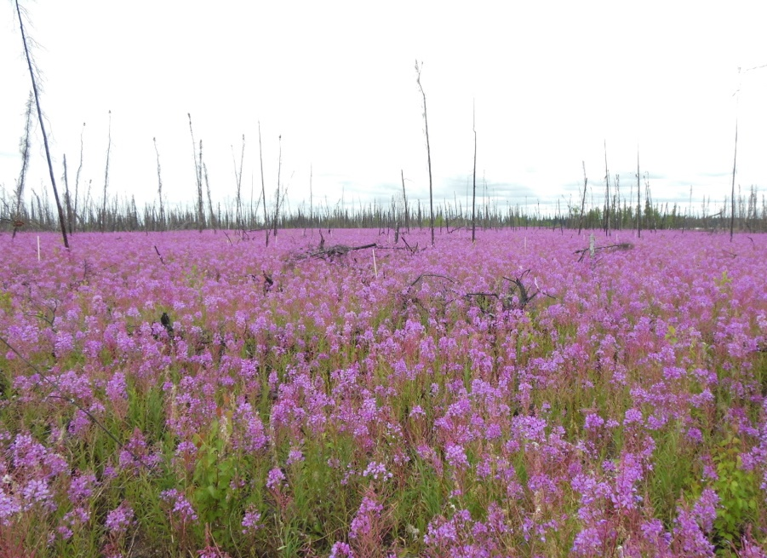
Fire & Insect Disturbance Working Group
Breakout Session Report
Dong Chen, Nancy French
With notes from Tyler Albrethsen
Photo by L Kendig

Slide 2
Participants: (±22)
Nancy French
Dong “Tony” Chen (virtual)
Chris Potter
Randi Jandt
Tammy Walker
Tyler Albrethsen
Bob Bolton
Peter Griffith
Jinyang Du
Jackie Dean
Kai-Ting Hu
Yingtong Zhang
Seamore Zhu
Arden Burrell
Jinhyuk Kim
Matt Macander
Max van Gerrevink
Elizabeth Hoy
JJ Frost
Hank Margolis
Sandra Yaccoub (virtual)
Michael Young (virtual)

Slide 3
Review & update list of Synthesis Activities
Previously documented:
Walker, X.J., et al. 2020. ABoVE: Synthesis of Burned and Unburned Forest Site Data, AK and Canada, 1983-2016. ORNL DAAC, Oak Ridge, Tennessee, USA. Doi: 10.3334/ORNLDAAC/1744
Walker, X. J., et al. 2020. Fuel availability not fire weather controls boreal wildfire severity and carbon emissions. Nature Climate Change. 10(12), 1130-1136. doi: 10.1038/s41558-020-00920-8
Baltzer, J. L., et al. 2021. Increasing fire and the decline of fire adapted black spruce in the boreal forest. Proceedings of the National Academy of Sciences. 118(45). doi: 10.1073/pnas.2024872118

Slide 4
Review & update list of Synthesis Activities (Cont)
Completed:
Multi-disturbance: Foster, A. C., et al. 2022. Disturbances in North American boreal forest and Arctic tundra: impacts, interactions, and responses. Environmental Research Letters. 17(11), 113001. doi: 10.1088/1748-9326/ac98d7.
Ongoing:
Tundra field data synthesis (led by Dong Chen)
Constructing a database of field data to support the study of ABoVE-domain Tundra fire dynamics
The compiled database is suitable for research activities that focus on various tundra processes (not just wildfire)

Slide 5
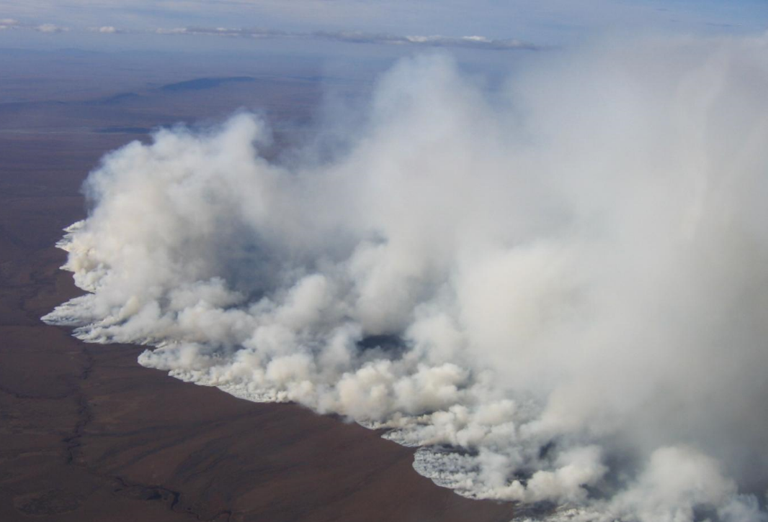
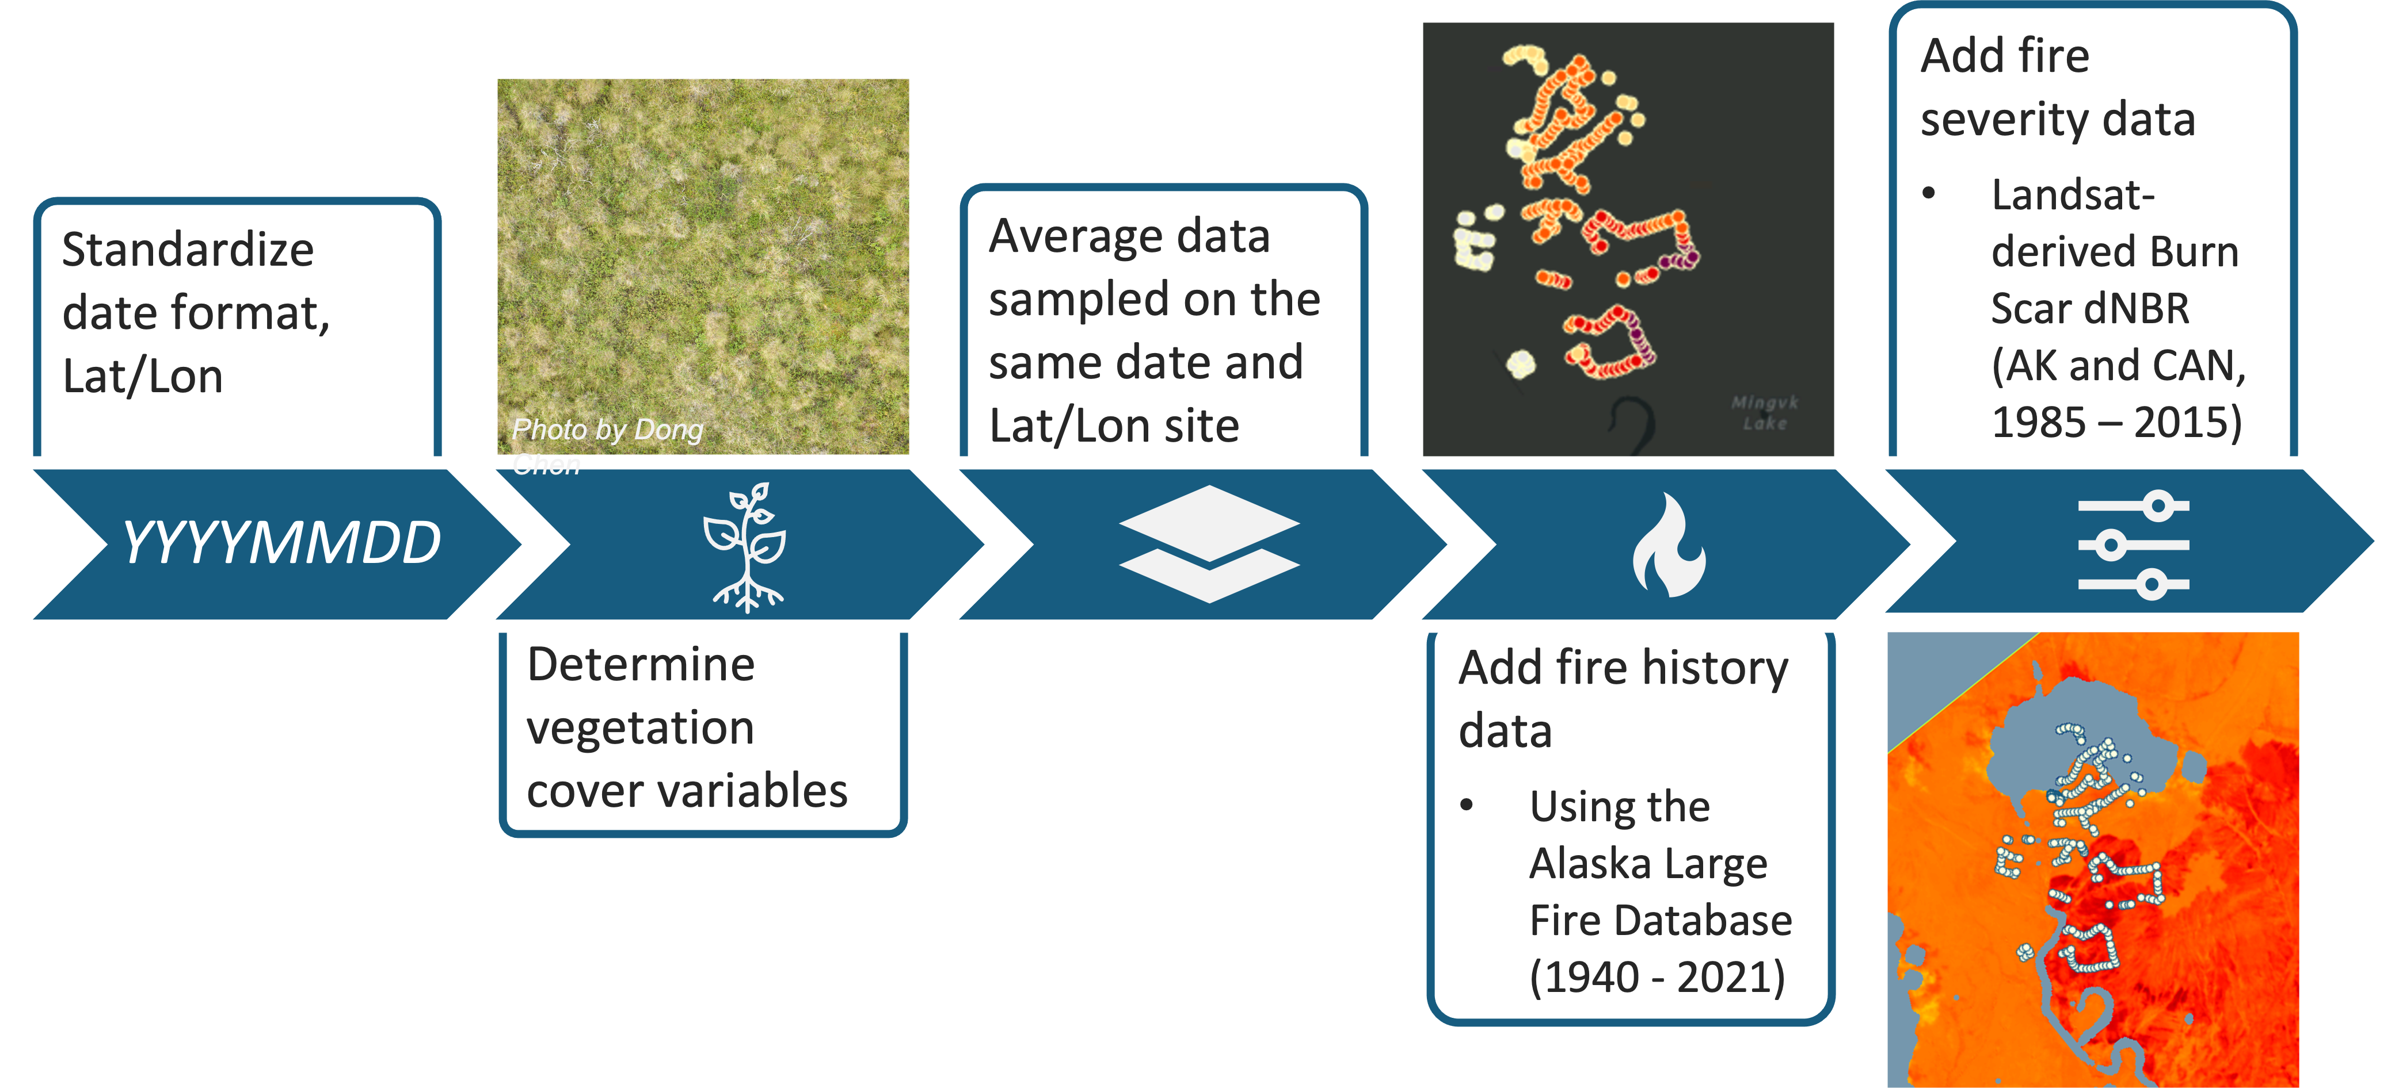
Tundra Fire Synthesis
Dong Chen, Seamore Zhu, Liz Hoy
Constructing a Database to Support the Study of ABoVE-domain Tundra Fire Dynamics
2007 Anaktuvuk River tundra fire, North Slope, Alaska (Photo: U.S. Bureau of Land Management)
See Poster presented by Seamore Zhu, Liz Hoy

Slide 6
Discuss how & when to bring the ongoing activities to fruition
Tundra field database is expected to be submitted to the ORNL DAAC in a few weeks
A manuscript documenting the database will be submitted to Earth System Science Data by June
We will make an effort to publish the database via Google Earth Engine (to reach broader audience)
Dong Chen will do a walk-through of the database and database assessments completed for the publication in an upcoming monthly WG meeting
Dong Chen will reach out to other WG leads to promote the database & discuss cross-cutting opportunities (e.g., modeling, permafrost, vegetation)

Slide 7
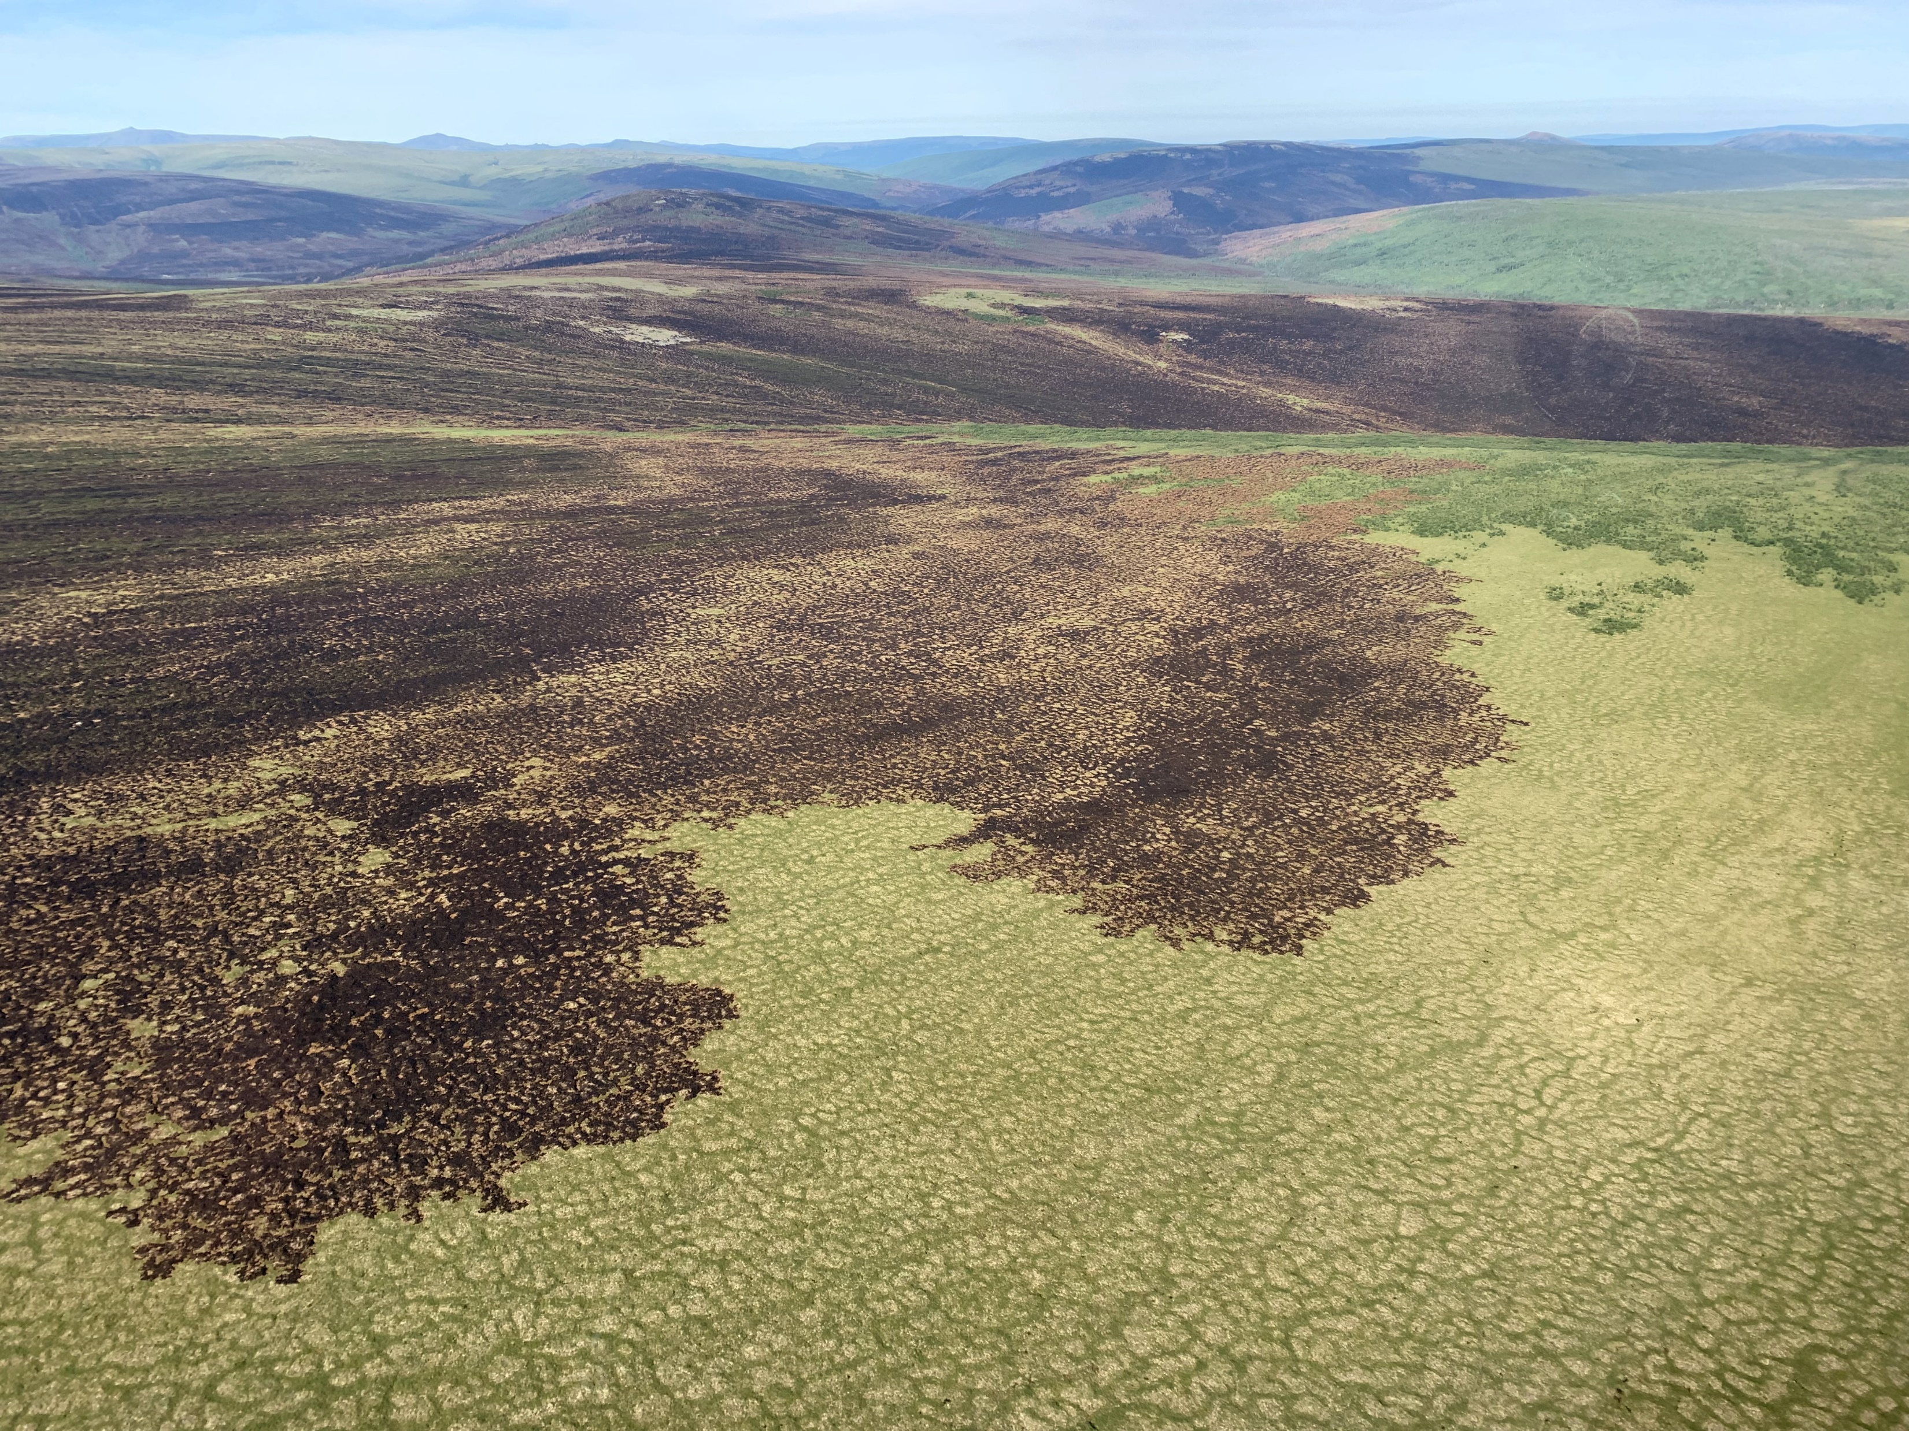
Discuss how & when to bring the ongoing activities to fruition Discussion Comments:
Having data compiled is very helpful and has great value
Need to be sure there is a way to query the data for users: Location/time should allow for this
Not all sites are in burn sites despite being a “fire synthesis” much of the data are pre-burn or adjacent to the fire site
The data files are not large, so easy to work with
Pre-ABoVE plot data – there is data, was it all captured, Liz in double checking, there will always be “more”

Slide 8
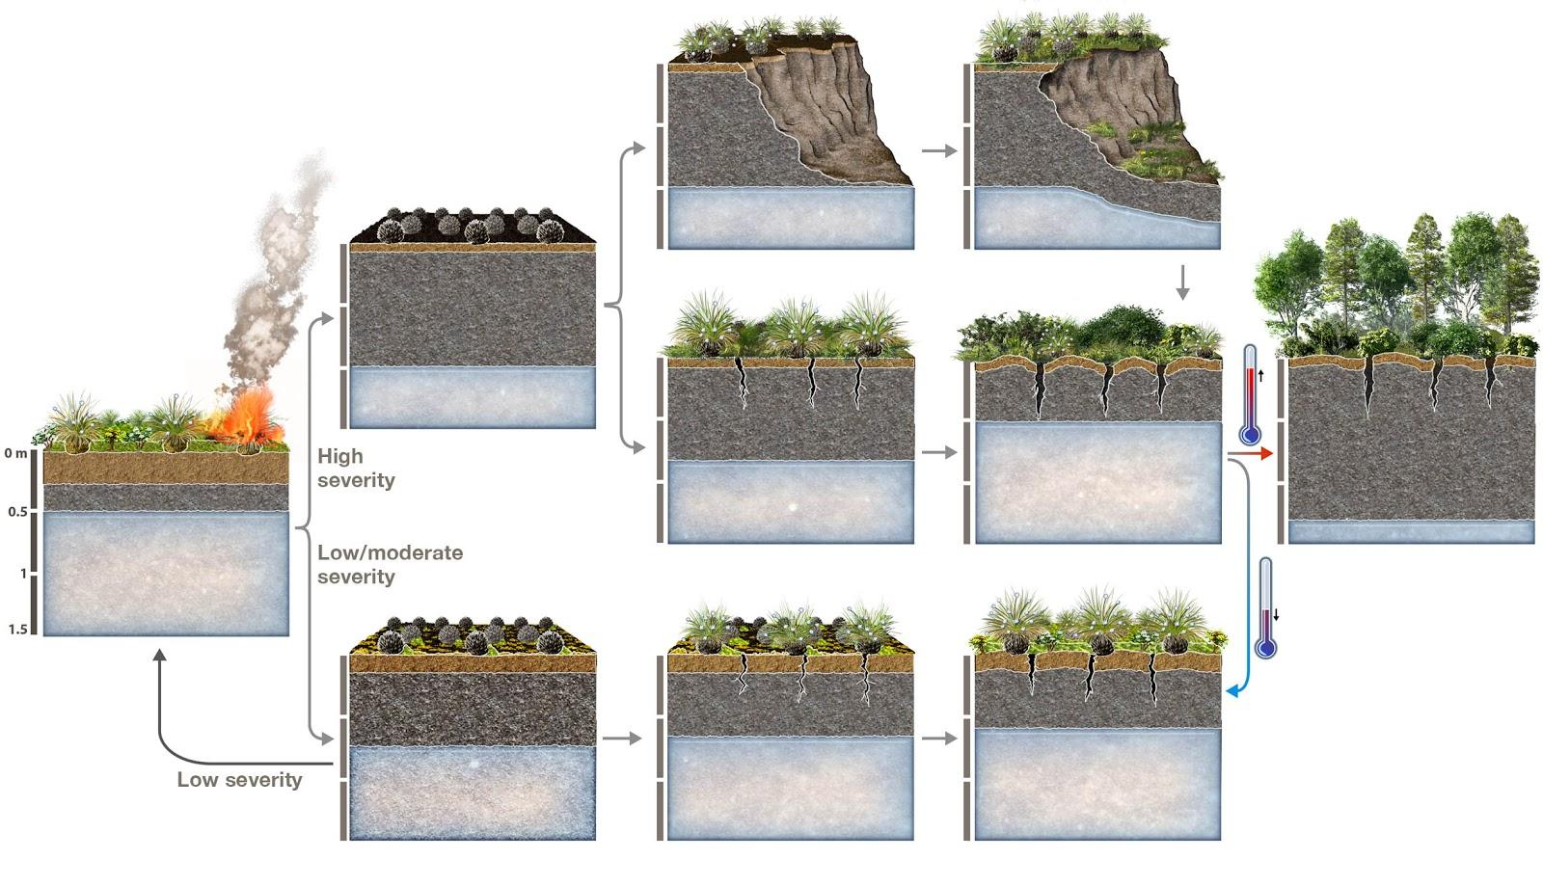
Consider new Synthesis Activities
Work with this Tundra field database and identified model benchmark assessment, to gauge data utility and gaps for model needs
Look at 2022 fires that are in the airborne swaths (that have pre-fire acquisition) → consider for other disturbances, too
NASA ES will have summer interns FREE!!!
Have a list from our earlier survey

Slide 9
Discuss how to bridge across working groups
Have more ABoVE project-level web meetings
Monthly webinars presenting results
Cross-WG “smackdown” driven by narrow topic
Thermokarst: disturbance & hydro/permafrost WGs
Insect infestations: disturbance & vegetation WGs
Build a list of topic-driven “hybrid” WG meetings that combine WGs
BEAVER Engineering ←
→ Methane = Carbon & disturbance (e.g thermokarst)

Slide 10
Discuss how Phase 3 projects might best augment current WG efforts / cross-project activities
Phase 3 fire projects are active in WG already
Much interest in fire and other disturbance in connection with MANY (ALL?) projects
Looking for a new WG deputy lead to work with Tony
If key projects / people were not re-selected, how to leverage & maintain engagement? (Not discussed)

Slide 11
Future of the WG:
Disturbance
Fire, Insects, Thermokarst, Herbivory, Climate (temp/precip), Beaver engineering
Vegetation
Ecosystem Services
Hydrology/Wetlands
Carbon
Permafrost
Grosse, G. et al. 2011 Vulnerability of high-latitude soil organic carbon in North America to disturbance https://doi.org/10.1029/2010JG001507

Slide 12
Future of the WG:
Disturbance
Fire, Insects, Thermokarst, Herbivory, Climate (temp/precip), Beaver engineering
Proposal: Broaden the “Fire & Insect” WG to “Disturbance” WG
We have been conducting the WG in this manner
Much of the fire synthesis activities are successfully completed
Monthly meeting topic: A review of the Multi-disturbance study and publication by Adriana Foster

Slide 13
Future of the WG:
Disturbance
Fire, Insects, Thermokarst, Herbivory, Climate (temp/precip), Beaver engineering
Monthly meetings: 1:00 to 2:00 PM ET 1st Thursdays of each month
Looking for a new WG deputy lead to work with Tony
Monthly meeting topic: A review of the Multi-disturbance study and publication by Adriana Foster
Next meeting March 2nd:
Review tundra field data synthesis database
Presentation from the group
Tony will be contacting people for this
Please step up

