Slide 1
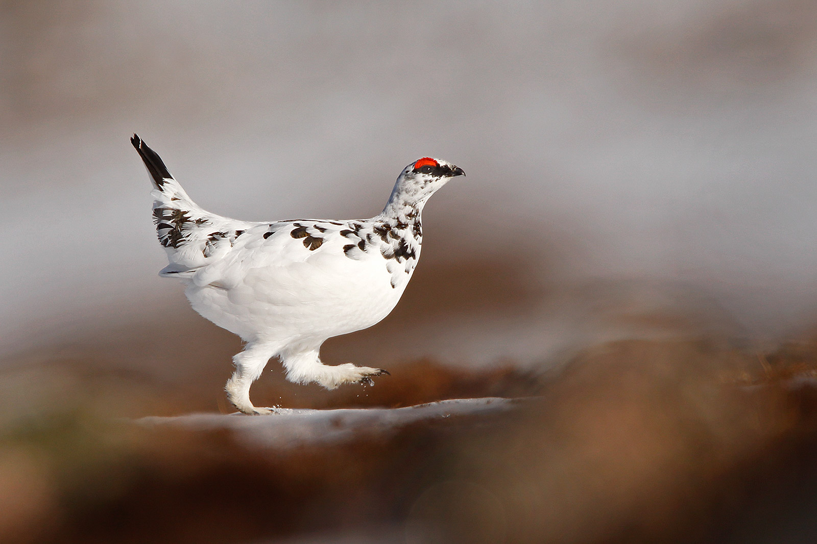
Carbon Dynamics Working Group
New Leads: Jenny Watts and Jon Wang
15 Participants (3 online)
Interested in joining? Email support@cce.nasa.gov
January 25, 2023

Slide 2
Carbon Dynamics Working Group
Current Synthesis Projects
The Central Question: Is the ABoVE a net source or a net sink?
How and why has it changed?
ABoVE Carbon Budget (2009-2018) Trends and Variability
Lead: Abhishek Chatterjee
Status: Writing
Impacts of fire and climate on GPP in Alaska
Lead: Nima Madani
Status: Published in 2021
ABoVE Methane Fluxes: Data-Model Mismatch and Data Needs
Lead: Luke Schiferl
Status: Ready to Write
CO₂ Amplitude Synthesis: remote sensing, models, and in-situ observations
Lead: Brendan Rogers
Status: On Pause, restarting soon

Slide 3
Carbon Dynamics Working Group
Focus for Phase 3
Maintain an integrated effort between projects
Frequent comparisons/discussions at monthly meetings
Coordinating between BU v TD groups (a workshop)
Communicate data/modeling needs
Connectivity with other working groups

Slide 4
Carbon Dynamics Working Group
Potential Phase 3 Synthesis Activities (we need leads!)
ABoVE CO₂ and CH₄ budget paper incorporating new processes/data
Perspectives paper highlighting atmospheric observations available or needed for top down estimates of the C budget
Cross-cutting perspectives – the importance of multi-scale field campaigns
Cross-cutting synthesis – the impacts of other processes on ABoVE carbon
Info will be sent to the C working group with sign up sheet for syntheses

Slide 5
Carbon Dynamics Working Group
Carbon depends on everything
Come share your stuff with us!
Spectral Imaging
Ecosystem Services
Carbon
Disturbance
Vegetation Dynamics
Hydrology and Permafrost
Vegetation Structure
Snow
Modeling
Wetlands

