Slide 1
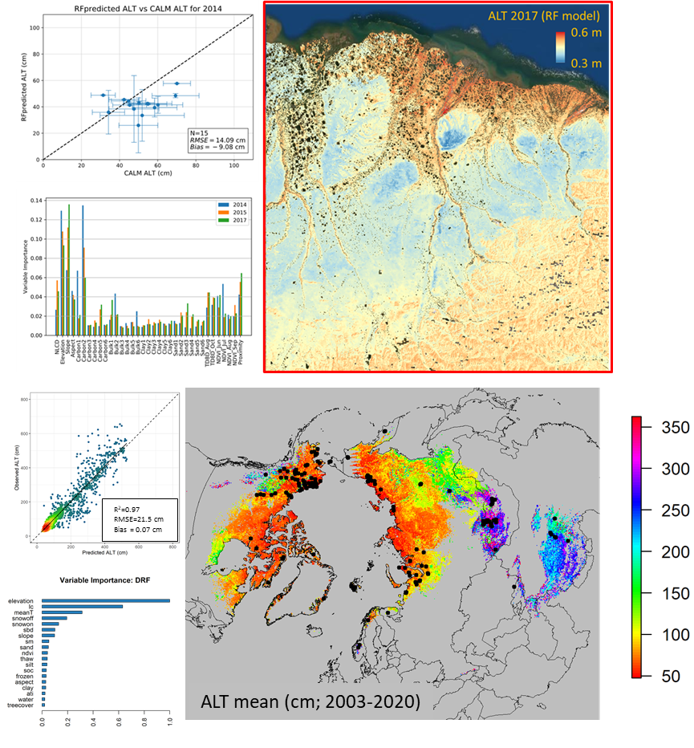
Permafrost Hydro WG
Wrap-up of Phase II Synthesis Activities
Active Layer Properties & Upscaling
Northern Hemisphere
Paper (Liu et al.); summer-22
Dataset (1km ALT, 2003-2020)
Northern Alaska
Paper (Whitcomb et al.); summer-22
Dataset (30m ALT, 3-yr record)
Boreal Fire-PF interactions review
3. Review Paper to ERL PF vulnerability focus issue (Jorgenson et al.); <Jan-23

Slide 2
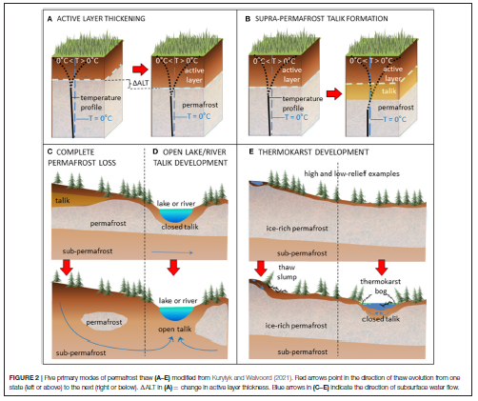
Permafrost Hydro WG
New Synthesis Topics for Phase III (Filling data & knowledge gaps)
What’s happening in deeper permafrost zones & how are changes in talik development and connectivity affecting surface and ground water budgets, and 3-D flows of energy and materials?
Relatively more is known about near-surface conditions than deeper geophysical energy and flow pathways (e.g., Walvoord and Striegl, 2021. Front. Clim.)
Crosscutting with other disciplines by affecting movement and cycling of water, water quality, animal habitats, C fates, GHG emissions and climate feedbacks

Slide 3
Permafrost Hydro WG
New Synthesis Topics for Phase III (Filling data & knowledge gaps)
What types of remote sensing and other observational data are available to address?
Indirect indicators vs more direct geophysical measures of below-ground changes;
Surface water trends and lake ice dynamics, water isotope analyses (indirect)
Snow properties (depth and density vs SWE or SCE) and winter processes in general (indirect)
Seasonal FT, ALT, and soil moisture profiles (indirect)

Slide 4
Permafrost Hydro WG (Room 103)
New Synthesis Topics for Phase III (Filling data & knowledge gaps)
Potential to leverage underutilized resources and other upcoming opportunities
Mining extensive existing data collections (ABoVE, NOAA, etc..)
Snow Model: Glen Liston, 1980-2020, 18 snow variables produced Incl., depth, density, SWE over AK at 3km res.
SnowEx: Developing better snow property retrievals; filling info gap in winter and shoulder season processes
NISAR: Both S-band and L-band to potentially resolve soil C and moisture profiles affecting zero-curtain formation; S-band possibility?
NEON: leveraging ongoing data collections to support studies along regional environmental gradients
**Enlist ABoVE mapping tool to overlay available airborne and ground data in relation to potential environmental gradients for study scoping.

