Slide 1
ASTM-8
Leadership Group
Goetz, Miller, Griffith,
Larson, Hoy, Hodkinson,
Margolis, Falkowski
Special thanks to
WG Leads
ABoVE Support Office
Planning Committee
+ All who
contributed data,
results, outreach &
interpretation
ABoVE & Beyond
the call..
above.nasa.gov

Slide 2
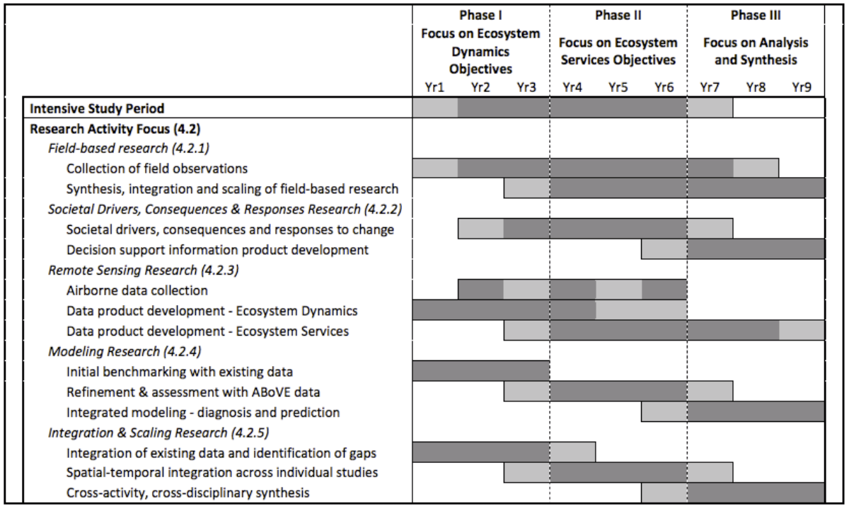
Phases & Timing of ABoVE
circa 2014 CEP
above.nasa.gov/about
ABoVE Concise Experiment Plan (2014)

Slide 3
ASTM-8 Objectives
Reports from NASA and Affiliated projects via plenary and parallel sessions & posters
Reports, interactions & advances of Working Groups
Review, discuss, refine & advance Integration, synthesis and modeling activities
Research to Operations discussions with representatives from resource and land management agencies
Finalize plans for airborne remote sensing in 2022
Identify any issues & opportunities to maximize impact
ASTM-8 Fairbanks
May 2022
above.nasa.gov

Slide 4
What have we accomplished / research highlights of Phase 2?
(some examples)
WG Leads will report on some of this & the Invited talks some more..
Significant insights into Fire Disturbance dynamics and implications for
Carbon emissions (combustion), reduced C sink in AGB
Vegetation dynamics (composition & successional trajectories)
Associated implications for wildlife & animal movement
Implications for fire management (e.g. overwintering fires.. more @RTO)
Significant insights into Fire Disturbance dynamics and implications for
Carbon emissions (combustion), reduced C sink in AGB
Vegetation dynamics (composition & successional trajectories)
Associated implications for wildlife & animal movement
Implications for fire management (e.g. overwintering fires.. more @RTO)
Hydrology & Permafrost changes and implications
Earlier snowmelt, reduced late season tundra productivity & C update
Invited talks by Douglas, Miner, Schaeffer
Carbon stocks in AGB from Lidar & SAR (invited talks)
Integrated monitoring & modeling (invited talks)
Much More!
ASTM-8 Fairbanks
May 2022
above.nasa.gov

Slide 5
ABoVE peer-reviewed Publications thus far..
447 publications reported by 130 projects*
339 publications by NASA funded projects
(66 ABoVE projects + 35 other NASA = 101)
+89 pubs by affiliated projects (n=29)*
*Not including ABoVE Partners (NGEE-Arctic, POLAR, CFS, NEON)
Please upload your publications to the ABoVE web site
& keep posting MSR and WWL slides w/your pubs.
The ABoVE ST currently has 868 members
and 1815 participants
(science team, resource managers, students & others following)

Slide 6
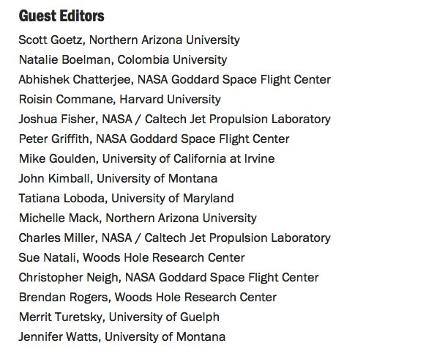
http://iopscience.iop.org/journal/1748-9326/page/ABoVE
80 papers published as of May 2022
Others in review
Acceptance rate well above the ERL norm (IF = 6.8)

Slide 7
Data Publications thus far..
202 Data sets archived
+23 publicly available
+6 in preliminary / early release status
another 120+ planned
Data archiving / publishing is critical for future research mining of
what we’ve measured and learned.
Early data release / sharing is valuable for collaborative efforts across projects and working groups, including synthesis activities
ABoVE and the DAAC have tools, resources and personnel to help you make data available.
Please take advantage of this!

Slide 8
Monday overview & highlights
Panel & discussion on Collaborating with decision-makers
Invited Talks on Permafrost Change, Implications & Remote Sensing
2022 Airborne Plans & Planning
Partner presentations
Research Highlights Intros >>>> Posters
ASTM-8 Fairbanks
May 2022
above.nasa.gov

Slide 9
Tuesday overview & highlights
Breakouts: Thematic & Synthesis Activities
Parallel thematic sessions on Research Highlights
Reports on working group activities
Invited Talks on Snowscapes & Wildlife, Active Remote Sensing of AGB
Research Highlights Intros >>>> Posters
ASTM-8 Fairbanks
May 2022
above.nasa.gov

Slide 10
Wednesday overview & highlights
Reports from Thematic & Synthesis Activity Breakouts
Breakouts sessions on Integrating decision-makers
Parallel thematic sessions on Research Highlights
Invited Talks on Integrated monitoring & modeling
Research Highlights Intros >>>> Posters
ASTM-8 Fairbanks
May 2022
above.nasa.gov

Slide 11
Thursday overview & wrapup
Reports from & Discussion of breakouts on Integrating decision-makers
Next Steps & Opportunities
Feedback & perspectives
Thoughts from HQ
Adjourn & transition to RTO workshop
ASTM-8 Fairbanks
May 2022
above.nasa.gov

