Slide 1
Carbon + Wetland Breakout
ASTM8 May 10, 2022
Discussion Leads: Abhishek Chatterjee, David Butman, Josh Fisher
Rapporteurs: Clayton Elder, Ludda Ludwig

Slide 2
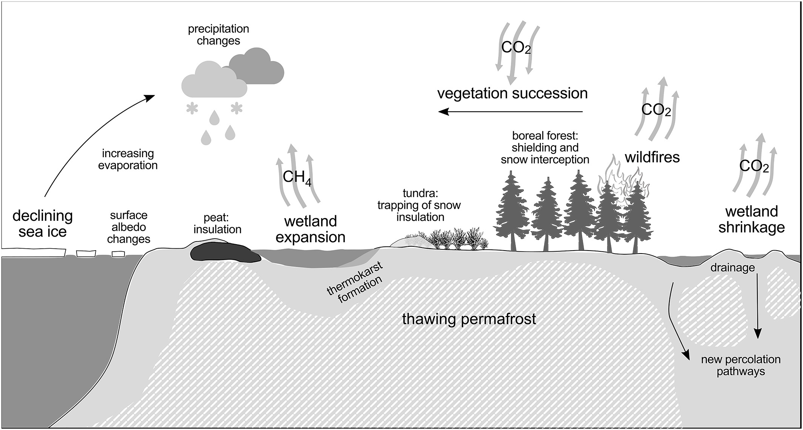
Wetlands link hydrological, ecological and permafrost processes and are inextricable from pressing carbon dynamics research
Summary of environmental changes caused by warming and their impacts on wetland systems (Kreplin et al., 2021)

Slide 3
The “known knowns” and “known unknowns”
Known discrepancy between observed CH₄ emissions and model simulations
Large spatial heterogeneity in methane emissions observed across lakes and wetlands
Factors such as geomorphology, emerging vegetation coverage, inundation characteristics are often not represented in models (from Elder, Kyzivat, Baskaran papers)
Inundation driven models don’t produce enough methane to match atmospheric top-down approaches from high northern latitudes (from Schiferl current CH₄ synthesis activity); Scale of model-data mismatch is highly variable across landscapes
Where do we stand on inundation products? How can we harmonize the various products & wetlands databases currently in the works? How accurate are they?
E.g., BAWLD dataset and CH₄-centric wetland classification (from Olefeldt, Kuhn)
Ducks unlimited wetland maps, Canadian Federal initiatives: Environment Canada Maps, Peatland inventory projects (from LBC, Smith)
Separate wetland mapping products have been useful, but how can we cross compare them or produce a universal product?

Slide 4
The “known knowns” and “known unknowns”
Can we use data-level investigations (e.g., AVIRIS-NG) to improve and reduce uncertainties in related modeling work?
Spatial averaging and upscaling methods are highly inconsistent in approaches. Example: upscaling CH₄ emissions from high-emission low area lakes and low-flux high-area lakes.
Integration of large and diverse (interdisciplinary) datasets is a major challenge. Scales of observations are very diverse and need packaging for modelers.
Are our granular experiments even comparable? Which ones are correct? Need for more analysis of approaches.
Model resolution may be the fundamental limitation to assimilating site-scale data. More scale-briding efforts are needed.
How can smaller scale process-oriented efforts benefit macro-scale synthesis activities?

Slide 5
ABoVE Structural Gaps
Site scale observations, complemented by remote sensing are somewhat disjointed by nature,
(gaps in airborne CO2/CH4 observations, except one summer)
scaling to modelling (discontinued/uncertain funding, which puts a pin on current synthesis activities) remains a major challenge,
we have not made the link between observations and models in a meaningful way yet.

Slide 6
Unknown unknowns
Primary CH₄ model-data synthesis activity was being led by Schiferl, Commane
Searching for a new lead for data model efforts – Phase 3 selections?
Current paper in preparation will provide recommendation for next steps

Slide 7
Current synthesis activities (C-dynamics focused)
# | Synthesis Topic Name | Leads | Email Contact | Start Date | End Date | Status/ Progress Bar
1 | Carbon Budget for the ABoVE domain | Abhishek Chatterjee, Jon Wang, Dan Hayes | abhishek.chatterjee@ jpl.nasa.gov | 2020 | 2022 | Abhishek’s paper draft
2 | Impact of climate & wildfire on Alaska’s GPP | Nick Parazoo | nicholas.c.parazoo@ jpl.nasa.gov | 2020 | 2021 | Madani et al. (2021), JGR-Biogeosciences
 |  | Nima Madani
3 | Methane fluxes, model-data mismatch and knowledge gaps | Jennifer Watts | jwatts@whrc.org | 2020 | TBD | Luke’s paper draft
 |  | Roisin Commane | r.commane@columbia.edu
4 | CO₂ amplitude synthesis - trends, drivers and projections | Brendan Rogers | brogers@whrc.org | Mid-2020 | TBD | broken up into four working groups – atmospheric, terrestrial remote sensing, in situ measurements, process-based models; various groups conducting literature review.
 |  | Manuel Helbig, Gretchen Keppel-Aleks, Zhihua Liu, Lei Hu | …
5 | “Productivity” synthesis – various indices of primary productivity | Nick Parazoo, Nima Madani, Logan | nicholas.c.parazoo@ jpl.nasa.gov | 2021 | TBD | Draft paper

Slide 8
Wetlands – future synthesis
Reconciling map products for carbon, vegetation, wildlife communities
Integration of multiple inundation products across WG communities
Coordinate with the CMS ‘Wet Carbon’ working group for integration between NASA concurrent efforts
Wetlands as cross-cutting with other WG in ABoVE – greater involvement with Carbon, Hydrology & Permafrost, Fire

Slide 9
6 COURSE SYNTHESIS TOPICS
BOTTOM-UP AND TOP-DOWN MODELS
What is the carbon budget over the ABoVE domain? Can we
reconcile top-down and bottom-up estimates of C-budgets?
$ RESOLUTIONS & DOMAINS $
Abhishek Chatterjee, Brendan Byrne, Lei Hu,
Anna Virkkala, Brendan Rogers, Jennifer Watts, Josh Fisher
STATE OF ABR ECOSYSTEM PROCESSES
Some models have more “advanced” ABR process
representation than others. Differences?
$ REVIEW & ROADMAP $
Elise Heffernan, Howie Epstein, Amanda Armstrong,
Josh Fisher, Anna Virkkala, Brendan Rogers, Jennifer Watts
SUB-GRID VARIABILITY
Fine spatial resolution landscape features drive ecosystem functioning in the ABR. Approaches and impacts?
$ REMOTE SENSING → MODELING $
Jennifer Watts, Ben Poulter, Mary Farina
Mary Farina: paper near completion
See work by Amanda Armstrong; Jackie Shuman/Sean Swenson
canva
page 1 of 2

Slide 10
6 COURSE SYNTHESIS TOPICS
INDIVIDUAL-BASED AND PFT MODELS
ABR ecosystem modeling is broadly grouped into two camps: individual-based models and PFT/trait-based models.
$ ED, UVAFME, CLM ⇿ CLM-FATES $
Adrianna Foster, Jackie Shuman, Erik Larson, Shawn Serbin
DRIVERS AND RUN PROTOCOLS
Specification paper needed on agreed-upon model drivers and run protocols for ABR model runs.
$ DAYMET, MESONET, CRU-NCEP, GSWP $
Dave Moore, Min Chen, Erik Larson, Kevin Schaefer, Nick Parazoo
ABOVE DATA FOR MODELS
Deep dive into entire ABoVE database. Extraction of functional relationships and benchmarks.
$ UNCERTAINTY, INTEGRATION $
Josh Fisher, Dan Hayes, Andy Fox, Shawn Serbin
Adrianna Foster + Jackie Shuman
Josh Fisher; Dave Moore; Brendan Rogers
canva
page 2 of 2

