Slide 1
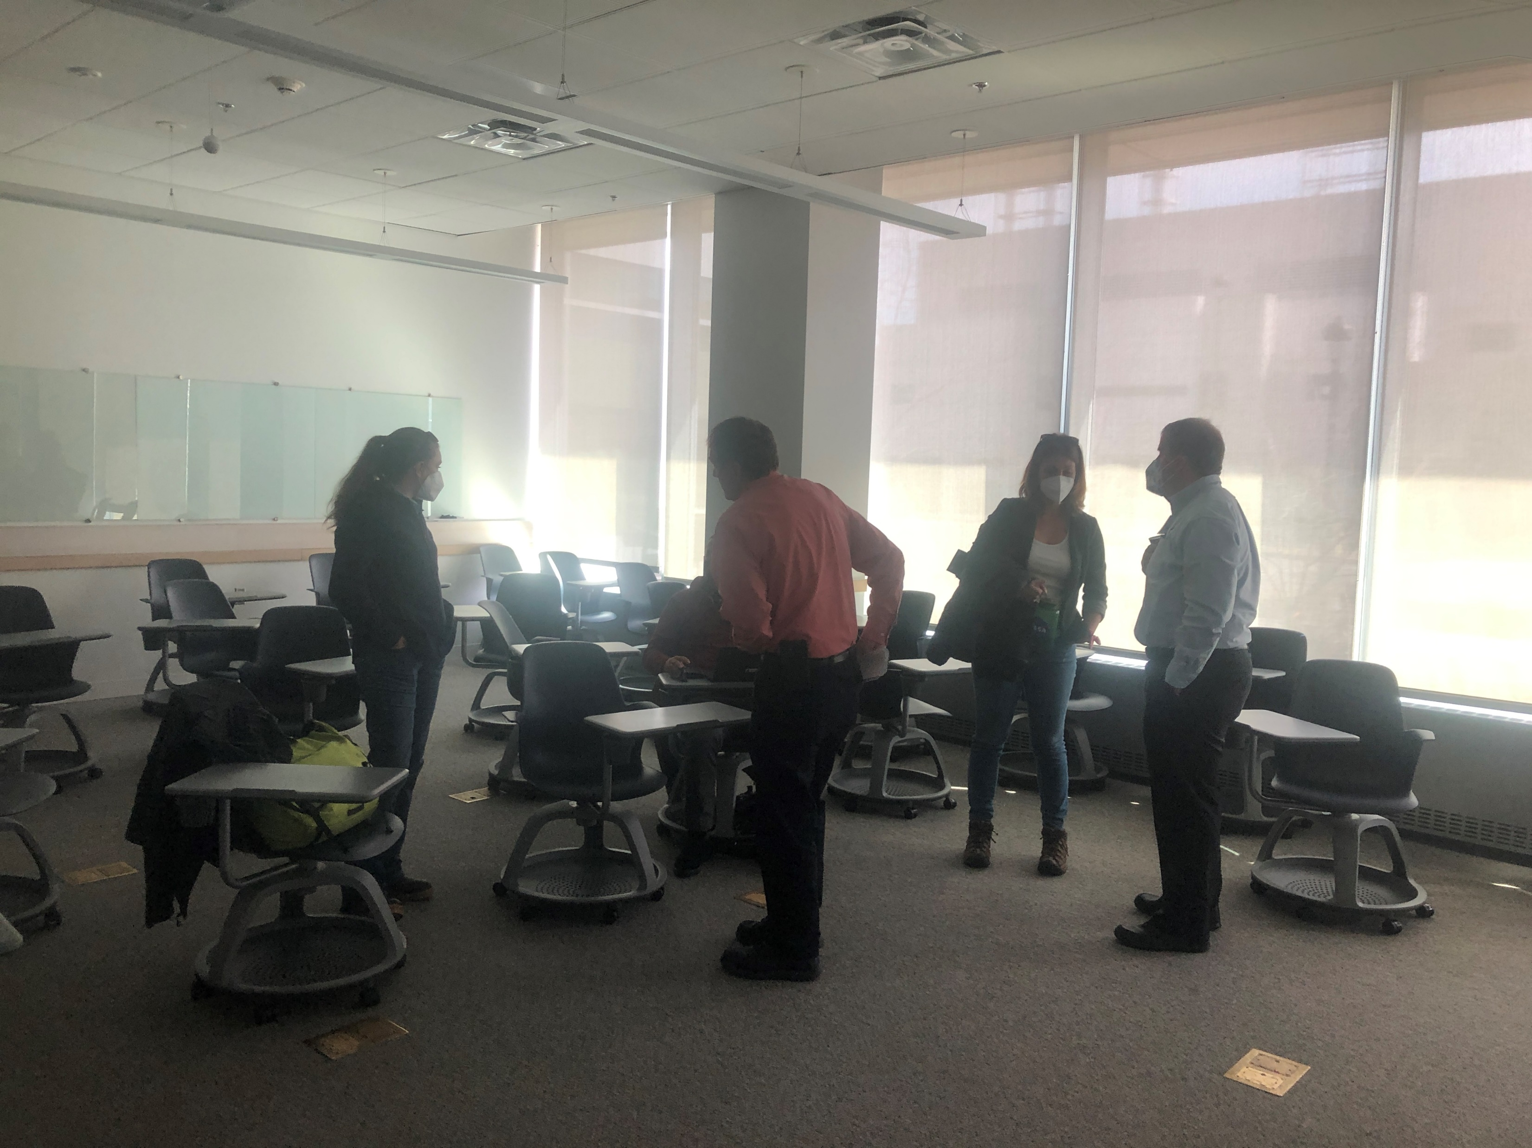
Integrating Decision Makers – Group 4 TVSF
16 Attendees representing Alaska Dept of Forestry, Fish and Wildlife, NASA, Goddard, JPL, University of Arizona, Dartmouth, and others.
The specific question poised to those involved in the Tanana Valley State Forest management plan revision was:
What ABoVE products would be useful and valuable for you?
The group discussed data needs, the capacity for the state DNR to process and handle data sets of varying complexity, as well as the challenge of engaging with tribal communities and corporations due to bureaucratic and resource barriers.
The AK Forester shared that models of future scenarios and maps of forest height would be valuable (however there are other ABoVE products that may be very valuable too!)

Slide 2
Integrating Decision Makers – Product Sharing
Our group thought that a shared living document that showcased the available products and their topics, as well as the direct needs by the agencies would be valuable.
However, while the DAAC shares data, often times the products need slight modifications for direct use (often which does not take significant effort e.g. the new forest biomass height product idea).
Managers have limited resources (human/computational), with their feedback slight modifications to our products could make them more usable/accessible.
Dave will help facilitate this interaction – email David.a.lutz@dartmouth.edu if you’d like to see your products find local end-users in the DNR and other agencies!
Requirements
Resource/Characteristic Need
e.g. Future changes in Road conditions which may impact harvest conditions
Current Products
NASA ABoVE Product
e.g. SAR subsidence product maps

