Slide 1
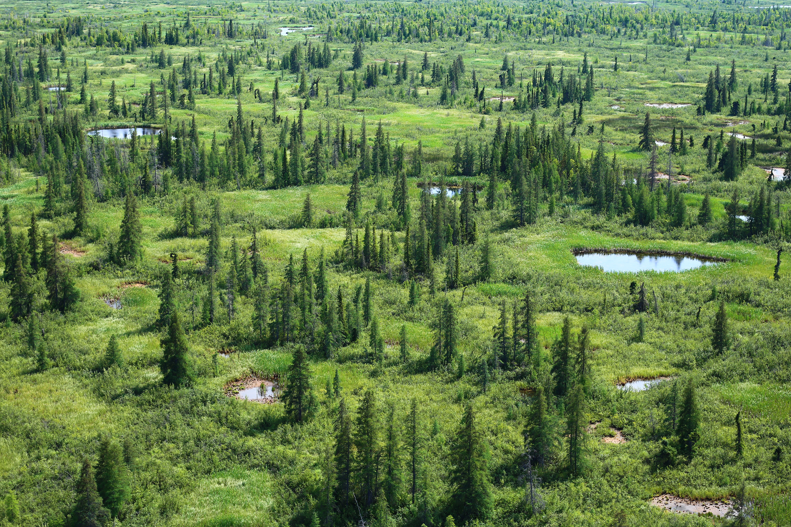
ASTM Breakout Session Report Back
May 11-12, 2022
Attendees: Laura Bourgeau-Chavez, Kevin Turner, Misha Warbanski, Jessica Fayne, Natalie Boelman, Kevin Smith

Slide 2
Opportunity/Needs
Do more than science for science sake – opportunity to address climate challenges
Communicate science results to reach a broader audience of end users
Develop meaningful and innovative climate mitigation and adaptation solutions
Influence policy and land planning to affect change
Work within an ethical space to braid ways of knowing

Slide 3
Challenges/Risks
Time/Cost to develop meaningful relationships with end users/communities
Many end users – often in remote areas with low bandwidth and capacity issues
Additional skillsets may be required – e.g. social science background
End user outreach funding often limited or lacking
Researchers are being asked to take on more – risk of burn out
ABoVE projects have many components and requirements
Research components complex alone – adding additional components a challenge

Slide 4
Ideas/Solutions
Create/reform/expand working group to focus on end user engagement/communication
Focus more on synthesis of ABoVE results to end users
Along with science summary slides – create deck of “translated” slides for general use to connect with larger audience
Seek new media types – social media big in ABoVE domain, Story Maps, others
Leverage new and existing links/tools being used/developed
E.g. Knowledge Basket, Canadian Conservation Land Management system
Expand partnerships with groups working on science communication/translation

Slide 5
Ideas/Solutions
Seek out ENGO partners who have long-term partnerships with end users or others (like Polar) who share mission of communicating with end users
Leverage external funding/partnerships to achieve common end user goals/outcomes
Provides more funding to this aspect which can be underbudgeted at present
Seek out advice/rethink end-user engagement workshops
Leverage NASA and other partners communication/knowledge mobilization, sharing and transfer skills

