Slide 1
Integrating with Decision Makers
Commonalities across agencies:
Desire the best available science
Agencies use a varity of information for decision making
Often similar “vital signs” monitored
Differences:
Different mandates
Different focus within individual land management agencies (place based)
Different approaches to doing science based on individuals, logistics, etc.

Slide 2
Can ABoVE help?
Low hanging fruit:
Vegetation height
Vegetation Biomass
Permafrost susceptibility to thaw
Snow characterisitcs
Other broadscale items of interest?
Observations:
ABoVE data/information getting used more than is apparent
No substitute for personnel connection

Slide 3
The last mile
Across the Grand Canyon:
Agencies may lack expertise in utilizing products
Lack of capacity at agencies
Need to bridge the gap between the products and utility
Solutions?:
ABoVE data/information getting used more than is apparent
Middle man
Elevator pitch
Training
Embedding

Slide 4
ABoVE message to Land Managers
The big picture:
ABoVE producing products at specific place, times..can be useful for programs
Scaling up!!

Slide 5
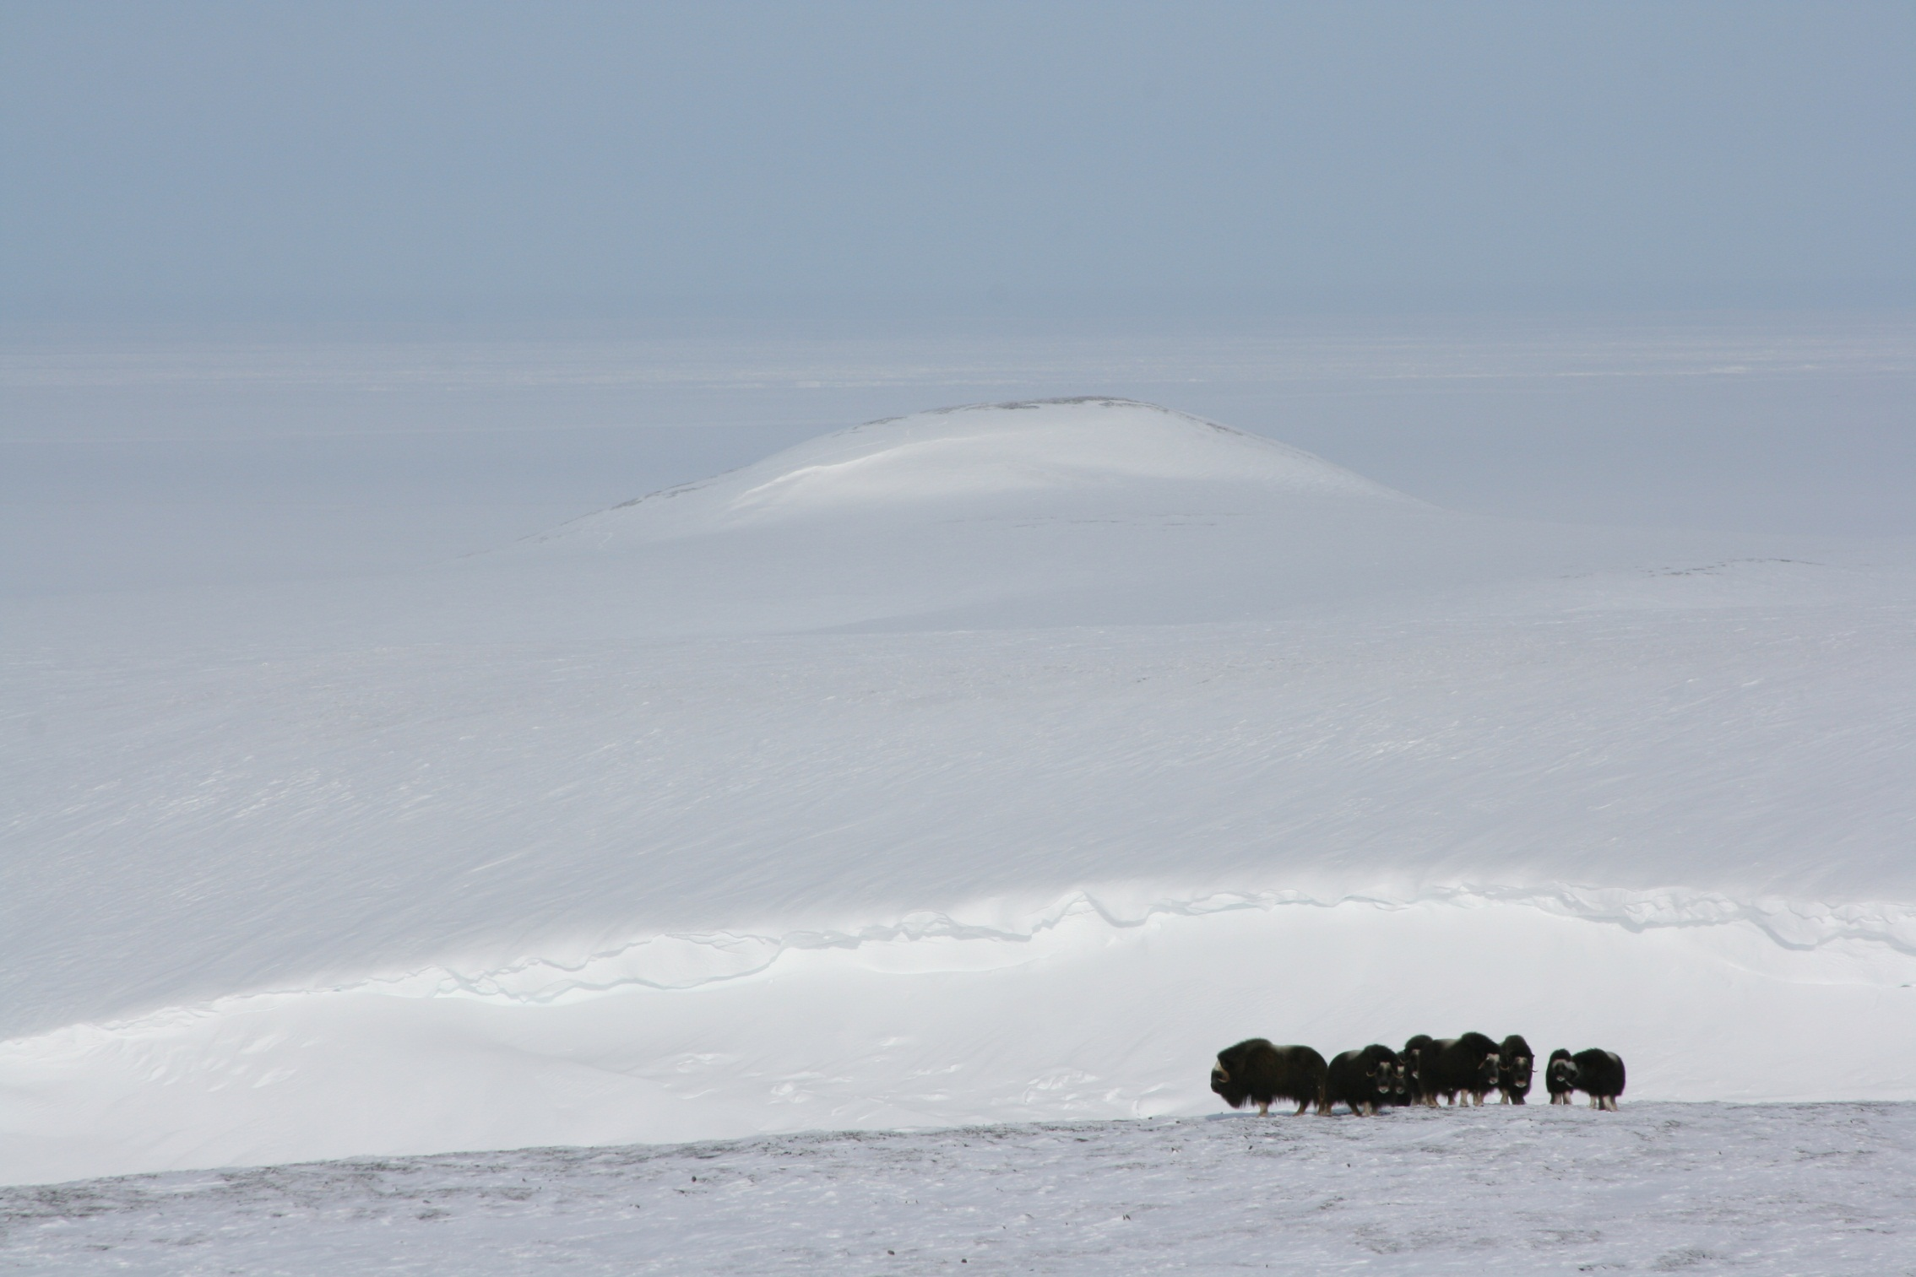
Parking lot thoughts
Whose missing?:
Canadian Parks, FWS, BLM, State
Land managers can be frustrating to work with, Don’t give up!!
Beyond agencies – Earth to Sky, Subsistence users….
Local residents as sources of information

Slide 6
More parking lot thoughts
Going into phase 3, how to interface with land managers?
should we have forum or workshop to show what we have?
should we have a training?
Think about how interaction will happen specifically

