Slide 1
Tues AM – Charge to Thematic Breakout groups
Review Synthesis Activities & update your current list of those
Include identification of leads & titles
Compile a list of those completed (e.g. “boreal regeneration synthesis,” Baltzer citation)
Discuss how & reasonably when to bring the ongoing activities to fruition
e.g. with publications as a working framework
Consider new Synthesis Activities (as makes sense).
In anticipation of Phase 3, consider (if possible) how new projects might augment current WG efforts / activities
If key projects were not selected for Phase 3, how to mitigate & maintain engagement?

Slide 2
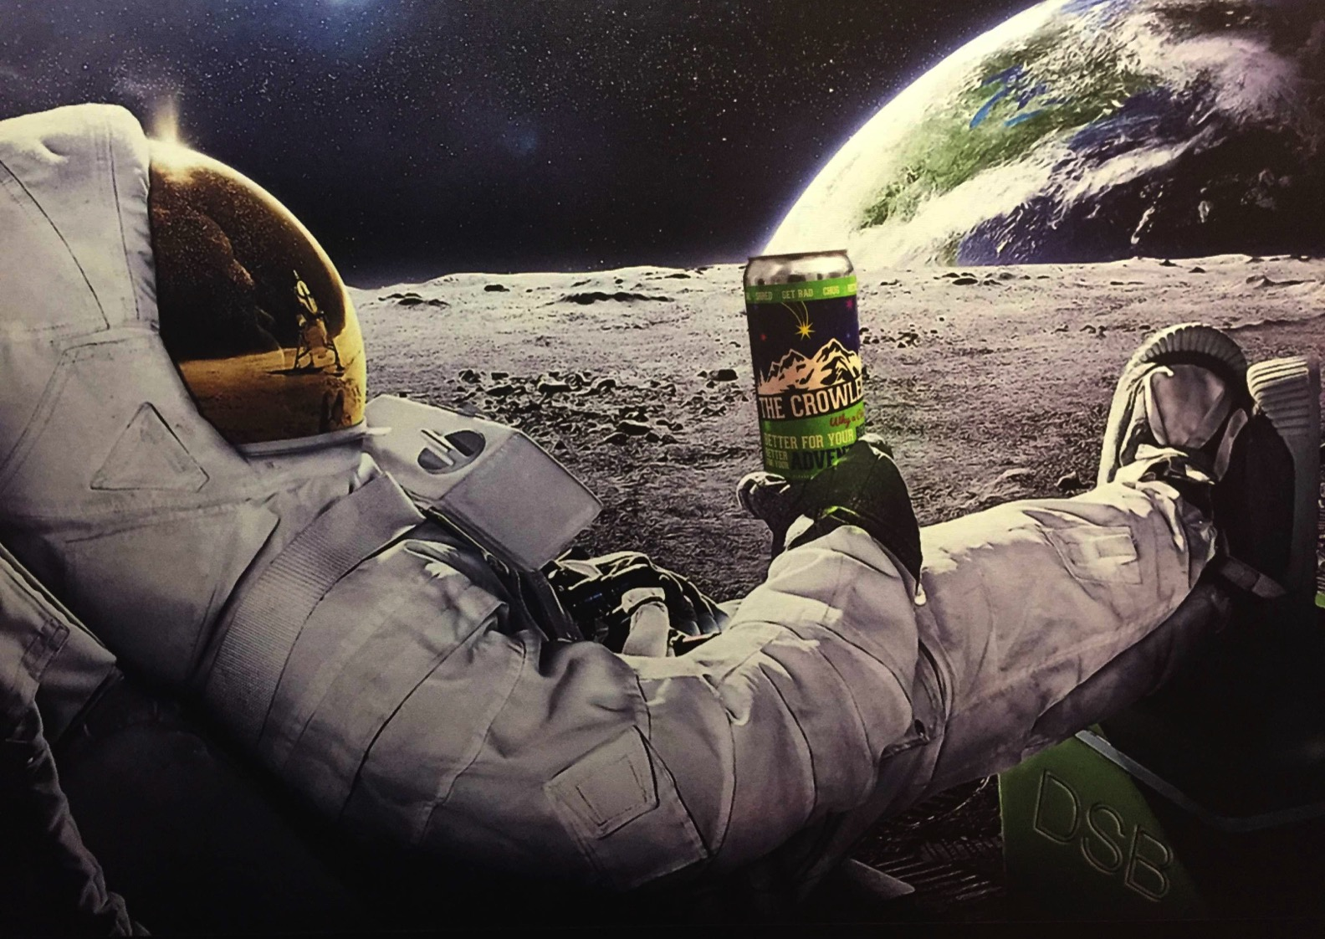
Carbon Dynamics:
Changes in seasonal amplitude of CO2 concentrations
Partitioning net ecosystem exchange components
C Flux measurements in permafrost ecosystems (with Hydrology/Permafrost WG)
Hydrology / Permafrost:
Active Layer Distribution - synthesize & assess active layer depths (with SAR WGs)
Freeze-thaw dynamics and timing (with C Dynamics WG)
Lake trends – comparison of methods & long-term trends in lake area, and drivers
Snow properties – crosscutting synthesis activity with Wildlife WG
Fire Disturbance:
√ Wildfire soil carbon combustion synthesis
√ Post-fire forest regrowth composition & trajectories (with Veg Dynamics WG)
Arctic Combustion and Regrowth Synthesis
Vegetation Dynamics:
Succession/recovery following disturbances (with Fire WG)
Forest greening/browning including role of climate & insects in forest decline
√ Tundra greening/browning including shrub expansion & densification
THIS IS OLD!

Slide 3
Synthesis Topic Name | Leads | Start Date | End Date | Status/ Progress Bar
Carbon Budget for the ABoVE domain | Abhishek Chatterjee | 1-Jan-20 | TBD | Draft_v1 Incorporate work by Jeralyn P.
 | Jon Wang
Carbon cycle response to disturbances | Nick Parazoo | 1-Jan-20 | TBD | 1st paper in review at JGR-Biogeosciences
 | Nima Madani
Methane fluxes, model-data mismatch and knowledge gaps | Jennifer Watts | 1-Jan-20 | TBD | Work by Shannon R./ Hailey W./ Luke S.
 | Roisin Commane
CO₂ amplitude synthesis - trends, drivers and projections | Brendan Rogers | 18-Jun-20 | TBD | Now in four WGs: atmospheric, terrestrial remote sensing, in situ measurements, process-based models
 | Manuel Helbig, Gretchen Keppel-Aleks, Zhihua Liu

Slide 4
5 breakout groups (chairs): Rooms
Carbon + Wetlands (Chatterjee / Laura B-C / Loboda): Auditorium
Vegetation Dynamics + Spectral Imaging (Epstein / Rogers / Huemmrich): Room 107
Permafrost and Hydrology (Kimball / Butman): Room 103
Fire and Insect Disturbance (French / Laura B-C / Loboda): Room 105
Vegetation Structure (Montesano / Macander? Duncanson?): Room 130
Self-select to breakouts
If you have multiple project participants, go to different WGs
Assign / volunteer a rapporteur and and liaise with the virtual and in-person group.

