Slide 1
Quantifying socio-economic impacts of changing Arctic ecosystems using ABoVE datasets in an integrated Human-Earth system modeling and data assimilation framework
PI: Min Chen
Co-I: Ben Bond-Lamberty
Corinne Hartin
Joint Global Change Research Institute
Pacific Northwest National Laboratory
College Park, MD
Notes:
About the Image: A Glass From the Past
While taking a closer look at ancient glass to better understand how it changed over time, Pacific Northwest National Laboratory scientists made an unexpected discovery-the remains of bacteria that once lived on the surface. PNNL researchers and collaborators are delving into the past to further their knowledge about the stability of glass that will be used to safely store low-activity nuclear waste at the Hanford Site. With support from the Department of Energy's Office of Environmental Management, International Programs through the Office of River Protection, they are analyzing this glass found in Swedish hillforts that predates the Vikings because it has a chemical composition similar to what will be produced at Hanford's Waste Treatment and Vitrification Plant and has been "stored" in a known environment for more than 1,500 years.
Research team: David Peeler, Bruce W. Arey, Carolyn I. Pearce, Tamas Varga, Micah D. Miller, Michele Conroy and Michael J. Schweiger (all of PNNL); John S. McCloy (Washington State University); Jamie L. Weaver (National Institute of Standards and Technology); Edward Vicenzi and Thomas Lam (Smithsonian Institution's Museum Conservation Institute); Rolf Sjoblom (Tekedo AB); Eva Hjarthner-Holdar and Erik Ogenhall (Arkeologerna); and Albert A. Kruger (Department of Energy Office of River Protection). The image was colorized by Nathan Johnson (PNNL).
Instrument: Scanning electron microscope and focus ion beam hybrid
https://www.flickr.com/photos/pnnl/24220123368/in/photolist-fqwiqF-aBF44N-fqwj9R-aEuQHd-CUfsRW-pZVLNL-aPjNkZ-fxBosi-aErWsK-aBCnZk-ECMqka-aEr4hT-6yL625-6xvZrp-6xh38v-6xmeiY-VNqjUa-CJUXKp-CPUyAo-25kubq5-BUPMLB-211nysv-Chikdn-Cq6fRm-BscBWe-CnhkRJ-CiHawx-CPUwEu-BUGK7J-CiHawn-BUPKMg-CGEBLY-BUGHTw-CJV1jx-CPUxnw-CSdgpF-CSdj4D-CJUWi6-CPUwFm-BXsubh-CPUxJd-CiHdVB-BUGG5b-BUGHYm-22DixCm-243ex8R-Cq6jHQ-CGEzzy-PEd3HJ-P9S5sd

Slide 2
Science Objectives
Our overarching scientific questions are: how will the key ecosystem services in the Arctic respond to the climate change in the past decade and in the future? How big are the socioeconomic impacts of these changes in the 21st century? And how valuable are current observed ecological datasets, in terms of reducing the uncertainties of the estimated responses and changes? -- response to ABoVE’s question and objective: “How are environmental changes affecting critical ecosystem services and how are human societies response?” and “Analyze how changes to natural resources might affect local communities or influence larger scale land management policies and practices”
Objective 1. Improve estimates of key terrestrial ecosystem dynamics in the ABoVE domain in the 21st century using CLM and DART with multi-source remotely-sensed and field-campaign datasets.
Objective 2. Quantify the responses of the land, agriculture, energy sectors to the Arctic ecosystem changes. Analyze these responses and provide the results to the interested organizations and stakeholders (resource managers and policymakers).
Objective 3. Quantify the additive value of the observational datasets in constraining the uncertainties when quantifying Arctic ecosystem changes and their socioeconomic impacts.

Slide 3
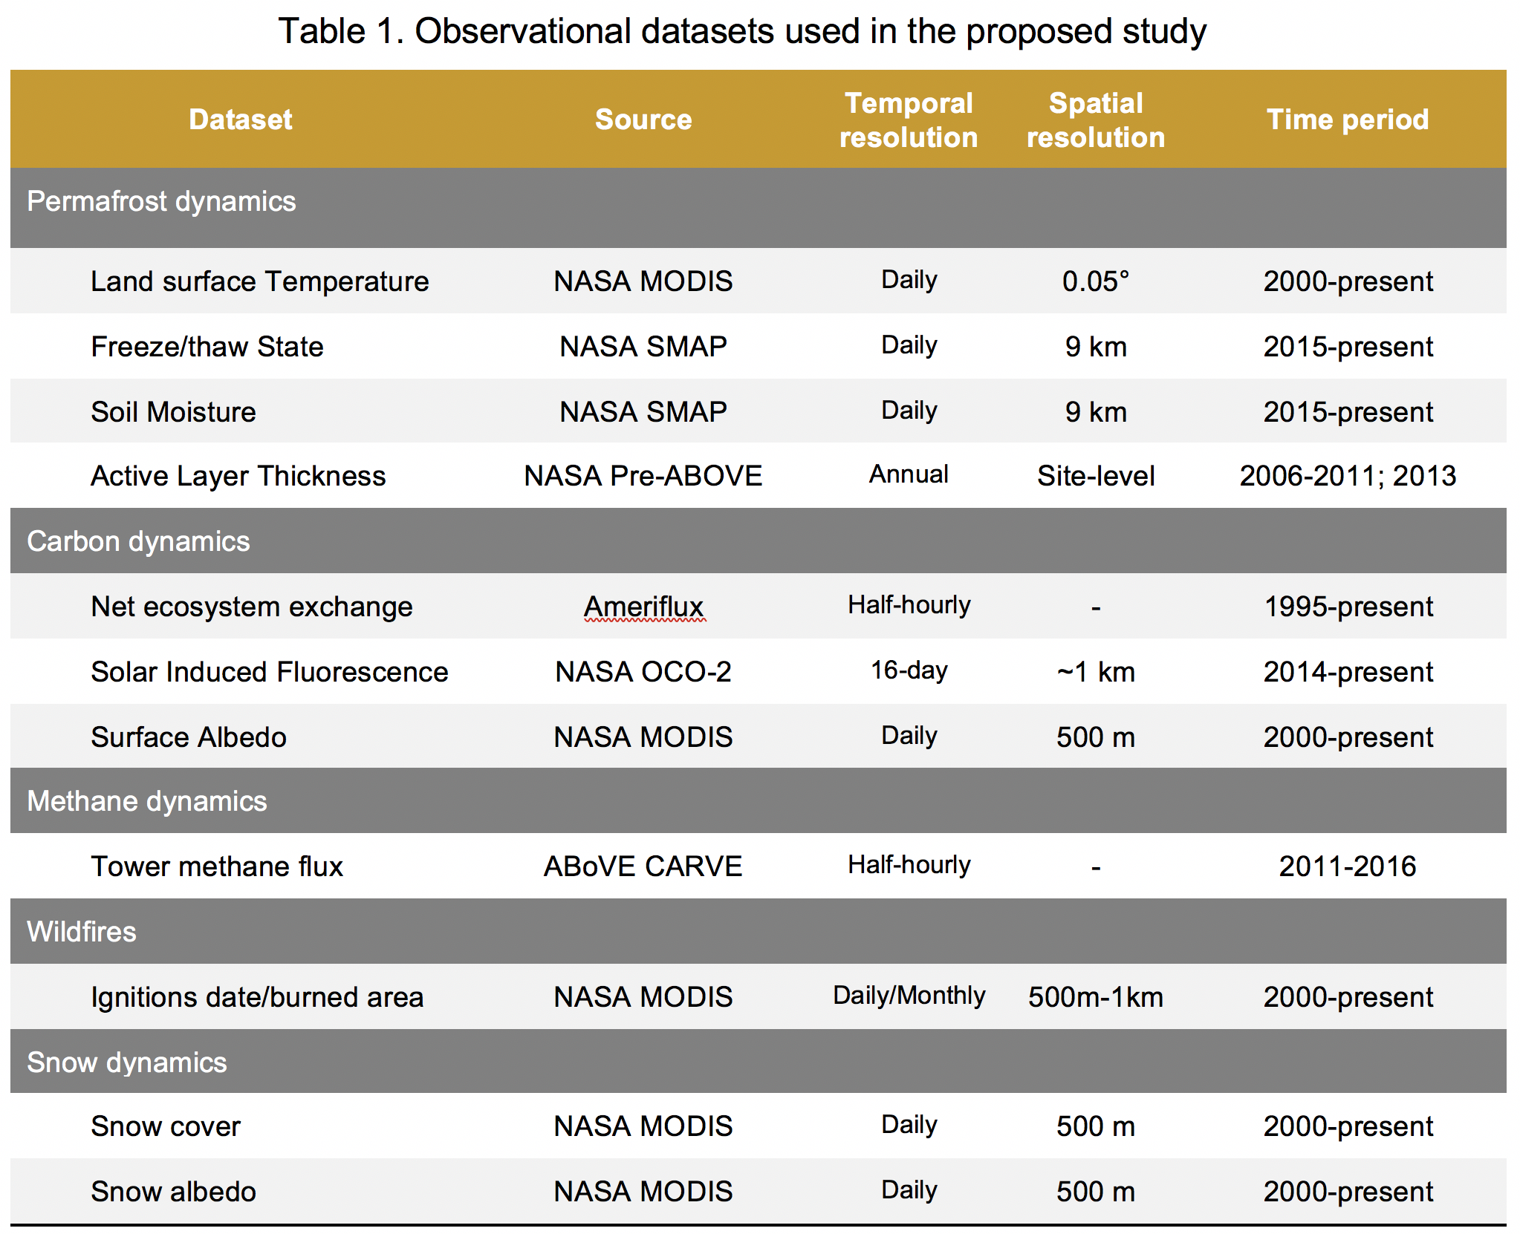
Observational datasets (Field and remote sensing)
Two-Phase data assimilation experiments:
  Phase 1: site-level
  Phase 2: Arctic domain

Slide 4
Modeling

Slide 5
Stakeholder Engagement
Stakeholder | AOI | Project Phase | E&I Approach | E&I Tools | Frequency
Northwest Boreal LCC | Alaskan forest management | All | Consult | Meetings; Emails; Reports | Reports once a year; Face-to-face meeting at GCAM annual meetings; Quarterly telecon; Email exchanges as needed.
US EPA | Energy use and emissions | All | Consult | Meetings; Emails; Reports
UMD ESSIC | Scientific Application of the results | All | Consult | Meetings; Emails; Reports
Local organization
Research Institution
Federal agency

