Slide 1
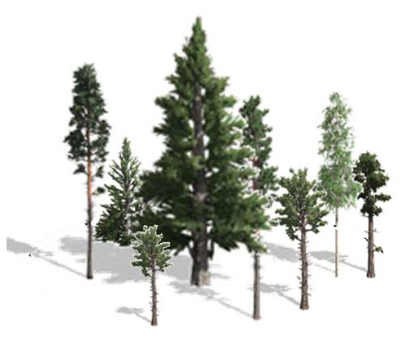
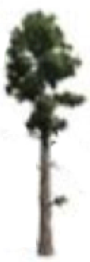
Vulnerability of the Taiga-Tundra Ecotone: Predicting the Magnitude, Variability, and Rate of Change at the Intersection of Arctic and Boreal Ecosystems
PI: Amanda Armstrong¹
Co-Is: Paul M. Montesano²,Batu Osmanoglu³, Kenneth J. Ranson³, Howard Epstein⁴
Collaborators: Herman H. Shugart⁴
¹Universities Space Research Association, GESTAR, NASA-GSFC, ²SSAI, NASA GSFC, ³NASA Goddard Space Flight Center ⁴University of Virginia, Charlottesville VA
Notes:
Grateful to be here to introduce our Phase 2 project.
Our team is comprised of: Armstrong, Montesano, Osmanoglu, Ranson, Epstein and a PhD student arriving this summer, and Shugart

Slide 2
Science Objectives
The goal of this work is to examine and quantify the likelihood of predicted changes in Tundra-Taiga Ecotone (TTE) forest structure patterns occurring within the ABoVE extended domain, using airborne imagery and lidar observations, site-scale forest and tundra vegetation modeling, and a Landsat-derived map of the extent & pattern of the TTE.
Our project directly addresses the ABoVE Phase 2 science question: How are flora and fauna responding to changes in abiotic and abiotic conditions, and what are the impacts on ecosystem structure and function?
We will discover:
1. how patterns of tree cover may be linked to processes (tree cover change),
2. where we can infer ‘process’ from these tree cover patterns (and where we cannot), and
3. what the lags associated with these changes are, to help understand the implications of these changes and their effects on wildlife, subsistence livelihoods, surface albedo, feedback mechanisms, etc.
Notes:
Variables like topography, climate, soils, permafrost

Slide 3
Study Sites
Notes:
The three proposed study sites are shown in association with the mapped TTE extent within the TTE Bioclimatic Domain (Montesano et al. in prep; Based on data from Montesano et al. 2016).
The inset areas to the right of the study site boxes provide examples of the variation in tree cover abruptness within each study site.
Black lines depict the centerlines of LVIS airborne data from which reference forest structure will be used to initialize model runs and validate results.

Slide 4
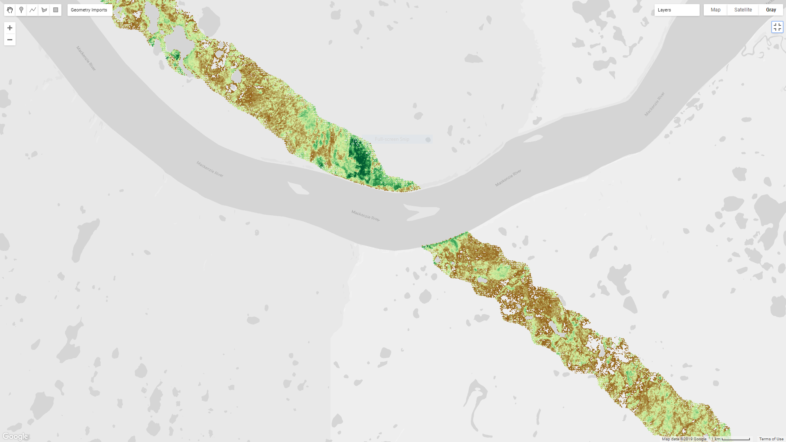
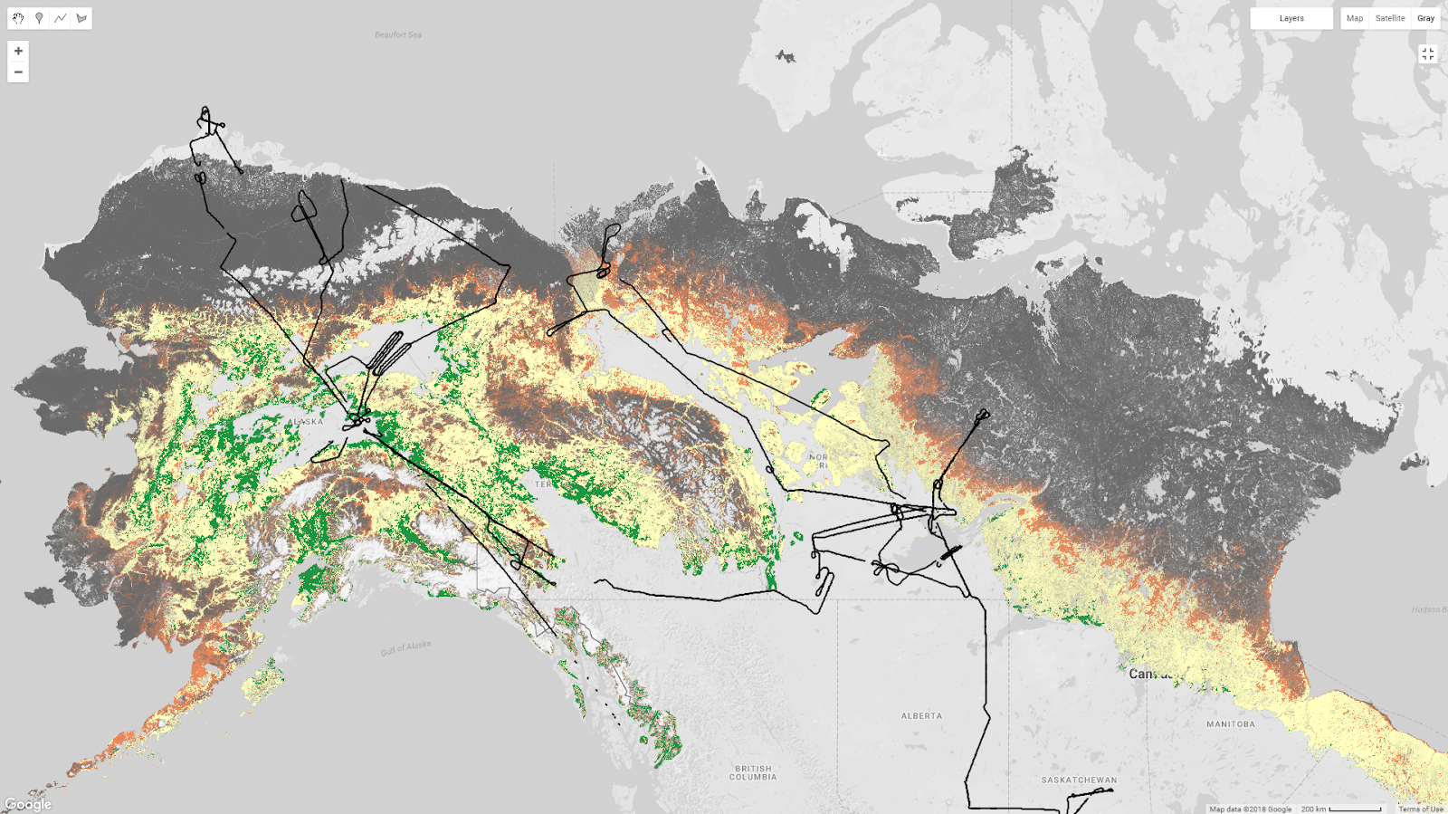
Remote Sensing
Airborne
Reference % tree canopy cover from LVIS 2017 & 2019 to:
validate spaceborne estimates of forest structure
calibrate statistical distributions of structure for models
Spaceborne
Landsat-based % tree canopy cover products with topographic details from ArcticDEM & Tandem-X DEM to:
create broad-scale maps of forest structure patterns
Planned data products
TTE forest structure patterns to constrain modelling of biome boundary & vulnerability/resilience of woody structure
Notes:
We will use reference % tree canopy cover from LVIS 2017 and 2019 to:
We will use landsat-based % tree canopy cover products with topography from Arctic DEM & Tandem-X DEM to
From this we’ll gain knowledge of TTE forest structure patterns to constrain modelling of biome boundary vulnerability/resilience of woody structure to change

Slide 5
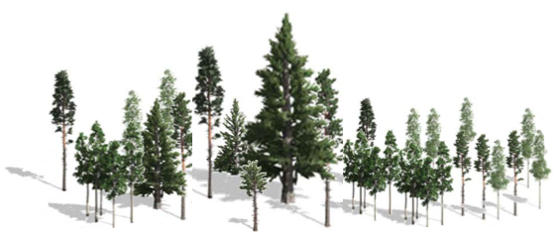
Modeling
Forest Inventory Data
Environmental Datasets
To understand how structural responses to environmental change will vary in timing and magnitude at sites within the ABoVE study domain, we will:
Parameterize a spatially-explicit Individual-Based Gap Model (IBGM) with field data, and spaceborne and airborne vegetation structure data
Improve permafrost & allometry routines, introduce litterfall and integrate a well-known tundra model’s parameters into our model to extend the simulation domain across the full tundra-taiga boundary at the individual scale.
Our updated model will have the capability to simulate fine scale processes associated with TTE conditions (tundra PFTs & woody structure), and will project changes in the study region initialized with CMIP6 climate scenarios.
CHMs
1. PARAMETERIZE SIBBORK
Permafrost updates
2. INTEGRATE ArcVeg parameters
Litter and Nutrient updates
Allometry updates
SIBBORK_TTE
Notes:
The new SIBBORK-TTE model which add the ability to simulate tundra plant functional types from ArcVeg in a spatially explicit individual-based gap model framework
The model will be a novel tool suited for examining changes in both tundra plant functional types and woody structure across a range of climatic and soil conditions.

Slide 6
Expected Products
Our research will provide a deeper understanding of the current productivity dynamics along the TTE, and allow for informed prognostication about the shift in the extent of tree cover, and spatial variability in the direction, rate, and magnitude of these shifts.
Products:
1) Updated Landsat (30m) Vegetation Abruptness Map
2) Validated Abruptness Map (<30m) using LVIS
3) Spatially-explicit IBGM capable of simulating TTE structure and dynamics
4) Regional scale (1ha) vulnerability hotspot maps
Stakeholders and Opportunities:
Local and Native communities associated with change hotspots
State and Federal Policymakers and decision-making bodies developing policy using informed predictions of change in the TTE
Disturbance prediction researchers
NASA Globe Observer opportunity to collaborate with local community stakeholders
Notes:
Stakeholders and Opportunities:
Our work will be accessible and interesting to
In addition, the new NASA Globe Observer provides an additional opportunity

