Slide 1
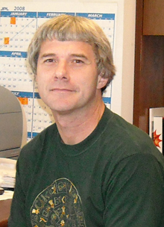
Analysis and Interpretation of UAVSAR Tomographic Data in the Arctic Boreal Region
Scott Hensley, Brian Hawkins, Bruce Chapman, Naiara Pinto, Razi Ahmed
Jet Propulsion Laboratory, California Institute of Technology
Paul Siqueira
University of Massachusetts Amherst
Konstantinos Papathanassiou, Matteo Pardini
German Aerospace Center (DLR), Microwaves and Radar Institute
ABoVE Science Team Meeting
May 20, 2019
Copyright © 2019 California Institute of Technology. Government sponsorship acknowledged. All Rights Reserved

Slide 2
Science Objectives
The primary goals of this proposal are to analyze and characterize the use of radar tomographic data at different radar wavelengths in conjunction with hyperspectral data to measure biomass and vegetation structure and their spatial gradients in the Arctic-Boreal zone.
Goals:
Generate tomographic products and polarimetric-interferometric (PolInSAR) heights using the UAVSAR L/P-band data collected at Delta Junction in Alaska and the BERMS site in Canada.
Compare tomographic and PolInSAR derived tree height and vegetation structure measurements to G-LiHT and LVIS lidar measurements at L-band and P-band based using scalar metric derived from the profiles.
Generate tomographic products and polarimetric-interferometric (PolInSAR) heights using the DLR F-SAR L-band and S-Band data collected at the BERMS site in Canada.
Determine the correlation between hyperspectral data to structure data derived from tomographic and PolInSAR data for S, L and P-bands.
Generate biomass maps, with and without hyperspectral data input, derived from S, L and P-band tomographic and PolInSAR data from F-SAR and UAVSAR from and quantitatively compare with lidar and in situ based measurements.
Characterize the spatial gradients of tomographic and PolInSAR derived biomass and structure gradients a function vegetation class.
Simulate boreal forests tomographic boreal forest data sets using the PolSARSimPro+ scattering tool and perform sensitivity analysis of tomographic derived vegetation signatures to temporal correlation, vegetation and soil moisture, surface slope and baseline configuration.

Slide 3
Field Studies
During year 2 we anticipate deploying to the field in Delta Junction, Alaska and in BERMS, Canada to resolve ambiguous results in the data and validate results obtained from the radar data.
Ground Measurements & Validation Efforts
Tree density and diameter at breast height
Species identification
Ground cover characterization
Canopy gap fraction

Slide 4
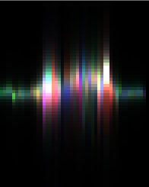
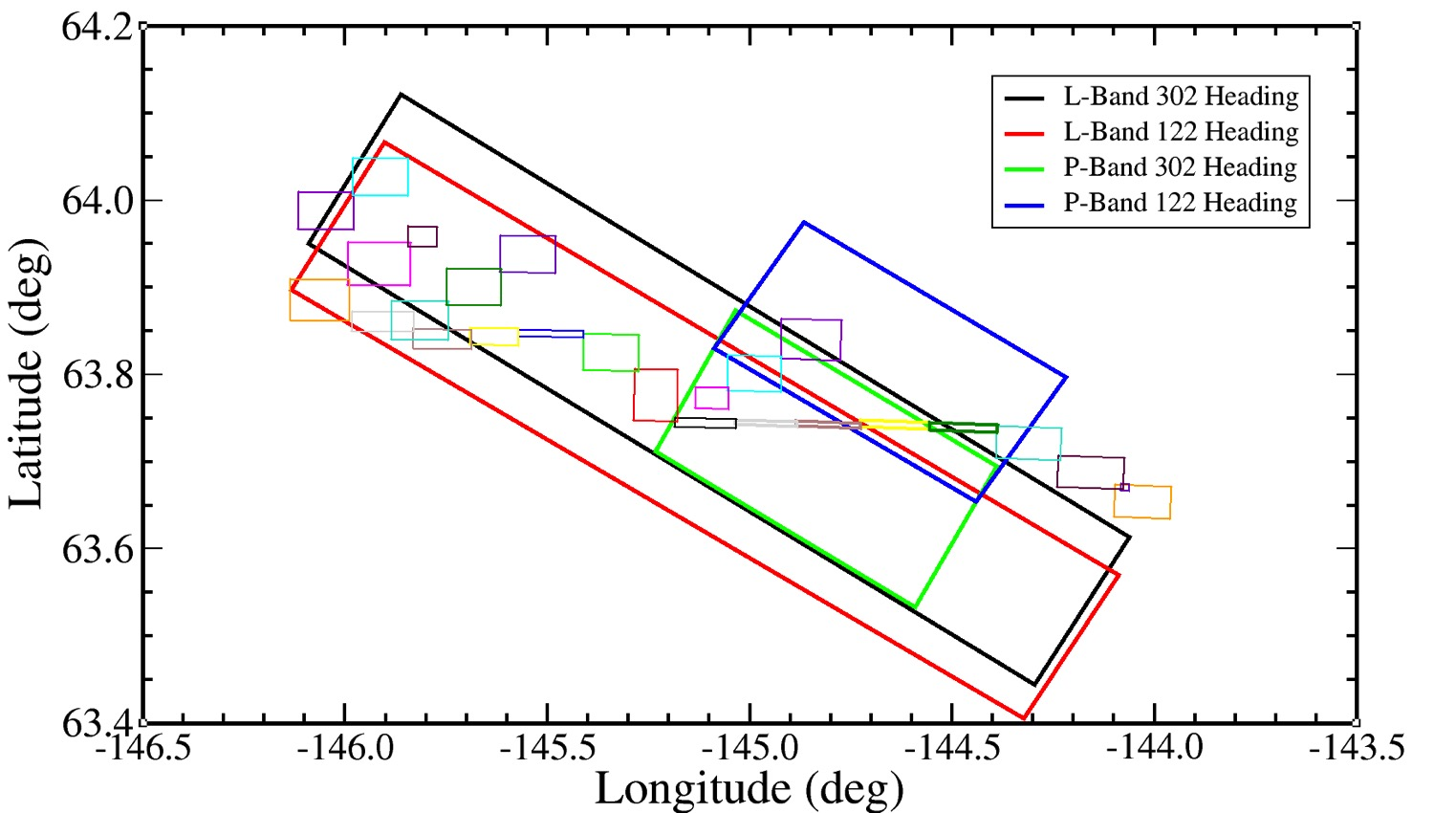
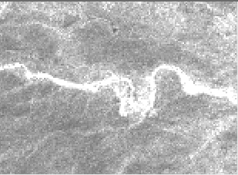
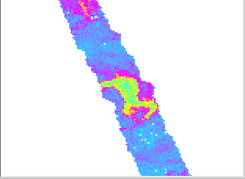
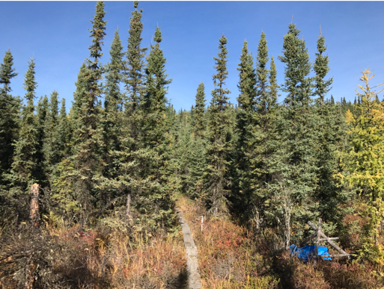
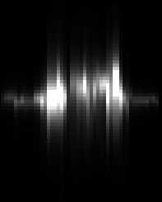
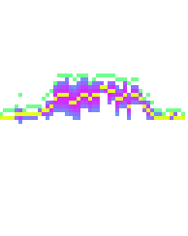
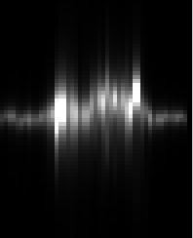
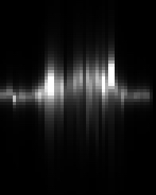
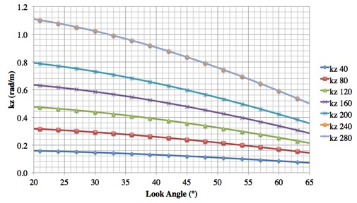
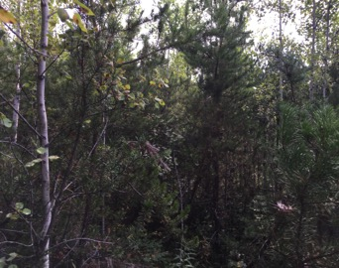
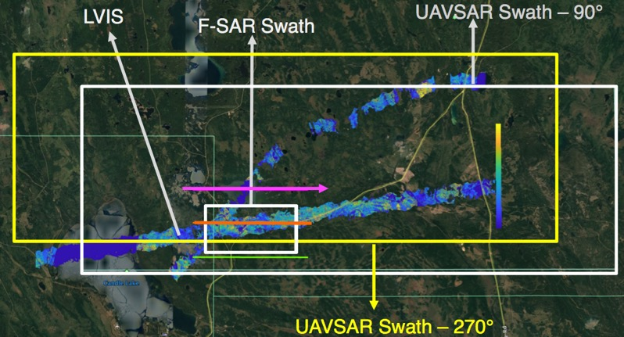
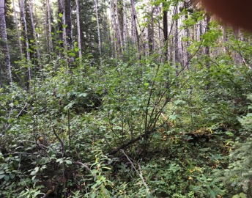
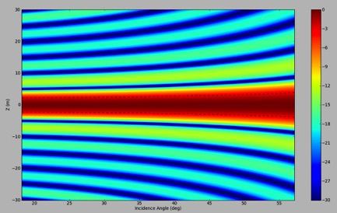
Remote Sensing
Our study uses the S,L,P-band tomographic data sets collected at Delta Junction, Alaska and BERMS in Canada by UAVSAR and DLR F-SAR along with G-LiHT and LVIS lidar and hyperspectral data.
Delta Junction
L-band 122°
HH=red
VV=blue
HV=green
HH + Lidar
HH
Mean
Max
Std
Max Tree Height (m)
VV
HV
BERMS

Slide 5
Modeling
PolSARproSim+ developed at the Jet Propulsion Laboratory is based on software distributed by the European Space Agency (ESA) as an open source tool for simulating radar backscatter from forests. The software (as distributed), was intended to be an educational tool with limited flexibility, it has been used for analyzing various radar algorithms.
PolSARproSim+, built on the distributed version of the software with improvements that allow more flexibility for simulating different mission requirements, observational scenarios and instrument parameters.
It is capable of simulating scattering from forests with mixtures of species supplied through two input database files, one for specifying tree-by-tree attributes such as species, location, height, canopy parameters etc. and the other database file for describing species attributes.
An important additional feature is the ability to simulate wind and rain induced-change, allowing for an analysis of temporal decorrelation that is known to significantly effect polarimetric interferometry and tomography
Simulating tomographic stacks at various frequencies allows the modification of key vegetation, instrument and environmental factors and to assess the sensitivity of tomographic profile metrics and height measurements to these variations.

Slide 6
Stakeholder Engagement
As with the fieldwork conducted in 2018 where students from indigenous communities assisted with the field work we will offer similar opportunities for any future field.
We will actively seek to have a an undergraduate or graduate student from Alaska do a summer internship at JPL working with us on using radar remote sensing for forest structure and biomass estimation.
Additionally, we will invite interested researchers for universities engaged in boreal forest research to visit JPL, not funded under this proposal, and learn in more detail about our research.

