Slide 1
Assessing impact of climate-driven increase in wildfire emissions on air quality and health of urban and indigenous populations in Alaska
PI
Tatiana Loboda, University of Maryland
Co-Is
Nancy French, Michigan Technological Research Institute
Robin Puett, University of Maryland
Dong Chen, University of Maryland

Slide 2
Science Objectives
ABoVE Phase 2 priority research question How are environmental changes affecting critical ecosystem services and how are human societies responding?
Ecosystem Services subcomponent of the ABoVE plan - [Human Health] Determine how changes to disturbance regimes, flora and fauna, permafrost conditions, and/or hydrology influence human health outcomes in the ABR
Premise: Wildfires are common and recurring events in ABR which have large impacts on air quality. Health studies of episodic wildfire events linked related PM_{2.5} to respiratory and cardiovascular distress. However, no studies have been conducted to assess impact of long-term repeated exposure of Alaskans to smoke. Therefore, in this study, a team of geospatial scientists, air pollution modelers, and spatial epidemiologists, will work together to measure the impacts of different levels of fire activity on health outcomes based on hospitalization records in Alaska between 2001 and 2018.

Slide 3
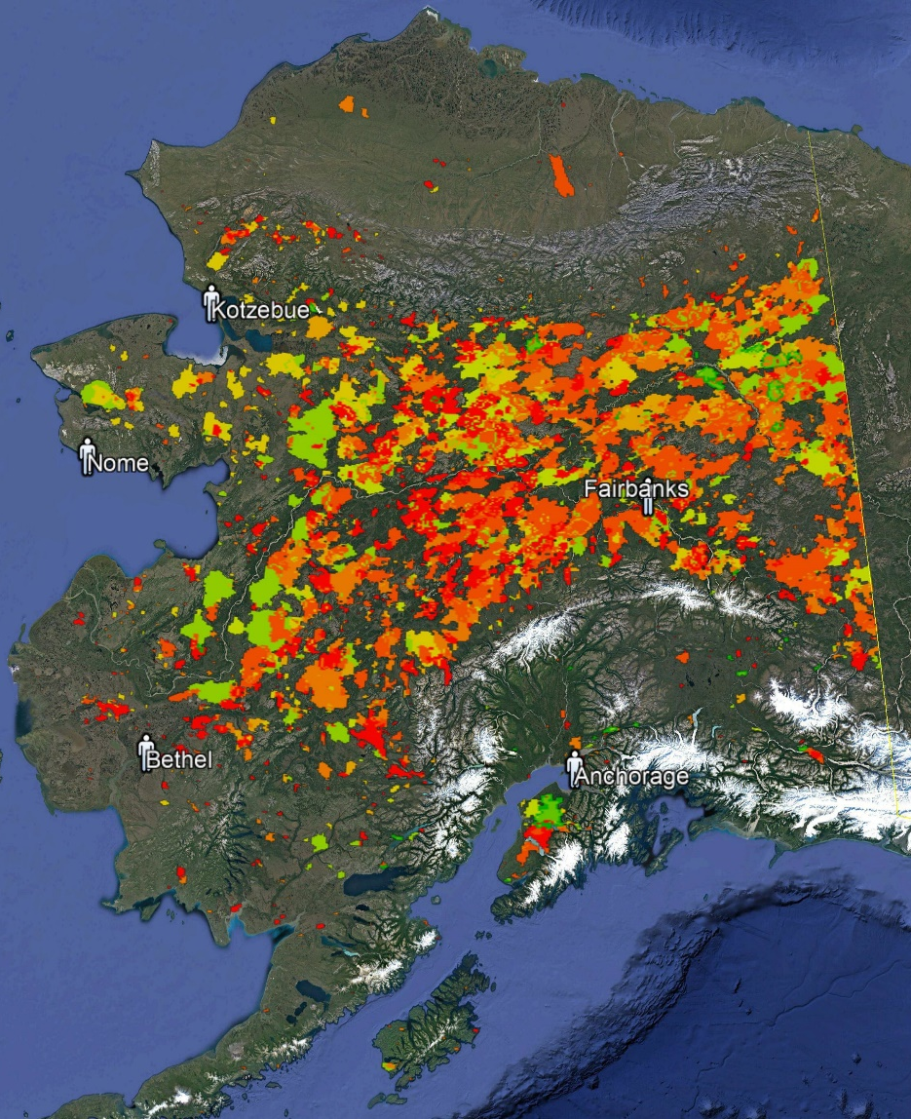
Remote Sensing
Wildfire is a persistent backdrop of life in Alaska during summer. Since 2000, Alaskans have experiences 3 largest fire seasons on record and there has not been a single year without fire since continuous satellite monitoring began.
Spaceborne remote sensing:
Landsat/Sentinel 2 optical data
MODIS active fires
Planned data products:
Annual 30m DOB and dNBR maps for Alaska 2016-2020 (to extend the existing record between 2001 and 2015).
Annual 30m fuel load maps for Alaska 2001 – 2020 with uncertainty estimates expressed as RMSE.
32km 3-hour mean FRP surfaces within fire perimeters.

Slide 4
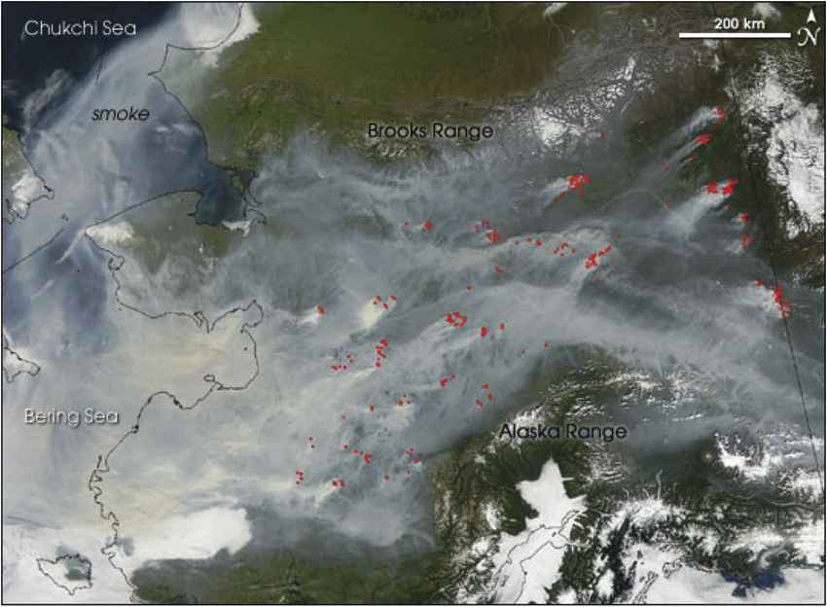
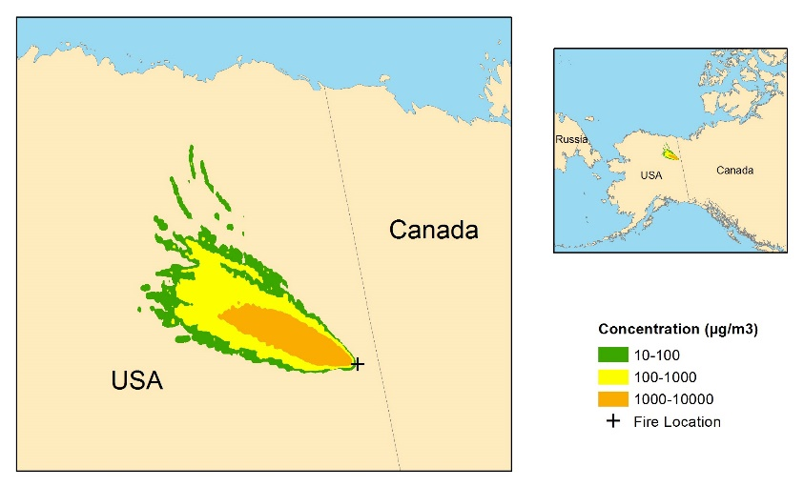
Modeling
Geospatial modeling activities:
Emissions modeling
Atmospheric transport modeling
Smoke plumes from wildfires in 2005 (shown in red), visible in satellite imagery, cover the entire Interior Alaska including the majority of populated areas.
Planned model products:
Daily 1 km PM_{2.5} emissions with associated uncertainty layers for selected years
Daily 32 km minimum, mean, and maximum surface-level wildfire-produced PM_{2.5} concentration layers
HYSPLIT-generated estimates of PM2.5 concentration emitted from the 2010 Big Mountain Fire in Alaska based on emissions delivered from the existing WFEIS-Alaska instance. This example shows 24-hour concentrations averaged over 0-500m of atmospheric column with plume injection height at 1 km above ground level.

Slide 5
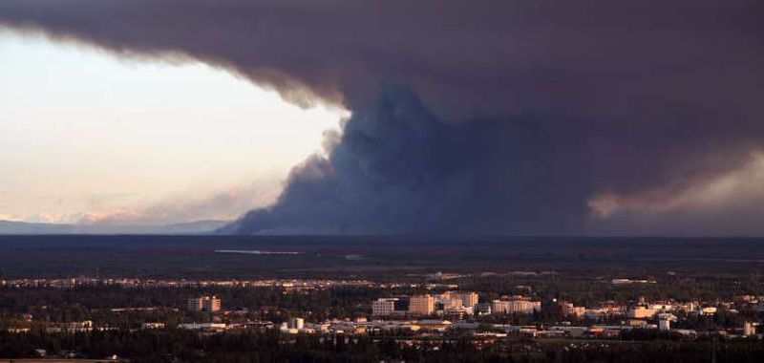
Health Outcomes Assessment
Primary aim: Quantify the impact of fire-generated PM_{2.5} concentrations across the state of Alaska during high, moderate, and low intensity fire seasons on hospitalizations of Alaskans specifically for respiratory and cardiovascular outcomes.
Secondary aim: Assess if there are differences in the overall exposure to PM_{2.5} from wildfire emissions and subsequent health outcomes based on socioeconomic or demographic status of the population.
Smoke plume near Fairbanks, AK on August 22, 2012 (AP Photo/Fairbanks Daily News-Miner, Sam Harrel/AP) www.nydailynews.com.

Slide 6
Stakeholder Engagement
Federal / state / territory agencies:
Alaska CDC
State of Alaska Department of Public Health
US Department of State
Other stakeholder organizations:
the IARPC Health and Human Well-being Collaboration Team

