Slide 1
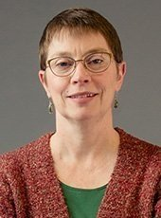
Wetland status, change, and seasonal inundation dynamics for assessing the vulnerability of waterfowl habitat within the ABoVE study domain
PI French
PI: Nancy HF French, Michigan Tech Research Institute
Co-Is: Liza Jenkins, Michigan Tech Research Institute
Laura Bourgeau-Chavez, Michigan Tech Research Institute
Michael Battaglia, Michigan Tech Research Institute
Kevin Smith, Ducks Unlimited Canada
Bruce Chapman, NASA JPL
Co-I Jenkins

Slide 2
Science Objectives
ABoVE Science Objectives addressed:
Ecosystem Dynamics
7. Changes to Fish and Wildlife Habitat - Determine how the spatial and temporal dynamics in both faunal abundance and characteristics of fish and wildlife habitat co-vary across gradients of climate and disturbance.
Ecosystem Services
3. Subsistence - Evaluate how changes to ecosystems will influence subsistence opportunities.
Wetlands of the ABoVE domain provide critical habitat for a variety of waterfowl and are valuable resources for subsistence hunters who rely on waterfowl as a seasonal source of food, but changing climatic conditions may impact wetland extent and hydroperiod. Therefore, this project will characterize changes in waterfowl habitat using remote sensing approaches developed using field, airborne, and satellite data collected during the ABoVE research campaigns.

Slide 3
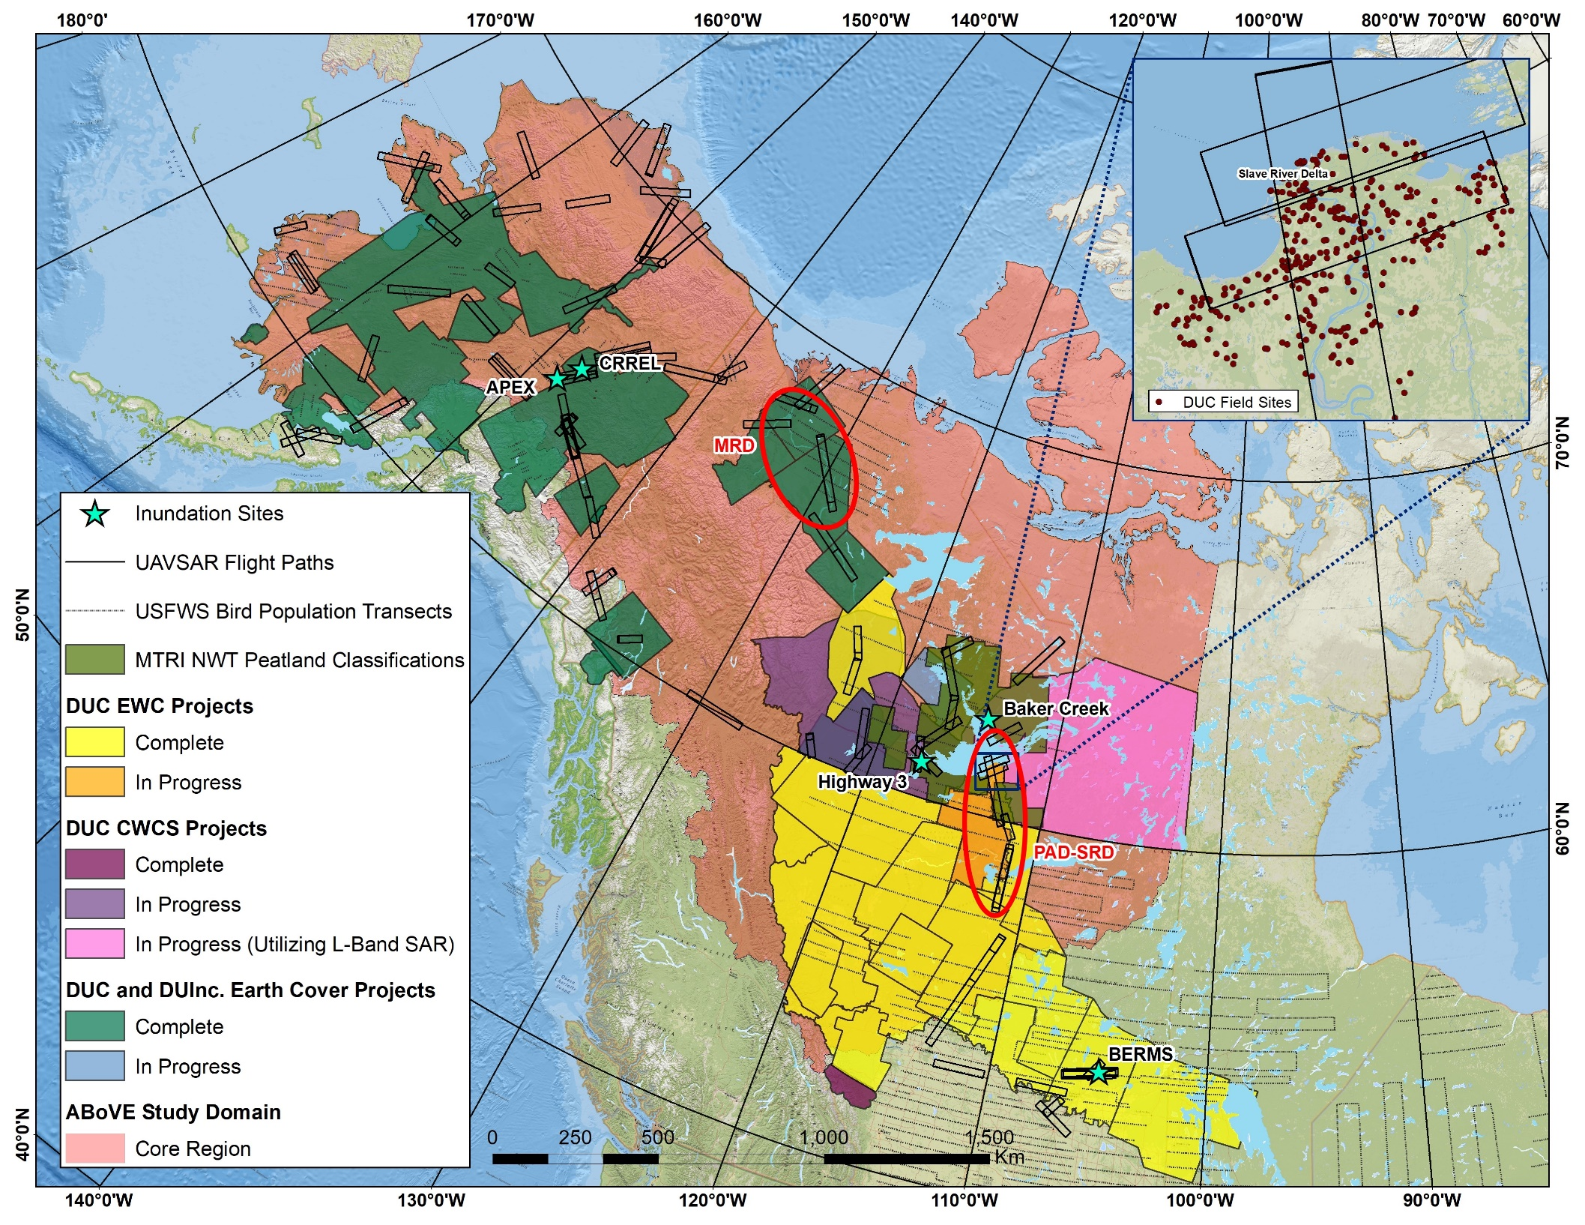
Field Studies
Wetland type and inundation extent are primary focus of field activities
Field data will be used to validate wetland type and inundation maps

Slide 4
Remote Sensing
Airborne remote sensing
Utilizing UAVSAR for inundation and wetland type mapping
2017 AVIRIS for assistance in distinguishing between wetland vegetation types
Spaceborne remote sensing
L-Band SAR: PALSAR (for circa 2007 mapping)
C-Band SAR: Sentinel-1, Archival ERS-2
EO: Landsat TM, Landsat OLI, Sentinel-2
Planned data products
Inundation extent maps
Wetland type maps for past and current conditions (c. 2007-2008 and c. 2017-2018)

Slide 5
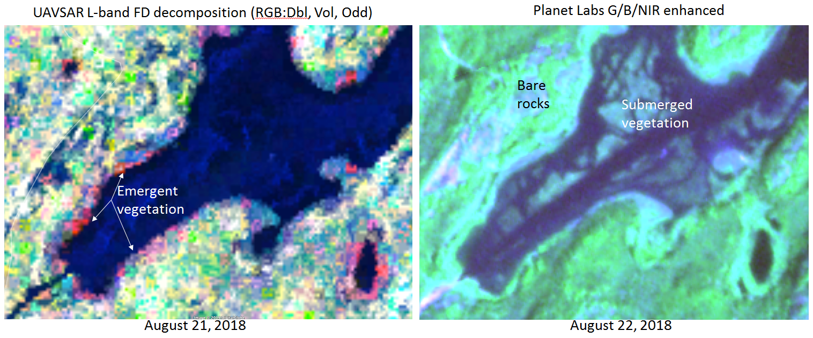
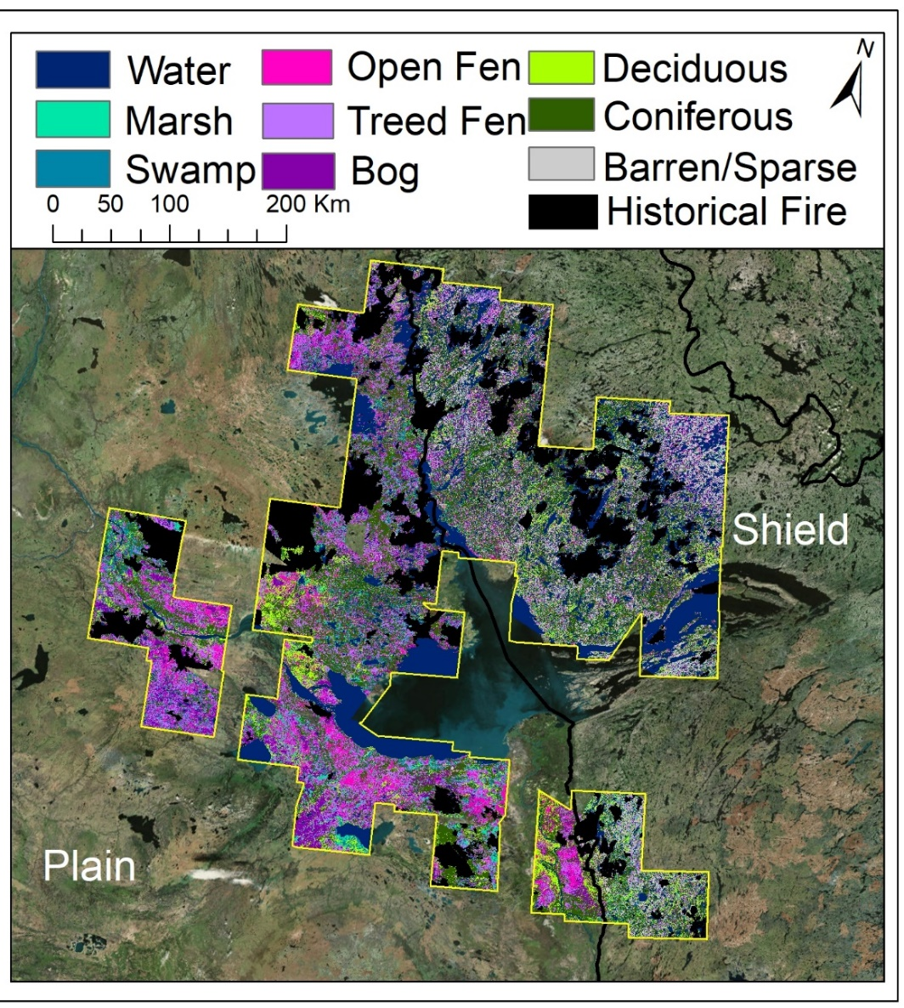
Example of Inundation Mapping
Using UAVSAR Data (Chapman)
Example of Wetland Type Maps
Created for Previous
ABoVE Project (Bourgeau-Chavez)

Slide 6
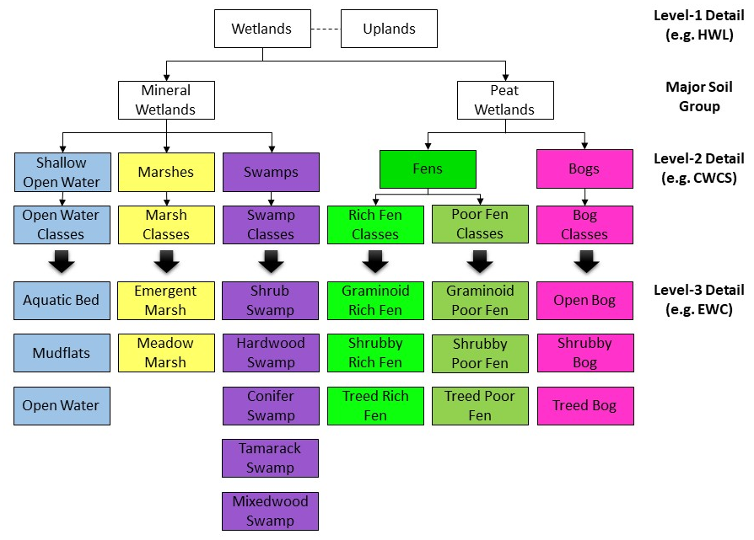
Waterfowl habitat suitability assessment
Enhanced Wetland Classification (EWC) and Canadian Wetland Classification (CWCS) classes used in DUC wetland classification maps
Generate spatial maps of predicted waterfowl abundance using waterfowl abundance predictive models

Slide 7
Stakeholder Engagement
Expanding and maintaining relationships with First Nations groups to ensure incorporation of local knowledge and usability and value of project outputs
DUC has existing partnerships with several communities in NWT
GNWT and non-government organization feedback will be solicited

