Slide 1
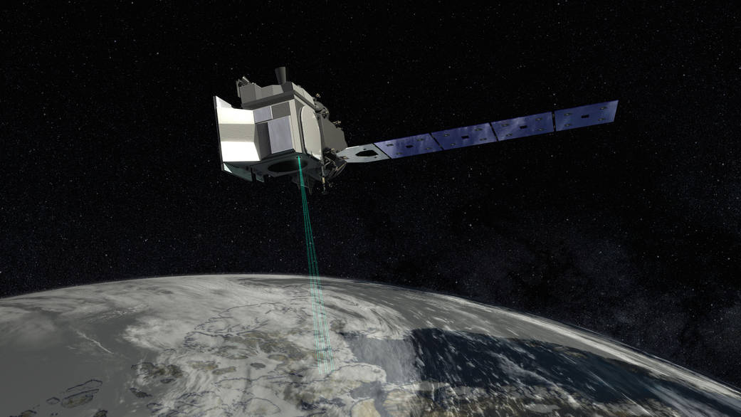
ICESat-2 Mission Update
Amy Neuenschwander
University of Texas at Austin

Slide 2
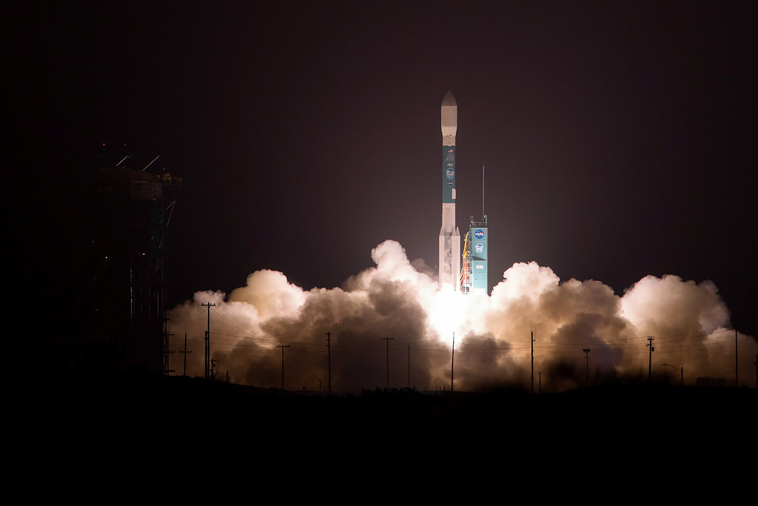
ICESat-2 Successfully Launched on September 15, 2018 from Vandenberg AFB
Data will be released ~May 28th

Slide 3

ICESat-2 Science Objectives
Quantify polar ice-sheet contributions to current and recent sea-level change and the linkages to climate conditions
Quantify regional signatures of ice-sheet changes to assess mechanisms driving those changes and improve predictive ice sheet models; this includes quantifying the regional evolution of ice sheet change, such as how changes at outlet glacier termini propagate inward.
Estimate sea-ice thickness to examine ice/ocean/atmosphere exchanges of energy, mass and moisture;
Measure vegetation canopy height as a basis for estimating large-scale biomass and biomass change.
Quantify polar ice-sheet contributions to current and recent sea-level change and the linkages to climate conditions
Quantify regional signatures of ice-sheet changes to assess mechanisms driving those changes and improve predictive ice sheet models; this includes quantifying the regional evolution of ice sheet change, such as how changes at outlet glacier termini propagate inward.
Estimate sea-ice thickness to examine ice/ocean/atmosphere exchanges of energy, mass and moisture;
Measure vegetation canopy height as a basis for estimating large-scale biomass and biomass change.
Notes:
The ICESat-2 mission developed as a direct call from the 2007 decadal survey which noted the critical importance of monitoring changes in our cryosphere and biosphere. As such, there are 4 primary science objectives/requirements for the ICESat-2 mission and they are listed here.

Slide 4
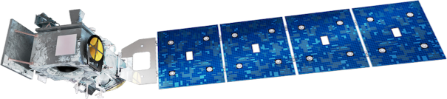



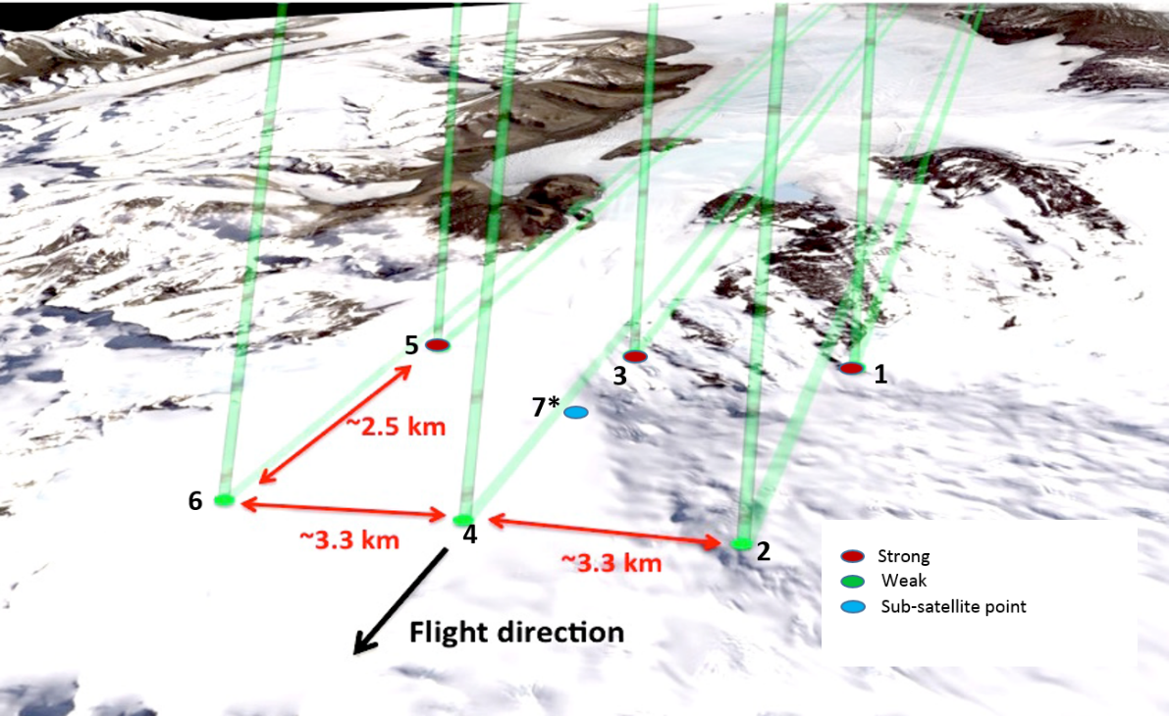
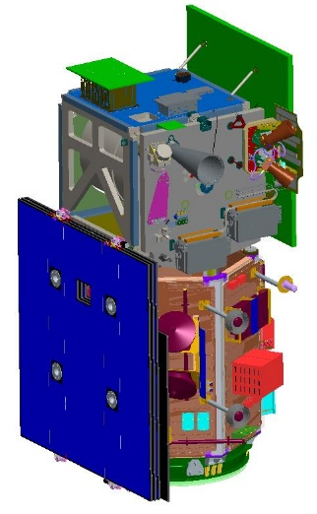
ICESat-2 Mission Overview
Payload
ATLAS – Advanced Topographic Laser
Altimeter System developed at GSFC
  Measures time of flight of laser pulses
  Measures pointing direction
  Single-photon sensitive detection
  6 beams, arranged in 3 pairs
  10 kHz pulse-rep. rate
  14 m footprint
  spaced 0.7m along-track
  532nm wavelength
Implementation
Launch Date: September 15, 2018
Lifetime: 3 years, with consumables for 5+
Orbit: 454 km, non-sun-synch, 92° inclination
Repeat: 91 day exact repeat, ~30 day sub-cycle
Science Data: 1 TB/day
System Pointing: Control = 45 m (14.3 m, CBE)
Knowledge = 6.5 m (4.0 m, CBE)
Single laser pulse at 532nm split into 6 beams.
Single-photon sensitive detection.
~3 km spacing between pairs provides spatial coverage
~90 m pair spacing for slope determination (2° yaw)
high-energy beams (4x) for better performance over low-reflectivity targets.

Slide 5

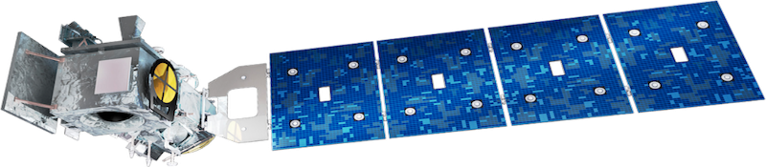

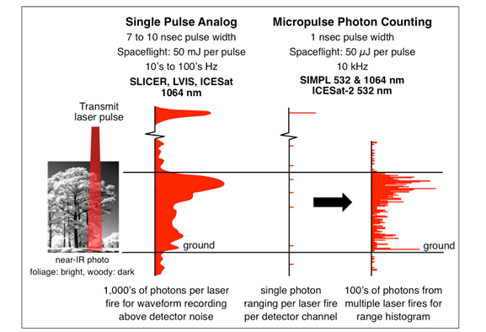
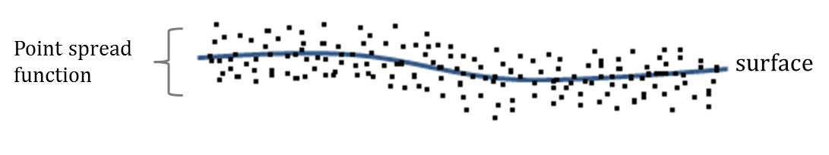
What is Photon Counting Lidar?
The reflectance of the surface at 532 nm drives the number of returned photons detected by ICESat-2
Land (“Vegetation and Ground”) are not as bright of reflectors as snow or ice.
We are expecting to get a per shot average of about 1 photon from the ground and 1 photon from vegetation
1 shot every 70 cm in the along-track direction

Slide 6
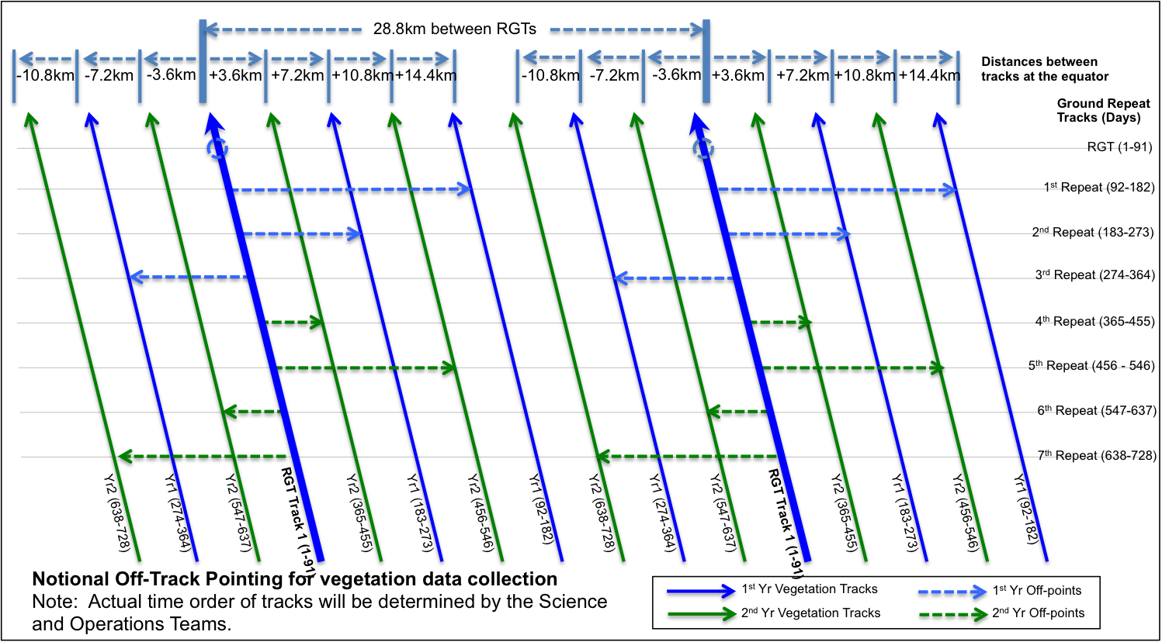
ICESat-2 Off Pointing for Land/Vegetation
Over mid-latitudes, ICESat-2 will systematically off-point to increase data density
ICESat-2 is in a 92 degree polar orbit with a repeat cycle every 91 days
Notes:
Over the mid-latitude, ICESat-2 will be systematically off pointed to increase the data density. ICESat-2 will be in a 91-day repeat cycle, so if we look at this chart, the large bold arrows indicate the nominal orbit groundtrack. The next 91 days, the satellite will be pointed to split the distance between the repeat ground tracks. Each 91 day cycle, I2 will split the difference between previously collected groundtracks.

Slide 7
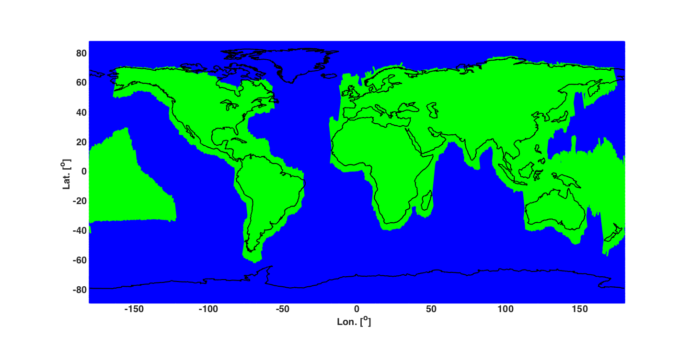
Off-Nadir Pointing over non-polar regions
Repeat Track Mode
Off-nadir Pointing Mode

Slide 8
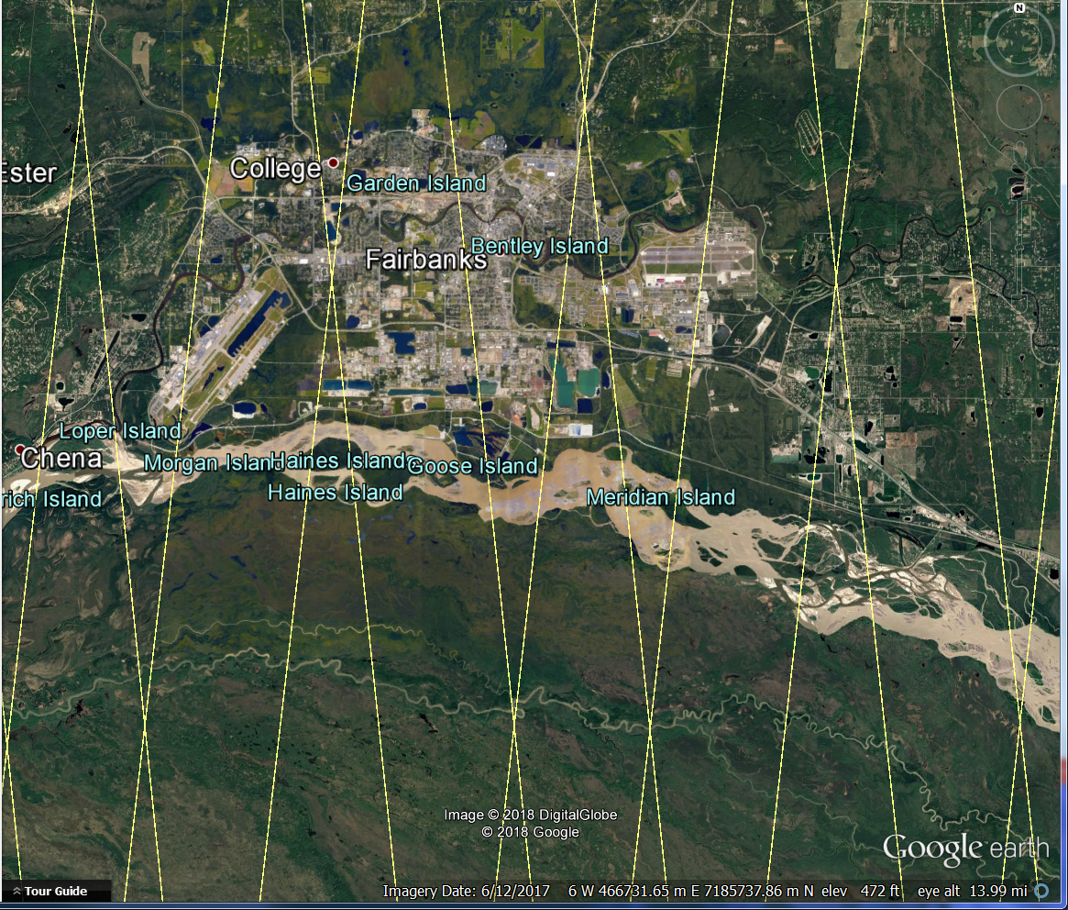
ICESat-2 Orbit
1st 91-day repeat cycle
3km

Slide 9
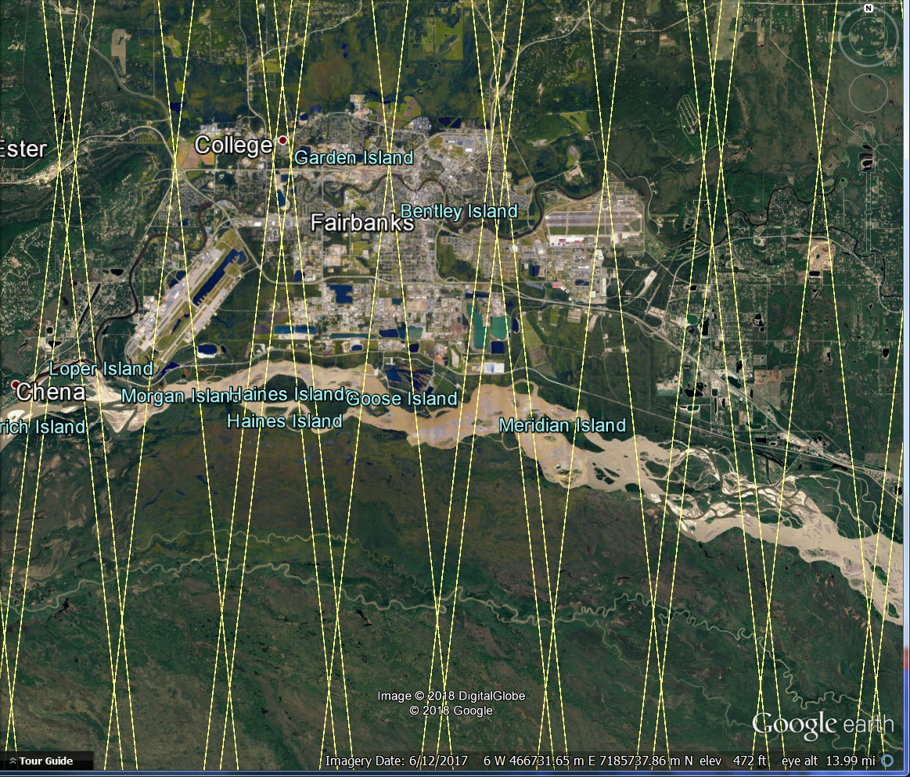
ICESat-2 Orbit
2nd 91-day repeat cycle
3km

Slide 10
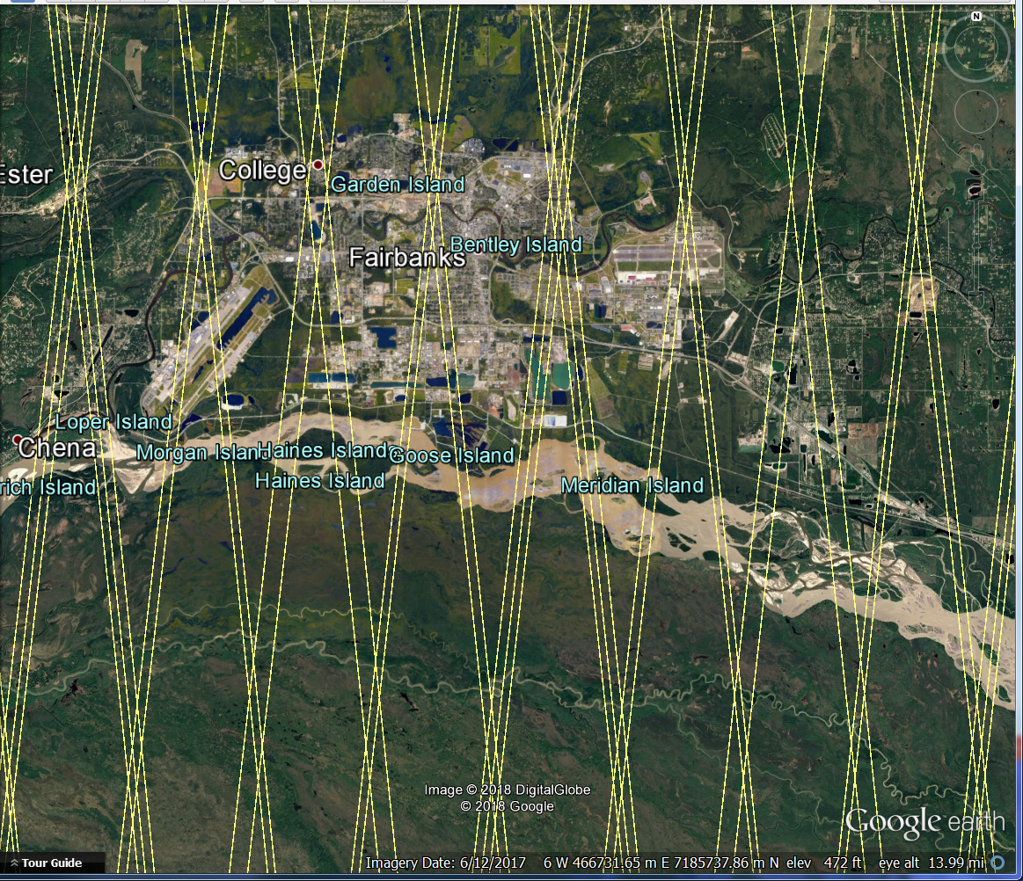
ICESat-2 Orbit
3rd 91-day repeat cycle
3km

Slide 11
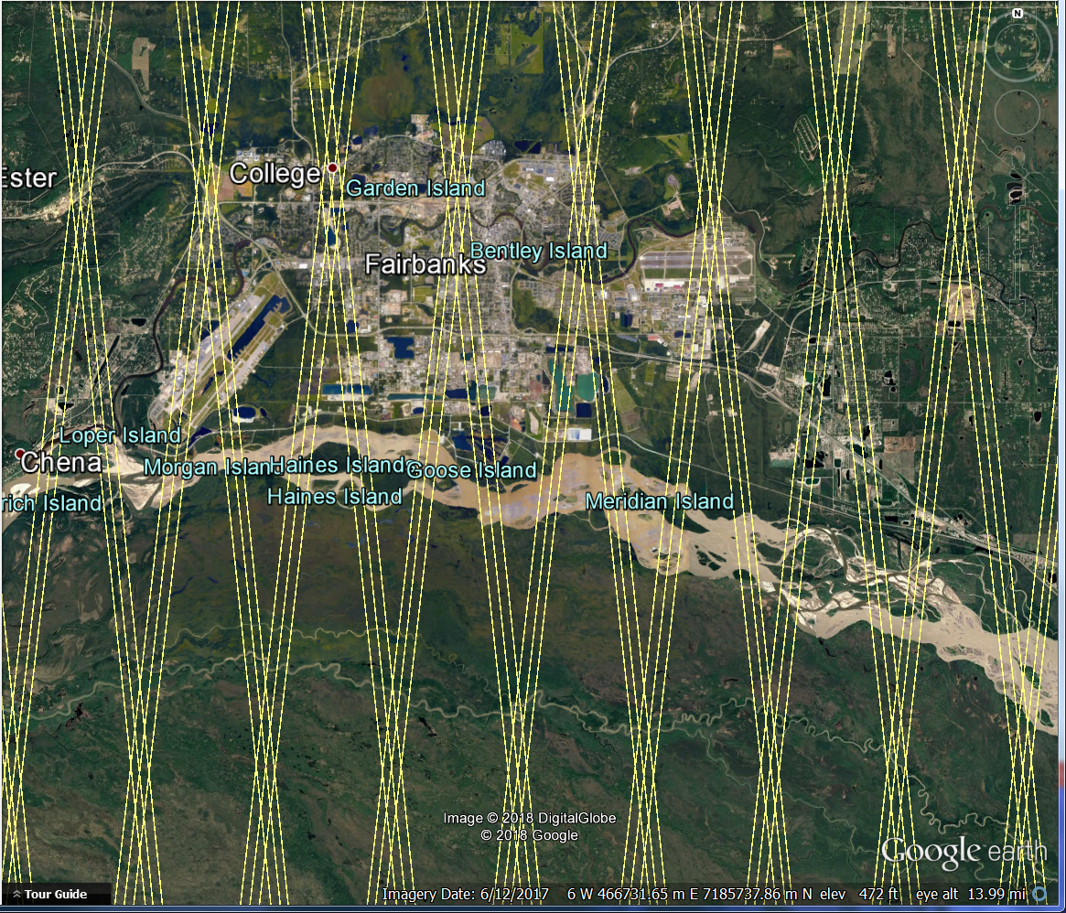
ICESat-2 Orbit
4th 91-day repeat cycle
3km

Slide 12


ICESat-2: Not just a cryospheric mission
ICESat-2 will collect range measurements globally (land, forests, lakes, oceans)
ICESat-2 will be off-pointed in the mid-latitudes to increase density of measurements
high along-track density
low cross-track density
ATL08 (Land and Vegetation) Data Product will report terrain and canopy heights, and other parameters
Suitable for stand level/regional assessments
Applications for biomass mapping, habitat/biodiversity, fuel loads, snow pack, and more!!

Slide 13
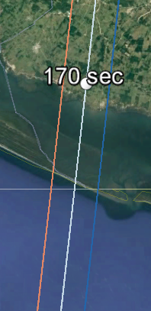
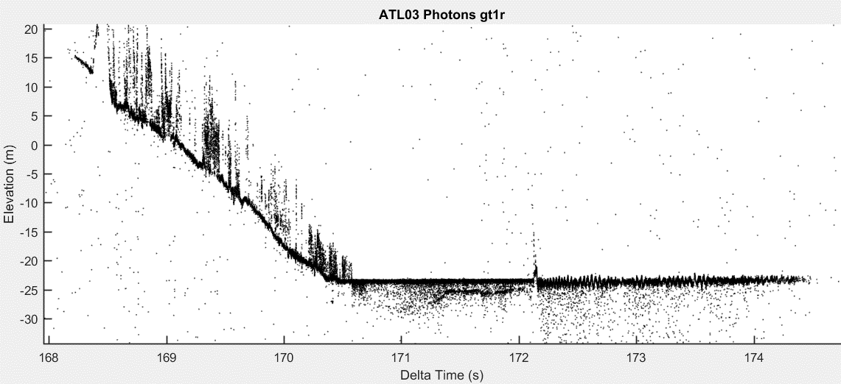
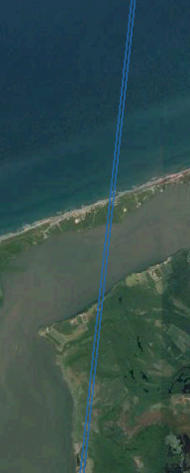
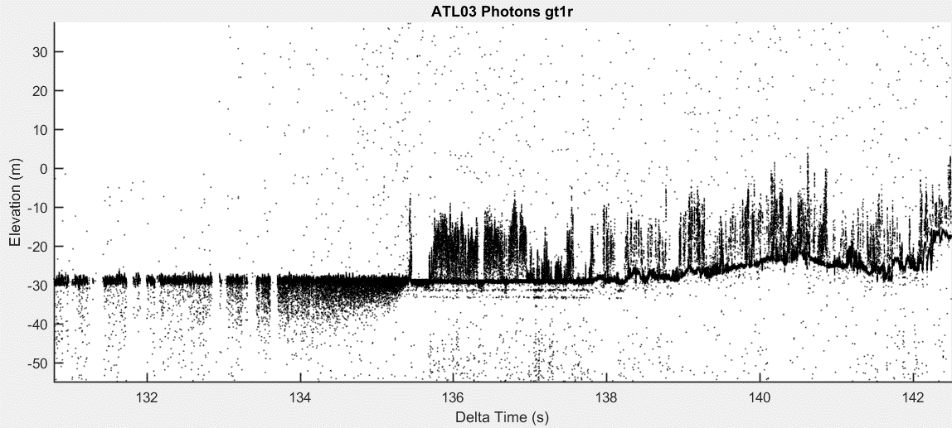
What does the data look like?
Forested hillside
Ground track through Mexico. Mountains in interior are cloud covered, but coastal areas are cloud-free
Shallow water bathymetry
Ocean waves
134
Mangrove forests
Non-flooded forests
136
Turbidity increases near shore
Gulf of Mexico
Specular returns (lines) beneath surface indicate standing water

Slide 14
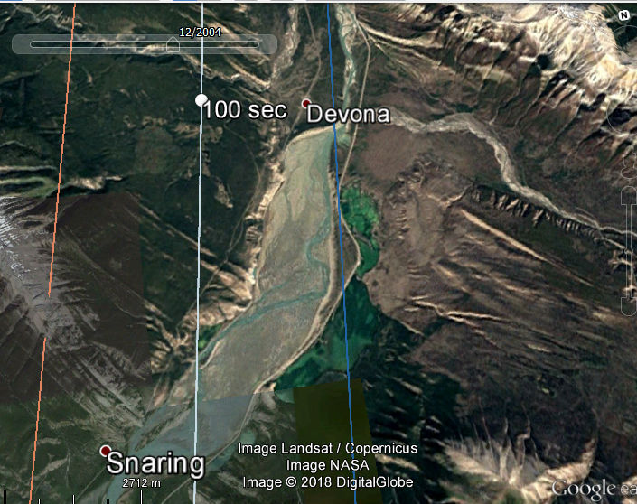
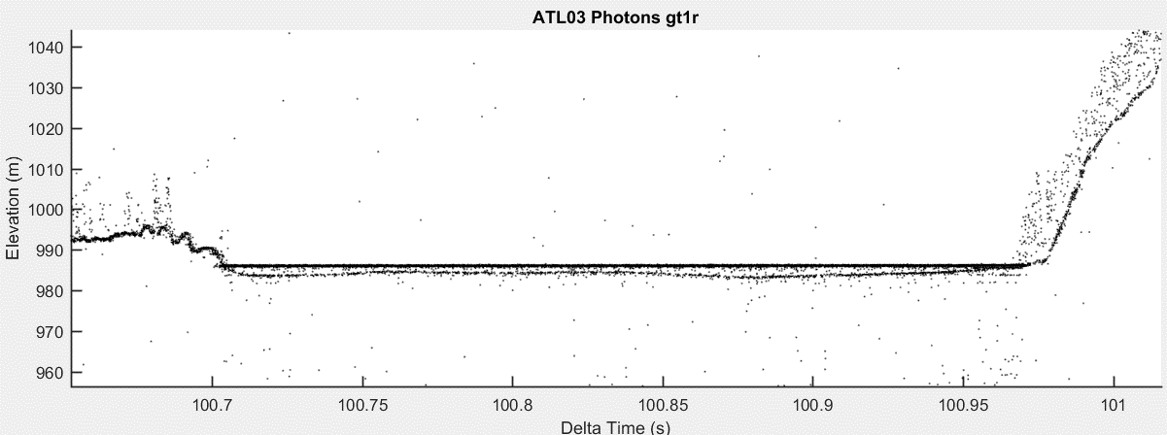
What does the data look like?
Inundated Floodplain near Calgary, CA
ATL03_20181014113520_02420106

Slide 15
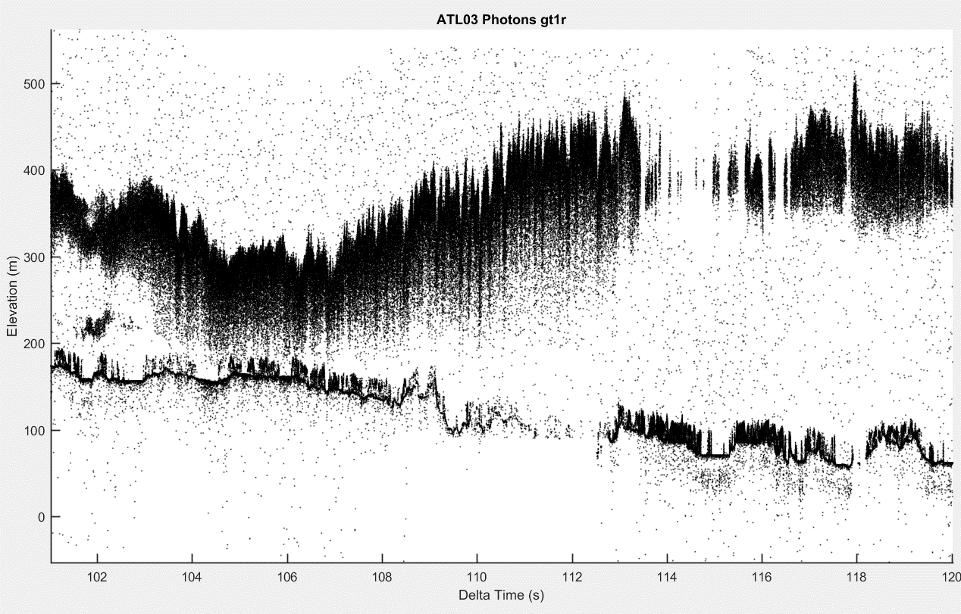
What about Clouds? Can ICESat-2 see through them?
Answer: Generally speaking NO
But, ICESat-2 green laser (532 nm) does penetrate through SOME (TBD) optical depth in the atmosphere.
Science Team and ICESat-2 Project Office is working hard to improve cloud flags.
clouds
land

Slide 16
ICESat-2 Data Products
When are they available? On or about May 28, 2019
Where can you get them? NSIDC or through Earth Data Search
What’s the latency for final products? Approximately 49 days from acquisition
Along-track Products
ATL03 – Along-track Geolocated Photons
ATL06 – Along-track Land Ice Data Product
ATL07 – Along-track Sea Ice Data Product
ATL08 – Along-track Land/Vegetation Data Product
ATL09 – Along-track Atmospheric Data Product
ATL12 – Along-track Ocean Data Product
ATL13 – Along-track Inland Water Data Product
You might want this product too
Definitely get this product
User’s Guide for each data product is available from NSIDC
Algorithm Theoretical Basis Document is available for each data product at
https://icesat-2.gsfc.nasa.gov

Slide 17
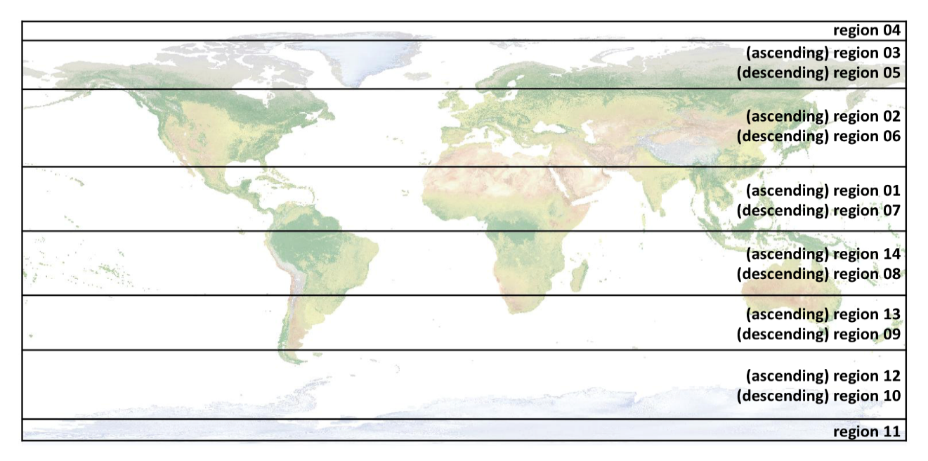
ICESat-2 Data Products
Along-track Granule Regions
(ATL03 and ATL08 use same granule regions)

Slide 18
ICESat-2 Land/Vegetation Data Products
ATL08 - Level-3 (Along-track)
  Products computed on a per-orbit/ per-beam basis
    Labeled Photons with indices back to ATL03
    Statistical parameters of canopy and terrain based on fixed 100 m distance to capture fine-scale geomorphology
    Segments output in 100 m step size
ATL18 - Level-4 (Gridded)
  Products released annually at a coarse resolution (1 km resolution tiles)
    Canopy Height
    Ground Elevation
  Higher resolution grid (e.g. 100 – 500 m, TBD) produced at end of mission
  Requires approximately 2 or 3 years of collections to produce a gridded product

Slide 19
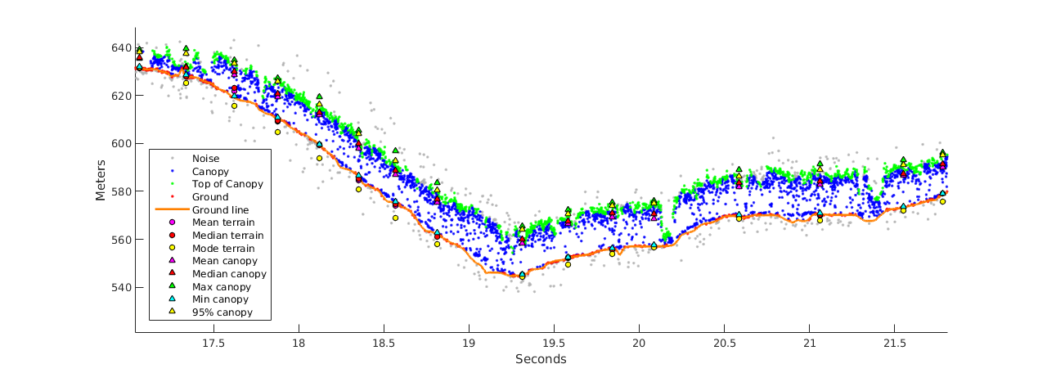
Example of Along-Track Data Products
100 m
Labeled photons for each ATL08 segment
Notes:
Here’s an example of what the data parameters would look like. In this example we are showing the labeled photons, and then you can see how the ground and canopy values would be represented on the actual data product.

Slide 20
ATL08 HDF5 File Format
RGT
GT 1 Group (left, right)
GT 3 Group (left, right)
Land
Canopy
Photons
Ref
Land
Canopy
Photons
Ref
Beam
QA/QC
Beam
QA/QC
Statistics for terrain points (mean, max, min, st. dev, etc. of Z, interpolated Z, bestFit)
Statistics of canopy heights, height metrics (e.g. RH75), top of canopy st. dev, Landsat Canopy Cover estimate
ATL03 Indices of labeled photons, photon label
n = 1 - 6
Reference DEM, Landcover, water mask, permafrost mask, apparent surface reflectance
Beam elevation and azimuth information, Geolocation uncertainty of XYZ, cloud flags, ground track number
QA/QC metrics for internal algorithm performance testing
Recommend using the STRONG Beam for Vegetation Studies

Slide 21
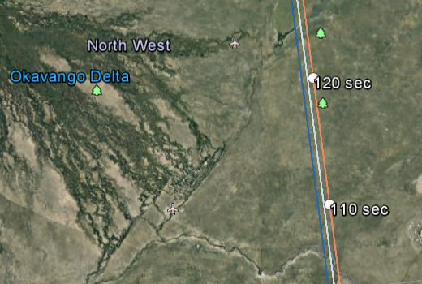
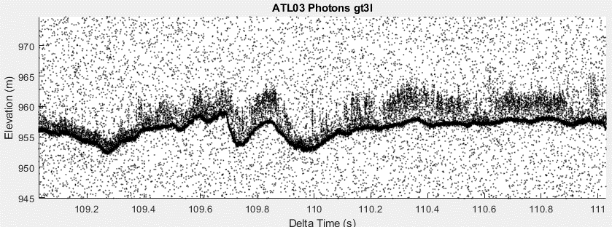
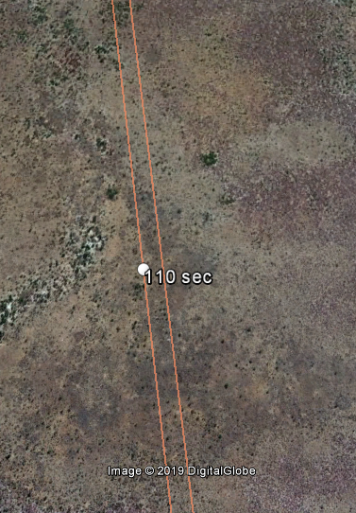
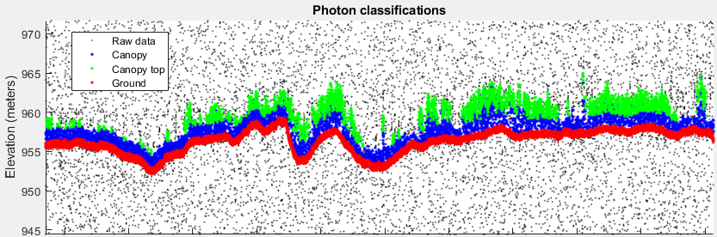
Semi-arid Woodlands in Botswana
February 3, 2019 day acquisition of ICESat-2 over northern Botswana. Trees with heights < 5m are detected and labeled with ICESat-2.
ATL03_20190203083806_05630214_205
A mixture of Mopane and Acacia trees dot the landscape in this region of Botswana
Biomass from woodlands are typically estimated empirically from optical data (e.g. Landsat).
With ICESat-2, we can now calculate canopy heights for these landscapes –thus reducing uncertainty in global biomass estimates
A. Neuenschwander, University of Texas at Austin

Slide 22
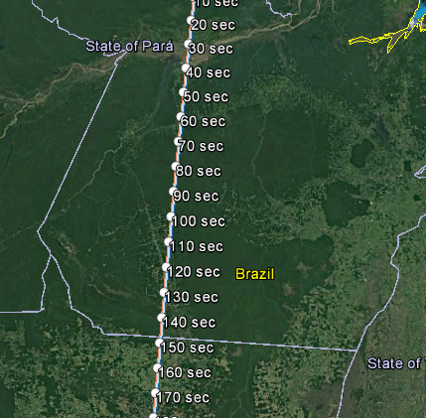
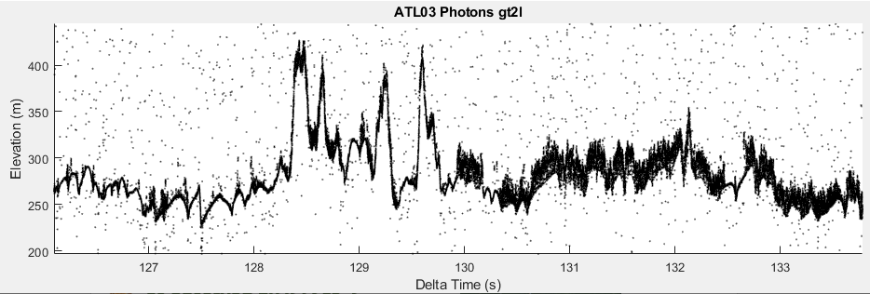
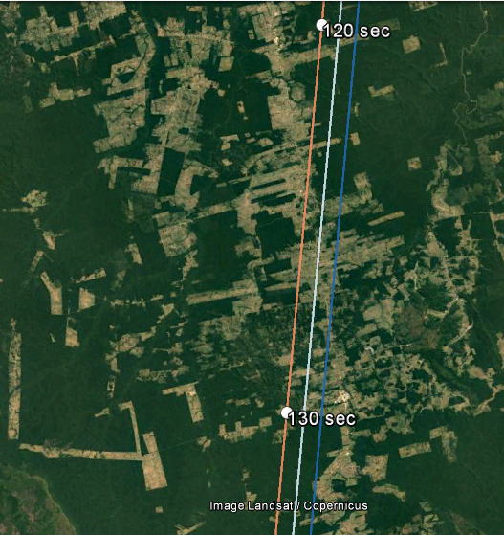
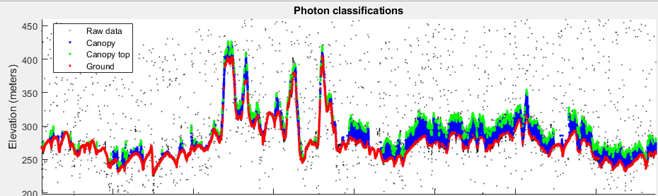
Deforestation from Logging
as observed by ICESat-2
March 19, 2019 night acquisition of ICESat-2 over Brazil’s tropical forest
ATL03_20190319234325_12450208_206
Forest experiencing logging
Intact tropical forest
  7 14 21 28 35 42 49
Along-track distance (km)
A. Neuenschwander, University of Texas at Austin

Slide 23
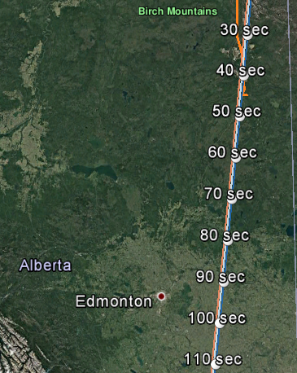
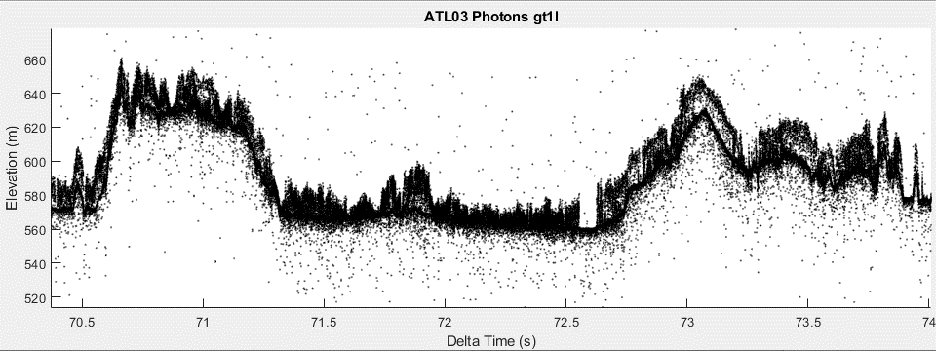
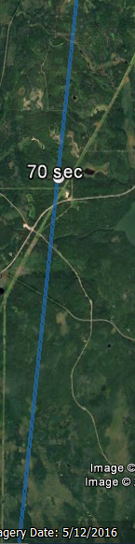
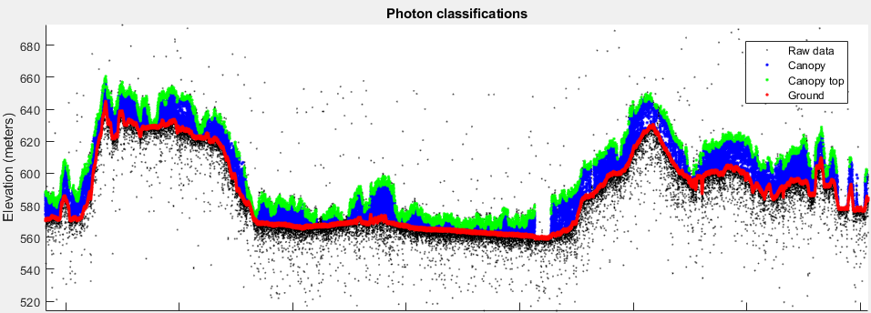
Boreal forest in Alberta Canada
as observed by ICESat-2
ATL03_20190212052542_06990206_206
1 4.5 8 11.5 15 18.5 22 25.5
Along-track distance (km)

Slide 24
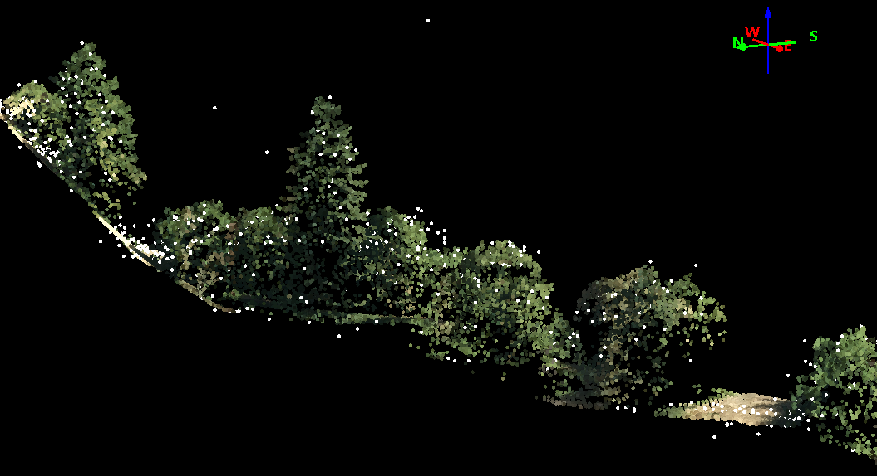
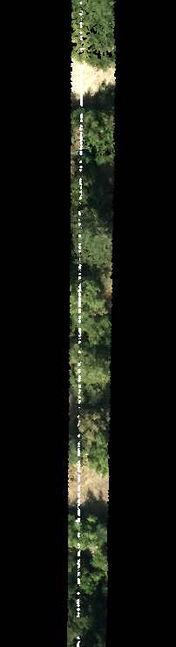
How Accurate are the Data
Mission Requirement: < 6.5 m horizontal
Current Geolocation Accuracy (bias): <6.5 m horizontal, <1 m vertical
Profile View
Top View
White dots: ICESat-2 photons
Airborne lidar from Sonoma County

Slide 25
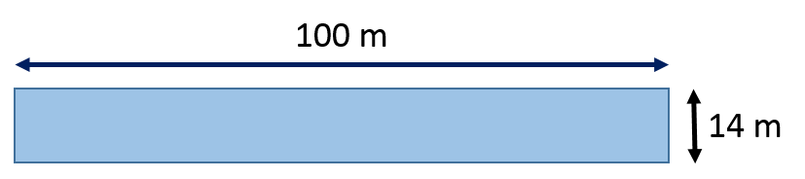
ATL08 Validation: General Methodology
ATL08 Lat/Lon coordinate for each 100 m segment converted into UTM projected coordinates
All airborne lidar falling within a 100 x 14 m box about that ATL08 coordinate value are used to calculate statistics.
Terrain (median, max, min, std) on ground points
Top of canopy (98th% canopy height) on canopy points
Calculate residuals on ATL08 parameters
ATL08: h_te_median
ATL08: h_te_bestfit
ATL08: h_canopy_abs (absolute 98% canopy height)
Report out the mean, mean absolute error, and RMSE for all 100 m segment residuals.

Slide 26
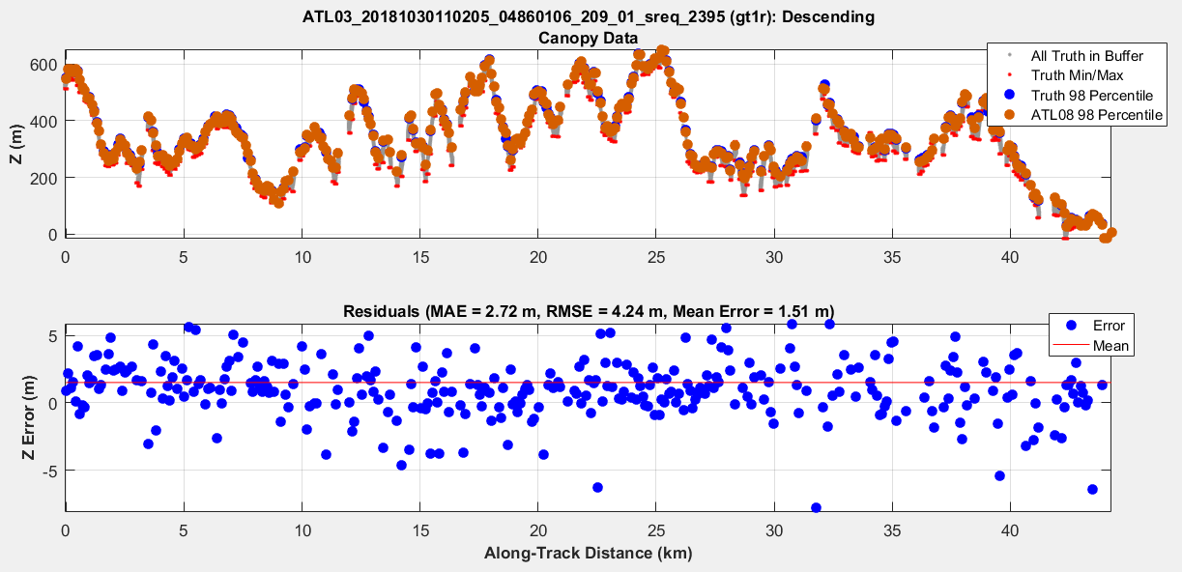
ATL08 Validation Results: Sonoma County, Oct 30 2018

Slide 27
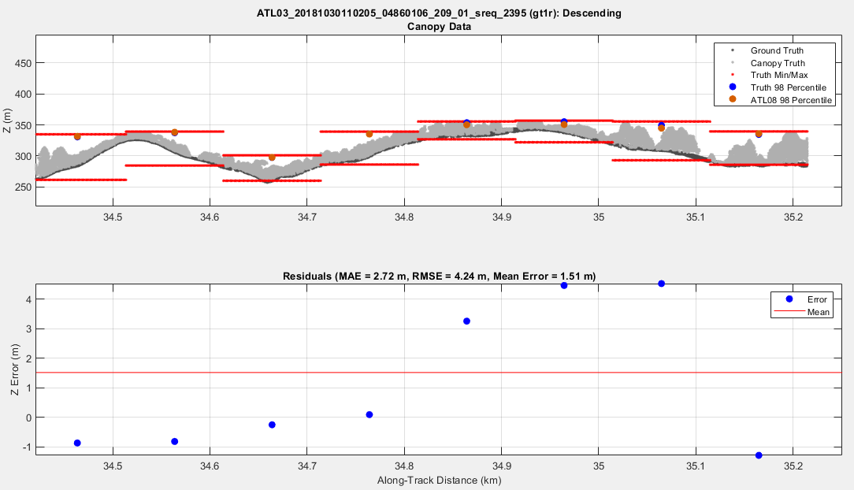
ATL08 Validation Results: Sonoma County, Oct 30 2018 -Zoomed in

Slide 28
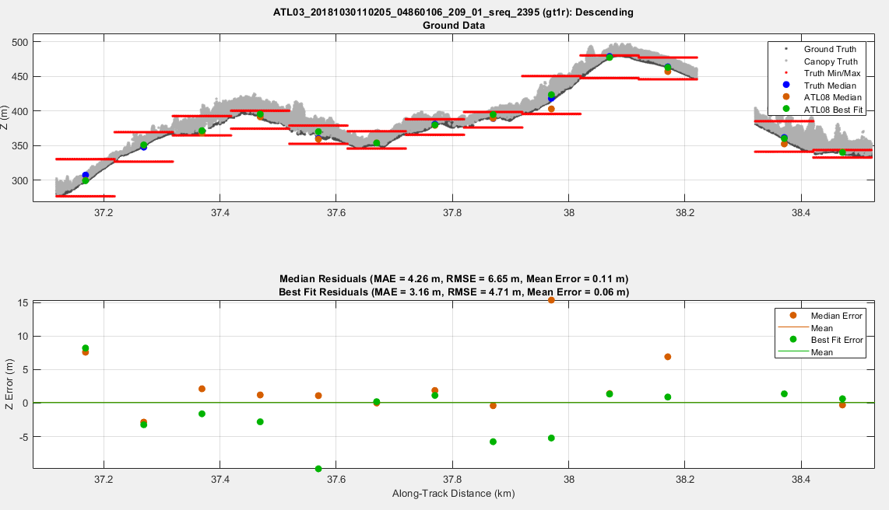
ATL08 Validation Results: Sonoma County, Oct 30 2018

Slide 29
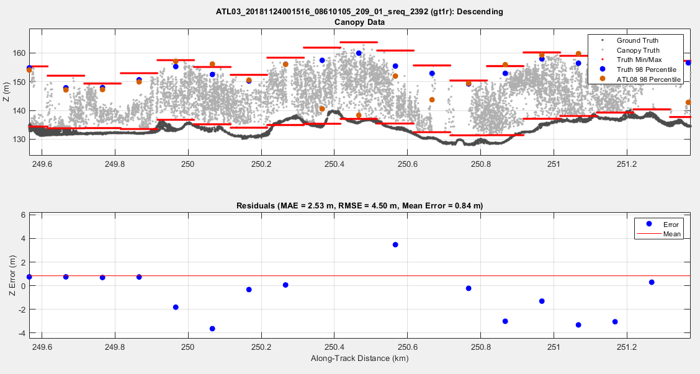
ATL08 Validation Results: Finland, Nov 24, 2018

Slide 30
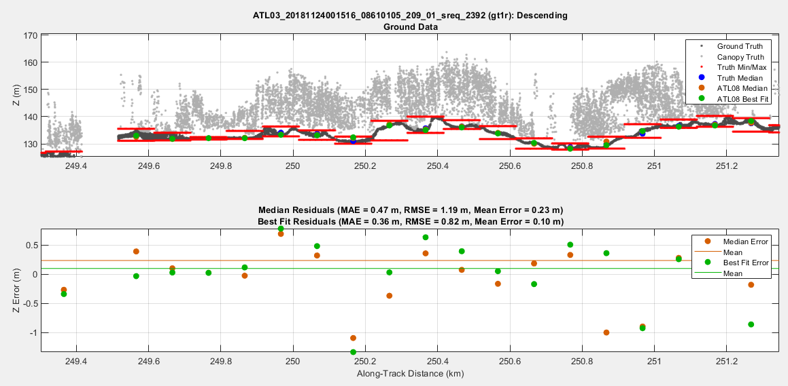
ATL08 Validation Results: Finland, Nov 24, 2018

Slide 31
Key Takeaways
ICESat-2 is a space-based, profiling lidar mission
  Does not provide the same resolution as airborne lidar mapping data
  Does provide global coverage
Use of strong beams are recommended for vegetation studies
Night acquisitions are probably better than day acquisitions
  Less background noise
Data quality should improve over time
  more calibration of the laser ranges
  Improved modeling of orbital variations
  Improvements to software will continuously be made
  data will be reprocessed periodically (Release 002 expected September 2019)

Slide 32
Questions: amyn@arlut.utexas.edu

Slide 33
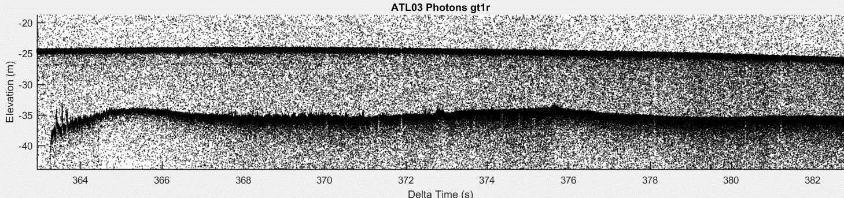
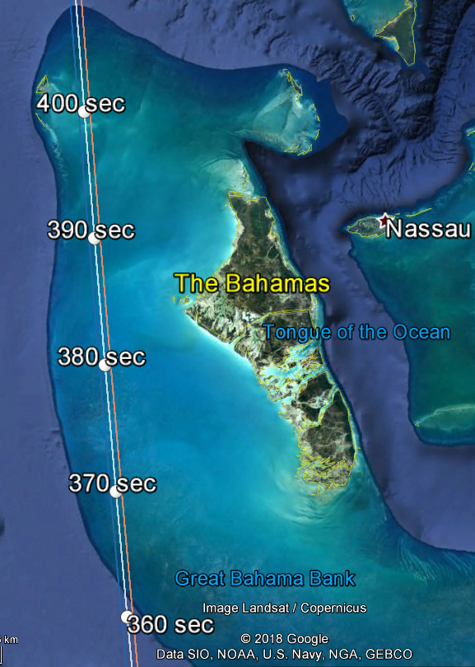
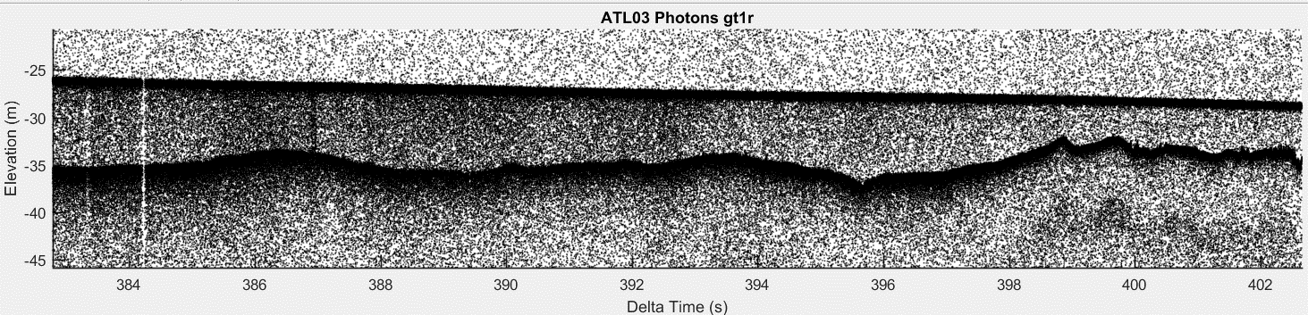
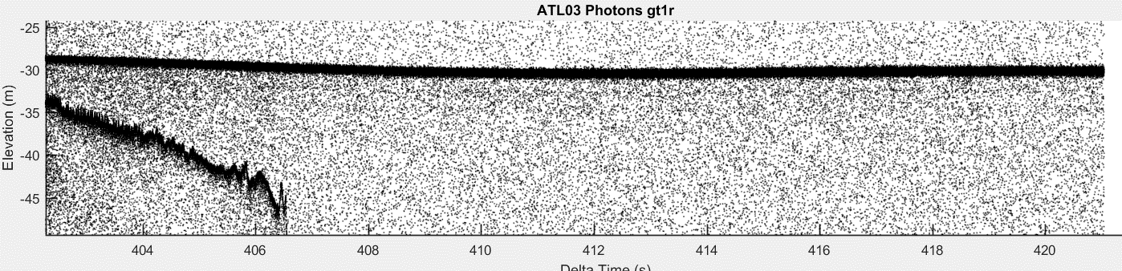
What does the data look like?
316 km of continuous bathymetry!
ATL03_20181026200436_04310101_201_01.h5
134
136
Amy Neuenschwander, U Texas

