Slide 1

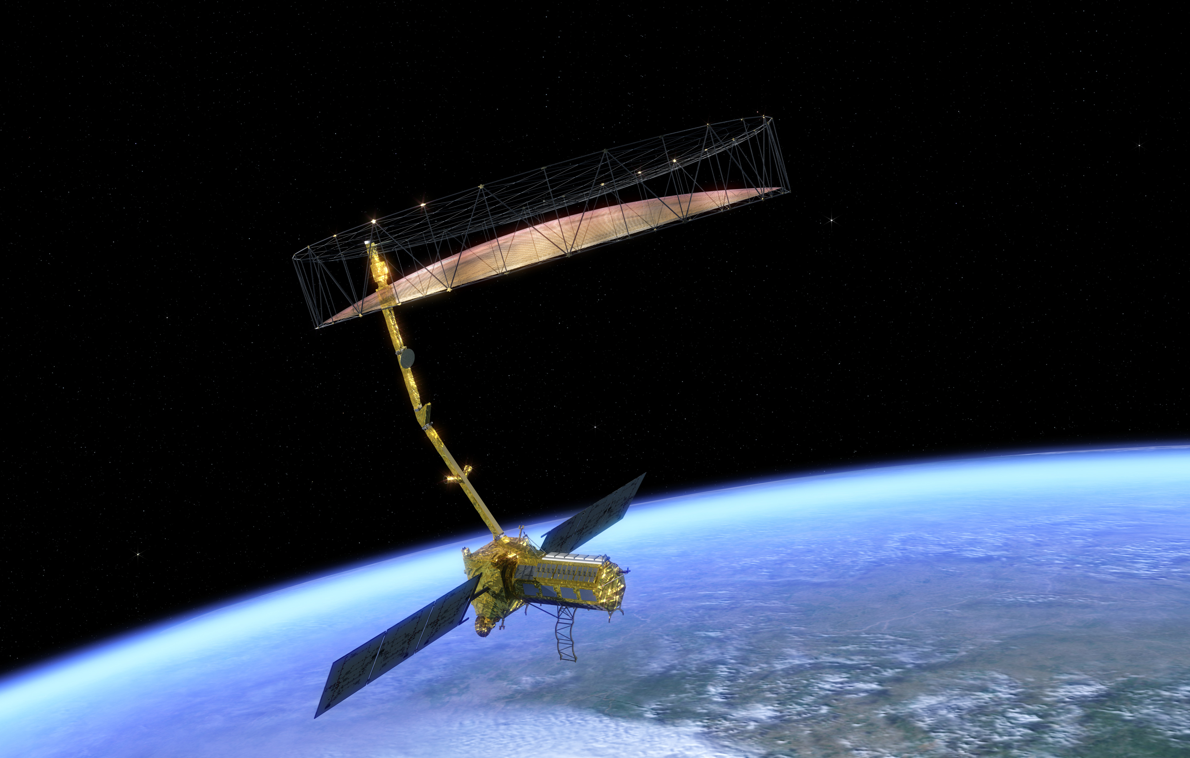

The NISAR Mission
Paul Siqueira
Lead NISAR Ecosystems Science Team
Goals & Efforts in the ABoVE Domain:
Permafrost, Biomass, Disturbance and Wetlands

Slide 2
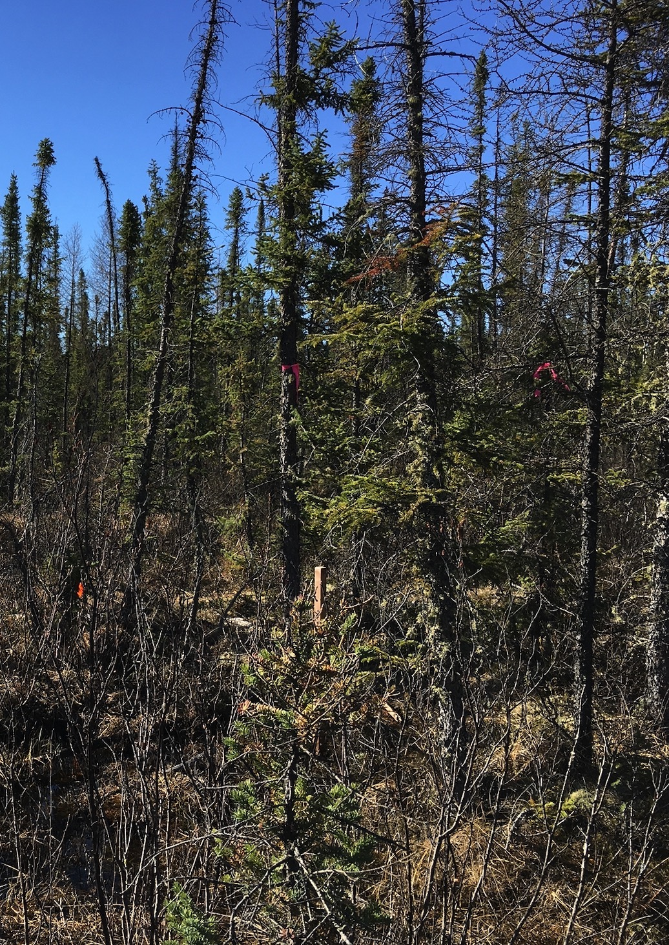
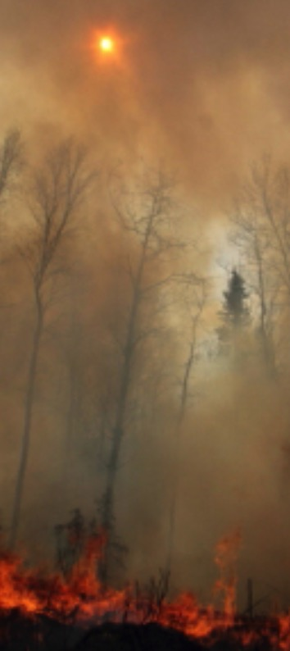
NISAR & ABoVE
The NISAR Mission and the ABoVE domain are tightly linked
strong inundation dynamics
permafrost monitoring
0 < biomass < 100 t/ha
disturbance

Slide 3
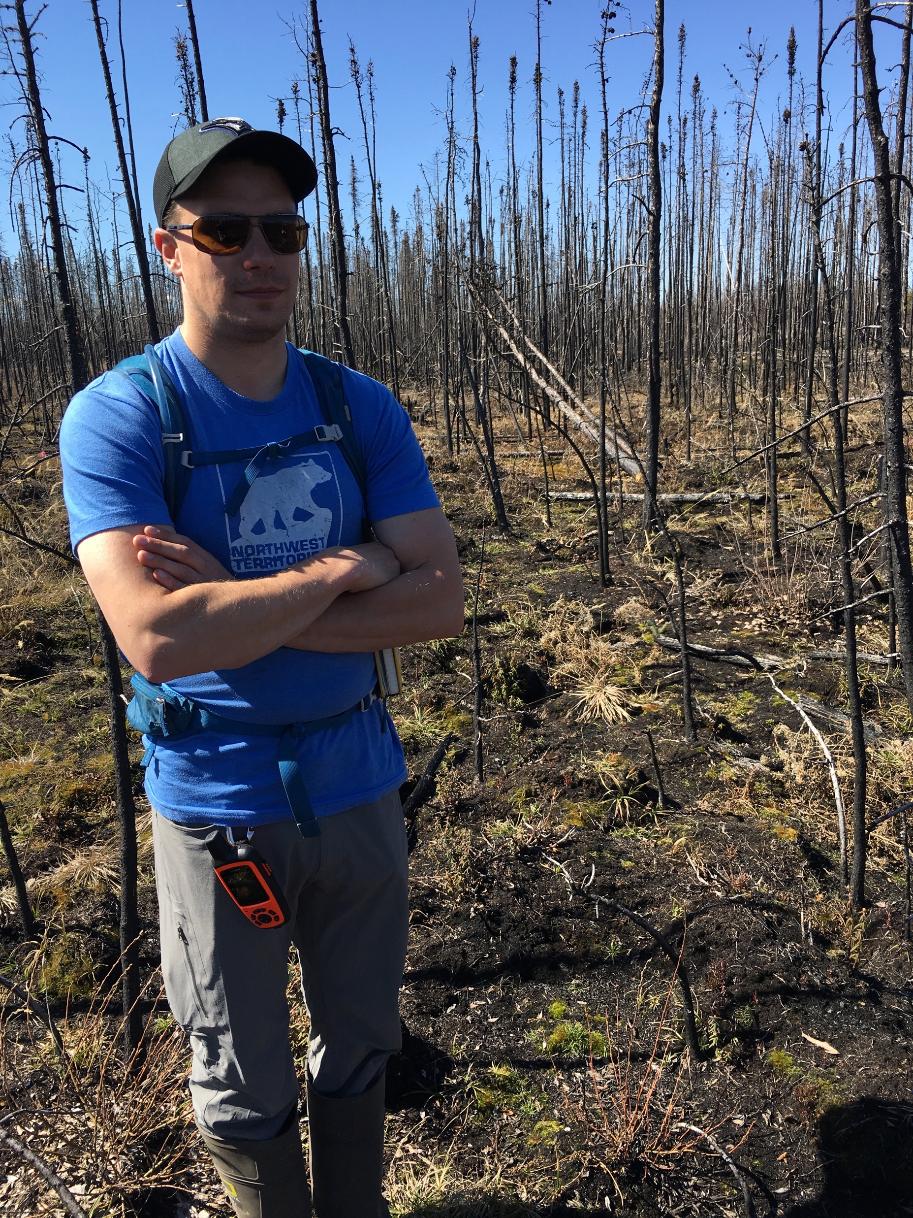
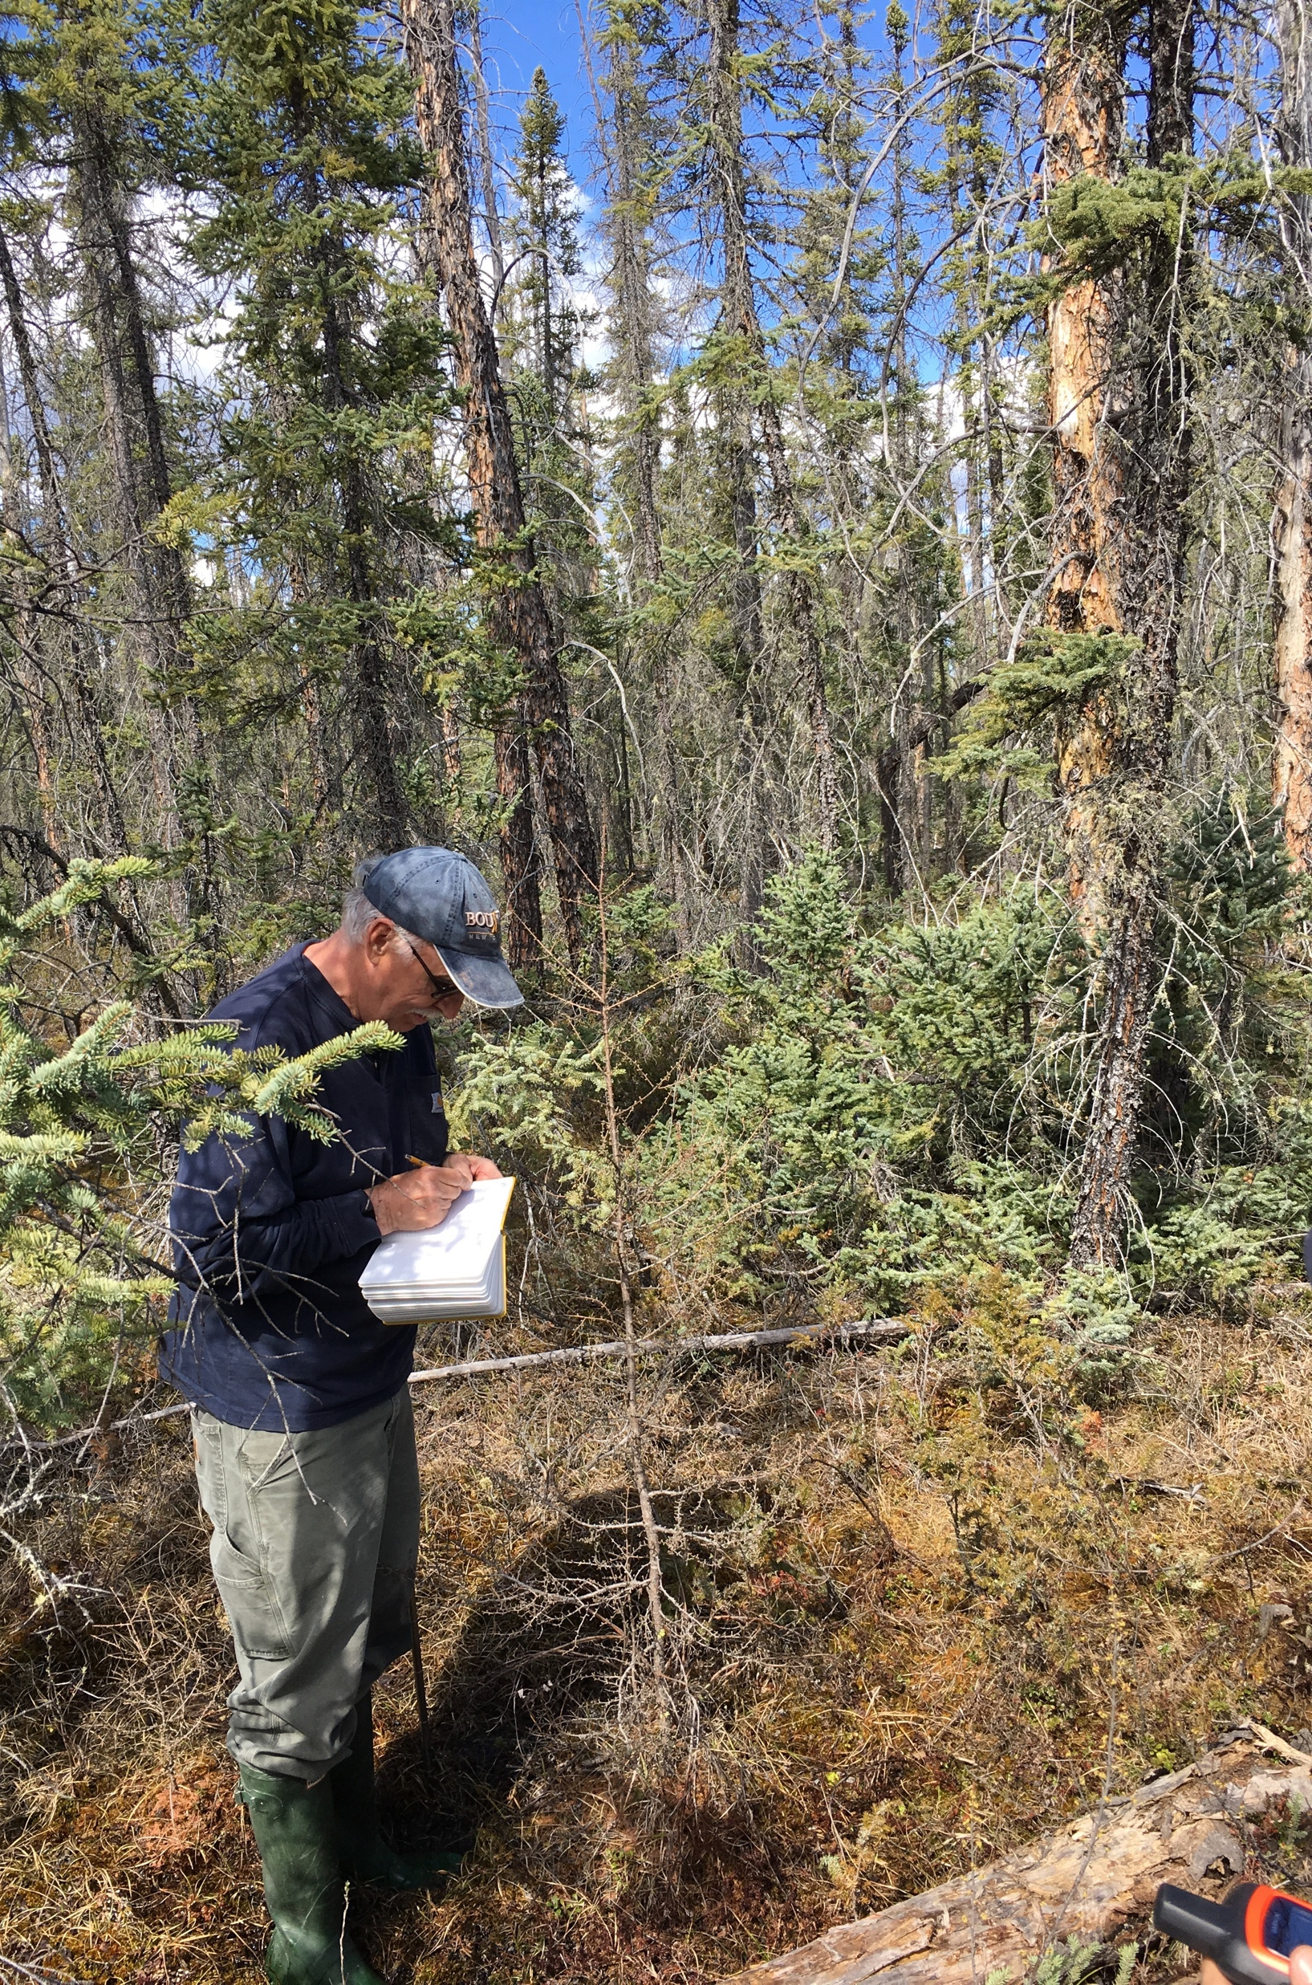
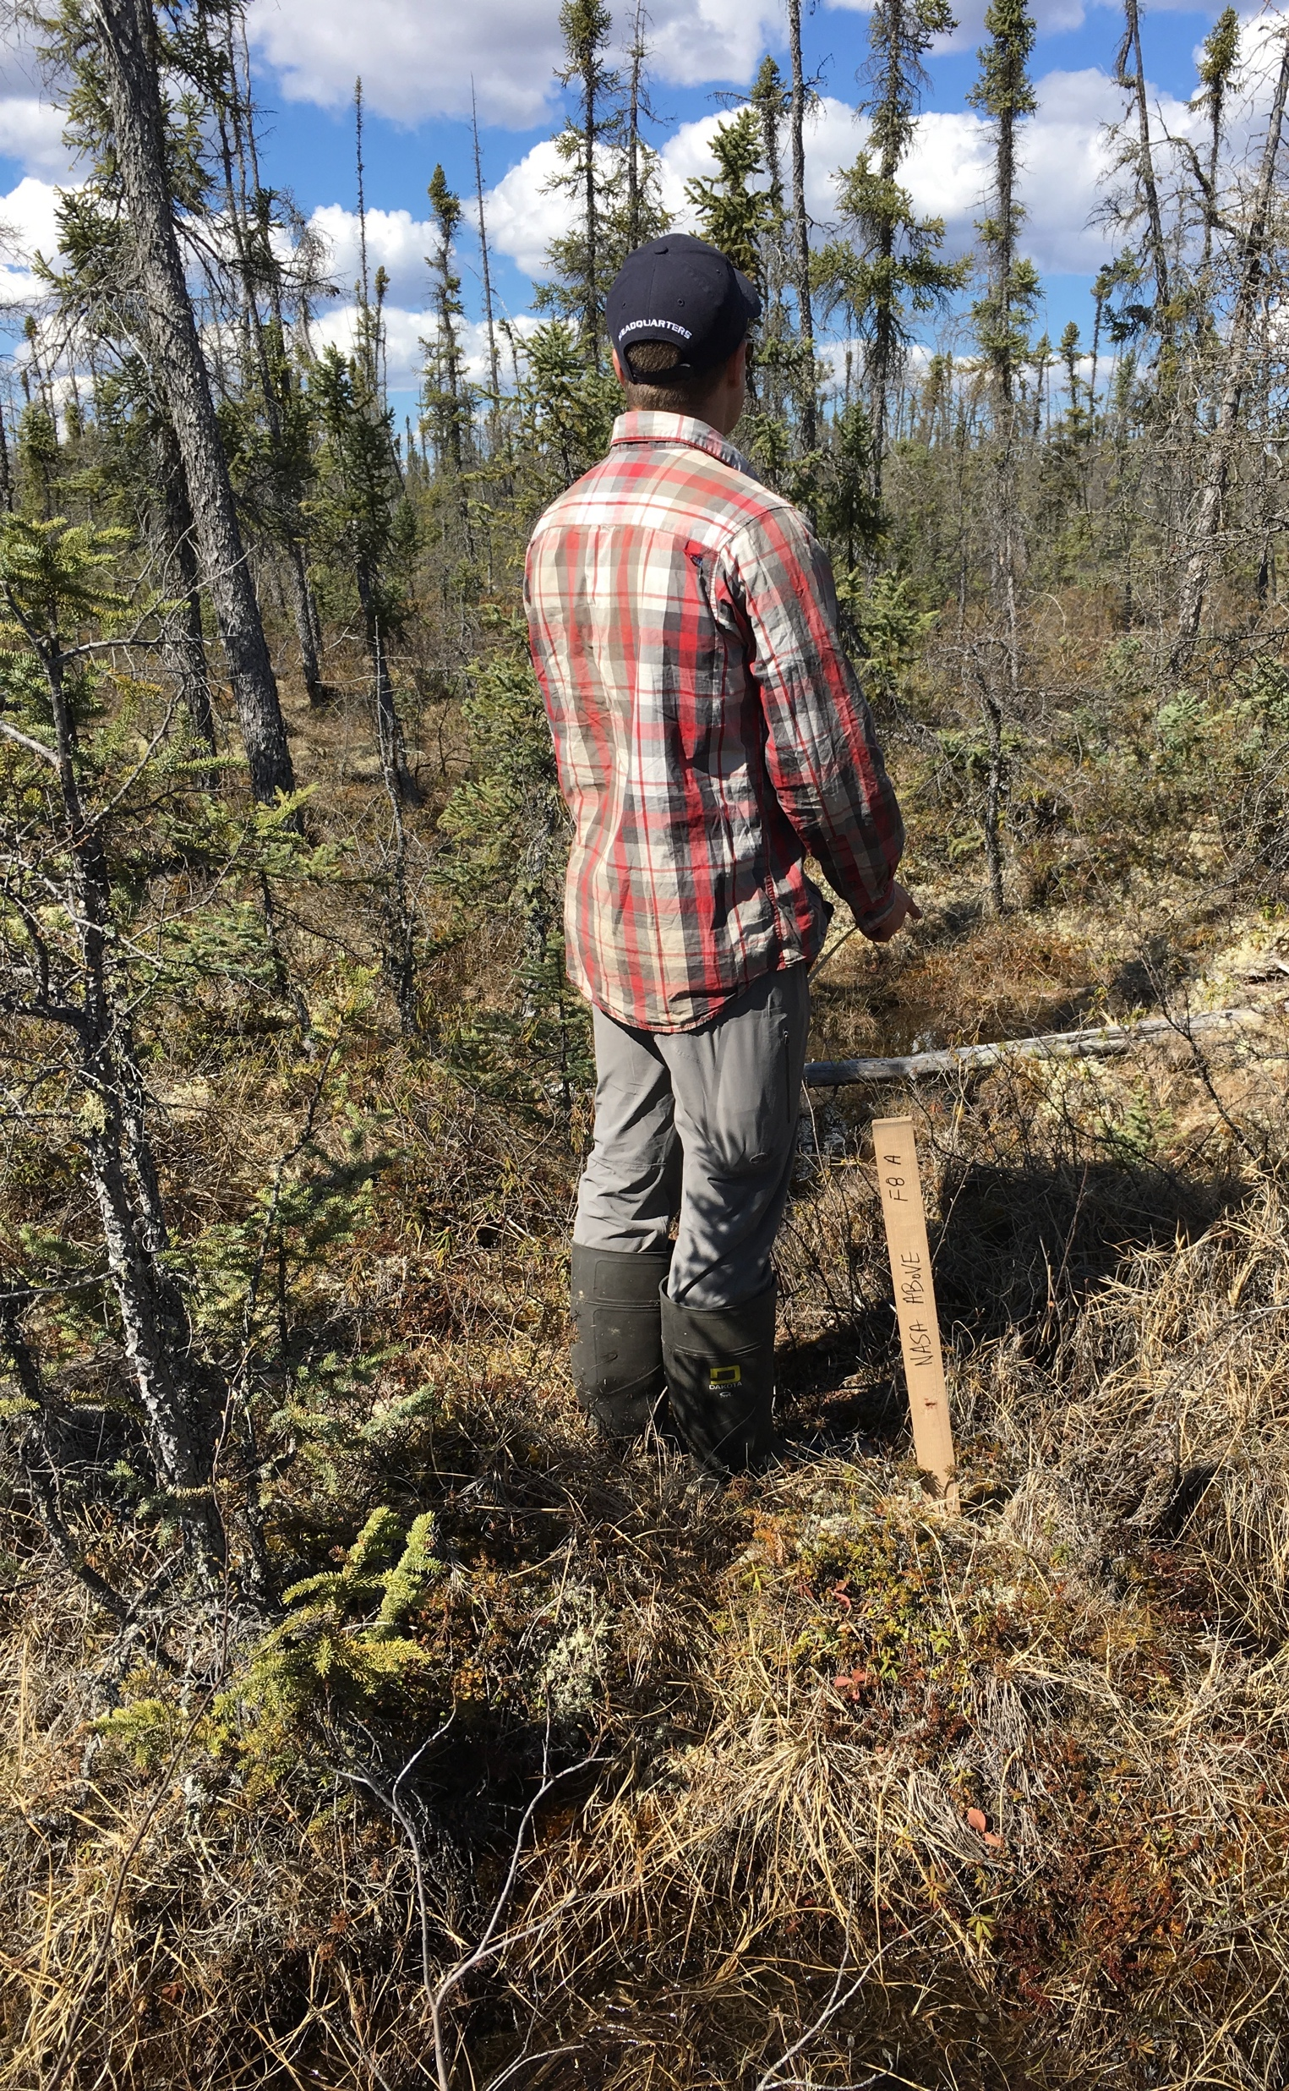
The combined effect of remote sensing and ABoVE
Different land-use histories (i.e. burn history and severity) and soil type governs the forest cover
Permafrost depth, soil moisture and biomass provide a means for understanding how the past effects the current state, and how things will change in the future
P1
F7
F8

Slide 4
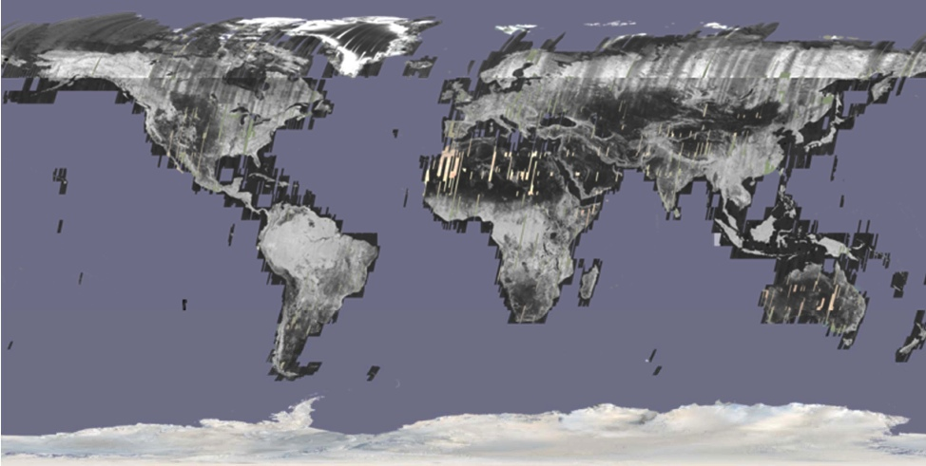
SAR coverage (JERS-1)
Active sensor and weather tolerance improves dependability
For JERS-1, Every 44 days, a partial view of the Earth’s surface could be made
NISAR will collect similar data, regularly, every 12 days at a 15m resolution
HH and HV polarizations
240 km swath
The radiometric quality is not great for this image, but it shows very well the different orbits of JERS-1 and the methodical way that it was able to collect data with a 70 km swath. NISAR will offer a similar capability, with global-land coverage, two times every 12 days.

Slide 5
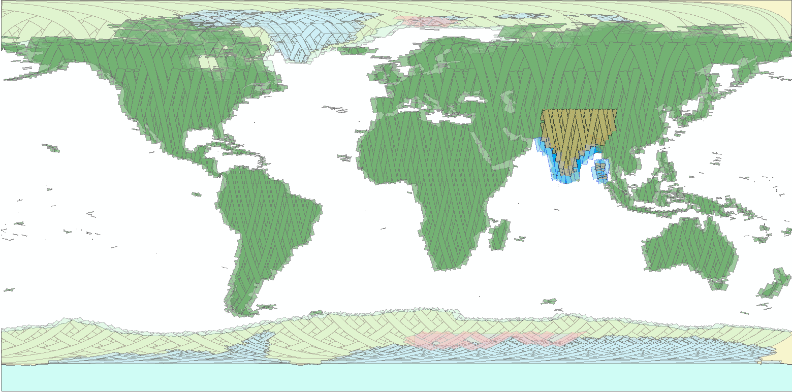
NISAR Systematic Observations Designed to Capture Earth’s Dynamics
No target conflicts: overlapping targets uses union of all modes specified
Colors indicate different radar modes
Note: conceptual plan – does not reflect current detailed plan
C. Ballard, JPL
12-day regular sampling on ascending and descending to the extent possible
Notes:
This is a good image to emphasize the time series

Slide 6
NISAR Mission at a glance
Four Level-1 Disciplines
  • Ecosystems, • Ice Sheets, • Solid Earth Dynamics, • Applications
L- & S-band 12-day orbital repeat, left-looking only mission
Majority of coverage will be L-band Dual-Polarized (and Quasi-quad-pol) 10 m resolution
240 km swath using SweepSAR
Launch in late-2022 (January)
4.5 TB/day data downlink
NISAR repeat-observations will create unprecedented time-series data and availability over the ABoVE study domain

Slide 7
NISAR Requirements related to ABoVE
NISAR is a requirements driven mission.
NISAR Biomass requirement:
      NISAR will estimate global above ground biomass up to 100 t/ha at a 1 ha resolution, with an accuracy of 20 t/ha.
NISAR Disturbance requirement
      The NISAR project shall measure global areas of vegetation disturbance at 1 hectare resolution annually for areas losing at least 50% canopy cover with a classification accuracy of 80%.
NISAR Inundation requirement
      The NISAR project shall measure inundation extent within inland and coastal wetlands areas at a resolution of 1 hectare every 12 days with a classification accuracy of 80%
NISAR Permafrost requirement
      The NISAR project shall measure surface deformation in permafrost-affected areas semi-monthly at 100-m resolution during snow free months over length scales 0.1 km < L < 50 km, over 80% of selected regions, and over any 90-day interval.

Slide 8
Ecosystem Requirements
Illustrated
Active agricultural crop area
Detection of Forest disturbance
Biomass
100 Mg/ha
Accuracy: 80% at 1 ha resolution
every 3 months
Accuracy: > 50% disturbance
at ha scale annually
Woody vegetation Biomass
Wetland inundation Extent
Permafrost
Accuracy: 20 Mg/ha
annually
0 Mg/ha
Accuracy: 80% at 1 ha resolution every 12 days
Accuracy: 5.2 mm @ 100m,
16 mm @ 10 km, semi-monthly

Slide 9

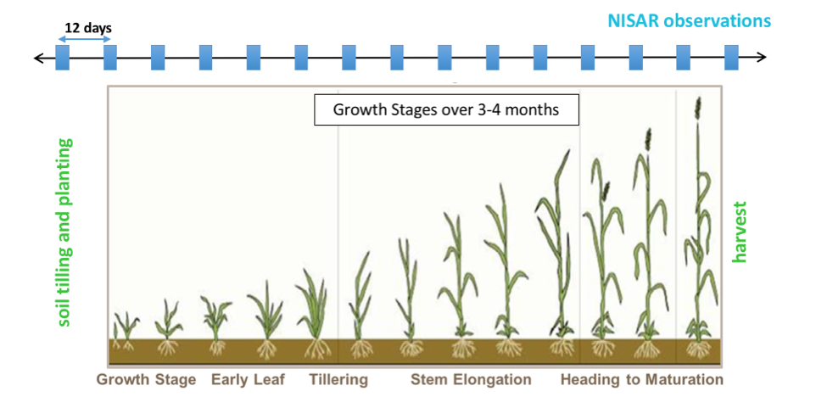
NISAR Development: Ecosystems
Basic Ecosystems Disciplines
• Biomass • Wetlands
• Disturbance • Agriculture
• Permafrost
Dense-time series of L-band data (dual-pol)
NISAR’s observing strategy and open data policy will allow many more disciplines than this to take advantage of this new resource
Notes:
A good slide to show the 12m reflector, our head shots, and the utility of a dense time series… in this case to monitor the growth of crops over time. The changing structure during the growing period is a signature in of itself.

Slide 10
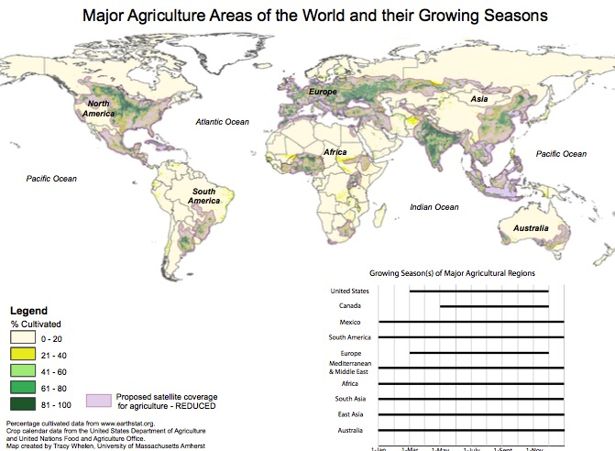
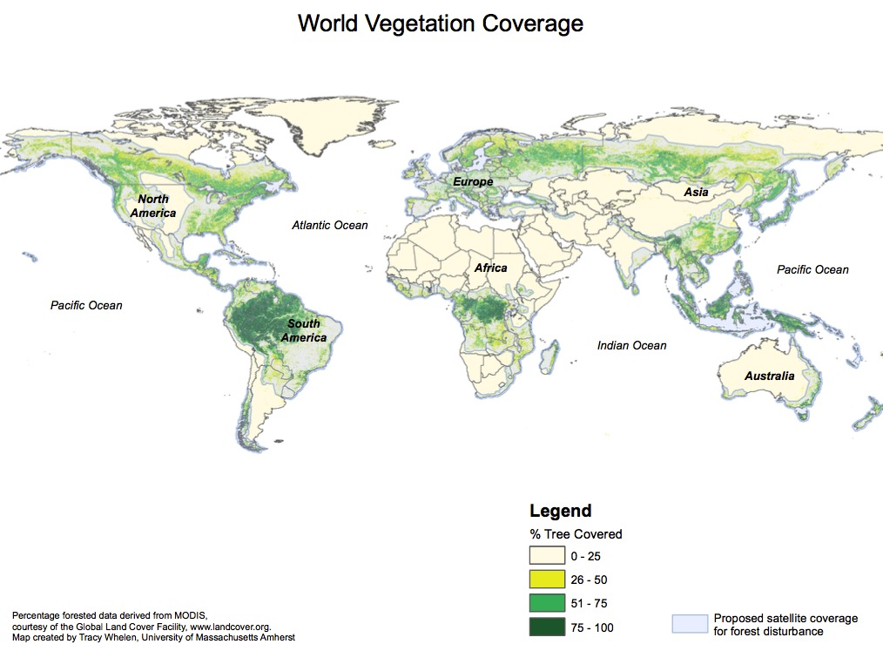
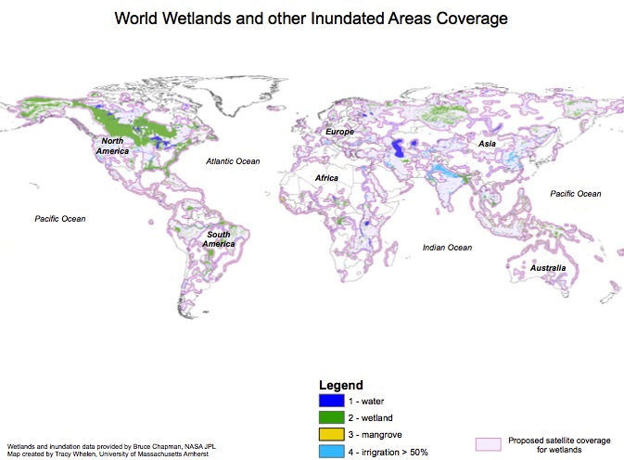
Ecosystems Data Masks

Slide 11
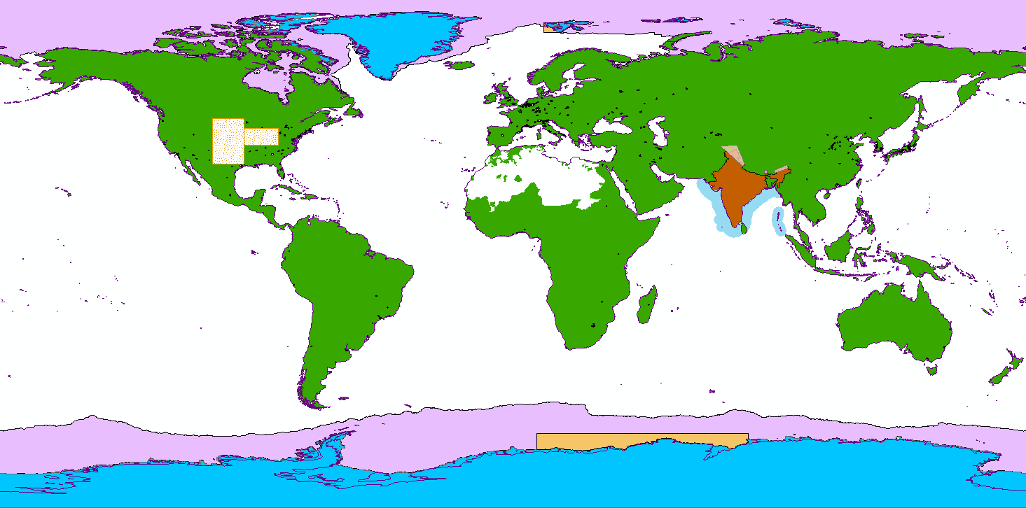
Mode-Specific Science Targets in Observation Plan
Each colored region represents a single radar mode chosen to satisfy multiple science objectives over that area
Avoids mode contention that would interrupt time series
Planned Acquisitions
Background Land
Land Ice
Sea Ice
Urban (small targets)
US Agriculture
Himalayas
India Agriculture
India Coastal Ocean
Sea Ice Type
Background Land satisfies most Solid Earth and Ecosystems objectives

Slide 12
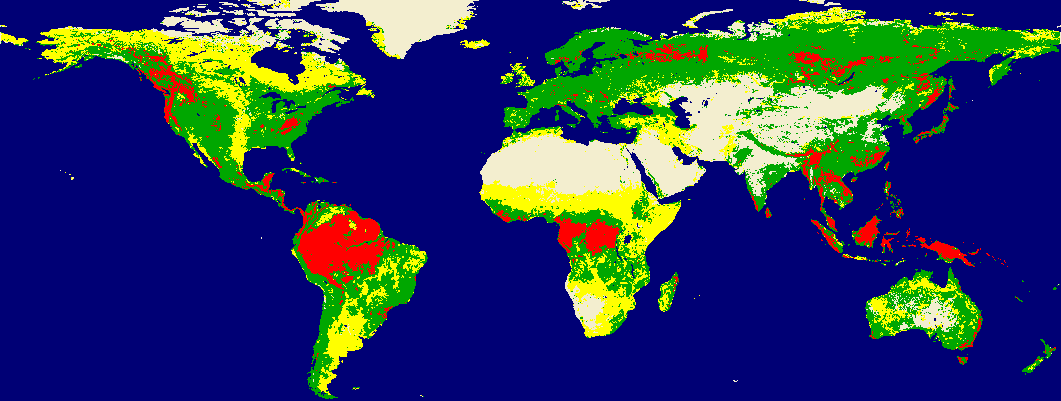
NISAR Biomass areas (< 100 tons/ha)
The global distribution of regions dominated by with woody biomass < 100 Mg/ha
Regions with
AGB < 100 Mg/ha
50% of area
Regions with
AGB > 100 Mg/ha
50% of area
Regions with
AGB < 20 Mg/ha
50% of area
Regions with
No woody
vegetation
Open
Water
Notes:
Sassan’s famous slide

Slide 13

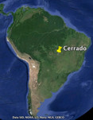
Disturbance Monitoring with Time Series
Time Steps
L-Band HH Backscatter
0 2006-12-04
1 2007-01-19
2 2007-03-06
3 2007-07-22
4 2007-10-22
5 2008-01-22
6 2008-03-08
7 2008-04-23
8 2008-06-08
9 2008-07-24
10 2008-09-08
11 2008-10-24
12 2009-01-24
13 2009-03-11
14 2009-07-27
15 2009-09-11
16 2009-10-27
17 2010-03-14
18 2010-04-29
19 2010-06-14
20 2010-07-30
21 2010-09-14
22 2010-12-15
23 2011-01-30
24 2011-03-17
Cerrado Area, Brazil
ALOS PALSAR DATA from
2006 to 2011
Abrupt drop in
Backscatter
Gradual drop in
Backscatter
Periodic patterns from
seasonal flooding
Notes:
Josef’s famous slide (sometimes works, sometimes not). The slide shows how the radar cross section changes over time, and how that signature can be used for detecting disturbance. By having a dense time series, as shown in this slide, it will make the detection of that disturbance much easier than an optical image (say) where cloud obsuraction during rainy season can cause some detection problems. With SAR, we will be getting dependable observations two times (ascending and descending) every 12 days.

Slide 14
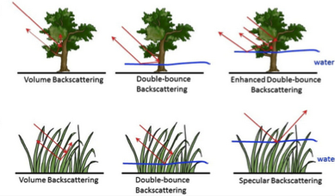
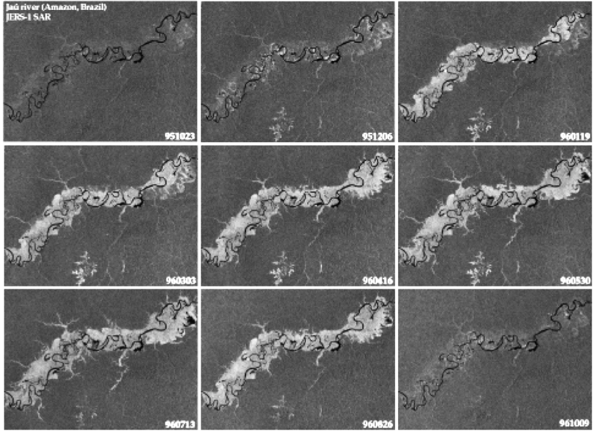
Vegetation Inundation Dynamics
L-band SAR observations are established as the most reliable tool for mapping vegetation inundation
JERS-1 L-band SAR (HH only) data showing inundation dynamics for 1 year (Jau River, Brazil)
Existing L-band SAR satellites have limited coverage and observations to accurately capture the spatial extent and temporal variations of inundation over wetlands.
NISAR plans to acquire minimum of dual-pol data globally over all wetlands twice per 12 day orbit cycle will contribute significantly to understanding wetland hydrology and the impacts of climate variations
Rosenqvist et al, 1998.
Notes:
bright areas are inundated forest, dark areas are open water, grey is undisturbed forest.

Slide 15
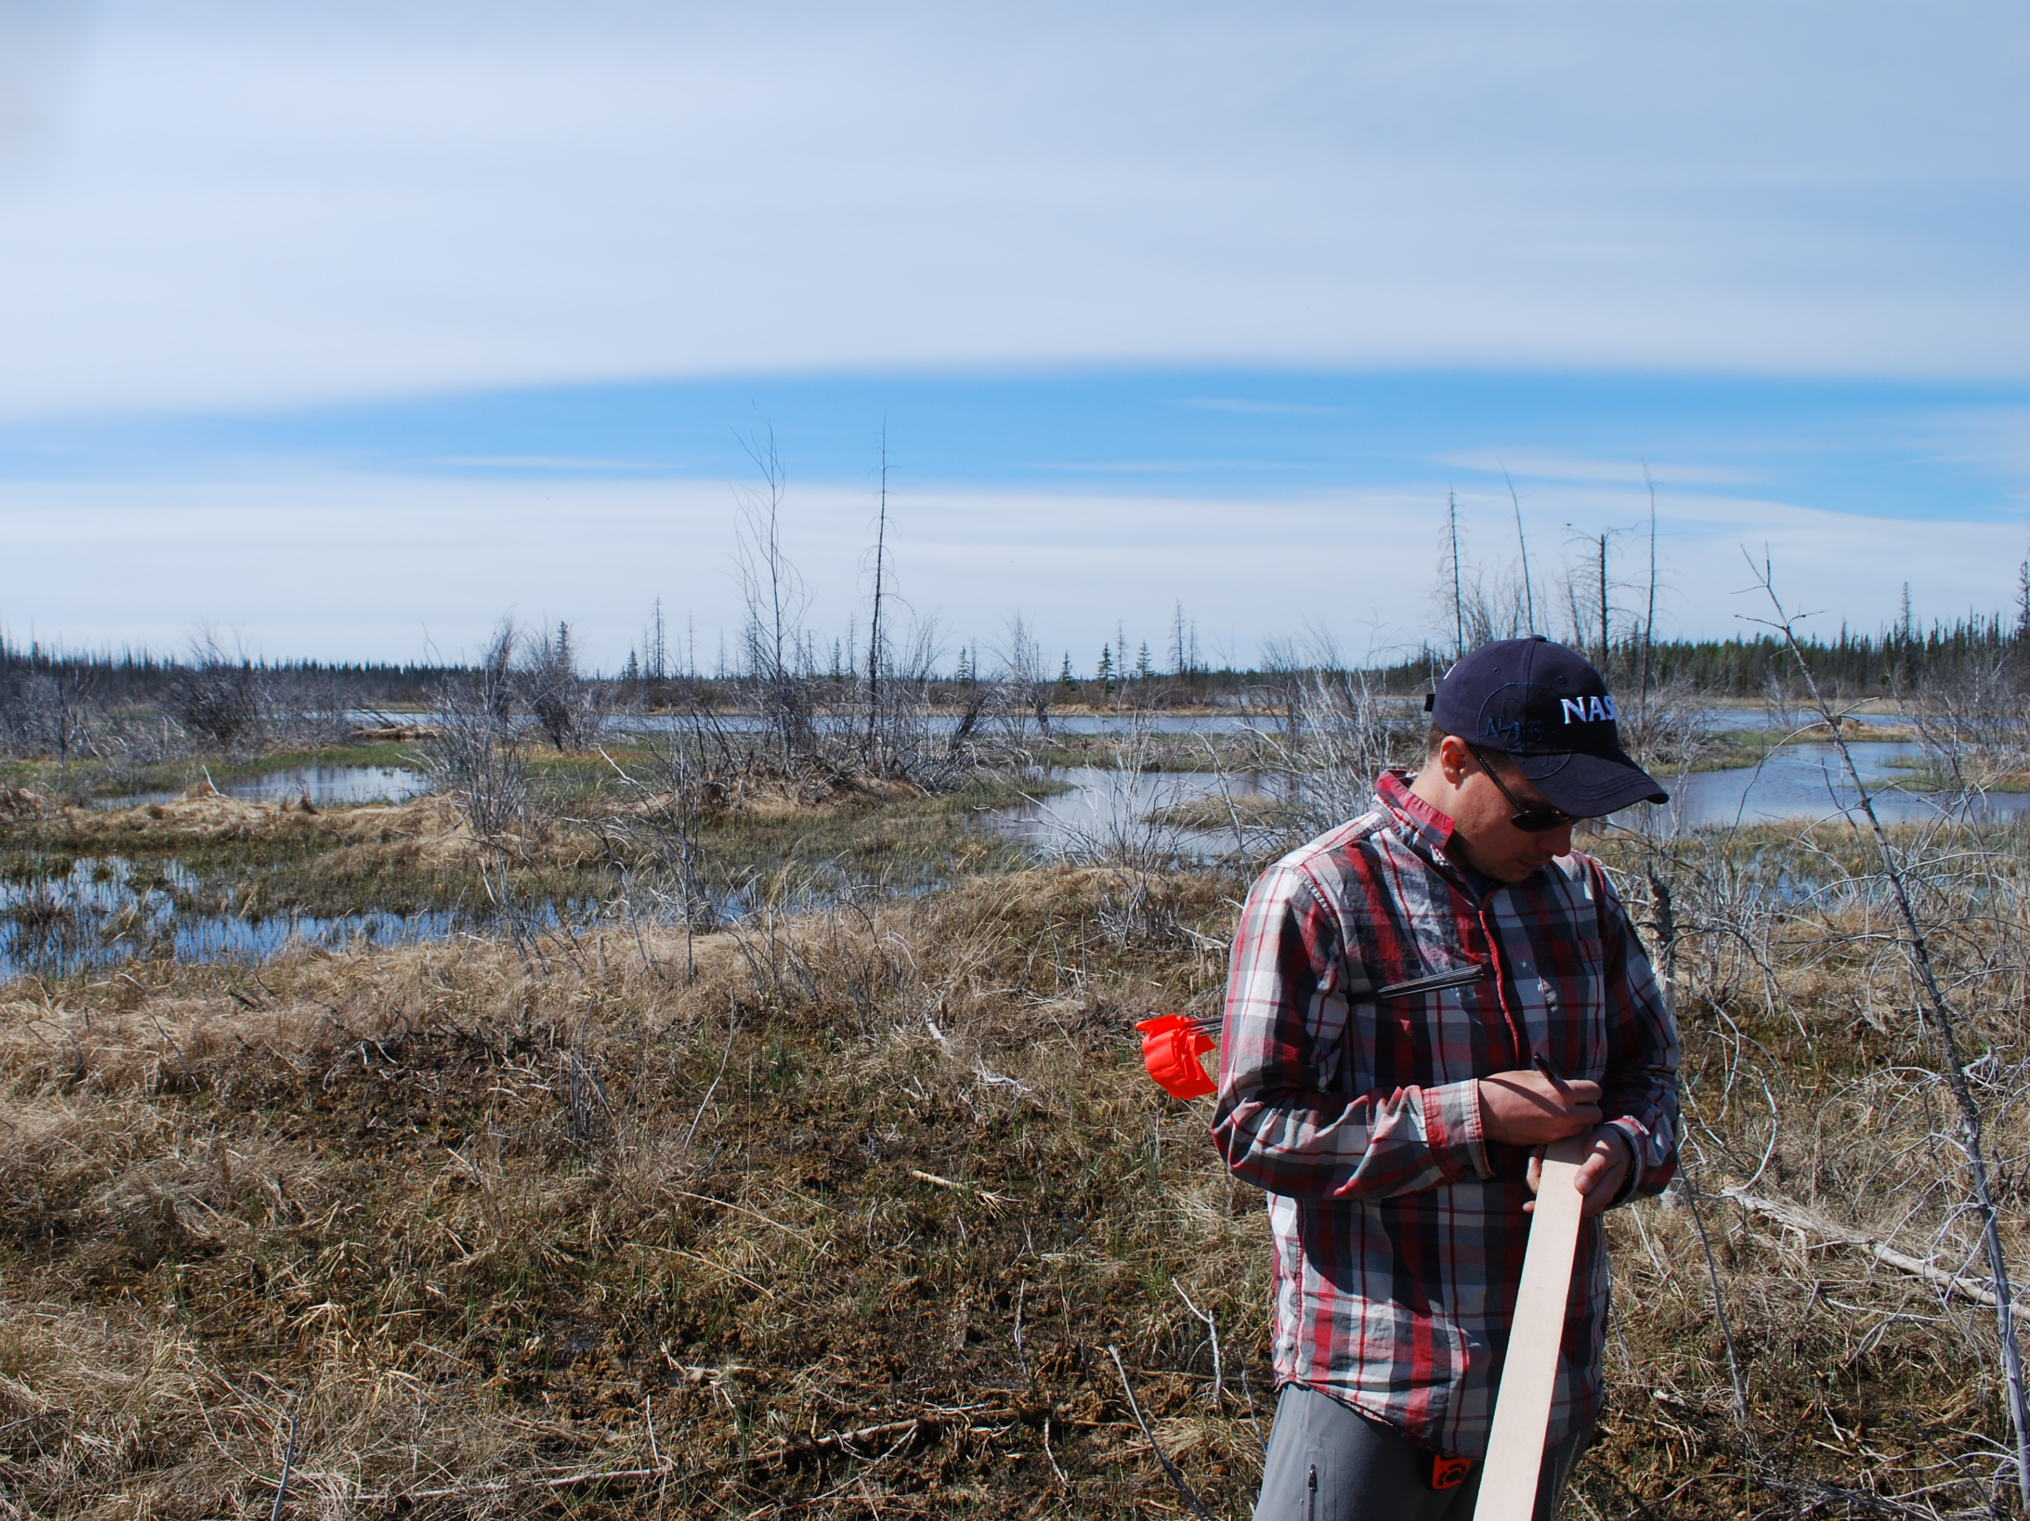
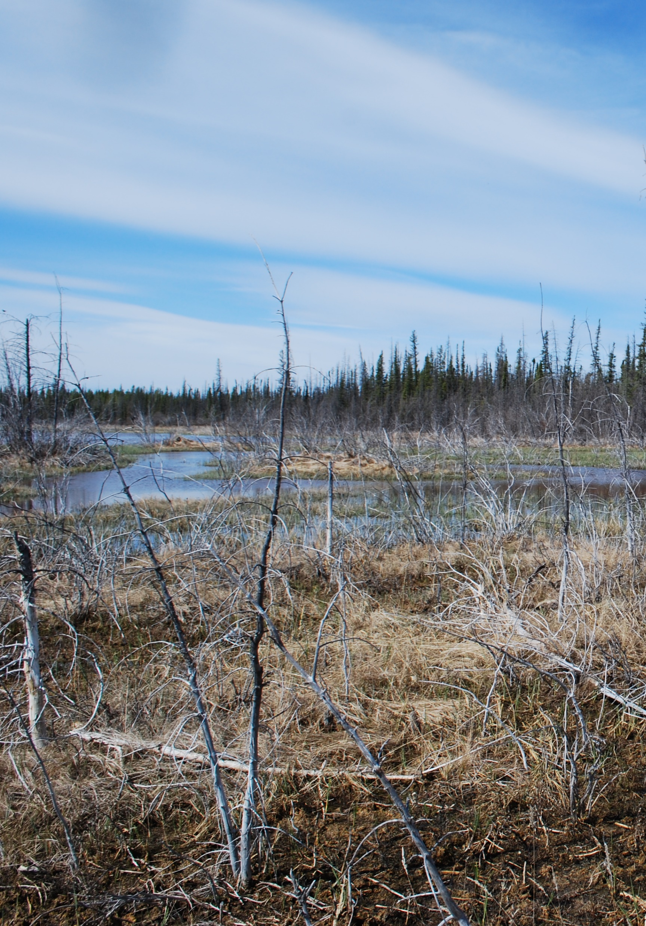
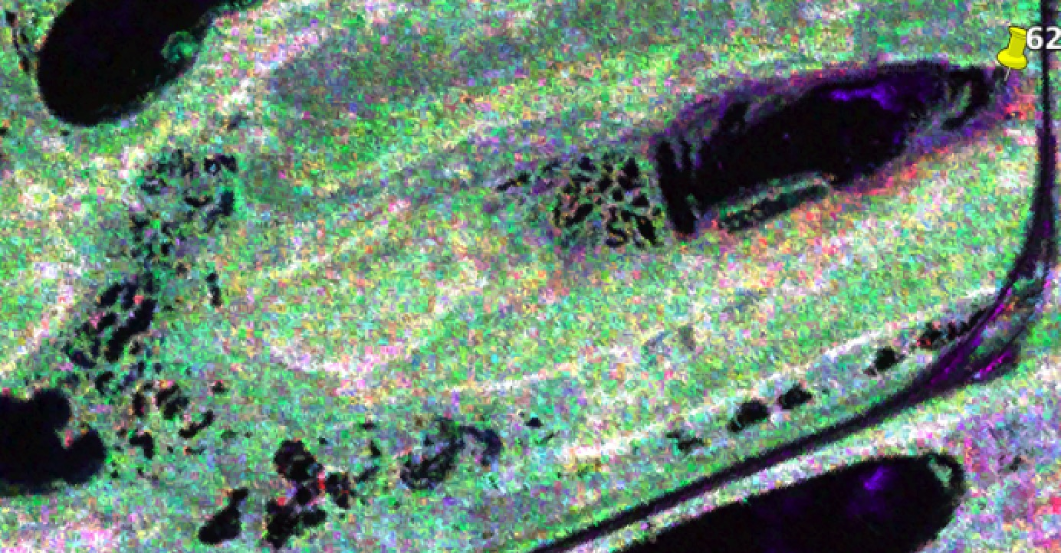
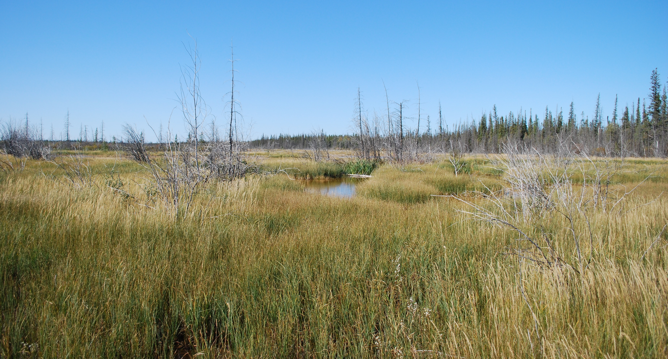
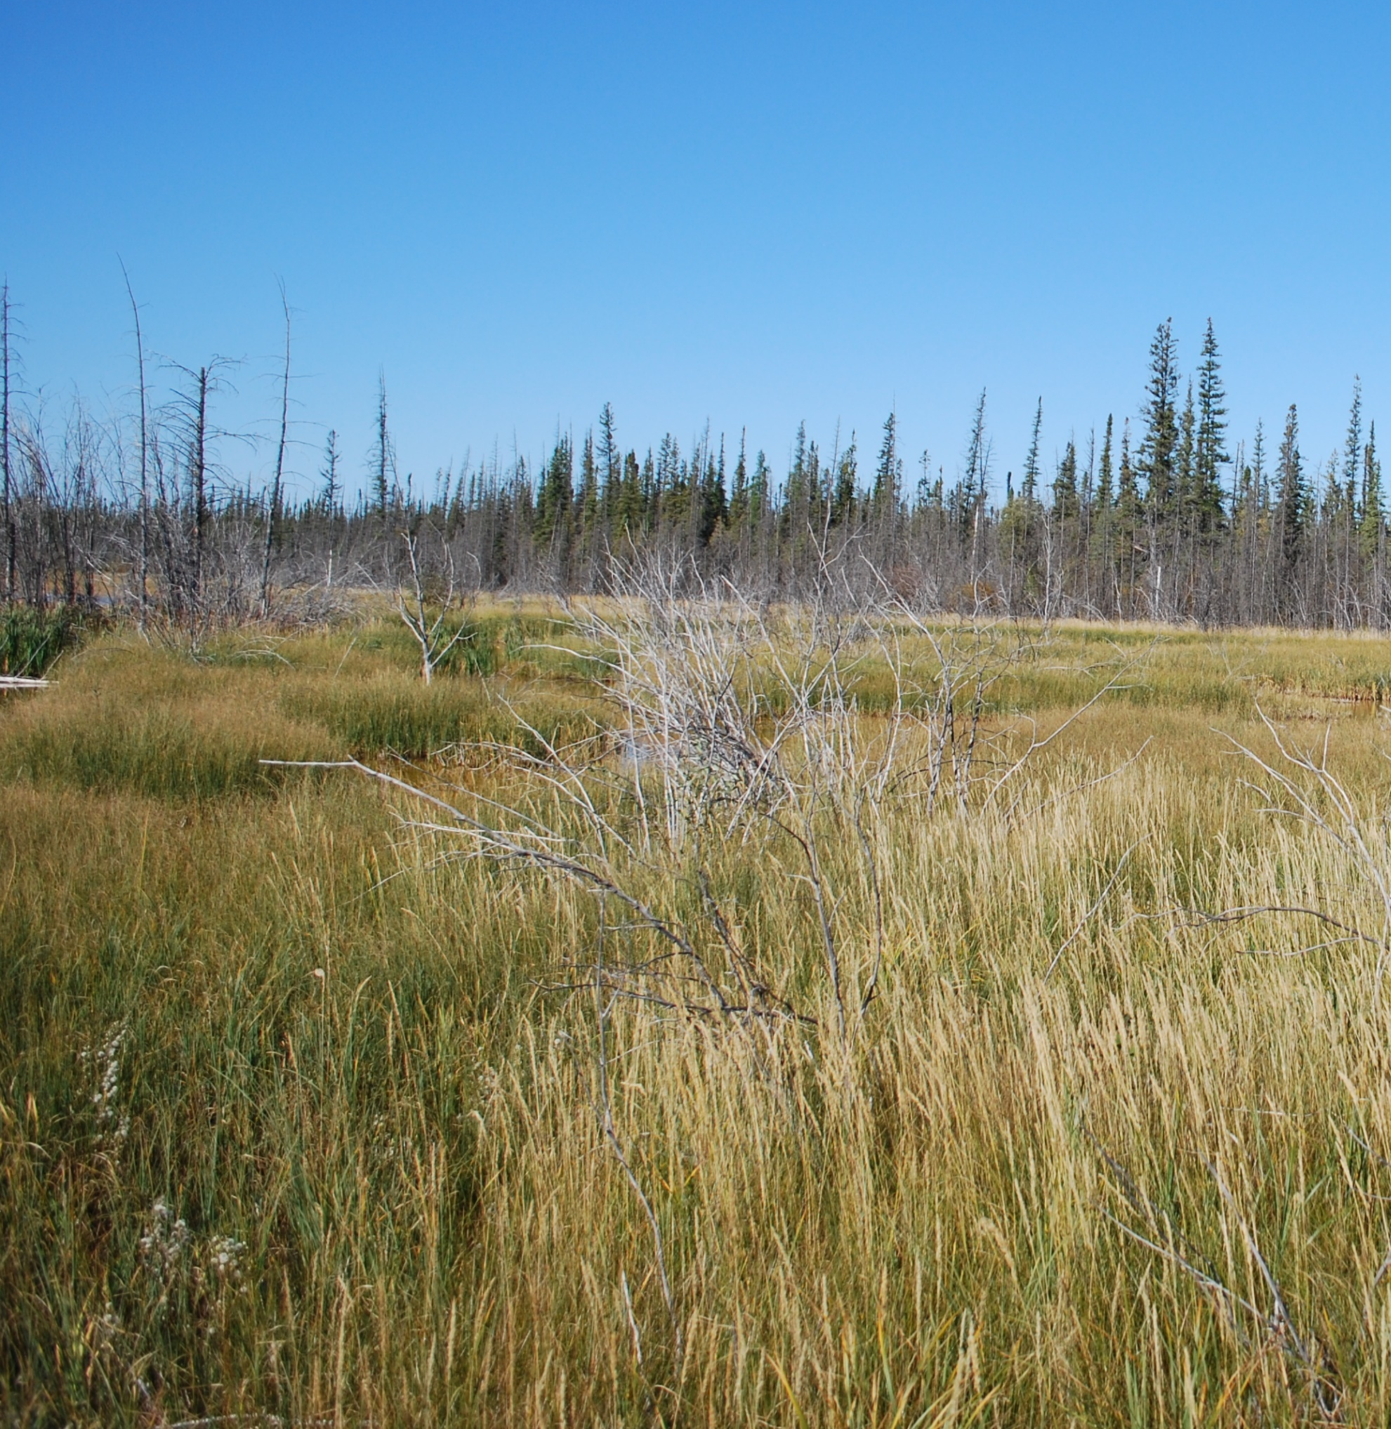
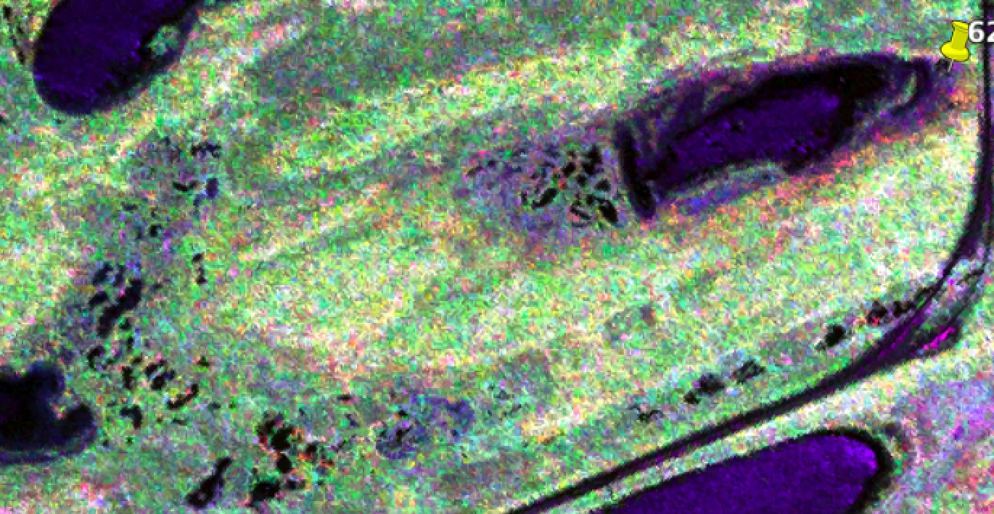
The ABoVE Landscape
Strong inundation dynamics
UAVSAR L-band observations are providing a context for making best use of NISAR data for the ABoVE region, as the data come in
Wetland water channels
May 2017
September 2017

Slide 16
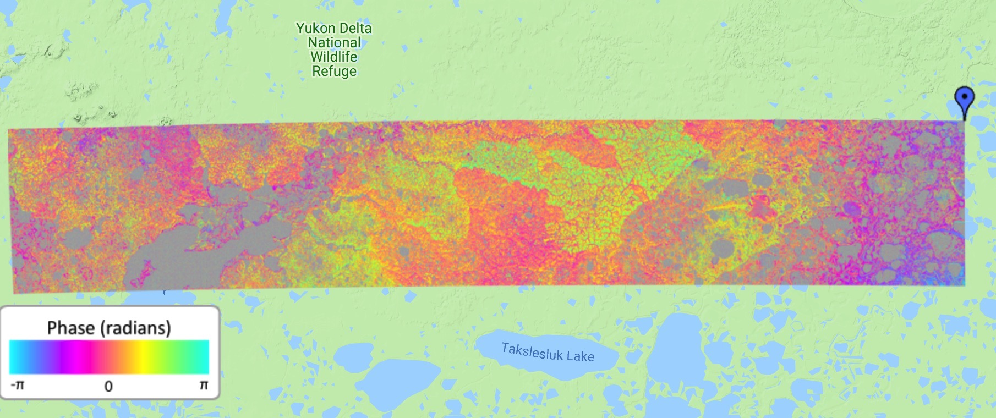
The ABoVE Landscape
Changing Permafrost Dynamics
Winter heave
UAVSAR Repeat-pass Interferometry from June & Sept 2017 indicate deformation in locations of the 2015 Yukon-Kuskokwin Delta fire (from Schaefer et al., 2018)
Active layer
Continuous permafrost
10 km

Slide 17
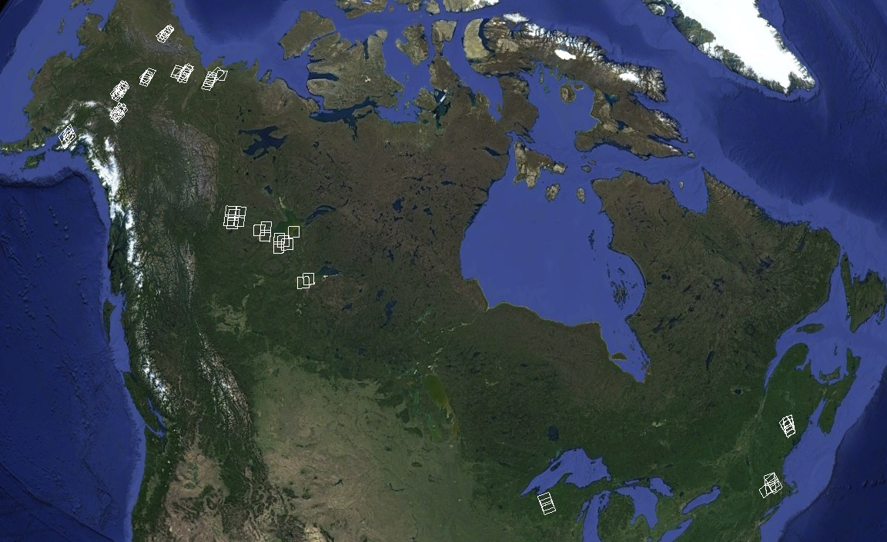
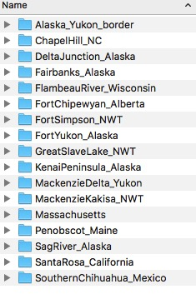
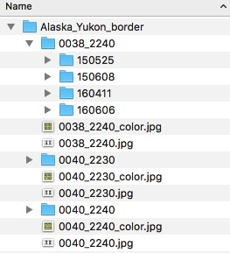
ALOS-2 FBD data

Slide 18
Displaying Dual-pol data
HH, HV, HH/HV
Vegetation is green (HV – Volume scattering)
Water is blue (HH/HV – smooth surfaces are very bright)

Slide 19
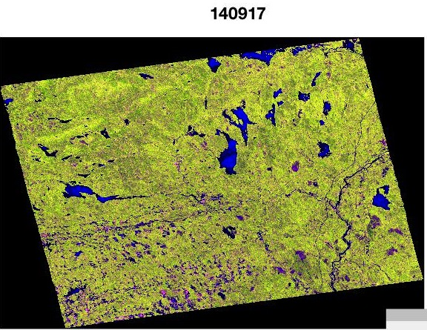
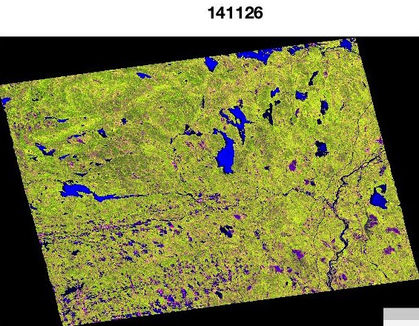
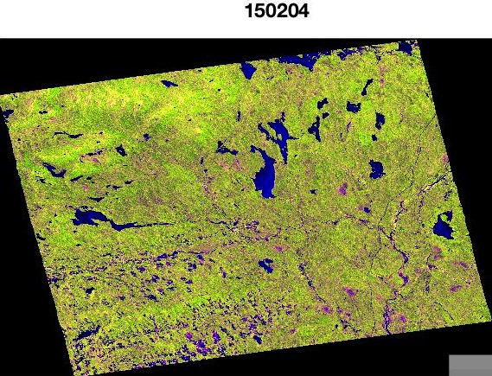
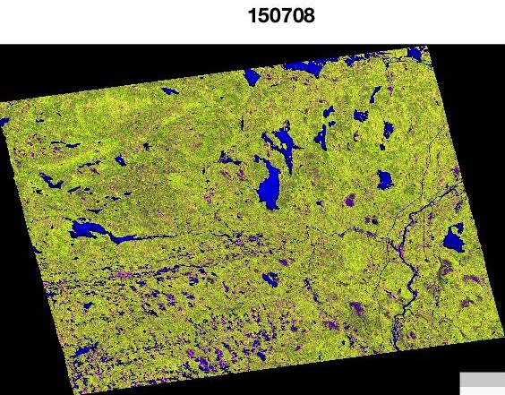
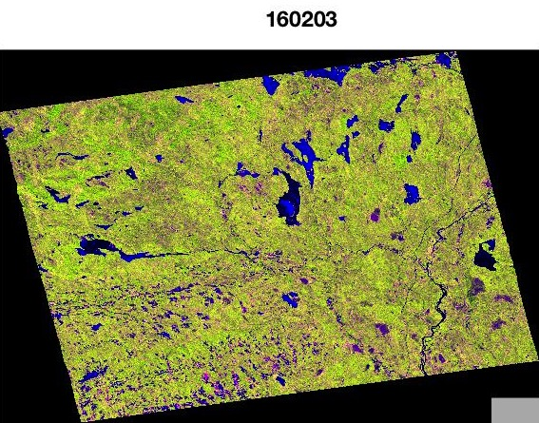
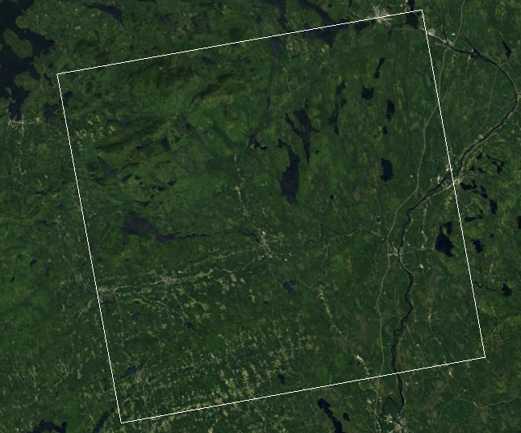
L-band Time Series
Sensors such as Sentinel-1 and NISAR are creating unprecedented, dependable time series of SAR data
September
November
February
July
February

Slide 20
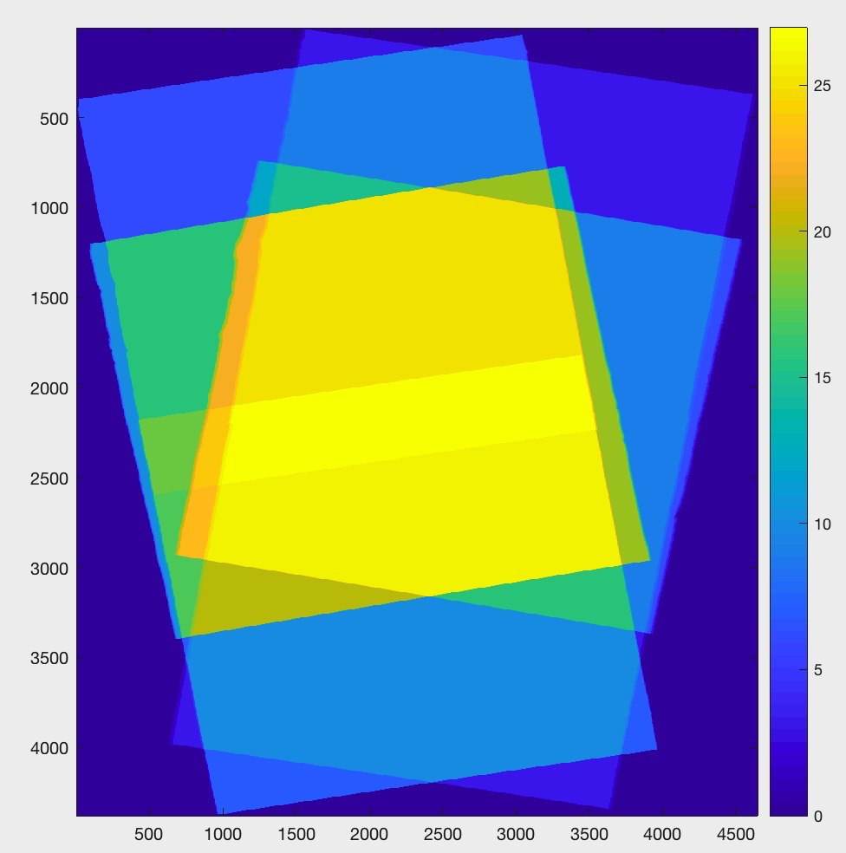
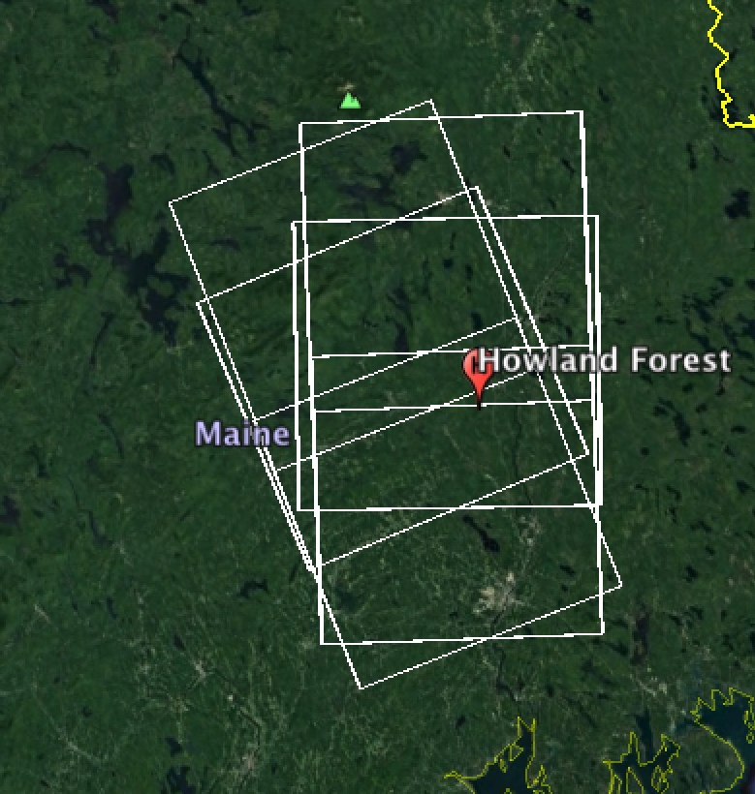
Time Series Analysis
ALOS-2 Observations in Maine
2014
2015
2016
2017

Slide 21
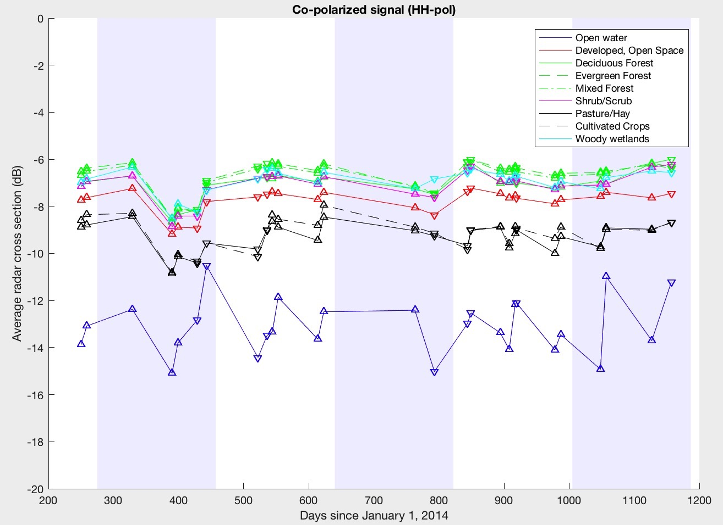
Compare HH and HV RCS for different landcovers

Slide 22
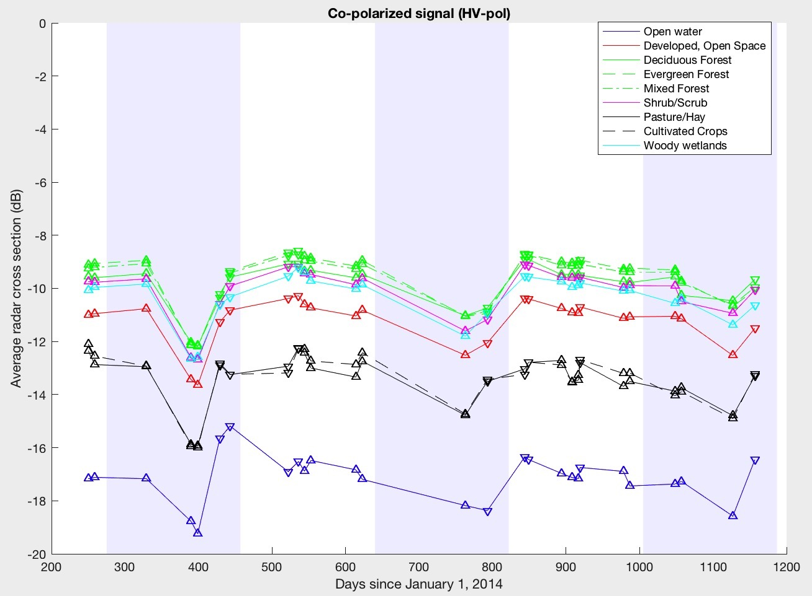
Compare HH and HV RCS for different landcovers

Slide 23
NISAR Current Events
Community Building
Educational Documents
Cal/Val
UAVSAR AM/PM Campaign

Slide 24
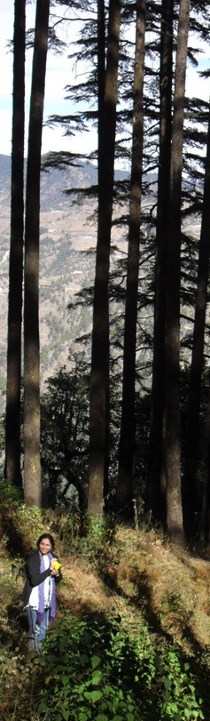


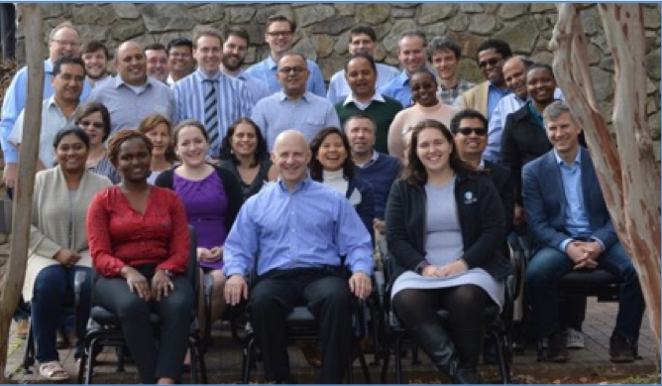
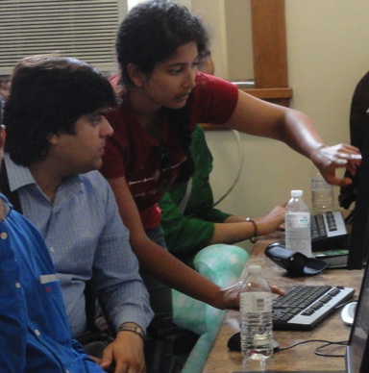

Ecosystems Community
SERVIR (https://www.servirglobal.net)
Forest-PLUS & Forest-PLUS2

Slide 25

NISAR Science Handbook
NISAR 264 page science handbook
  Available as a pdf (nisar.jpl.nasa.gov/getengaged/resources/) and hard copy
  Describes instrument, observations, and theoretical basis for the mission components

Slide 26
The SAR Handbook
Forest Monitoring & Biomass Estimation
7 Technical chapters with examples
  Basic principles and data access
  Forest Disturbance Monitoring
  Forest Stand Height Estimation
  Biomass Mapping
  Remote Sensing of Mangroves
  Sampling Designs for SAR-driven surveys
Peer reviewed
Deployed at SERVIR centers distributed worldwide

Slide 27
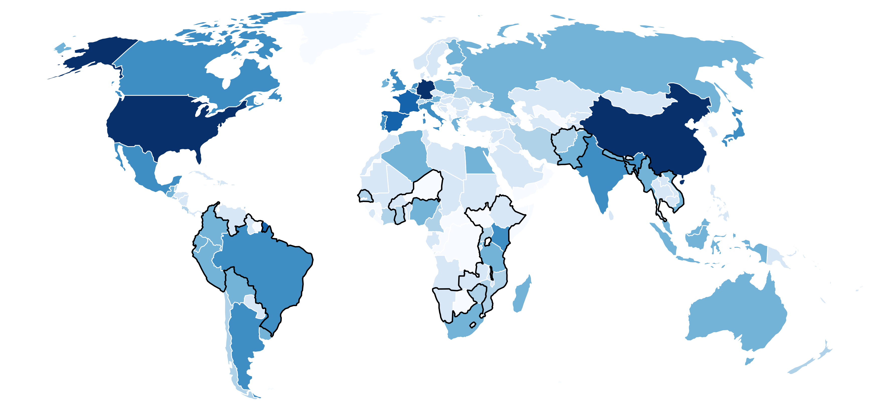

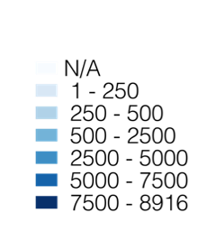
SAR Handbook Materials Have Had Global Reach
Top countries by Handbook materials accessed:
U.S.A. Germany China Spain France | 14,280 9,615 8,543 6,142 5,175
SERVIR Amazonia
SERVIR Mekong
SERVIR
Hindu Kush Himalaya
SERVIR
West Africa
Top countries currently covered by SERVIR:
Country | SERVIR Region | Access
Brazil Kenya Colombia Vietnam Peru Nepal Bangladesh Myanmar Pakistan Ecuador | Amazonia E&S Africa Amazonia Mekong Amazonia HKH HKH HKH/Mekong HKH Amazonia | 3,903 3,586 2,448 2,273 1,674 1,668 1,426 1,262 1,137 1,047
SERVIR
Eastern and Southern Africa
Between April 10 – May 5, 2019
The full Handbook has been accessed more than 103,000 times
Full Handbook and additional materials have been accessed more than 136,000 times
149 countries have accessed SAR Handbook and complementary materials

Slide 28
Nominal Ecosystem Cal/Val sites
https://nisar.jpl.nasa.gov/files/nisar/NISAR_Science_Users_Handbook.pdf

Slide 29
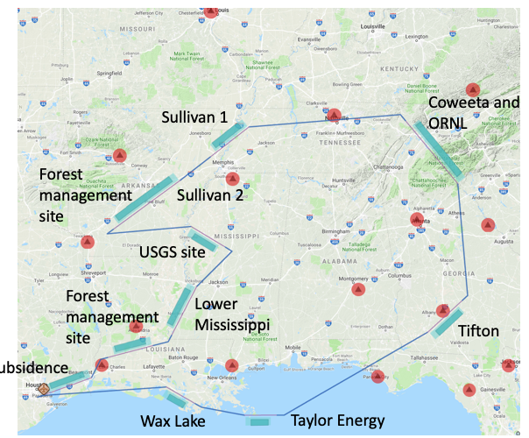
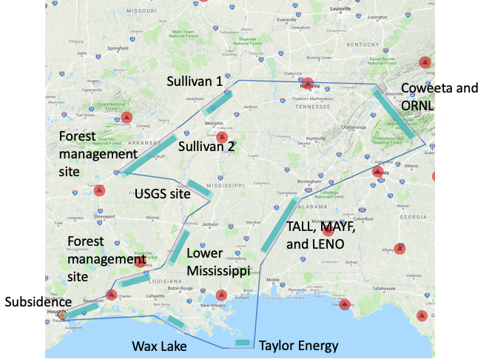
NISAR Ecosystems
UAVSAR AM/PM Campaign
Ecosystems are driven by a strong hydrologic cycle
There is a lack of dense time-series L-band data over Ecosystems sites
NISAR will be flying a concerted UAVSAR observing campaign to collect data two times every 12-days over a 6 month period in the northeastern US.
AM Loop (clockwise)
PM Loop (counter-clockwise)
Notes:
Northeastern flights for UAVSAR are important to capture the temporal variability of water dynamics in a hydrologically driven environment. To date, most of UAVSAR time series are collected in California, where the water cycle does not support significant vegetated ecosystems. In the northeast, it does. While there will be a lot of data collected as part of this campaign, it is a small fraction of what NISAR will produce on a daily basis.

Slide 30
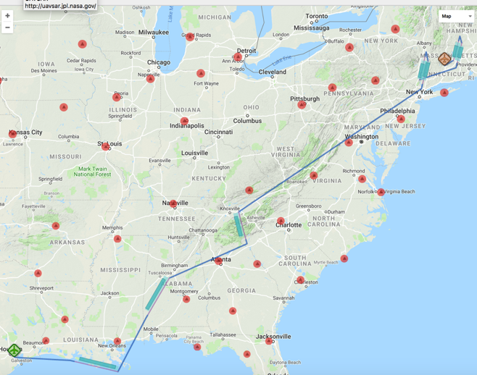
Participating in the SMAPVEX19 campaign
East Coast Up (EC Up) and East Coast Down (EC Down) campaign will add additional data for the Harvard Forest and Millbrook region as part of a SMAP ground validation.
SMAP ground validation will include passive airborne radar.
Goal is to better sense soil moisture beneath canopies (the greatest source of error for SMAP).
EC Up
EC Down

Slide 31
UAVSAR AM/PM Schedule
The current schedule of the flights are as follows:
Date | Track | Δ Days
2 June | AM | -
3 June | PM | 1
14 June | AM | 11
15 June | PM | 1
26 June | AM | 11
27 June | PM | 1
8 July | EC Up | 11
9 July | EC Down | 1
20 July | EC Up | 11
21 July | EC Down | 1
31 July | EC Up | 10
1 August | EC Down | 1
ABoVE Flights
Date | Track | Δ Days
6 September | AM | 36
7 September | PM | 1
18 September | AM | 11
19 September | PM | 1
30 September | AM | 11
1 October | PM | 1
12 October | AM | 11
13 October | PM | 1
24 October | EC Up | 11
25 October | EC Down | 1

Slide 32
Take Home Messages
NISAR will collect 30-60 dual-pol images per year over most land surfaces
Ecosystems are driven by the hydrologic cycle
  In terms of biomass, disturbance this is the dominant source of error. For inundation and permafrost, it is the signal
NISAR and the ABoVE program are tightly linked
  Low biomass • Wetlands & Inundation
  Strong hydrologic cycle • Permafrost
  Disturbance events control ecologic trajectory
NISAR is set to launch in 2022.
UAVSAR AM/PM campaign is set to start in June and go to October
Active engagement of NISAR with ABoVE
Now is a good time to start working with data!

Slide 33

The NISAR Mission
Coming Soon!

Slide 34
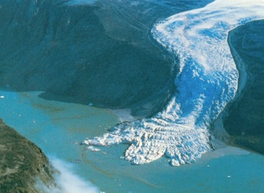
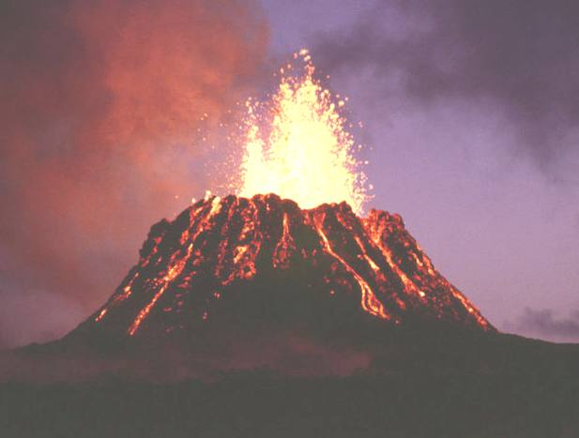
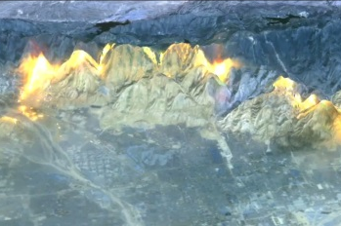
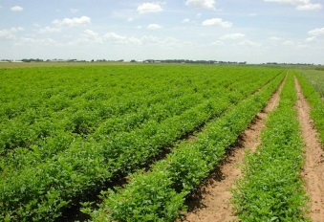
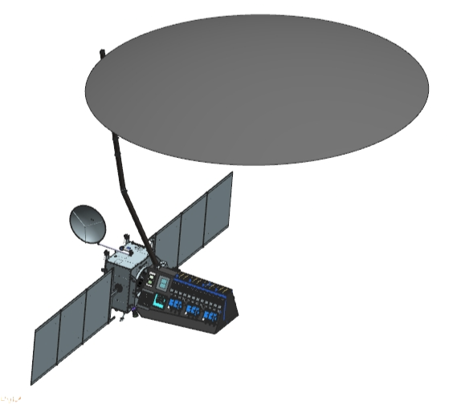

NISAR Concept Science Observation Overview
NISAR Characteristic: | Would Enable:
L-band (24 cm wavelength) | Low temporal decorrelation and foliage penetration
S-band (12 cm wavelength) | Sensitivity to light vegetation
SweepSAR technique with Imaging Swath > 240 km | Global data collection
Polarimetry (Single/Dual/Quad) | Surface characterization and biomass estimation
12-day exact repeat | Rapid Sampling
3 – 10 meters mode-dependent SAR resolution | Small-scale observations
3 years science operations (5 years consumables) | Time-series analysis
Pointing control < 273 arcseconds | Deformation interferometry
Orbit control < 500 meters | Deformation interferometry
> 30% observation duty cycle | Complete land/ice coverage
Left/Right pointing capability | Polar coverage, north and south
NISAR Would Uniquely Capture the Earth in Motion
NISAR Uniquely Captures the Earth in Motion
Observation Geometry
747 km
33º
6 AM / 6 PM
47º
Earth surface
>240 km
Notes:
This is a generic slide that shows what NISAR is.

Slide 35
Science Observing/Operations Modes (Pre-2016)
Observation strategy employs a small subset of possible modes
Observation Strategy | L-band |  | S-band |  | Culling Approach
Science Target | Mode⁺ | Resolution | Mode | Resol. | Sampling | Desc Asc
Background Land | DP HH/HV | 12 m x 8 m |  |  | cull by lat
Land Ice | SP HH | 3 m x 8 m |  |  | cull by lat
Sea Ice Dynamics | SP VV | 48 m x 8 m |  |  | s = 1 p
Urban Areas |  | 6 m x 8 m |  |  | s = 1 p
US Agriculture | QP HH/HV VV/VH |  |  |  | s = 1 p
Himalayas |  |  | CP RH/RV |  | s = 1 p
India Agriculture |  |  |  |  | s = 1 p
India Coastal Ocean |  |  | DP HH/HV or VV/VH |  | s = 1 p
Sea Ice Types | DP VV/VH |  |  |  | s = 3 p

Slide 36



Learn More about NISAR
applications

