Slide 1

Permafrost Active Layer Properties Retrieved from Time-Series P-Band Radar
Mahta Moghaddam
On behalf of:
Richard Chen, Kazem Bakian-Dogaheh, Alireza Tabatabaeenejad
University of Southern California
In Collaboration with: Yonghong Yi (JPL), John Kimball (U Montana)

Slide 2
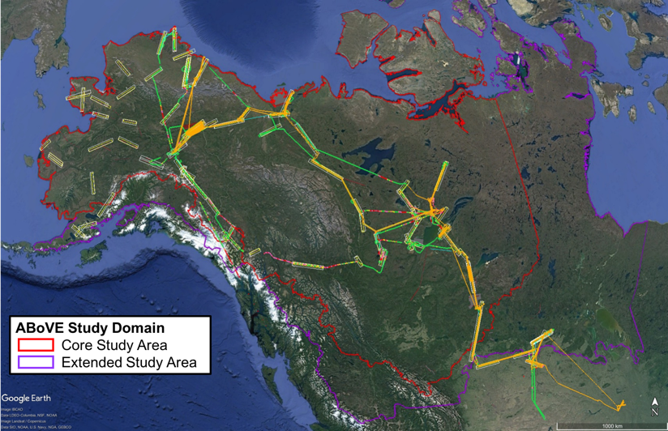
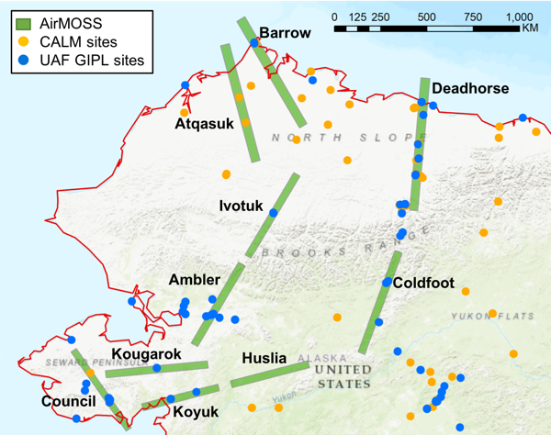
P-Band POLSAR Observations in ABoVE Study Domain
Airborne Microwave Observatory of Subcanopy and Subsurface (AirMOSS)
  Polarimetric Synthetic Aperture Radar (SAR), P-band (420 – 440 MHz)
  0.5- and 3-arcsec resolutions (～5 m x 15 m and 30 m x 90 m in the Arctic)
Pre-ABoVE Legacy Lines (10)
2014/08
2014/10
2015/04
2015/08
2015/10
P-band
2017/05
2017/08
2017/10
L-band
2015
2016
2017
2015/10
2017/06
2017/09

Slide 3
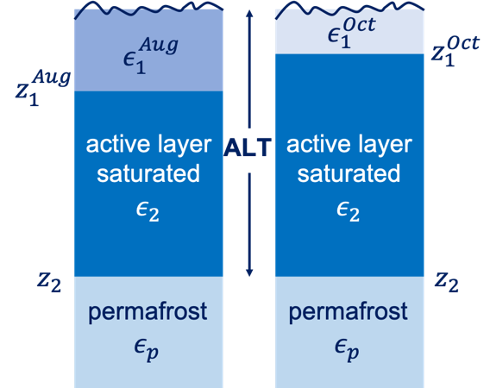
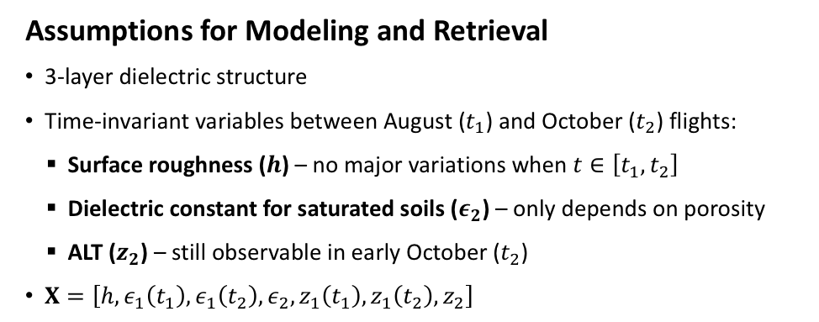
P-band POLSAR Time-Series Approach*
Observations from in-situ measurements
Soil dielectric constant $ε$ at different depths at SoilSCAPE Prudhoe Meadow site:
thawed
frozen
frozen
Assumptions for Modeling and Retrieval
3-layer dielectric structure
Time-invariant variables between August ($t_{1}$) and October ($t_{2}$) flights:
    Surface roughness ($h$) – no major variations when $t∈\left[t_{1},t_{2}\right]$
    Dielectric constant for saturated soils ($ε_{2}$) – only depends on porosity
    ALT ($z_{2}$) – still observable in early October ($t_{2}$)
$X=\left[h,ε_{1}\left(t_{1}\right),ε_{1}\left(t_{2}\right),ε_{2},z_{1}\left(t_{1}\right),z_{1}\left(t_{2}\right), z_{2}\right]$
* Chen et al., “Retrieval of Permafrost Active Layer Properties Using Time-Series P-Band Radar Observations,” IEEE-TGRS 2019

Slide 4
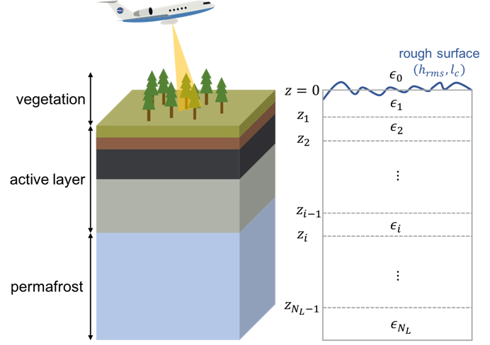
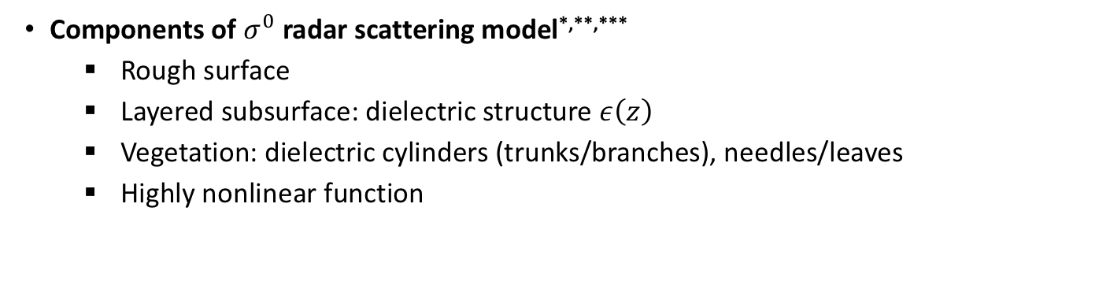
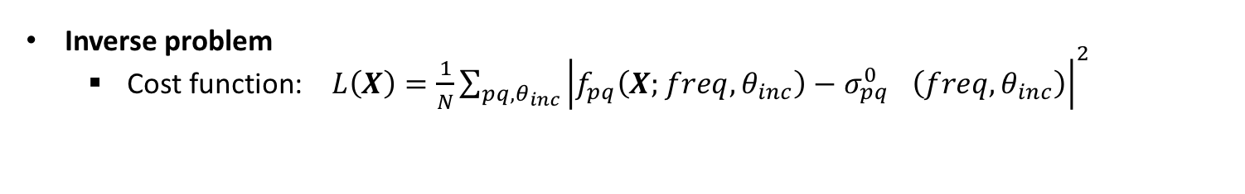
Radar POLSAR Retrieval at-a-Glance
Components of $σ^{0}$radar scattering model*,**,***
  Rough surface
  Layered subsurface: dielectric structure $ε\left(z\right)$
  Vegetation: dielectric cylinders (trunks/branches), needles/leaves
  Highly nonlinear function
Inverse problem
  Cost function: $L\left(X\right)=\frac{1}{N}\sum_{{pq, θ}_{inc}}{{\left|{f_{pq}^{}\left({X;freq,θ}_{inc}\right)−σ_{pq}^{0}}_{}^{}\left({freq,θ}_{inc}\right)\right|}^{2}}$
model
data
* Tabatabaeenejad and Moghaddam, TGRS 44(8), 2006
** Tabatabaeenejad et al., TGRS 51(7), 2013
*** Burgin et al., TGRS 49(12), 2011

Slide 5
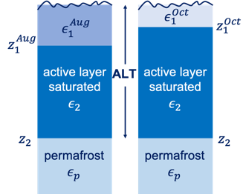
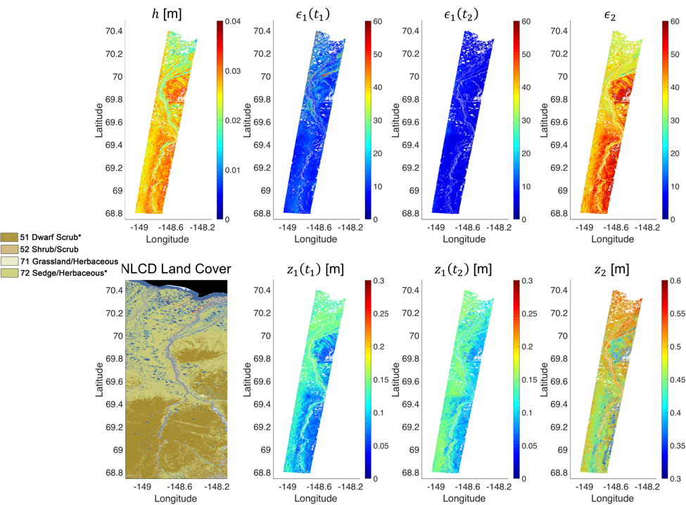
P-Band POLSAR Retrievals (1)
Example shown: Deadhorse (Dalton HWY) line, 2015
Retrieval results show ALT and m_{v} are strongly influenced by land cover
August
October
ALT
* Chen et al., “Retrieval of Permafrost Active Layer Properties Using Time-Series P-Band Radar Observations,” IEEE-TGRS 2019

Slide 6
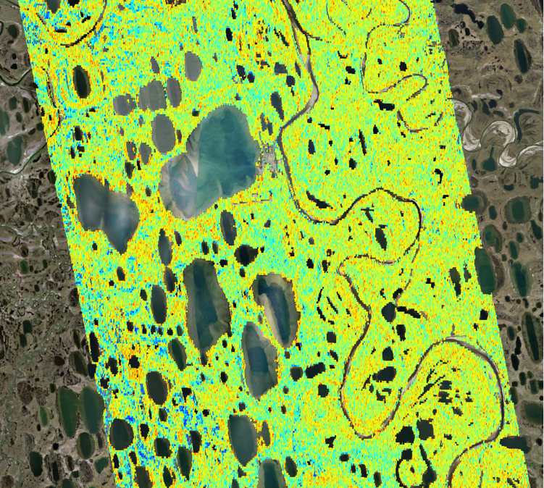
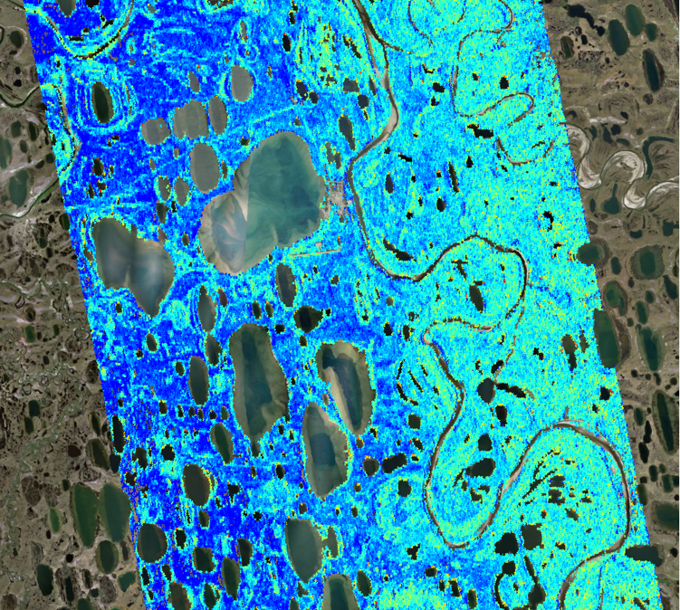
P-Band POLSAR Retrievals (2)
Example shown: Atqasuk line, 2015
Note spatial variability of ALT and soil moisture around the rims of ponds
2015
2015
0.25
0.45
0.65
0.25
0.45
0.65
ALT [m]
Subsurface Soil Moisture [m³/m³]
* Chen et al., “Retrieval of Permafrost Active Layer Properties Using Time-Series P-Band Radar Observations,” IEEE-TGRS 2019

Slide 7
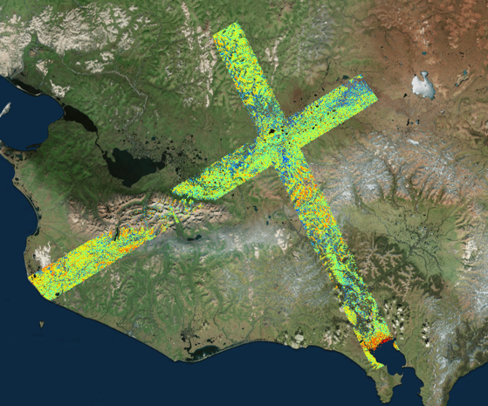
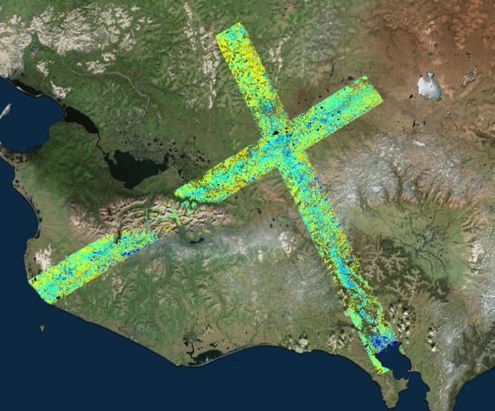
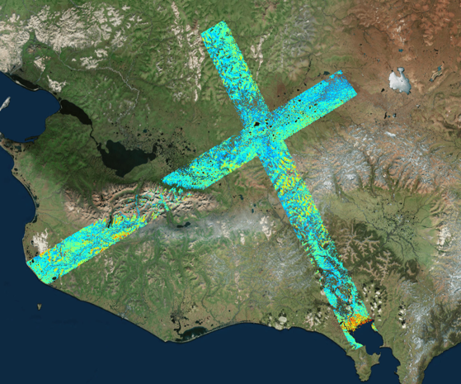
P-Band POLSAR Retrievals (3)
2017
Seward Peninsula
0.25
0.45
0.65
ALT [m]
2017
2017
0.0
0.1 5
0.3
0.35
0.55
0.75
Surface Soil Moisture [m³/m³]
Subsurface Soil Moisture [m³/m³]

Slide 8
Radar “Sensing Depth”
“Sensing depth” δ_{s} defined as subsurface depth beyond which observed radar signals are not sensitive to the presence of permafrost interface
δ_{s} is different from the conventional penetration depth δ_{p} (or the 1/e depth)
δ_{s} depends on radar calibration uncertainty and dielectric properties of active layer
δ_{s} is larger for longer wavelengths: δ_{s, P-band} > δ_{s, L-band}
Example for calibration uncertainty = 0.5 dB
* Chen et al., “Retrieval of Permafrost Active Layer Properties Using Time-Series P-Band Radar Observations,” IEEE-TGRS 2019

Slide 9
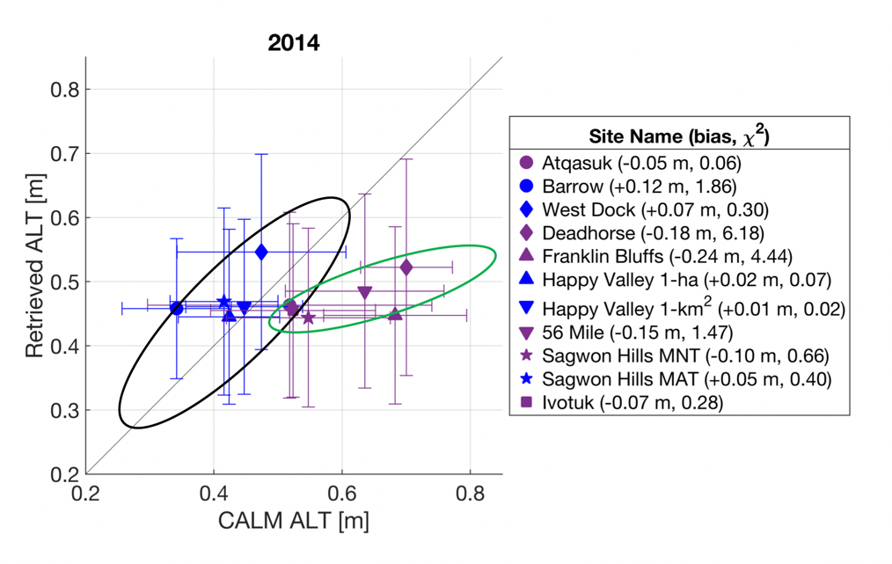
ALT Retrieval Accuracy*
Retrieved ALT was compared against available in-situ observations at several CALM sites
“error” bars show spatial distribution of retrieved ALT within 2 arcsec pixels
For ALT < sensing depth, retrieval RMSE is < 0.05 m and mean bias is < 0.03 m
For ALT > sensing depth, retrieval errors increase nearly linearly with ALT
* Chen et al., “Retrieval of Permafrost Active Layer Properties Using Time-Series P-Band Radar Observations,” IEEE-TGRS 2019

Slide 10
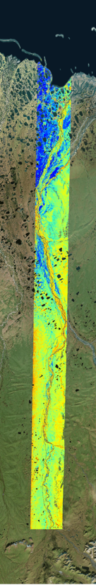
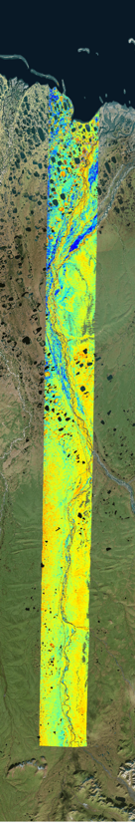
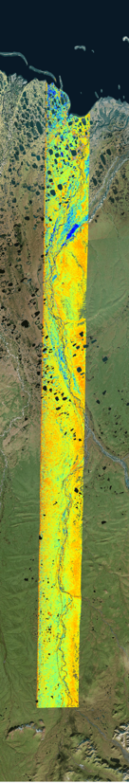
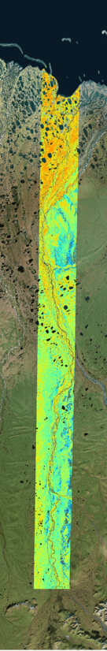
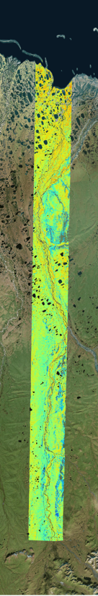
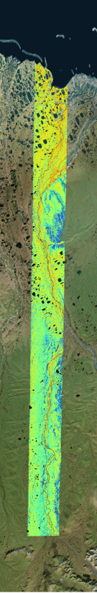
Interannual Variations: Dalton HWY / Deadhorse
2014
2015
2017
2014
2015
2017
Spatial patterns influenced by landcover
ALT decreased from 2014 to 2015, but increased slightly from 2015 to 2017
ALT was stable from 2014 to 2015, but decreased slightly from 2015 to 2017
0.0
0.25
0.5
0.25
0.45
0.65
Surface Soil Moisture [m³/m³]
ALT [m]

Slide 11
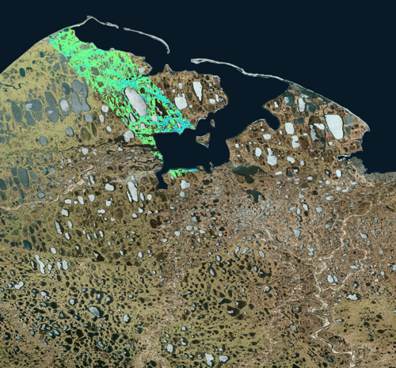
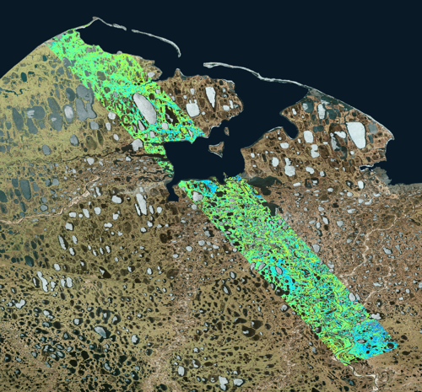
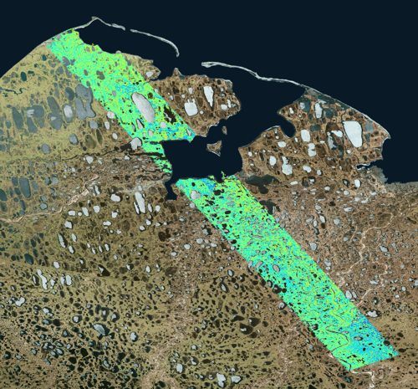
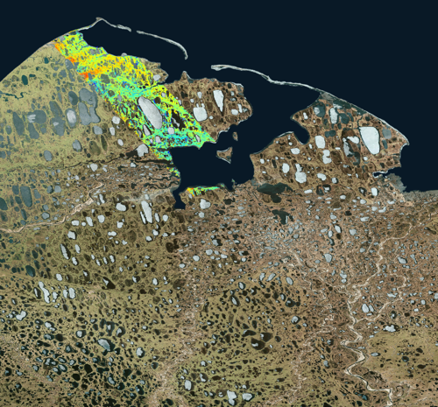
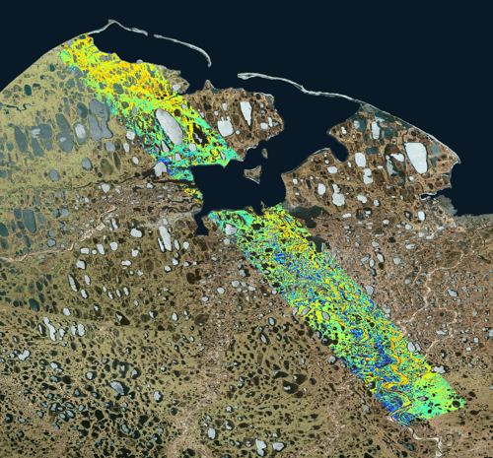
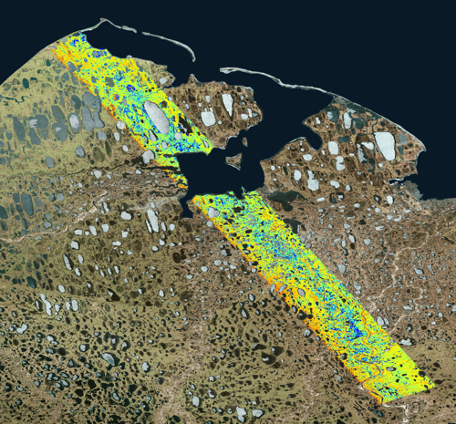
Interannual Variations: Barrow
2014
2015
2017
0.25
0.45
0.65
ALT [m]
2014
2015
2017
0.0
0.25
0.5
Surface Soil Moisture [m³/m³]

Slide 12
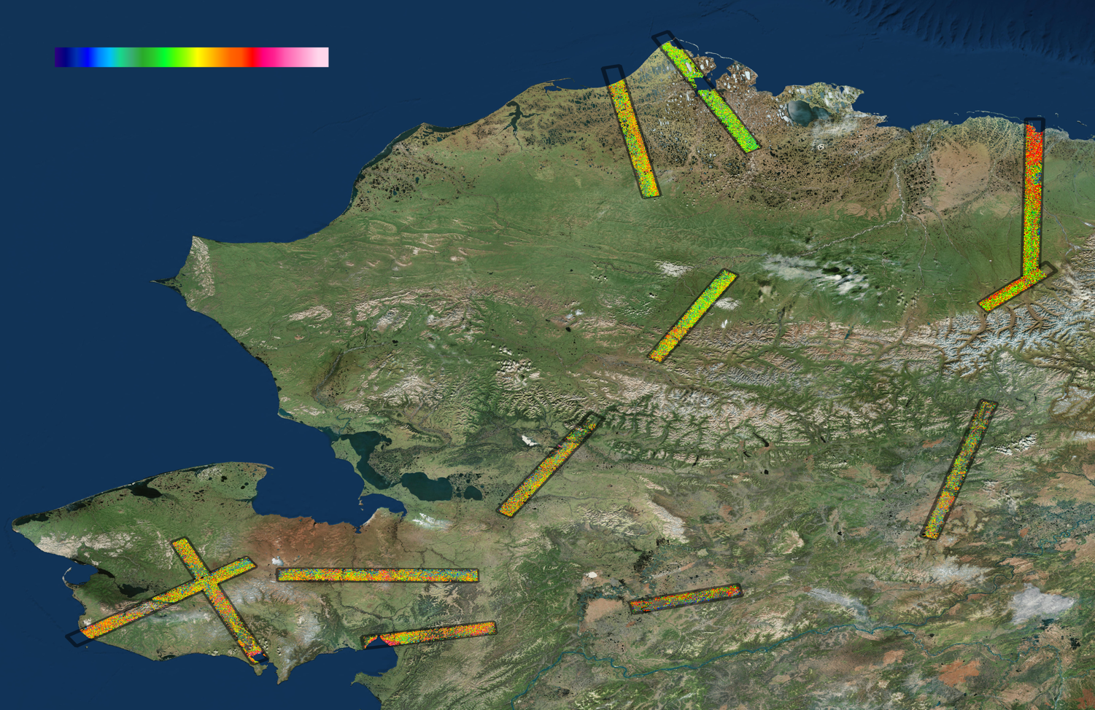
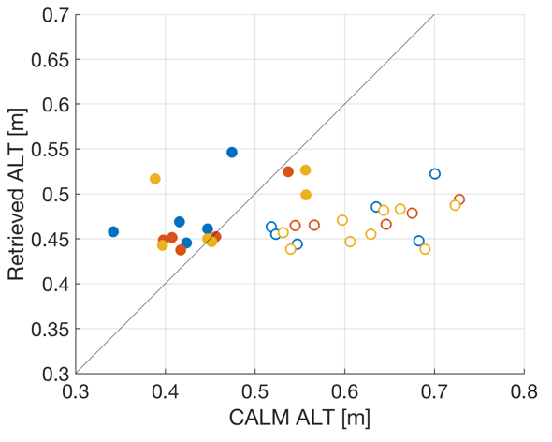
3-Year Retrieval Performance
0.2
0.45
0.7
ALT [m]
2014
2015
2017
within sensing depth
RMSE = 0.056m
Bias = 0.029 m
beyond sensing depth

Slide 13
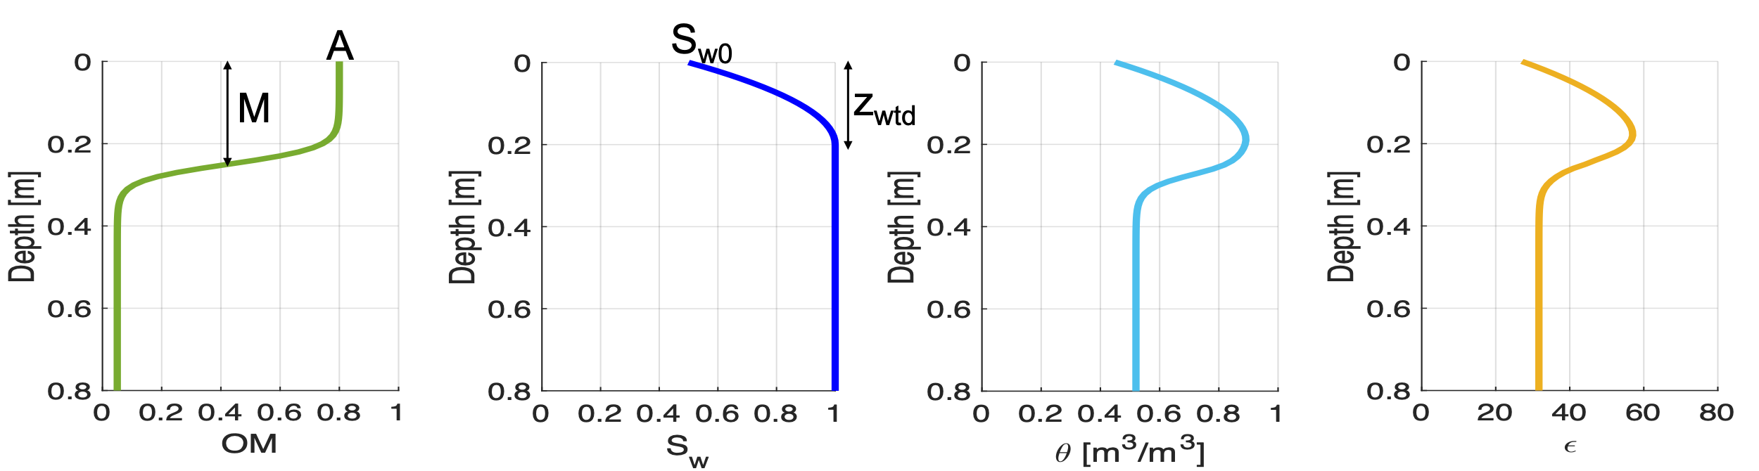
Current Work: Advanced Profile Retrievals (1)
In order to directly retrieve soil moisture profiles for high-organic Arctic soils and to address the sensing depth limitation, we have developed:
  A soil parametrization scheme to estimate soil hydraulic properties for a given organic matter (OM) content and mineral texture
  A soil dielectric mixing model using the derived hydraulic properties
With these developments and based on our in-situ OM profile data, we now can model the active layer soil profile as:
organic matter
water saturation
soil moisture
soil dielectric const.
OM profile as an S-shaped function:
$OM\left(z\right)=A+\frac{K−A}{1+e^{−B\left(z−M\right)}}$
Water saturation fraction profile:
$S_{w}\left(z\right)=\left\{\begin{aligned}\frac{S_{w0}−1}{z_{wtd}^{2}}{\left(z−z_{wtd}\right)}^{2}+1, z<z_{wtd} \\ & 1, z≥z_{wtd}\end{aligned}\right.$
S_{w0}: water saturation at z=0
z_{wtd}: water table depth

Slide 14
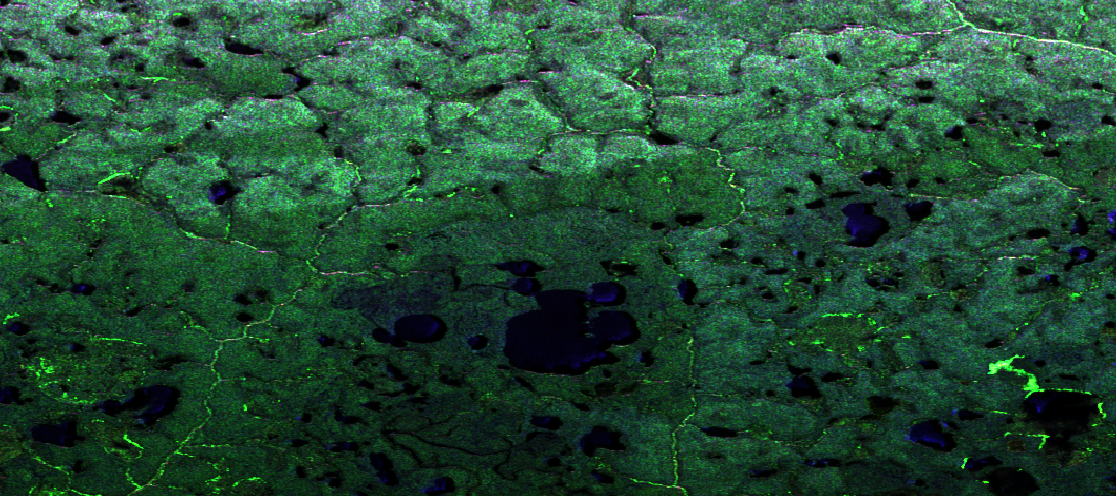
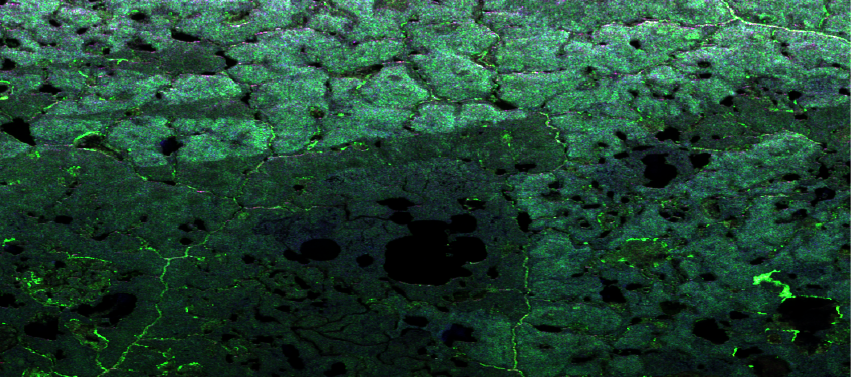
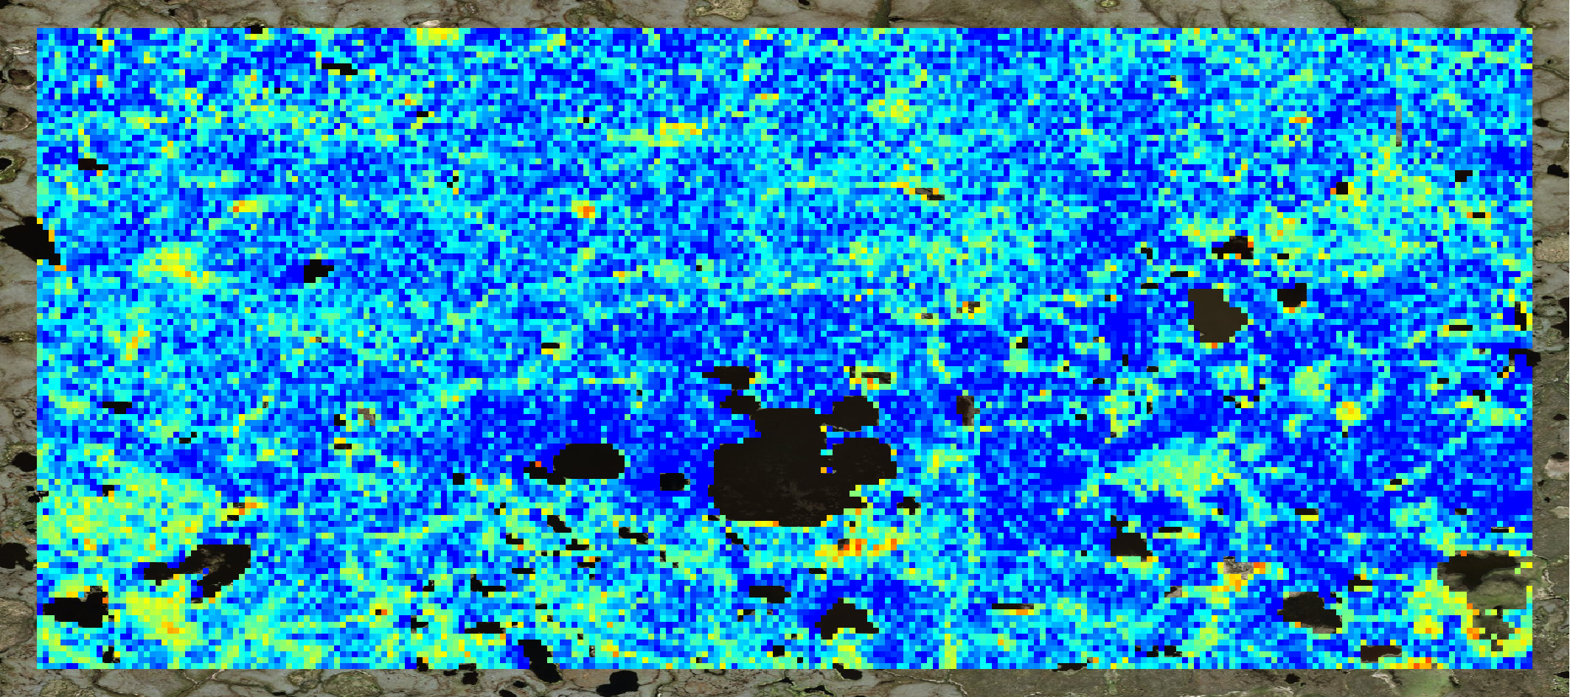
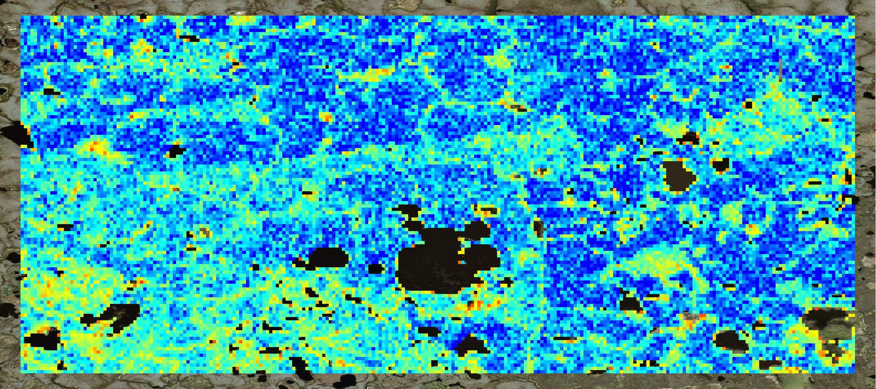
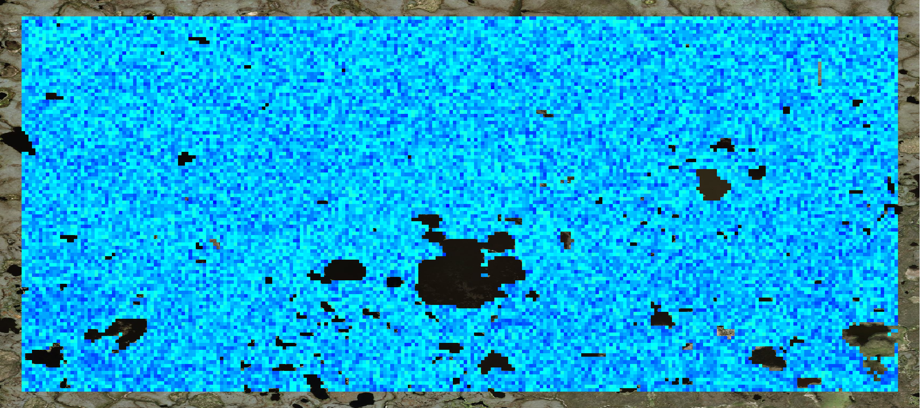
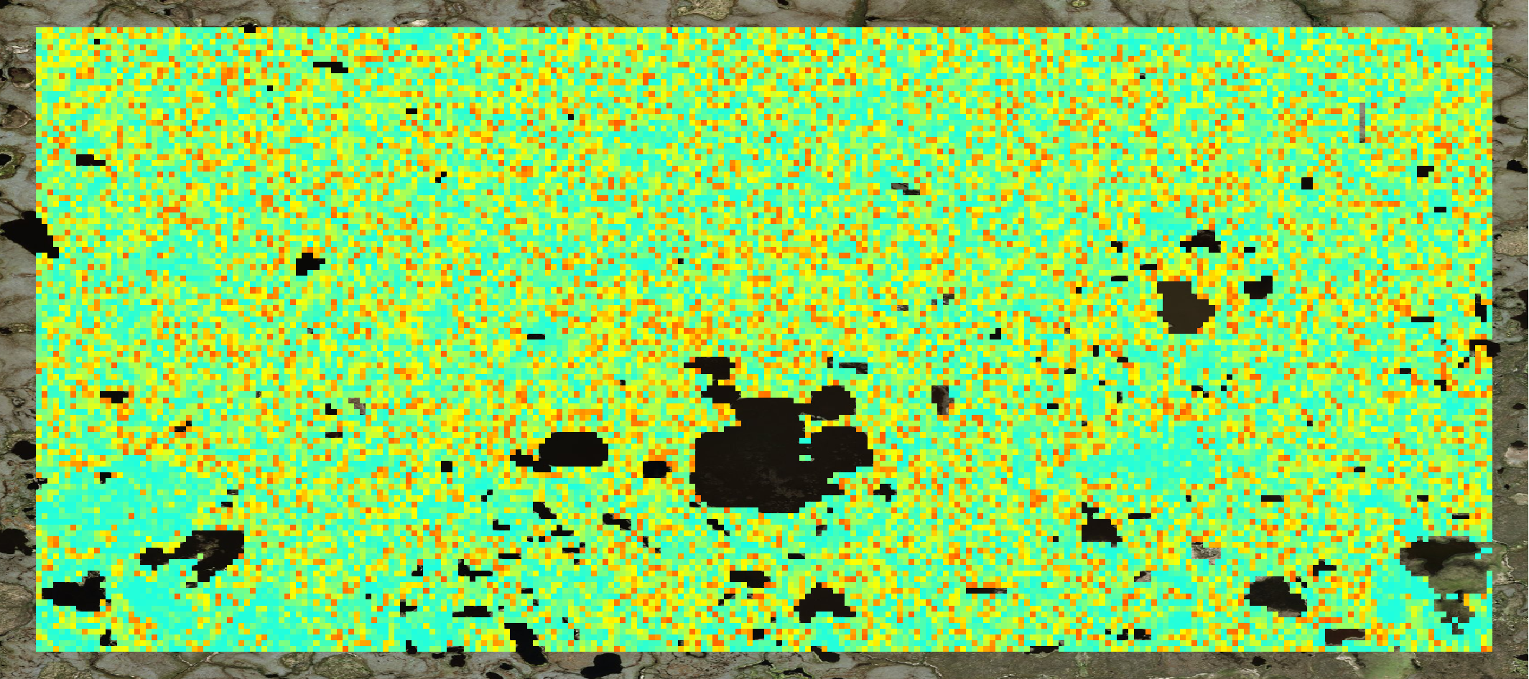
Current Work: Advanced Profile Retrievals (2)
Happy Valley (Deadhorse Legacy Line), 2017
Yukon-Kuskokwim Delta (ykdelB Line), 2017
2017-05-27
2017-08-14
2015 Fire
2006 Fire
0.35
Surface Soil
Moisture
[m³/m³]
0
0.8
Thaw
Depth
[m]
0
Notes:
Happy Valley results: the new profile model can improve upon the baseline model so that the retrieved products are more realistic.
YK Delta results: since we don’t have Oct flight for most foundational flights (such as YK Delta), we incorporate the late May P-band flights into the time-series. Results show that the active layer had thawed to about 15-20 cm in late May 2017. The wetter surface can be due to closer distance from thaw depth to the surface. August soil moisture is higher within the fire scars, which is likely due to weaker evapotranspiration out of less surface vegetation (lost to fire).

Slide 15
Summary and Status
We used P-band time-series AirMOSS observations from 2014, 2015, and 2017 to retrieve ALT and other soil properties at 30-m resolution over the “legacy lines”
For locations with ALT smaller than the radar sensing depth, overall retrieval RMSE from all 3 observation years is less than 6 cm and retrieval bias is less than 3 cm
3 years of observations have helped establish a temporal baseline; longer-term assessments require continued observations
All products delivered to ORNL-DAAC:
https://daac.ornl.gov/cgi-bin/dsviewer.pl?ds_id=1657
Currently working on retrieving ALT and soil moisture for remainder of Foundational flights using new soil profile model: See posters

Slide 16
See Posters for More Detail
Wednesday
3-48 Advancing Retrieval of Active Layer Properties from
AirMOSS P-band PolSAR Data
3-47 Dielectric Model of Permafrost Active Layer Organic Soil for
Remote Sensing of Carbon and Water Dynamics in the
Active Layer
3-38 Sensitivity of longwave radar backscatter to the soil
freezing process in Arctic tundra

