Slide 1



Results from ABoVE Radar Projects

Slide 2
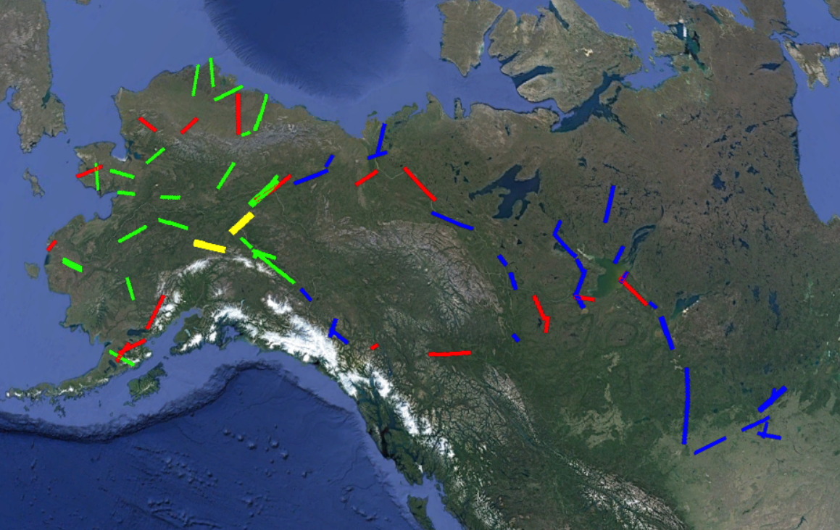
ABoVE Radar Flights
Processed
Processed (L-band only)
Processed Atmospheric Noise
To be processed

Slide 3
ABoVE Radar Projects

Slide 4
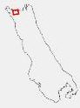
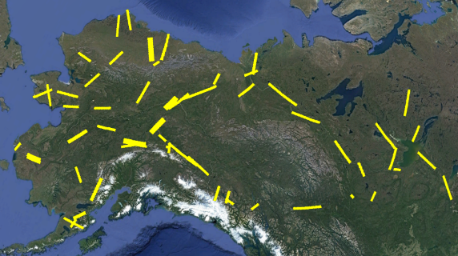
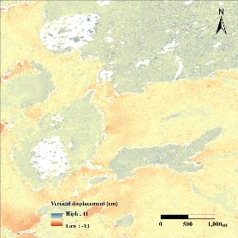
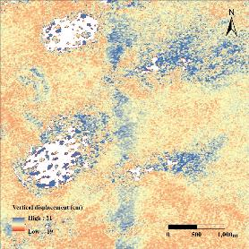
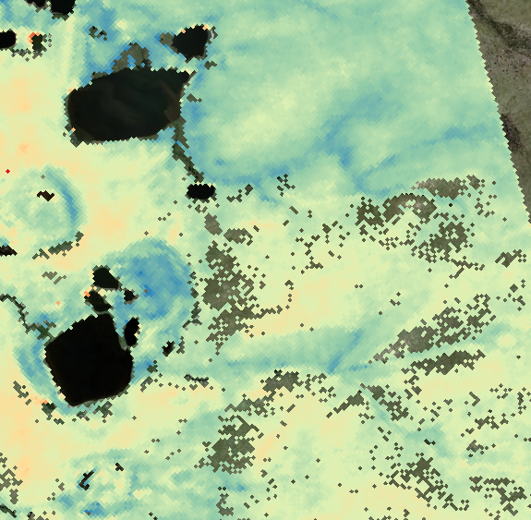
2007 Anuktuvik Fire
1-3 Years
ALOS (2008-2010)
8-10 Years
ALOS2 (2015-2018）
10 Years
ABoVE (2017）
Burned areas have higher subsidence, deeper active layers, wetter soils
PI: Go Iwahana

Slide 5

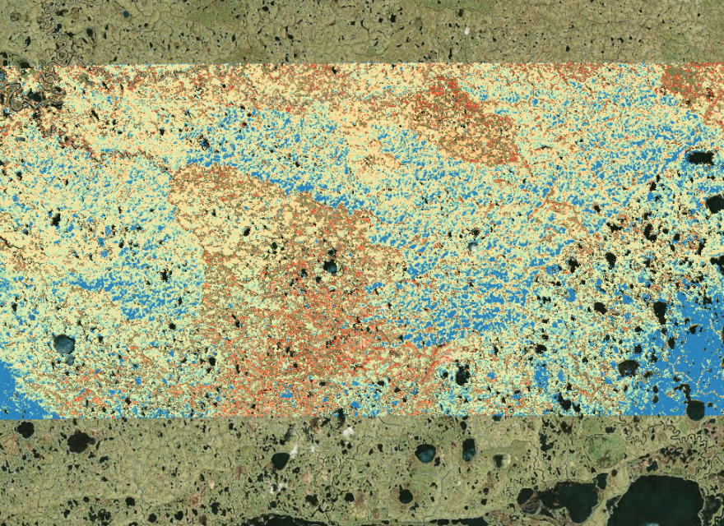

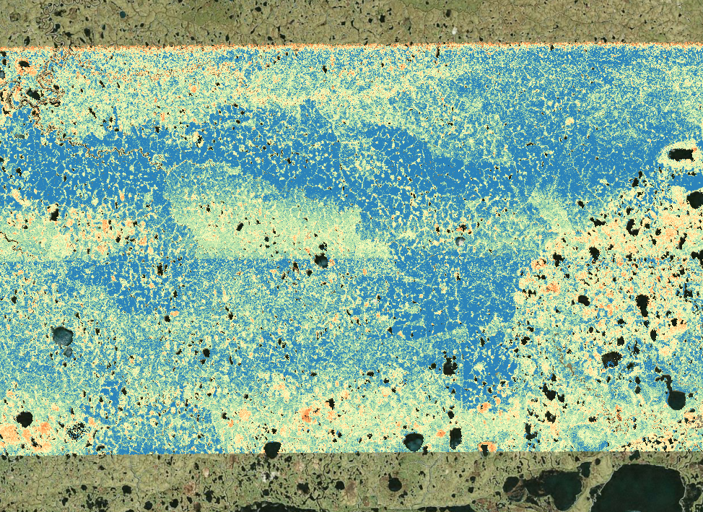
Yukon-Kuskokwim Delta
ALT (m)
2015 Fires
Deeper active layers wetter soils in burned areas
VWC (-)
Unburned
Burned
PI: Kevin Schaefer

Slide 6

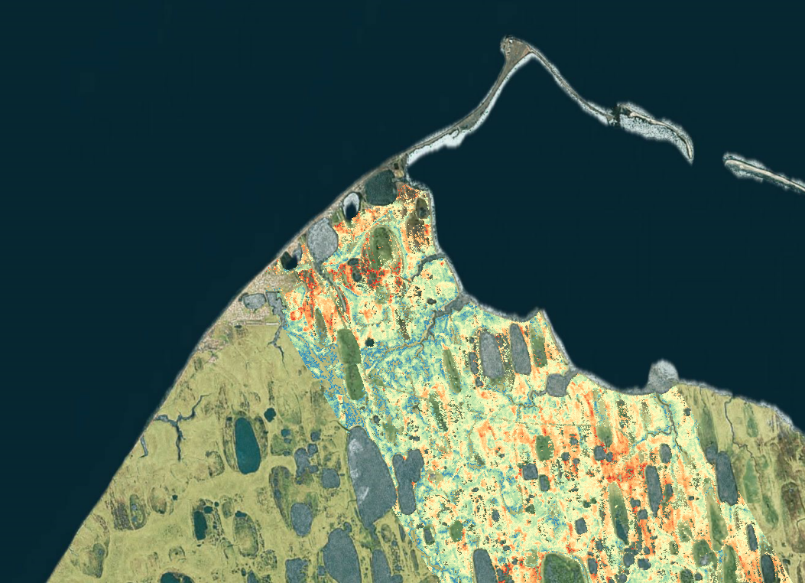
Utqiagvik (Barrow)
ALT (m)
Utqiagvik (Barrow)
CALM Site
Ipkik Slough
PI: Kevin Schaefer

Slide 7
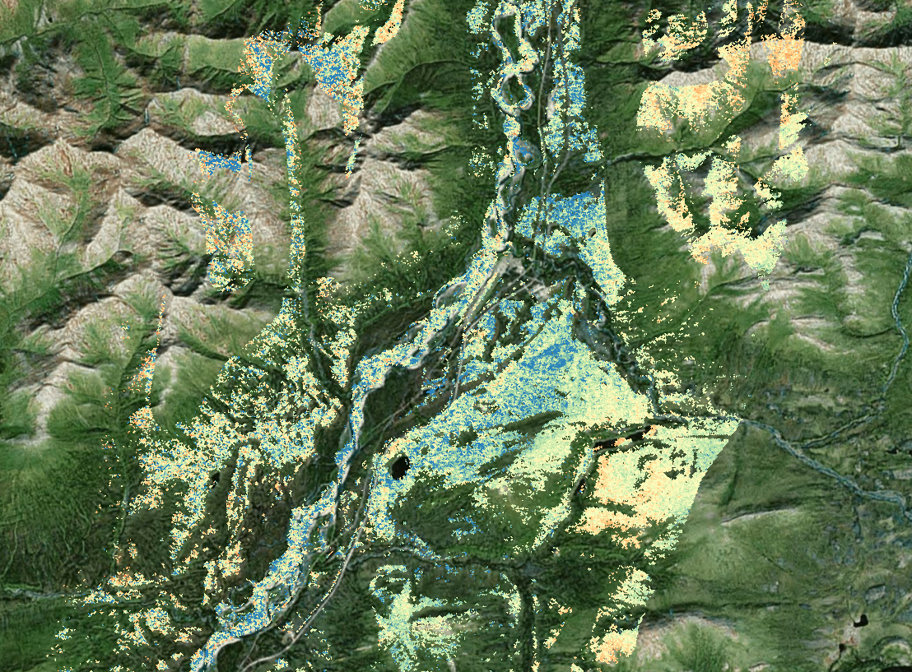
Coldfoot
VWC (-)
Trees
Open
Shadow
PI: Kevin Schaefer

Slide 8
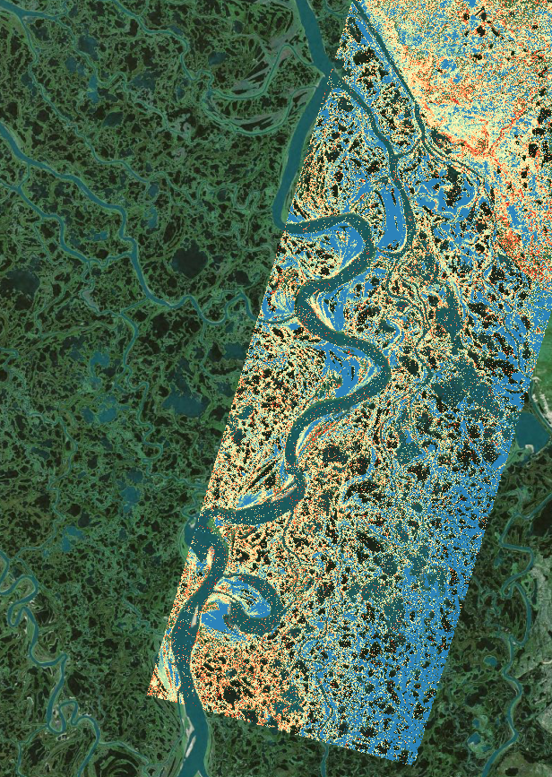

Mackenzie Delta
ALT (cm)
Wetlands
Sand Bar
Mackenzie River
PI: Kevin Schaefer

Slide 9

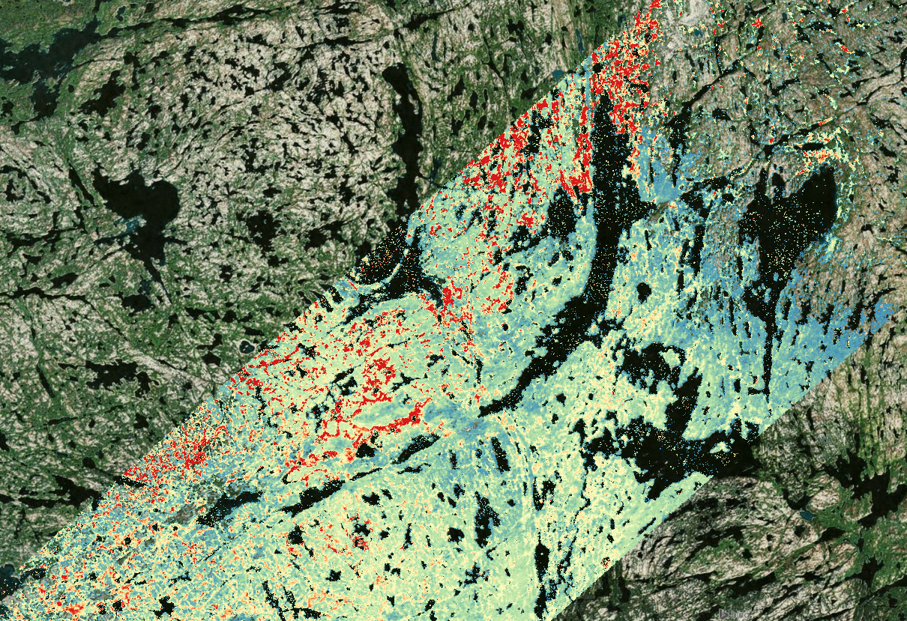
Yellowknife
Subsidence (cm)
Burned
Unburned
Bare Rock
PI: Kevin Schaefer

Slide 10

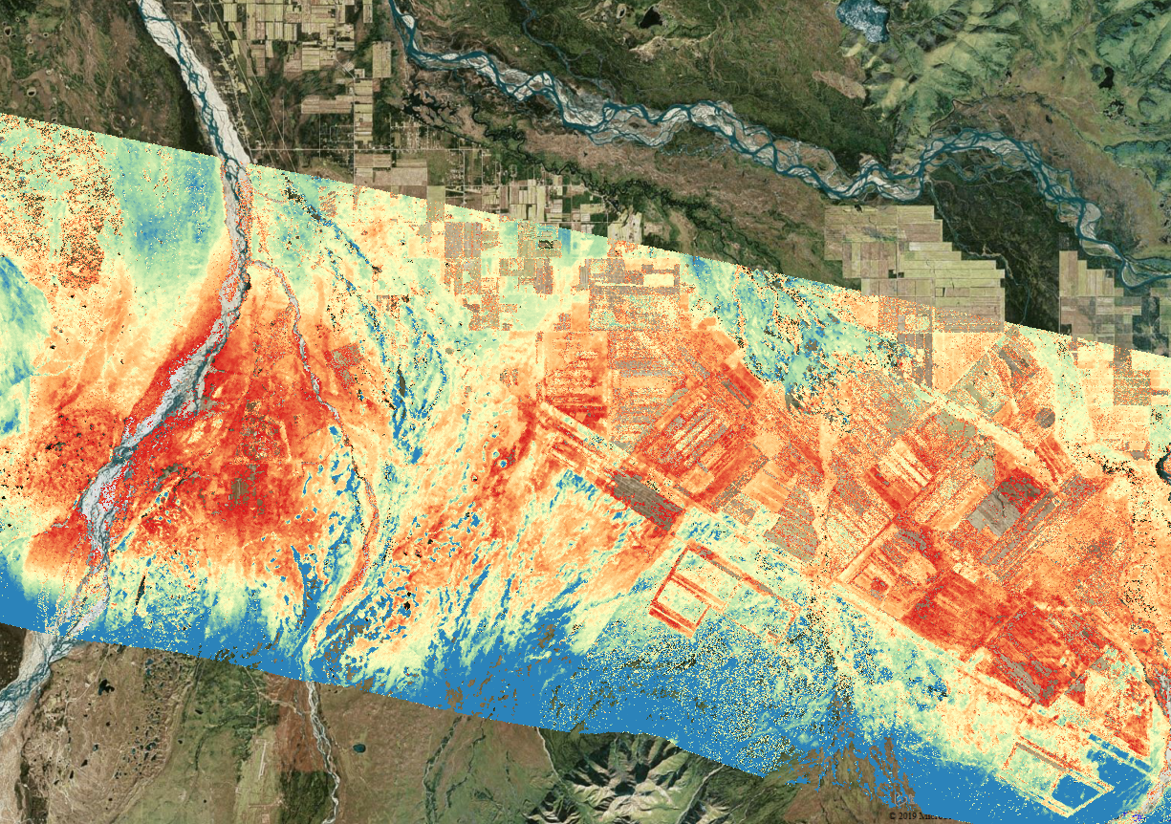
Delta Junction
Subsidence (cm)
Fire Scar
Undisturbed
Agriculture
PI: Kevin Schaefer

Slide 11
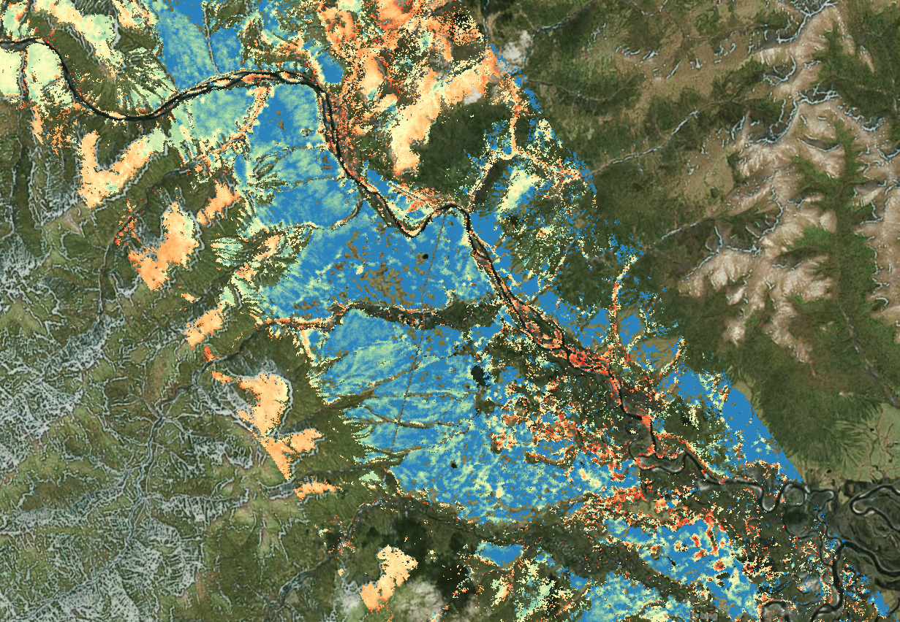
Seward Peninsula
ALT (m)
High and Dry
Low and Wet
PI: Kevin Schaefer

Slide 12
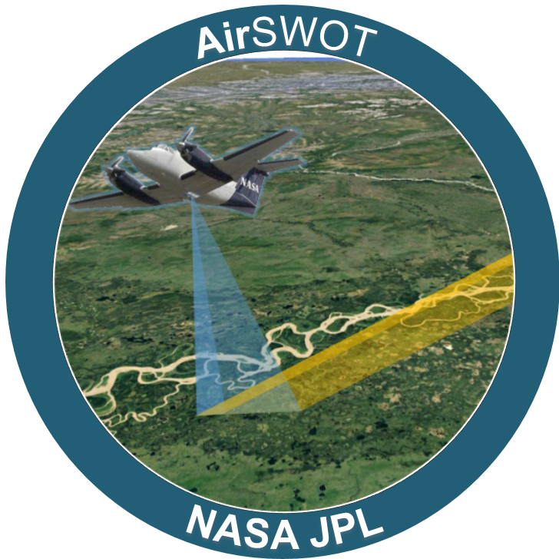
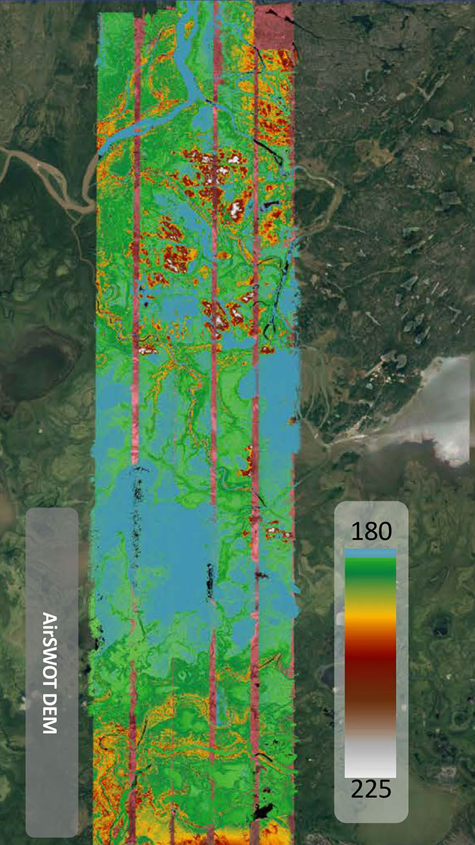
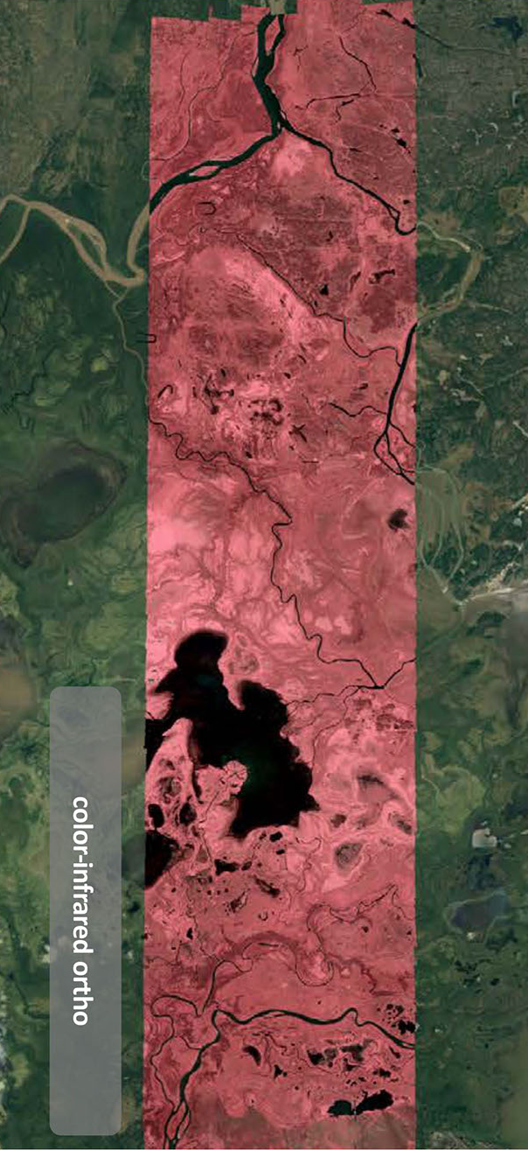
AirSWOT
Ka-band DEM
Infrared
Ka-band, cal/val for SWOT satellite
Backscatter, coherence, uncertainty
PI: Larry Smith

Slide 13
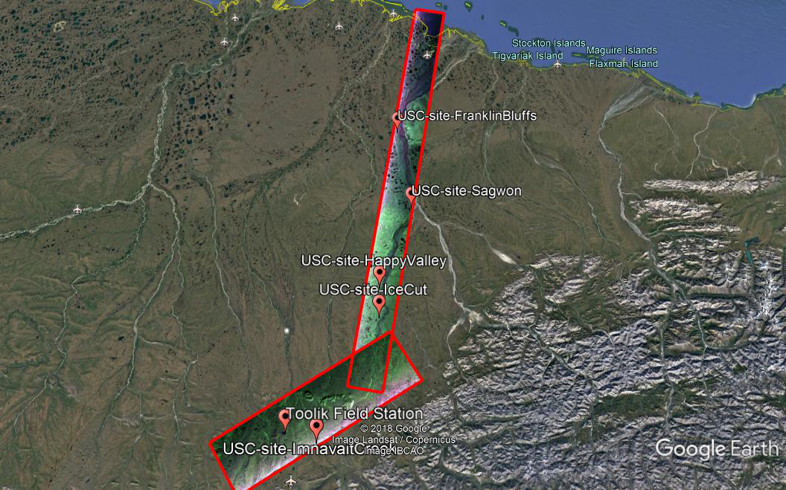
Belowground Biomass
2018 Fieldwork Locations
Compare in situ and LVIS Canopy Height
Mean = 3.0
Std. = 2.2
Mean = 5.6
Std. = 2.6
Mean = 4.8
Std. = 2.5
Lab measurements nearly done
First product at ORNL
PI: Alireza Tabatabaeenjad

Slide 14
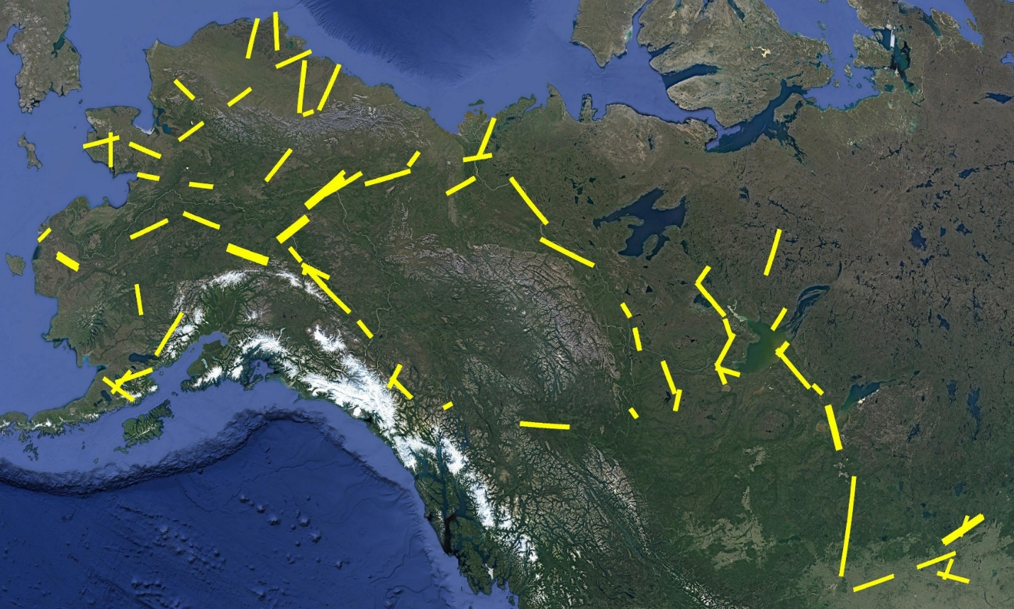
Validation of ALT and VWC
Integrate data from all ABoVE teams
Send data to Kevin, Laura, or Liz

Slide 15
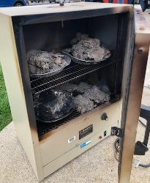

Soil Moisture Calibration for HSII
HSII underestimates VWC for organic soils
Analyze soil samples in lab
Fire in the hole!
PI: Laura Bourgeau-Chavez

Slide 16
Conclusions
We have seriously cool results
Come see our posters on Wednesday
We have only scratched the surface…

Slide 17
The End

Slide 18
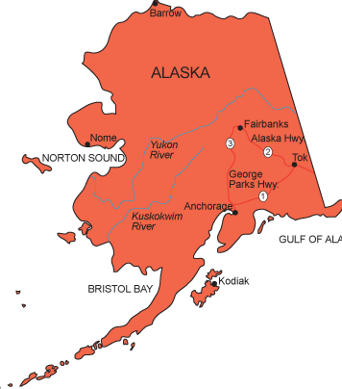
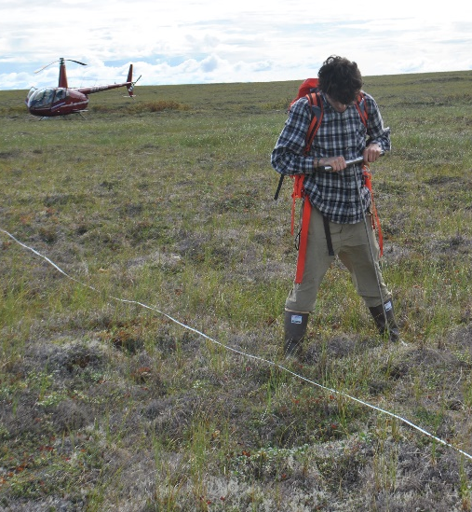
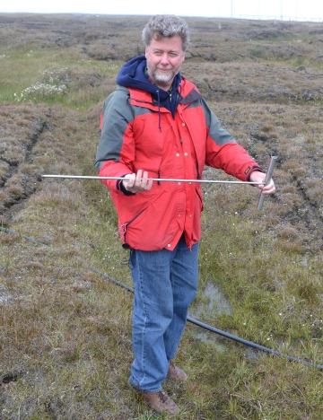
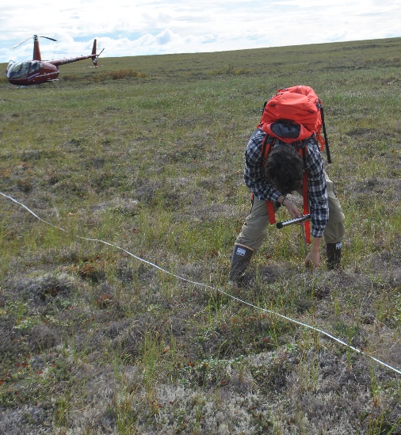
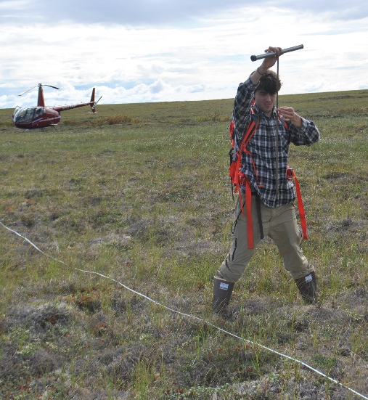
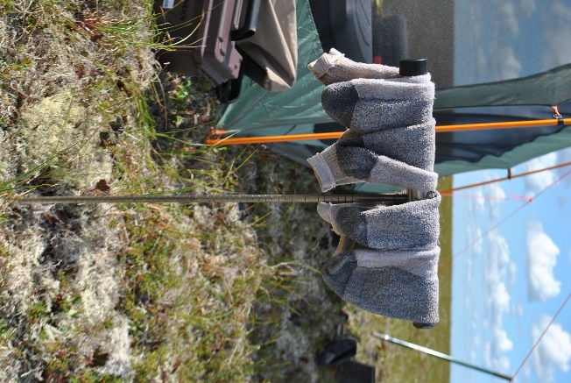
Probing Active Layer Thickness (ALT)
Typical Probe
Push into ground
Thumb at surface
Pull and measure
Multi-purpose Probe

Slide 19
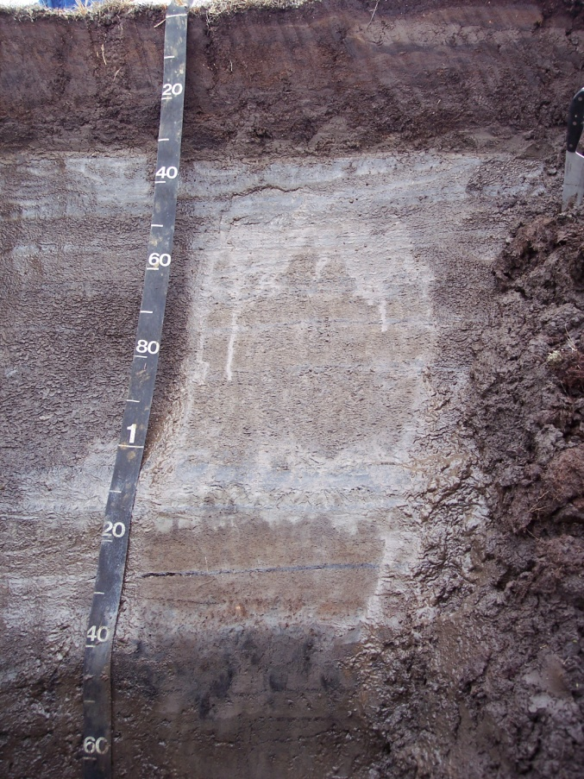
Permafrost Profile
Vegetation
Active Layer
Permafrost Table
Permafrost
Barrow, Alaska

Slide 20
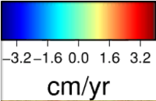
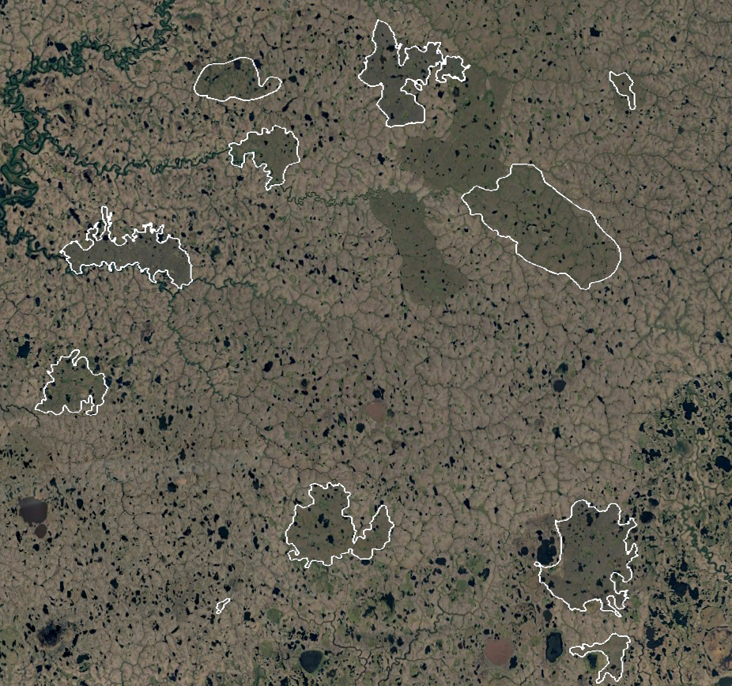
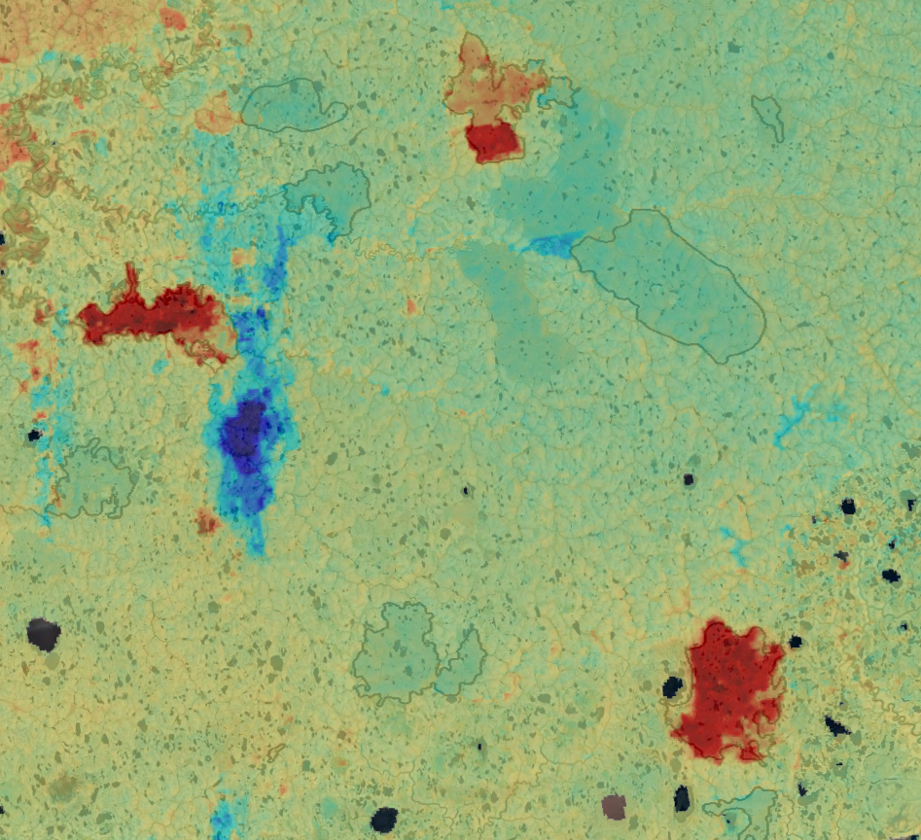
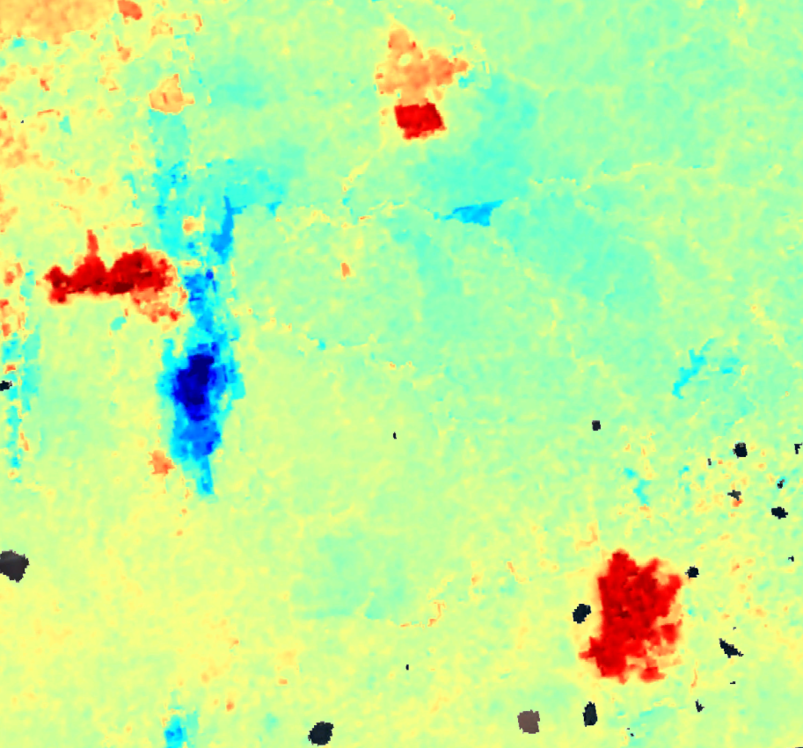
Yukon-Kuskokwim Delta Fires
1972
2007
1990
1972
?
2007
1971
?
?
1972
1971
2006
1971
Fire Scars from LandSat
ALOS Subsidence trends (cm yr⁻¹)

Slide 21
Leveraging the Freezing of Soil Water
1-4 cm Seasonal Subsidence
Thawed
Frozen Active Layer
Frozen
Thawed
ALT
Permafrost
Permafrost
Permafrost
Winter
Spring
Late Summer
Water expands 9% when frozen
Soil expands ~4% when frozen

Slide 22
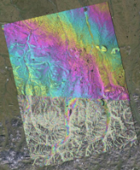
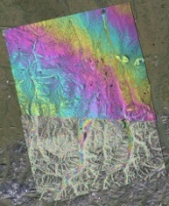
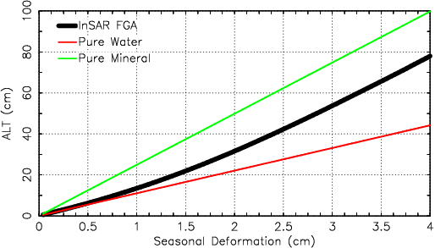
Remotely Sensed Active Layer Thickness (ReSALT)
Interferogram Stack
Subsidence Trend
Seasonal Subsidence
ReSALT
ALT (cm)
Seasonal Subsidence (cm)

Slide 23
Seasonal Subsidence Model
Summer Thaw
Winter
Freeze
Winter
Seasonal Subsidence

Slide 24
Remotely Sensed Active Layer Thickness (ReSALT)
Use InSAR to measure seasonal subsidence
Assume vertical water profile to estimate ALT
ReSALT
ALT (cm)
Seasonal Deformation (cm)

Slide 25
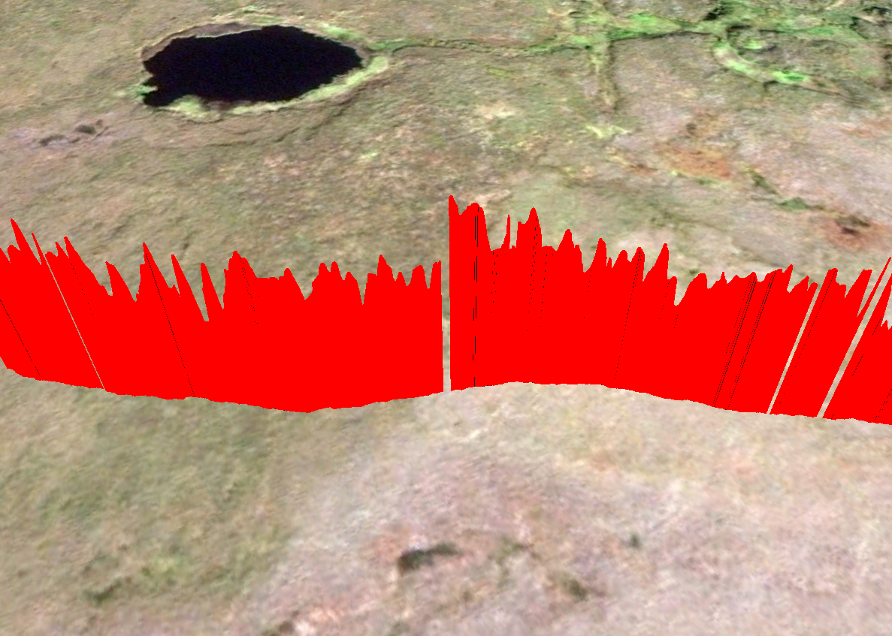
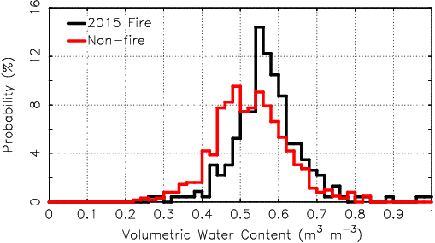
ALT Increases due to Fire
Kuka Creek Fire, Yukon-Kuskokwim Delta
Undisturbed Tundra
2015 Kuka Creek Fire
GPR measurements of ALT
Probing measurements of ALT

Slide 26
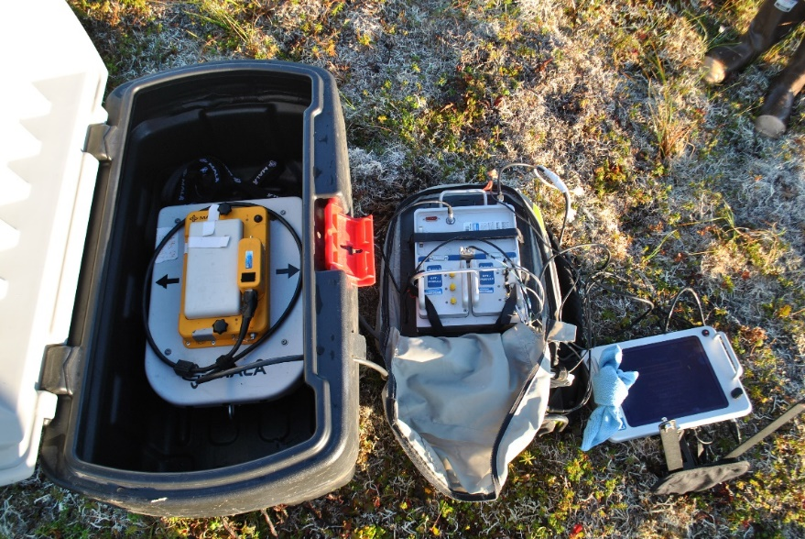
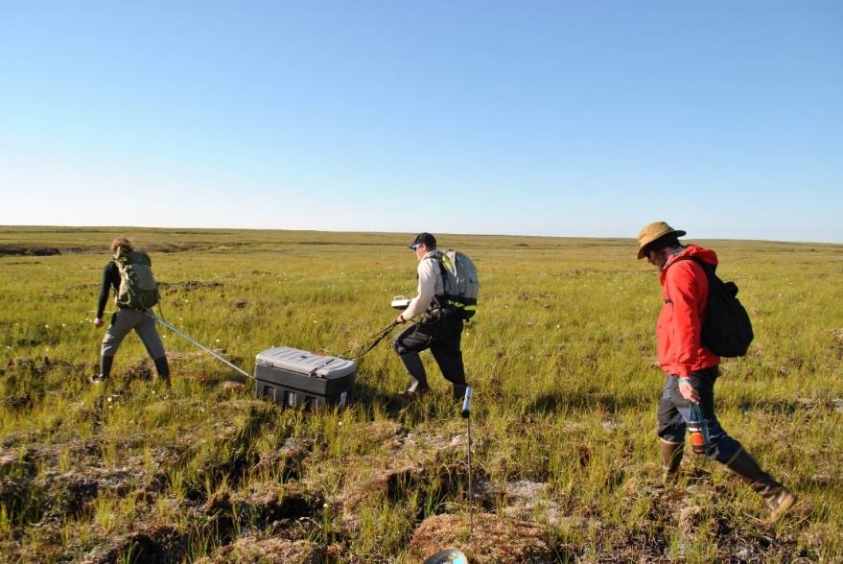
GPR Surveys
500 MHz Antenna
Controller
‘Horse’
‘Driver’
‘Mule’
Computer
500 MHz (60 cm) antenna works best
20-30 cm trace spacing
2-6 km per day (4-6 hours)

Slide 27
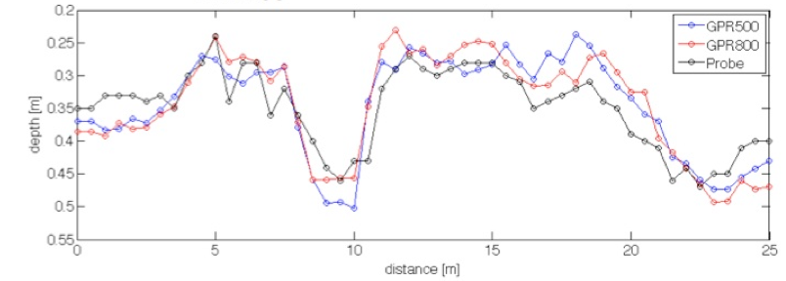
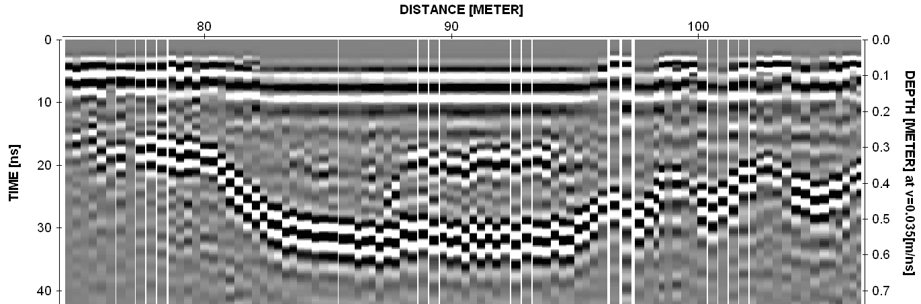
ALT from GPR
Calibration survey, Barrow
Distance (m)
Veg
Water
Radargram showing floating vegetation mat, Barrow

Slide 28
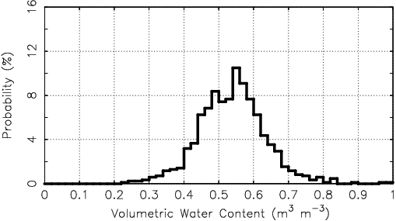
VWC Yukon-Kuskokwim Delta
All trace-probe pairs
burned and unburned areas

Slide 29
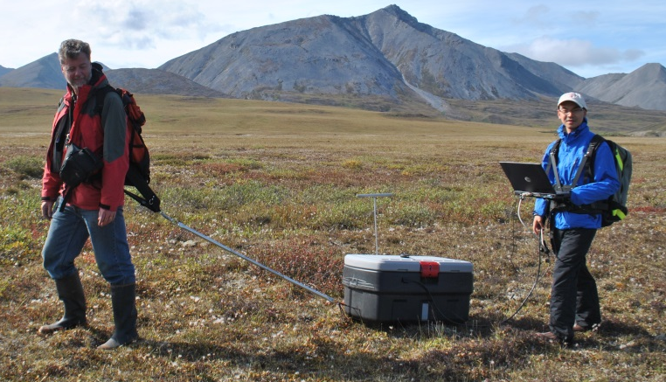
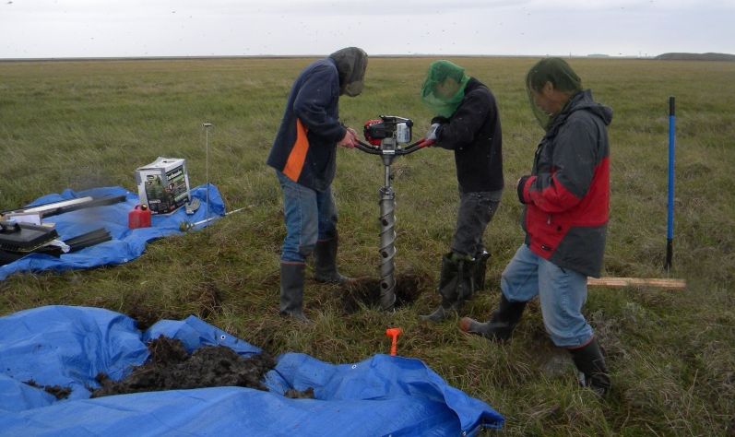
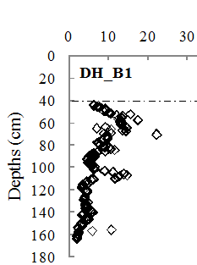
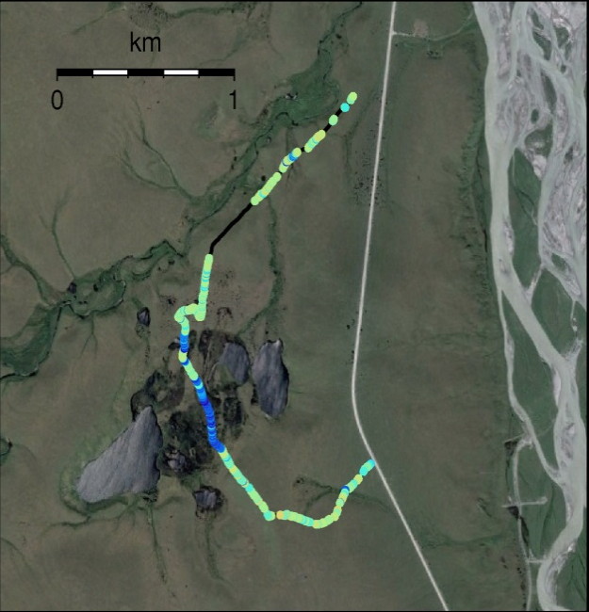
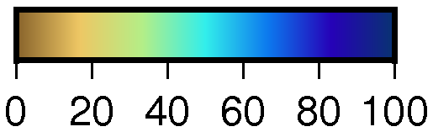
Field Work
Ground Penetrating radar (GPR)
Permafrost Core Near Deadhorse
Organic Matter (%)
Big Hole

