Slide 1
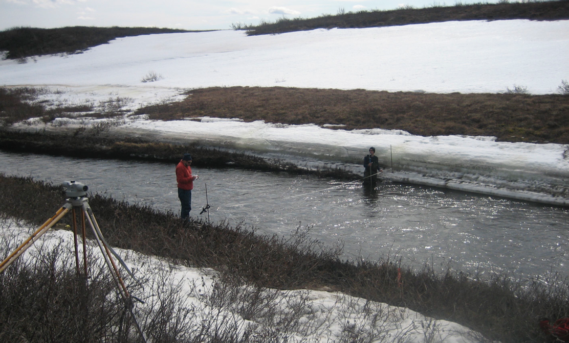


Snow research in the western Canadian Arctic: links to ABoVE and SnowEx
Philip Marsh
Professor and Canada Research Chair in Cold Regions Water Science
^{Wilfrid Laurier University}
^{Waterloo, Ontario, Canada}
^{pmarsh@wlu.ca}

Slide 2
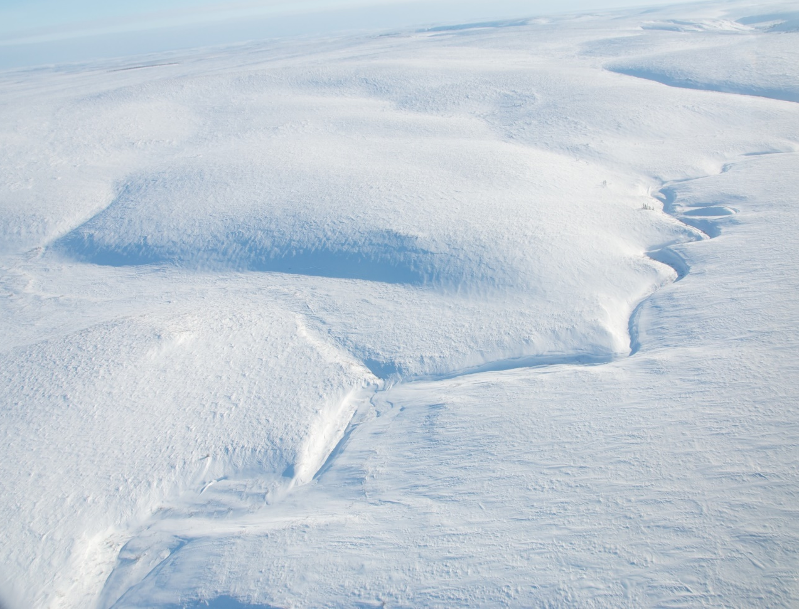
Make the case that:
Snow has unique properties and spatial variability and has important controls on the ecosystem,
The winter climate and snow is changing more rapidly than the summer climate,
Snow is poorly measured during the Arctic winter, and snow models have limited ability to model Arctic snow,
Although important, winter and snow process studies have been relatively ignored by ABoVE.
And provide an example from the western Canadian Arctic where we are attempting to understand the links between winter and summer processes. And consider further developing the links between our research ABoVE and SnowEX

Slide 3
Outline
Winter & snow dominates many aspects of the Arctic & is changing the most rapidly when compared to other seasons
The role of snow in ecosystem change: A case study from the western Canadian Arctic
Lack of winter and snow measurements
Integrated observing program in the Western Canadian Arctic
Links to ABoVE and SnowEx
Conclusions and next steps

Slide 4
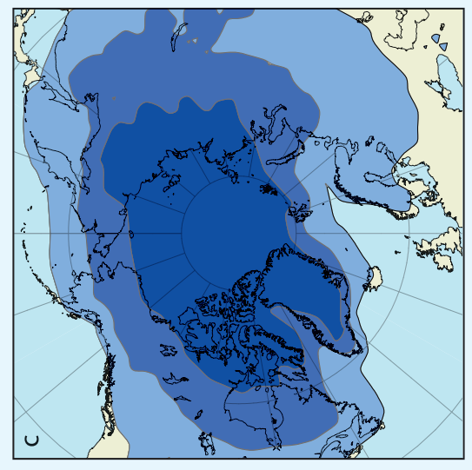
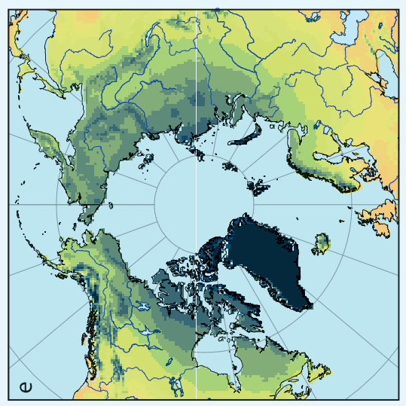
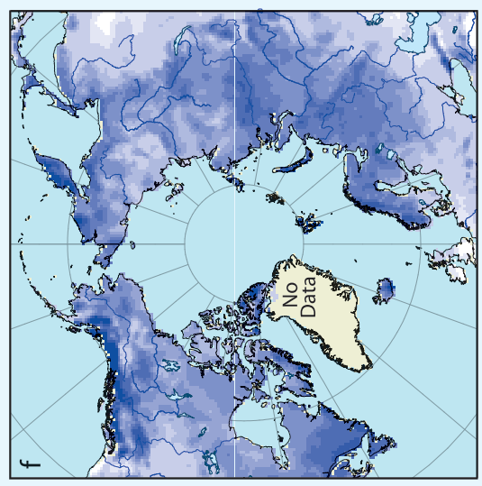
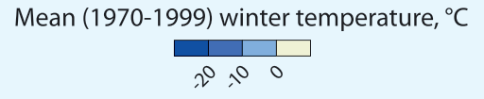
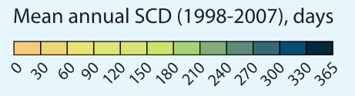
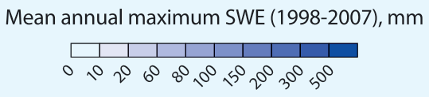
Winter & snow dominates many aspects of the Arctic
c. Winter air temperature
e. Snow cover duration
f. Snow water equivalent
(c) winter isotherms (November–May) for the period 1970 to 1999, from the NCEP Reanalysis,
(e) snow-cover duration for the period 1998 to 2007 from the NOAA IMS 24 km product,
(f) mean annual maximum snow-water equivalent for the period 1998 to 2007 from CMC
Johansson, M., et al. 2011. 4 . Changing Snow Cover and its Impacts. SWIPA.

Slide 5
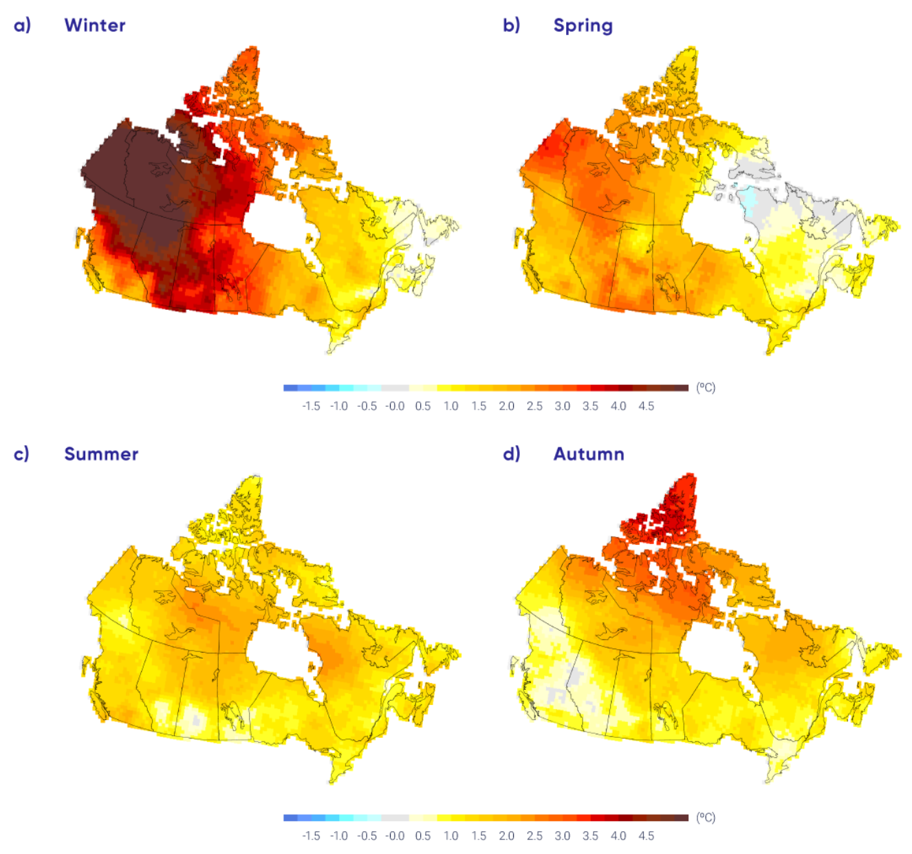
Winter air temperature is warming faster than the other seasons across Canada
Observed changes in seasonal mean air temperature between 1948 and 2016
Zhang et al. 2019. Changes in temperature and precipitation across Canada. Chapter 4 in: Bush and Lemmen (eds). Canada’s Changing Climate Report. Government of Canada, Ottawa, Ontario, pp 112-193.

Slide 6
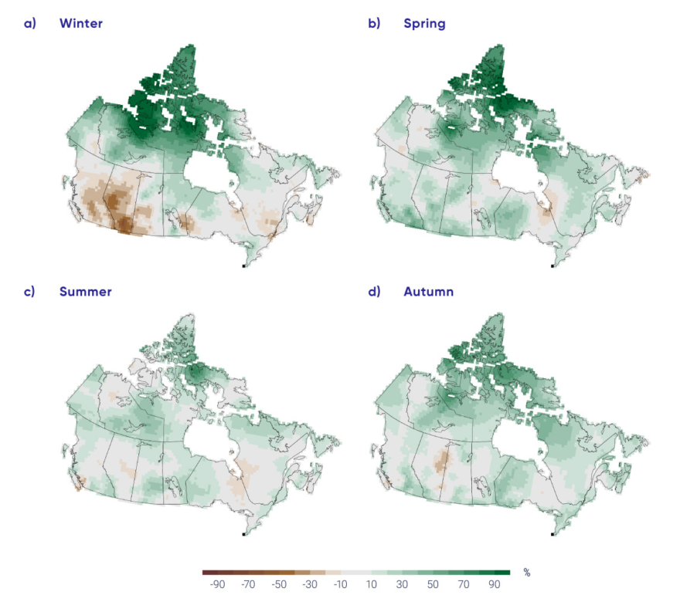
Precipitation change across all season has been variable, with both increases and decreases
Observed changes in seasonal precipitation between 1948 and 2012
Zhang et al. 2019. Changes in temperature and precipitation across Canada. Chapter 4 in: Bush and Lemmen (eds). Canada’s Changing Climate Report. Government of Canada, Ottawa, Ontario, pp 112-193.

Slide 7
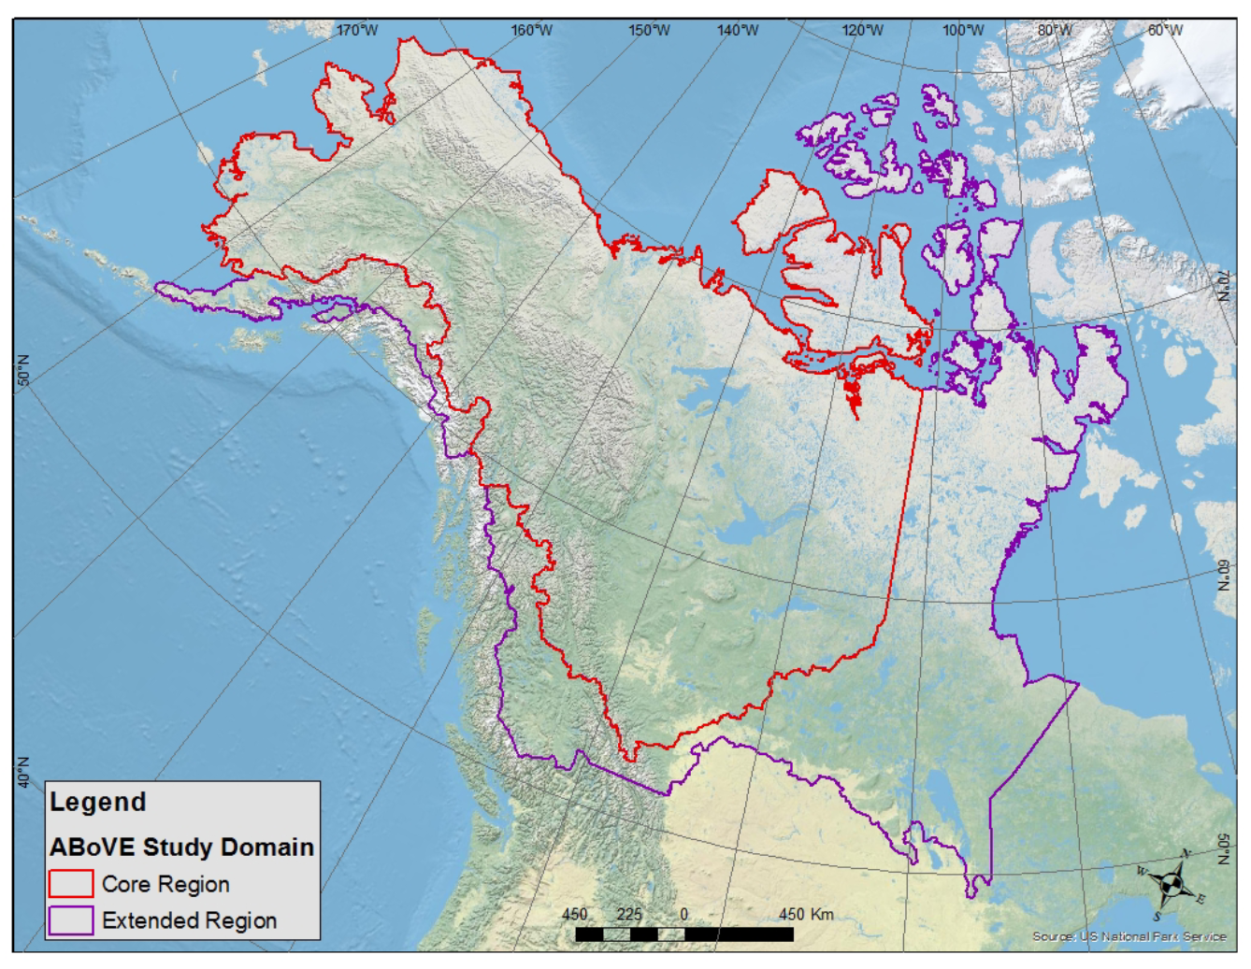
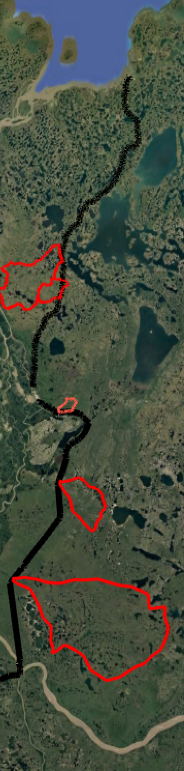
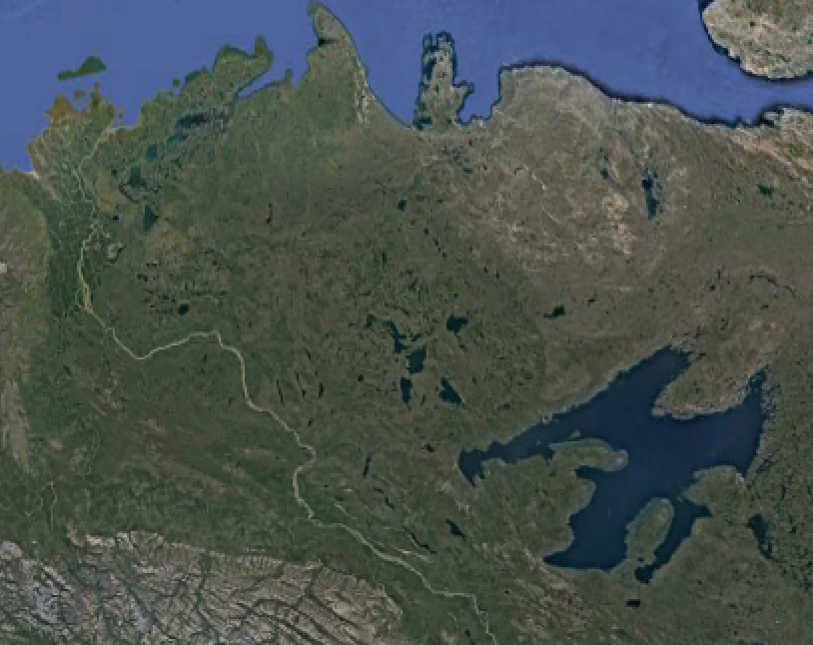
2. A case study from the western Canadian Arctic: along strong environmental gradients in temperature, precipitation and vegetation
.
Western Canadian Arctic
Tuktoyaktuk
7
1000 km west of the Canadian High Arctic Research Station (CHARS) in Cambridge Bay
Tundra
6
5
4
Inuvik
Continuous permafrost
Tundra – taiga ecotone
Five Water Survey Canada streamflow stations
  Rengleng River. taiga
  Caribou Riever. taiga
  Havikpak Creek. taiga
  Trail Valley Creek. tundra
  Hans Creek. Tundra, large lake numbers and area
  + 2 new tundra stations this summer
Four ECCC weather stations, + a number of research stations
3
2
Taiga
1
Mackenzie
River

Slide 8
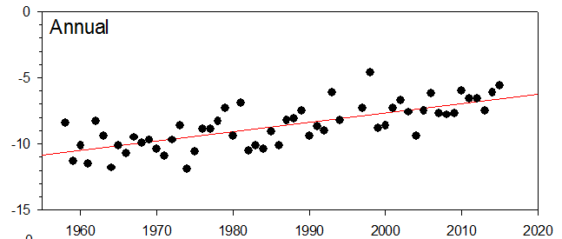
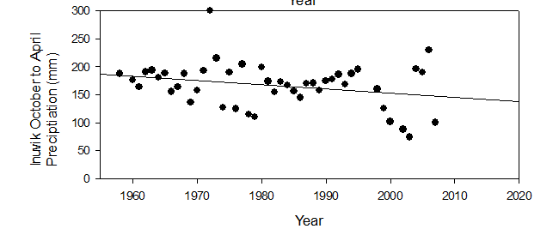
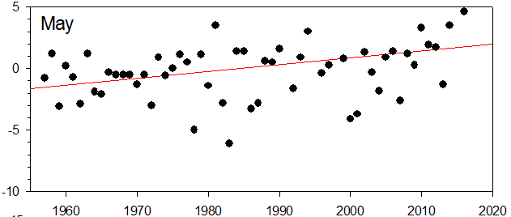
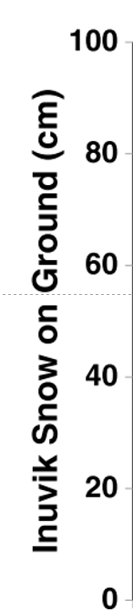
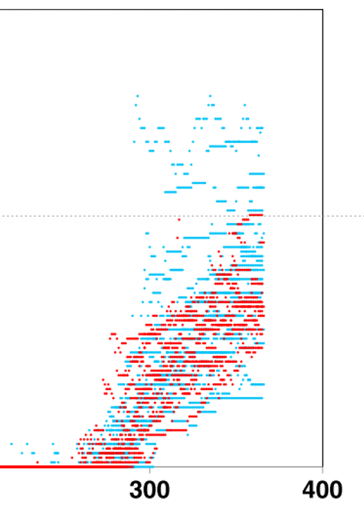
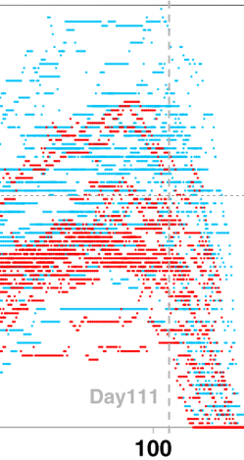
Climate is warming and drying with contrasting impacts on soil temperature and permafrost
Air temperature is warming: Warmer soils?
Snow fall & cover are decreasing:
Colder soils?
Air Temperature C
Inuvik, NT
Inuvik, NT
1960
2020
1960
2020
1957
Lesack et al.
Inuvik, NT
Air Temperature C
Inuvik, NT
May is the usual snow melt period
1960
2020
Year
October
May

Slide 9
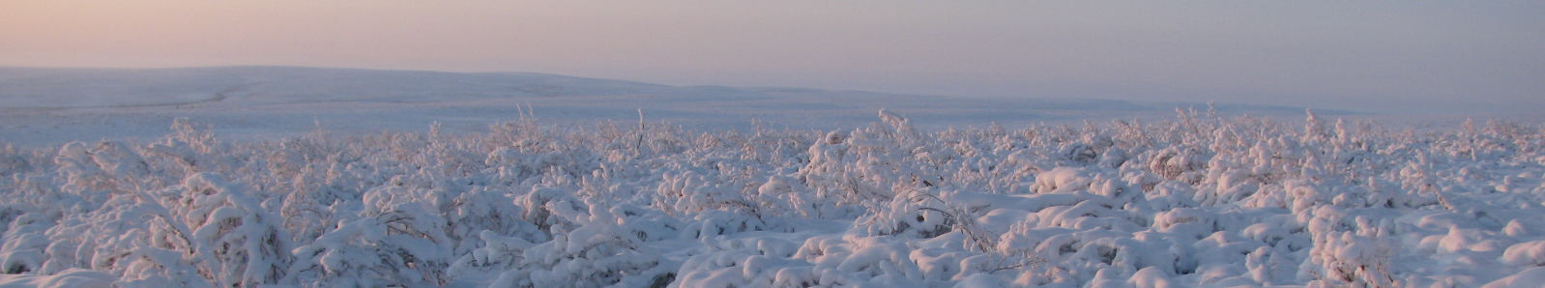
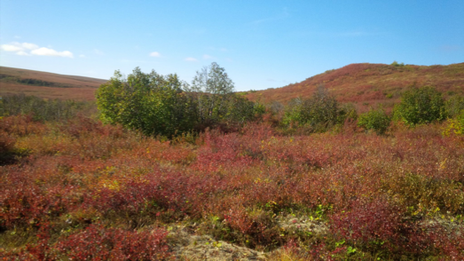
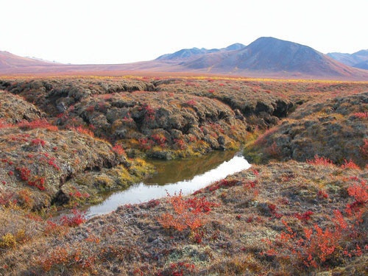
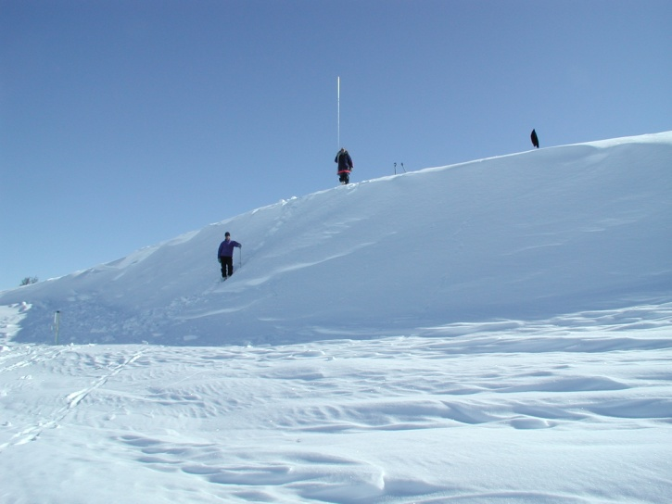
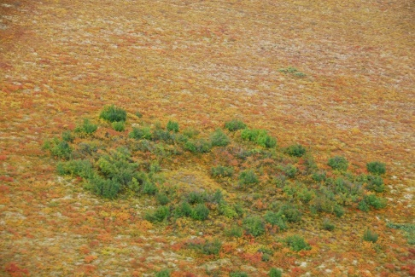
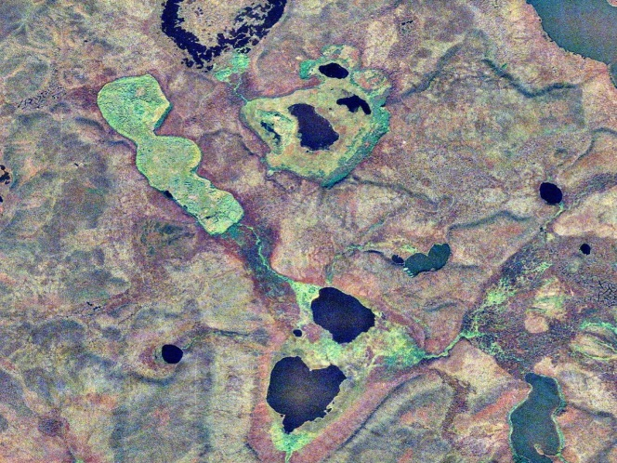
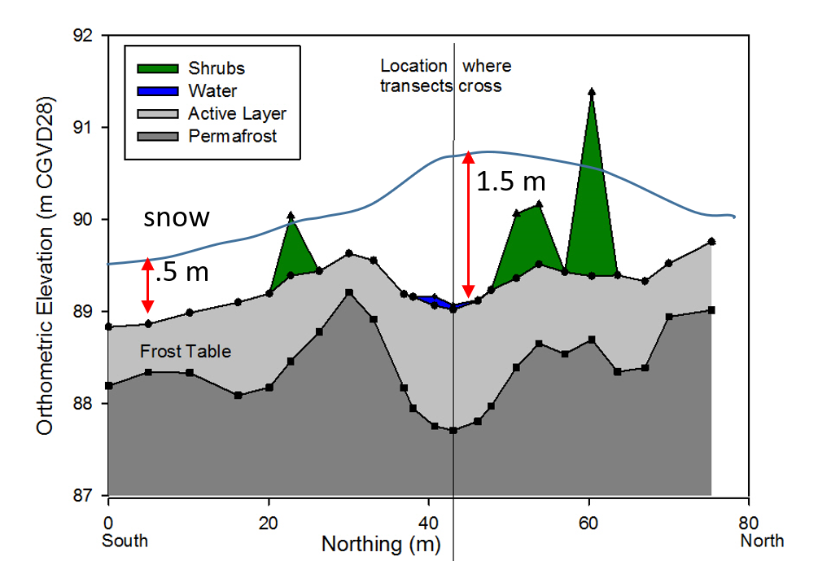
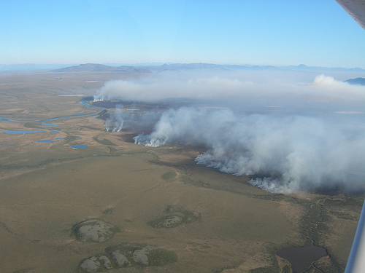
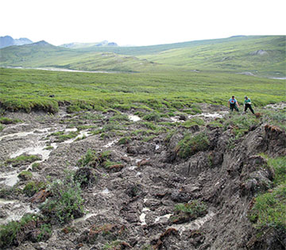
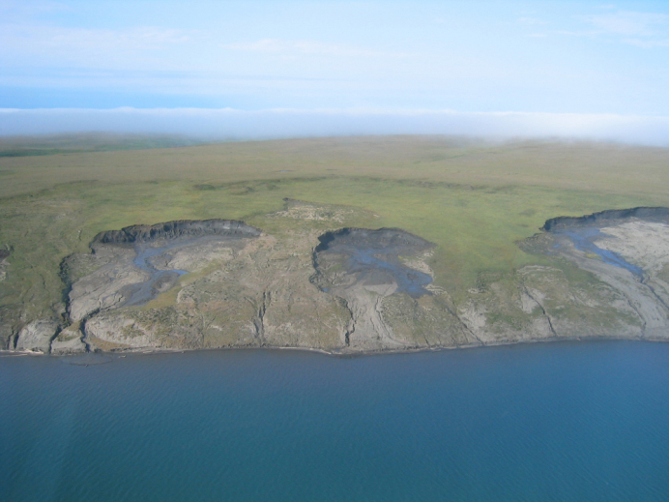
Combination of warming/drying is resulting in numerous ecosystem changes
Expanding shrubs
Changing lakes
Resulting in changes in snow
New lakes?
Decreasing slope drifts
Disappearing lakes
Increasing fires?
Changing topography
Active layer slides
Increasing snow in shrub patches

Slide 10
But …. There area also difficult to explain changes
Dramatically changing climate, but – unexpected hydrological changes, that currently are unpredictable by our models
  Spring melt is starting earlier, but time of Q5 to Q50 either not changing or occurring later (John Shi, ERL)
  Precipitation is decreasing, ET must be increasing, but
    upland lakes don’t appear to be changing
  Rate of rapidly draining lakes
    - declining

Slide 11
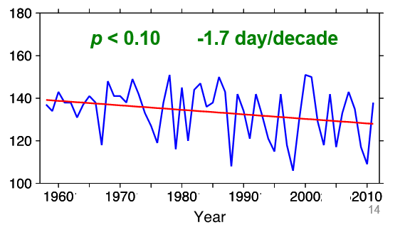
John Shi, ERL.
Earlier snowmelt, but spring melt discharge is not changing
Much warmer air temperature during
the melt period
Date of Q50. i.e. 50% of runoff
0.5 day/decade
Air Temperature C
Inuvik
1960
2020
1985
2010
Start of snowmelt
Trail Valley Creek
May 20
Shi et al
May 1
1960
2010
Defined as first 5 days, mean temp > 0⁰C
Possible reason: increasing shrub patch size and density, deeper snow in shrub patches, changes in snow melt energy balance, delayed percolation of meltwater & delayed runoff

Slide 12
But …. There area also difficult to explain changes
Dramatically changing climate, but – unexpected hydrological changes, that currently are unpredictable by our models
  John Shi ERL paper earlier start of spring melt, but time of Q5 to Q50 either not changing or occurring later
  Precipitation is decreasing, open water season is increasing, and ET is likely increasing, but upland lakes don’t appear to be changing
  Rate of rapidly draining lakes
    - declining

Slide 13
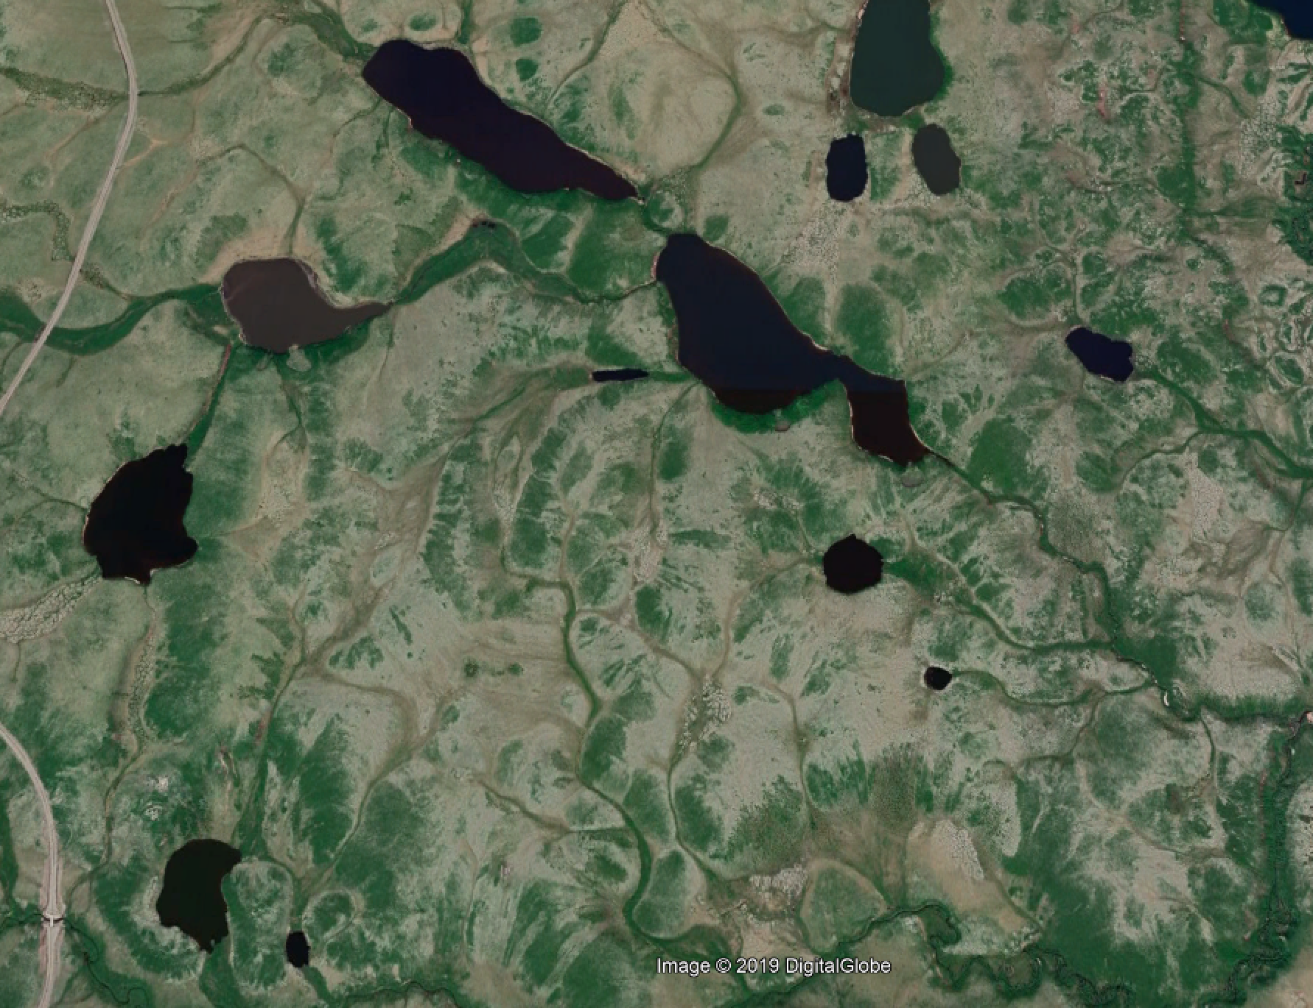
Upland lakes, with small contributing area area not decreasing. Why?
X
X
X
X
X
Possible reason: increased shrubs around lake edge, resulting in increased snow accumulation and runoff to the lakes

Slide 14
But …. There area also difficult to explain changes
Dramatically changing climate, but – unexpected hydrological changes, that currently are unpredictable by our models
  John Shi ERL paper earlier start of spring melt, but time of Q5 to Q50 either not changing or occurring later
  Precipitation is decreasing, ET must be increasing, but
    upland lakes don’t appear to be changing
  Rate of rapidly draining lakes
    - has been declining for decades

Slide 15
Rapidly draining lakes
J.R. Mackay showed that lakes in the area have drained at a rate of 1 per year over the last few thousand years.
Marsh et al., showed that since 1950, the rate of lake drainage has been decreasing, and has reduced to about 0.5 per year
Possible reason: decreased ice wedge cracking in the winter, as a result of warming winter temperature, but decreasing snow fall and average depth (but deeper snow in shrub patches)

Slide 16
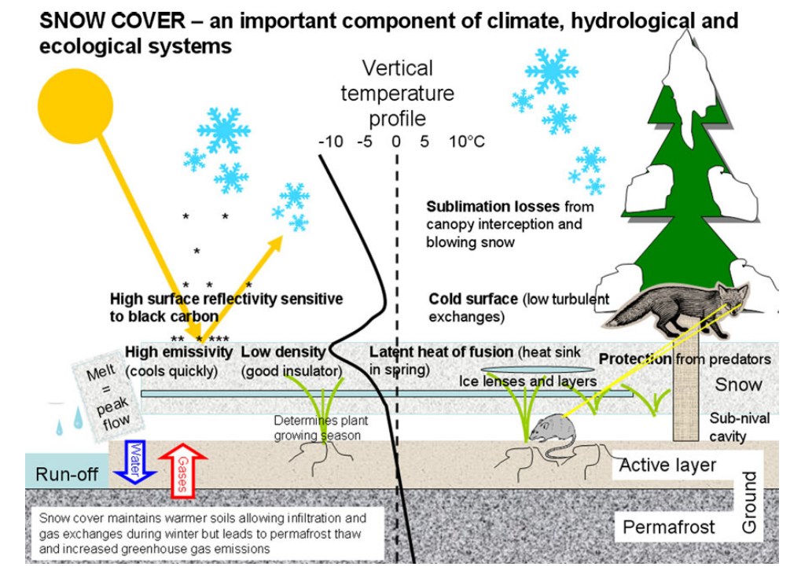
Understanding these, and other ecosystem changes, requires improved understanding of snow and links to other key aspects of the Arctic and Boreal systems
Johansson, M., et al. 2011. 4 . Changing Snow Cover and its Impacts. SWIPA.

Slide 17
3. But – there is a lack of the required snow measurements
Due to extreme winter conditions, limited electrical power, and field crews focussed on summer conditions, there is a significant lack in winter snow measurements across the Arctic.
Point measurements of the following are prone to large errors and are extremely unreliable:
Snowfall: extreme under catch is normal
Sublimation: eddy covariance difficult to operate in winter
Snow depth: continuous measurements in deep snow drifts have not been possible
Snow density: no methods for continuous observations
Snow water equivalent: limited options for continuous measurement

Slide 18
Very few methods available to map spatial variability in snow & measure discharge
Mapping the extreme spatial variability in snow is difficult as it has traditionally relied on manual snow surveys of depth and density. Difficult / impossible to properly account for spatial variability across terrain/vegetation type.
Recent advances:
Snow depth: photogrammetry and lidar
SWE: airborne gamma – lines, not mapping
Streamflow during melt: prone to huge errors
These limitations make understanding the role of snow and the development and testing of snow models extremely difficult.

Slide 19
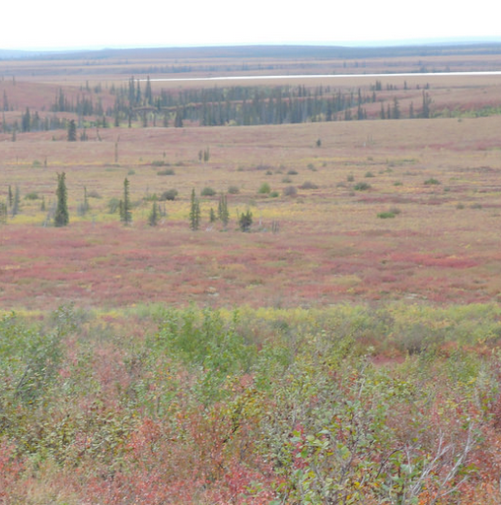
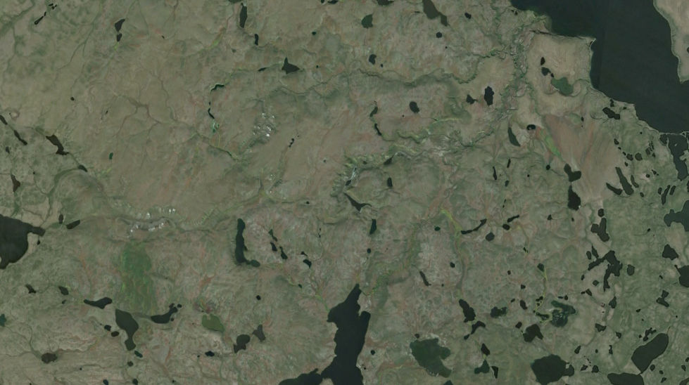
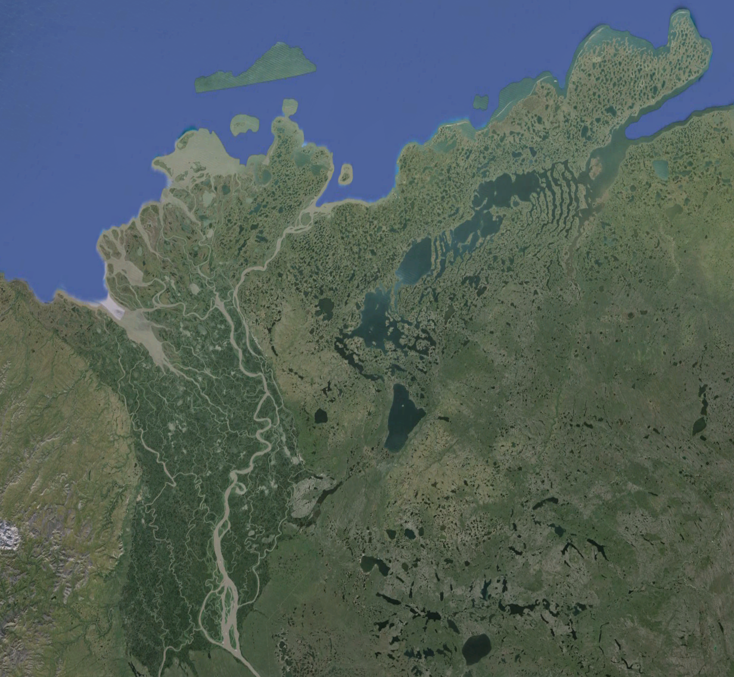
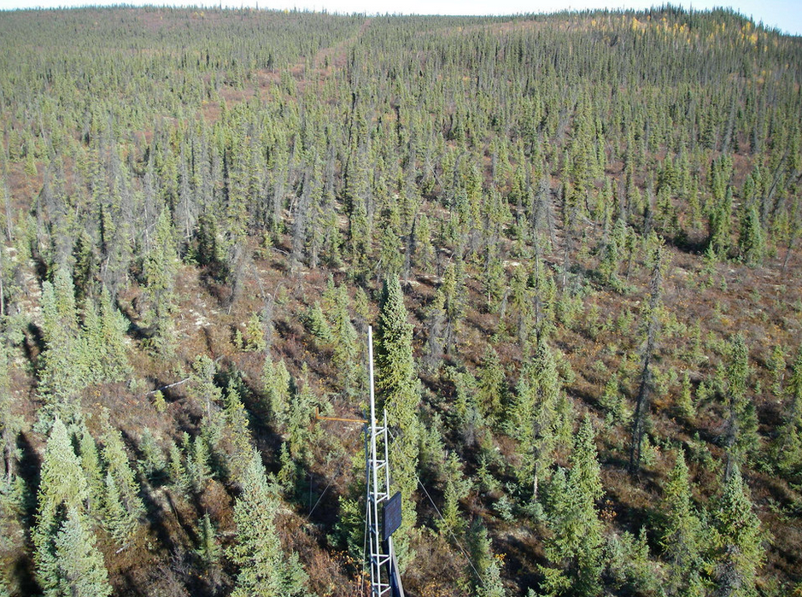
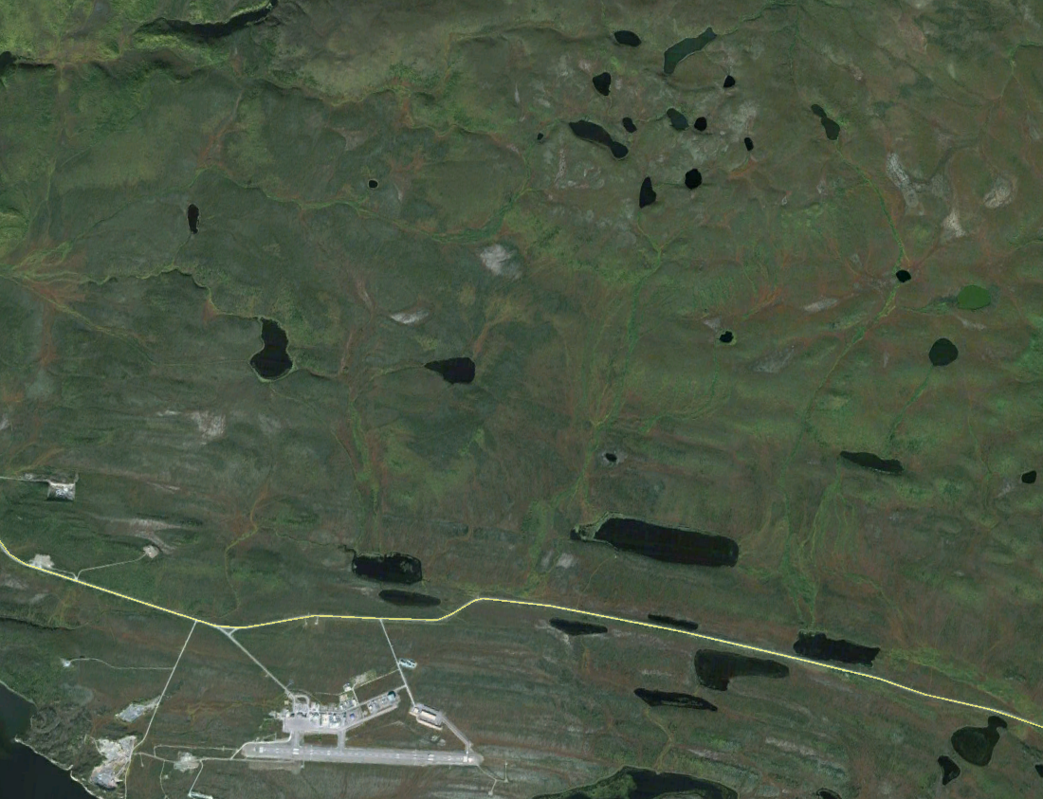
4. Integrated observing program in the Western Canadian Arctic
58 km²
Beaufort Sea
Trail Valley
Creek
Treeline
TVC
Inuvik
HPC
Eskimo Lakes
50 km apart
Both are continuous permafrost.
Climate very similar
15 km²
Havikpak
Creek
Notes:
5 communities – food, recreation, tourism, employment
- two major rivers entering the delta - Mackenzie R. Peel Rivers

Slide 20
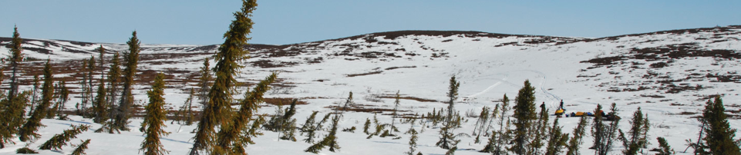
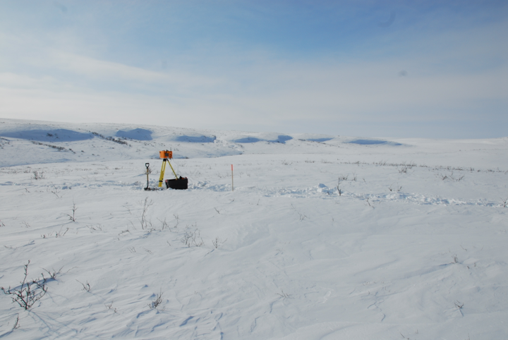

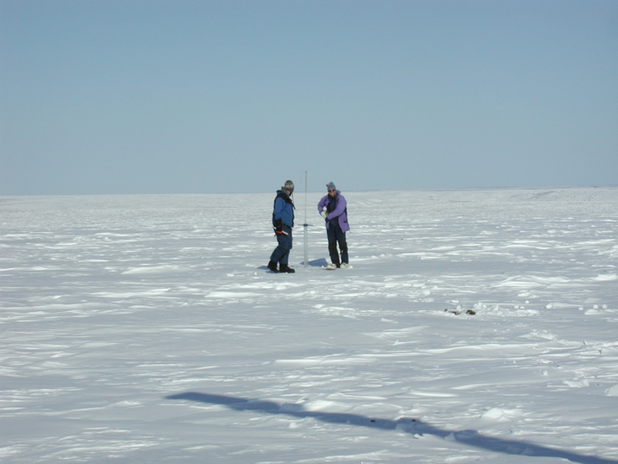

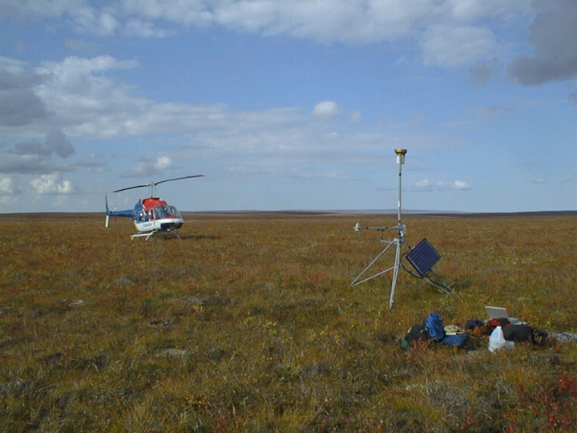
Trail Valley Creek:
Southern Arctic Tundra Plains
Siksik Ck
- Tributary to TVC

Slide 21
Point snow measurements

Slide 22
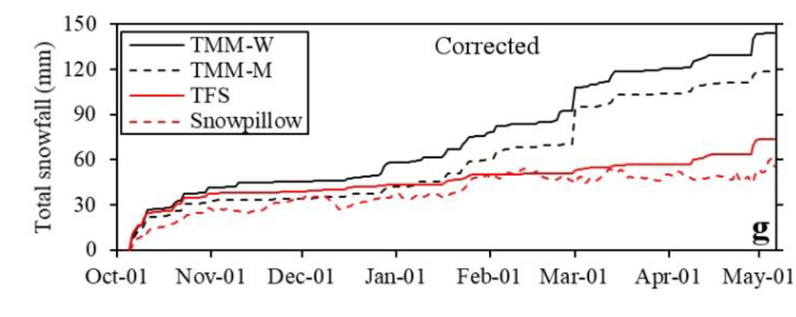
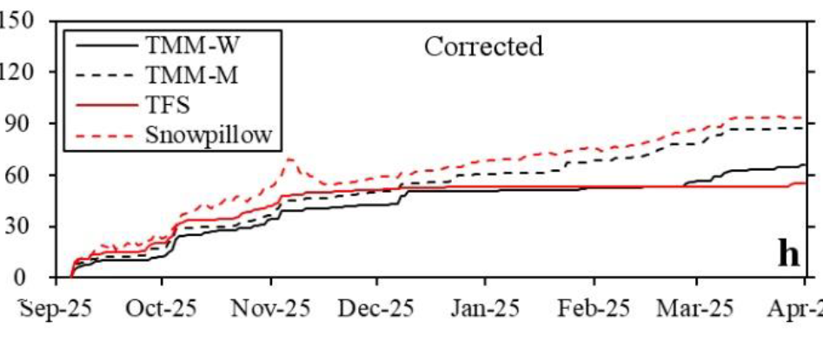
Improving snowfall measurements
TFS
TMM-M
TMM-W
2015
150
Problem
Unacceptable errors using multiple Geonor Weighing snow gauges
Solution
Agreement with ARI to maintain gauges
New power system to allow heating of gauges to overcome snow capping issues
Installation of a Micro Rain Radar (MRR) and Disdrometer to measure snowfall
Install hot plate snowfall sensors
60
2016
90
60
Phil Mann. 2017

Slide 23
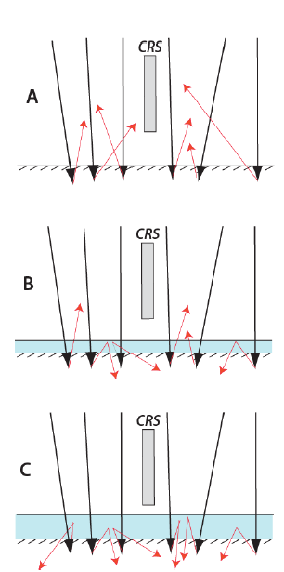
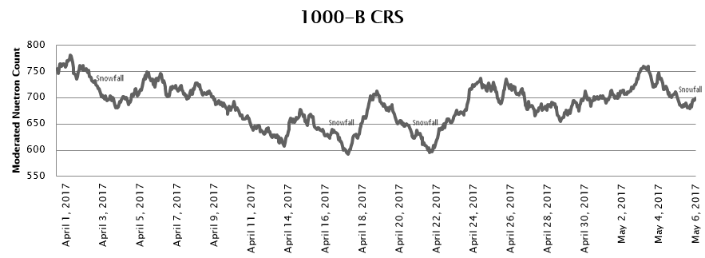
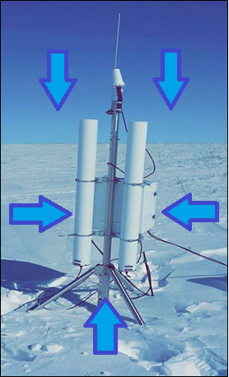
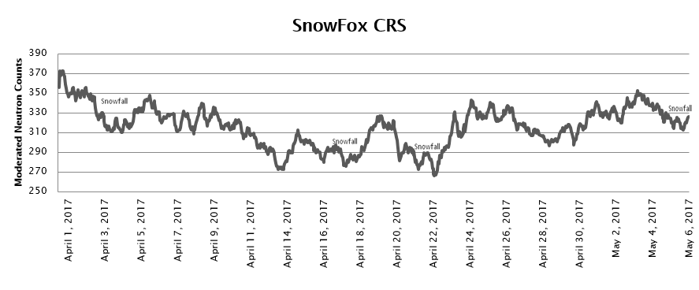
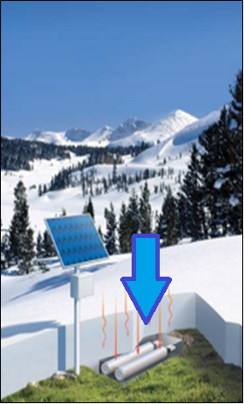
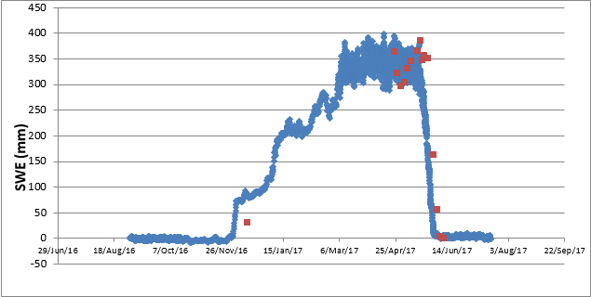
Improving snow water equivalent accumulation measurements
CRS-1000
Modulate Neutron Counts
SnowFox
April 1/17 May 6/17
Anton Jitnikovitch. 2018

Slide 24
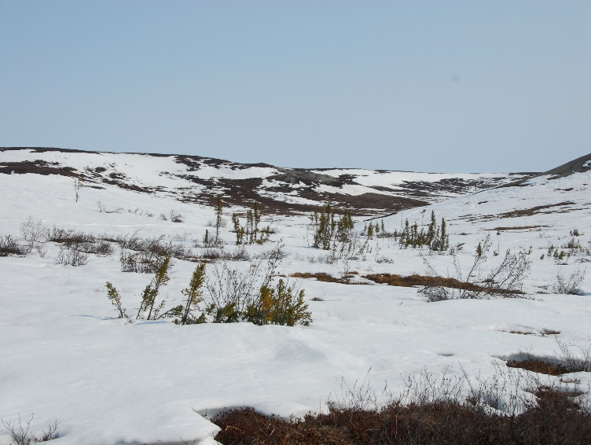

Sensible & latent Heat Flux and carbon dioxide & methane fluxes
Eddy covariance and chambers
Nested towers + Chambers – tundra and shrub tundra
Lake tower
Forest tower
Oliver Sonnentag

Slide 25




Stream channel hydrothermal conditions
Are taliks forming in stream channels?
Do we expect changes in stream channel size due to thermokarst?
What role do stream icings play in the hydrology & ecology of these systems?
Tim Ensom

Slide 26
Snow remote sensing

Slide 27

Structure-from-motion snow depth mapping
Branden Walker, 2019

Slide 28

Mapping end of winter snow water equivalent by vegetation type
Branden Walker, 2019

Slide 29









Improved mapping of snow depth through melt period
Unmanned Aerial System
April 29
May 5
May 10
May 12
May 13
May 19
Tundra
Tall shrubs
Short shrubs
Drifts
Branden Walker

Slide 30




High temporal and spatial resolution water balance during the melt period
This figure is the average for the entire watershed, but….. We can now map snow accumulation and melt for every grid point at hyper-resolution for model validation
Critical data for testing high resolution models
Branden Walker

Slide 31



Using snow-radar to map snow across Arctic tundra
TVCSnow Project
Chris Derksen and Josh King, ECCCC

Slide 32

Radar Mission Drivers
Trail Valley Creek is an important test-bed for determining snow/radar interactions
Chris Derksen and Josh King, ECCCC

Slide 33


Trail Valley Creek Snow Experiment: TVCSnow
April to May, 2019
  Snowmelt period
Chris Derksen and Josh King, ECCCC

Slide 34


TVCSnow: supporting measurements
Chris Derksen and Josh King, ECCCC
Philip Marsh and Branden Walker, WLU

Slide 35

Mapping snow depth over the winter SfM
January – weather conditions too severe for UAS flights
- Low temperature, high winds, low light
Branden Walker, 2019

Slide 36
Modelling
Snow accumulation:
  – Glen Liston’s SnowModel - Ally Toure
- John Pomeroy’s Prairie Blowing snow model - Barun Majumder PhD
- Hydrology:
– John Pomeroy’s Cold Regions Hydrological model (CRHM). M. Tsui
- GWF MESH hydrological model
Permafrost:
  – AWI CryoGrid. Evan Wilcox, PhD
Integrated modelling: Global Water Futures next generation model, the Canadian Hydrological Model

Slide 37

Canadian Hydrological Model
GWF Next Generation Modelling

Slide 38

CHM – variable size triangular network

Slide 39

CHM – variable size triangular mesh
Allows high resolution simulations where required, and saves computer resources where large TINs are sufficient

Slide 40
5. Snow research and expanding our links to ABoVE and SnowEX

Slide 41

Snow and ABoVE Science Objectives

Slide 42
But ….. Snow plays a key role in many other aspects of ABoVE Tier 2 Objectives

Slide 43
Improved use of ABoVE airborne data
Improved leveraging of ABoVE summer airborne data to map:
vegetation cover and structure
active layer depth
lake elevations
and many others
One reason I am here is to consider how my research team, and my research collaborators (Aaron Berg, Oliver Sonnentag, Jenn Baltzer, and Chris Derksen), can enhance our participation in ABoVE science and better leverage ABoVE summer data products

Slide 44
SnowEX
Address the most important gaps in snow remote sensing knowledge.
focuses on airborne campaigns and field work,
comparing the various sensing technologies, from the mature to the more experimental, in globally-representative types of snow.
The goal is to address the most important gaps in our snow remote sensing knowledge, and thus lay the groundwork for a future snow satellite mission.
2016-2017 winter field campaign was designed to evaluate the sensitivity of different snow remote sensing techniques to increasing forest density.
In the remaining years, SnowEx will focus on the efficacy of SWE measurement and modeling techniques in up to four regions of interest:
  1. Mountain ranges and temperate forests of the western United States
  2. Boreal forests (taiga) and arctic tundra of North America
  3. Cold prairies in interior regions of North America, and/or
  4. A maritime gradient spanning the Pacific Northwest region of the United States

Slide 45

A possible Canadian Contribution to SnowEX
?
We do not have the capacity at TVC to house a full SnowEx campaign
But – coordinating and collaborating with SnowEx on future snow campaigns could be extremely worthwhile.
An Alaksan SnowEx and a Canadian TVCSnow campaign could be very interesting

Slide 46





How can our snow research better contribute
ABoVE and SnowEx?
And how can we better leverage ABoVE and
SnowEx products to enhance our snow
research?
Questions?

