Slide 1
Michael Falkowski
My Time at NASA HQ
ABoVE STM5
May 20th 2019
Notes:
STILL-option 1

Slide 2
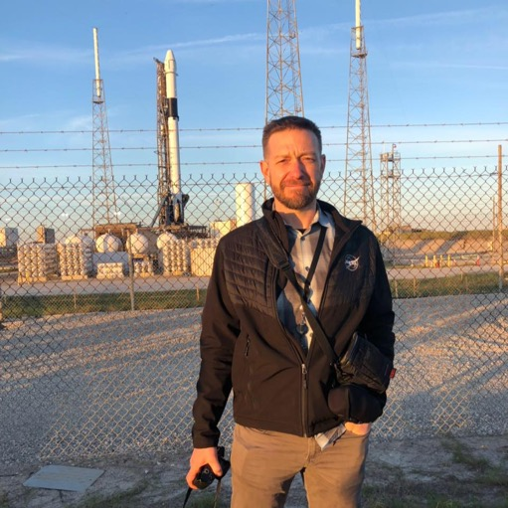
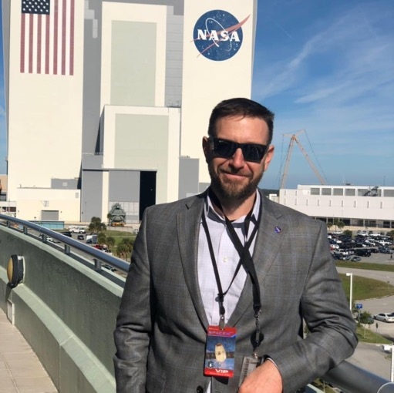
Introduction
I’m an Associate Professor in the Department of Ecosystem Science and at Colorado State University
Research in the areas forest, rangeland, fire, peatland, and wildlife ecology, leveraging a variety of remotely sensed datasets
Have taught courses in remote sensing, GIS, spatial statistics, forest ecology and biometry, water resources, among others
Received tenure in 2017, started reflecting on career (past, present, and future)
Saw Hank’s announcement for the TE Program Scientist
I am currently on detail as an ‘IPA’ Program Scientist in the Terrestrial Ecology Program at NASA Headquarters
IPA (Intergovernmental Personnel Act, not India Pale Ale)
A means to share experts between agencies, universities, and tribal organizations on a short term basis
I support the TE program in a variety of ways

Slide 3
TE IPA Job Announcement
What are my duties?
The successful candidate will support the Program Manager for Terrestrial Ecology in:
(i) developing solicitations for research in the areas covered by the program, (ii) conducting the evaluation of proposals by organizing and implementing peer review panels as well as reporting the results to NASA management, (iii) monitoring the performance of researchers who are selected for funding, (iv) supporting the planning and implementation of the Arctic-Boreal Vulnerability Experiment (ABoVE); (v) supporting NASA satellite missions that are pertinent to the Terrestrial Ecology Program (e.g., GEDI, GeoCarb) whether they be in formulation/pre- formulation, development, and operation, (vi) supporting the implementation of Decadal Survey recommendations that are pertinent to Terrestrial Ecology; (vii) providing oversight to the Carbon Cycle and Ecosystem Office (CCEO) at NASA Goddard; (viii) supporting data archiving activities at the Oak Ridge National Laboratory Data Active Archive Center (DAAC); (ix) assuring interagency and international coordination of the program with those of other entities such as the Global Change Research Program (GCRP), Interagency Arctic Research and Policy Committee (IARPC), the National Academy of Science (NAS), and the Committee of Earth Observation Systems (CEOS); (x) assisting CC&E Focus Area personnel in their reporting requirements of research activities. He/she will also interact closely with the terrestrial ecology research communities in the US and abroad.

Slide 4
A picture is worth a thousand words…

Slide 5
White House Office of Science Technology Policy (OSTP)
Interagency Research Policy Committee (IARPC)
IARPC, which consists of principals from 14 agencies, departments, and offices across the Federal government, is charged with enhancing both the scientific monitoring of, and research on, local, regional, and global environmental issues in the Arctic
I’m the NASA representative to the IARPC Staff Group
Co-lead the Terrestrial Ecosystems Collaboration Team (TECT) along with Steve Gray and Jeremy Littel (USGS) and Member of Permafrost Collaboration Team:
Monthly webinars (will be highlighting ABoVE projects and results)
Natalie Boleman and Todd Brinkman gave presentations in TECT meeting two months ago
The Queen of Peat presented in the PCT meeting this month
Member of the Carbon Cycle Interagency Working Group within the US Global Change Research Program

Slide 6
U.S. Group on Earth Observations (USGEO) Satellite Needs Working Group (SNWG)
Process by which Federal departments and agencies can communicate their Earth observation satellite measurement or product needs to NASA and other providers of satellite observations
Federal departments and agencies complete a survey describing how they used remote sensing data to support operations and research and provide a self-assessment of the degree to which their needs are being currently met
NASA staff review the needs and determine if more can be done to fully meet users needs
NASA ESD leadership presents results to OMB and sometimes requests additional funds to meet certain needs
NISAR was able to get additional funding from OMB to build a quad-pol system

Slide 7
NASA ESD Monthly Status Review
MSR is a process in which exciting/impactful research results from your project publications are selected to highlight to NASA SMD leadership
Typically these are based on the quad charts you submit
Can be a long process with multiple iterations of presentation and editing sessions with ESD leadership
One of my first assignments at NASA HQ was to develop a MSR story from an ABoVE project
Selected a recent publication by Katey Walter Anthony on thermokarst lakes
I can (un)proudly claim the record for the longest MSR story development process in ESD, probably across all SMD (~6 months to develop the story)
Mike Frelich selected this story for his last MSR story prior to retirement

Slide 8
What we need from you
1. Quality quad charts!!!!
Story must be understandable to a broad, scientifically literate, and inquisitive audience
Don’t simply copy and paste text and figures from publications
Need to make sure the story is self-contained on the slide
Avoid specialist language and use consistent terminology
2. Presentations at IARPC staff group meetings and CT webinars
I plan to highlight Phase 1 and Phase 2 ABoVE projects this year. I will be reaching out
Consider joining one of the IARPC collaboration teams (request and account at iarpccollaborations.org)

Slide 9
What we need from you
1. Quality quad charts!!!!
Story must be understandable to a broad, scientifically literate, and inquisitive audience
Don’t simply copy and paste text and figures from publications
Need to make sure the story is self-contained on the slide
Avoid specialist language and use consistent terminology
2. Presentations at IARPC staff group meetings and CT webinars
I plan to highlight Phase 1 and Phase 2 ABoVE projects this year. I will be reaching out
Consider joining one of the IARPC collaboration teams (request and account as iarpccollaborations.org)
3. Be sure to report your publications to Hank, myself, and the CCEO

Slide 10
Overall this has been a great experience I have learned a ton, and I think I have been helpful to Hank, NASA ESD/SMD, and the TE community I encourage each of you to consider this type of service as future opportunities arise

Slide 11
Questions

