Slide 1
ASTM-5 La Jolla
Leadership Group
Goetz, Miller, Griffith
Margolis, Falkowski
Special thanks to
++ Org Cmte ++
++ WG Leads ++
and all who
contributed results
about
“What we’re Learning”
from
Phase I projects
above.nasa.gov

Slide 2
ASTM5 Organizing Committee
Boelman, Natalie Lamont-Doherty Earth Observatory, Columbia Univ.
Boyer, Alison Oak Ridge National Laboratory
Chatterjee, Abhishek NASA GSFC / USRA GESTAR
Commane, Róisín Columbia University
Falkowski, Mike NASA HQ
Fisher, Joshua NASA JPL
Houben, Adam Polar Knowledge Canada
Kimball, John University of Montana
Larson, Elisabeth NASA GSFC / SSAI
Loboda, Tatiana University of Maryland
Mack, Michelle Northern Arizona University
Neigh, Christopher NASA GSFC
Prugh, Laura Univ of Washington
Rogers, Brendan WHRC
Schaefer, Kevin National Snow and Ice Data Center
Serbin, Shawn Brookhaven National Laboratory
Turetsky, Merritt University of Guelph

Slide 3
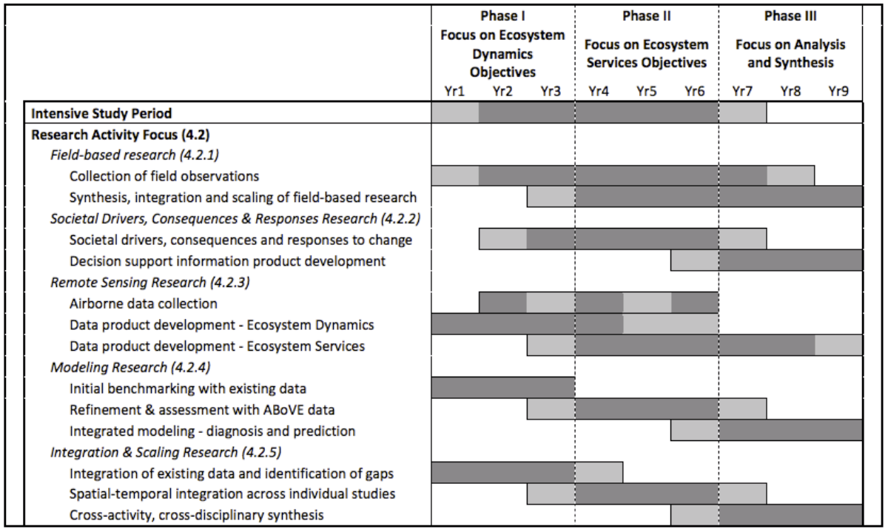
Phases & Timing of ABoVE
circa 2014 CEP
above.nasa.gov/about

Slide 4
ASTM5 Objectives
Report on Phase 1 and Airborne project progress
Introduction of new Phase 2 projects
Integration of Phase 2 projects into the ABoVE science team and working groups
Finalize plans for airborne remote sensing in 2019
Review / refine / advance:
Research progress
Processing, integration & scaling of field & airborne data
WG synthesis activities
Modeling (of all types)

Slide 5
ABoVE Phase 1 Progress thus far..
208 publications reported by 108 projects
136 publications by 33 of the 85 NASA funded projects
(66 ABoVE + 19 other NASA projects)
13 pubs by 4 of the 21 affiliated projects.
58 pubs by Partners (NGEE-Arctic & POLAR).
**Upload your pub citations to your ABoVE project web site**
and keep Leadership group / NASA HQ appraised of them.
ABoVE currently has 683 ST members
and ~1300 “participants”
(as of this week)

Slide 6
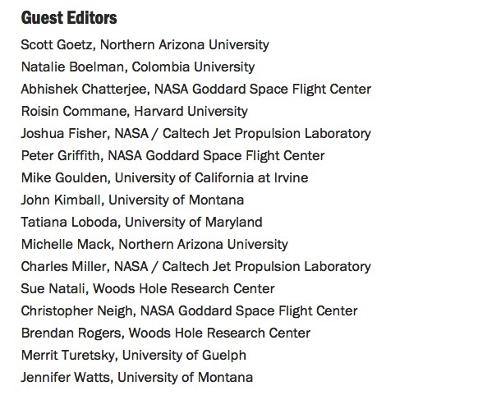
http://iopscience.iop.org/journal/1748-9326/page/ABoVE
24 contributed papers thus far.
Several more in press / in review

Slide 7
Phase 1 Core Disciplinary Science Working Groups
Wildfire Disturbance
Vegetation Dynamics
Hydrology & Permafrost
Carbon Dynamics
Wildlife & Ecosystem Services
Modeling
Airborne RS
+ other standing & ”ad hoc” WGs
ASTM-5
La Jolla, May 2019
above.nasa.gov

Slide 8
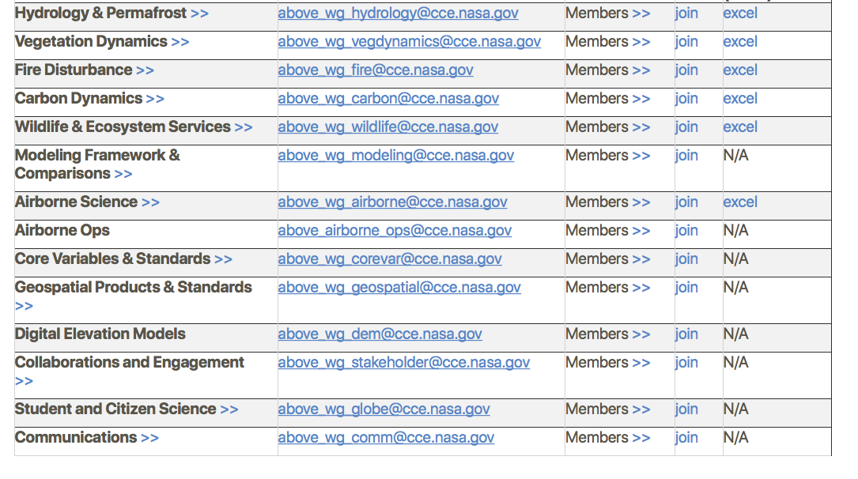
Core WGs
Other standing WGs
ASTM-5
La Jolla, May 2019
above.nasa.gov

Slide 9
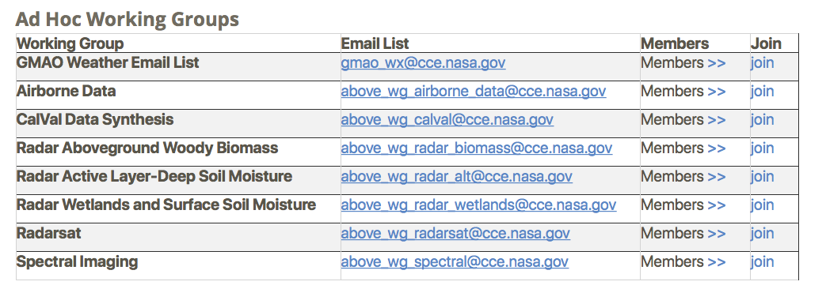
ASTM-5
La Jolla, May 2019
above.nasa.gov

Slide 10
Phase 1 Core Disciplinary Science Working Groups
Wildfire Disturbance (Mack)
Vegetation Dynamics (Epstein, Goulden)
Hydrology & Permafrost (Kimball)
Carbon Dynamics (Chatterjee, Commane, Natali)
Wildlife & Ecosystem Services (Boelman)
Modeling (Fisher)
Phase 2 WGs the same, similar, different?
New interdisciplinary WGs?
If so, what should they be?
ASTM-5
La Jolla, May 2019
above.nasa.gov

Slide 11
Day 3 afternoon Cross-Disciplinary Breakouts
Notional breakouts
Disturbance – Vegetation
Wildlife – Vegetation Dynamics – Fire
Carbon – Disturbance
Permafrost – Carbon – Hydrology Interactions
Carbon – Modeling – Scaling
Modeling groups may want to break into various sub-groups
Ideas on other possible cross-cutting themes?
Volunteers to lead breakout groups welcome

Slide 12
Phase 1 ABoVE WG Coordination & Synthesis Activities
Fire Disturbance:
Wildfire soil carbon combustion synthesis
Post-fire forest regrowth composition & trajectories (with Veg Dynamics WG)
Vegetation Dynamics:
Succession/recovery following disturbances (with Fire WG)
Forest greening/browning including role of climate & insects in forest decline
Tundra greening/browning including shrub expansion & densification
Carbon Dynamics:
Changes in seasonal amplitude of CO2 concentrations
CH4 data/knowledge gaps; Aquatic carbon fluxes
Partitioning net ecosystem exchange components
CO2 flux syntheses / C Flux measurements in permafrost ecosystems (with Hydrology/Permafrost WG & Permafrost C Network)
Hydrology / Permafrost:
Active Layer Distribution - synthesize & assess active layer depths (with SAR WGs)
Freeze-thaw dynamics and timing (with C Dynamics WG)
Lake trends – comparison of methods & long-term trends in lake area, and drivers
Snow properties – crosscutting synthesis activity with Wildlife WG

Slide 13
What have we learned / are we learning from ABoVE (thus far)?
WG Lead summaries & Invited presentations
Modeling (Josh Fisher – invited overview Weds AM)
Hydrology & Permafrost (John Kimball)
Vegetation Dynamics (Howie Epstein, Brendan Rogers)
+ Invited overview Tues AM (Isla Myers Smith)
Wildfire Disturbance (Laura Bourgeau-Chavez)
+ Invited overview Weds AM (Xanthe Walker)
Carbon Dynamics (Abhishek Chatterjee)
Wildlife & Ecosystem Services (Natalie Boelman)

Slide 14
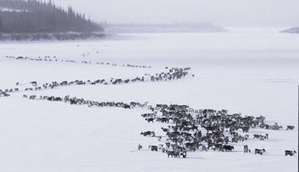
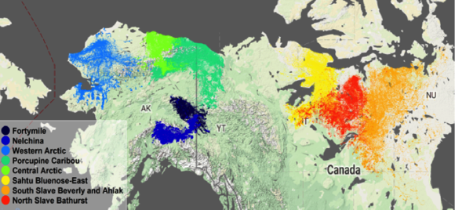
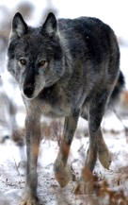
Effects of Interacting Disturbances on Caribou Habitat and Population Dynamics Climatic Drivers of Arctic Barrenground Caribou Migration During Spring
Palm, E., Ehlers, L., Bentzen, T., Brainerd, S., Herriges, J., Hebblewhite, M.
Croft, B., Kelly, A., Suitor, M., Joly, K., Adamewicz, J., Boelman, N.
38 populations
1200 individuals
> 4 million GPS locations
(above) Modeling drivers of Barrenground herds using tracking data during Spring migration.
(left) Woodland herd ranges are impacted by fire and predator utilization of gas exploration cut lines

