Slide 1


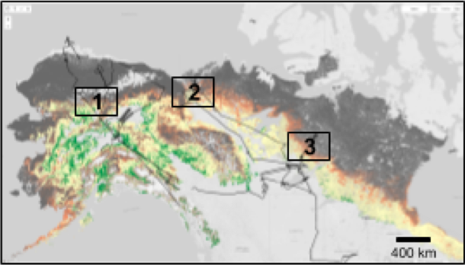
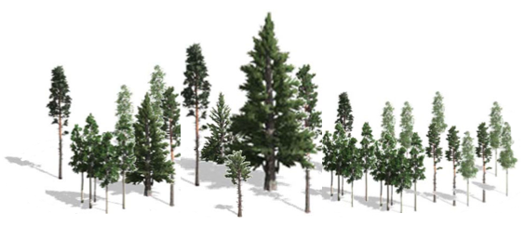


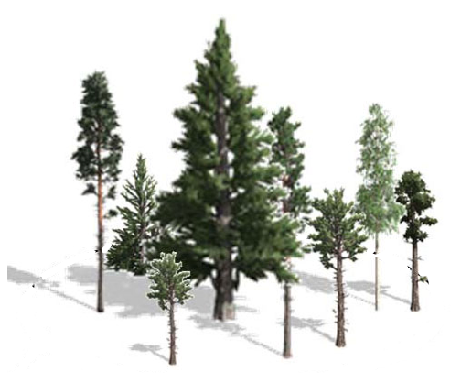
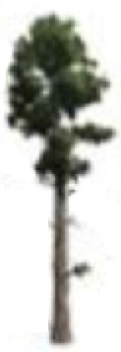

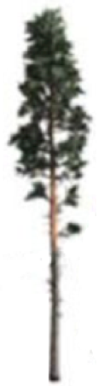



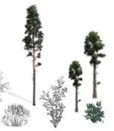


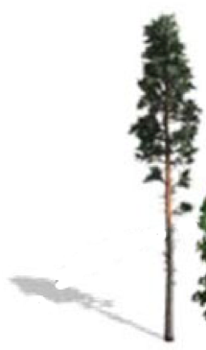
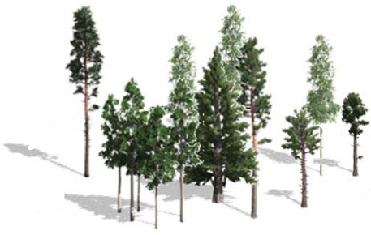
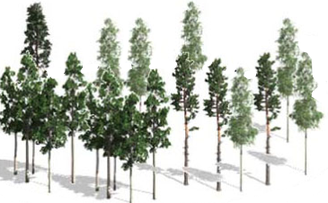
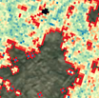
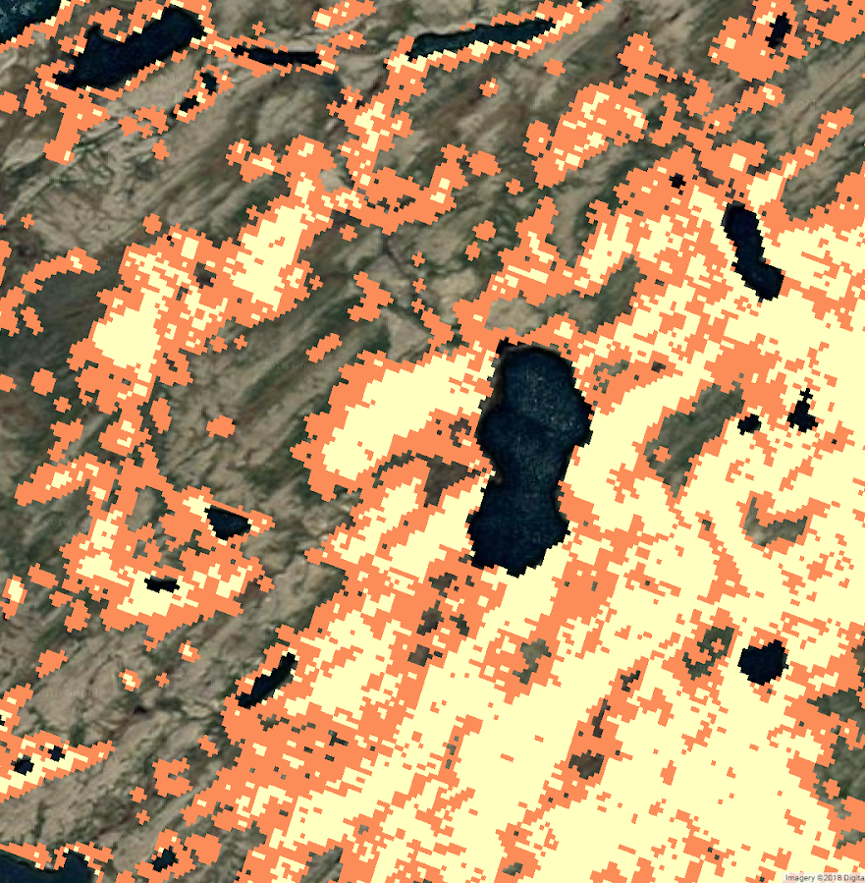
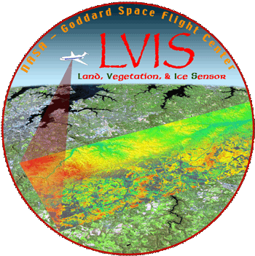
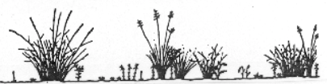
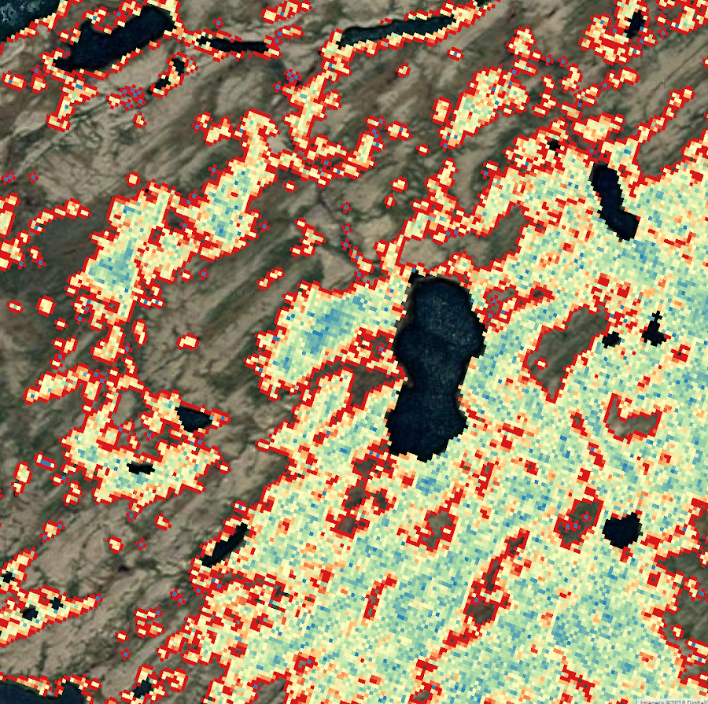
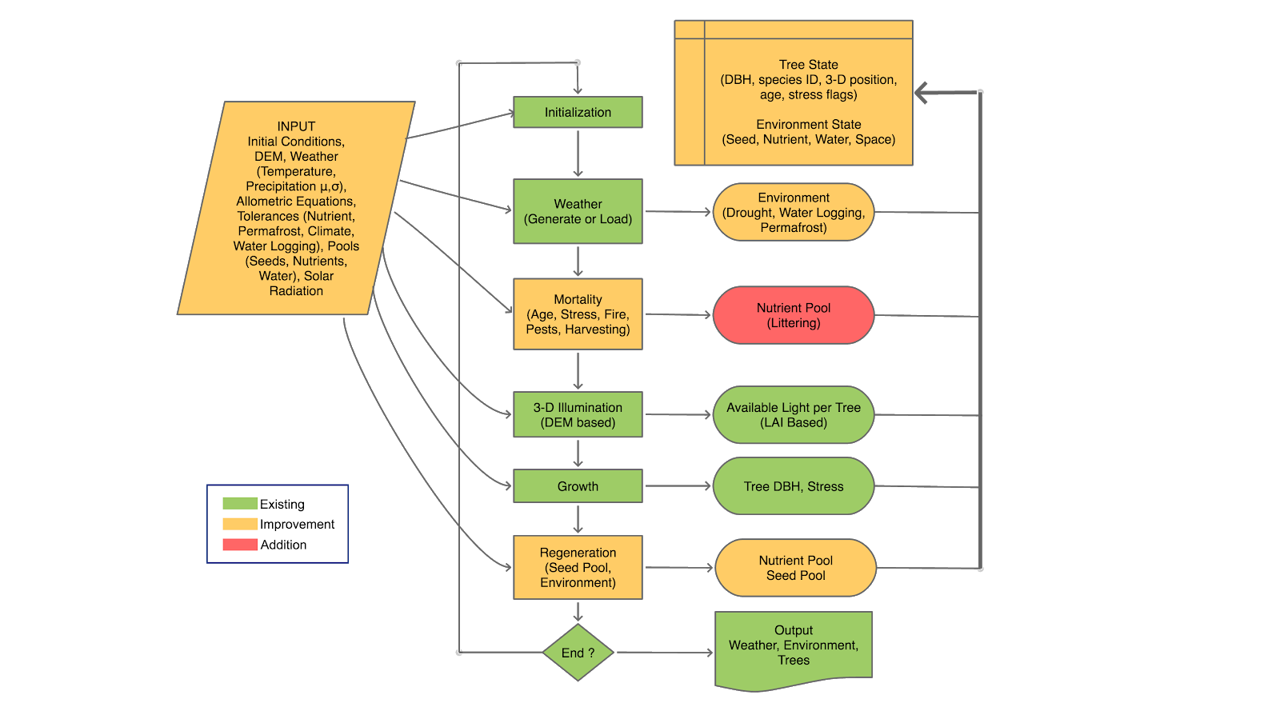
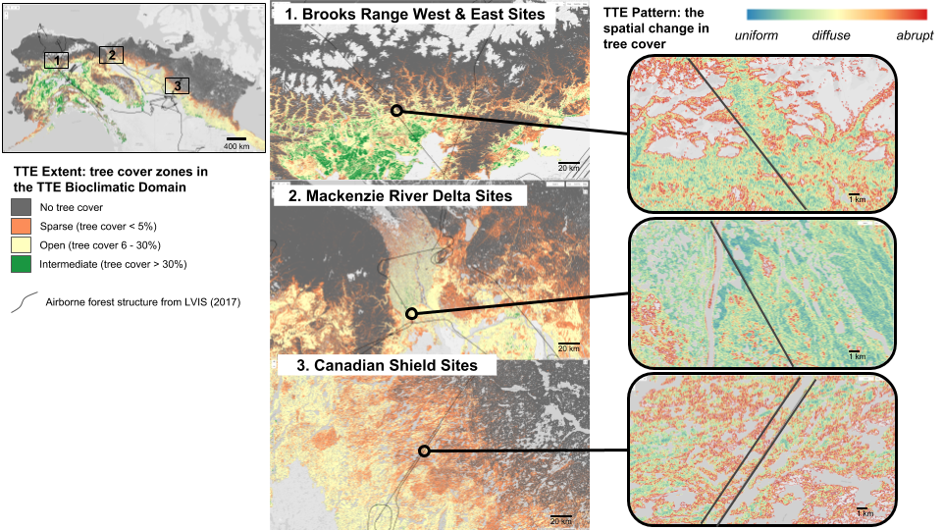
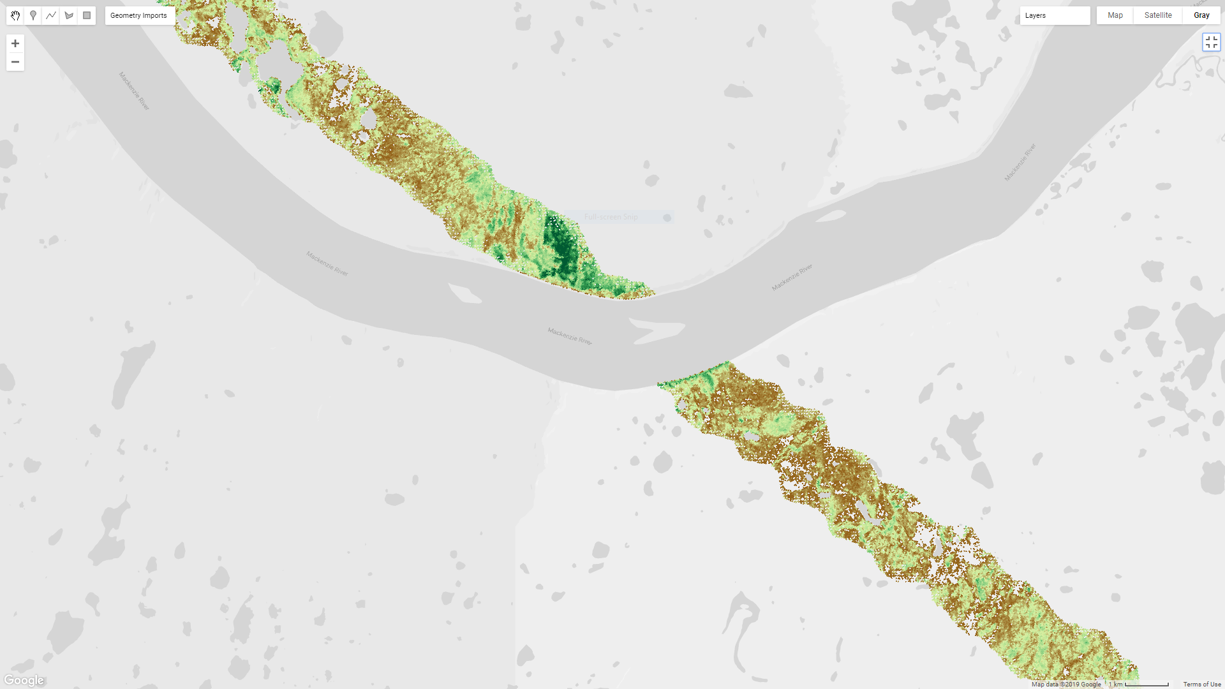
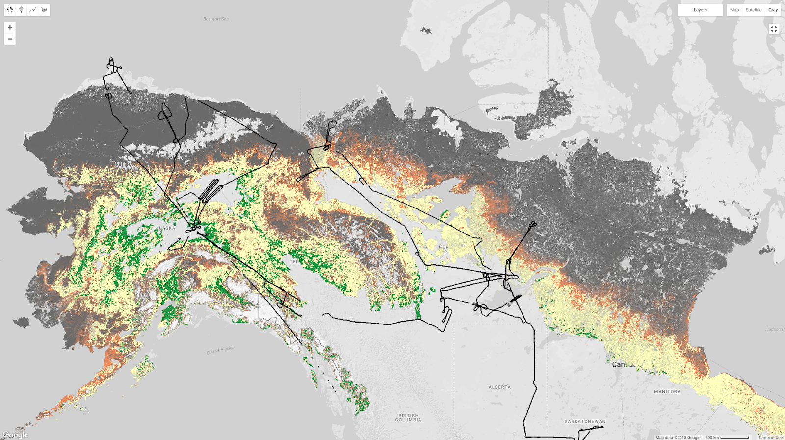
Vulnerability of the Taiga-Tundra Ecotone: Predicting the Magnitude, Variability, and Rate of Change at the Intersection of Arctic and Boreal Ecosystems
Project
NNH18ZDA001N-TE
PI: Amanda Armstrong
Universities Space Research Association
Amanda Armstrong, Universities Space Research Association, GESTAR; Paul Montesano, SSAI; Batu Osmanoglu and Jon Ranson, NASA Goddard Space Flight Center; Howard Epstein and Herman Shugart, University of Virginia
Introduction
Methodological Framework
Boreal forests are expected to advance northward as the result of persistent warming in the northern latitudes, resulting in changes to the structure and function of the high-northern latitudes. However, the rates and patterns of forest expansion are heterogeneous and the environmental drivers that lead to the shift from tundra to forest are poorly understood.
At the biome boundary between boreal (taiga) and tundra, the taiga-tundra ecotone (TTE) is recognized for its sparse woody vegetation cover (Callaghan et al. 2002). These high-northern latitude regions are among the fastest warming on the planet (Graversen et al. 2008, Bader, 2014).
Predictions of changes in vegetation across the TTE must incorporate multiple scales and often opposing feedback mechanisms. The variability patterns and processes that determine woody structure is linked to numerous controlling factors, including: climate, site history and local conditions associated with hydrology, permafrost, soil, bedrock, snow cover and wind (Holtmeier and Broll, 2007; Dalen and Hofgaard, 2005; Danby and Hik, 2007; Frost et al., 2014; Haugo et al. 2011; Holtmeier and Broll, 2010; Lloyd et al., 2003).
Ecological modeling has been effective at integrating the effects of the multi-scale controls in the TTE. A number of modelling studies have examined the role of these factors and the resulting changes (Brazhnik and Shugart 2015, Zhang et al. 2013, Kruse et al. 2016, Shuman et al. 2009, Wieczorek et al. 2017).
Our research directly addresses the ABoVE Phase 2 science question: How are flora and fauna responding to changes in abiotic and abiotic conditions, and what are the impacts on ecosystem structure and function?
Environmental Datasets
Forest Inventory Data
LVIS CHMs
Landsat (30m) 2010-2015
Vegetation Abruptness Map
1. PARAMETERIZE SIBBORK
Permafrost updates
2. INTEGRATE ArcVeg parameters
4. QUANTIFY:
- Site-level drivers of change
- Regional scale vulnerability maps
Table 1 describes the variables that will be collected for the field sites in Alaska (AK) and Canada (CA). The soil and atmospheric information will be gathered from previously collected datasets from our collaborators, and the following: SoilGrids (https://soilgrids.org), Soil Survey Geographic database (SSURGO), the National Soil Database (NSDB), NSF’s Arctic Transition in the Land Atmosphere System (ATLAS), DOE’s Next Generation Ecosystem Experiment (NGEE) Arctic, Taiga Plains Research Network TPRN), Trail Valley Creek and Havikpak Creek (TVC/HC) meteorological data and Canadian High Arctic Research Station (CHARS). The ArcticDEM from the Polar Geospatial Center (PGC), plant functional type data, and disturbance data will gathered from previously collected collaborator datasets, from the United States Department of Agriculture’s Cooperative Alaska Forest Inventory (USDA-CAFI), United States Forest Service (USFS) and the International Tree Ring Data Base (ITRDB).
Litter and Nutrient updates
Allometry updates
Objectives
Expected Outcomes
The goal of this work will be to examine and quantify the likelihood of predicted changes in TTE forest structure patterns occurring within the ABoVE extended domain, using airborne imagery and lidar observations, site-scale (i.e., high resolution spatially-explicit individual-based) forest and tundra vegetation modeling and a Landsat-derived map of the extent & pattern of the TTE. Using the mapped extent of the TTE to spatially guide our modelling, our specific objectives are to:
Parameterize the spatially-explicit individual-based gap model SIBBORK for the TTE forest study sites using leveraged field data and forest structure derived from LVIS and GLiHT datasets.
Improve permafrost, allometry routines, introduce litterfall and integrate the ArcVeg (tundra) model parameters into the SIBBORK (forest) model to extend the simulation domain across the full tundra-taiga boundary at the individual scale.
Predict future forest and tundra productivity and ecotone location using CMIP6 projections.
Quantify the ability of the tree cover abruptness variable to predict patterns of TTE change.
Calibrated with an ABOVE airborne product (LVIS) and initialized with a Landsat-derived map, our modeling framework will deliver the first high resolution, spatially-explicit forest and tundra model that has the capability to model ecotone shift across the ABoVE study domain. Our research will provide a deeper understanding of the current productivity dynamics along the TTE, and allow for informed prognostication about the shift in the extent of tree cover, and the spatial variability in the direction, rate, and magnitude of these shifts.
Validated Abruptness Map
(<30m resolution)
The expected outcomes from the proposed work include the following:
Four Model parameterizations for the 3 study sites that can be expanded to simulate more areas of the ecotone within ABoVE domain
The new SIBBORK-TTE model which add the ability to simulate tundra plant functional types from ArcVeg in a spatially explicit individual-based gap model framework
Study site maps corresponding to specific modelled tiles of the magnitude of predicted changes at each time interval for each grid cell and the overall rate of change for each simulation area.
Regional-scale TTE maps of the rate of structural change at ~ 1 ha. across the TTE in the AboVE domain, representing hotspots of change.
Our maps will predict the rate of structure/productivity changes across the TTE in the ABoVE domain, and these predictions will highlight areas that are particularly likely (i.e., vulnerable) to change above certain thresholds in the future. These predictions will have a few direct and immediate uses:
Of interest to stakeholders in communities associated with the most likely change
Targeting of high-resolution remote sensing (airborne and spaceborne) and future field level examinations/verification of TTE change.
Predictions of change will complement ongoing studies of recent (decadal) changes in structure (e.g., biomass, height and cover), along with multi-decadal (retrospective) structural changes across the ABoVE domain to understand how past and near-term measurements of change match with our predictions of expected changes over the coming decades and century.
3. PREDICT
Vegetation change with SIBBORK-TTE using CMIP6
SIBBORK_TTE
CMIP6
Figure 4 The diagram outline the workflow of the technical approach. The numbers in yellow correspond to the objective numbers.
Remote Sensing and Modeling
Airborne:
  Reference % tree canopy cover from LVIS 2017 & 2019 to:
  validate spaceborne estimates of forest structure
  calibrate statistical distributions of structure for models
Spaceborne:
  Landsat-based % tree canopy cover products with topographic details from ArcticDEM & Tandem-X DEM to:
  create broad-scale maps of forest structure patterns
Study Sites
References
Bader, J., 2014. Climate science: the origin of regional Arctic warming. Nature, 509(7499), p.167.
Brazhnik, K. and Shugart, H.H., 2015. 3D simulation of boreal forests: structure and dynamics in complex terrain and in a changing climate. Environmental Research Letters, 10(10), p.105006.
Callaghan, T.V., Crawford, R.M., Eronen, M., Hofgaard, A., Payette, S., Rees, W.G., Skre, O., Sveinbjörnsson, B., Vlassova, T.K. and Werkman, B.R., 2002. The dynamics of the tundra-taiga boundary: an overview and suggested coordinated and integrated approach to research. Ambio, pp.3-5.
Dalen, L. and Hofgaard, A., 2005. Differential regional treeline dynamics in the Scandes Mountains. Arctic, Antarctic, and Alpine Research, 37(3), pp.284-296.
Danby, R.K. and Hik, D.S., 2007. Variability, contingency and rapid change in recent subarctic alpine tree line dynamics. Journal of Ecology, 95(2), pp.352-363.
Frost, G.V., Epstein, H.E. and Walker, D.A., 2014. Regional and landscape-scale variability of Landsat-observed vegetation dynamics in northwest Siberian tundra. Environmental Research Letters, 9(2), p.025004.
Graversen, R.G., Mauritsen, T., Tjernström, M., Källén, E. and Svensson, G., 2008. Vertical structure of recent Arctic warming. Nature, 451(7174), p.53
Haugo, R.D., Halpern, C.B. and Bakker, J.D., 2011. Landscape context and long‐term tree influences shape the dynamics of forest‐meadow ecotones in mountain ecosystems. Ecosphere, 2(8), pp.1-24.
Holtmeier, F.-K. & G. Broll 2007. Treeline advance – driving processes and adverse factors. Landscape Online 1, 1-33. DOI: 10.3097/LO.200701
Kruse, S., Wieczorek, M., Jeltsch, F. and Herzschuh, U., 2016. Treeline dynamics in Siberia under changing climates as inferred from an individual-based model for Larix. Ecological modelling, 338, pp.101-121.
Lloyd, A.H., Yoshikawa, K., Fastie, C.L., Hinzman, L. and Fraver, M., 2003. Effects of permafrost degradation on woody vegetation at arctic treeline on the Seward Peninsula, Alaska. Permafrost and Periglacial Processes, 14(2), pp.93-101.
Shuman J.K. and H.H. Shugart. 2009. Evaluating Sensitivity of Eurasian Forest Biomass to
Climate Change using a Dynamic Vegetation Model. Environ. Res. Lett. 4 045024 (7pp).
Wieczorek, M., Kruse, S., Epp, L.S., Kolmogorov, A., Nikolaev, A.N., Heinrich, I., Jeltsch, F., Pestryakova, L.A., Zibulski, R. and Herzschuh, U., 2017. Dissimilar responses of larch stands in northern Siberia to increasing temperatures—a field and simulation based study. Ecology, 98(9), pp.2343-2355.
Zhang, W., Miller, P.A., Smith, B., Wania, R., Koenigk, T. and Döscher, R., 2013. Tundra shrubification and tree-line advance amplify arctic climate warming: results from an individual-based dynamic vegetation model. Environmental Research Letters, 8(3), p.034023.
Figure 3 SIBBORK flow chart. Different colors indicate existing modules (green), as well as planned improvements (orange) and additions (red) to the modules. (Figure adapted from Brazhnik and Shugart 2016)
Figure 1 The three proposed study sites are shown in association with the mapped TTE extent within the TTE Bioclimatic Domain (Montesano et al. in prep; Based on data from Montesano et al. 2016). The inset areas to the right of the study site boxes provide examples of the variation in tree cover abruptness within each study site. Black lines depict the centerlines of LVIS airborne data from which reference forest structure will be used to initialize model runs and validate results.
  Modeling:
  The Spatially Explicit Individual Based Gap Model SIBBORK will be updated and the ArcVeg Tundra process parameters will be integrated toward achieving the ability to accurately simulate vegetation structure and dynamics occurring along the TTE.
Figure 2

