Slide 1
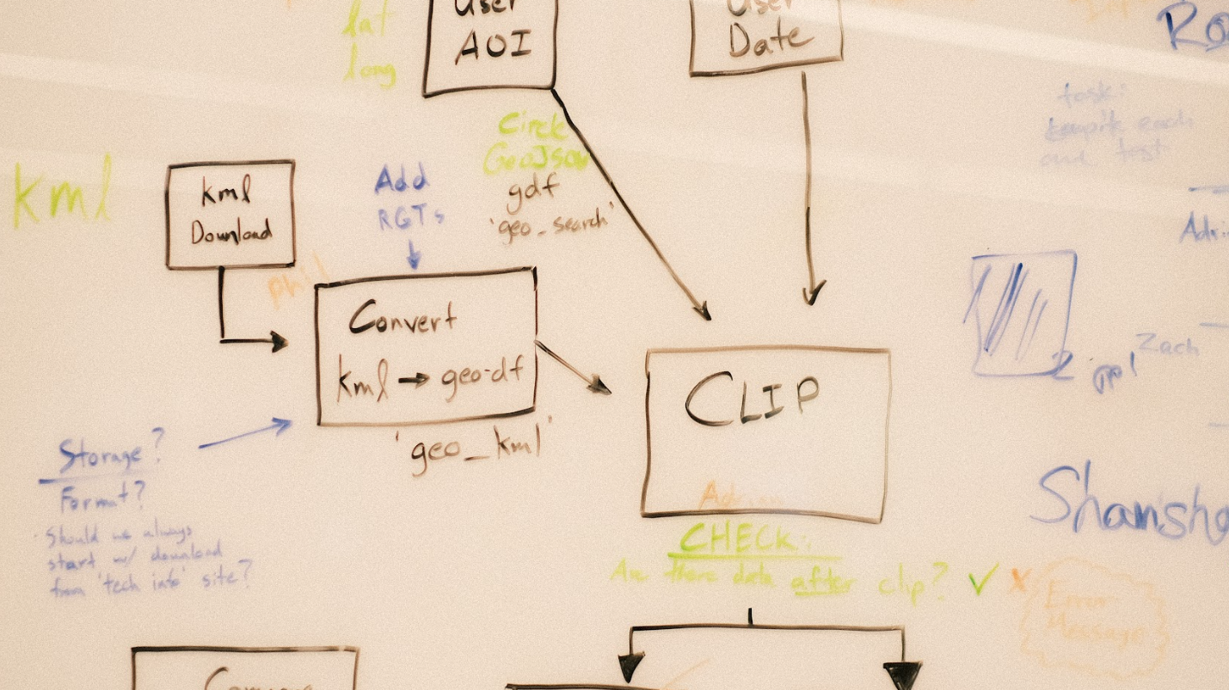

SnowEx WORKSHOP
BOULDER, CO 2024
How can the hackweek model be used to support future snow community collaborations?
Anthony Arendt
Senior Data Science Fellow
eScience Institute
University of Washington

Slide 2
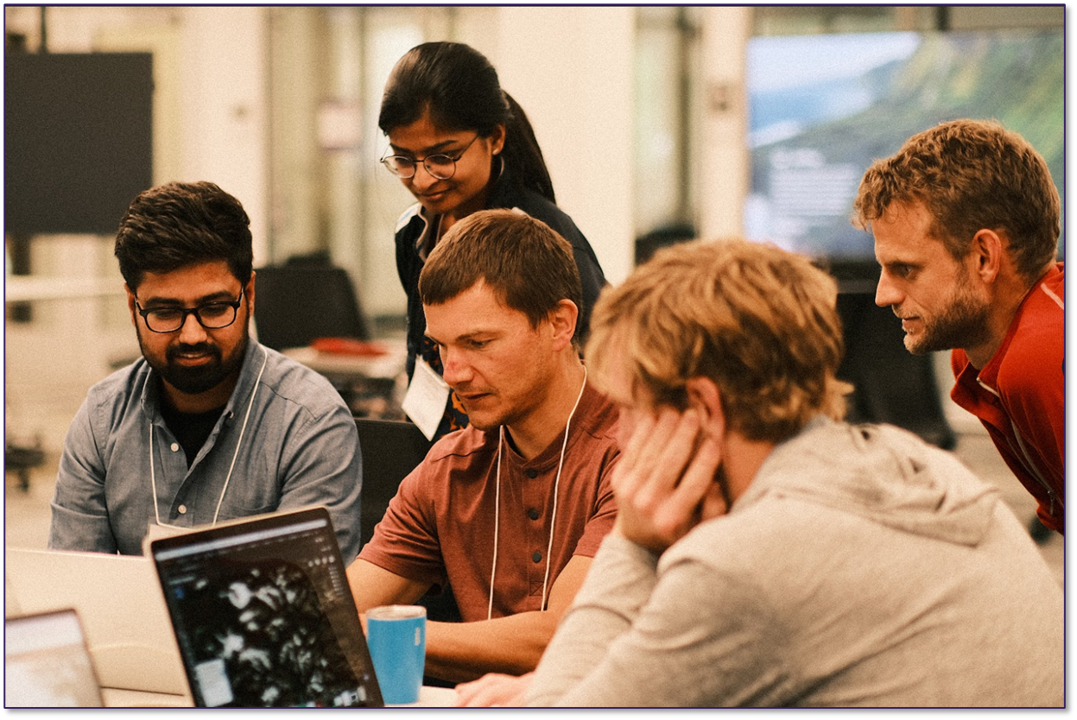
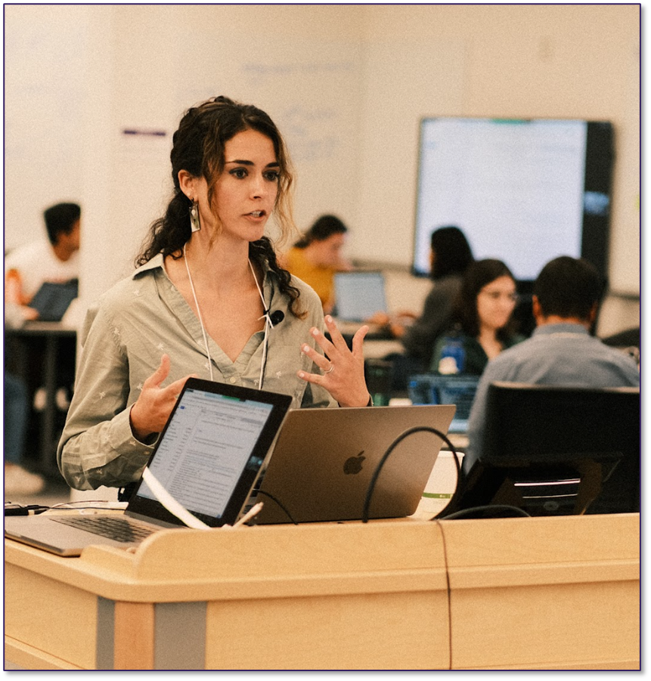

Projects (Hacking)
Hackweeks
Participants pitch ideas, form small teams and collaborate through the week.
Provide hands-on opportunities for people to learn the tools of open-source science in a collaborative and welcoming environment.
Tutorials
Designed by the community to address emerging research and analysis needs.

Slide 3

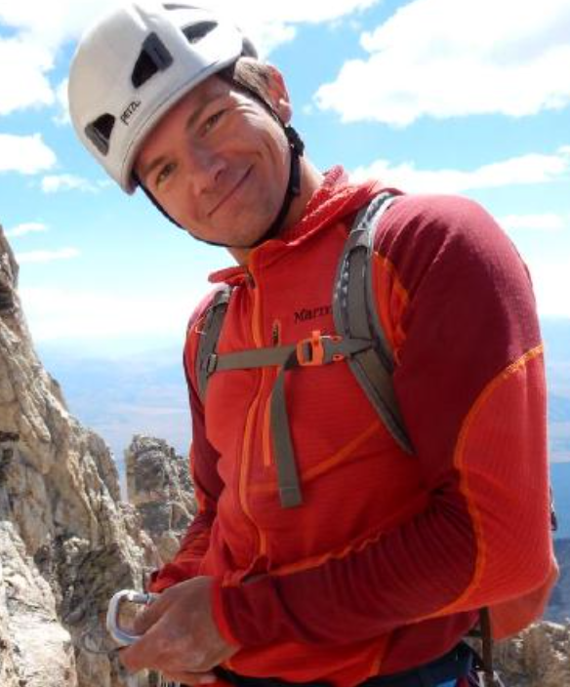
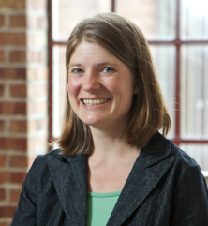
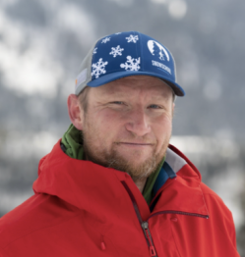
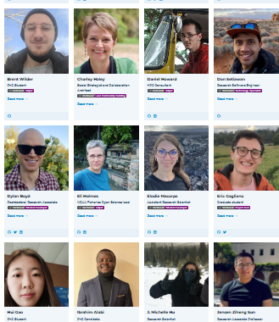
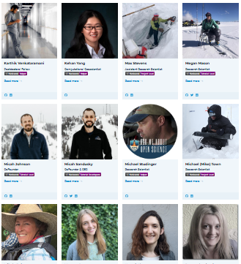
SnowEx Hackweek
Joachim Meyer, 2024 SnowEx hackweek Lead
2021
2022
2024
In person (Seattle)
In person (Seattle)
Virtual
Virtual
Working with Alaska Campaign, Collaborative Database Development
Data Integration, Improved Data Access
Webinar for community training

Slide 4
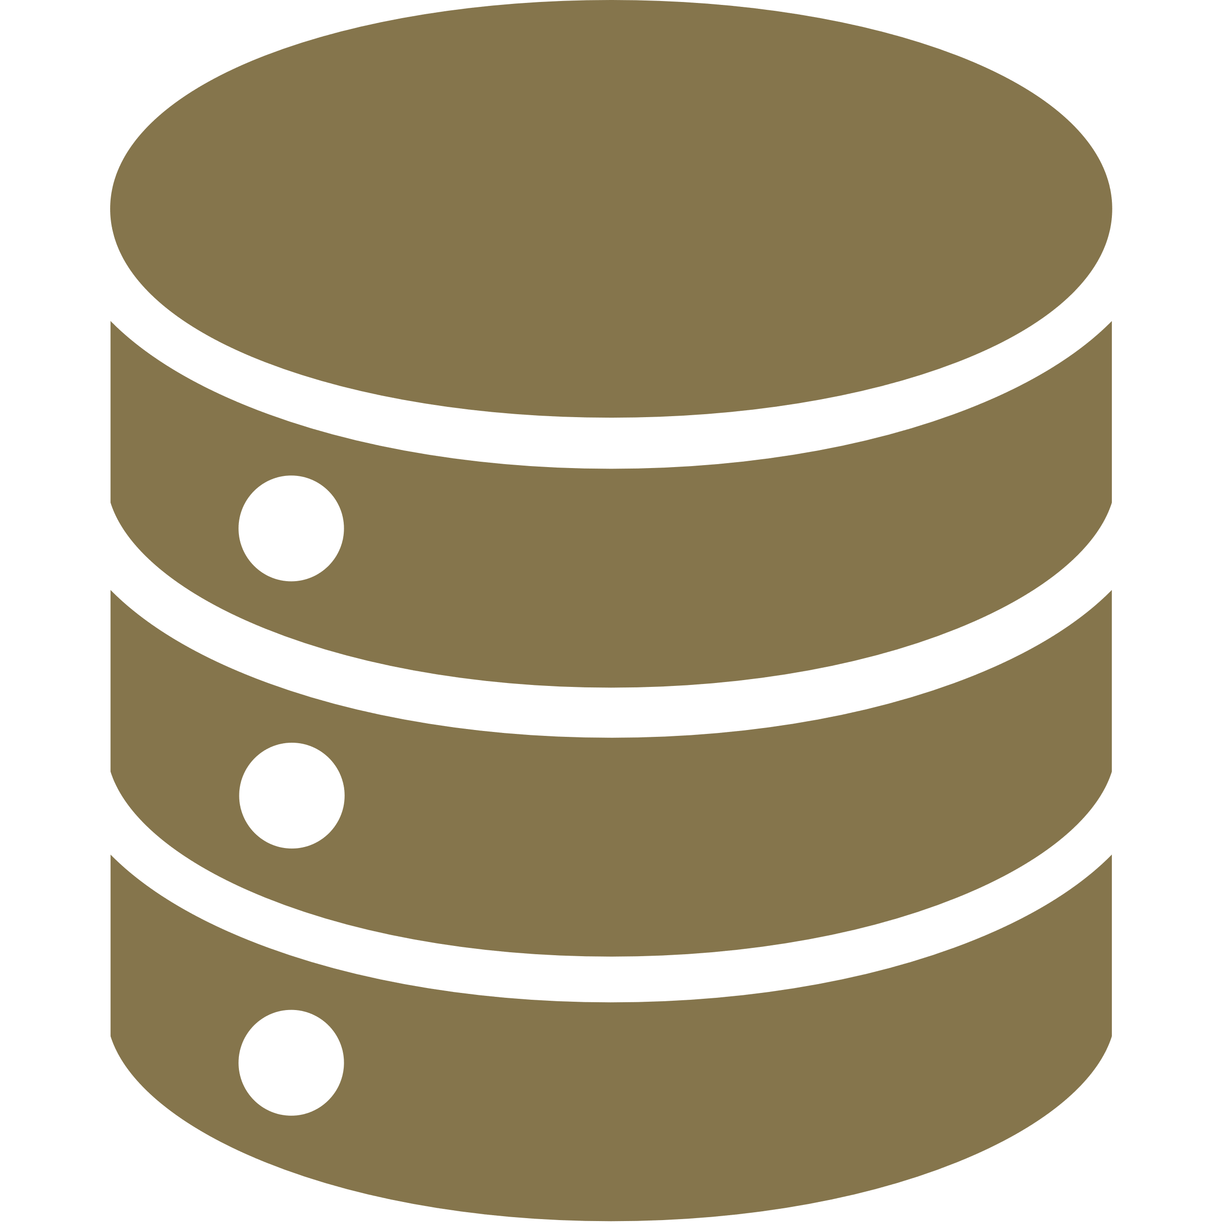

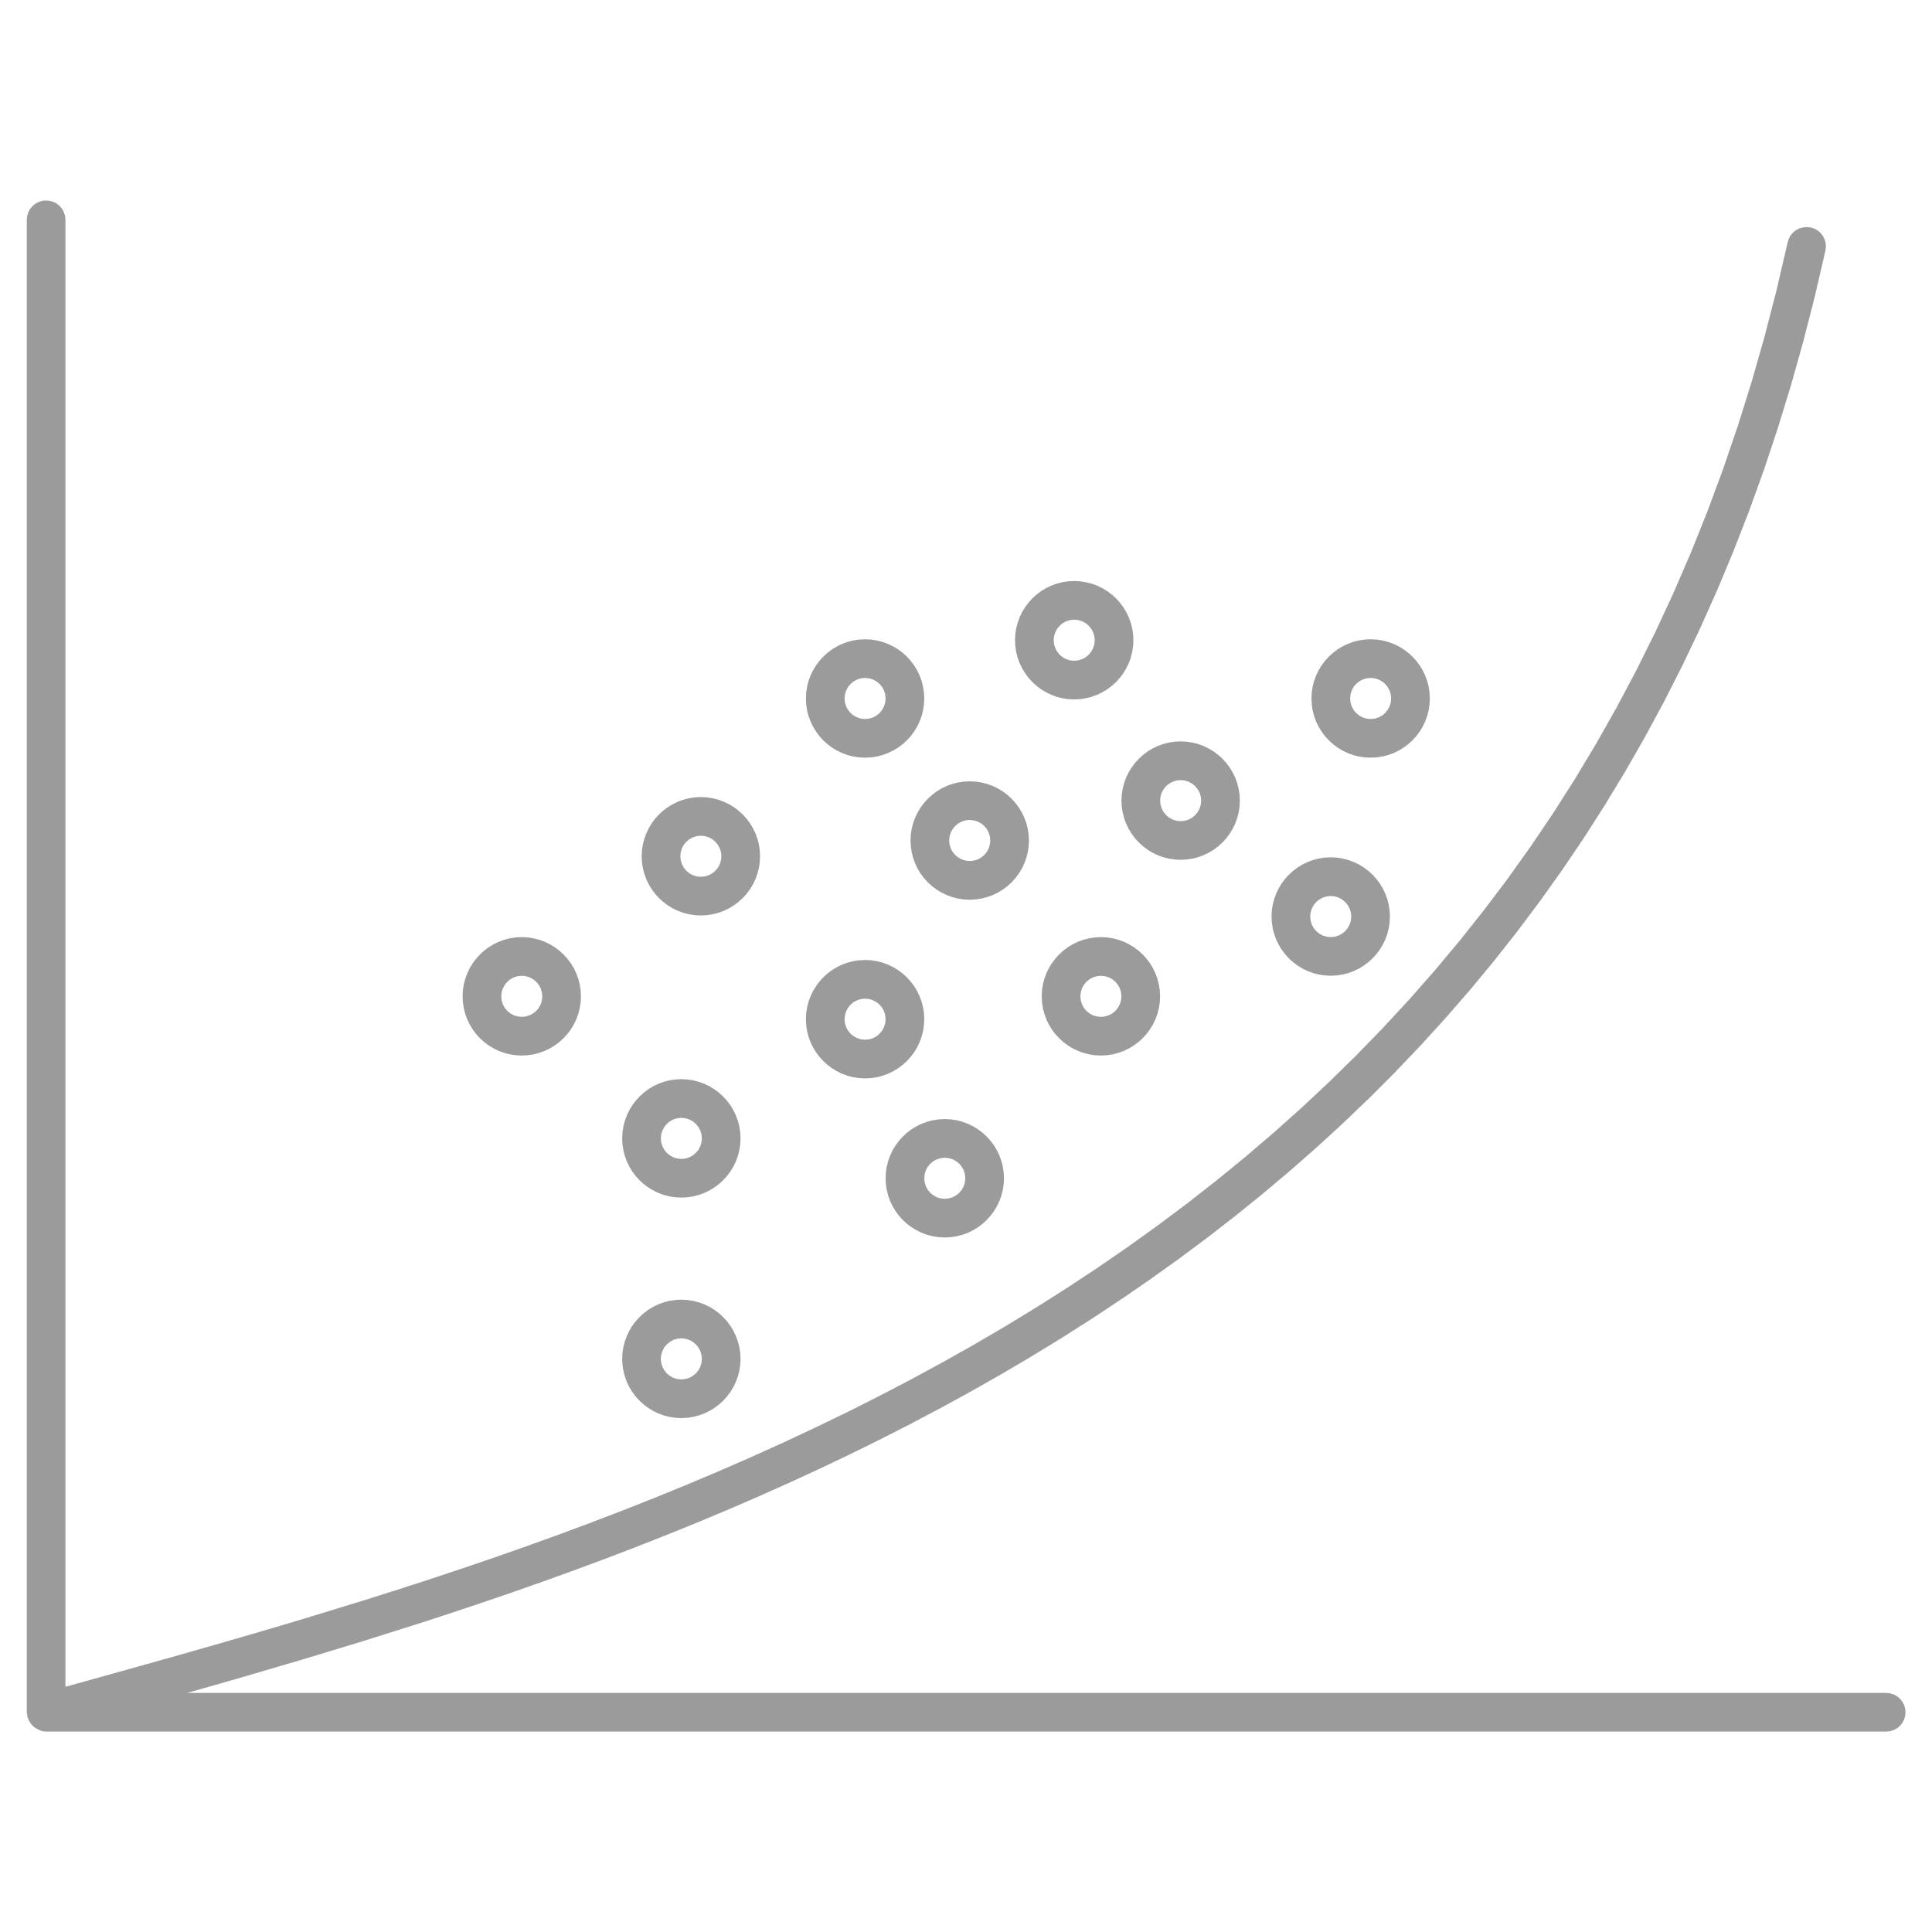

SnowEx Curriculum
Fundamentals
Data Access
SnowEx Campaigns
Modeling / ML
GitHub, JupyterHub/Notebooks, Object Oriented Programming, Core Python tools.
NSIDC,
EarthData access,
SnowExSQL community database.
Land Surface Models, Machine Learning.
LiDAR, UAVSAR, SWESARR, Microwave, AVIRIS-NG, Photogrammetry

Slide 5
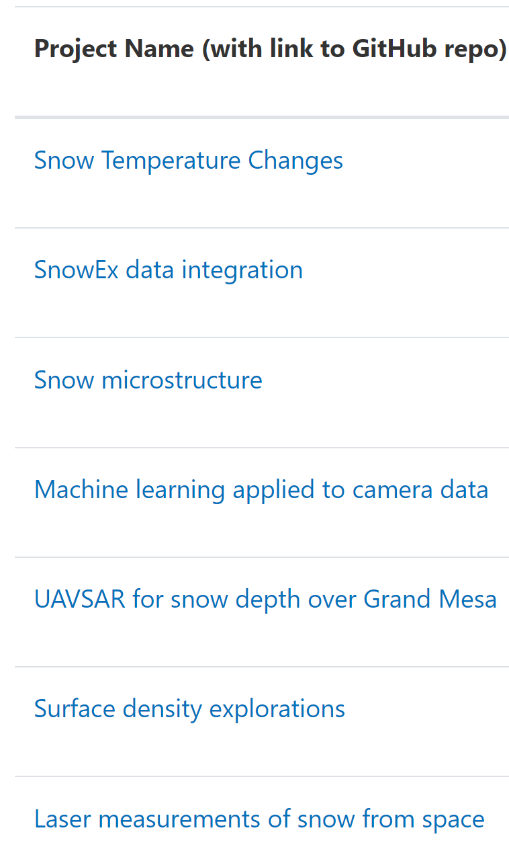
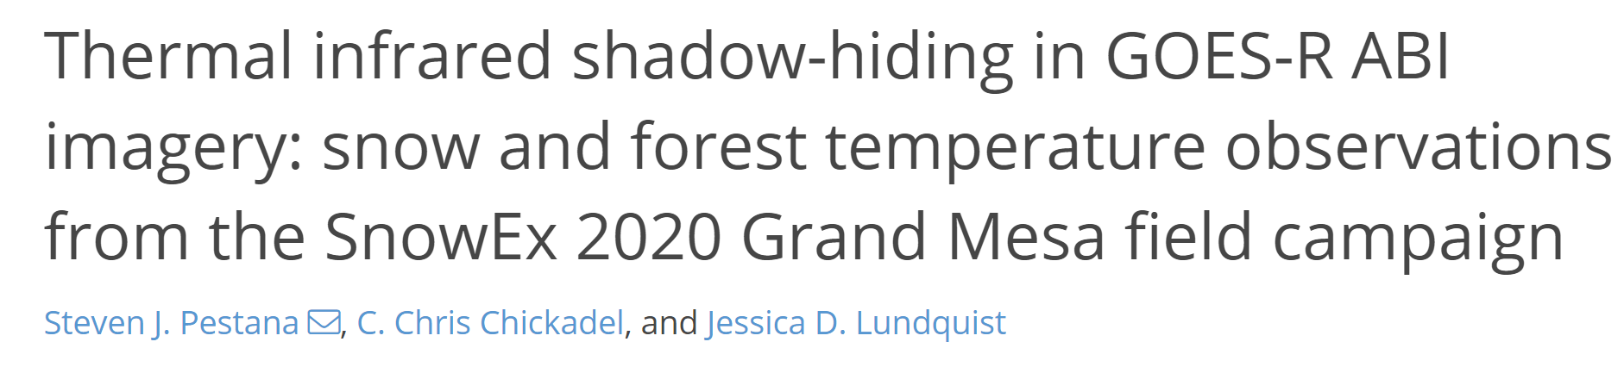
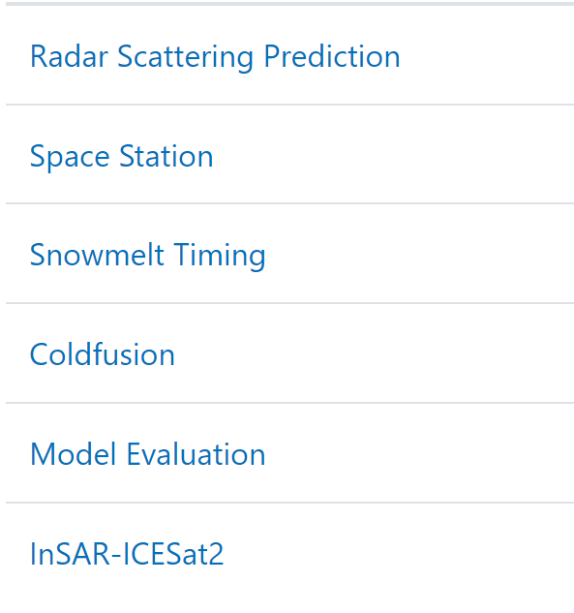
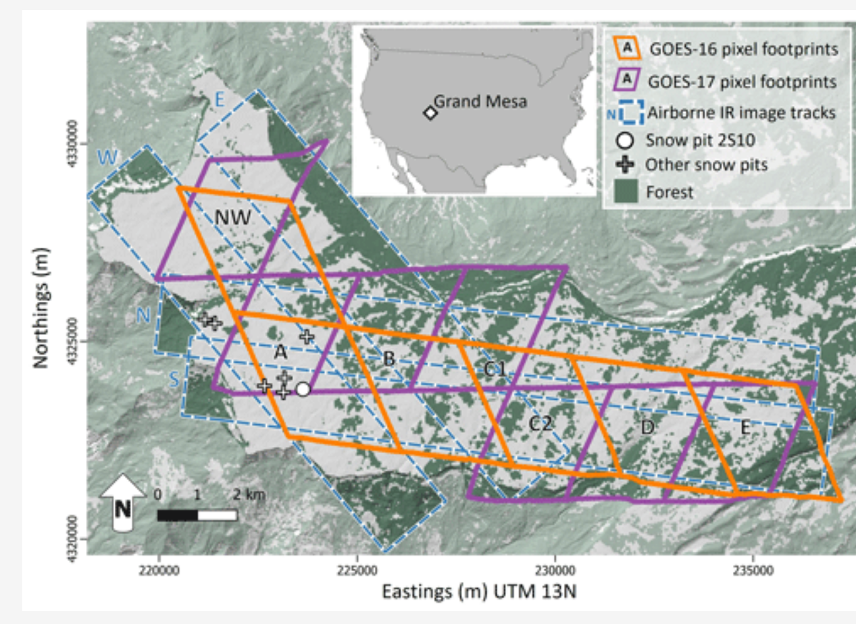
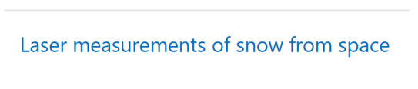
SnowEx Projects

Slide 6
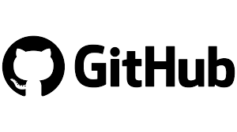


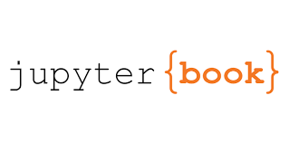
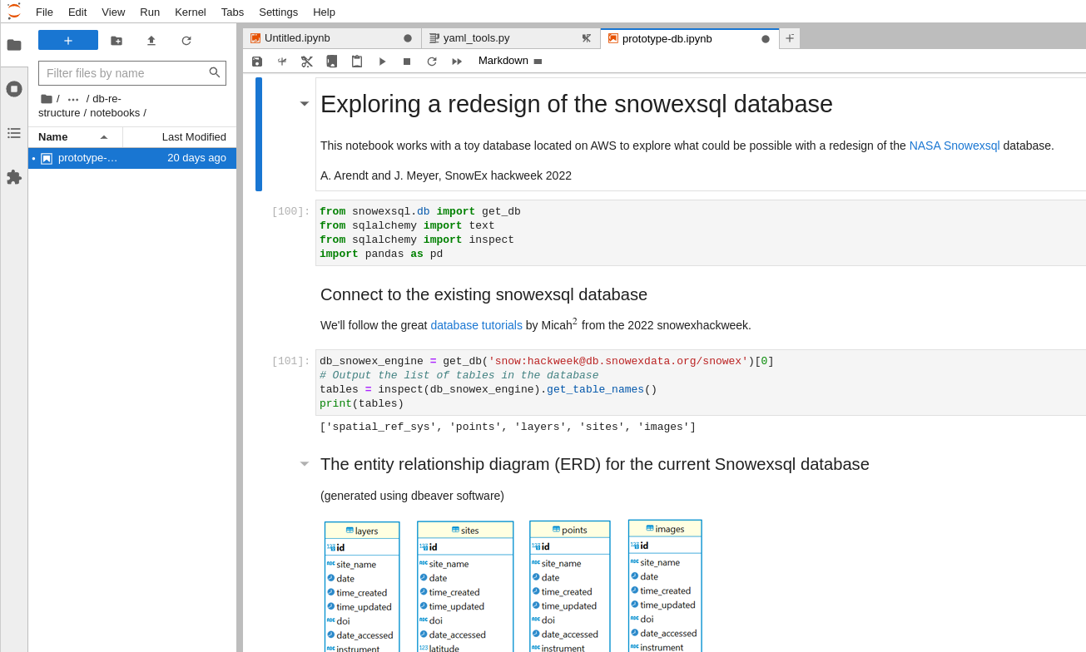
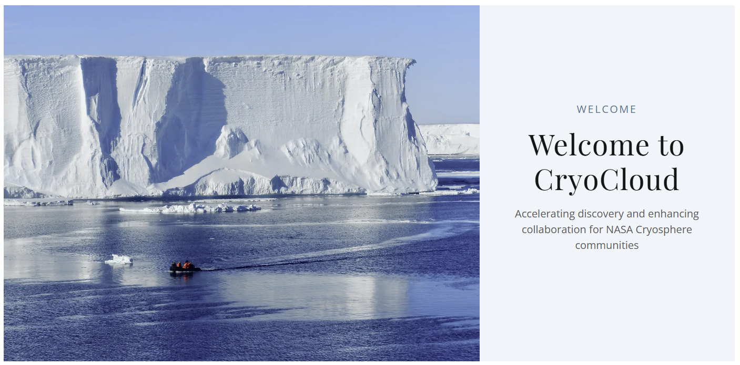
Open-source framework
Cloud-computing environment with public infrastructure as code for replicability.
Simplifies access to latest computing hardware, data and code sharing, and software development.
www.cryointhecloud.com

Slide 7
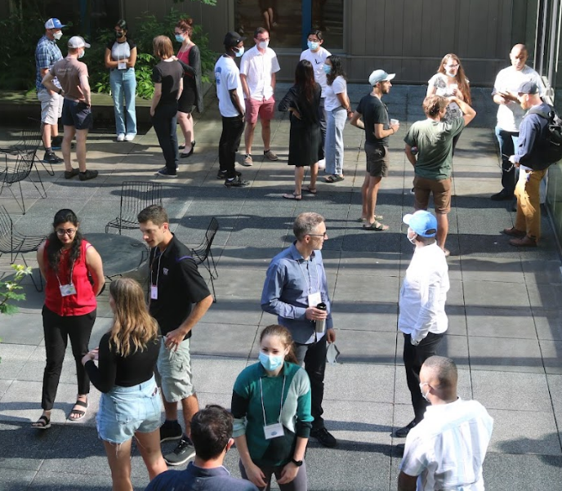
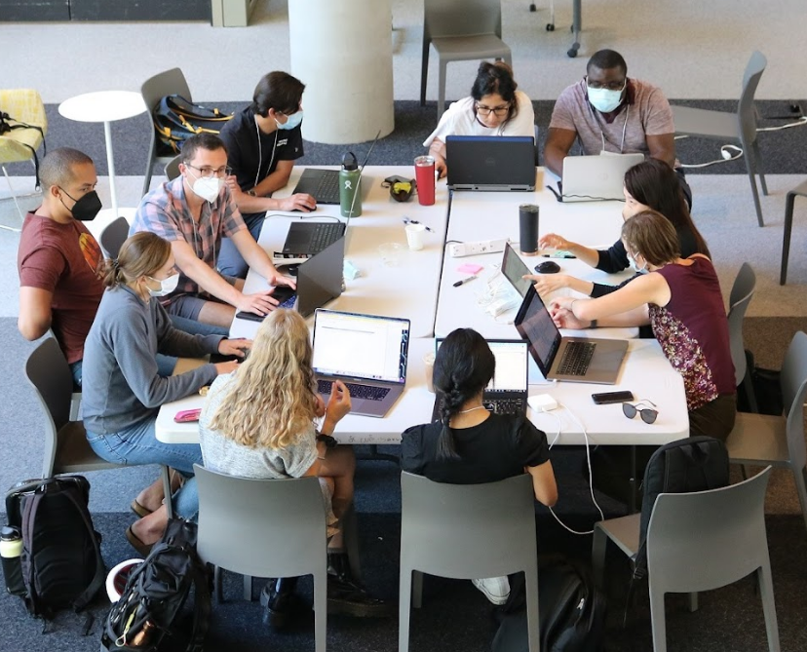
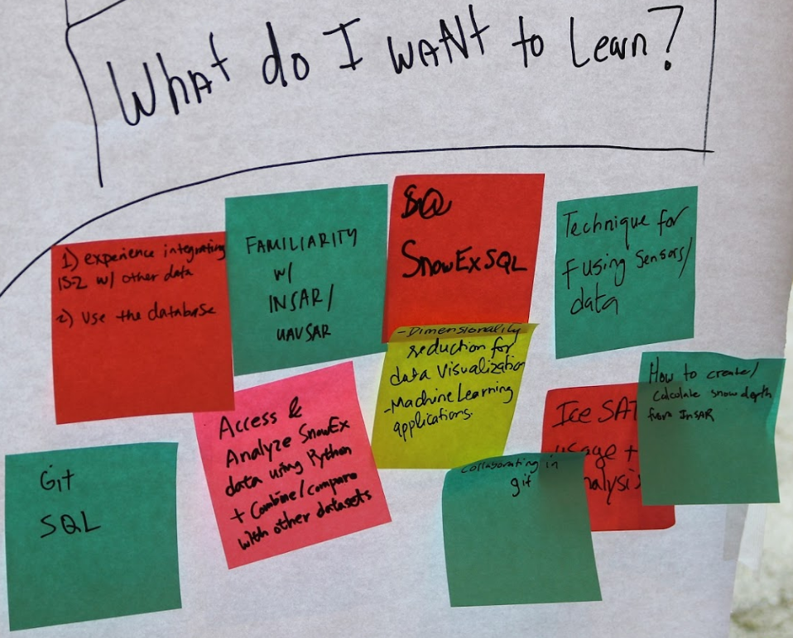
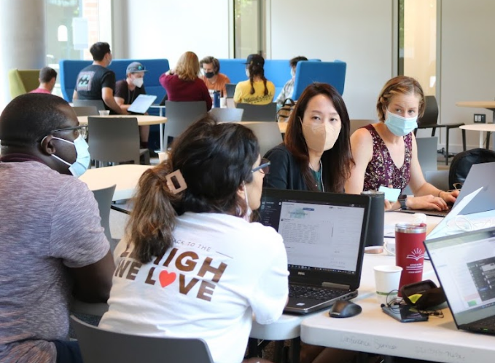
SnowEx Community Development

Slide 8
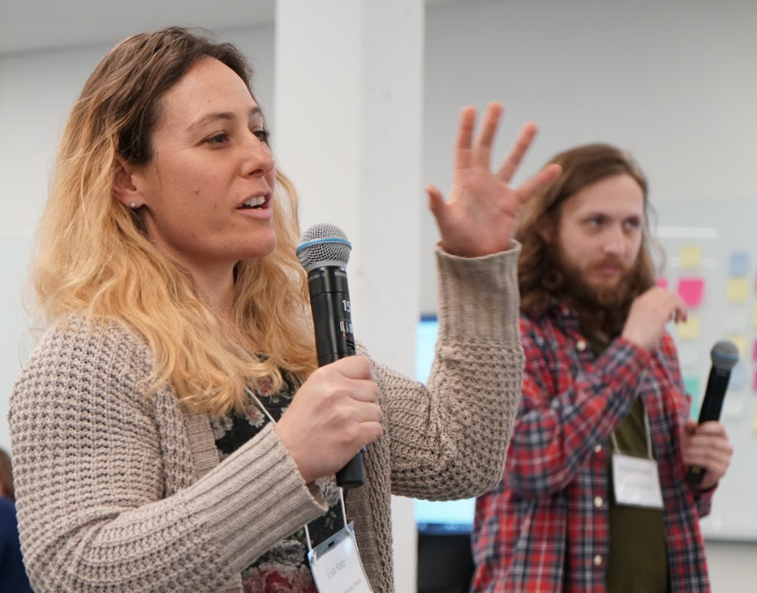
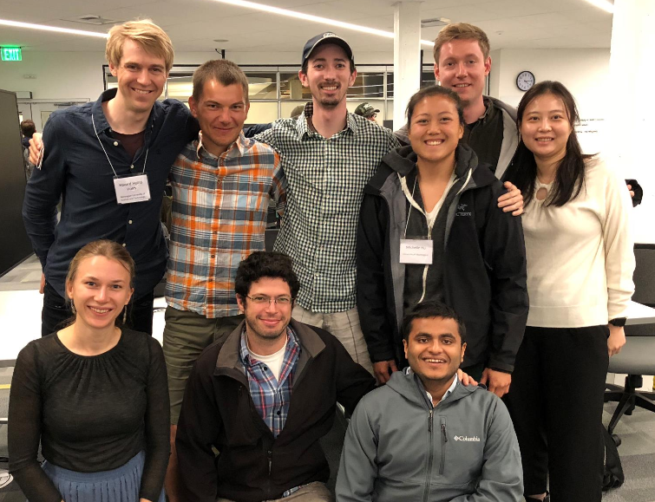
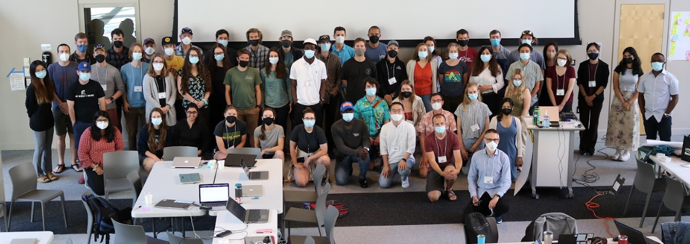
What comes next?
Research Infrastructure
Community Software
Applied Snow Science
Cross-Mission Collaborations

Slide 9
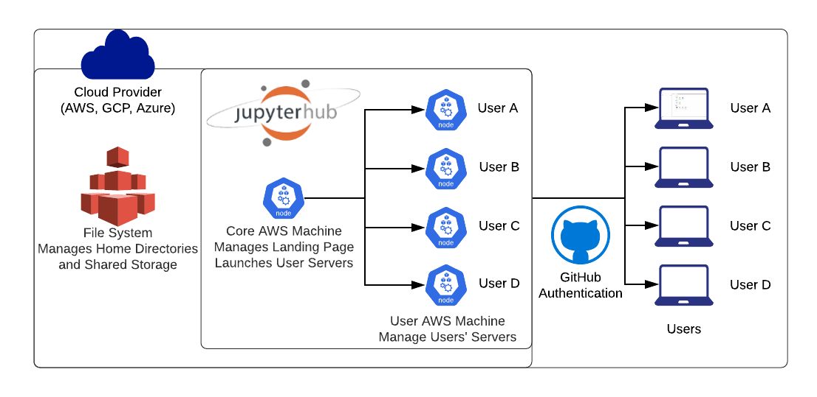
Expanded Computing Infrastructure
Persistent JupyterHub Access
Allows researchers to continue cloud optimized workflows and maintain collaborations after workshops.
Clarity on Funding Model
We need a process for infusing project funding into shared community infrastructure.
Expand to include data access and compute
We need a place to host community-designed databases, and a process for maintaining them. We need access to GPU and multiple processors for large modeling and ML workflows.

Slide 10
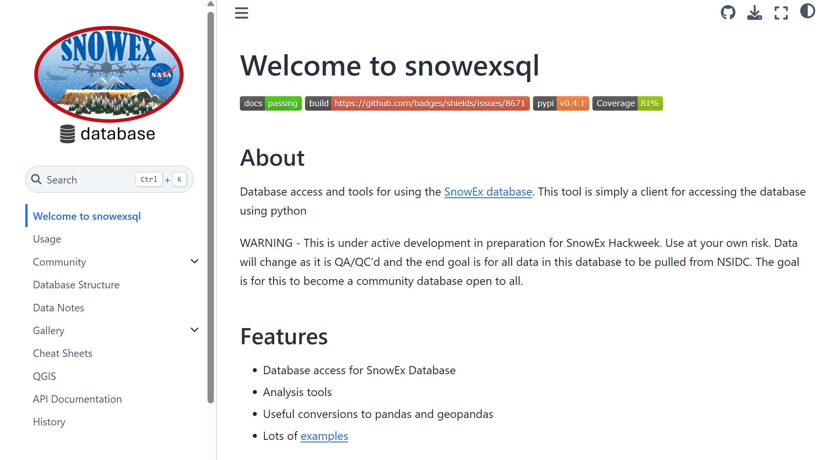
Open-Source Software
SnowEx Examples
SnowExSQL Database
Centralized API level access to SnowEx field campaign datasets.
Data harmonization
Reduce barriers to connecting model output with field and other satellite observations (common reference frames, formats, etc).
snowexsql.readthedocs.io

Slide 11




Documentation
Remove barriers for newcomers and ensure reproducibility.
Infusing Software Design into Research
Testing
Maintain code integrity and check against physical constraints.
Scientific Python Development Guide
learn.scientific-python.org
We already have strict norms and patterns around how we share scientific research.
We advocate for similar norms to be applied to our research software.
We can learn this from professional Software Engineers.
Packaging
Make it easy for others to install and test code.

Slide 12

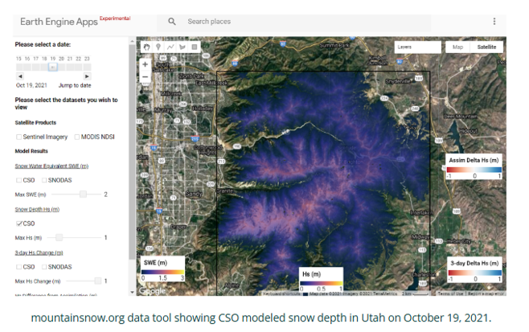
communitysnowobs.org

Slide 13

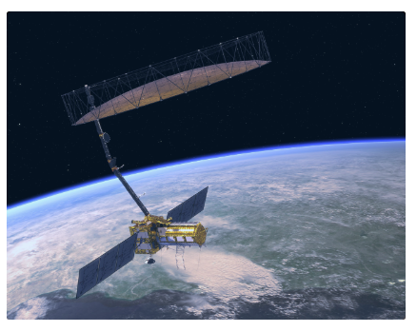

Future Related Hackweeks
Hackweek focused on fostering development of early career hydrologists (Funded 2025 - 26)
Hackweek focused on building an open science community shortly after the launch of NISAR (in discussion).

Slide 14


Building a Culture of Inclusion and Collaboration
Professionalizing Short-Format Trainings
Organizer team training on pedagogy, technical collaboration tools, and creating a positive learning culture (guidebook.hackweek.io)
Recognizing Contributions
Efforts to fund travel, lodging and time contributed to content creation and hackweek support; badging to certify progression through training series.
Normalizing conversations about how we collaborate
Intentional hackweek programming on best practices for group work and creating lasting community engagement.

Slide 15



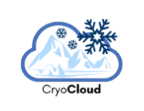


Funding

Slide 16

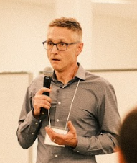
Contact Us
arendta@uw.edu
https://escience.washington.edu

