Slide 1
NASA NSIDC DAAC: Promoting Open Science
Focusing on:
By: Stephanie Wong

Slide 2
What is open science?

Slide 3
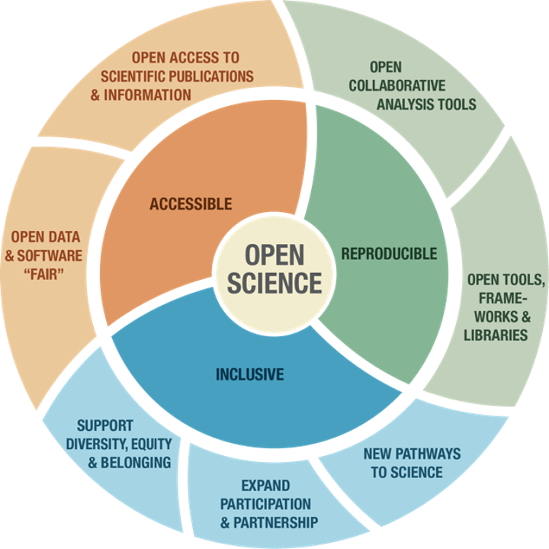
What is Open Science?
NASA’s Earth Science Data Systems (ESDS) Program defines open science as: “A collaborative culture enabled by technology that empowers the open sharing of data, information, and knowledge within the scientific community and the wider public to accelerate scientific research and understanding.”​

Slide 4
The Key Components of Open Science
Open sharing of software, data, and knowledge as early as possible in the scientific process
Open source (non-commercial) software​ that is publicly available & well-documented​
Freely available data in a self-describing format, rich metadata​
Clear and complete documentation for tools/data and all ancillary information required for reproducibility

Slide 5

Additional Open Science Principles
FAIR data: Findable-Accessible-Interoperable-Reusable
Promotes Collaboration
Community can build upon each other’s work
Faster development than when people are separated
Transparency and reproducibility
Publish not only data, but also software used to create/analyze data
Allow users to reproduce data and verify science
Clear and comprehensive documentation
Notes:
Findable: Collaboration
Share software resources, track change
Community can build upon each other’s work
Branch to new applications rather than start from scratch
Faster development than in a silo
Accessible Version control
Track changes in software
Be able to roll back to previous versions
Interoperable Documentation, transparency, and reproducibility
Publish not only data, but also software used to create/analyze data
Allow users to reproduce data and verify science

Slide 6
The Role of DAACs in Open Science
How is NASA NSIDC DAAC contributing?

Slide 7
Role of the NASA NSIDC DAAC
DAACs are repositories to archive, distribute, and support NASA earth science data products
Data are free and accessible to all
NSIDC provides comprehensive, self-describing metadata for all NASA data sets
Review all submitted data & work with PIs to increase the accessibility and interoperability of data prior to publication
Publish tools and services to support data users
Currently mostly publishing those developed in-house at NSIDC
Expanding to include those contributed by science teams or data providers
Expanding to include more community-developed tools and services (and collaborating with communities on development)
Largely static and interaction is primarily one-way (users download tools or use services from the DAAC)

Slide 8
Role of the NASA NSIDC DAAC: Today and in the Future
An impending paradigm shift in how DAACs operate:
More community-developed tools and services
Open sharing of software
Collaborative, rapid evolution
Data and services in the cloud

Slide 9
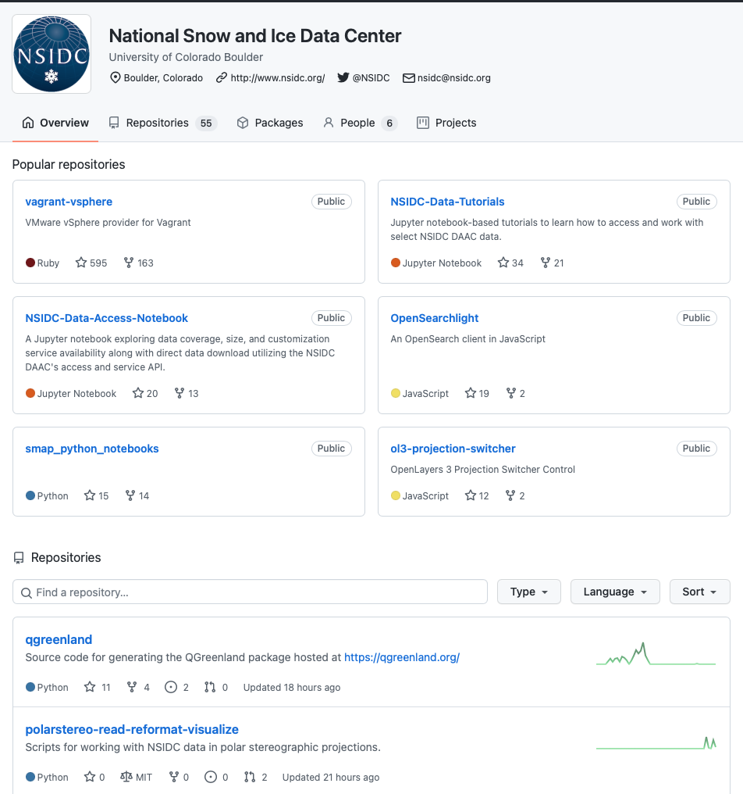
Current NSIDC Open Science activities
Data Use and Education (DUE) team
Participation in Openscapes
Supporting data producers and users through the migration to the cloud
Participation in TOPS (Transition to Open Science)
Open Science curriculum and training for scientists and agencies
Software sharing thru NSIDC GitHub (https://github.com/nsidc)
Data Tutorials
Data Access Notebooks
Data-related Tools
Source code for data and tools

Slide 10
How Can NSIDC help SnowEx achieve its Open Science Goals?

Slide 11
NSIDC, SnowEx, and Open Science
Data publication:
Publishing more raw and unprocessed data so others can reproduce higher level products
18 raw data in total
Have doubled our raw data publications over the past year
NSIDC produces self-describing file-level and data-set-level metadata for all SnowEx products
Helping PIs publish data prior to peer review and article publication
PIs should submit data with their estimated timeline for article publication
NSIDC will pull DOIs immediately (useful for article review)
Will publish data prior to initial peer review if given sufficient (minimum 6-weeks) notice
Data can be updated after its initial publication through the minor or major version update process
Best effort to publish data prior to article publication

Slide 12
NSIDC, SnowEx, and Open Science
Tools and services
Developing more tutorials for SnowEx data sets, tools, and services
Sharing community-produced tools/services (e.g. the SnowEx SQL database)
Collaborating with the snow community on new tools/services (e.g. through Hackweek participation)
NSIDC encourages PIs to submit code alongside data sets
Option 1: NSIDC can advertise to PI’s original code repository
Option 2: NSIDC can publish as part of the NSIDC GitHub for widespread sharing and community access

Slide 13
NSIDC, SnowEx, and Open Science
Knowledge sharing:
NSIDC-produced user guides for all higher-level products
Long-term archive for PI-provided documentation (e.g. tech references, flight plans) and ancillary info (experiment plans, shapefiles, photographs, etc.)
NSIDC offers user support for all SnowEx data sets
Over 1,200 visitors to our SnowEx website in the last year
~65% were first-time visitors!
Translated into 183 unique data users – more than all of 2023
SnowEx continues to grow in popularity amongst NSIDC visitors
NSIDC continues to expand SnowEx offerings and advertise to broad groups
Airborne Field Data Working Group
Monthly Airborne/Earth Venture Suborbital meetings
Generated a lot of Cross-DAAC buzz for SnowEx-airborne data

Slide 14
SnowEx Moving to the Cloud?
NSIDC plans to migrate all current and future SnowEx publications to the cloud beginning in late 2024:
We expect to have the entire mission published in the cloud by mid-2025
No change for data providers or data publication
No change for users – adding services, not taking any away:
Data will always remain free to download
Users will have the option to pay to rent space in the cloud for data processing
Accessing SnowEx data in conjunction with other missions (ICESat-2, MODIS, VIIRS, other airborne campaigns, etc.) will be simpler
All NASA DAACs are migrating = easier to use data from multiple DAACs
NSIDC Cloud Access presentation at the upcoming SnowEx Hackweek
All tutorials will be posted to our website after the fact

Slide 15
Questions?

