Slide 1
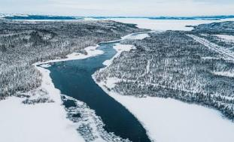
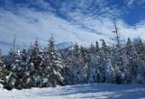
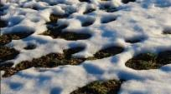
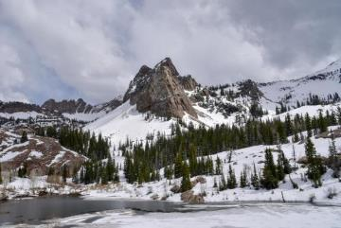

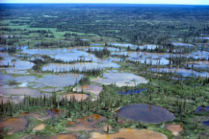
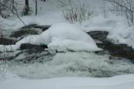
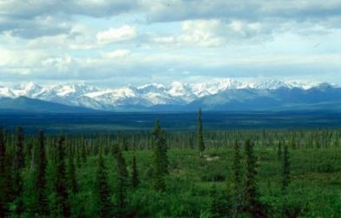
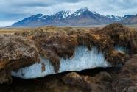
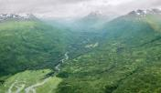
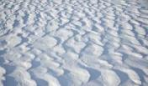
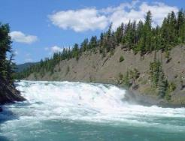
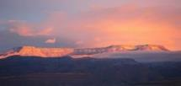
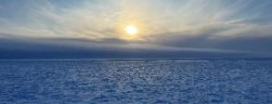
SnowGlobe: A Concept For Global Snow Water Equivalent Observations From Space
Presented by Ana Barros
SnowGlobe Science Team: Ana P Barros (PI), Paul Siqueira (DPI), Michael Durand (DPI), Carrie Vuyovich, Batuhan Osmanoglu, Leung Tsang, Edward Kim, Paul Houser, Dorothy Hall, Hans-Peter Marshall, Mehmet Kurum, Sujay Kumar, Joel T. Johnson, Martin Perrine, Mark Raleigh, Jim Garrison, Michael Goldstein, and Kristine Larson, plus University and Organizational Partners
SnowEx Community Call
July 18, 2024

Slide 2
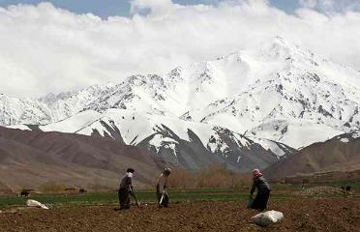
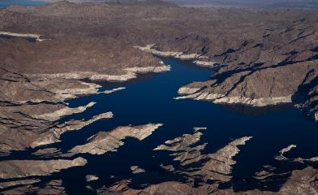
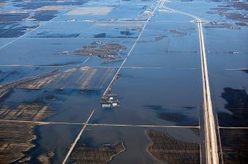
Snow
is a vital source of water for billions of people
is a major moderating force opposing climate warming
contributes to widespread disasters
~ $30-$50 Billion/event
Notes:
Seasonal snow is an important source of water, helps cool our planet and also contributes to widespread disasters.

Slide 3
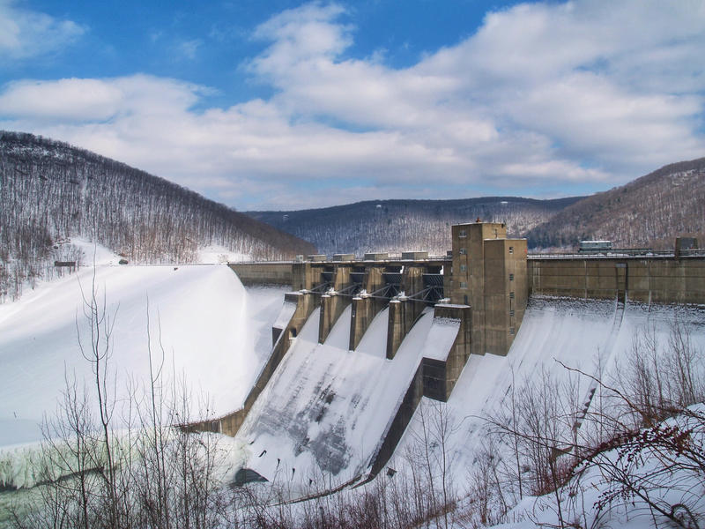
Water Availability
Snow is a source of water for ~2 billion people
Water Supply
Agriculture
Hydropower
Industrial Use
The estimated value of snow to the global economy is on the order of trillions of dollars. As snow changes, a better understanding is critical for management decisions.

Slide 4
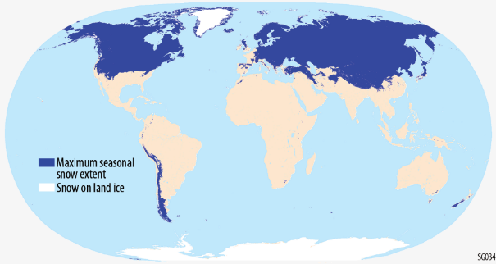
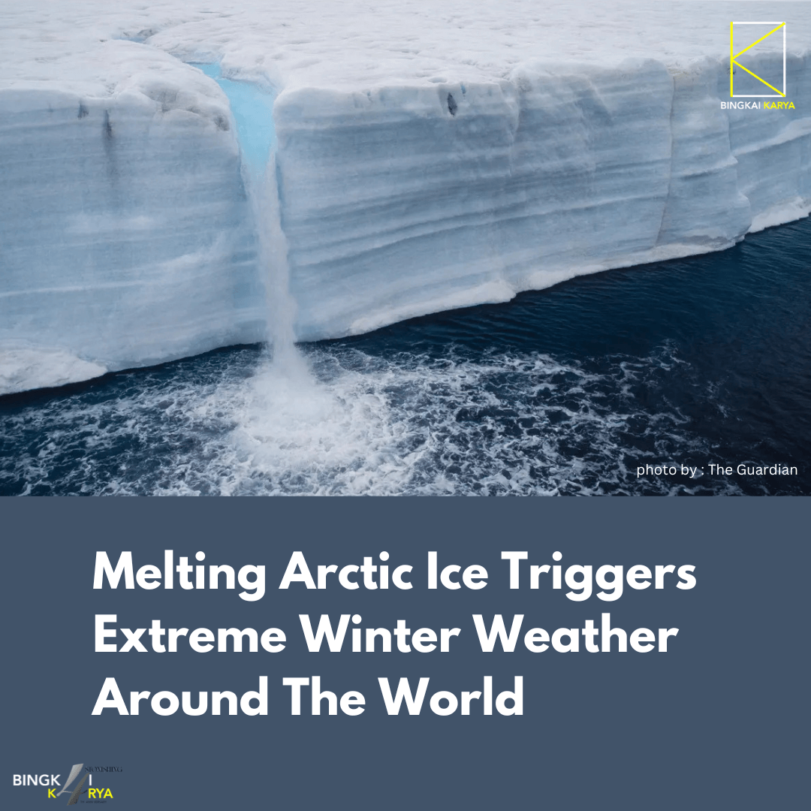
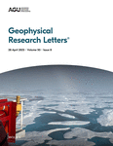
Energy Balance
Snow plays a major role in modulating
weather and climate
Covers vast areas of land surface each winter and reflects up to 85% of incoming solar energy
Land-Atmosphere Interactions impact regional and global water cycle via teleconnections

Slide 5


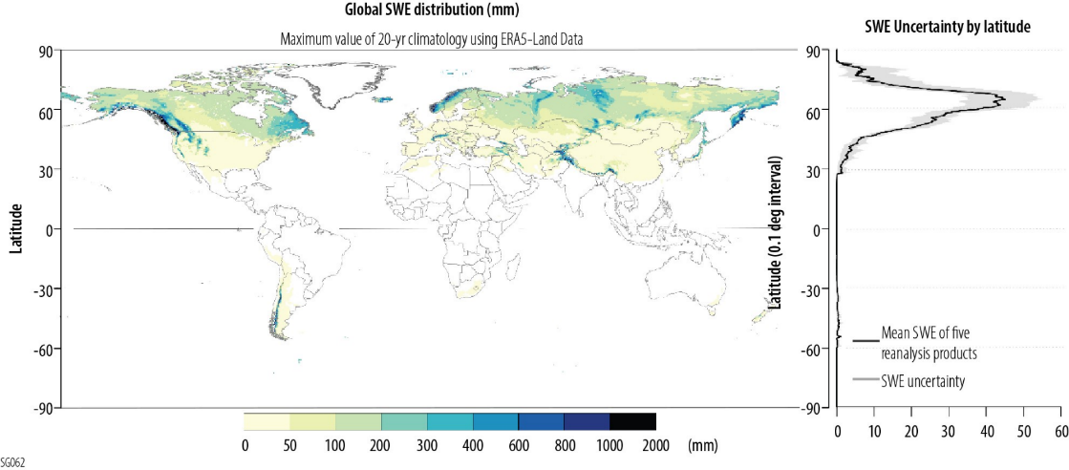
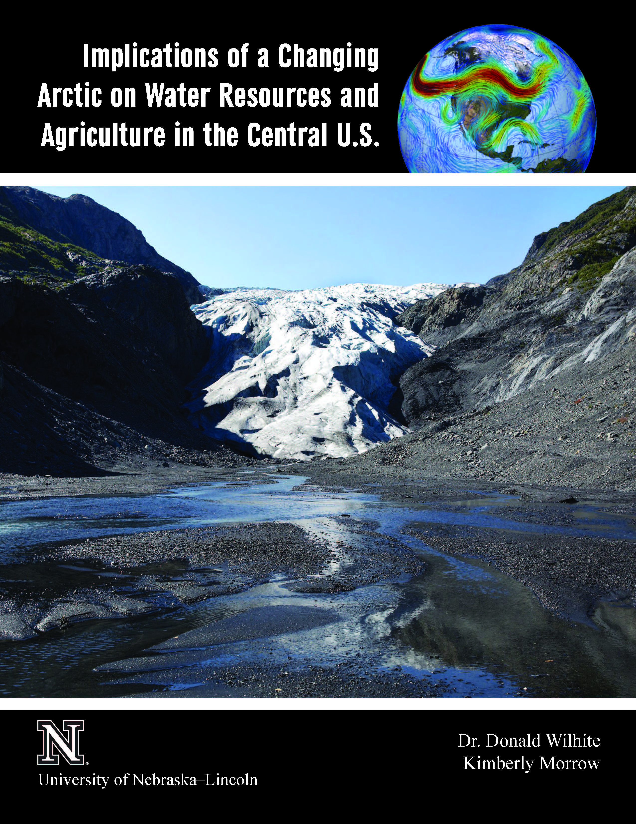
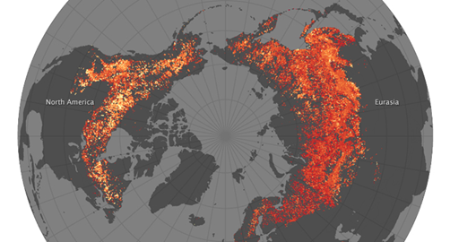
What measurements do we need?
The Decadal Survey ranked the development of an Integrated Earth System analysis as Most Important
Global Observations of SWE and onset of melt
Frequency to capture snow accumulation and melt events
Resolution to match spatial heterogeneity of snowpack processes
SWE by latitude
When do we need them?
We need them NOW.
The majority of SWE exists above 45 N, and more than 50% of global SWE is above 60 N.
Wildfires
Sentinels of Change
ERA5, 5 mm/day threshold

Slide 6
https://snowglobe.illinois.edu/
SnowGlobe is a constellation of X (9.6 GHz) and Ku (17.2 GHz) band SAR sensors to measure global SWE and melt onset.
Product Resolution 250 m
Frequency 5-day maximum revisit
Global coverage > 95% seasonal snow extent
SWE Uncertainty < 20% for SWE > 50mm and < 800mm; +/- 10mm for SWE < 50mm
Product Level | Data Products
L0/L1 | SAR Data
L2/L3 | Snow Water Equivalent Onset of Snow Melt
L4 | Data Assimilation Output (e.g., SWE, sublimation, melt, runoff, etc.) -- Earth Information System (Digital Twin of Earth)

Slide 7

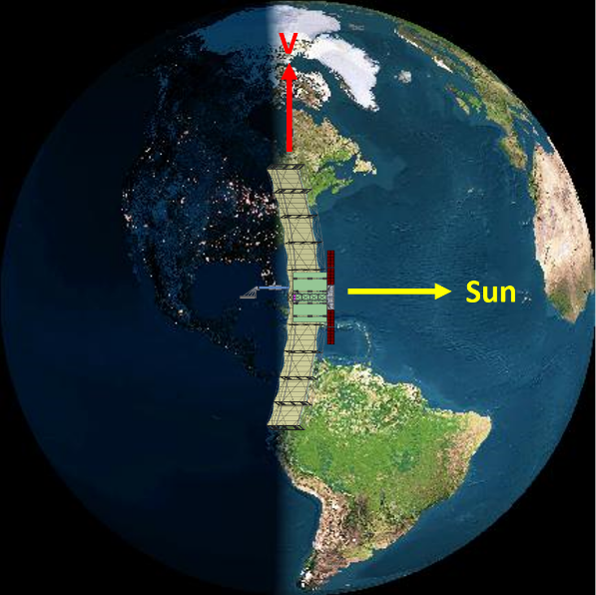
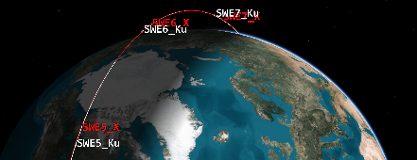
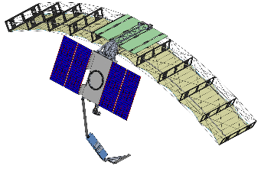
SnowGlobe Mission Architecture
Partnership between multiple universities, NASA Goddard and Capella Space
Pairs of X-Band (9.6 GHz) and Ku-Band (17.2 GHz) satellites
Initially 5 pairs (10 satellites) – can expand easily over time
Observing same area on the ground with no more than 10 min delay
Circular SSO 6am/6pm orbits enable observation before dawn (melt)
Near-Identical platform allows economies of scale and simpler design
Large reflector design coupled with high power → very good NESZ
High TRL due to heavy reuse of proven / tested technologies
Leveraging all of Capella SAR investments and Capella ground automation
Leveraging other ongoing technology: SNOWWI; SWESARR; SnowSAR
Radar Parameters:
X-Band & Ku-Band - VV & VH
< 50m resolution
10 x 1 m Reflector
400 W (X) / 800 W (Ku) Peak Tx Power
NESZ -32 to -23 dB (X) / -25 to -20 dB (Ku)
Radiometric uncertainty +/- 0.5 dB
~ 30% max orbital duty cycle

Slide 8
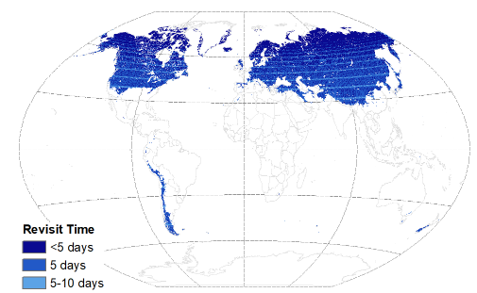
SnowGlobe Constellation
The constellation design provides flexibility and resiliency in performance
Meets the coverage requirements with graceful degradation and scientific benefit at all levels
90%
graceful degradation
% Max Seasonal Snow Extent
Days between Repeat Observations
The full constellation provides at 5-day maximum revisit frequency over 95% of the maximum snow extent (1-4 day revisit times over Canada)
A constellation provides flexibility in both spatial and temporal coverage that will enable the collection of global SWE data

Slide 9
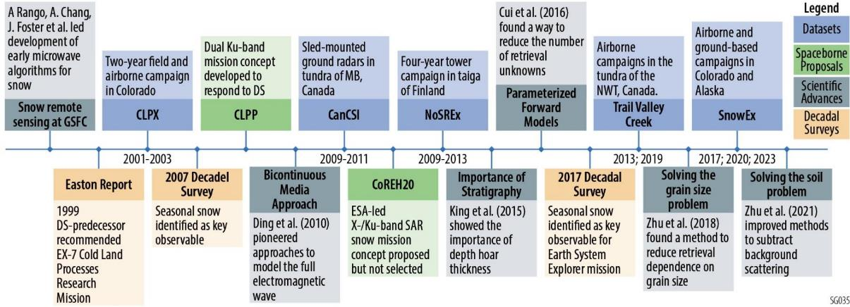
Retrieval of SWE from X- and Ku-backscatter: History & Maturity
Most mature SWE retrieval method available
Multiple field campaigns, in different snow types and instruments
Decades of research and analysis by the entire community
At least fourteen papers been published, with steady progress made discovering and solving challenges
CoReH2O helped pioneer new field measurements and motivate the research community
Recent review paper (Tsang et al. 2022, The Cryosphere) details this progress

Slide 10
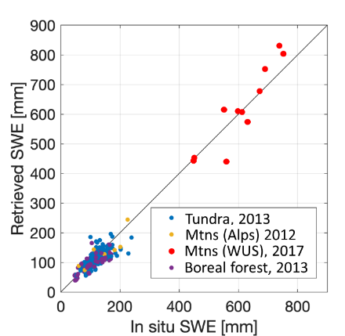
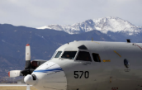
SnowGlobe SWE Retrieval Algorithm
Baseline SWE retrieval product has been validated with airborne & tower datasets
Validated using 9 datasets (five airborne and four tower datasets) with SWE ranging from 50 to 750 mm.
SWE retrieval algorithm uses a parameterized radar backscatter model for X- and Ku-band, derived from the bi-continuous Dense Media Radiative Transfer (bicDMRT) model and subtracting the surface scattering component from the data.
Algorithm improvements reduced the requirement for detailed ancillary information on snow microstructure.
X- and Ku-band SAR data allows for SWE retrieval in both shallow and deep snow regimes, which includes over 95% of the Earth’s snow-covered landscape
Algorithm will be used to produce the mission’s Level 2 SWE products.
Zhu et al. 2018, doi: 10.1109/TGRS.2018.2848642
Zhu et al, 2021, https://doi.org/10.1029/2020WR027563
Durand, M., et al, 2023, https://doi.org/10.5194/egusphere-2023-1653, 2023.
Singh, S., et al,. 2023, https://doi.org/10.5194/egusphere-2023-1987, 2023
Airborne retrieval results demonstrating X- and Ku-band SAR systems allows for SWE retrieval in both shallow and deep snow regimes
10

Slide 11
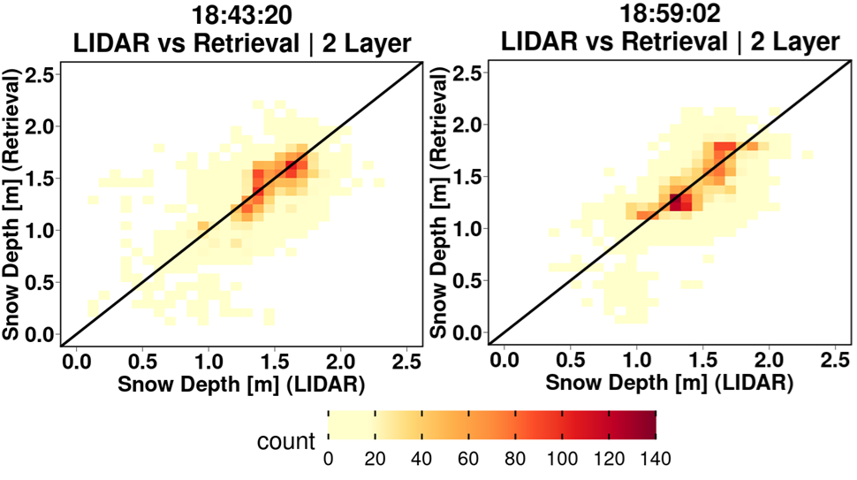
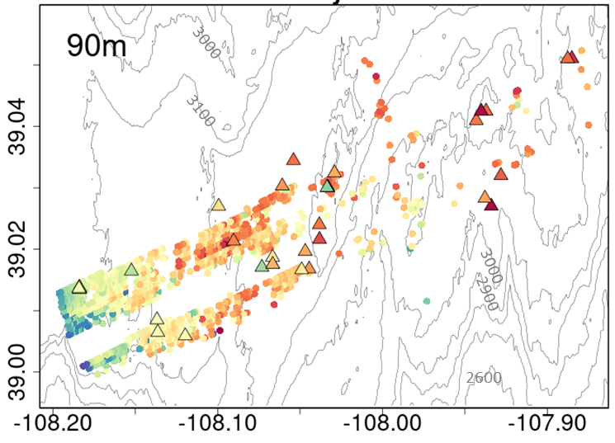
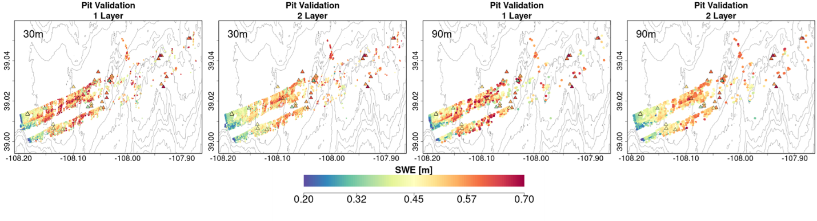
Airborne SAR Demonstration
SWE Retrievals
SnowSAR Snow Depth Retrievals
Bayesian Retrievals using a 2-layer snowpack
using MSHM priors driven by NWP (grassland pixels)
Singh et al., (2023, 2024)
Average Relative SWE Difference @ Snowpits < 12 %
Maximum Relative SWE Difference @ Snowpits < 18%
Data Assimilation SWE bias reduction from > 20% to < 3%

Slide 12
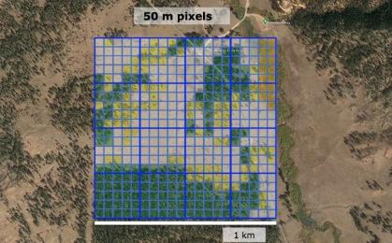

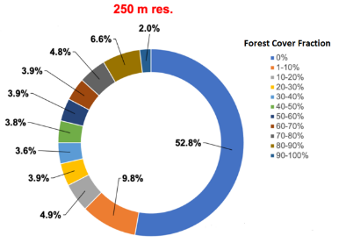
Solution for SWE retrieval in forests
High imaging resolution SAR will be used retrieve SWE in and around forested areas
Snow in forests plays a crucial role in ecological processes and forest health
Variation in forest structure for boreal regions occurs at a hectare (100 m x 100 m) scale
By aggregating the native footprints in open areas we can retrieve SWE in pixels with a forest cover fraction of 50% or less. This represents 79% of the snow-covered landscape
For the 21% of global snow cover that is in dense forests, we will leverage the NASA Land Information System (LIS) and use data assimilation to estimate SWE in forested pixels
79%
Global snow cover distribution by forest fraction at 250 m resolution, calculated using 30m GLAD data.
12

Slide 13

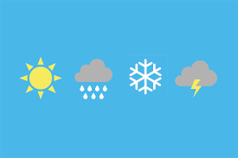







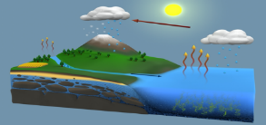
NASA Land Information System
NASA GSFC maintains state-of-the-art terrestrial hydrology modeling systems, specifically designed to incorporate information from remote sensing observations
Terrestrial hydrology
applications
NWP
Water Availability
Water Quality
Food security
Hazards and Extremes
Mission development,
science-data processing
Science/research
Improved quantification of terrestrial water budget components and their variability
Observation System Simulation Experiments (OSSEs), Development of higher level science data processing systems.

Slide 14
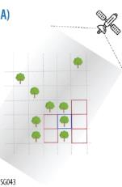
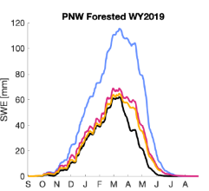
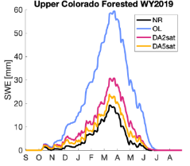
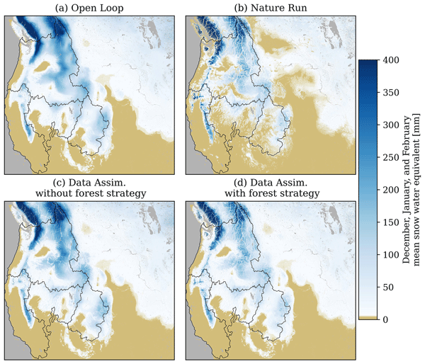
NASA LIS Observing System Simulation Experiment (OSSE)
LIS enables the development of higher-level science products from SnowGlobe
OSSE conducted over Western US. Significant improvement shown:
In forested basins
In spring and early-summer periods
Improvements between the open loop simulation and simulation with data assimilation employing the forest strategy over the domain:
Total annual streamflow over the Western U.S. domain was improved to within 1%
Pearson correlation improved from 0.74 to 0.90
Pflug et al. 2023, https://doi.org/10.5194/egusphere-2023-1603

Slide 15

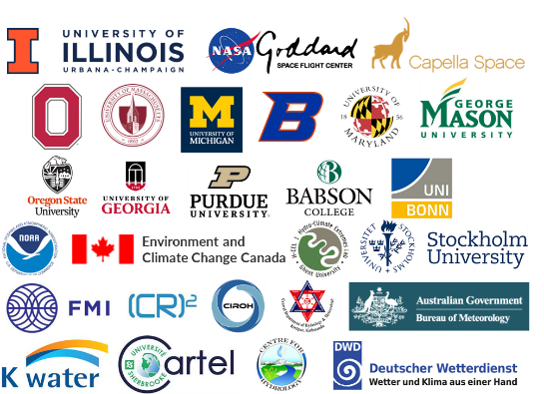


























https://snowglobe.illinois.edu/
Environment and Climate Change Canada

Slide 16
Outcome

Slide 17
1 – Review Science

Slide 18
2 – Review TMC
Limited, Minimal, Very Minimal, Likely
management/cost: reserves

Slide 19


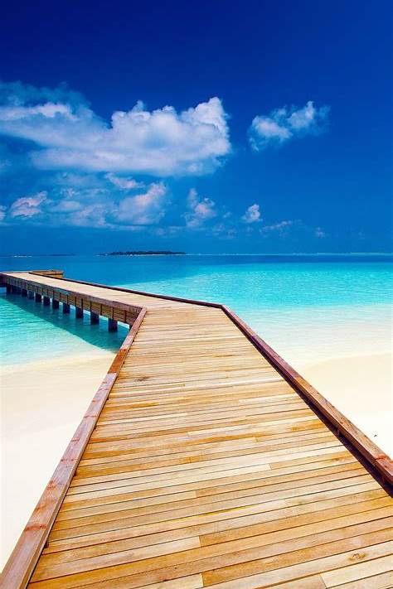
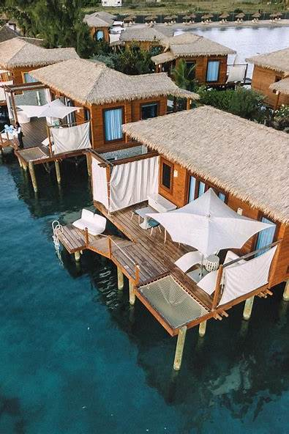
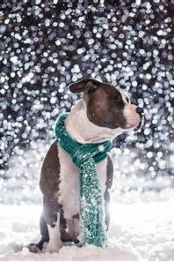
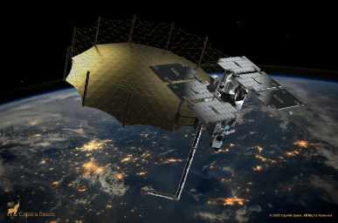

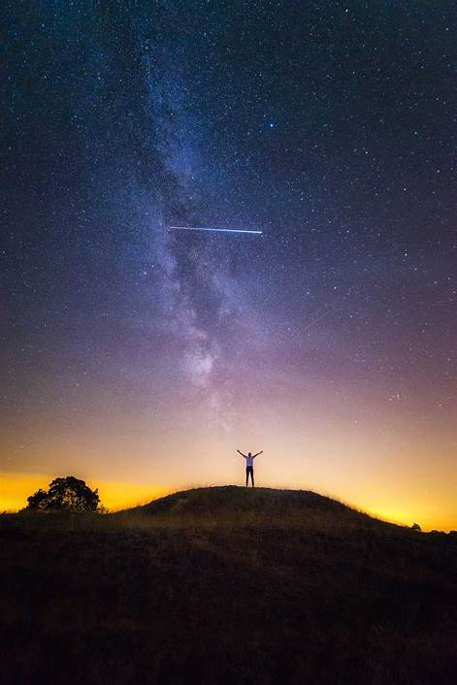
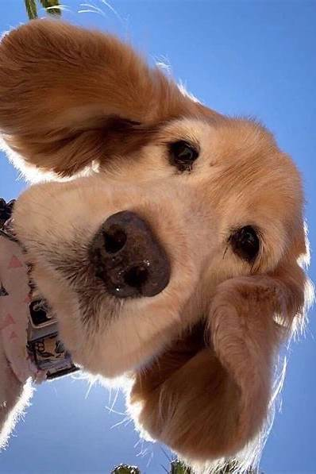
Selectable Proposals: Cat 1, Cat2, and Cat3
Selection Statement
Selected (Phase 1)
STRIVE (UW/GSFC) – Cat 1
Carbon-I (JPL) – Cat 1
EDGE (UCSD/GSFC) – Cat 2
ODYSEA (UCSD/JPL)- Cat 3
Nonselected
CarbonFOX (Columbia) – Cat 1
STRATUS (JPL)- Cat 2
SnowGlobe (UIUC/GSFC) – Cat 2
The World Economic Forum (weforum.org), April 2024
NewSpace Paradigm Shift
Previously, all deorbits have been the result of increased drag. Capella’s C14 satellite has proven out a new propulsion system that has 15x more deltaV. They have shown that they can acquire and maintain a frozen orbit with it and the system will allow an orbital life of up to 6 years.

Slide 20
