Slide 1













A Mission Concept for Measuring Mountain Snow Using P-band Signals of Opportunity: SnoWatch
Steve Margulis, Jessica Lundquist, Simon Yueh, Elias Deeb, Jeff Dozier, Kelly Elder, Dara Entekhabi, Manuela Girotto, Ethan Gutmann, Adrian Harpold, Mimi Hughes, Dennis Lettenmaier, Dongyue Li, Glen Liston, Keith Musselman, McKenzie Skiles, Rashmi Shah, Xiaolan Xu
NASA Community Snow Meeting (Boulder, CO)
14-15 August 2024

Slide 2
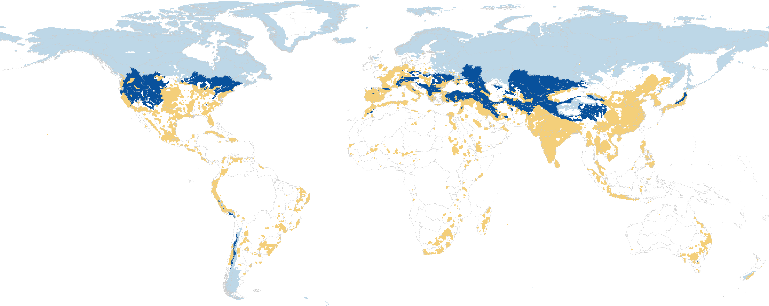

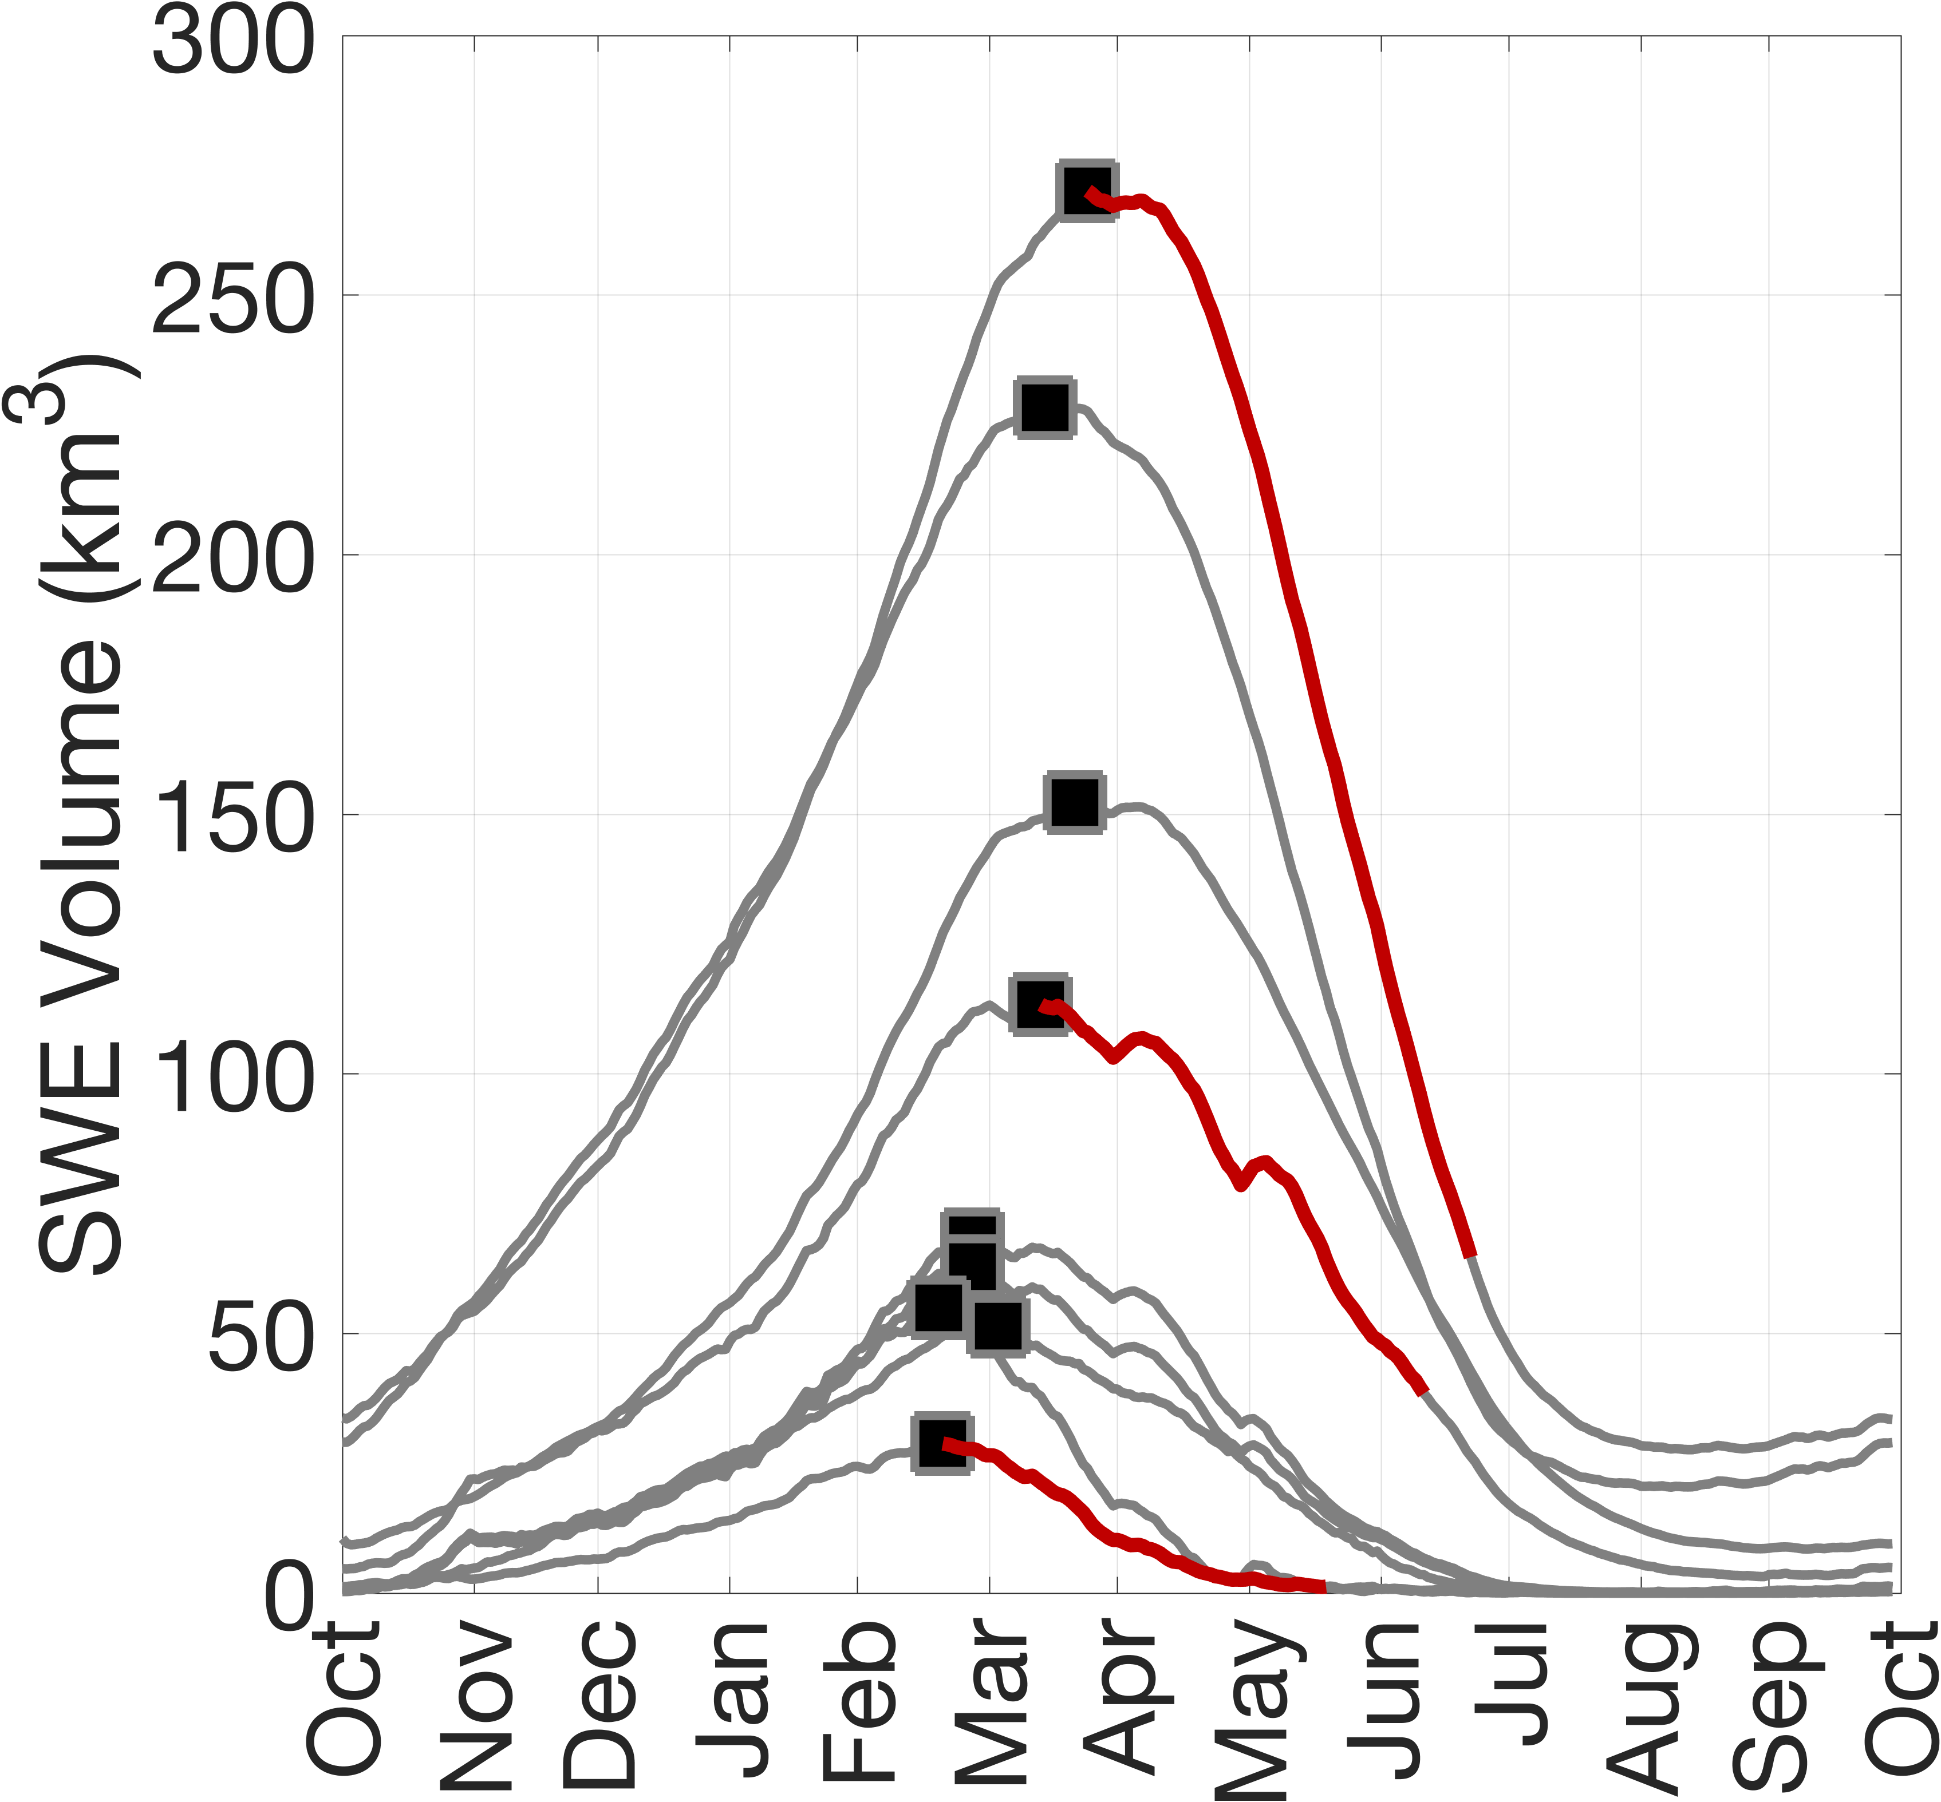
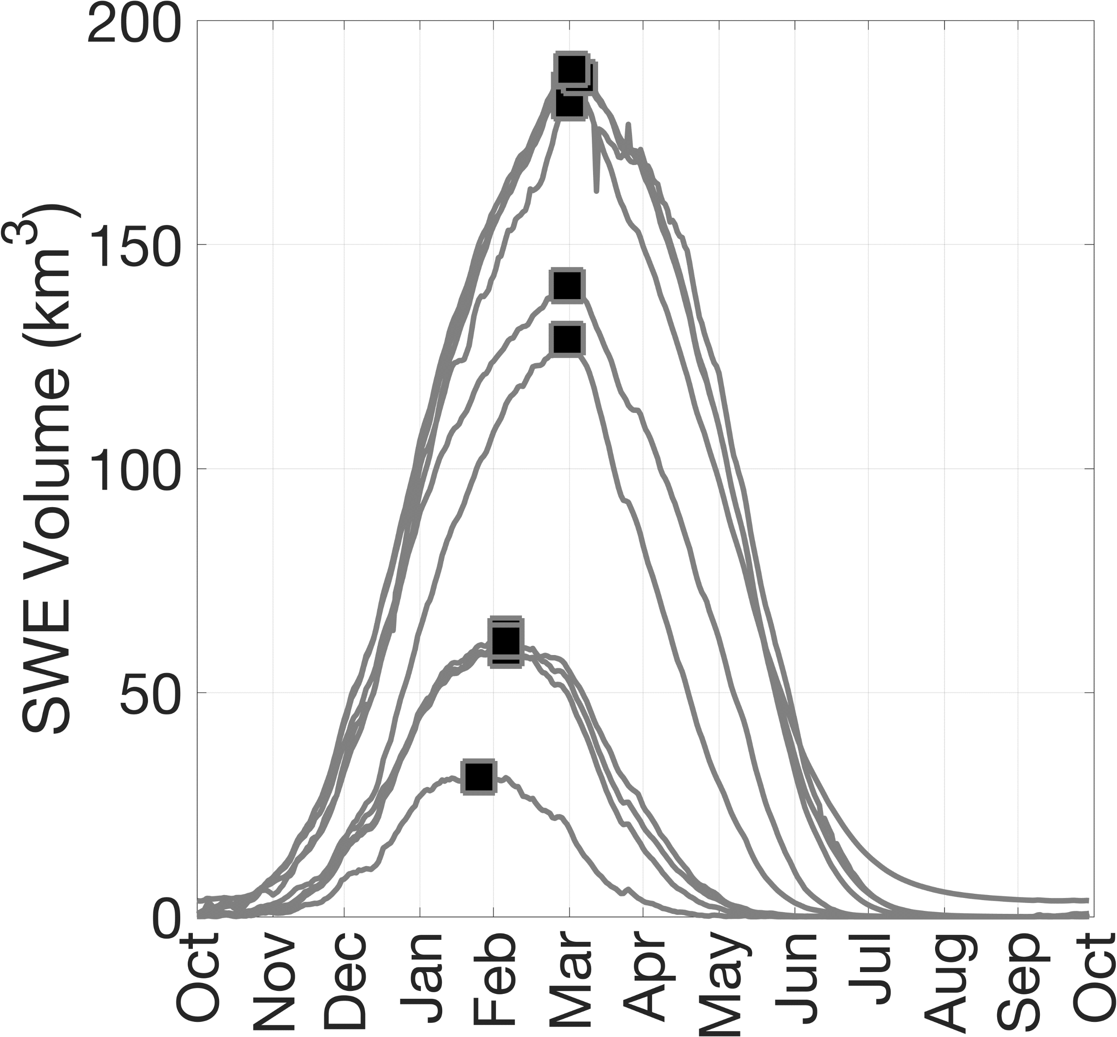
Need for mountain SWE measurements
SnoWatch_002
~5x Lake Mead
~1x Lake Mead
Lake Mead holds ~35 km³ of mostly snow-derived water, sustaining over 20 million people and over 5 million acres of farmland
High human water use areas
Reputable estimates of average water stored in Western U.S. mountain snow show large uncertainty in peak SWE volume
[Fang et al., 2023]
Snow areas upstream of high water needs
Reputable estimates of average water stored in High Mountain Asia span an even wider range than WUS and highlight the large uncertainty in timing and rate of spring melt
[Liu et al., 2022]
Snow areas not upstream of high water needs

Slide 3
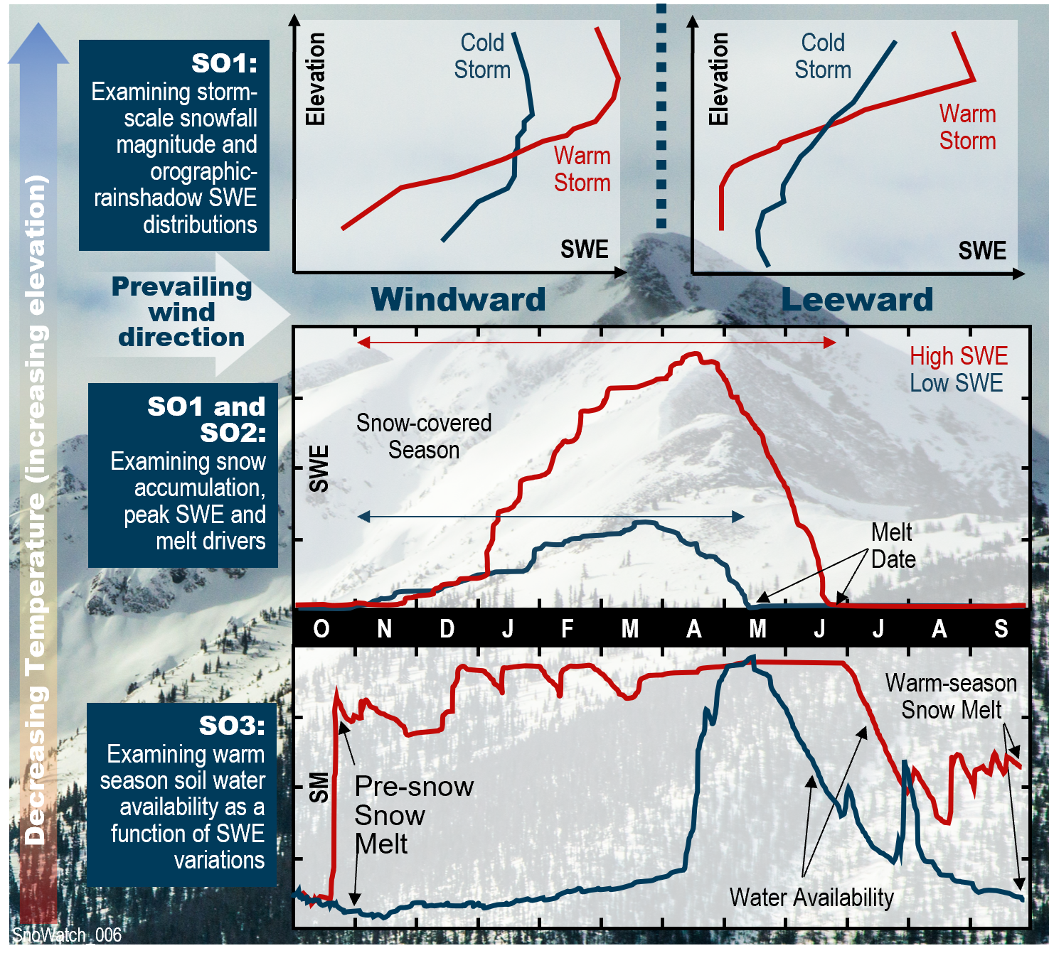
SnoWatch Science Goal and Objectives
Goal: To understand why, when and where mountain snow accumulates and melts, and how these rates and spatial patterns contribute to the water cycle from headwater catch­ments to continental-scale river basins.
Science Objective 1 (SO1): | Determine how snowpack accumula­tion processes depend on terrain and synoptic meteorology.
Science Objective 2 (SO2): | Determine how snowmelt rates depend on snow albedo, elevation, peak SWE, synoptic meteorology, forest cover, and snowmelt timing.
Science Objective 3 (SO3): | Determine how warm-season water availability depends on pre-snow soil moisture, peak SWE, and snowmelt, as a function of elevation, terrain, and vegetation cover.

Slide 4
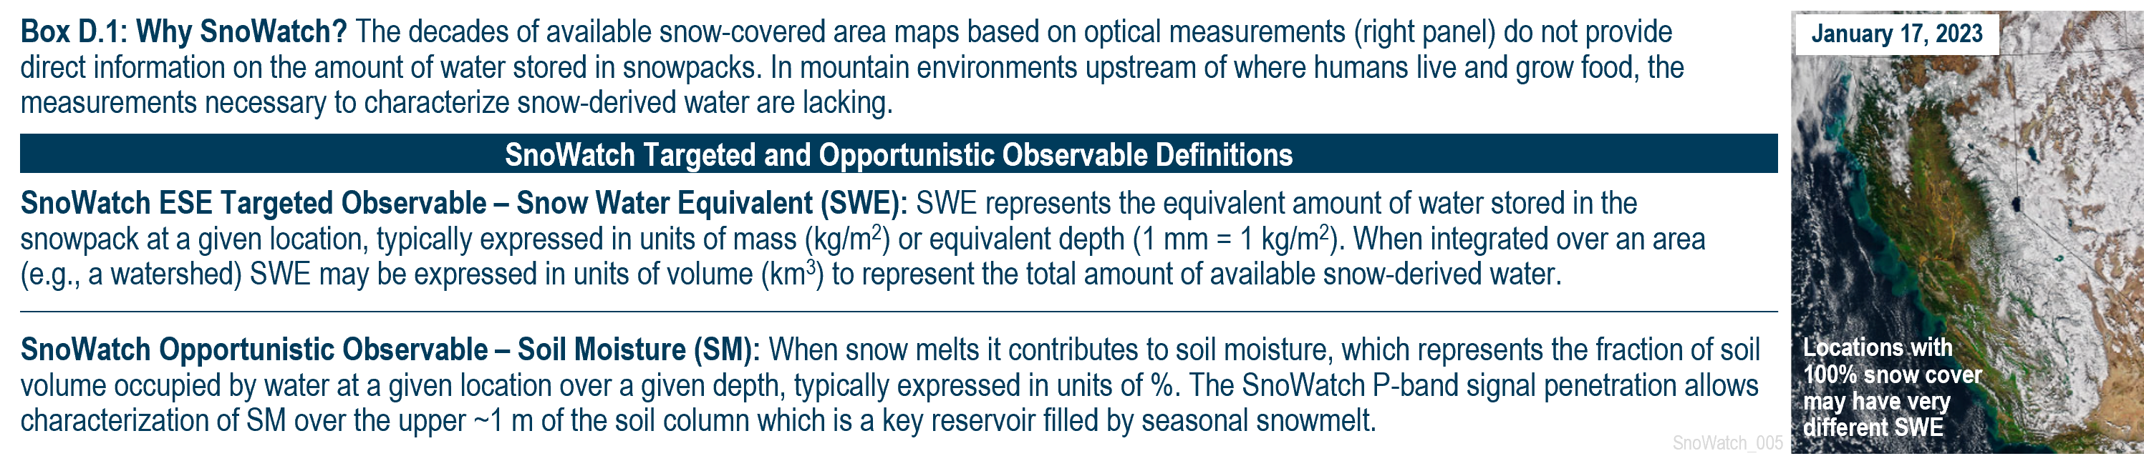
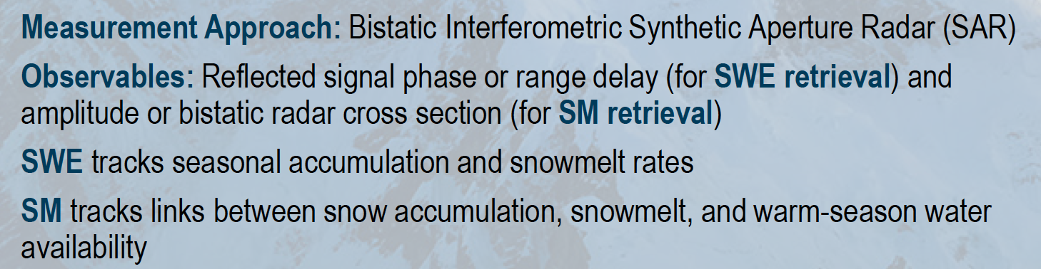
SnoWatch Observables

Slide 5
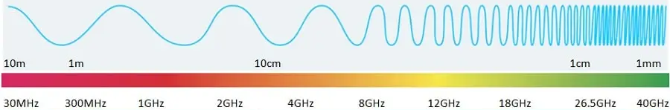
Microwave wavelengths useful for SWE retrievals
VHF-band
UHF-band
L-band
S-band
C-band
X-band
Ku-band
K-band
Ka-band
P-band
Adapted from: https://www.rfpage.com/microwave-frequency-bands/
FM Radio, TV
TV, Radio astronomy, Mobile phones, Military comm.
Telemetry, GPS/GNSS, Air traffic control radar
Weather radar, surface radar, 5G networks
Long-distance radio telecom.,
Wi-Fi
Satellite comm., Radar
Satellite comm., Radar
Radar, Astronomical obs.
Satellite comm.,
SnoWatch NASA ESE concept
(P-band)
NISAR, ROSE-L
(L-band)
Sentinel-1
(C-band)
SnowGlobe NASA ESE concept
(Ku-/X-band)
TSMM (CSA) concept,
(Ku-band)
Snow changes cause phase shift in incident waves
Snow causes volume scattering of incident waves
Snow-relevant active microwave missions or mission concepts

Slide 6
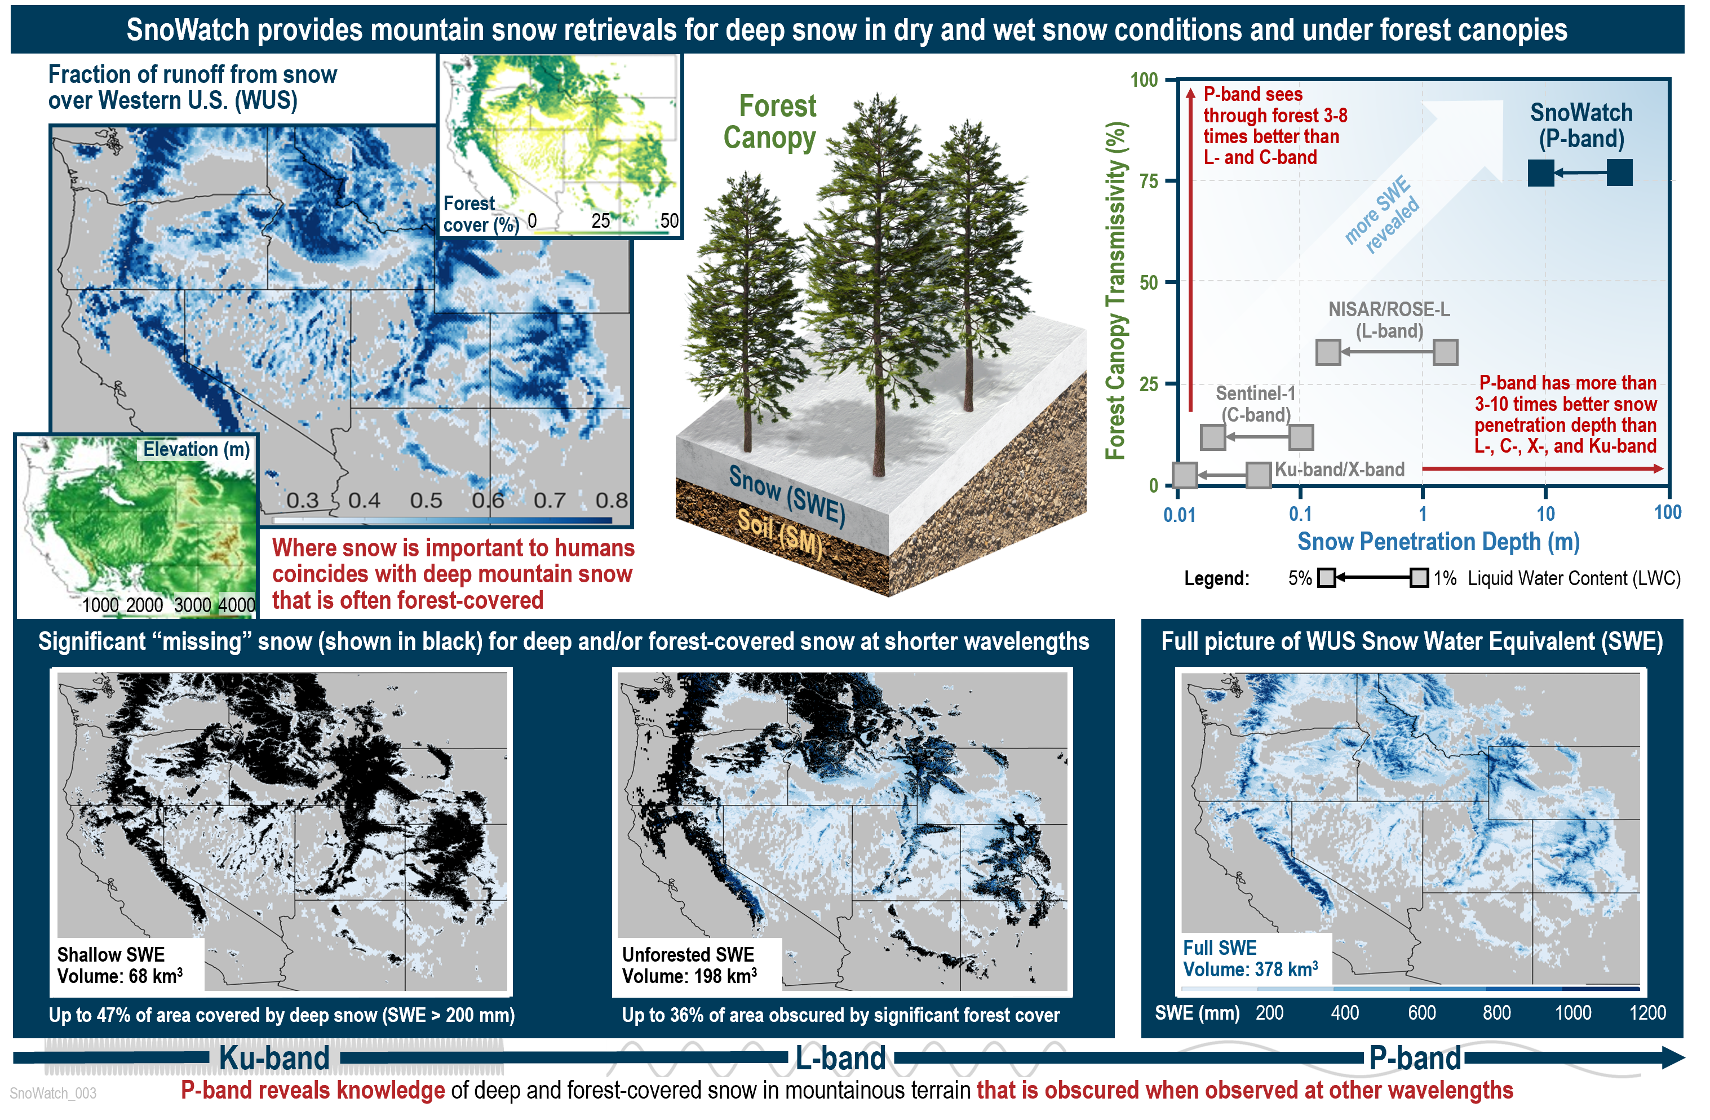
Why P-band?: Benefits of longer wavelengths

Slide 7
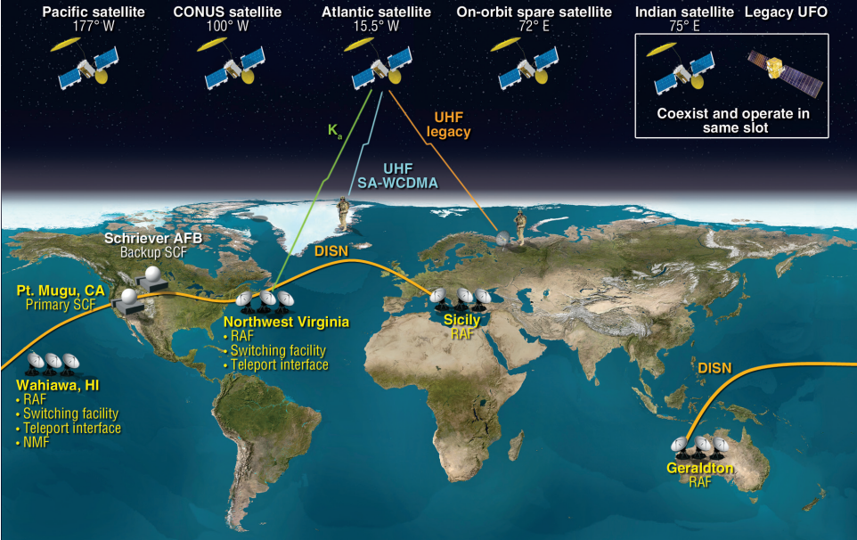
Why P-band?: A Signal of Opportunity (SoOp)
MUOS (U.S. Military) Signal of Opportunity
Four geosynchronous communication satellites: allows global coverage up to +/- 60 deg. latitude
P-band (240-400 MHz): designed for all-weather, all-terrain, and penetration through dense foliage
Stable long-term signal (since 1978)
Image: JOHNS HOPKINS APL
Provides a existing and “free” transmitter with signal in band that is otherwise difficult to use for earth science due to RFI → passive SoOp receivers with active radar benefits

Slide 8
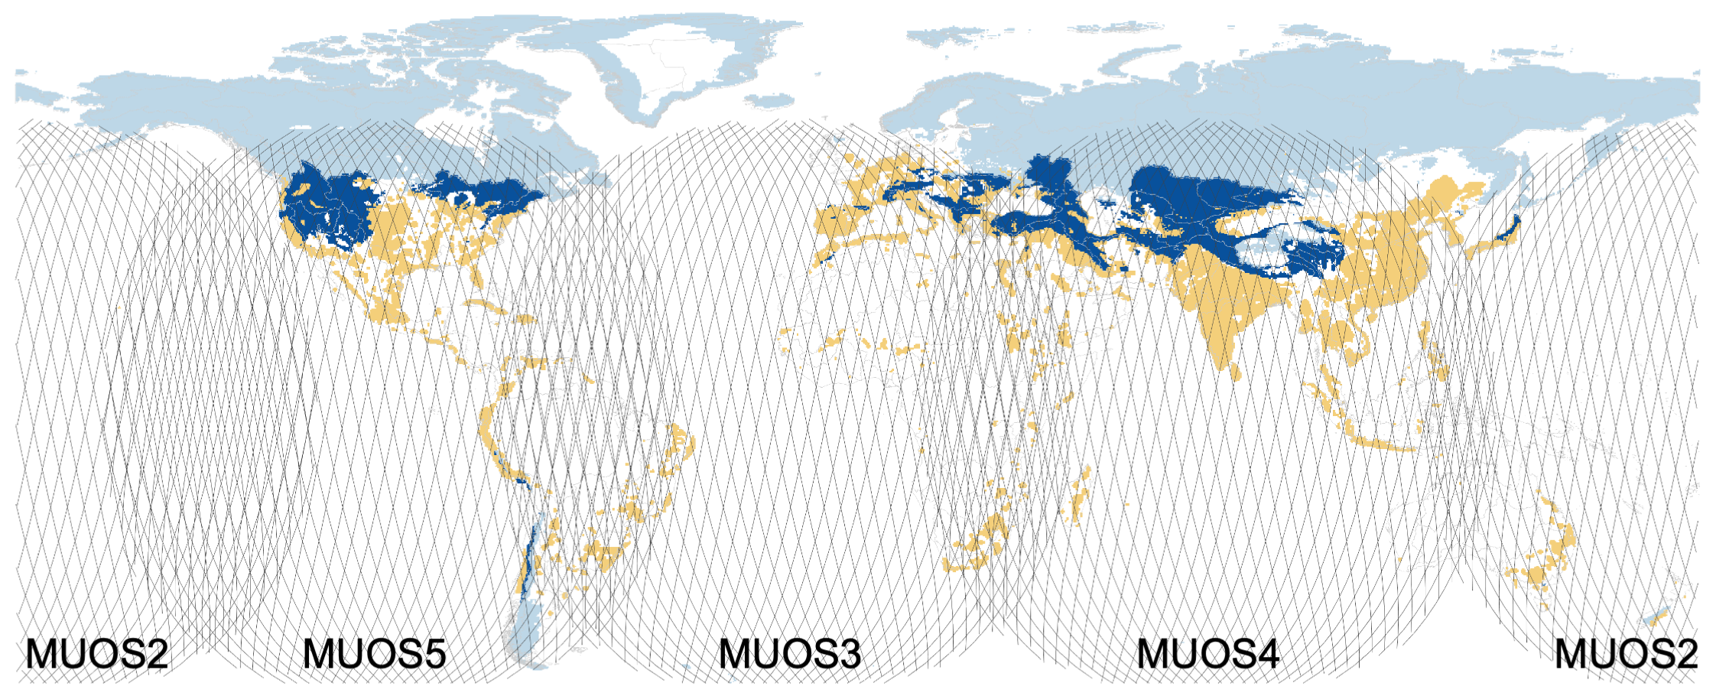
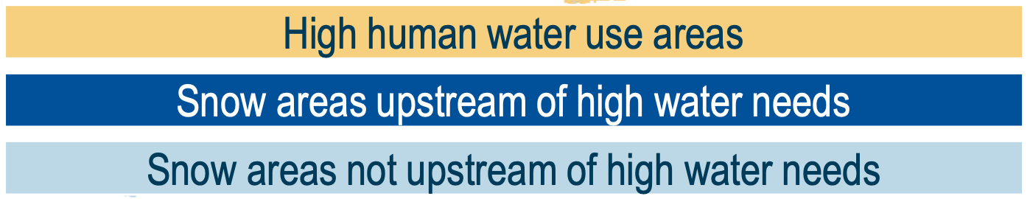
Signals of Opportunity + LEO receivers can cover global mountains

Slide 9
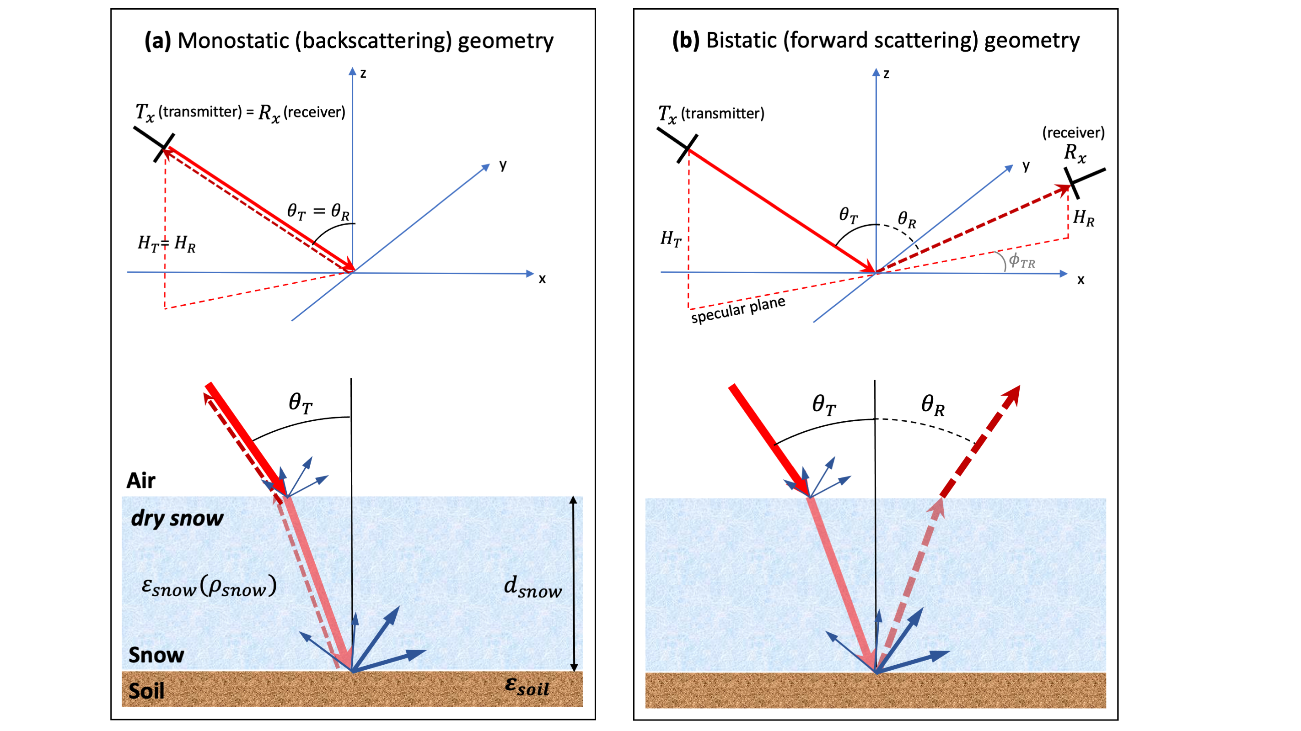

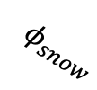





Measuring reflected signal: Interferometric SAR (InSAR)
(e.g., Sentinel-1, NISAR, ROSE-L)
$$R_{x}$$
$$φ_{snow}$$
(e.g., SnoWatch)
reflected signal on Day n (e.g. snow-off)
reflected signal on Day m (e.g. snow-on)
$$φ_{snow}=−2k_{0}d_{snow}\left[\cos\left(θ_{T}\right)−\sqrt{ε_{snow}−\sin^{2}(θ_{T})}\right]$$
SnoWatch uses same physical basis for SWE retrieval as backscattering approaches proposed and validated over ~ 2 decades
$$H_{T}=transmitter height$$
$θ_{T}=transmitter zenith incidence angle$
$φ_{TR}=transmitter−receiverspecular plane azimuth angle$
$$H_{R}=receiver height$$
$θ_{R}=receiver zenith incidence angle (={ θ}_{T} for specular plane measurements)$

Slide 10
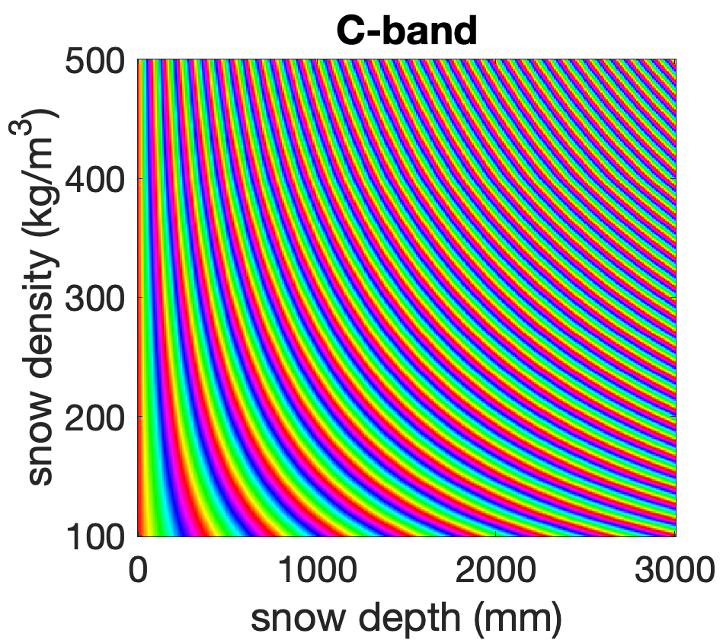
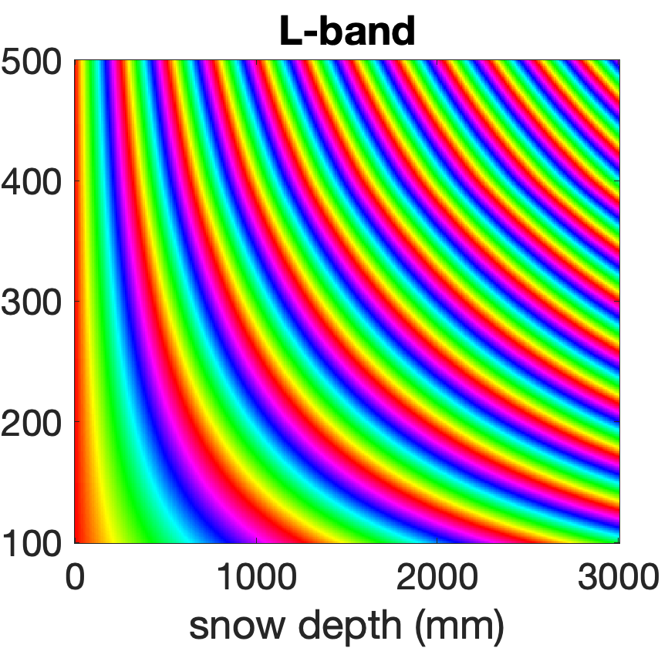
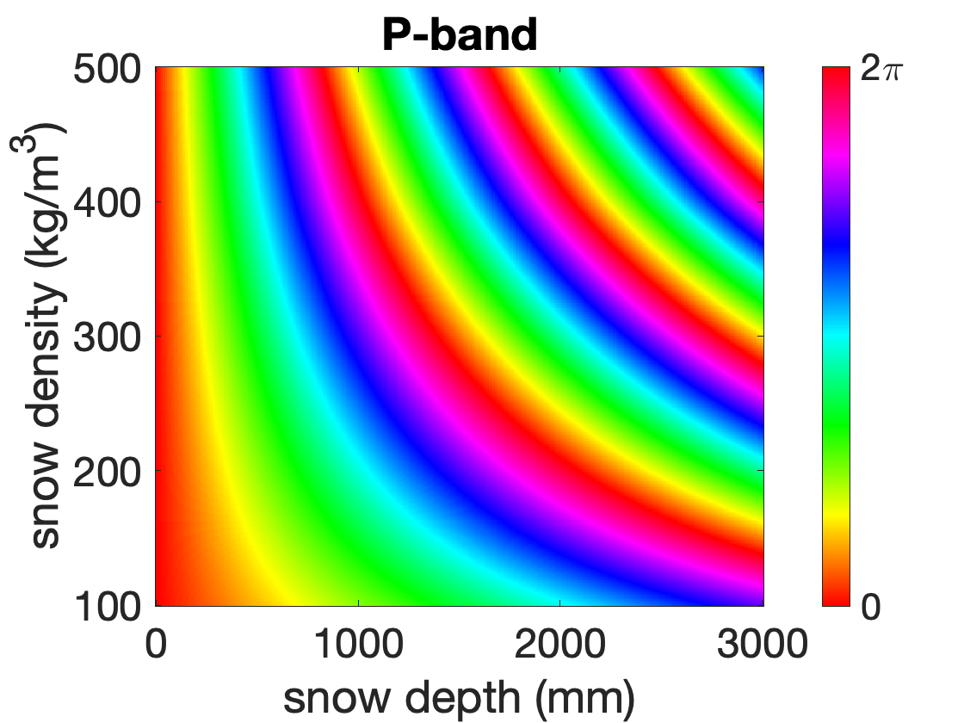







Interferometry: Phase wrapping (and benefits of P-band)
A $2π$ phase delay corresponds to a wavelength-dependent SWE change.
$$φ_{snow}=−2k_{0}d_{snow}\left[\cos\left(θ_{T}\right)−\sqrt{ε_{snow}−\sin^{2}(θ_{T})}\right]$$
$φ_{snow}$ (C-band)
$φ_{snow}$ (L-band)
$φ_{snow}$ (P-band)
$$\left(\frac{40 mm SWE }{2π rad}\right)$$
$$\left(\frac{120 mm SWE }{2π rad}\right)$$
$$\left(\frac{400 mm SWE }{2π rad}\right)$$
Implications:
Longer wavelengths introduce less phase wrapping ambiguity due to SWE changes (and improved coherence between scenes)
Phase wrapping errors can be mitigated by using successive pairs of measurements (with smaller SWE changes)

Slide 11
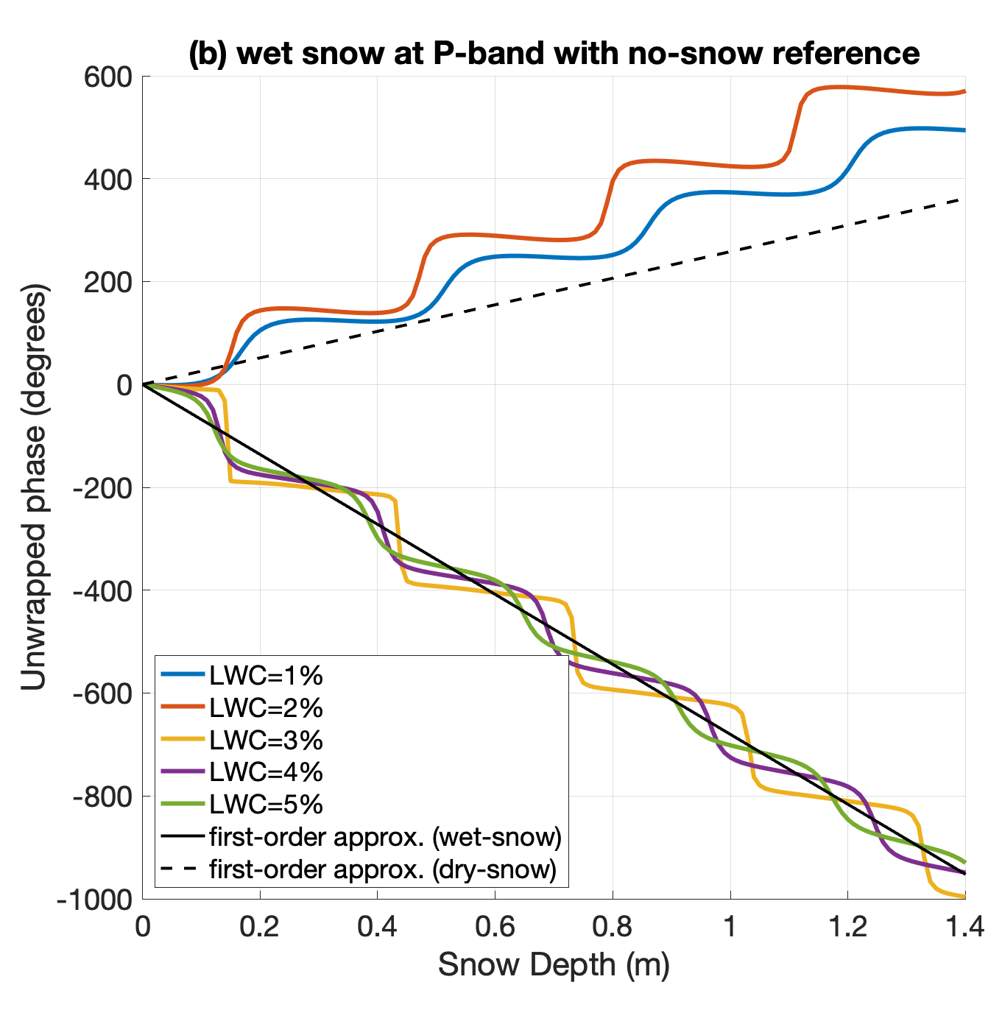





Interferometry: Wet snow
When snow become sufficiently wet the snow layer becomes opaque and the bulk of reflected signal comes from surface
Measurable phase shift ($φ_{snow}$) related to changes in height of snow-air interface (snow depth)
$$θ_{T}$$
$$θ_{R}$$
Air
wet snow
Snow
Soil
$$φ_{snow}=−2k_{0}d_{snow}\cos\left(θ_{T}\right)$$
Reflection from wet snow surface

Slide 12
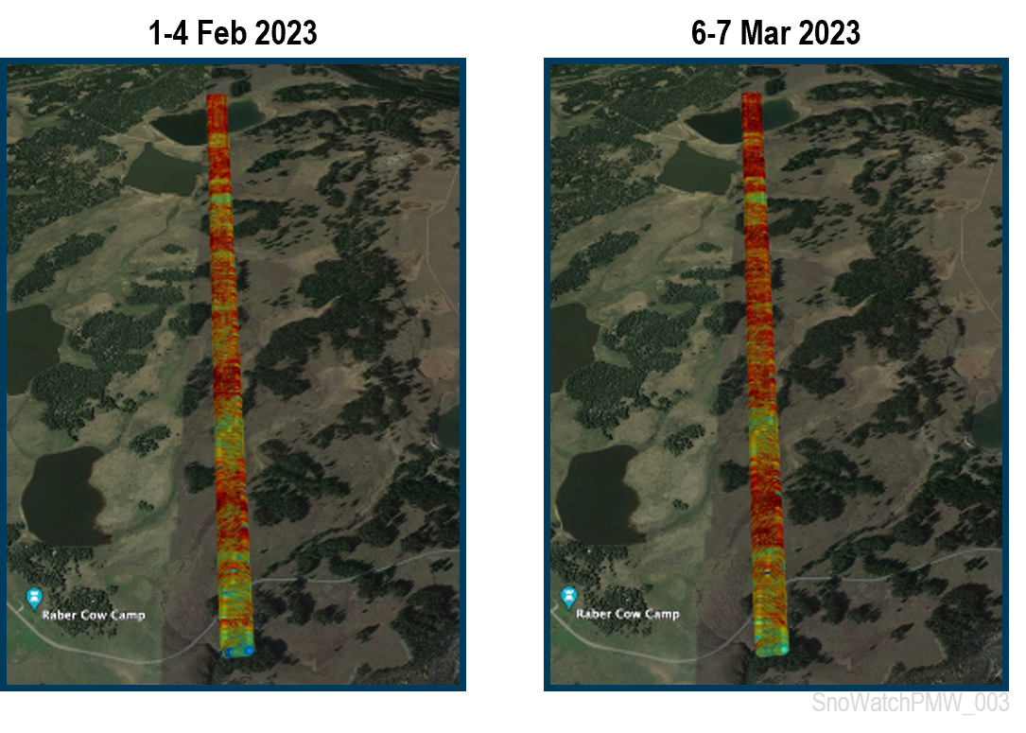
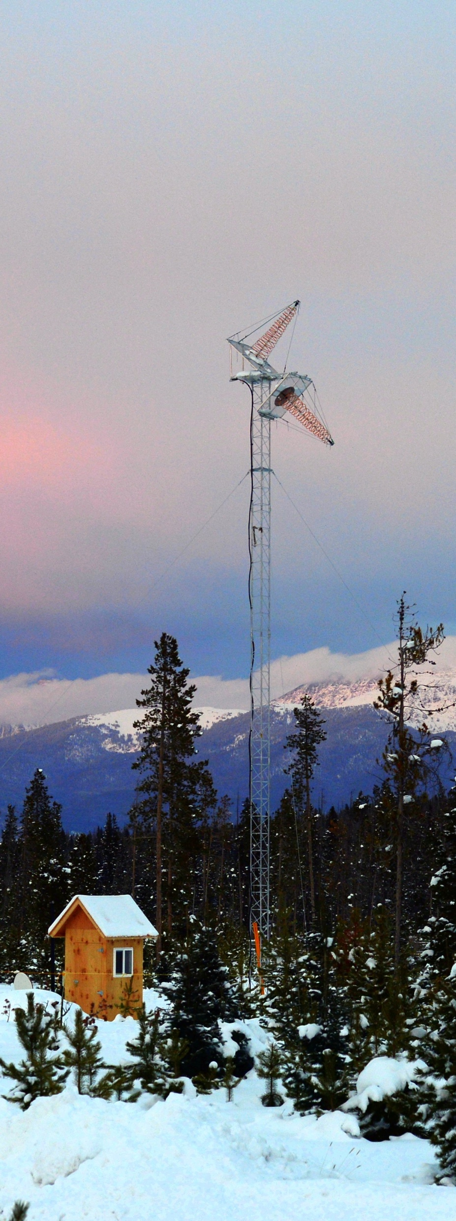
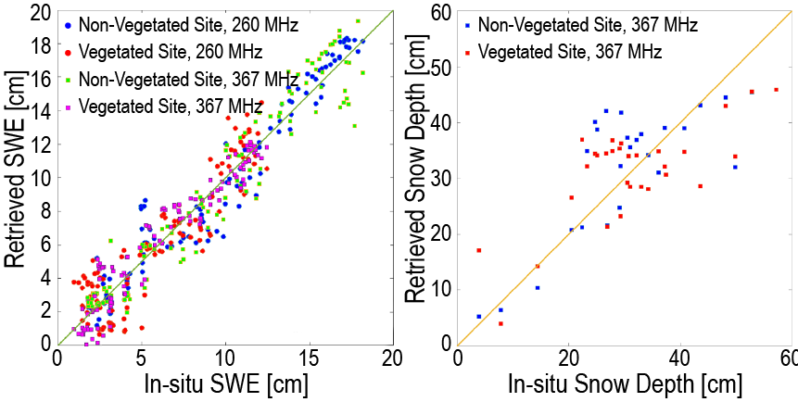
P-band SWE and snow depth retrieval: proof-of-concept
Airborne campaign over Grand Mesa, CO and Sierra Nevada, CA
Multi-year tower-based implementation at Fraser, CO for two sites: open and with trees
Dry-snow SWE retrieval
Wet-snow SD retrieval
bistatic reflection intensity from SoOpSAR flights over Grand Mesa
RMSE:1.2-1.6 cm
RMSE: 7.8-8.9 cm
Demonstration of bistatic measurements
Correlation (coherence) seen in reflected signal
“off-the-shelf” JPL receiver bandwidth did not allow for demonstrating phase retrieval
Shah et al. (2017, 2018); Xu et al. (2018)
Demonstrates dry-snow SWE and wet-snow SD retrievals in tree-covered and open plots

Slide 13
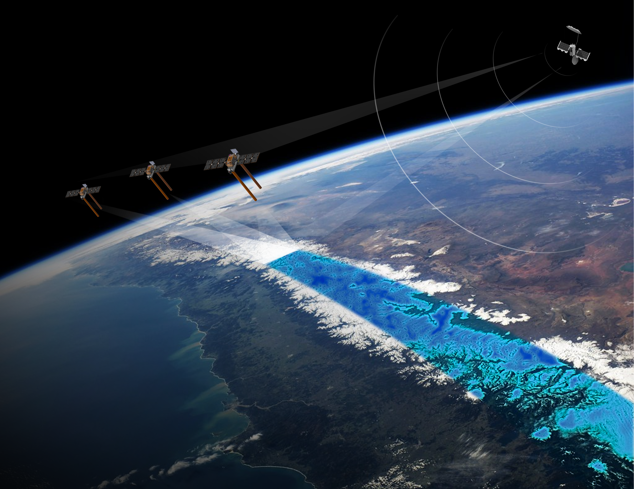
SnoWatch Implementation
MUOS transmitters
3 P-band SAR receivers
Baseline design: 3-satellite receiver constellation:
zenith antenna
3 receivers on one orbit plane
Earth rotation used to create separate ground tracks
nadir antenna
Dual frequency (~370 MHz & ~260 MHz) SAR receivers
P-band zenith (direct) and nadir (reflected) antennas
Baselines for SAR processing from (1) dual antenna on each spacecraft and from (2) antennas across spacecraft

Slide 14
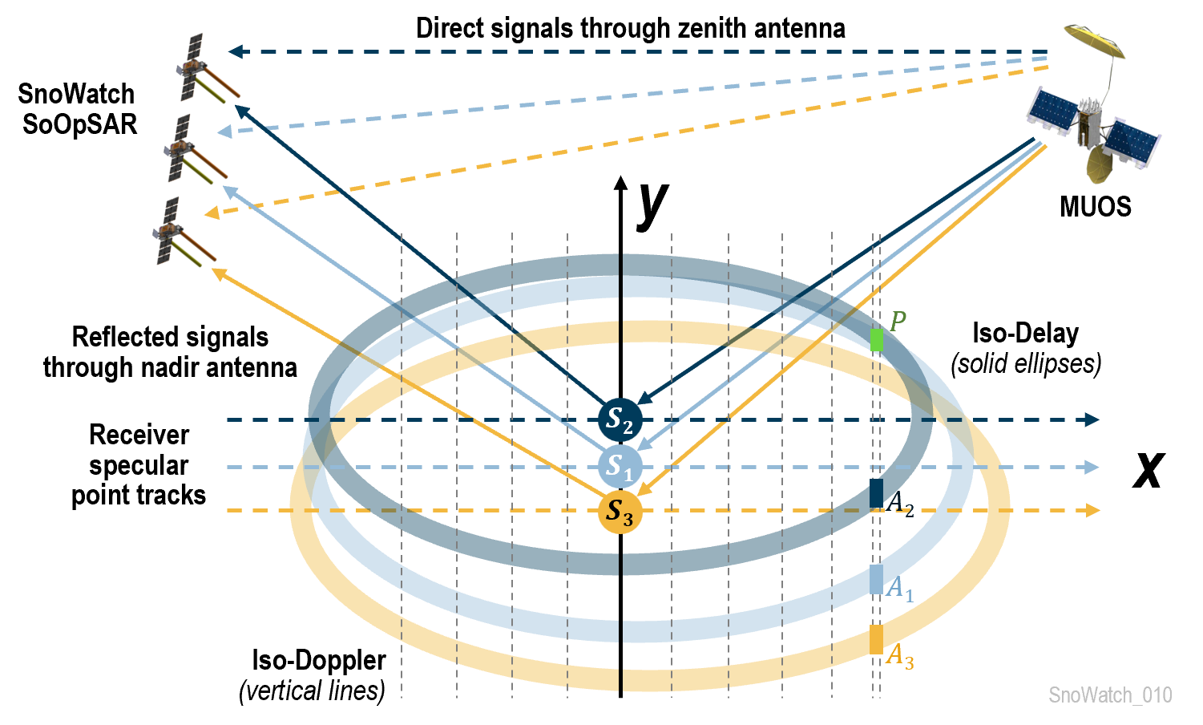
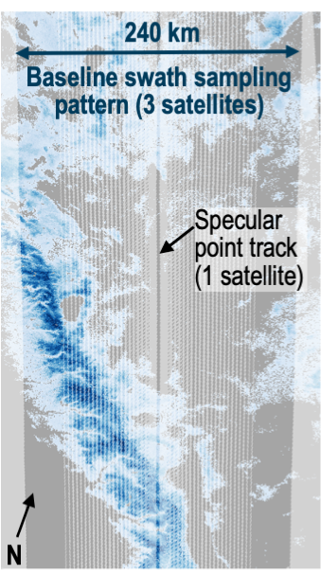
SnoWatch Implementation
Baseline (3-satellite receivers) characteristics:
Temporal repeat: 6-day
Swath width: ~240 km
Spatial resolution:
along-track: ~40 m;
across-track: ~80 m – 2 km
MUOS transmitters
A single receiver provides only one unambiguous reflection point (specular point)
A constellation of receivers reduces the ambiguity of reflected signal to build up a swath via SAR post-processing (SoOp-SAR)
Retrieved phase → SWE
Retrieved amplitude of reflection → Soil moisture
Sampling pattern contains within-swath and between-swath gaps (more receivers → better resolution and fewer gaps)

Slide 15
Open Questions/Next Steps
Primary criticism from ESE review: Need for further validation of retrieval algorithm (how much and what method validation is enough?)
Ongoing efforts to install tower with P-band receivers in Central Sierra Snow Laboratory; key objective is to get seasonal time series of phase
Need resources to develop new airborne receivers and undertake new airborne campaigns (future SnowEx efforts?)
Other criticisms/comments/suggestions:
Further investigation of dry-to-wet snow transition needed
Refinement/validation of error budgets involved in phase shift determination
Stability of MUOS transmitters in future?
Further test assumptions and choices made in design; Explore synergisms and complementarity with other missions/mission concepts

