Slide 1
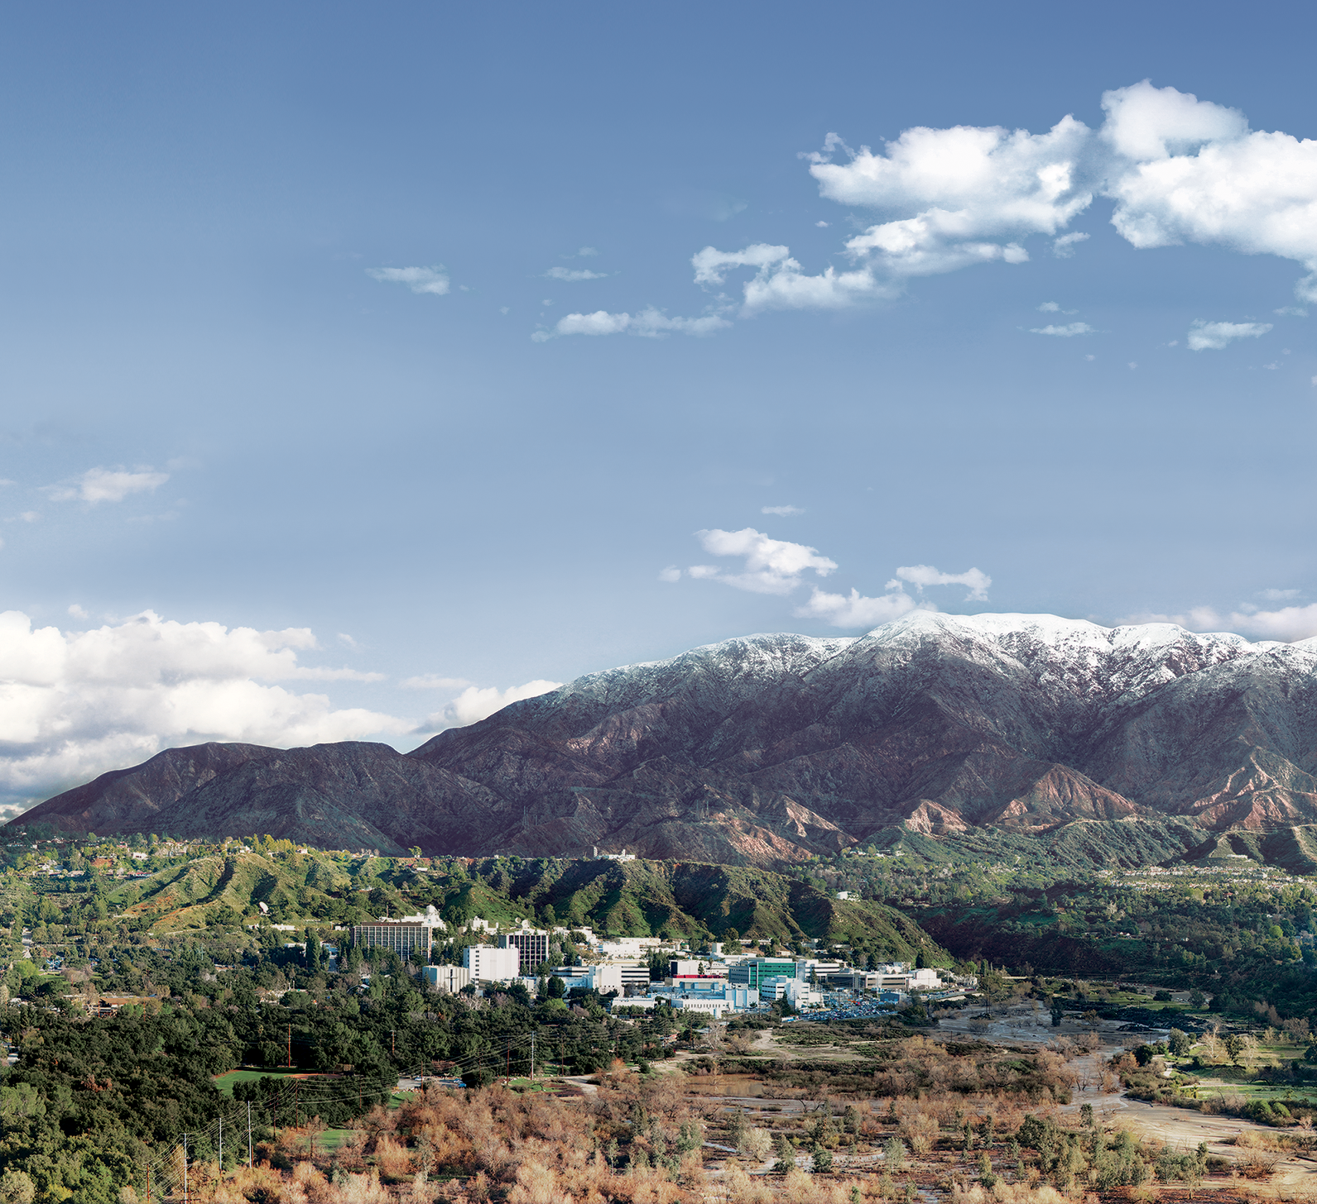
Getting The Snow Community Ready for The NASA-ISRO SAR Mission
Shadi Oveisgharan, NASA L-Band InSAR SWE Working Group, NISAR Project Team
Jet Propulsion Laboratory
California Institute of Technology
2024 NASA Snow Community Meeting
Boulder, CO
August 14, 2024
Copyright 2023 California Institute of Technology. Government sponsorship acknowledged.

Slide 2
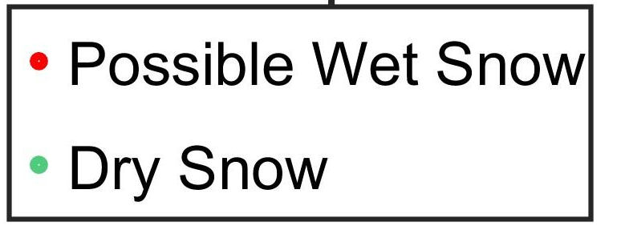
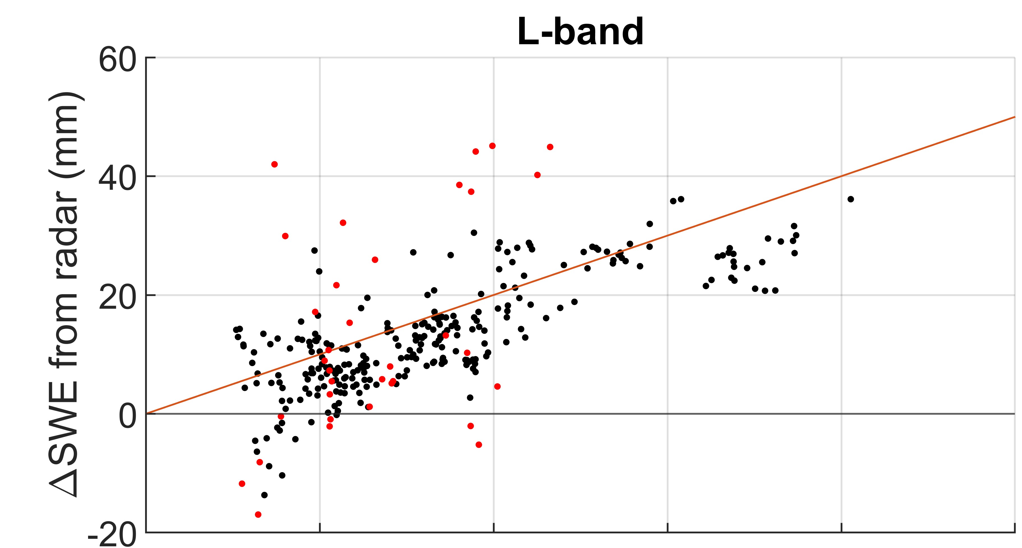
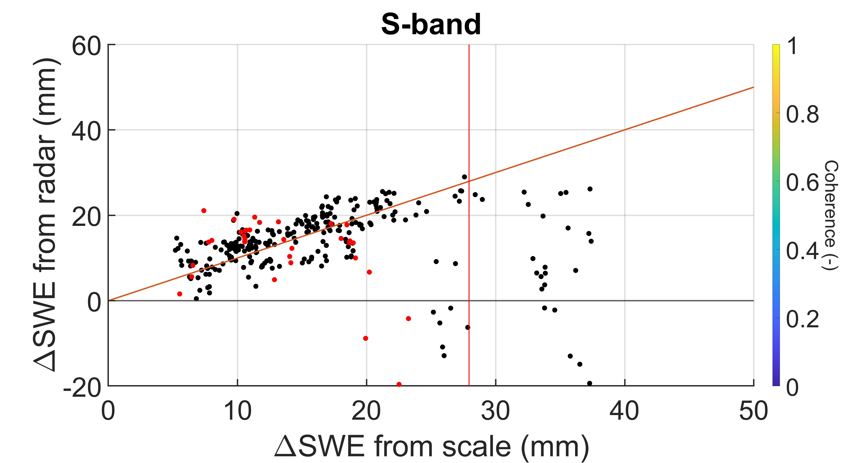
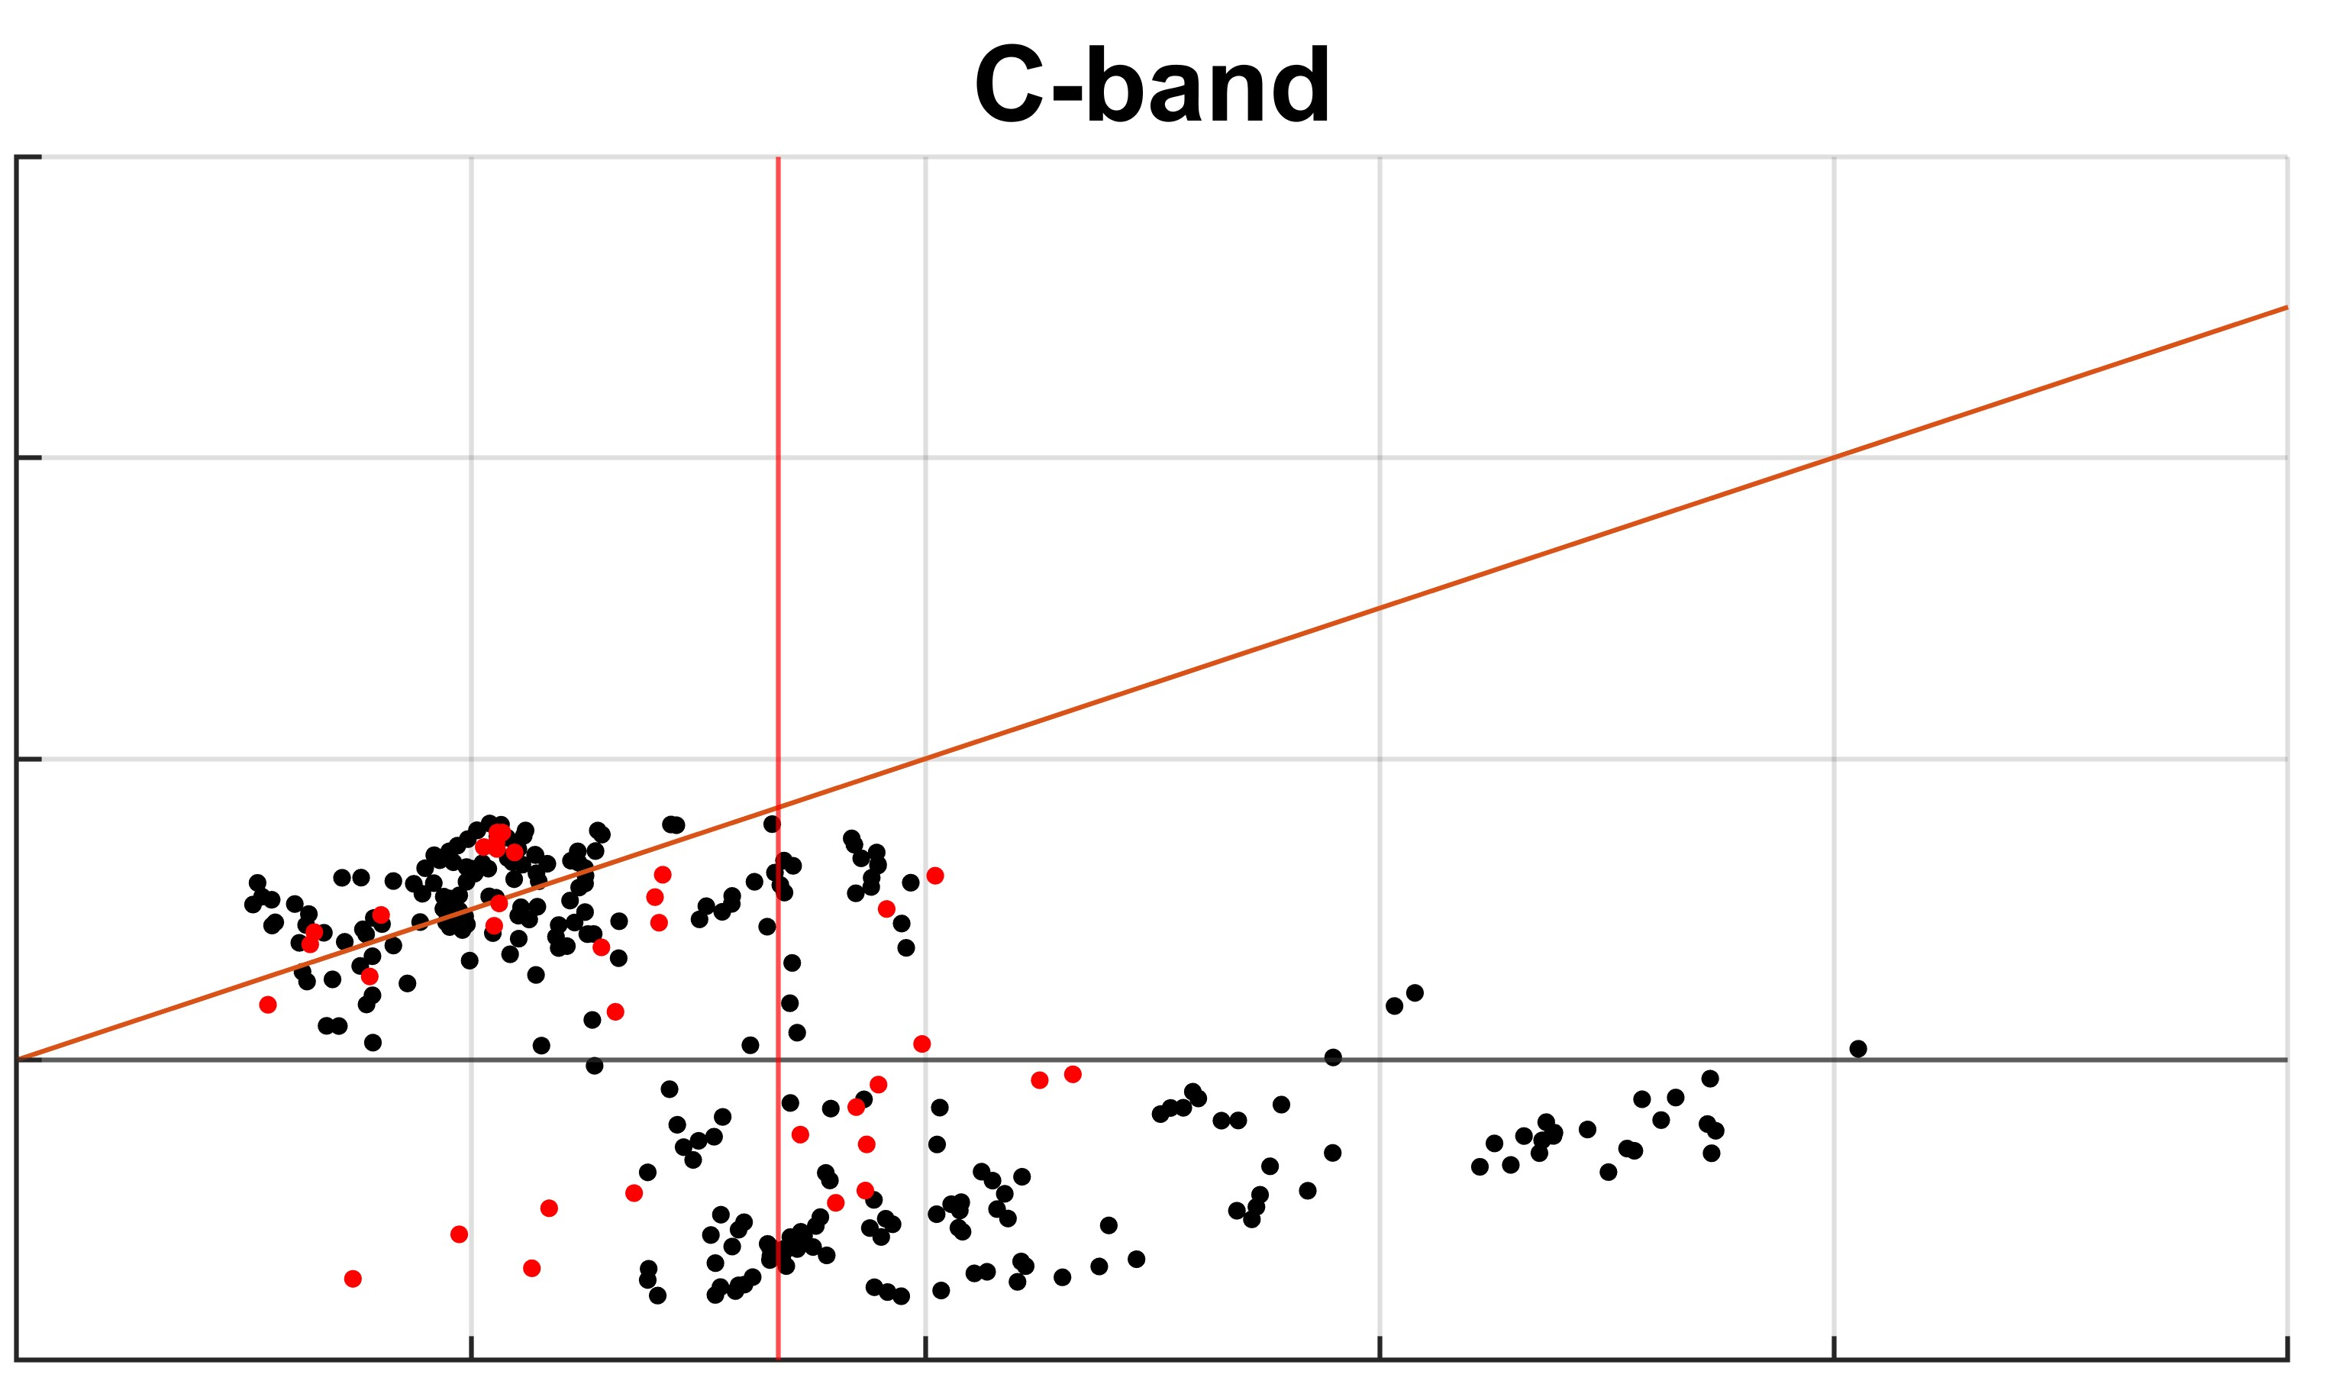
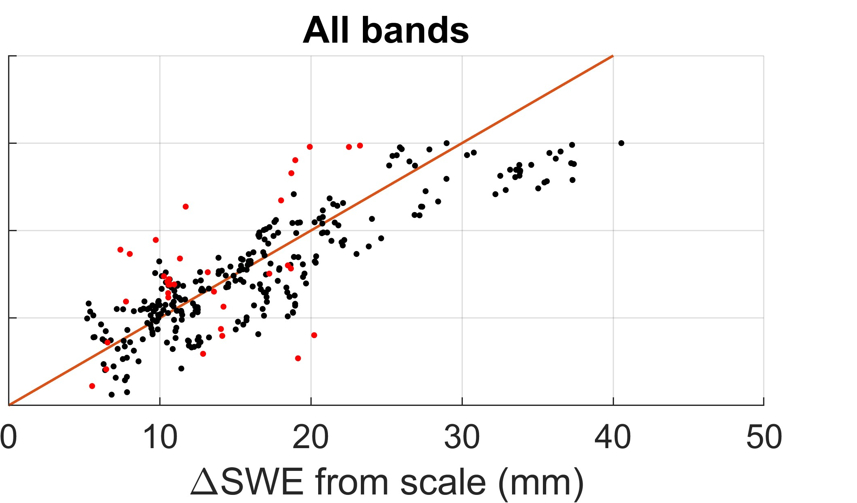
SWE Retrieval Using Zero baseline repeat-pass interferometry
Guneriussen et al., TGRS 2001
2017 Decadal Survey calls for Snow Water Equivalent (SWE) measurement with 3cm accuracy, using active sensor (radar) as part of the DS Earth Explorer mission category.
Leinss et al, TGRS 2015 (First Experimental demo) : Tower based repeat-pass interferometry at X-band
successful with very fast (every 10 minutes) revisit time
Ruiz et al, TGRS 2022: Multi channel (1-18 GHz) SodSAR tower radar in northern Finland.
L-, S- C and X-bands over open and clear area.
all possible pairs with 12 days temporal baseline (NISAR replica)
Provides robustness against decorrelation and can solve for lost phase cycles on high frequency bands.
 | RMSE (mm)
L- | 6.63
S- | 12.63
C- | 21.75
L+S | 4.21
L+C | 4.42
All | 3.97
ΔSWE from scale (mm)
ΔSWE from scale (mm)
ΔSWE from scale (mm)

Slide 3
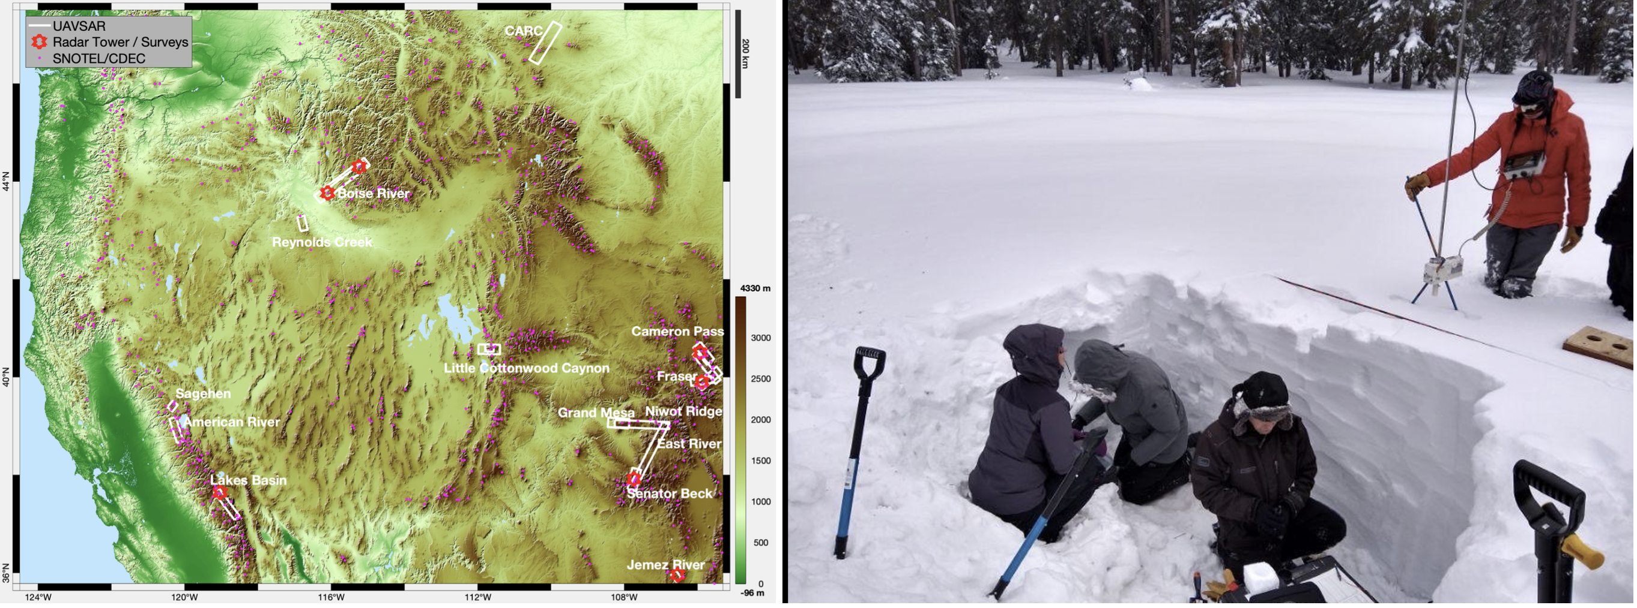
Repeat-pass Interferometry; SnowEx UAVSAR Time Series
SnowEX campaign was focused on UAVSAR repeat-pass interferometry.
winter 2020: Biweekly spread over different US sites (6 sorties over 13 sites, across 5 states)
winter 2021: Weekly with fewer regional sites and more frequent temporal sampling (10 sorties over 6 sites, across 4 states)
Local experienced field teams deployed on the date of each over pass (Source of validation)
Airborne LIDAR over subdomain at a subset sites (Great source for validation)
coordinated with Sentinel-1 team for 6 days revisit for some of the SnowEx sites

Slide 4
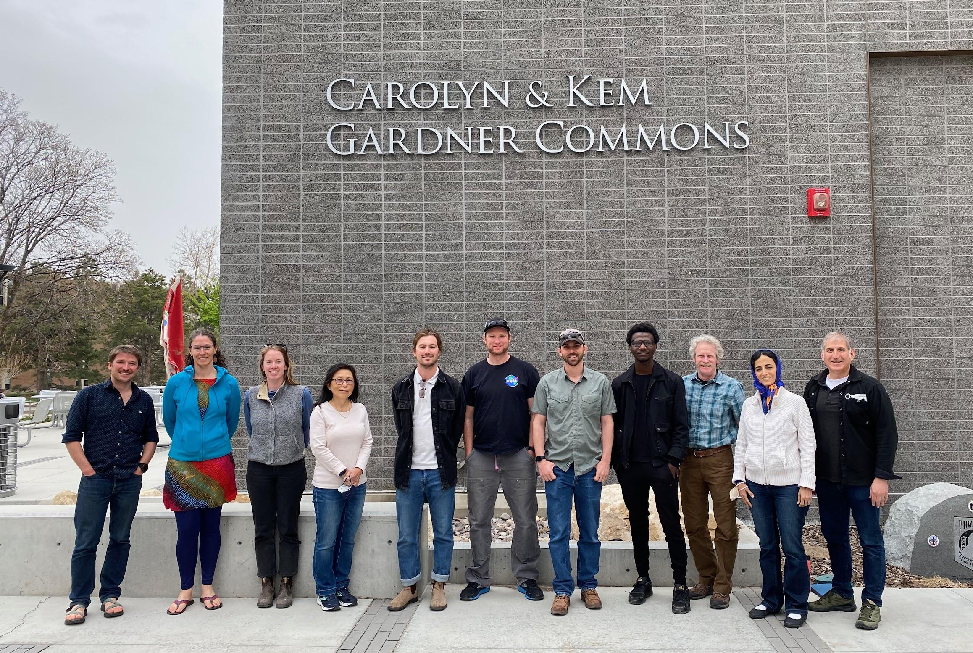
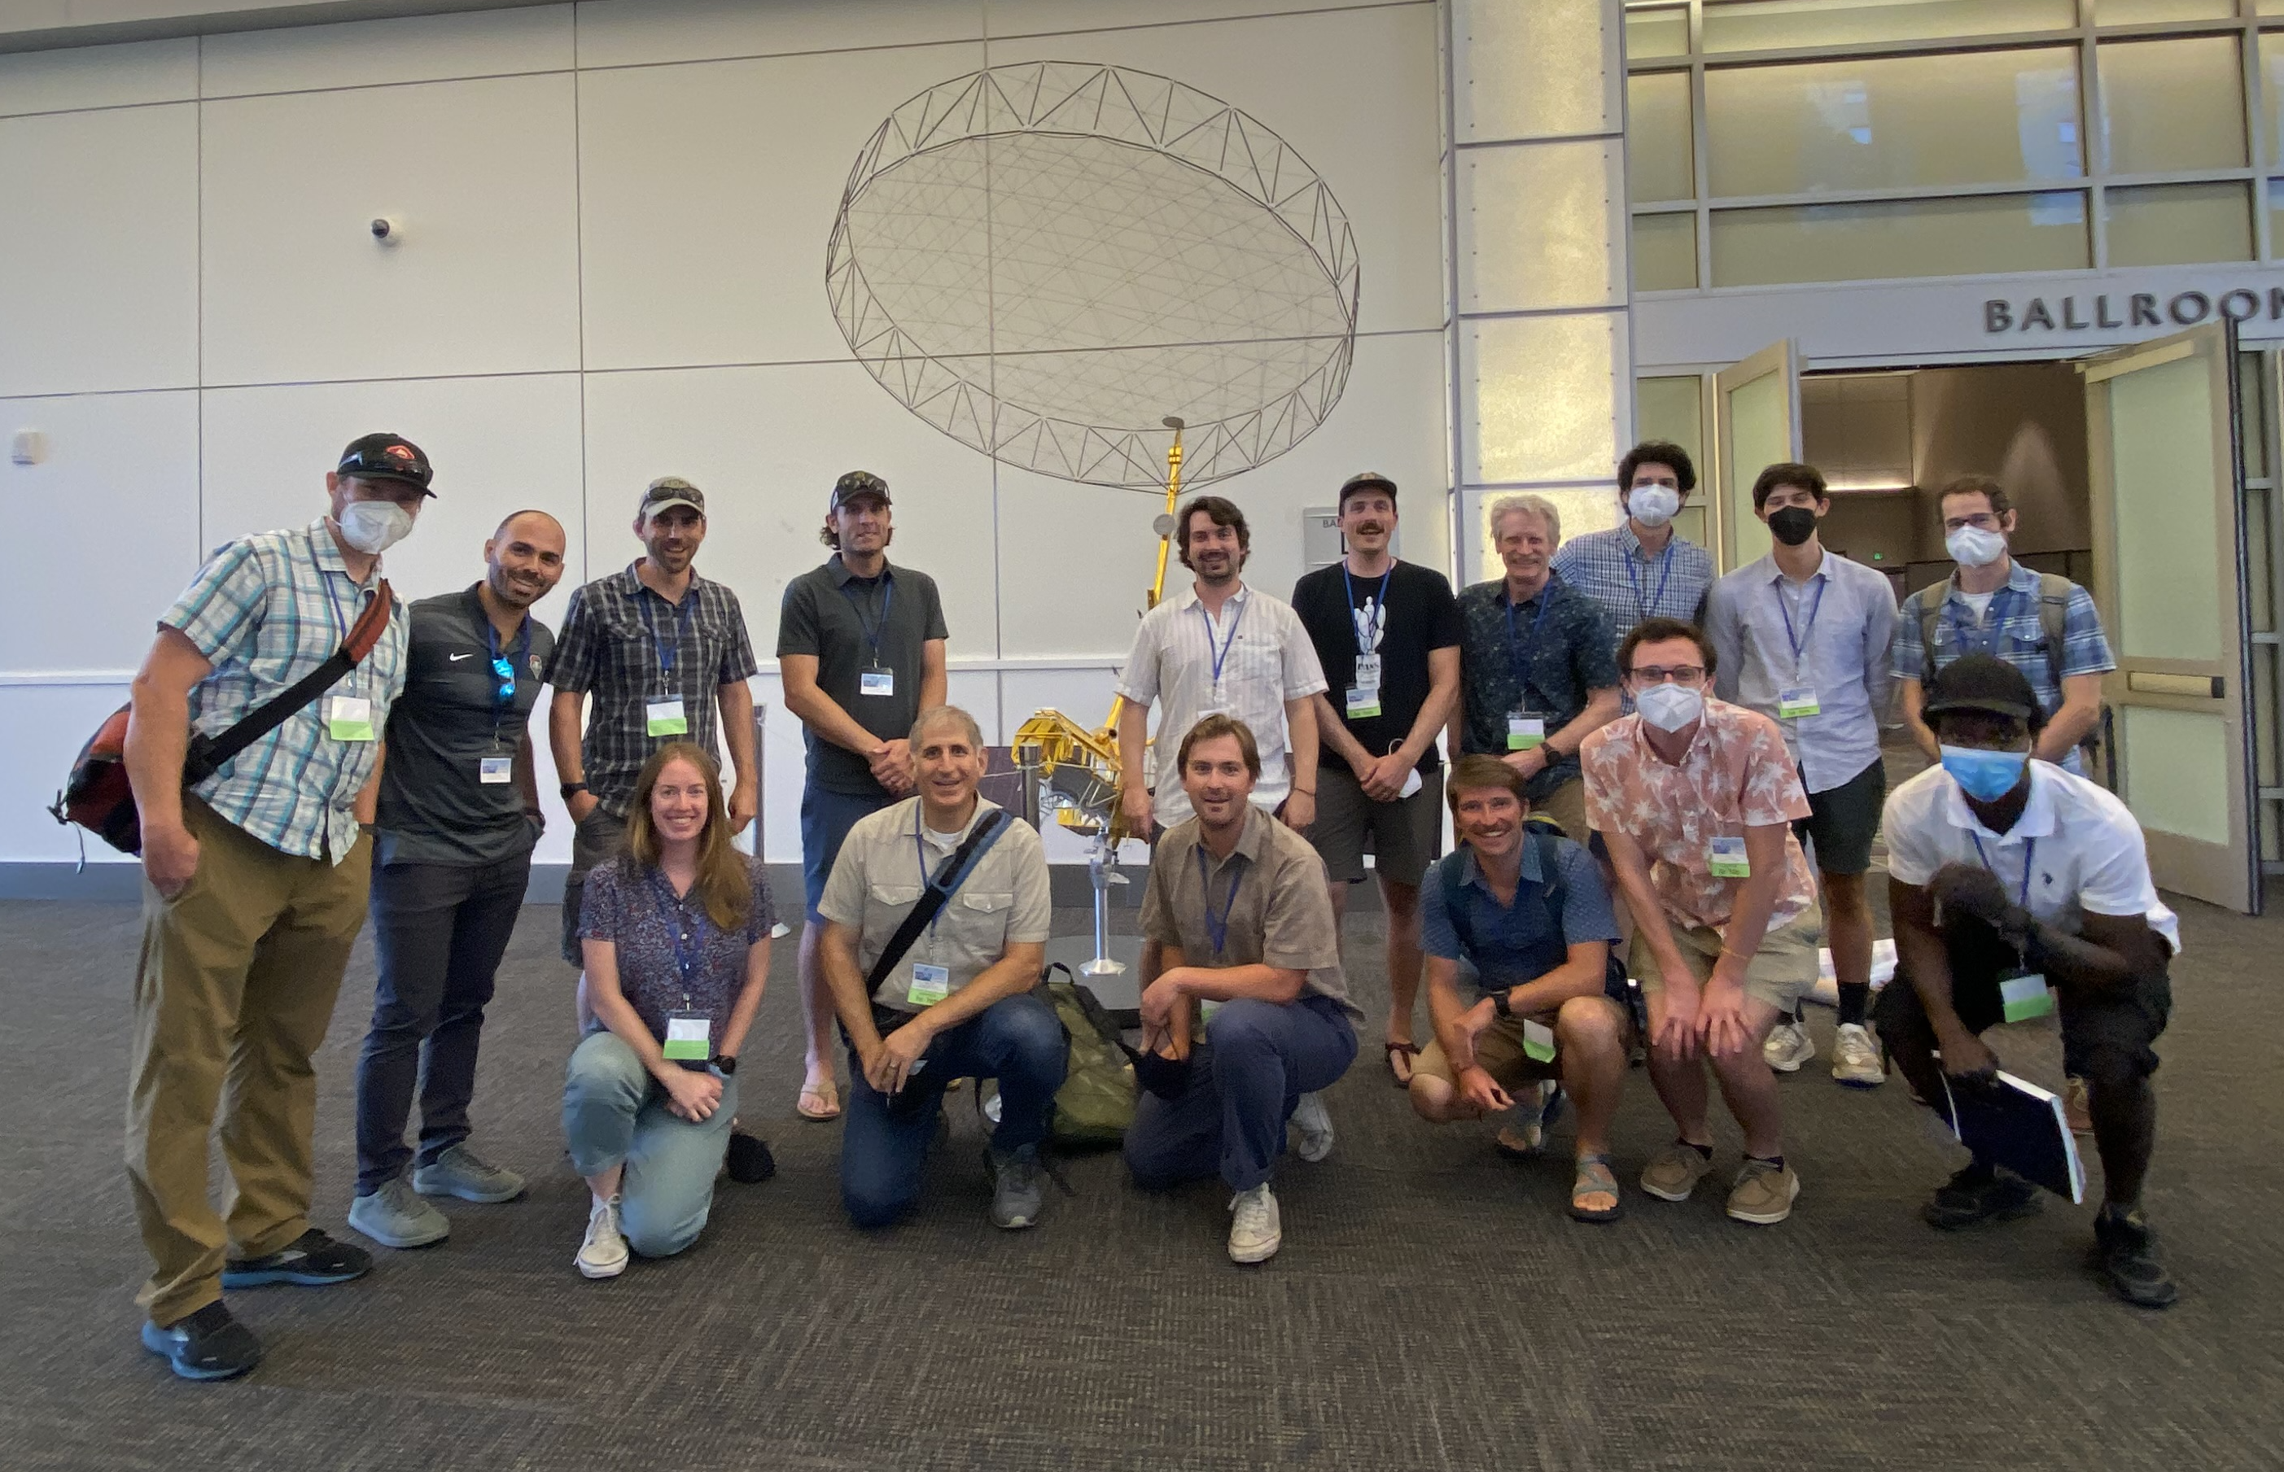
NASA L-Band InSAR SWE Working Group
Eli Deeb, HP Marshall, Jack Tarricone organized monthly zoom meetings for InSAR SWE retrieval since 2021
(30+ people, 12 students/recent grads)
In person meetings at different conferences (WSC, NISAR Workshop, IGARSS)
Some recent InSAR SWE/depth publications using SnowEx data:
Zachary Hoppinen, Shadi Oveisgharan, Hans-Peter Marshall, Ross Mower, Kelly Elder, and Carrie Vuyovich, Snow water equivalent retrieval over Idaho – Part 2: Using L-band UAVSAR repeat-pass interferometry, The Cryosphere, 18, 575–592, https://doi.org/10.5194/tc-18-575-2024, 2024
Shadi Oveisgharan, Robert Zinke, Zachary Hoppinen, and Hans Peter Marshall, Snow water equivalent retrieval over Idaho – Part 1: Using Sentinel-1 repeat-pass interferometry, The Cryosphere, 18, 559–574, https://doi.org/10.5194/tc-18-559-2024, 2024
Jack Tarricone, Ryan W. Webb, Hans-Peter Marshall, Anne W. Nolin, and Franz J. Meyer, Estimating snow accumulation and ablation with L-band interferometric synthetic aperture radar (InSAR), The Cryosphere, 17, 1997–2019, https://doi.org/10.5194/tc-17-1997-2023, 2023
Palomaki, R. T. and Sproles, E. A., Assessment of l-band insar snow estimation techniques over a shallow, heterogeneous prairie snowpack, Remote Sensing of Environment, 296:113744, 2023.
Randall Bonnell, Daniel McGrath, Jack Tarricone, Hans-Peter Marshall, Ella Bump, Caroline Duncan, Stephanie Kampf, Yunling Lou, Alex Olsen-Mikitowicz, Megan Sears, Keith Williams, Lucas Zeller, and Yang Zheng, Evaluating L-band InSAR Snow Water Equivalent Retrievals with Repeat Ground-Penetrating Radar and Terrestrial Lidar Surveys in Northern Colorado, EGUsphere, https://doi.org/10.5194/egusphere-2024-236, 2024

Slide 5
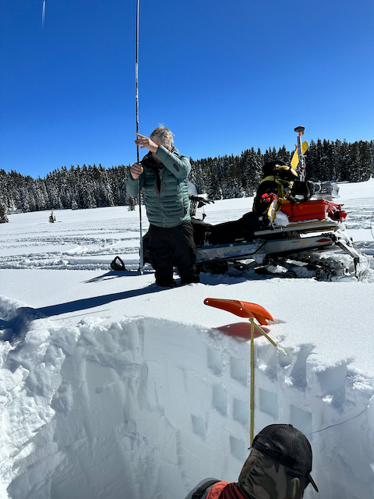
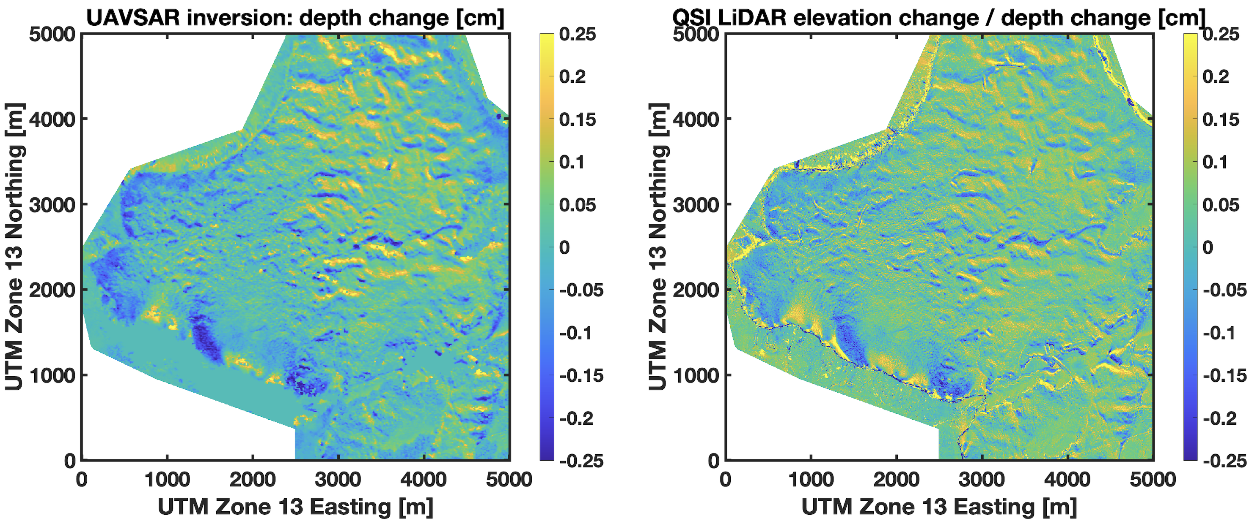
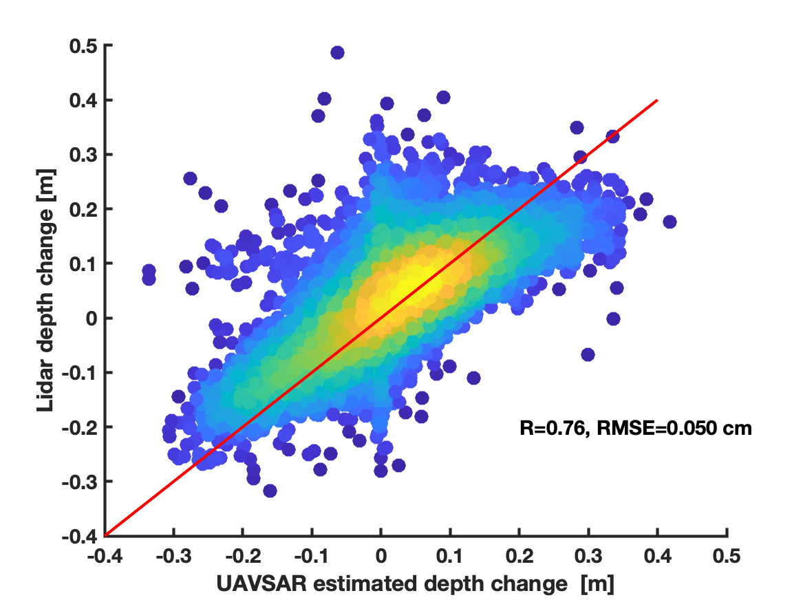
InSAR Working Group Findings: UAVSAR over Grand Mesa
HP Marshall et al, IGARSS 2021
Retrieved snow depth change using UAVSAR shows a very good agreement with LIDAR over flat 5km x 5 km region on Grand Mesa with dry snow
Motivated the time series SnowEx campaign 2021
Airborne Lidar flights aligned with UAVSAR overflights, allowing direct comparison of depth change
Marshall, H.P., Deeb, E., Forster, R., Vuyovich, C., Elder, K., Hiemstra, C., and Lund, J. (2021). L-band InSAR depth retrieval during the NASA SnowEx 2020 Campaign: Grand Mesa, Colorado. IGARSS, DOI:10.1109/IGARSS47720.2021.9553852

Slide 6
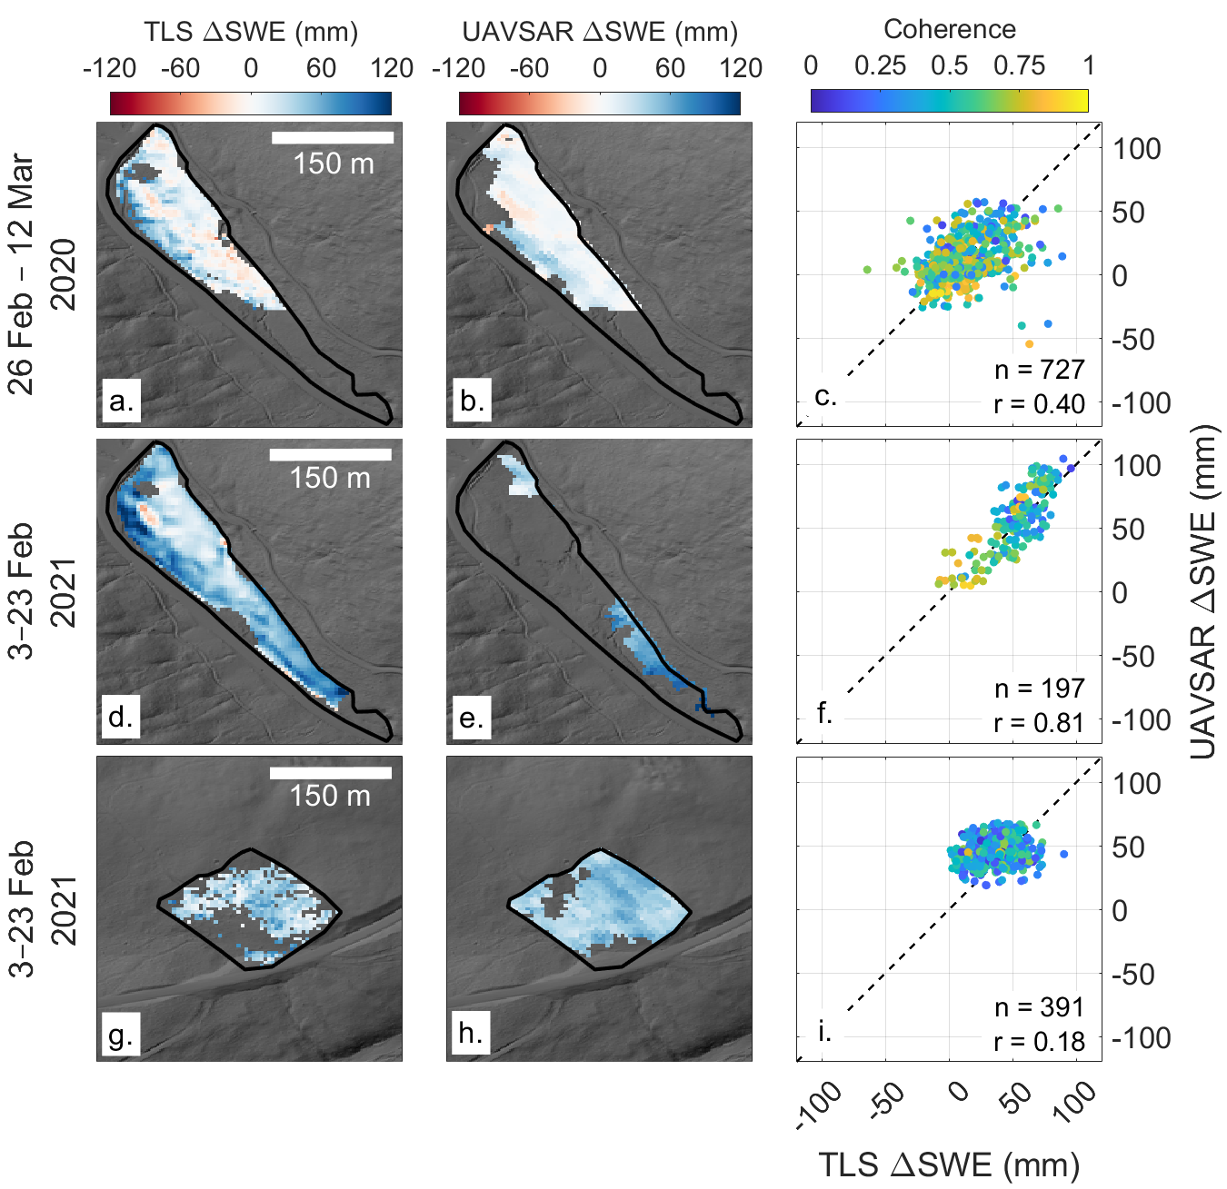
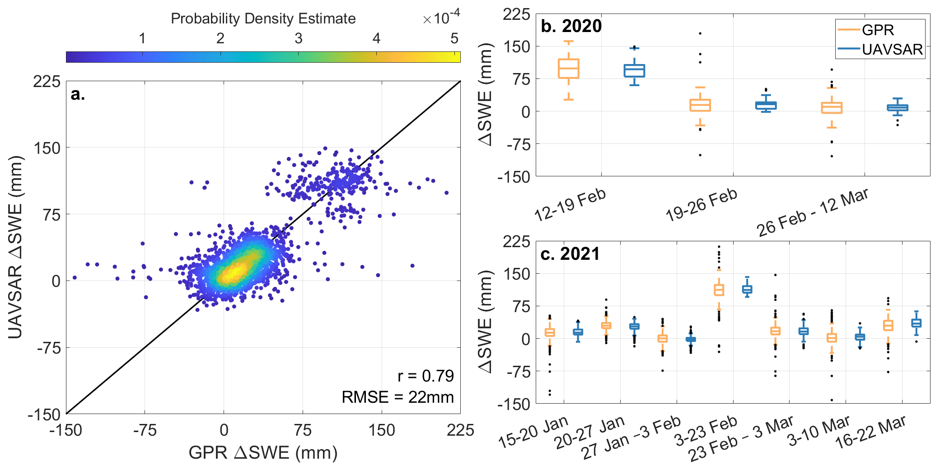
InSAR Working Group Findings: UAVSAR over Northern Colorado
Randall Bonnell, EGUsphere 2024
Right figure; UAVSAR vs TLS (Terrestrial Lidar Scan)
UAVSAR and TLS ΔSWE retrievals exhibit similar spatial patterns and ΔSWE magnitudes
Correlation: 0.72, RMSE = 19 mm
Poor UAVSAR coherence for 3–23 February 2021 – unwrapping issues
Below figure; UAVSAR vs GPR (Ground penetrating Radar)
ΔSWE retrieval comparison: Large spread, but absolute difference in medians = 2 mm
ΔSWE retrieval accuracy degrades at lower coherence
TLS ΔSWE retrievals (first column) and UAVSAR ΔSWE retrievals (second column) overlaid on a shaded relief raster, and pixel-wise comparison (third column). Rows organized by date/field site.
Figure: (a) UAVSAR ΔSWE retrievals vs. GPR ΔSWE retrievals. Box plot distributions of UAVSAR and GPR ΔSWE retrievals for the (b) 2020 and (c) 2021 seasons.

Slide 7
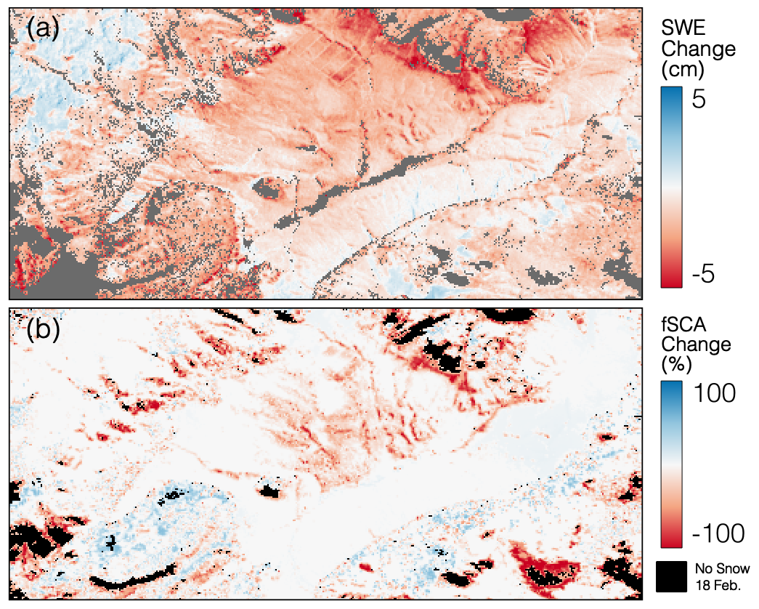
InSAR Working Group Findings: UAVSAR over Jemez Mountains, NM
Jack Tarricone et al, The Cryosphere 2023
SWE loss and gain can be estimated within the same radar swath
Morning (~9 AM) acquisitions held coherence and provided reasonable ΔSWE results
InSAR SWE loss visually similar to Landsat fSCA loss patterns
(a) InSAR ΔSWE between 19 and 26 February aggregated to the 30 m Landsat resolution. (b) The Landsat ΔfSCA between 18 February and 5 March. The color scale for panel (a) was changed to −5 to 5 cm to exemplify the patterns.

Slide 8
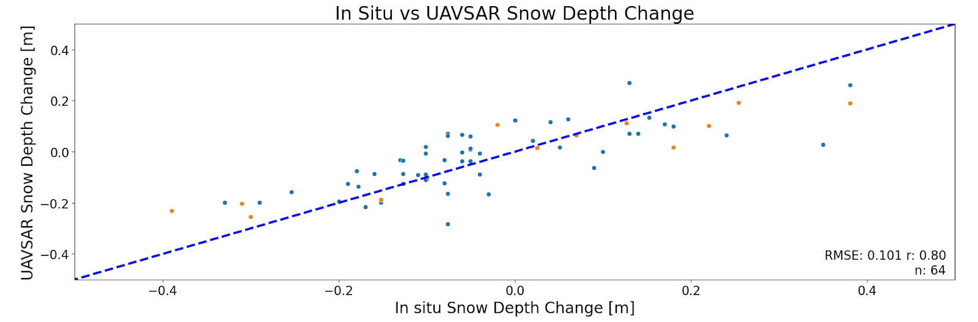
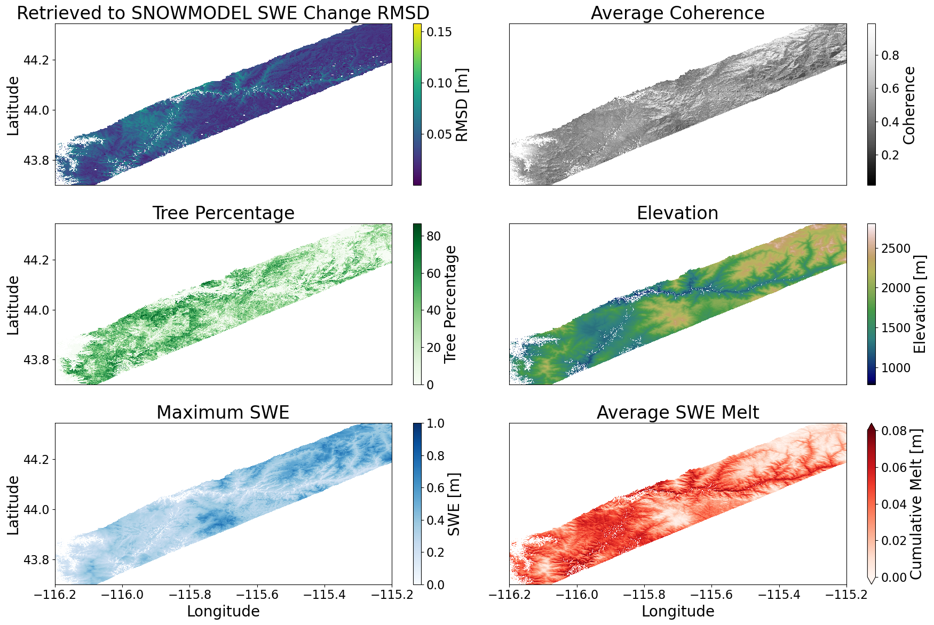
InSAR Working Group Findings: UAVSAR over Idaho
Zach Hoppinen et al, The Cryosphere 2024
UAVSAR retrieved snow depths vs in situ (RMSE = 0.1m, r = 0.80, n = 64)
UAVSAR retrieved SWE vs. SNOWMODEL (RMSD = 0.023m, r= 0.60, n = 3e6)
Best performance in high elevation, dry snow regions

Slide 9
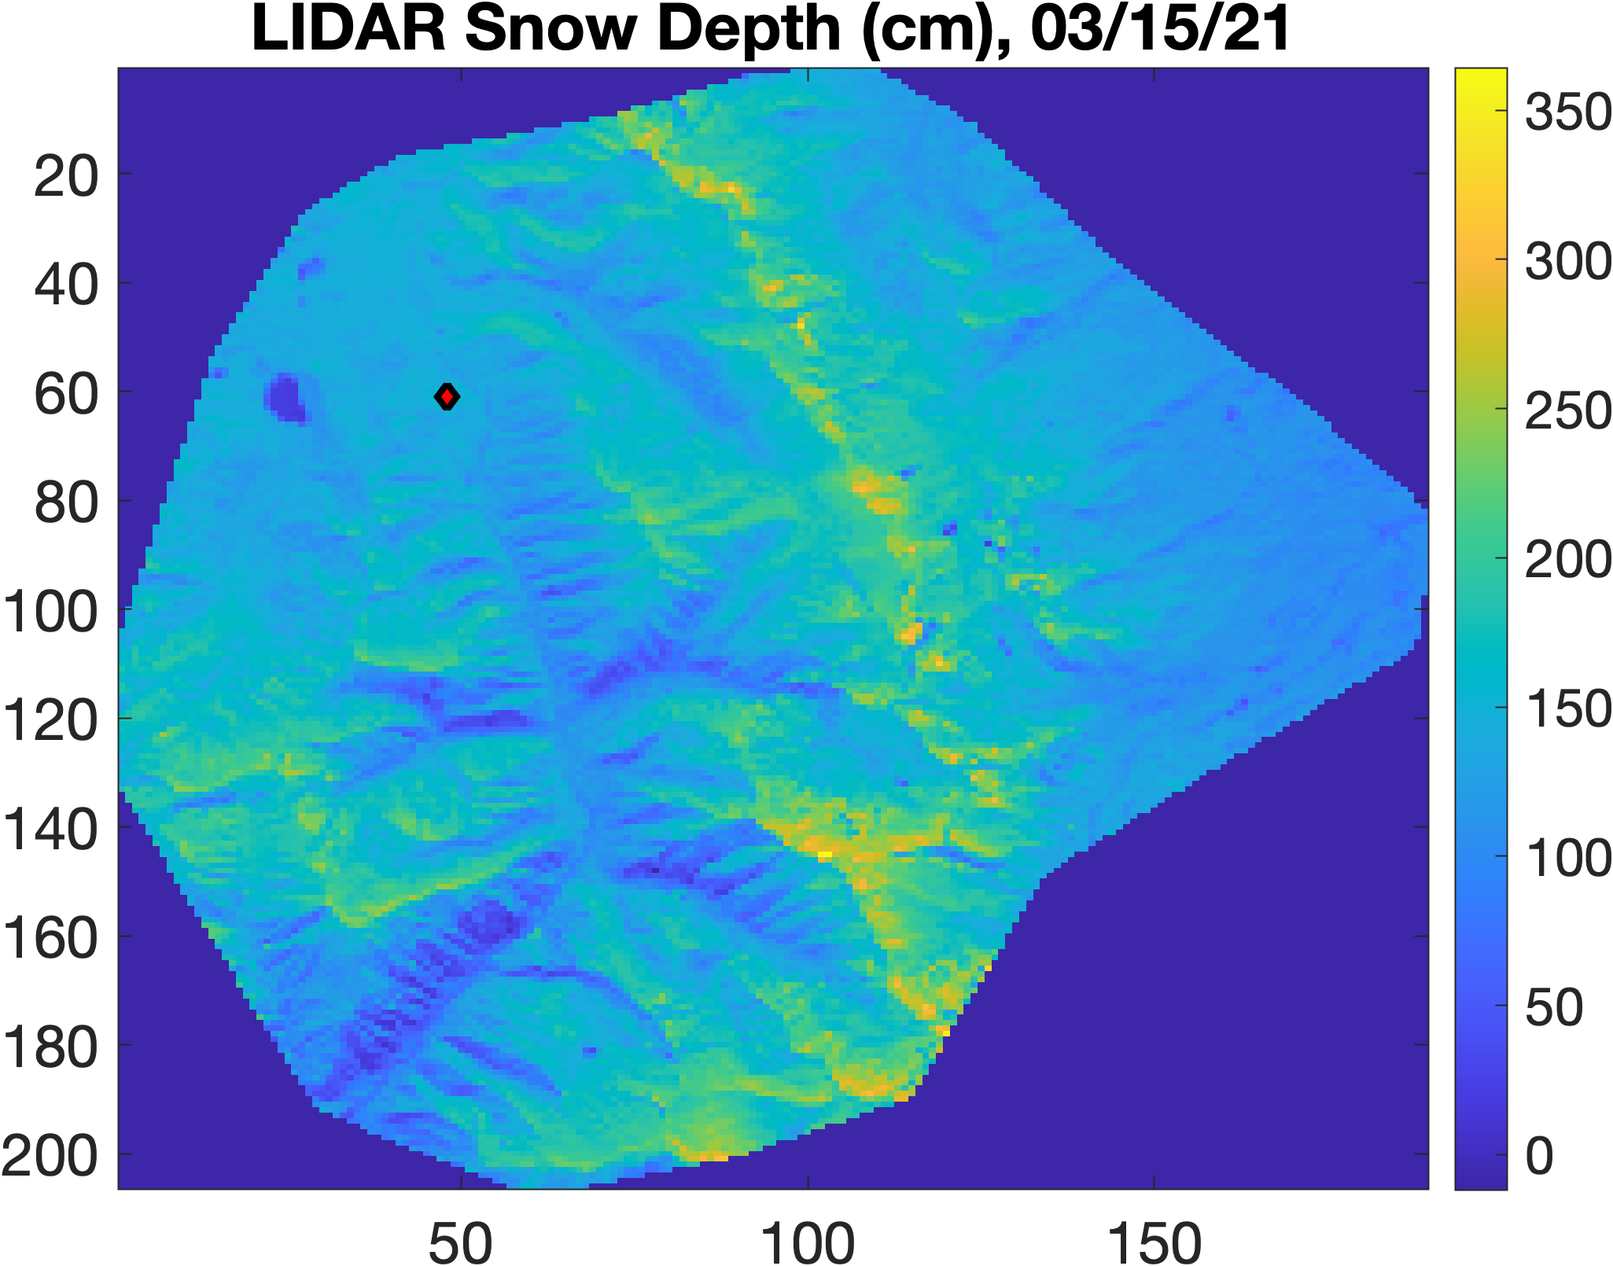
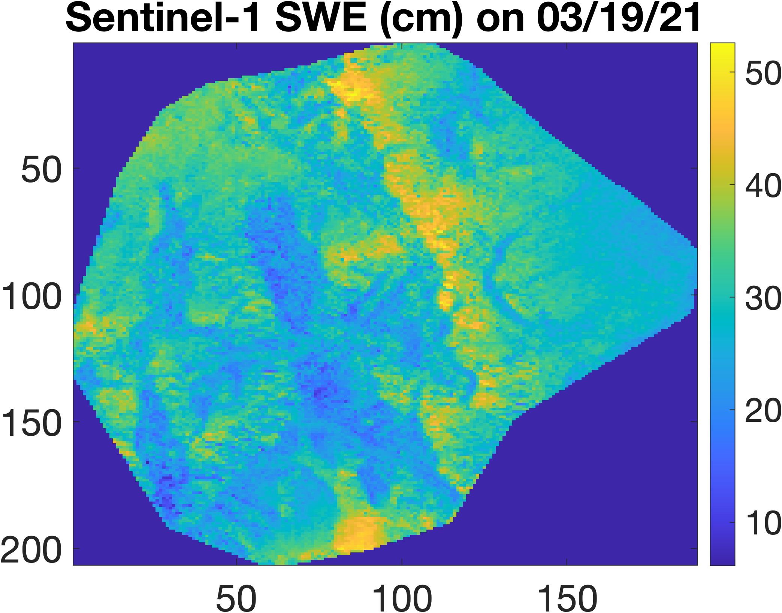
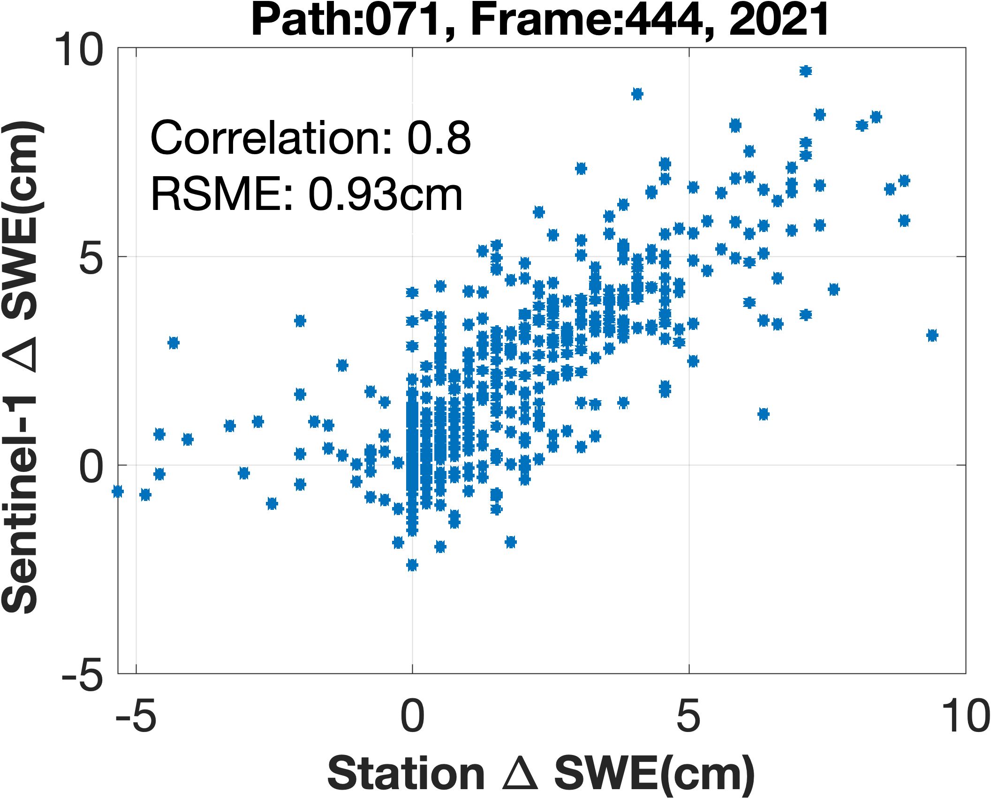
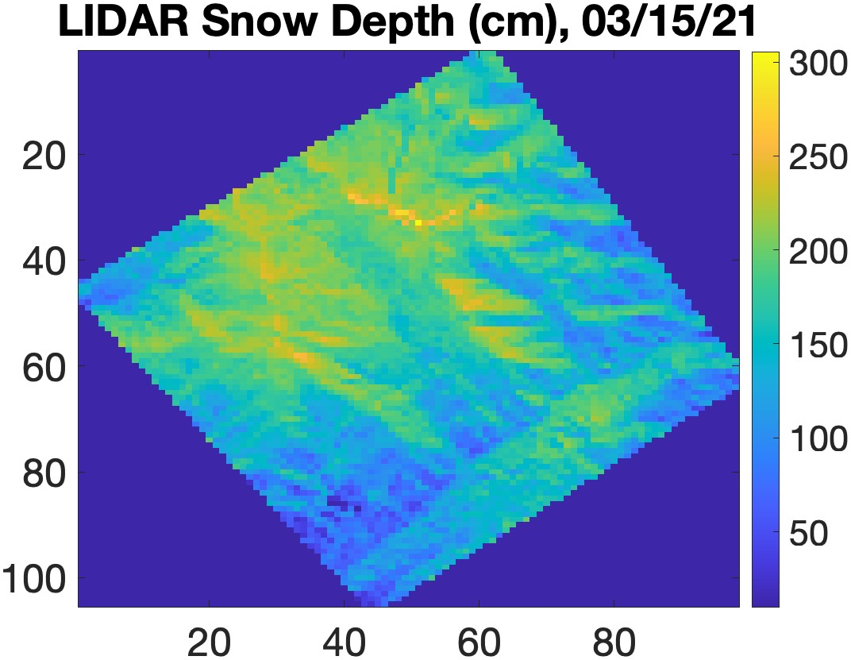
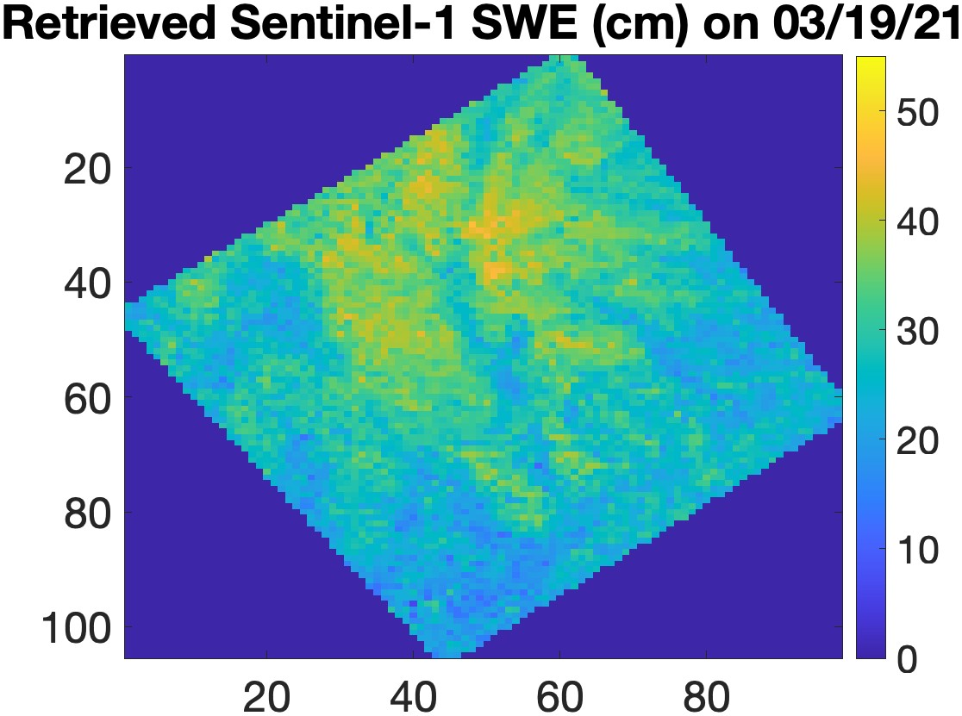
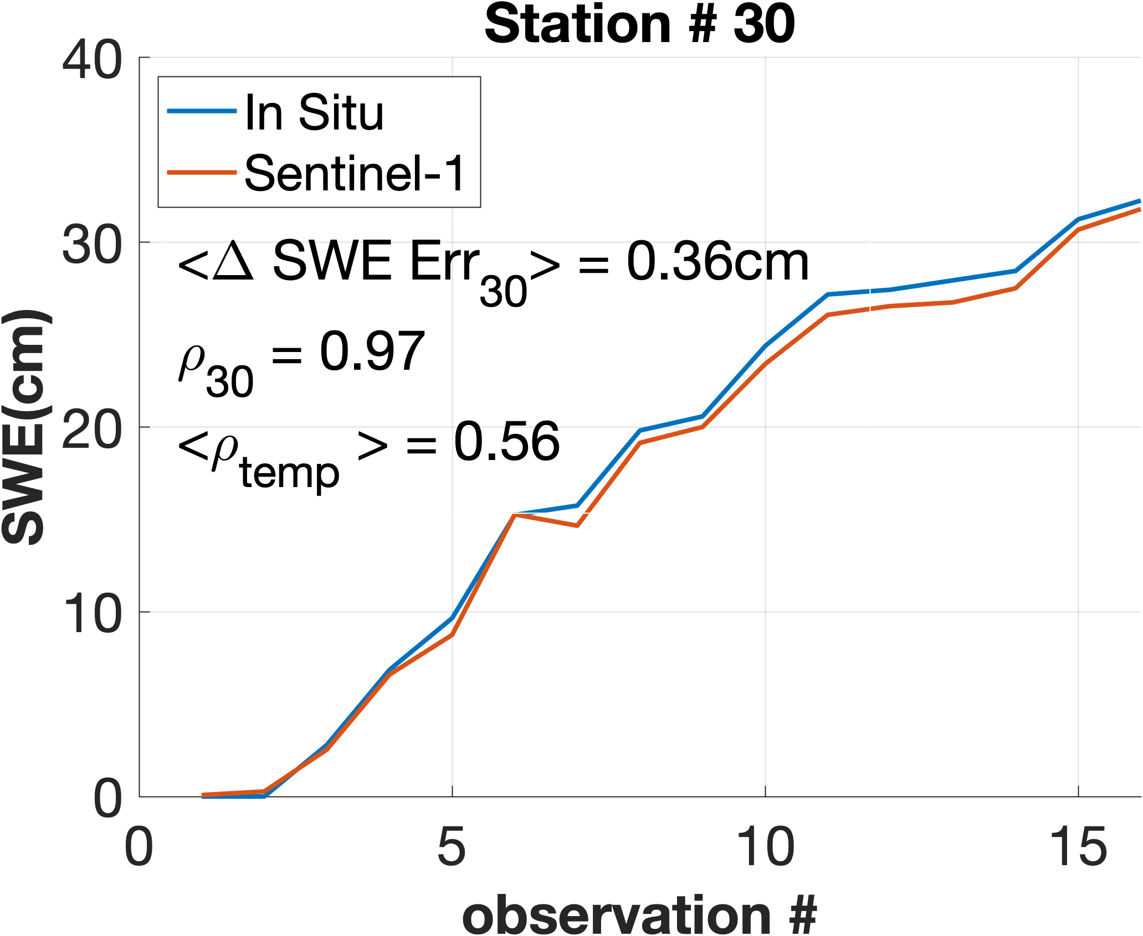
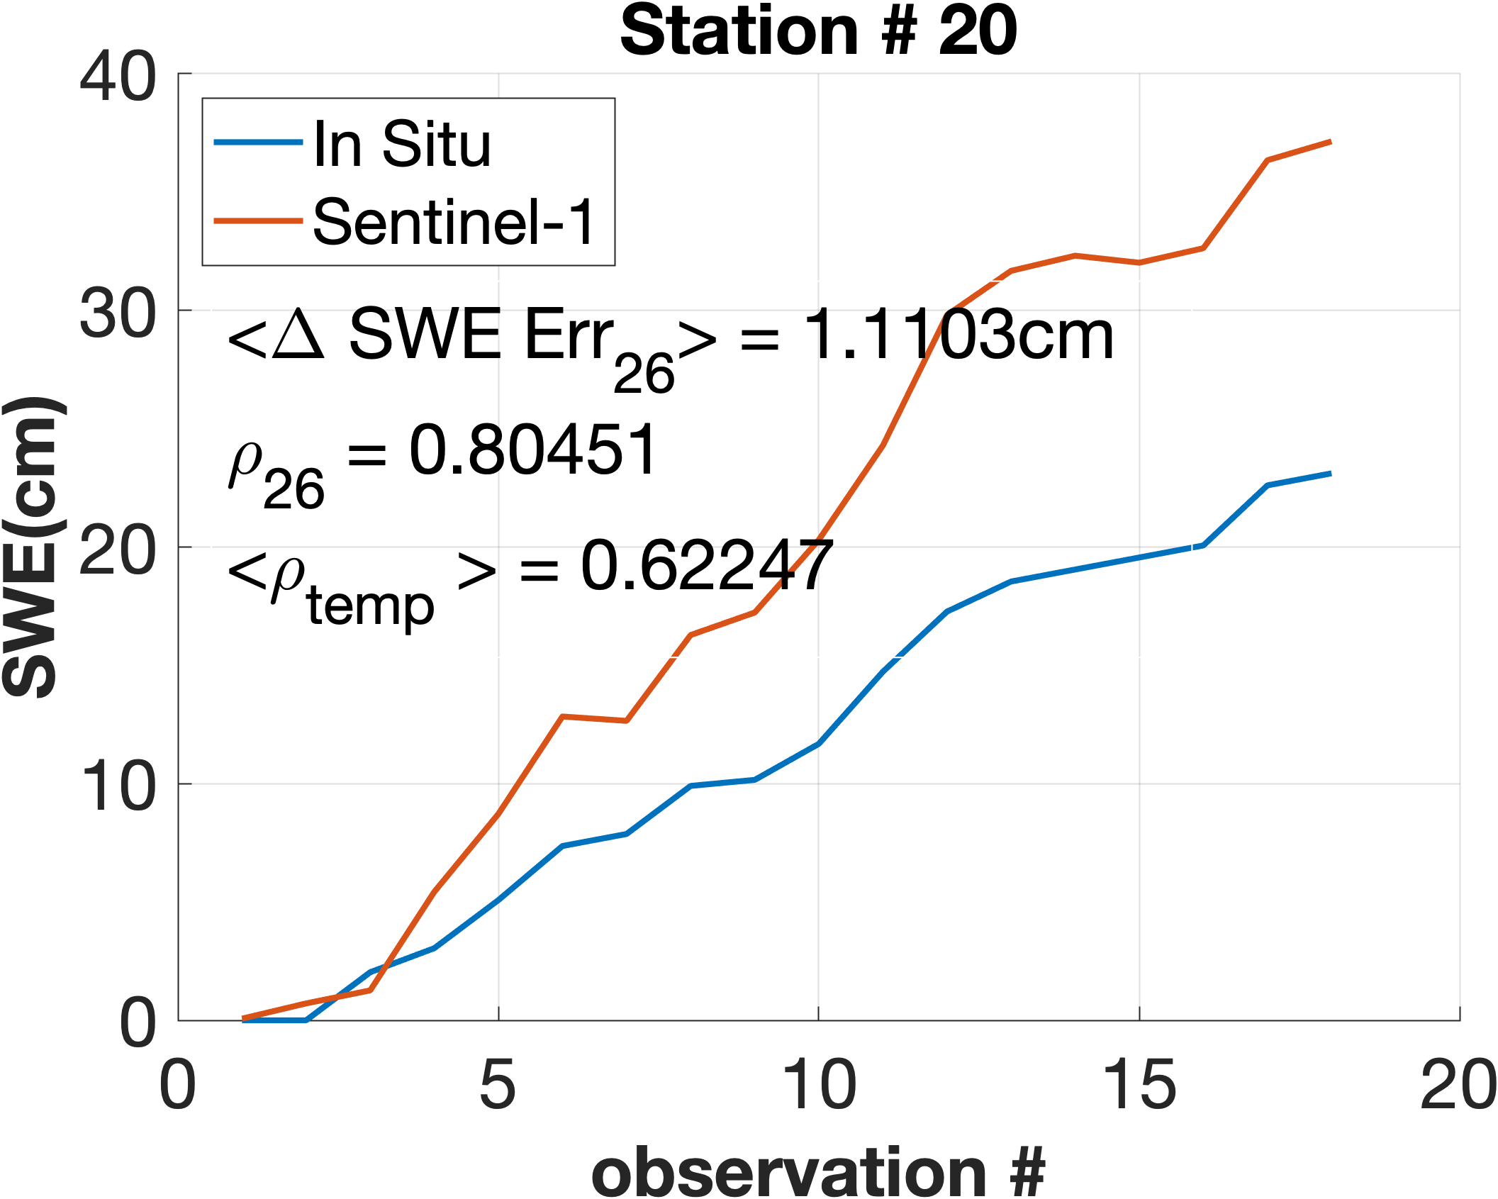
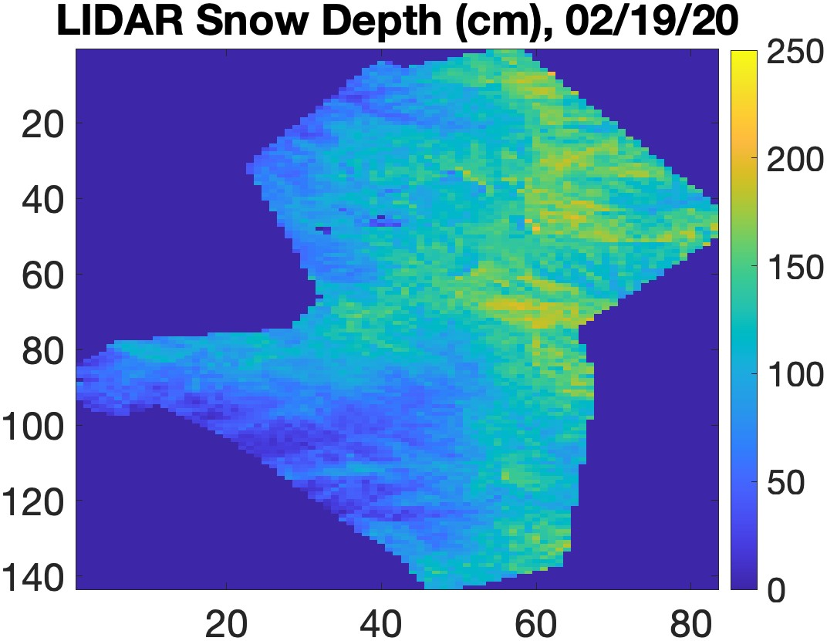
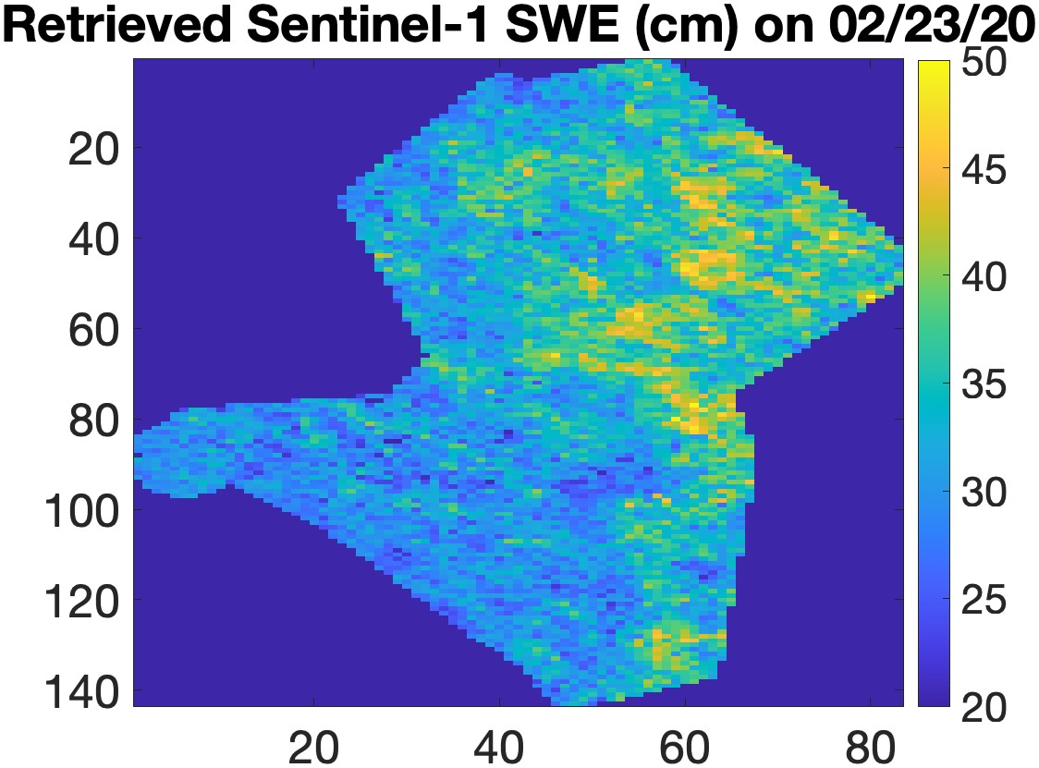
InSAR Working Group Findings: Sentinel-1 C-band Time Series over Idaho
Shadi Oveisgharan et al, The Cryosphere 2024
SnowEx Coordination
Sentinel-1 6-days revisit over Idaho
Closest to NISAR time series
240km covers 32 in situ stations
Continuous time series for the entire winter (12/1 to 3/31)
The correlation between Sentinel-1 and In Situ ΔSWE is 0.8 and the RMSE error is 0.93cm.
SWE = ΣΔSWE for in situ stations
9 stations, with total SWE error < 2 cm for the entire time series
15 stations, with total SWE error > 2 cm but similar pattern
Site | LIDAR Date | Correlation
Basin Summit (BS) | 02-19-2020 | 0.51
Basin Summit (BS) | 03-15-2021 | 0.47
Mores Creek (MC) | 02-09-2020 | 0.66
Mores Creek (MC) | 03-15-2021 | 0.59
Dry Creek (DC) | 02-19-2020 | 0.56
SWE = ΣΔSWE at LIDAR dates
Very good resemblance and correlation between LIDAR snow depth and Sentinel SWE.

Slide 10
InSAR Working Group Findings: Summary
Retrieving ΔSWE using UAVSAR and Sentinel-1 InSAR data is very promising
Limitations
It works on dry snow or refrozen snow
Therefore the 6 am NISAR data is a better fit than 6 pm during warm weather/spring
Challenges
Temporal coherence and phase unwrapping are the main two challenges
Shallow snow is challenging for SWE retrieval (Ross Palomaki et al., RSE 2023)
Need to develop retrievals accounting for LWC for early spring
Environmental Effect
Vegetation can degrade the performance of SWE retrieval, but promising results are observed in vegetated areas – retrieval development needed
The retrieval performance is better in colder temperatures
UAVSAR for SnowEx Time Series
Advantages
It was a great testbed to show the method works
It helped to get ready for NISAR and understand NISAR limitations better
Limitations
Not a complete time series to compare with LIDAR snow depth
Limited spatial coverage to capture spatial variability of snow
number of SNOTEL covered in the flight path is limited due to scale
LIDAR is an ideal validating source to capture the spatial variability, but need lidar coincident with InSAR observation to further retrieval

Slide 11


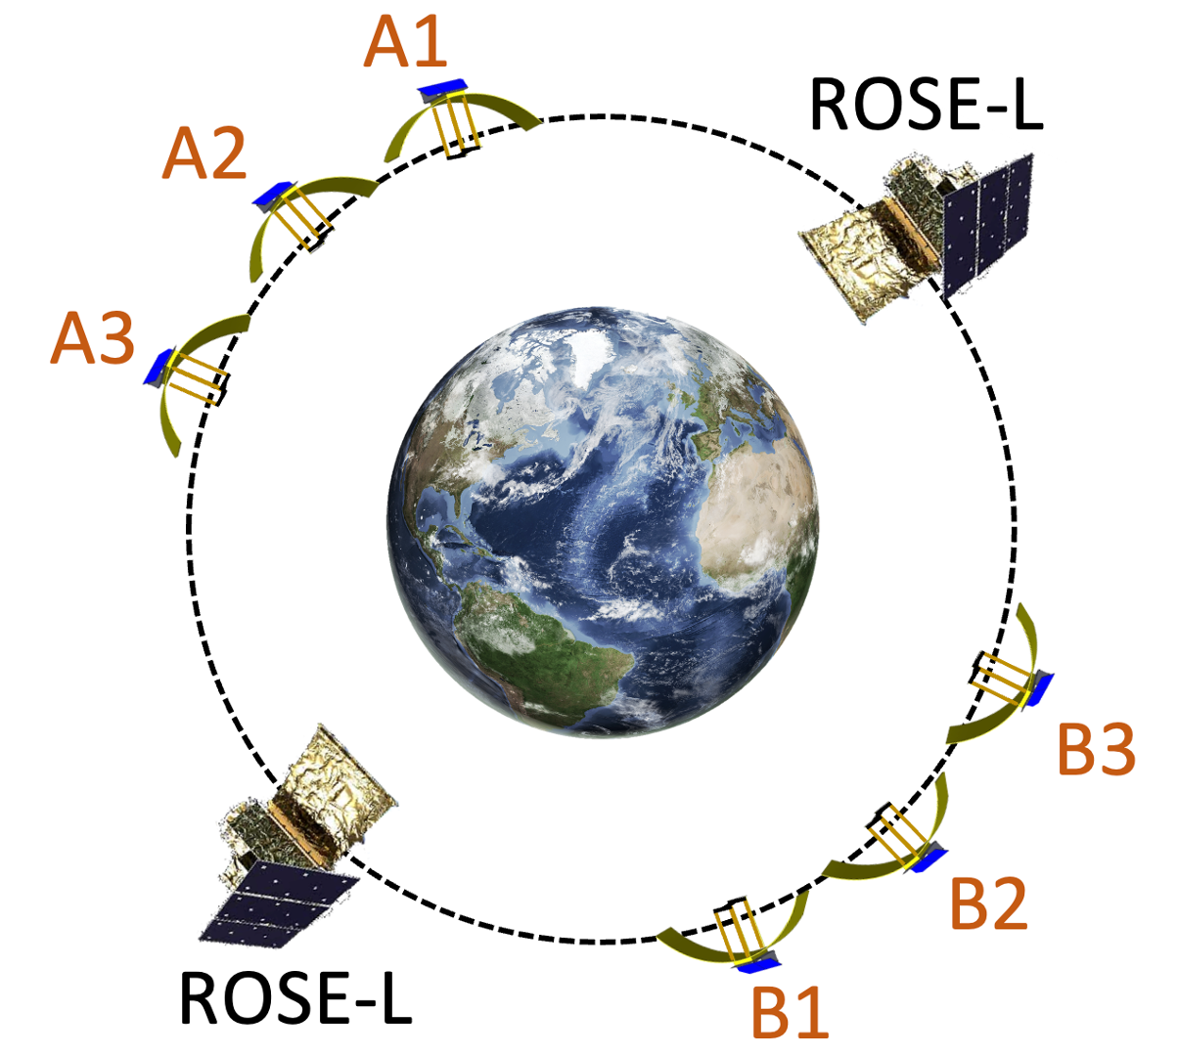
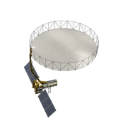

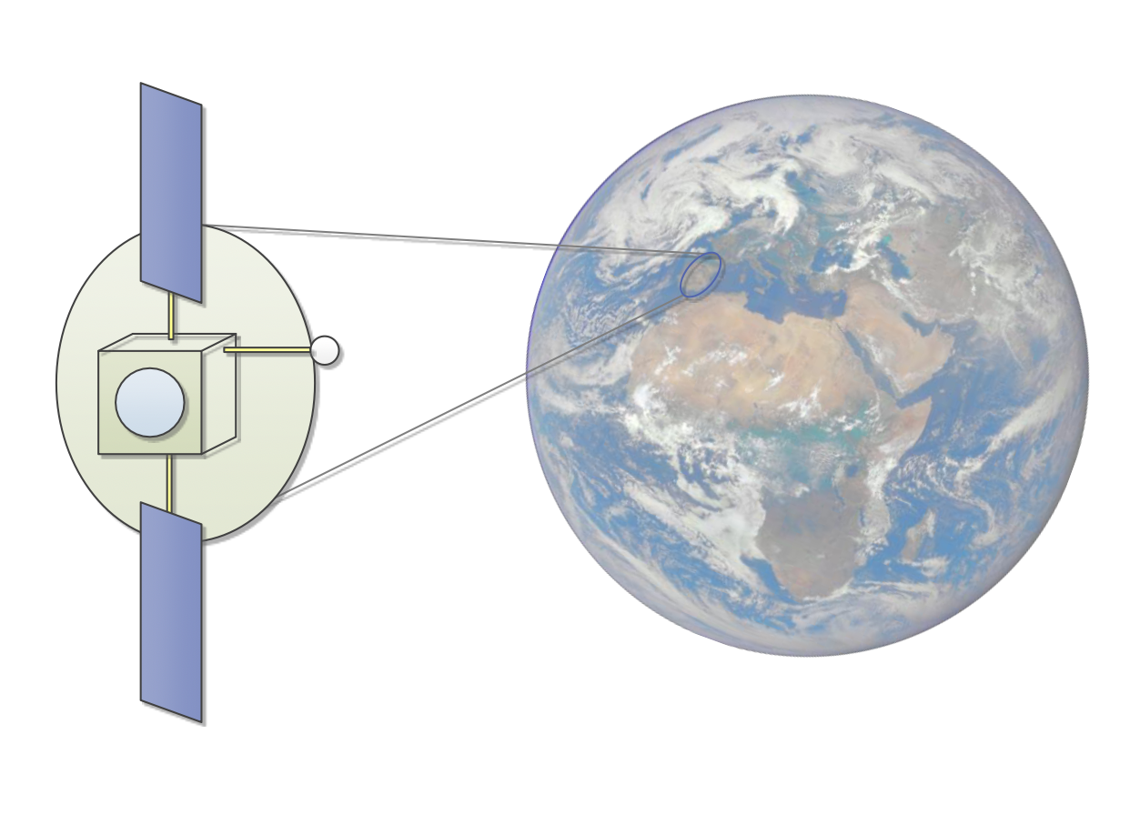

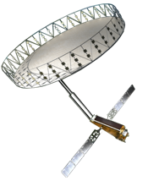
Future SAR Systems used for Repeat Pass Interferometry
Present
2024-2028
2028 …
Sentinel-1s (C)
ALOS-4 (L)
ALOS-2
(L)
ROSE-L
(L)
SDC
(L)
SAOCOM1-A/B (L)
NISAR (L/S)
Hydroterra+
COSMO-SkyMeds (X)
Tandem-L (?)
Others…
Others…
Notes:
Point of slide: The age of SAR is upon us with a myriad of systems and potential systems. Details on commercial sector are not well known.

Slide 12
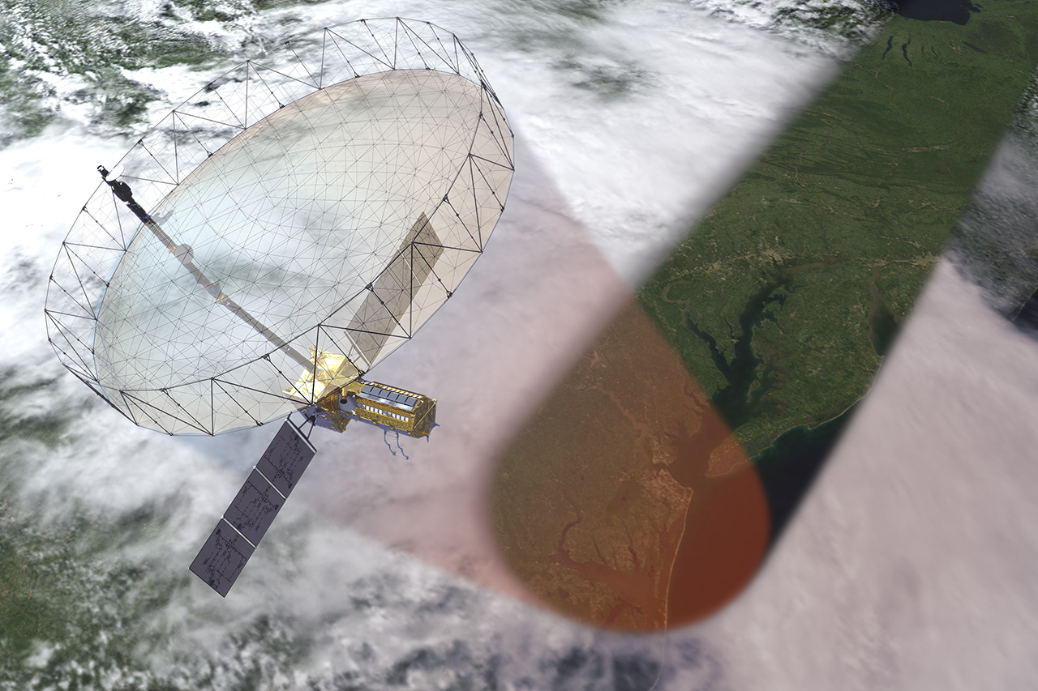
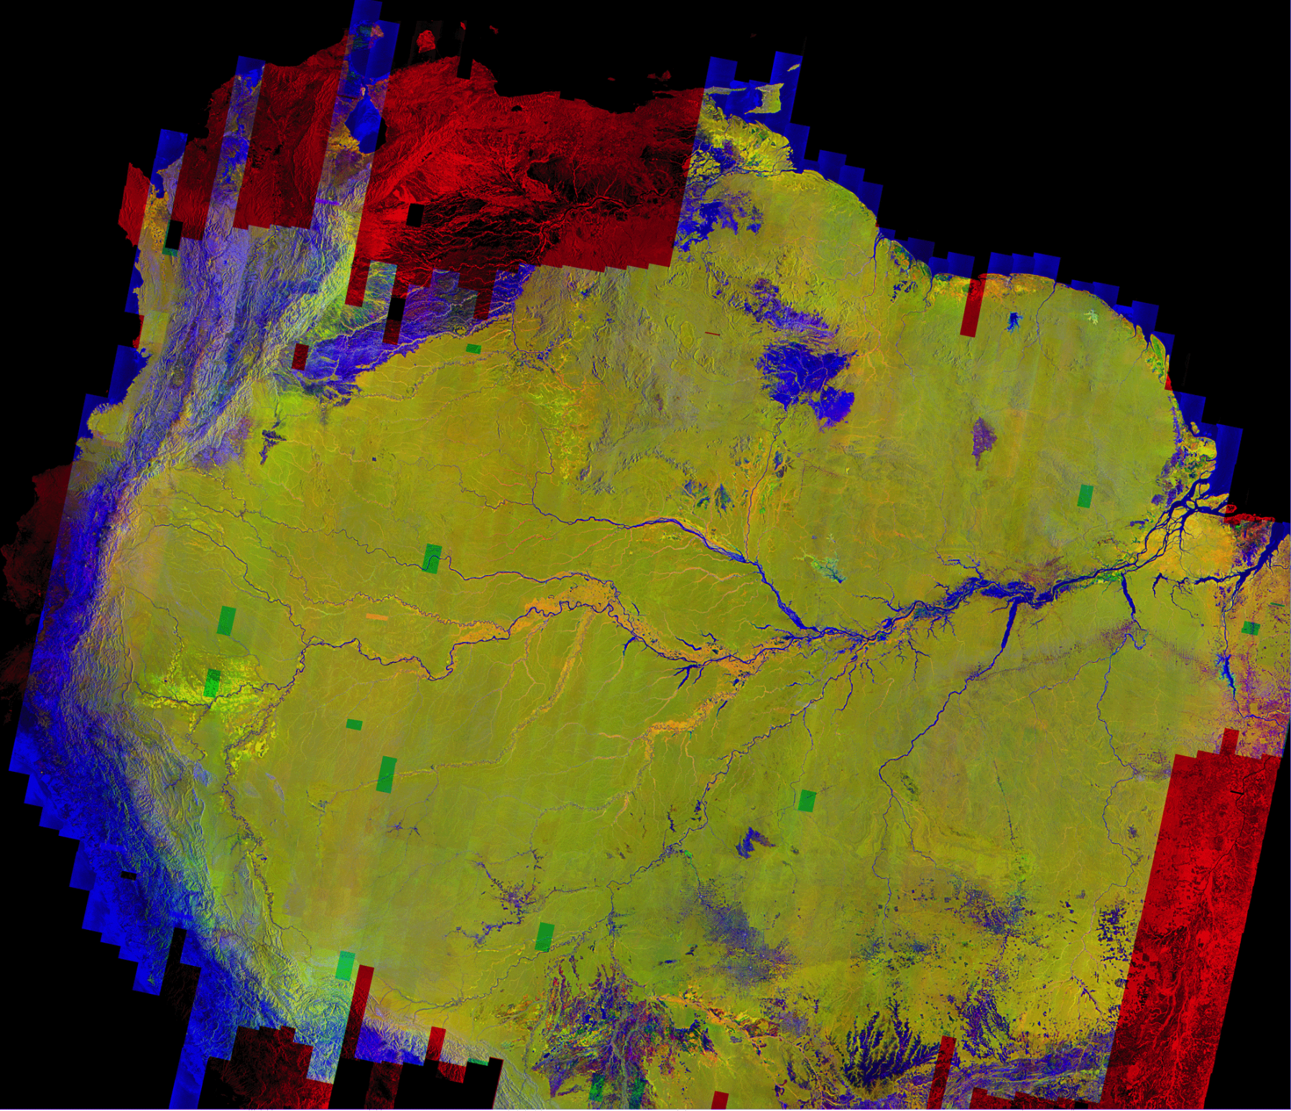
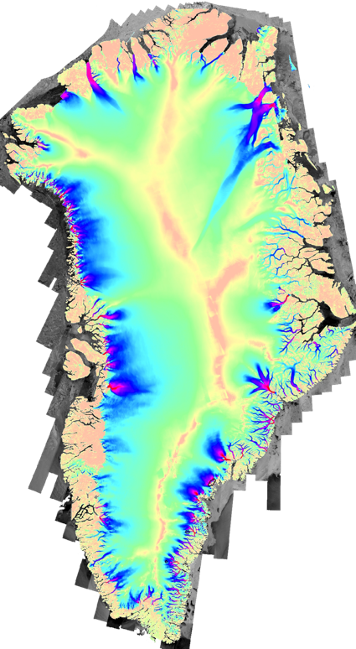
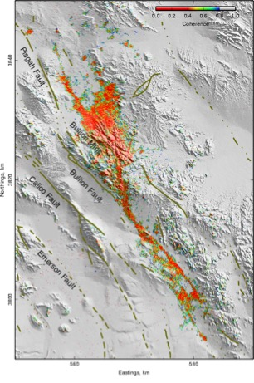
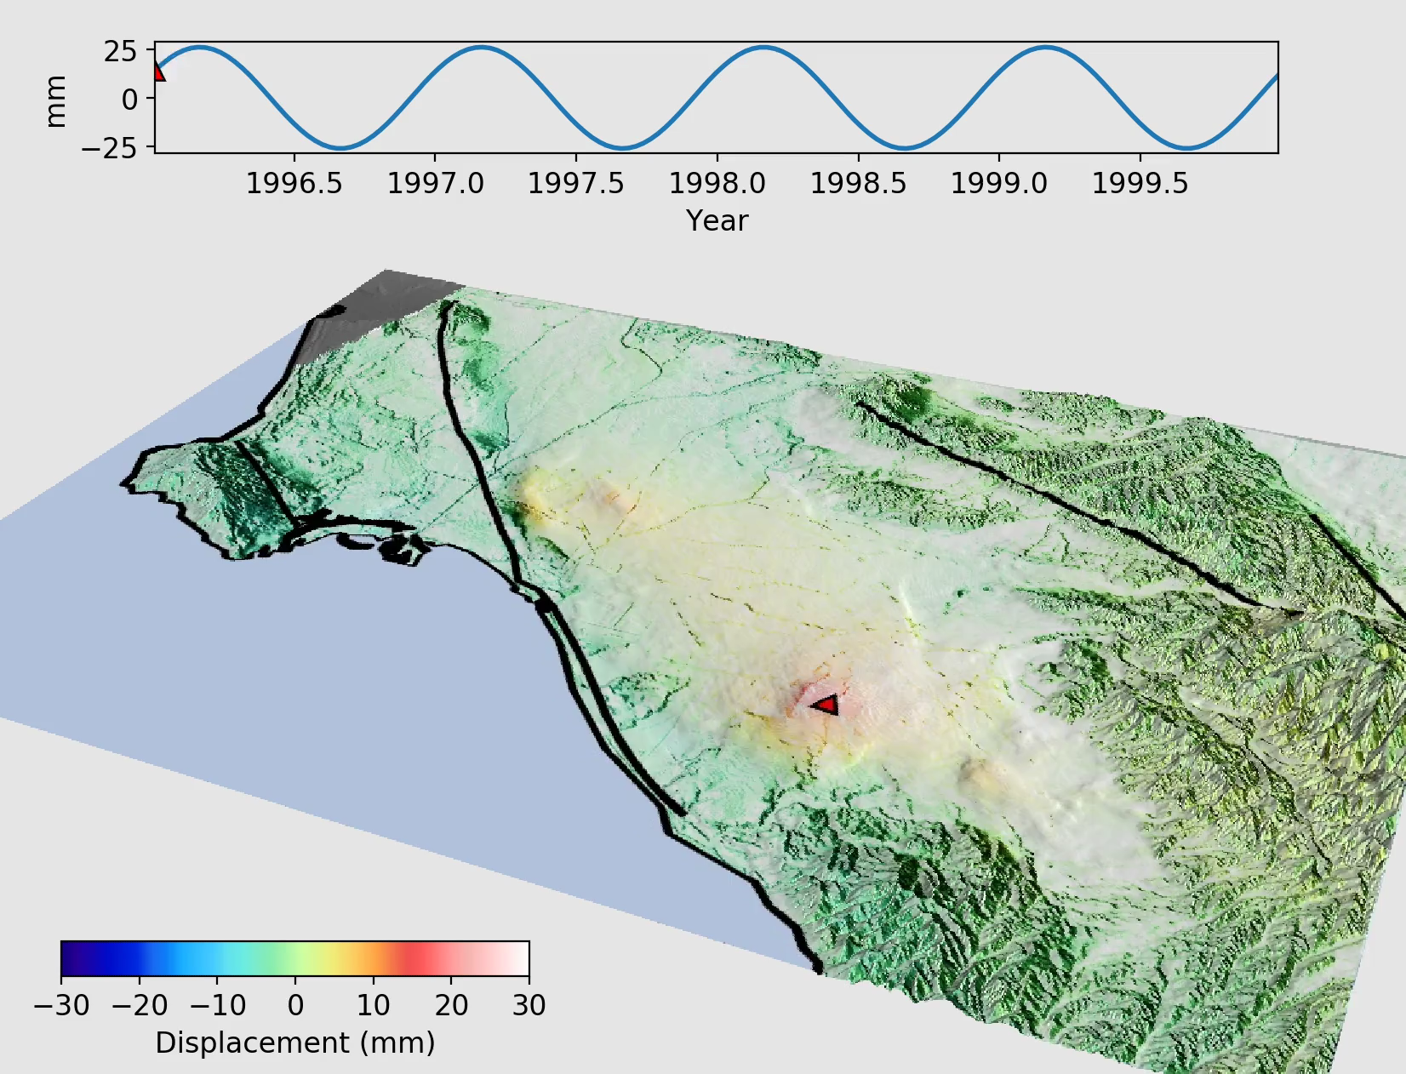
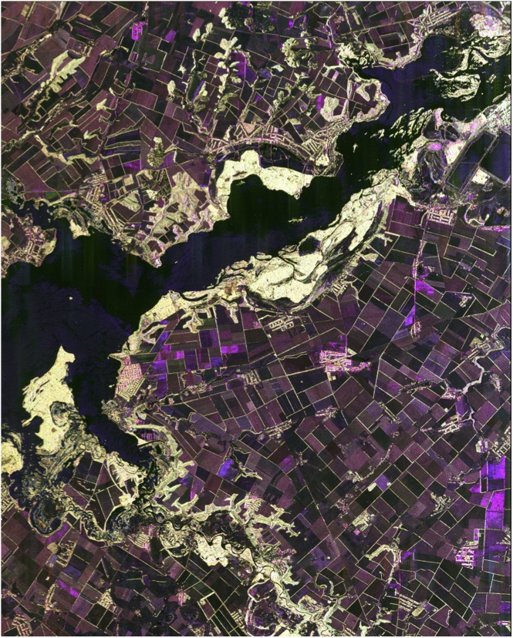
NISAR Science and Applications Understanding Climate, Carbon, and Catastrophic Change Resource Management
Global Biomass
Dynamics
Global Ice
Dynamics
Global
Hazards
Greenland
Amazonia
Earthquake damage
Aquifer Health
Agriculture
Global systematic, all-weather, day-night, time-series measurements of surface deformation and change
Notes:
Response of ice sheets to climate change and the interaction of sea ice and climate
Carbon storage and uptake dynamics in wooded, agricultural, wetland, and permafrost systems
Earthquake, volcanic, and landslide cycles, exploring potentials for urgent response and hazard mitigation
Aquifer health
Agricultural activity and productivity measures
Field-scale soil moisture weekly variability
Infrastructure monitoring and land-level change

Slide 13
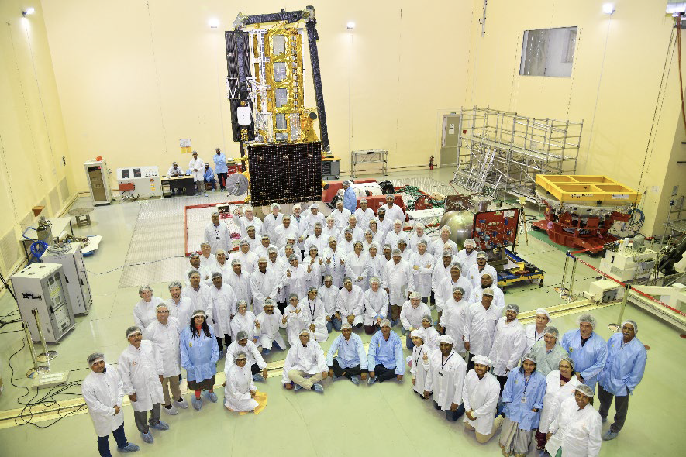
NISAR Status
NISAR completed mechanical integration and environmental testing in January 2024
Late-breaking thermal issue has delayed the launch further
Current launch estimate is Feb. 2025
First light images: day 60
Continuous global science data: day 90 (2026 first snow data)

Slide 14
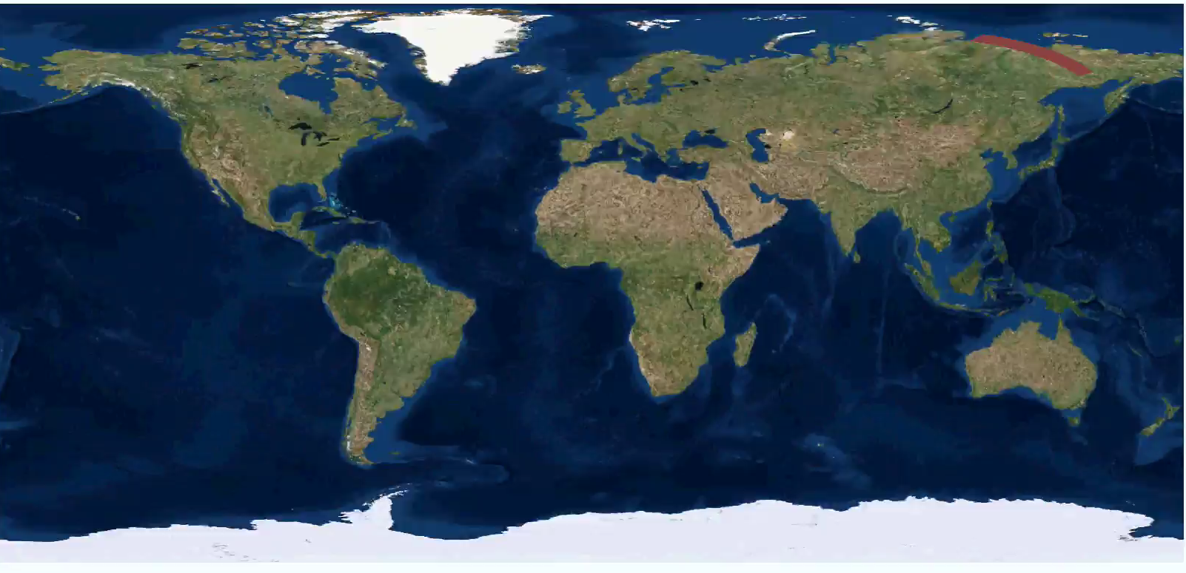
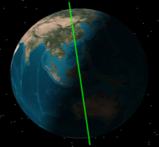
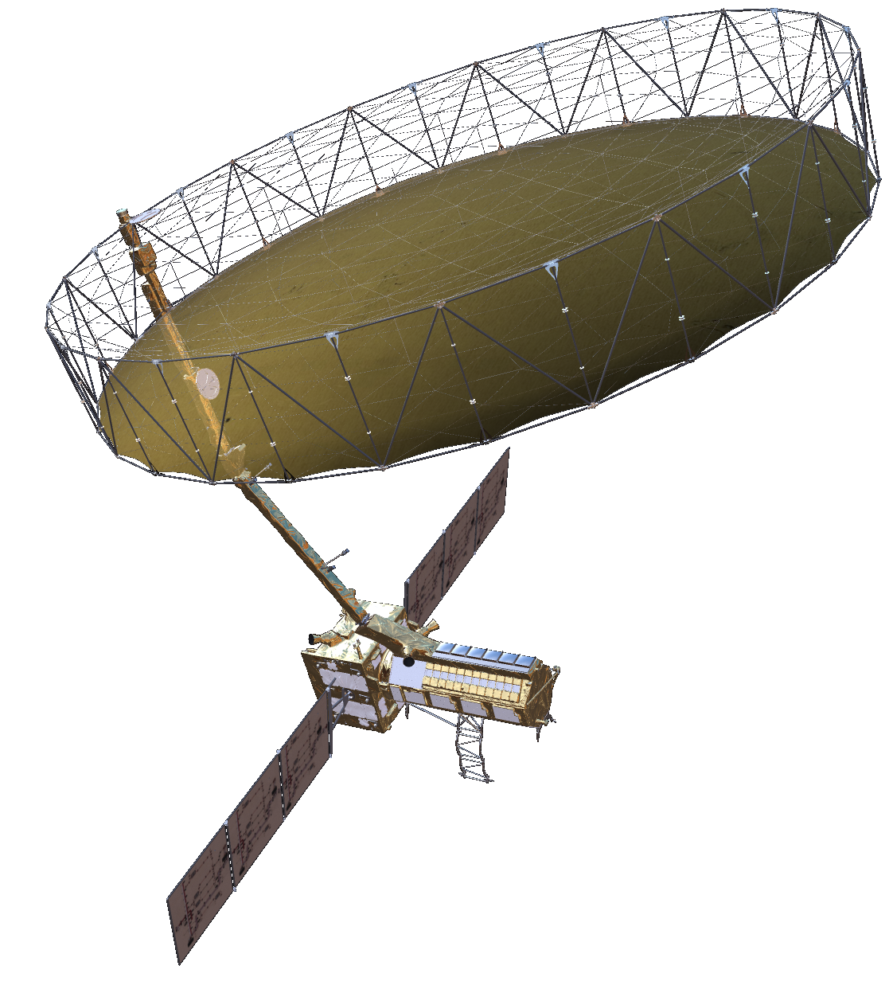
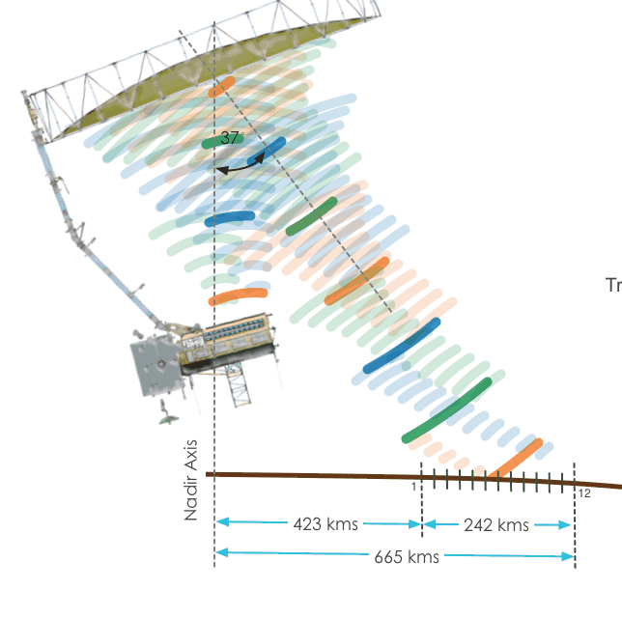
NISAR Science Observation Summary
NISAR Characteristic: | Would Enable:
L-band (24 cm wavelength) | Low temporal decorrelation and foliage penetration
S-band (9.4 cm wavelength) | Sensitivity to light vegetation
SweepSAR technique with Imaging Swath > 240 km | Global data collection
Polarimetry (Single/Dual/Quad) | Surface characterization and biomass estimation
12-day exact repeat | Rapid Sampling
3 – 10 meters mode-dependent SAR resolution | Small-scale observations
3 yrs (NASA) / 5 yrs (ISRO) science operations | Time-series analysis
Pointing control < 273 arcseconds | Deformation interferometry
Orbit control < 500 meters | Deformation interferometry
> 10% (S) / 50% (L) observation duty cycle | Complete land/ice coverage
Left-only pointing (Left/Right capability) | Uninterrupted time-series Rely on Sentinel-1 for Arctic
NISAR Uniquely Captures the Earth in Motion
6 AM / 6 PM
Observing
Geometry
747 km
33º
47º
Earth surface
>240 km

Slide 15
NISAR Science Data Analysis and Archive Approach
Level 3-4 (Validation Only)
Level 3-4 Satellite Needs Working Group
Development began in FY2021
Level 0
Level 1
Level 2
Level 0, Level 1, Level 2, Level 3-4 Validation, Browse Products, and Catalog delivered to DAAC
Ancillary Data
(Meteo, DEM, etc.)
Woody biomass for regions < 100 t/ha
VP
Global Soil Moisture -200 m product
Vegetation disturbance product
VP
Radar Reformatted Raw Data
Time Varying Parameter Files
Calibrated Single Look Complex Images in Radar Coordinates
(multiple modes)
SLC & Multi-looked & Geocoded polarimetric images
Sahara Soil Moisture -500 m product
Wetlands inundation area
VP
Crop area
VP
Level 3-4 SNWG – FY2021
Vegetation structure*
Products
Ground deformation/rates
VP
Instrument
Ecosystems
Solid Earth def.
Dynamics of ice
Hydrology
Multi-looked & Geocoded Interferograms and Images
Global surface water extent product
Change proxy
VP
Global disturbance product
Ice sheet/glacier velocity and velocity change
VP
North America deformation
product
NISAR’s DAAC:
Alaska Satellite Facility
Sea ice velocity
VP
Managed by the OPERA Project outside of NISAR Project
VP = Validation Product
*experimental
15

Slide 16
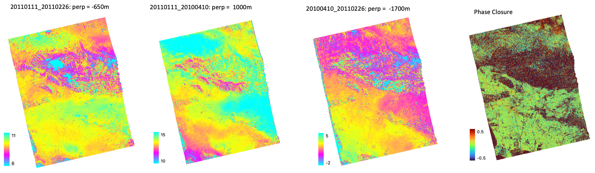
InSAR products from NISAR
All InSAR products will be produced for nearest neighbor pairs
12 days global interferograms
Global spatial scope for Geocoded Unwrapped Interferogram (GUNW)
Correction layers in GUNW products
Ionospheric phase screen
Tropospheric delay
Generating product with better resolution (spatial correlation of. Snow: 50m) or longer time sampling (24, 36, … ) needs tools for snow community
Product | Grid | Posting | Spatial scope
GSLC | Geocoded | 5m x (40/10/5/2.5)m | Target dependent
GUNW | Geocoded | 80 m | Global
Three sample GUNW products produced with NISAR processor (ALOS-1 raw data > RSLC > GUNW)

Slide 17
NISAR for Snow Community
NISAR launch is close – global coverage every 12 days, 80m resolution
It will be an incredible time series data for retrieving SWE
UAVSAR: shown the capability of L-band InSAR to retrieve changes in SWE and depth
Sentinel-1 data analysis have shown the capability of InSAR time series to retrieve total SWE
Advantages
Global data at 80m resolution, every 12 days
The large frame covers large number of in situ stations and SWE spatial variability
Temporal coherence is higher at L-band compared to Sentinel-1 C-band
Ambiguous ΔSWE is higher at L-band compared to Sentinel-1 C-band
It propagates through the vegetation more at L-band compared to Sentinel-1 C-band
Limitation
C-band is more sensitive to DSWE than L-band
NISAR collects InSAR data every 12 days, compared to 6-days for Sentinel-1. It reduces the temporal coherence.
We need to develop software workflows to generate InSAR data with desired spatial resolution and time sampling
UAVSAR_pytools, an open source library led by students (now postdocs) started at SnowEx Hackweek
LIDAR data is the best resource to quantify the sources of error
Targeted field observations to identify melt, temperature, interval boards, density are very helpful to identify the limitation of this method
Huge opportunity for snow community – but lots of work to do for a global snow retrieval

Slide 18
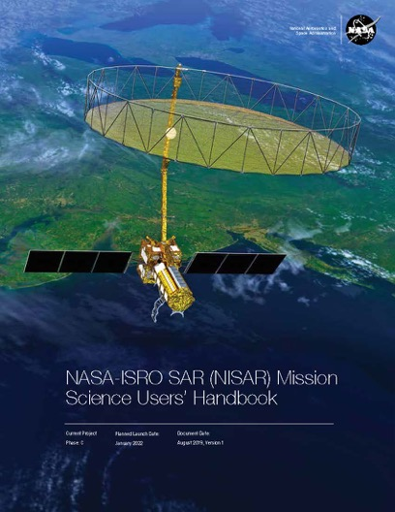
NISAR is almost here…
For more information:
https://nisar.jpl.nasa.gov

Slide 19
Back Up

Slide 20

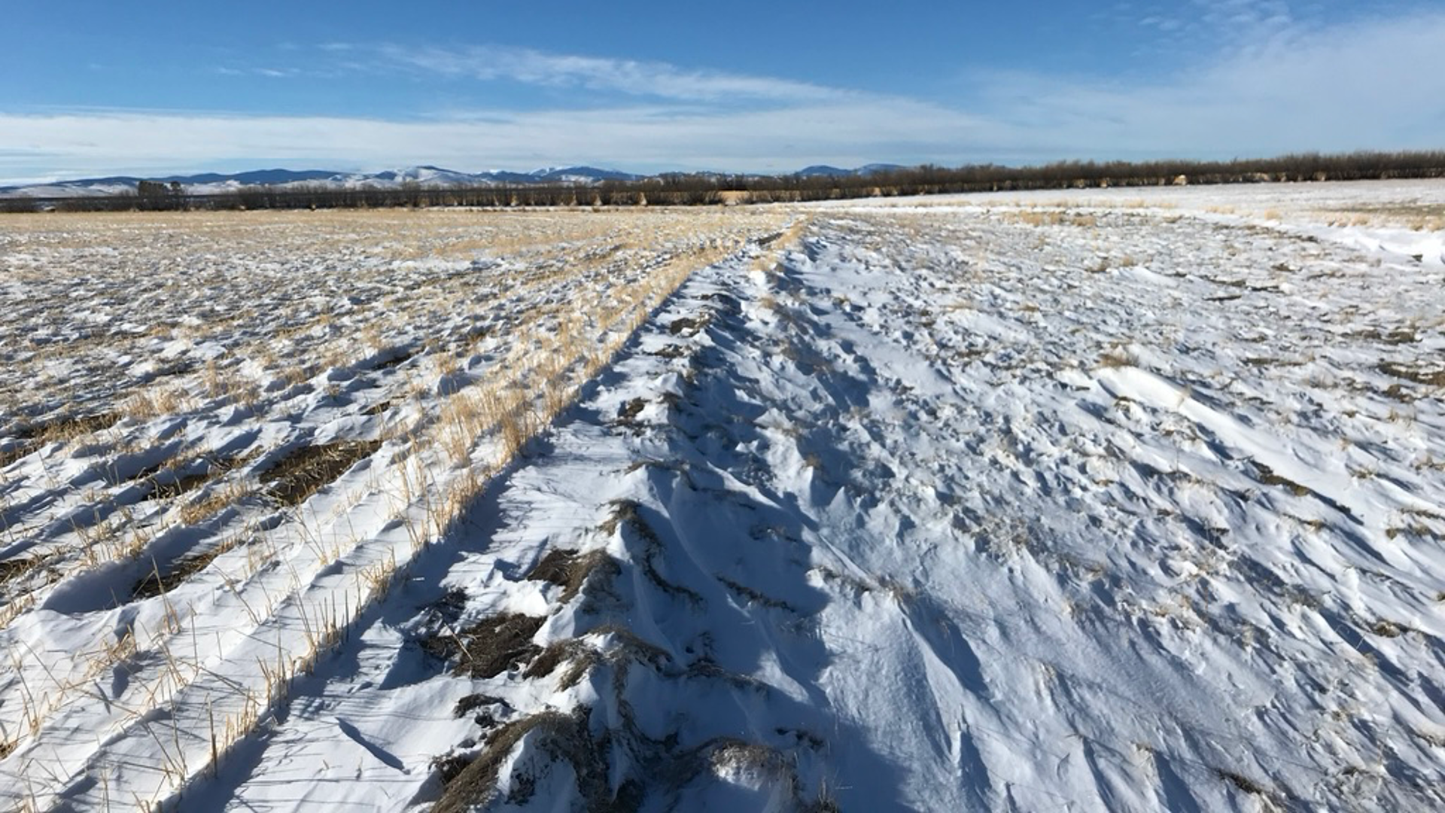
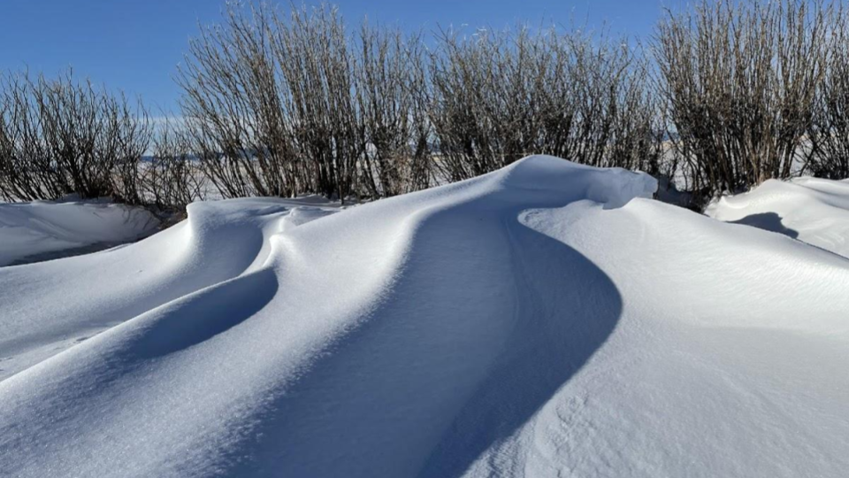
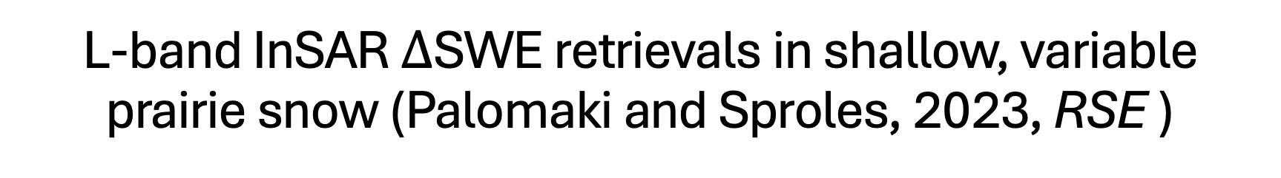
L-band InSAR $Δ$SWE retrievals in shallow, variable prairie snow (Palomaki and Sproles, 2023, RSE )
average snow depth = 12 cm
good absolute agreement
poor absolute agreement
Subgrid spatial variability within InSAR pixels contributes to poor absolute agreement.
Lidar and L-band InSAR show similar
spatial patterns in shallow snow.
Notes:
Main points:
Snow depths at the CARC SnowEx 2021 site were shallow (average ~12 cm) and highly variable within and between agricultural plots, including some areas of snow-free ground
LiDAR and InSAR $Δ$SWE retrievals show similar spatial patterns across the site.
Exposed agricultural crop stubble did not affect the InSAR $Δ$SWE retrievals.
High levels of subgrid spatial variability at the UAVSAR pixel scale (~5 m) contributed to poor absolute agreement between LiDAR and InSAR $Δ$SWE measurements.
Such small amounts of $Δ$SWE (~mm) are difficult to measure with any remote sensing platform – we do not necessarily trust the LiDAR in this environment.

Slide 21
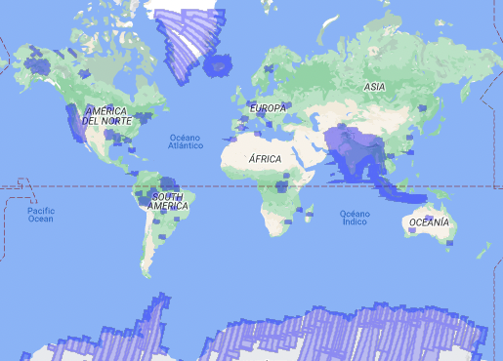
Planned joint L/S band observations for one 12-day orbit cycle
Shown is about 100 Tb of raw SAR data that will be downlinked over each 12 day orbit cycle.
Many of NISAR’s science Cal/Val sites are jointly imaged by L-band and S-band
Targets include:
India/ISRO (land, ice, ocean)
Global distribution of Ecosystem Cal/Val sites
Arctic/Antarctic ice sheets
Deformation–Western U.S.
Reflector arrays –India, Alaska, California

Slide 22
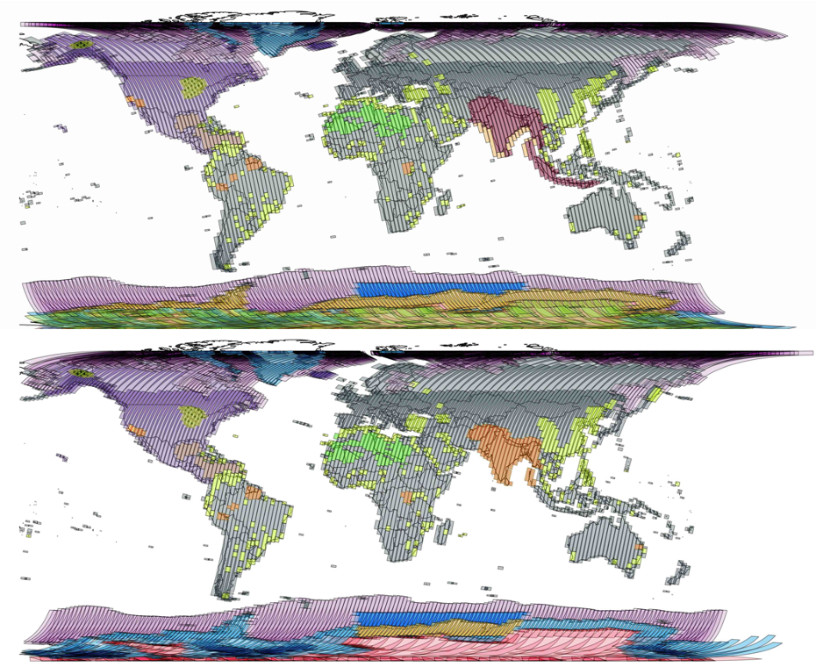
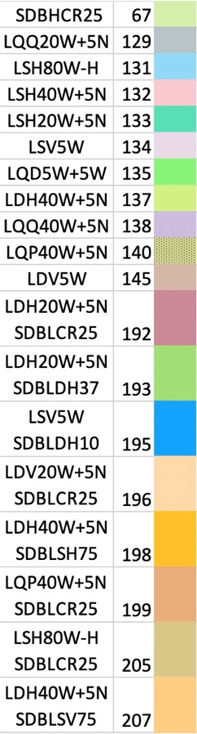
NISAR Observation plan
Ascending
Currently most science observations over the globe are dominated by 20+5 MHz Dual-Pol H-transmit
North America is mostly covered by 40+5 MHz Dual-Pol H-transmit acquisitions
The observation plan is diverse in space but consistent in time (few exceptions)
Dual-pol 40+5 MHz
Dual-pol 20+5 MHz
Descending
Dual-pol 40+5 MHz
Dual-pol 20+5 MHz

Slide 23
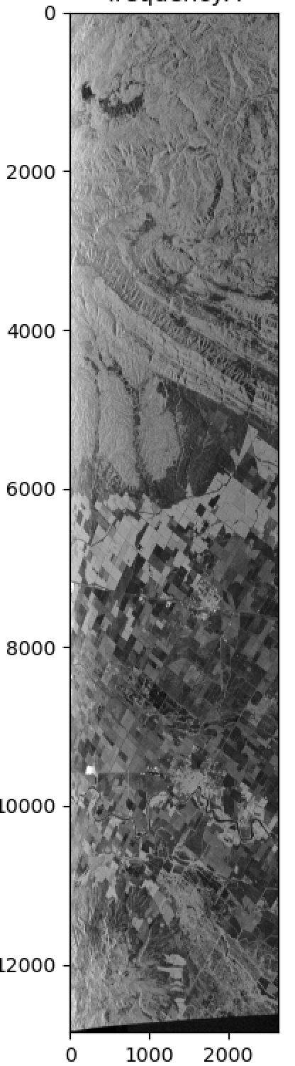

Geocoded Single Look Complex from NISAR
GSLC products are Single Look Complex (SLC) SAR imagery geocoded on a map coordinate system
The GSLC products are provided on NISAR frames and will be produced globally
The grid of the products are in UTM projection at mid latitudes and in Polar stereographic in polar regions
The grid of GSLC products from different frames have an integer spacing difference allowing to mosaic the products without interpolation.
RSLC
GSLC
Range
Azimuth
Azimuth
Northing
Range bandwidth | North spacing | East spacing
5 MHz | 5 m | 40 m
20 MHz | 5 m | 10 m
40 MHz | 5 m | 5 m
80 MHz | 5 m | 2.5 m
Range
Easting
RSLC represents simulated NISAR product from UAVSAR
GSLC is derived by geocoding the RSLC

Slide 24
RSLC Specification
The RSLC products will be ~1.2x oversampled in both range and azimuth directions
Azimuth spacing: 1520 Hz (equivalent to ~5 m pixel size)
Slant range spacing: mode dependent
A Kaiser(1.6) window to weight the Range spectrum
The azimuth weighting is the antenna pattern
Range spectrum of different radar modes
80 MHz
40 MHz
5
20 MHz
5
40 MHz
RSLC resolution and posting
20 MHz
Range bandwidth | Azimuth resolution | Slant range resolution | Azimuth posting | Slant range posting
5 MHz | ~6 m | 30 m | ~5 m | 25 m
20 MHz | ~6 m | 7.5 m | ~5 m | 6.25 m
40 MHz | ~6 m | 3.75 m | ~5 m | 3.12 m
80 MHz | ~6 m | 1.95 | ~5 m | 1.56 m
5
1257.5
Range frequency [MHz]
The variation of the wavelength (center frequency) across all different L-band modes is less than 3%.

Slide 25


NASA’s DAAC
(ASF DAAC for NISAR L1-L2 products)
Users
ISCE3
HySDS
InSAR Scientific Computing Environment, Enhanced Edition
(ISCE3)
ISCE3 is the core software to produce the NASA’s SAR products from NISAR (and Sentinel-1)
https://github.com/isce-framework/isce3

