Slide 1
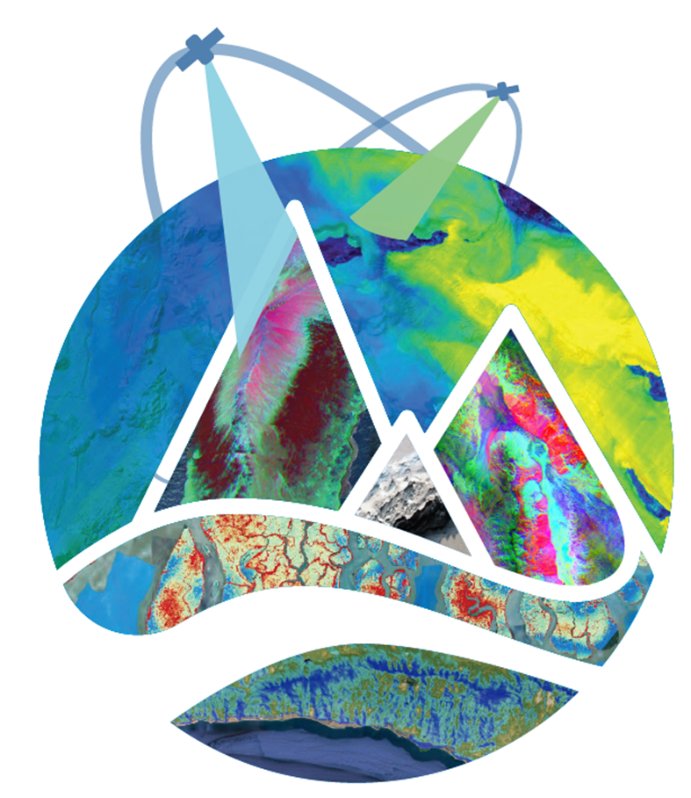
Niklas Bohn, Edward H. Bair, Amy Braverman, Philip G. Brodrick, Jeff Dozier, Robert O. Green, Maggie Johnson, Kimberley R. Miner, Noah Molotch, Karl Rittger, David Schimel, David R. Thompson, et al. 14 August 2024 NASA Community Snow Meeting, Boulder (CO)
NASA Surface Biology and Geology (SBG)
Snow & Hydrology
The research was carried out at the Jet Propulsion Laboratory, California Institute of Technology, under a contract with the National Aeronautics and Space Administration (80NM0018D0004).
Reference herein to any specific commercial product, process, or service by trade name, trademark, manufacturer, or otherwise, does not constitute or imply its endorsement by the United States Government or the
Jet Propulsion Laboratory, California Institute of Technology.

Slide 2

SBG with VSWIR Imaging Spectroscopy Earth Decadal Survey Designated Observable
Delivers “Most Important and Very Important” Objectives Across the Decadal Focus Areas
VSWIR
ECOSYSTEMS AND NATURAL RESOURCES
E-1. What are the structure, function, and biodiversity of Earth’s ecosystems, and how and why are they changing in time and space?
E-2. What are the fluxes of carbon, water, nutrients, and energy between ecosystems and the atmosphere, the ocean, and the solid Earth, and how and why are they changing?
E-3. Fluxes within ecosystems. What are the within ecosystems, and how and why are they changing?
SOLID EARTH
S-1. How can large-scale geological hazards be accurately forecast in a socially relevant time frame?
S-2. How do geological disasters directly impact the Earth system and society following an event?
HYDROLOGY
H-1. How is the water cycle changing?
H-2. How do anthropogenic changes in climate, land use, water use, and water storage, interact and modify the water and energy cycles locally, regionally and globally.
H-4. Hazards, extremes, and sea level rise. How does the water cycle interact with other Earth system processes to change the predictability and impacts of hazardous events.
CLIMATE
C-3. How large are the variations in the global carbon cycle and what are the associated climate and ecosystem impacts?
WEATHER
W-3. How do special variations in surface characteristics (influencing ocean and atmospheric dynamics, thermal inertia and water) modify transfer between domains?
TIR
VSWIR Imaging Spectroscopy
Next Generation Technology
>10X the performance of EMIT
Terrestrial ecology and agriculture
Coastal and inland waters
Geology and minerals
Snow/ice and hydrology
GHGs as value added
2

Slide 3
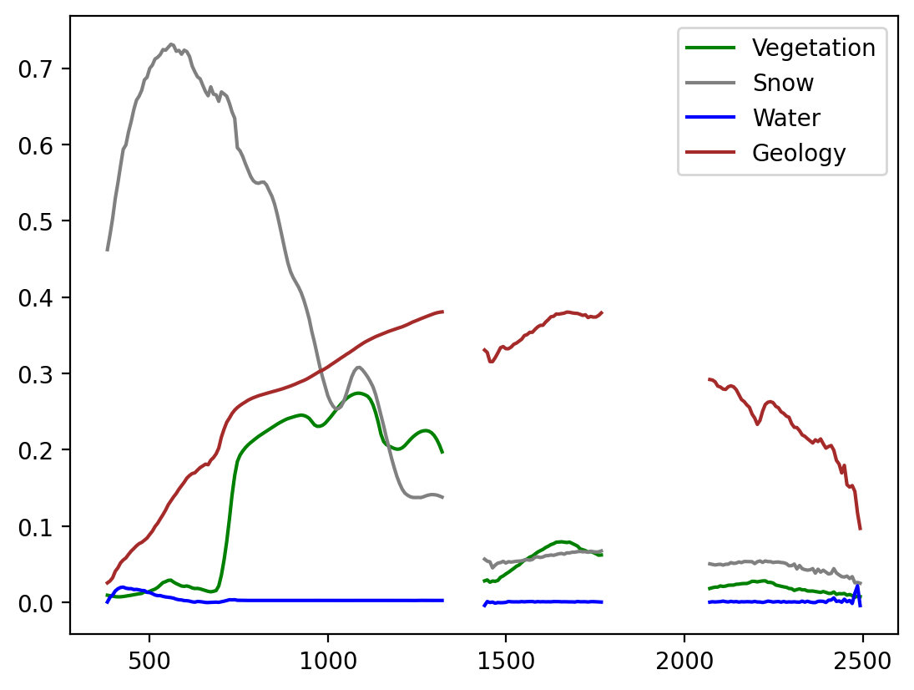
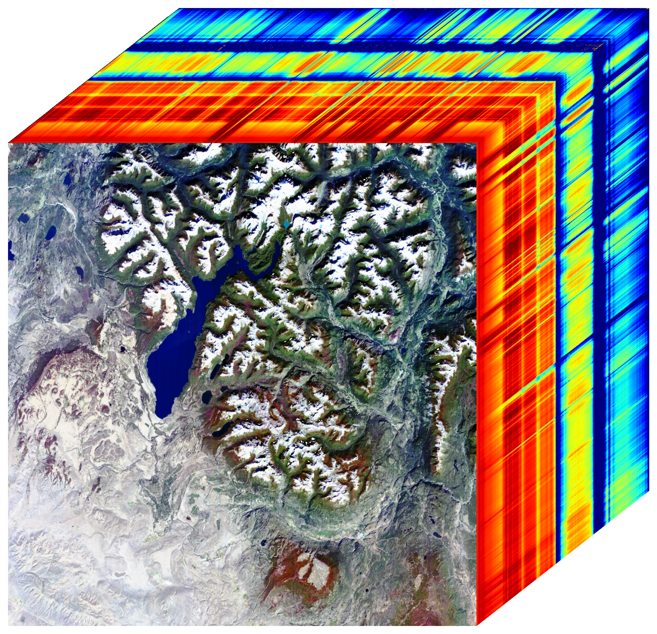
SBG VSWIR Observes the Earth System
Atmosphere
GHG Point Source Emissions
Water Vapor
Aerosols
Clouds, etc.
Aquatic Ecosystems
Hydrology Snow/Ice Physics
Coastal Ocean
Inland Lakes
Aquatic biomass
Benthic composition
Seasonal snow
Mountain snow
Water Resources
High latitude snow
Ice Sheets
Sea Ice
Snow Melt
Glacial
Algae
Sediment
Land Interface
Coastal Erosion
Snow and Ecosystems
Glaciers
Floating Vegetation
Snow and Rock/Soil
Terrestrial Ecosystems
Plant
Composition,
Function, and Structure
Solid Earth
Geology and Soils
Geobotany
Soil-Ecosystems
Mineralogy
Exposed Outcrops
Open Desert
Climate Weather Connections
Ecosystems
Biodiversity
Agriculture
Forests

Slide 4
SBG VSWIR Observation Requirements from Decadal Survey Substantiated and Refined with Studies and Analyses
The SBG Research and Applications Traceability Matrix (SATM) follows the National Academies 2017 decadal survey directions for desired capabilities. Key performance parameter ranges for the VSWIR instrument, derived from the SATM are shown below.
Spectral Range: 380-2500 nm
Spectral Bands: Between 8 to 12 nm with continuous spectral coverage
Radiometric and Signal to noise (SNR) performance: SNR ≥400 VNIR and SNR ≥250 SWIR at 25% reflectance, <5% absolute radiometric uncertainty with high uniformity, low stray-light, and low polarization sensitivity needed to meet key RA objectives
Ground Sampling Distance (GSD) at nadir: 31 to 35 m
Revisit Period: ≤16 days at the equator
Coverage: All global land, inland waters, and coastal oceans
Local Time for Acquisition: Between 10:30 to 11:30 AM
Stability and duration: Measurements must be able to detect changes for addressing dynamics of the Earth System over the prime mission lifetime of 3 years with possible extensions

Slide 5
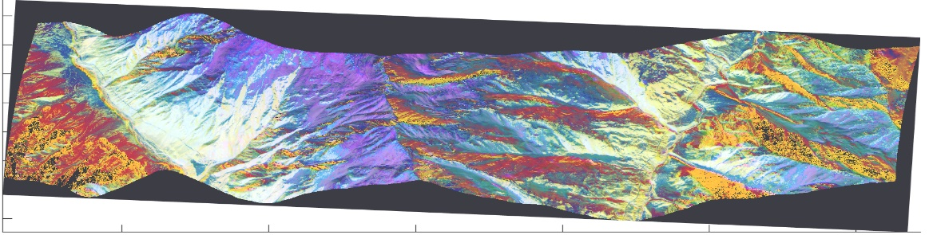
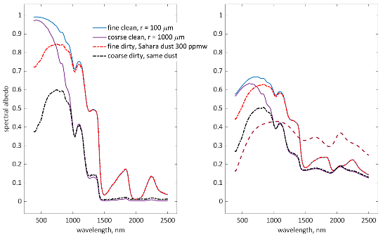
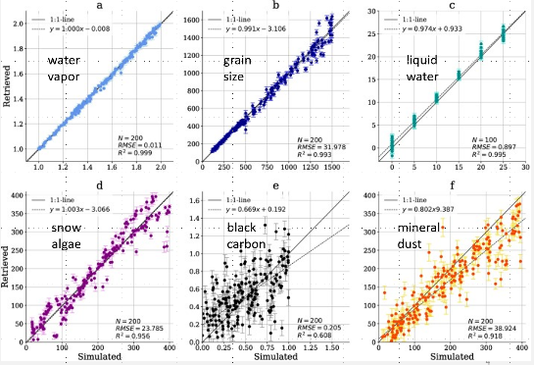
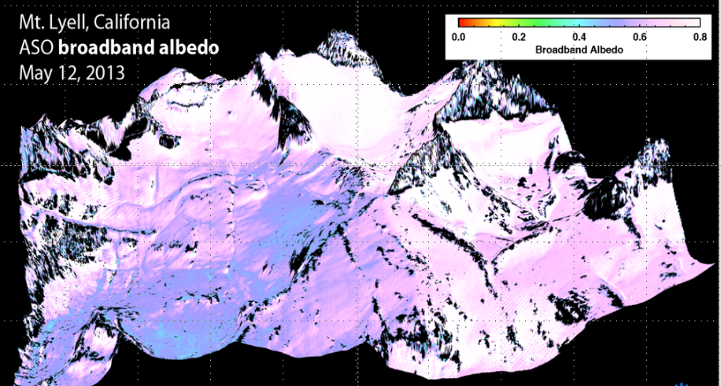
New Global Research Called for in the Decadal Survey Evidence of Low Risk from Local/Regional Studies
AGRICULTURE, FOOD SECURITY AND SURFACE WATER MANAGEMENT
Information on crop health to inform optimized fertilization
Improve water supply management through characterization of snow properties and reservoir inflows
Information to reduce the impacts of drought, such as crop loss and famine, on global scales
WATER QUALITY AND COASTAL ZONES
Support early detection of and response to harmful algal bloom formation
Protect sensitive aquatic habitats by monitoring/reducing water pollutant loading, particular in coral reefs and other sensitive ecosystems
CONSERVATION
Support biodiversity understanding and protections by mapping invasive species composition, structure, distribution; support removal and restoration Monitoring of endangered species habitat; provide alerts of disease mortality of impacted vegetation, including insect infestation
Biodiversity hotspots, priority conservation areas, 30 x 30 plans
WILDFIRE RISK AND RECOVERY
Fuel mapping (cover type, extent, status) for wildfire danger management
Post fire severity assessment and recovery, including prediction of areas with higher likelihood of debris flows
DISASTERS AND HAZARDS
Detect and track oil spill events and
Mine waste hazard mapping before and after events
Toxic mineral mapping and related airborne dust impacts
GEOLOGY APPLICATIONS
Mineral mapping for exploration efforts and reduction of environmental hazards
Landslide risk assessment with improved surface mineralogy knowledge and land cover maps
Weak mineral zones in active volcanos to predict debris flow potential
CLIMAGE CHANGE MITIGATION
Methane and Carbon Dioxide point and localized sources
Hydrology
Understand and quantify snowmelt, ice melt, and sublimation from snow and ice worldwide at scales driven by topographic variability
Water Resources
Snow melt prediction in California

Slide 6
SBG VSWIR Snow & Hydrology – Decadal Survey Focus
DS Science/Application Objective | Priority | DS Suggested Biogeophysical Parameters | Geophysical Parameters (one-sigma uncertainty target) | Applications enabled
H-1c. Quantify rates of snow accumulation, snowmelt, ice melt, and sublimation from snow and ice worldwide at scales driven by topographic variability. | Most Important | Snow and glacier albedo and surface temperature. Spectral albedo of subpixel snow and glaciers at weekly intervals to an accuracy to estimate absorption of solar radiation to 10%. Ice/snow temperature to ± 1K. At spatial resolution of 30 to 100 m. | Snow and ice coverage fraction (coverage fraction +/- 7%) | EA1 Water resource management, EA2 Drought monitoring, EA3 Drought / flood prediction, EA4 Weather forecast, EA5 Climate modeling, EA6 Shipping / navigation around sea ice
 |  |  | Snow surface reflectance, 380-2500 nm
 |  |  | Snow grain size, used to calculate albedo (absorption +/- 7%)

Slide 7
SBG VSWIR Snow & Hydrology – Recommendations
Slide courtesy
of Jeff Dozier
The Science/Applications Traceability Matrices for SBG should:
Specify that the sensor, data processing, and algorithms retrieve square root of effective radius of snow grains to within 18% RMS error
And that the “darkening” of snow—the difference between estimated clean albedo and actual albedo integrated over wavelengths 400 to 900 nm—is retrieved to within 12% RMS error
(these thresholds to be explored under a range of illumination conditions and fractional snow-covered area)
Two problems to solve
Effect of surface roughness (rougher surfaces a little darker)
Atmospheric correction for bright surfaces (avoid spurious darkening)
SBG VSWIR Snow and Hydrology
14 August 2024
7

Slide 8
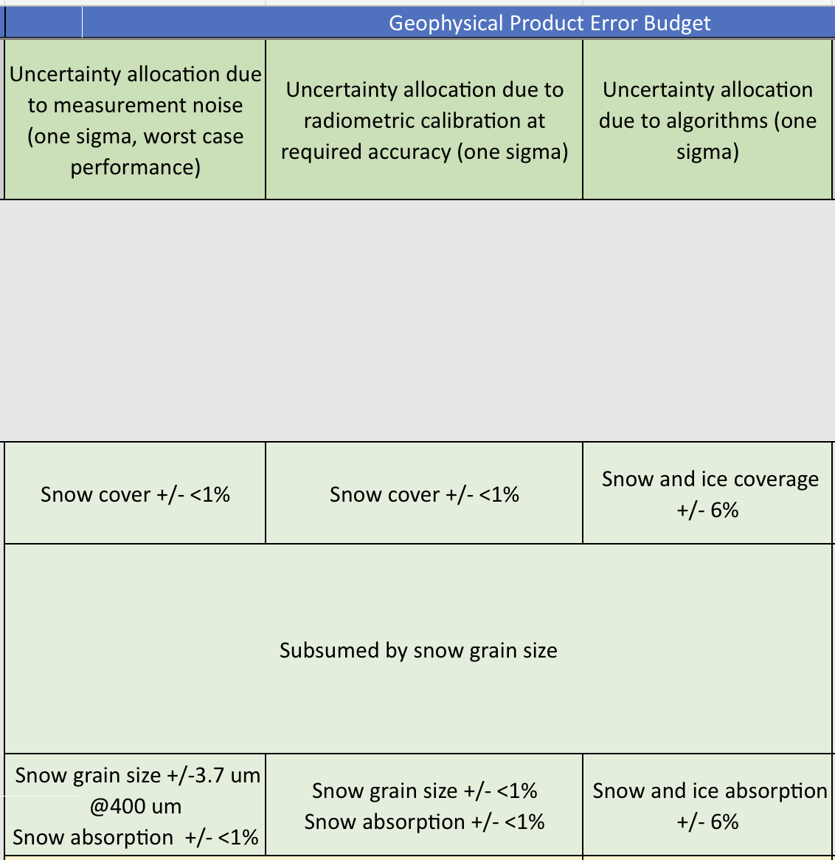
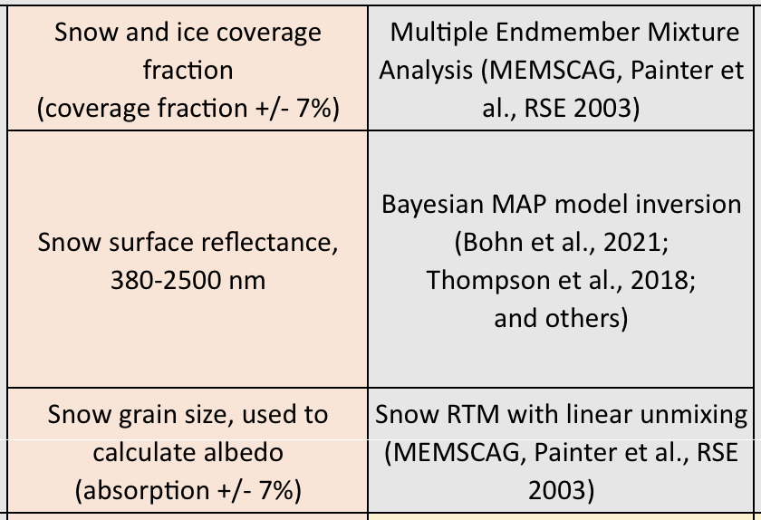
SBG VSWIR Snow & Hydrology – Product Error Budget
From albedo to absorption
From grain size to square-root of grain size
Radiative forcing: error budget for integrated difference between clean and dirty snow in VIS to NIR wavelengths

Slide 9
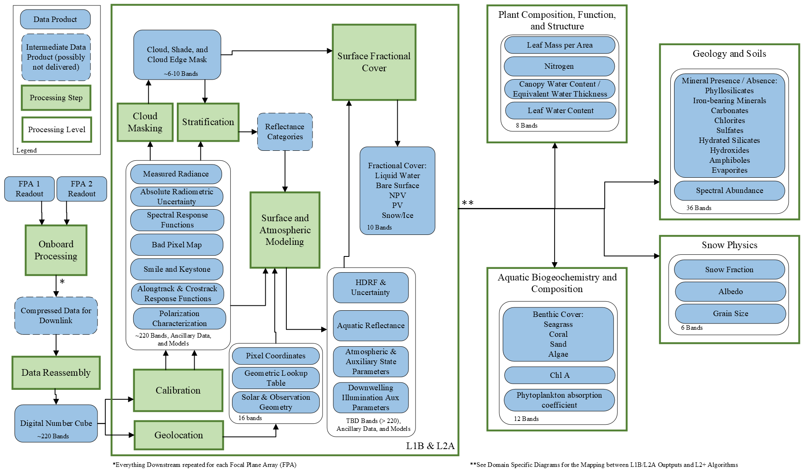
SBG VSWIR Snow & Hydrology – Algorithm Context

Slide 10
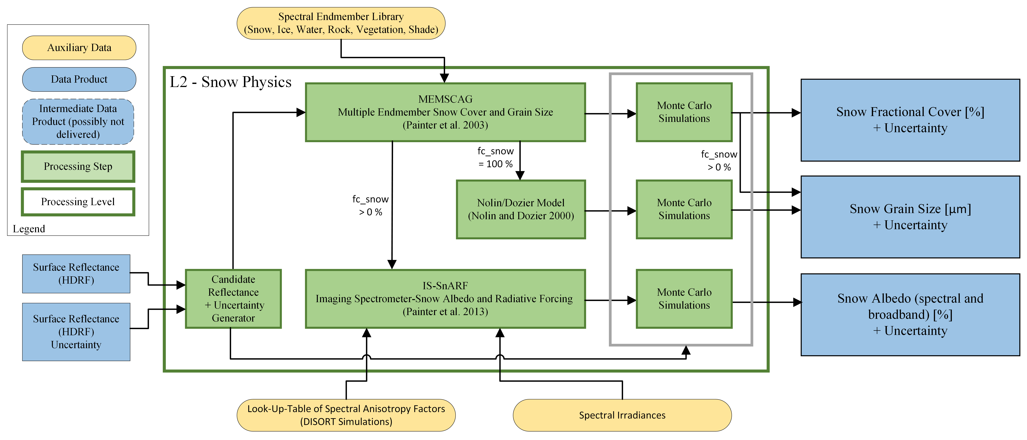
SBG VSWIR Snow & Hydrology – Candidate Algorithms

Slide 11
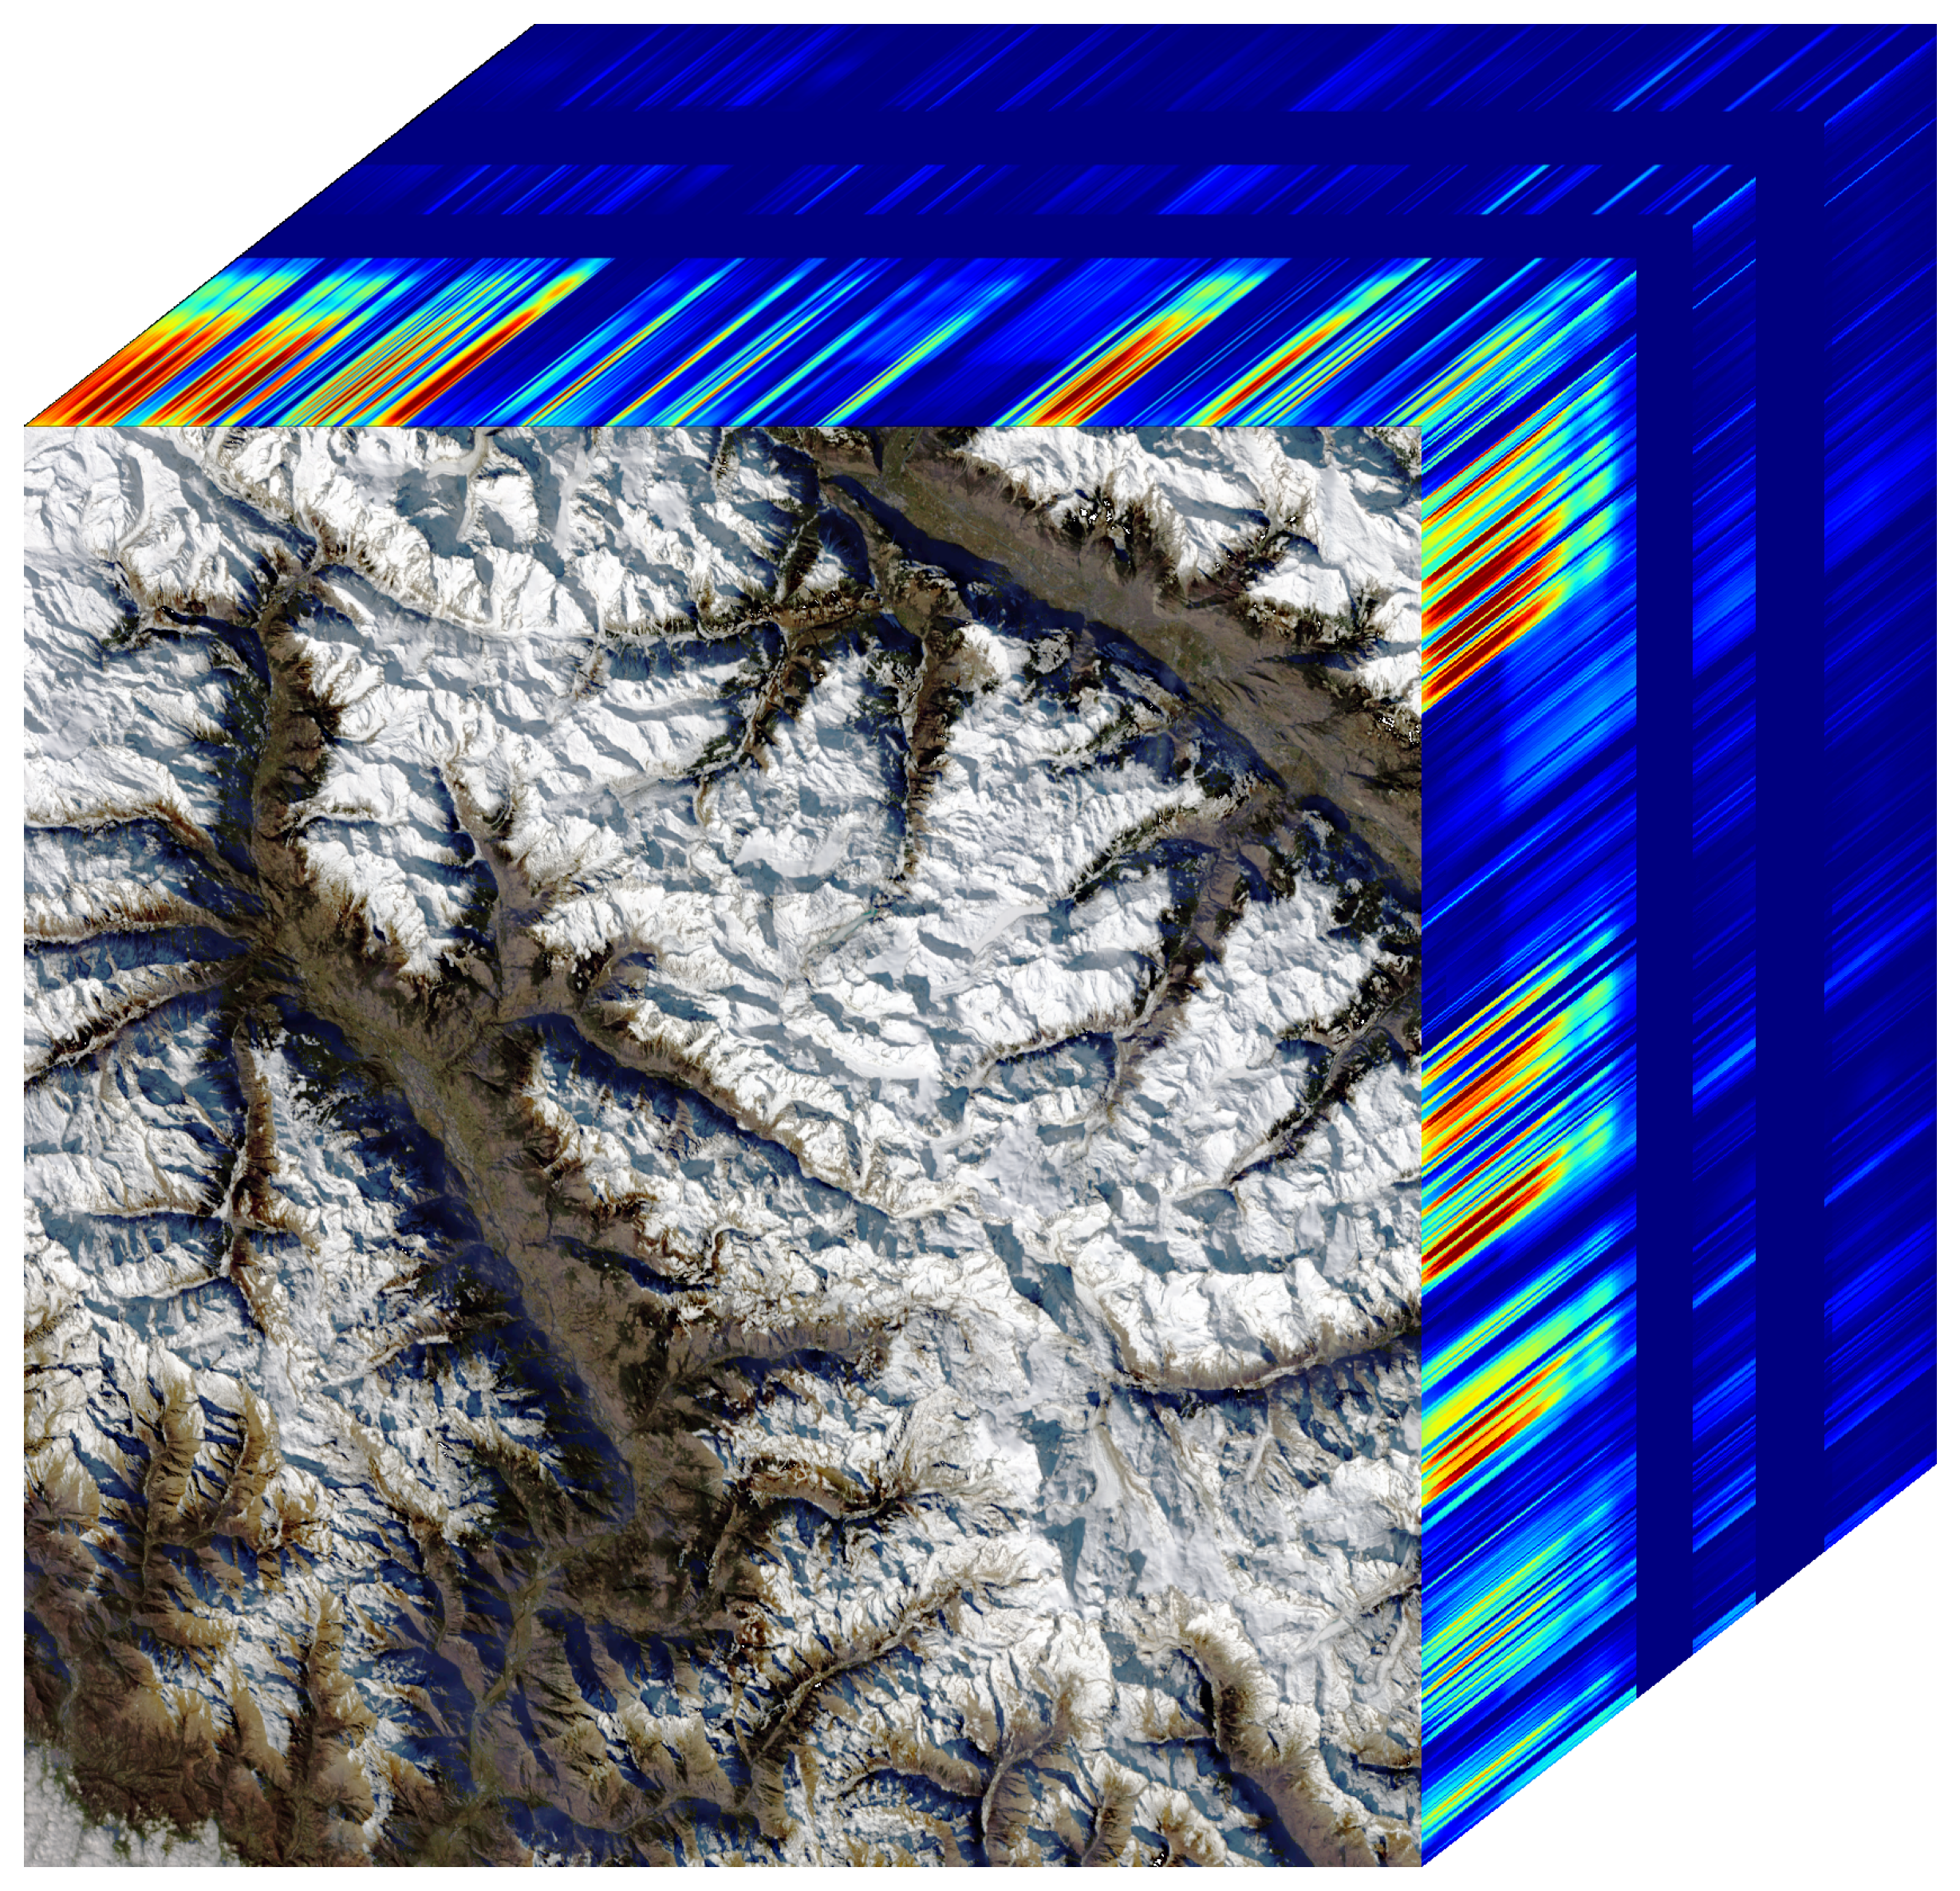
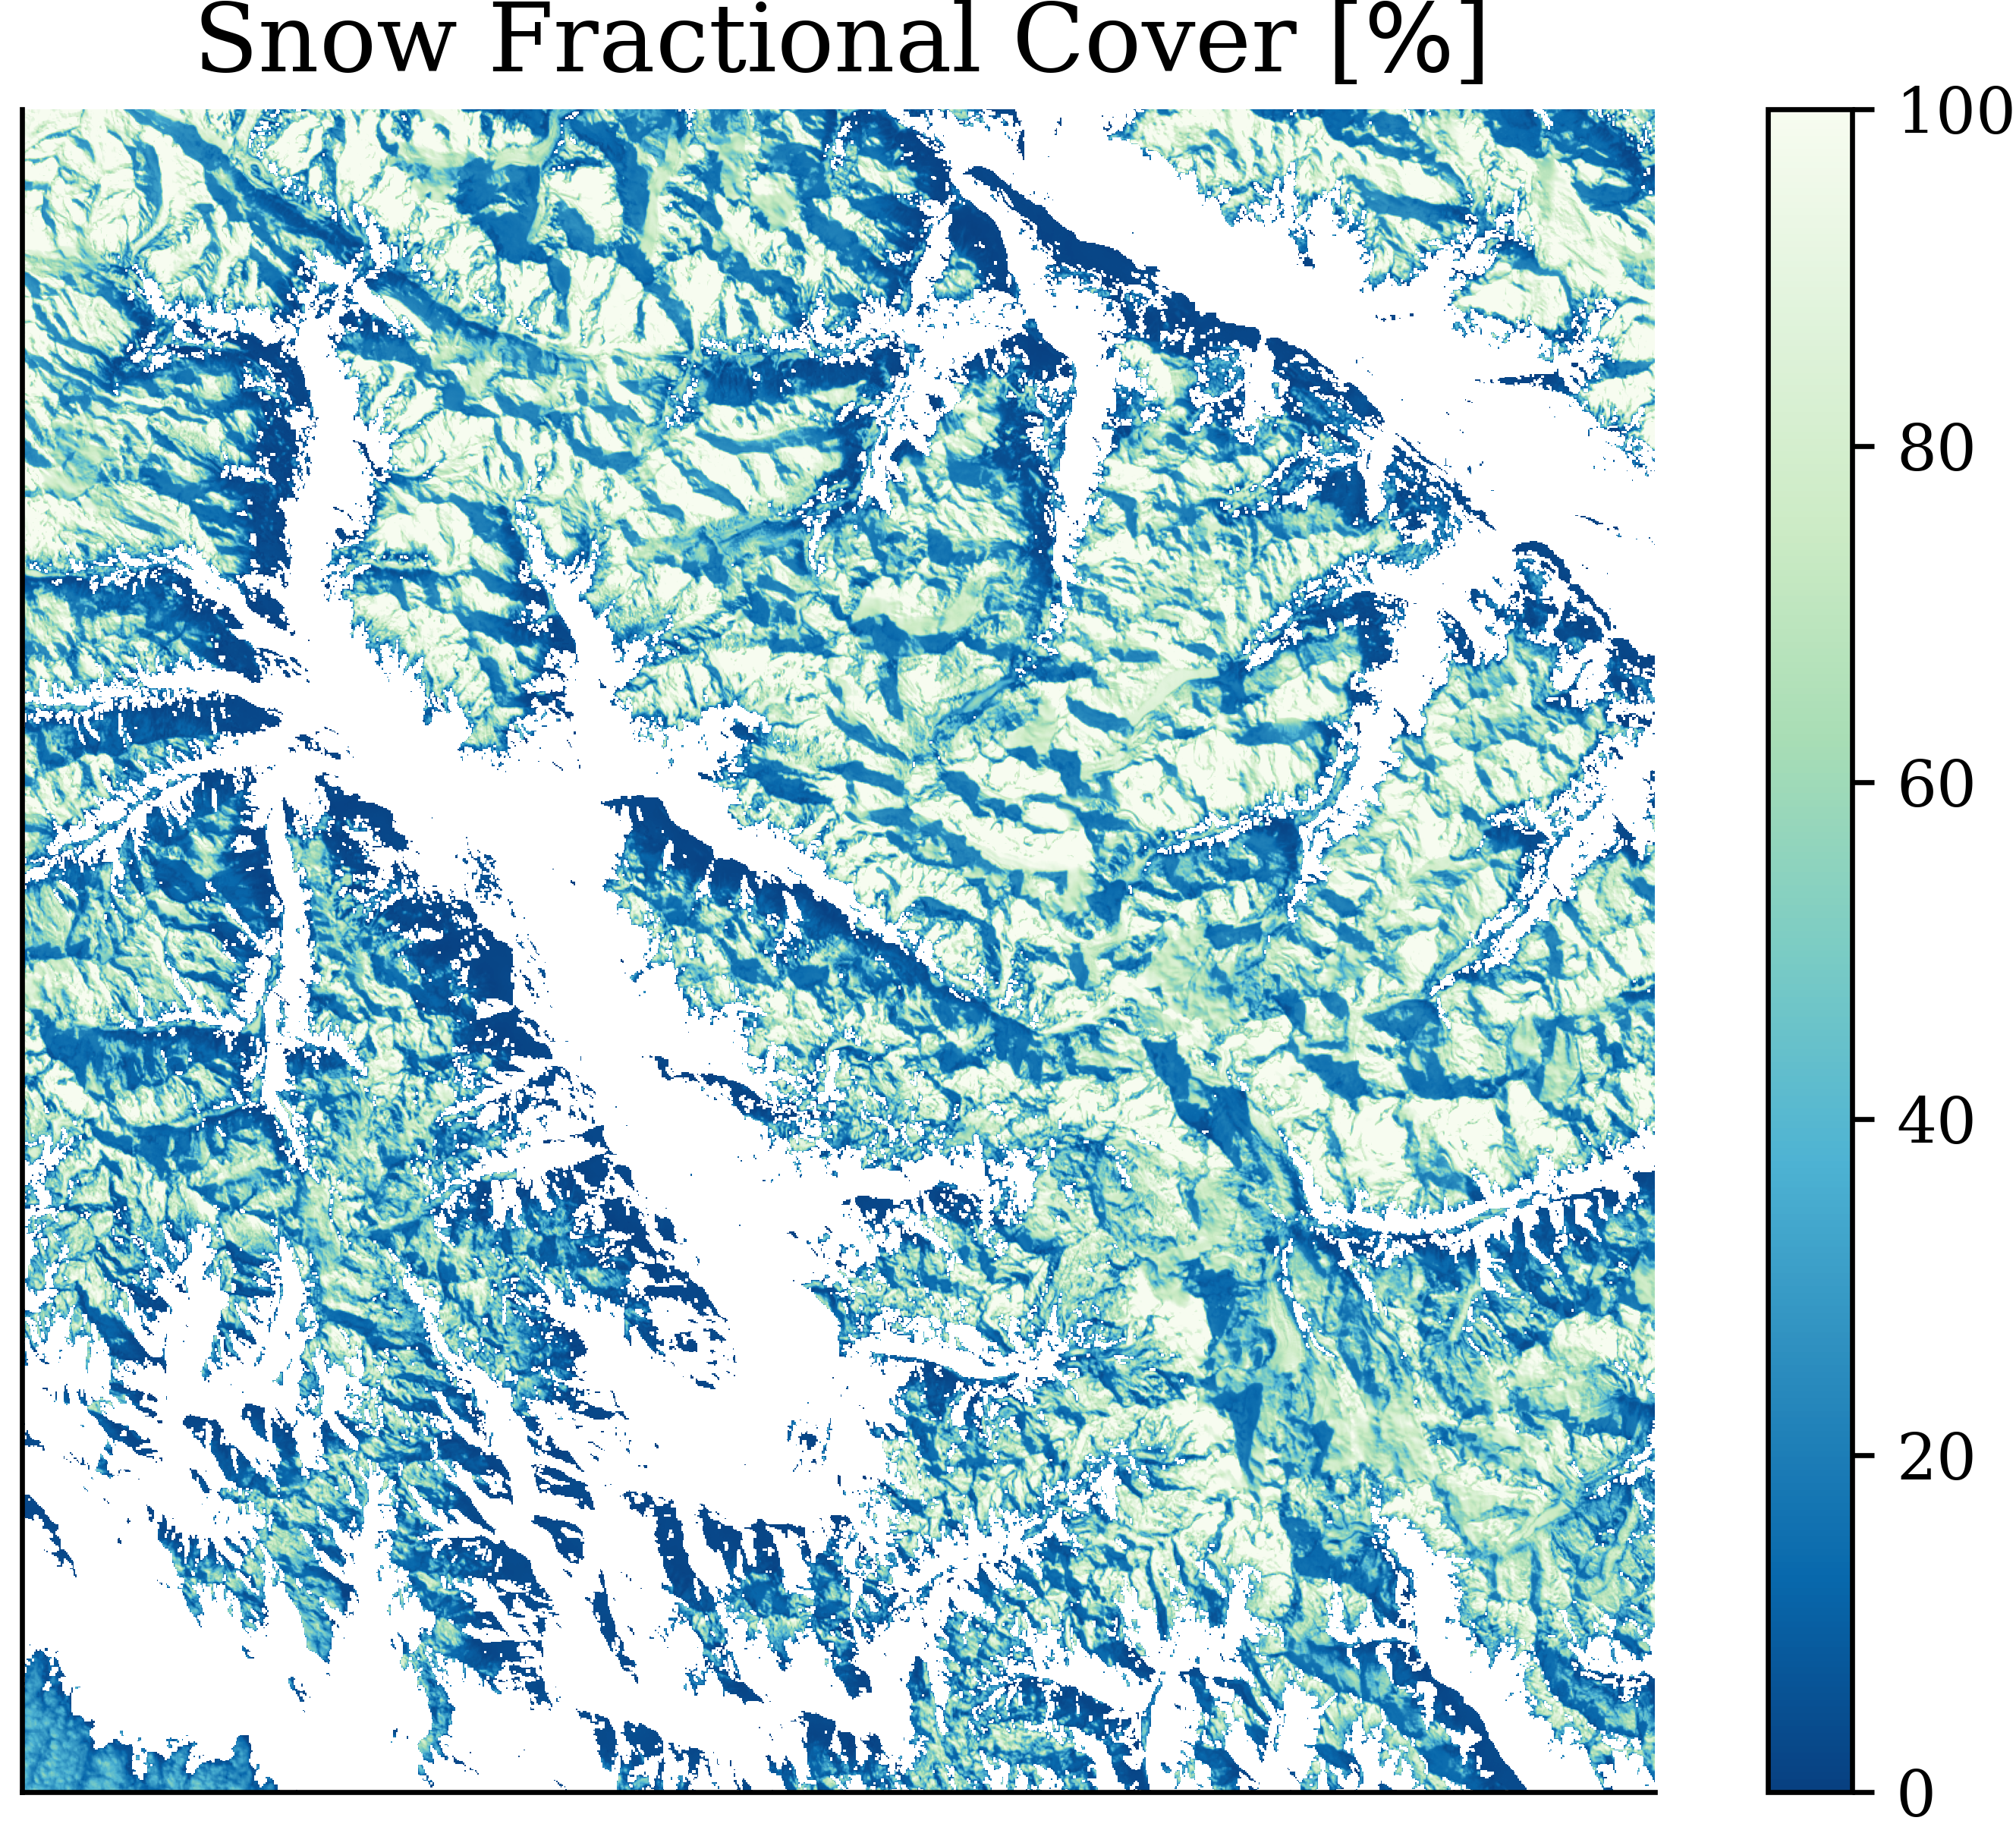
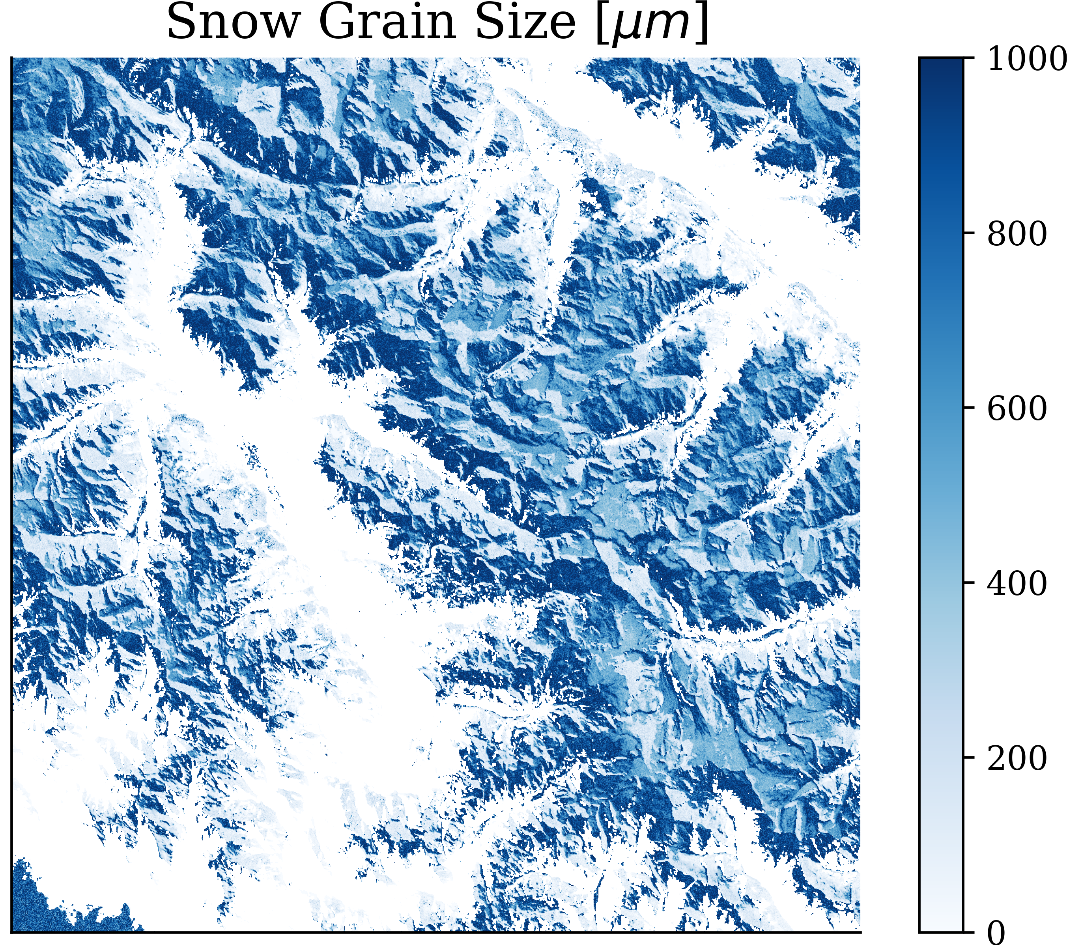
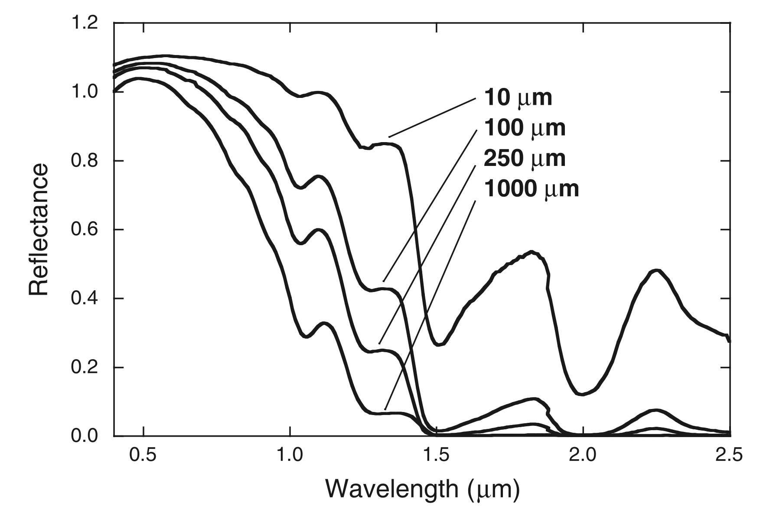
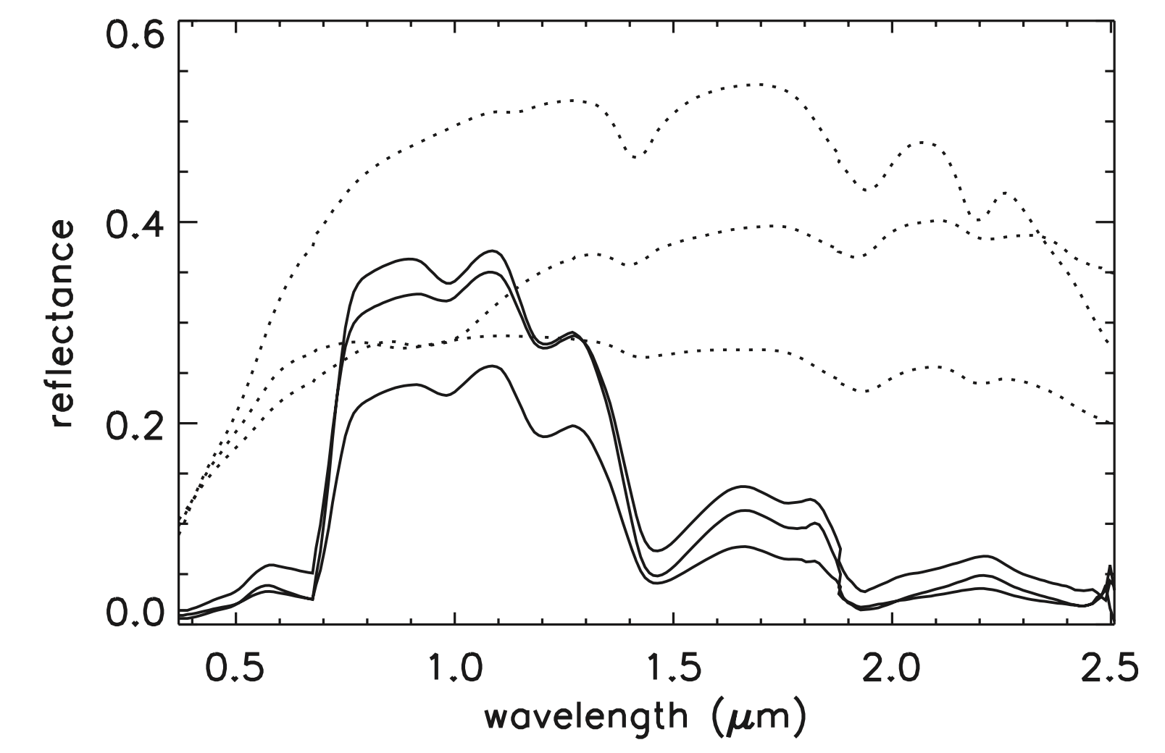
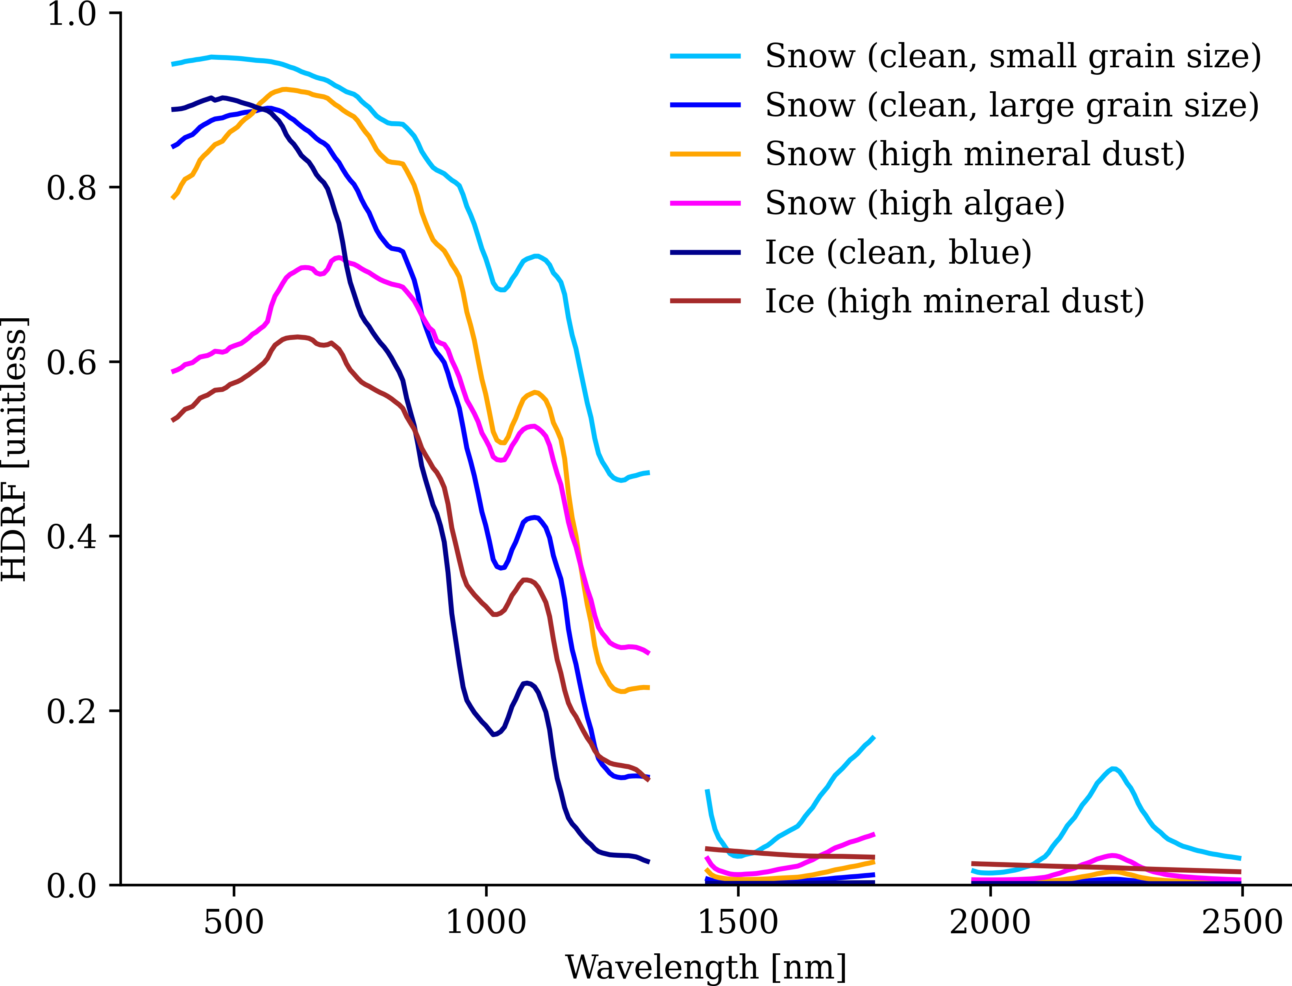
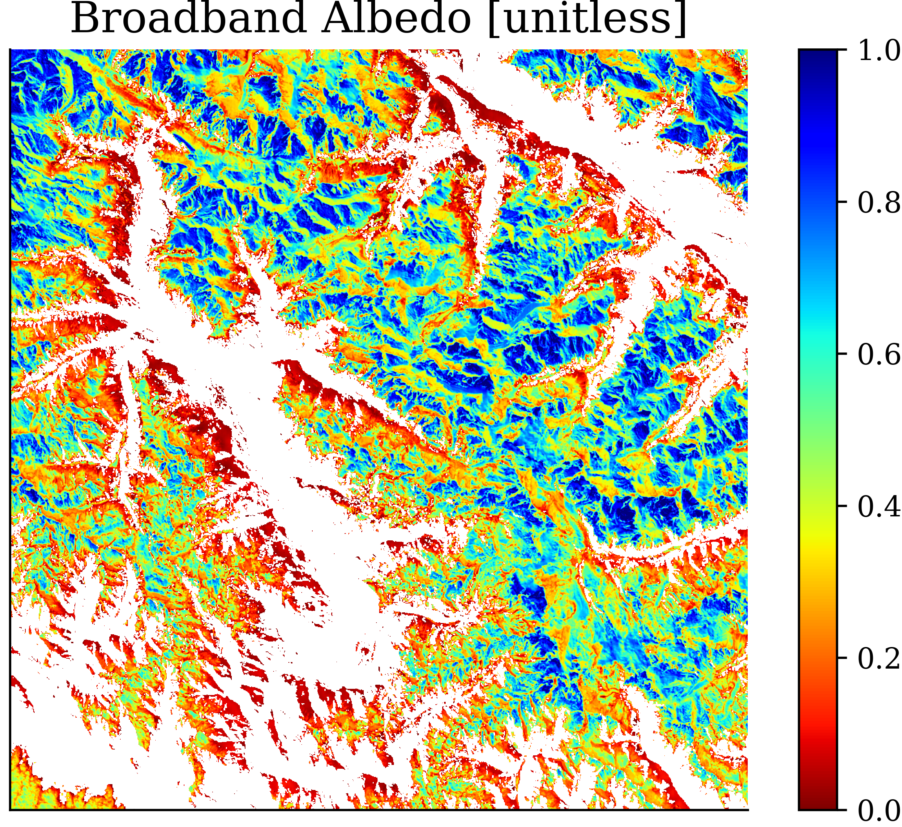
SBG VSWIR Snow & Hydrology – Example Products
Spectral Unmixing
(Painter et al. 2003)
Snow Fraction
Grain Size
Albedo
+ Uncertainty
HDRF
+ Uncertainty

Slide 12
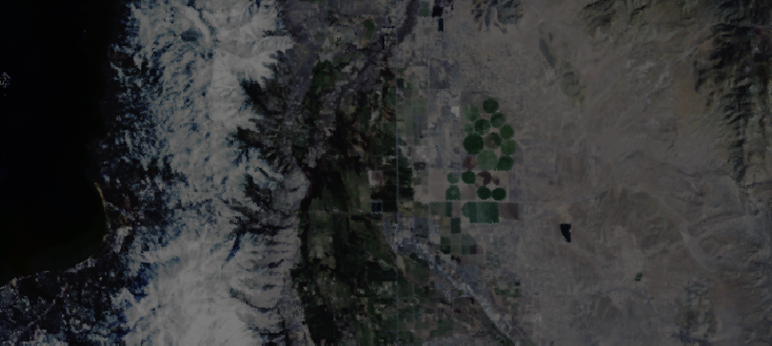
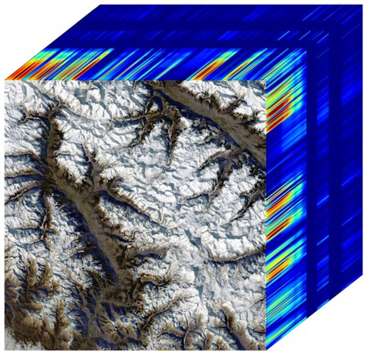
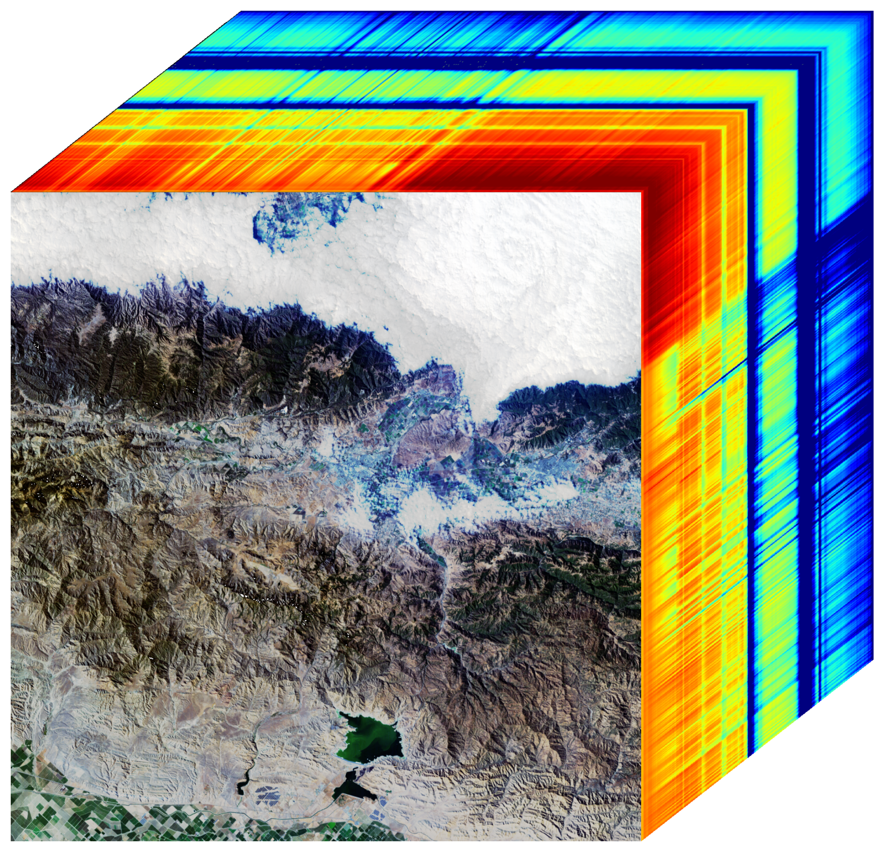
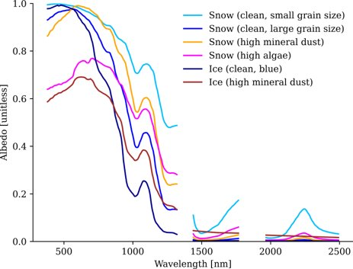

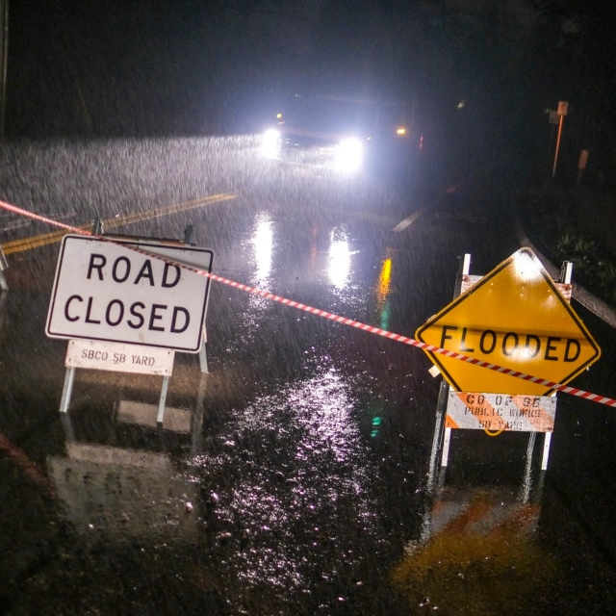
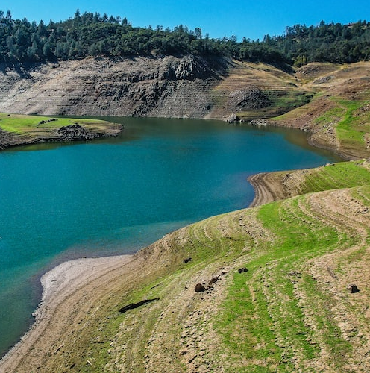
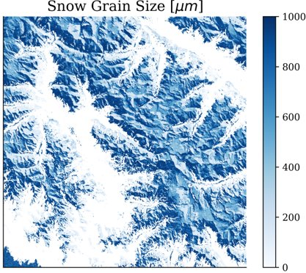
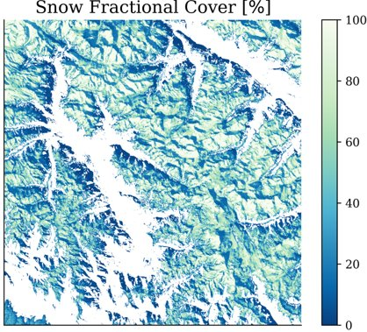

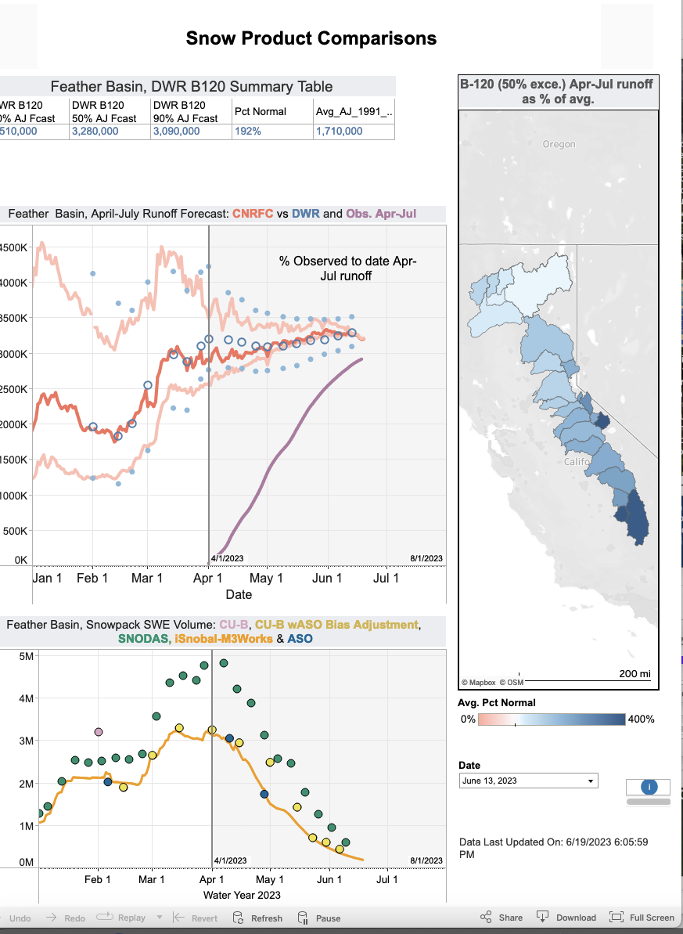
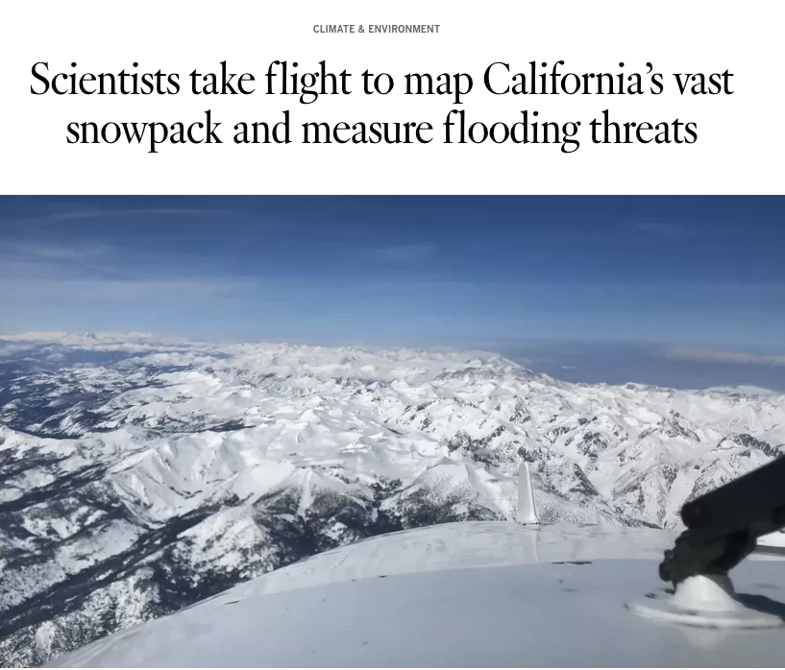
SBG VSWIR Snow & Hydrology – Applications
Earth System Observatory
Data
SBG
Wisdom and Knowledge
Information
Assessment snowpack and water supplies
Improved flood forecasting and inflow estimates
Drought monitoring
Water resources allocations and management
Action

Slide 13
SBG VSWIR Snow & Hydrology – Applications Needs
=> Data Fusion!
Slide courtesy
of Karl Rittger

Slide 14
SBG VSWIR Snow & Hydrology – Timeline
Prior to Phase-A​
HyspIRI Working Groups​
SBG Working Groups (Algs, Apps, CalVal, Modeling)​
SISTER Pipeline Development​
March-May 2023​
Formation of VSWIR Snow Physics Team​
Review and adaptation of Pre-Phase A SBG materials​
June-August 2023​
Cross center meetings with team members from Goddard, Ames, and external institutions
VSWIR Project Community Webinar #1​
VSWIR Project Community Webinar #2​
August-December 2023
Pre SRR Peer review
Outline plan for engaging community of SMEs and interested research and applications practitioners
SRR (November 2023)
January 2024 -Today
SBG Technical Interchange Meeting (TIM), Washington D.C.
(May 2024)
Set up task plan with funded SMEs
Exploration of data fusion with SBG TIR

Slide 15
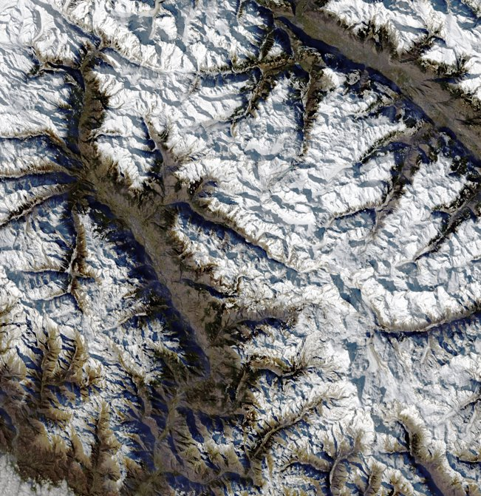
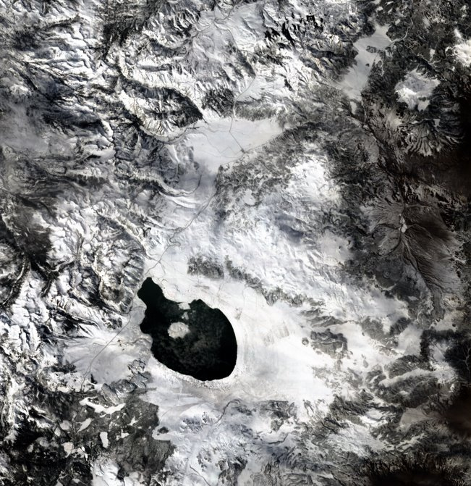
SBG VSWIR Snow & Hydrology – Next Steps
Develop open-source tools, including algorithms and ATBD repositories on GitHub
Work with SBG VSWIR calibration experts on strategy for snow calibration sites
Develop data fusion and UQ strategy
Strengthen connections to Earth Action & Applications
Foster input from community
EMIT Candidate Scenes:
Aosta Valley, Alps (top),
Mono Lake, Sierra Nevada (bottom)

Slide 16
Thank you!
The research was carried out at the Jet Propulsion Laboratory, California Institute of Technology, under a contract with the National Aeronautics and Space Administration (80NM0018D0004).
Reference herein to any specific commercial product, process, or service by trade name, trademark, manufacturer, or otherwise, does not constitute or imply its endorsement by the United States Government or the
Jet Propulsion Laboratory, California Institute of Technology.

